Slide 1
RSVP Project
Telecommmunicatiesystemen
Bart Braem, Johan Bergs

Slide 2
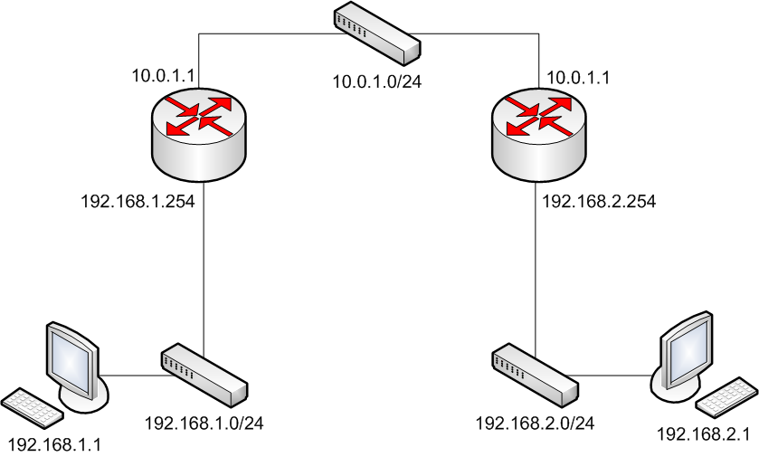
Example Network
BE
Reserve resources for QoS class
+
Priority Queueing
Reserve resources for QoS class
+
Priority Queueing
1.0 Mbps
1.0 Mbps
1.0 Mbps
QoS (0.3 Mbps)
QoS (? Mbps)
BE (1.0 Mbps)
BE (? Mbps)
Source
Destination

Slide 3
RSVP
Resource ReSerVation Protocol
Some key properties
Simplex flows
Receiver-initiated
Not a routing protocol, reservation signaling only
An internet control protocol like ICMP, IGMP or routing protocol

Slide 4
RSVP Host Model
BE
1.0 Mbps
PATH
RESV
1.0 Mbps
1.0 Mbps
Source
Destination

Slide 5
RSVP Signaling
Succesful reservations are acknowledged by
Confirmation messages
PATH and RESV messages
Periodically sent along the path
Keep alive state information
Reservations are removed by
Explicit Teardown messages
Soft Timers (missed K PATH messages)

Slide 6
A simple DiffServ QoS solution
We support only 2 traffic classes
Quality of Service
Best Effort
Reservations
Adds resources to the QoS class
All sessions are mapped on the QoS class
Session id = (DestAddr, ProtocolD, DstPort)
When a reservation is removed
Resources are removed from the QoS class
No differentiation is made between QoS traffic

Slide 7
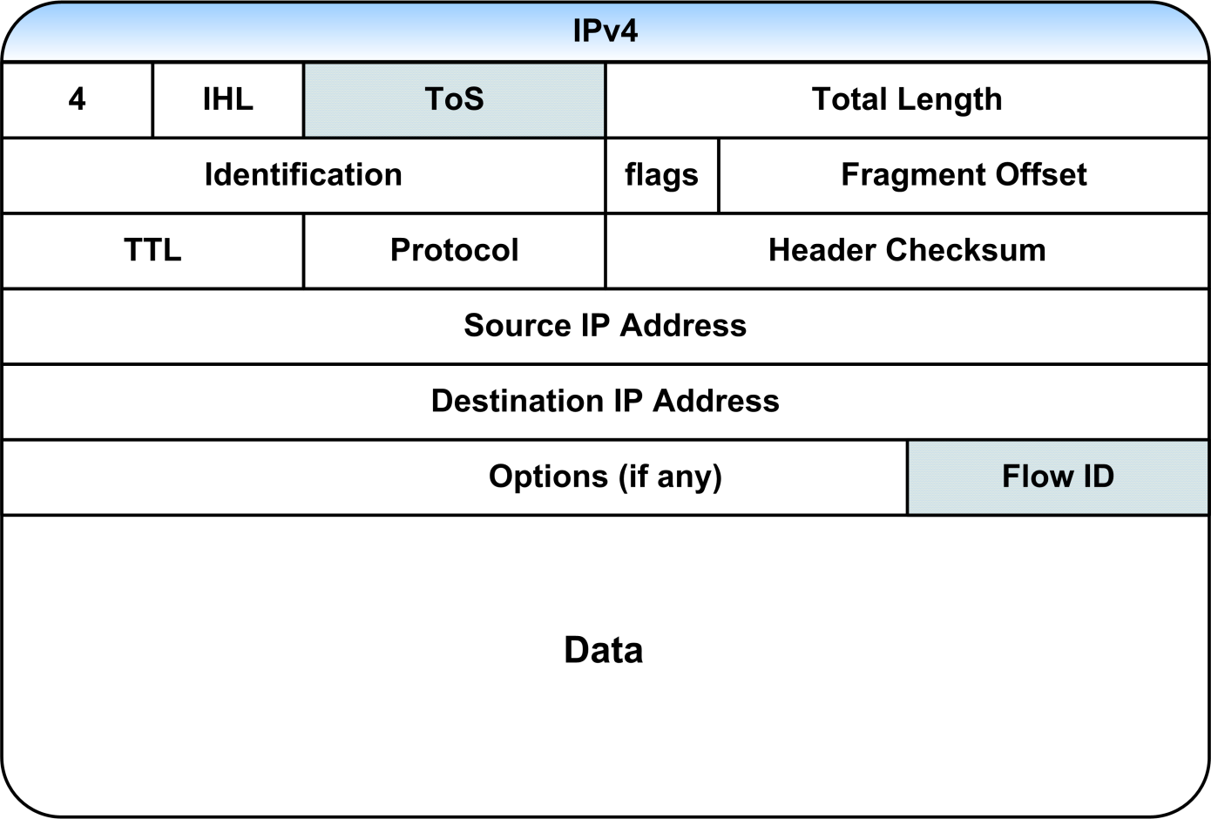
QoS class in IPv4 header

Slide 8
Result
BE
1.0 Mbps
1.0 Mbps
1.0 Mbps
QoS (0.3 Mbps)
QoS (0.3 Mbps)
BE (1.0 Mbps)
BE (0.7 Mbps)
Source
Destination

