Slide 1
Human-level control through deep reinforcement learning
Thierry Deruyttere & Armin Halilovic
Notes:
ARMIN
Hello everyone, we will present our work for the topic “Human-level control through deep reinforcement learning”.

Slide 2
Overview
Introduction
Reinforcement learning
Deep learning
Deep reinforcement learning
Demo!
What may be next
Notes:
ARMIN
Out presentation will go as follows:
We will explain what exactly we want to do. We’ll give you a refresher on reinforcement learning and an introduction on deep learning. Then, we will explain how deep reinforcement learning works.
Then, we will show you a demo, and if there’s enough time after that, what may be the future after deep reinforcement learning.

Slide 3
Introduction - Problem statement
We want to create an agent that can:
learn to solve problems
with human-level performance
without any human interference
Notes:
ARMIN
So for our project, we didn’t just want to do a presentation on how deep reinforcement learning works and leave it at that. We actually wanted to create something with it, instead of just looking at the theory. That lead us to the following problem statement for our project:
We want to create an agent that can learn to solve problems, and can solve the problems with human level performance, and do it all without any human interference. That means we never actively help the agent solve and we will never give examples.

Slide 4
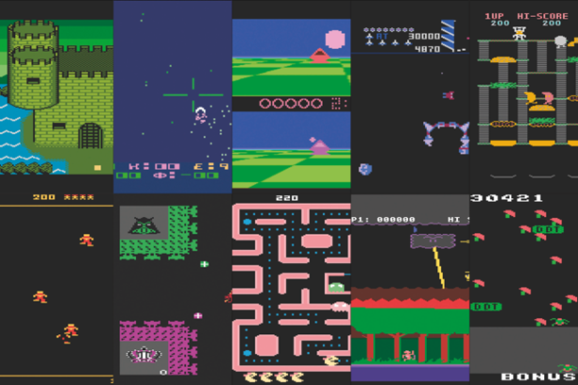
Introduction - Problem statement
retrogamer.net/top_10/top-ten-atari-2600-games
Notes:
ARMIN
And the problems we wanted out agent to solve, was playing video games.
The agent wouldn’t just have to learn to play one game, but many different games.

Slide 5
Introduction - An approach
A combination of:
Reinforcement learning
Deep learning
Deep reinforcement learning!
Notes:
ARMIN
Recently, a new method was developed for the purpose of learning to play many different games. It was a combination of reinforcement learning and deep learning, called deep reinforcement learning.

Slide 6
Reinforcement learning
Notes:
ARMIN
We will start with a refresher on reinforcement learning

Slide 7
Reinforcement learning
We want to create an agent that:
given a state s (e.g: lives left, current pos, pos of enemies, …)
returns an action a (e.g: move left, move right, fire, …)
gets a reward r for that action (from environment)
Agent’s goal:
learn a policy π that will maximise the sum of rewards
π = function that says which action a to take in state s
Notes:
ARMIN
Remember that in reinforcement learning, you try to create an agent that can take a state s and return an action a. The state s was built out of certain features you had to extract from the game, and the action a was then a move you could make in the game. For every action, the agent gets a reward r.
The agent’s goal was then to lean a policy π that will make sure the agent can get the best rewards from the game. So simply put, the policy π will be a function that says what to do in certain states. In deep reinforcement learning, we will also try to learn such a policy function.

Slide 8
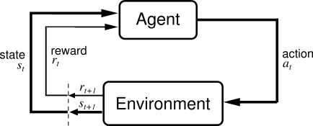
Reinforcement learning (visual)
Richard Sutton and Andrew Barto, Reinforcement Learning: An Introduction (1st Edition, 1998)
Notes:
ARMIN
Here we see a visual version of the previous slide. The agent can execute actions in its environment, which can cause the state of the environment to change, and after every action, the environment gives the agent a reward.

Slide 9
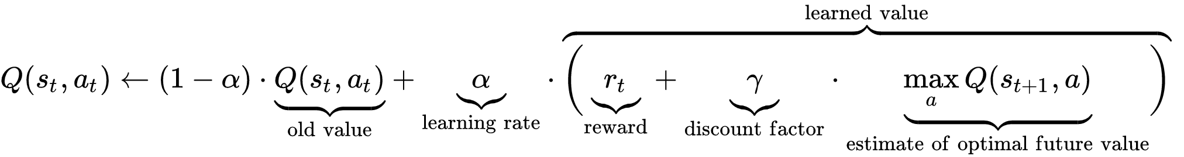
Reinforcement learning - Q-learning
Computes the optimal policy π
Iterative improvement
Implemented using tables or neural networks (function approximation)
wikipedia.org/wiki/Q-learning
Notes:
ARMIN
A very known method in reinforcement learning is Q-learning. It is used to learn the optimal policy π and does this based on iterative improvement. Here you see the core of the algorithm, which I assume everyone here already knows.
There are different ways to actually implement this algorithm. What we have seen in the machine learning course is an implementation using tables. So you initialized a table with random values and then did iterative improvement with this algorithm to learn the optimal policy.
Another way to do this is using neural networks. We know that neural networks are good for function approximation, and here we see the function. So you can train a neural network to approximate this function. This is what we will do in deep reinforcement learning. This formula will come back later, it will not be exactly the same, but it will be based on this.

Slide 10
Deep learning
Notes:
THIERRY

Slide 11
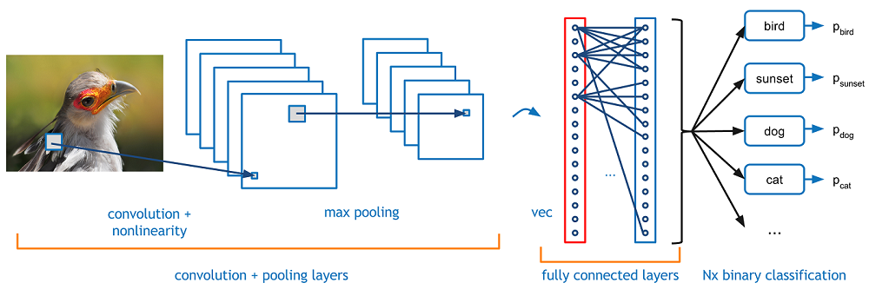
Deep learning - CNN
Maps image to class probabilities
Classification example: return the likeliest category for this picture
adeshpande3.github.io/A-Beginner's-Guide-To-Understanding-Convolutional-Neural-Networks
Notes:
THIERRY

Slide 12
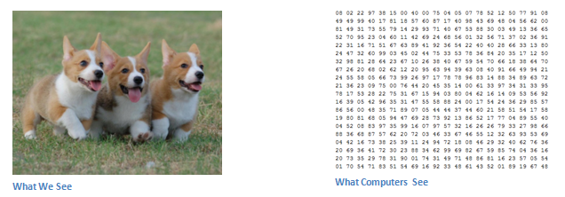
CNN - How it’s done
adeshpande3.github.io/A-Beginner's-Guide-To-Understanding-Convolutional-Neural-Networks
Notes:
THIERRY

Slide 13
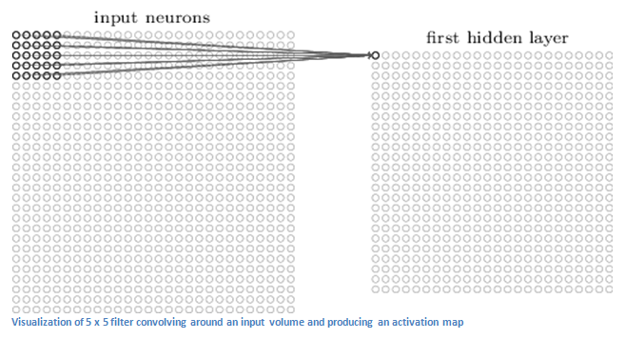
CNN - Convolution
http://neuralnetworksanddeeplearning.com/images/tikz44.png
Notes:
THIERRY
http://cs231n.github.io/convolutional-networks/#conv
a typical filter on a first layer of a ConvNet might have size 5x5x3 (i.e. 5 pixels width and height, and 3 because images have depth 3, the color channels). During the forward pass, we slide (more precisely, convolve) each filter across the width and height of the input volume and compute dot products between the entries of the filter and the input at any position. As we slide the filter over the width and height of the input volume we will produce a 2-dimensional activation map that gives the responses of that filter at every spatial position. Intuitively, the network will learn filters that activate when they see some type of visual feature such as an edge of some orientation or a blotch of some color on the first layer, or eventually entire honeycomb or wheel-like patterns on higher layers of the network. Now, we will have an entire set of filters in each CONV layer (e.g. 12 filters), and each of them will produce a separate 2-dimensional activation map. We will stack these activation maps along the depth dimension and produce the output volume.

Slide 14
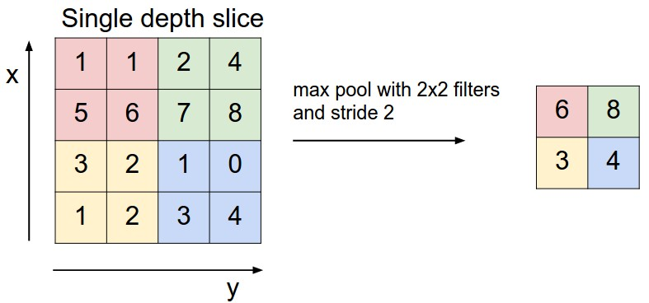
CNN - Max pooling
http://cs231n.github.io/convolutional-networks/
Notes:
THIERRY
It is common to periodically insert a Pooling layer in-between successive Conv layers in a ConvNet architecture. Its function is to progressively reduce the spatial size of the representation to reduce the amount of parameters and computation in the network, and hence to also control overfitting. The Pooling Layer operates independently on every depth slice of the input and resizes it spatially, using the MAX operation. The most common form is a pooling layer with filters of size 2x2 applied with a stride of 2 downsamples every depth slice in the input by 2 along both width and height, discarding 75% of the activations

Slide 15
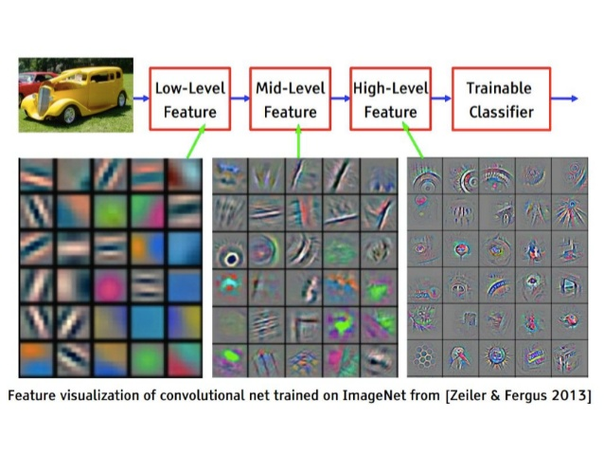
CNN - What it sees
Stack convolutional layers and then stack a classifier on top to predict the class
Notes:
THIERRY

Slide 16
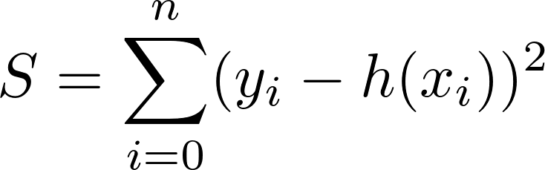
CNN - How to train it (loss function)
Input: image x_i with known class y_i
Output: prediction h(x_i)
Loss: distance metric between real class y_i and output h(x_i)
Example loss function:
adeshpande3.github.io/A-Beginner's-Guide-To-Understanding-Convolutional-Neural-Networks
Notes:
THIERRY

Slide 17
Deep reinforcement learning
Notes:
THIERRY

Slide 18
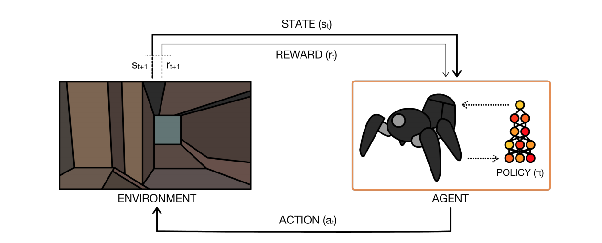
Deep reinforcement learning (DRL)
Combination of reinforcement learning and deep learning!
We introduce the concept using Deepmind’s Deep Q-Network (DQN).
A Brief Survey of Deep Reinforcement Learning, arXiv:1708.05866
Notes:
THIERRY
We will introduce the concept of deep reinforcement learning by Deepmind’s Deep Q-Network. There are many ways to do DRL, but this is the most popular one. Later on, we will touch on some other methods.

Slide 19
Why combine RL with DL
Traditional RL agents perform well in a variety of specific domains (robot soccer, games, …) but it has drawbacks:
Feature extraction (by hand)
Not scalable (curse of dimensionality)
Cannot apply the same RL model to a variety of video games
Solution:
Neural network for feature extraction
+ Neural network for policy function π!
Notes:
THIERRY
We could extract features for every game and feed that to a neural network, but this is something we are trying to avoid!

Slide 20
RL vs DRL - Differences
Differences between standard reinforcement learning and DRL:
Representation of states
Policy function π
Stored data
Notes:
THIERRY
We will explain how DRL works by explaining how it is different from RL

Slide 21
RL vs DRL - Differences
Differences between standard reinforcement learning and DRL:
Representation of states
Policy function π
Stored data
Notes:
THIERRY
Let’s begin with a game’s state.

Slide 22
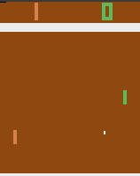
RL vs DRL - Representation of states
RL:
Handcrafted features:
Which features would you use for this?
Notes:
THIERRY
What is a state of the game? How do we represent it? Well, traditionally, this job would be up to the developer of the agent. They would have to figure out which features to use for a game and which to leave out and how to represent those features in their algorithm. When you try to model something, usually, there are many different approaches.
For example, let’s look at Pong. Well, for this game it’s pretty simple, there’s only a handful of things to keep in mind, the player, the enemy, and the ball. Maybe you would include more info, such as distance from one wall or the other, speed of the ball, and so on. Overall, it’s not too hard. Now, let’s look at something else...

Slide 23
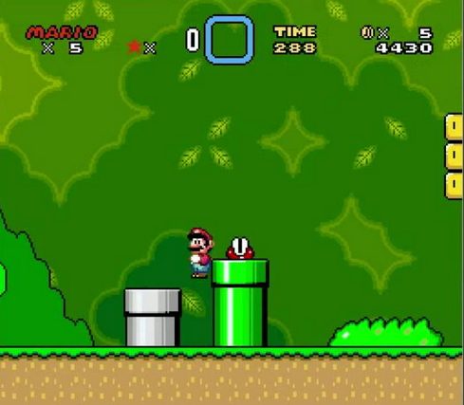
RL vs DRL - Representation of states
RL:
Handcrafted features:
Which features would you use for this?
https://github.com/aleju/mario-ai
Notes:
THIERRY
Here, there are many more concepts to model, and thus also even more ways to model the game. Each way will perform differently. In reinforcement learning, the agent will learn by trial and error. But when modeling a game like this, there’s also a trial and error component for the developer. They’ll have to figure out how to model the game efficiently, and that can take a ton of time already.
To make matters even worse, when doing feature extraction like this, the algorithm will not perform well at all on different games, which is what we’re trying to achieve! So, in DRL, the state representation is done differently:

Slide 24
RL vs DRL - Representation of states
RL:
Many handcrafted features, e.g.:
Pong: location of player and ball
Mario: location of Mario, map? enemies? power up locations? secret tubes?
Tons of time for even simple games.
DRL:
Want something more universal, something that every game uses!
Pixels!
Notes:
THIERRY
We’ll just use pixels as input features. This is something that every game has in common. In deep reinforcement learning, the network will learn features by itself. It will learn which features are important and which are not.

Slide 25
DRL - Representation of state s
Not just raw pixels as input
Preprocessing:
Frames are represented as RGB arrays
Luminance Y from RGB:
2. Resize Y to an 84 x 84 matrix
State s is the result of these transformations!
Notes:
THIERRY
Duidelijk zeggen luminance = grayscale
However, we can’t simply use the raw pixels as input to the network to achieve decent performance. Games’ video frames will go through a bit of preprocessing first.

Slide 26
RL vs DRL - Differences
Differences between standard reinforcement learning and DRL:
Representation of states
Policy function π
Stored data
Notes:
ARMIN
Next, we will discuss the policy function

Slide 27
RL vs DRL - Policy function π
RL:
if π = determined by a table of (state, action) pairs
=> not scalable (memory & sample complexity)
Notes:
ARMIN
In the beginning of the presentation, we have seen that the policy function π could be implemented in different ways.
If the policy is determined by a table of (state, action) pairs, it is not scalable. I will show you why it’s not scalable.

Slide 28
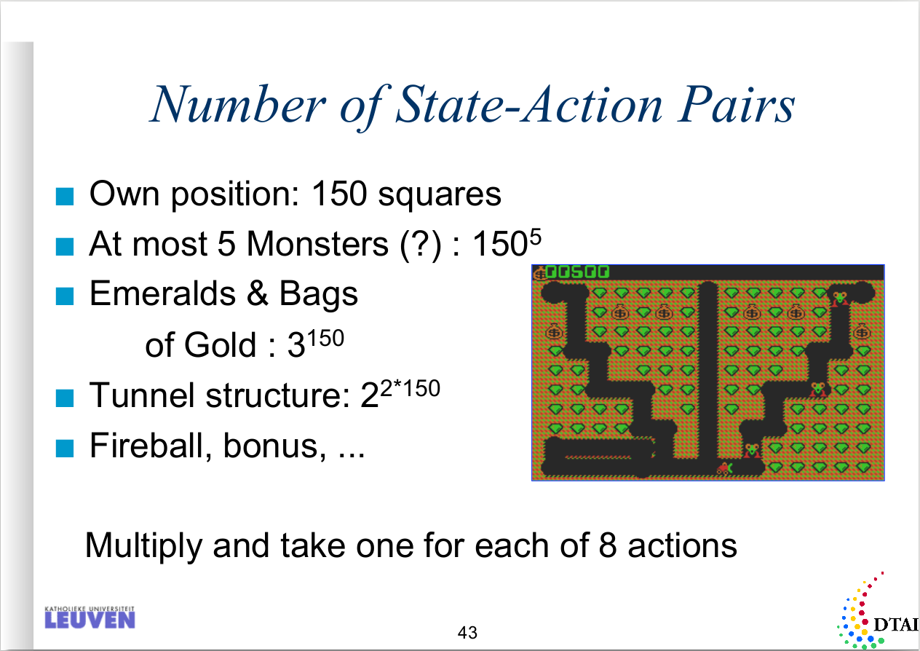
RL vs DRL - Policy function π
If using images for state:
Image = 210x160 8-bit RGB
|S|
= 256^{210*160*3}
≈ 4 * 10²⁴²⁷⁵⁰
Machine Learning and Inductive Inference, Reinforcement Learning - Hendrik Blockeel
Notes:
ARMIN
Some of you might remember this slide from the machine learning course. The professor mentioned the curse of dimensionality here. The size of the table exponentially increases in the number of states and actions. You already see these huge numbers, and this is after feature extraction! The professor mentioned that supervised learning would be a way to solve this problem. What we present today is a different solution!
On the right side, let’s say we want to create a table for the images for atari games. The dimensions then are 210 by 160 pixels, with 8 bits for the colours. Even if we could use a table of this size, we would then need to spend an eternity to learn all the values of the table.

Slide 29
RL vs DRL - Policy function π
RL:
if π = determined by a table of (state, action) pairs
=> not scalable (memory & sample complexity)
if π = neural network
=> also not scalable for our goal (feature extraction for each game)
DRL:
π = deep neural network for feature extraction and policy function
=> can automatically find compact low-dimensional representation
Notes:
ARMIN
If the policy is determined by a neural network, it is also not scalable for our goal, because you would need to do feature extraction for every different game. That is what we are trying to avoid. We want our agent to work for many different games without us having to do anything.
So what we will do differently in deep reinforcement learning is, we will use a deep neural network to learn the policy. The deep neural network can then do feature extraction and learn the policy function. It can automatically find compact low-dimensional representations for different games.

Slide 30
RL vs DRL - Differences
Differences between standard reinforcement learning and DRL:
Representation of states
Policy function π
Stored data
Notes:
ARMIN
Finally, we will discuss the data that is stored in DRL

Slide 31
RL vs DRL - Stored data
RL:
A table entry for every possible (state, action) pair or the weights of a NN
DRL:
Store 4-tuples in a list:
Current state s
Action a taken in s
Reward r for taking action a
Next state s’
Such a 4-tuple is called a transition.
Stored inside a replay memory that can hold N transitions.
Notes:
ARMIN
If you do traditional reinforcement learning using a table, then you’ll need to store a table entry for every possible state-action pair. If using a NN to approximate the policy function, then you’ll need to store the NN’s weights.
A new concept in DRL is that you’ll store some extra data apart from the neural network weights. You will store 4-tuples of the following: …
These 4-tuples are called transitions and they will be stored in a replay memory. This memory will hold transitions that gave positive rewards. The replay memory is used to improve training, we will come back to this later.

Slide 32
DRL - Deep Q-Network
Plug in Neural network and problem solved?
NO!
Reinforcement learning caveats when using neural networks:
unstable
can diverge when a nonlinear function approximator such as a neural network is used to represent the policy π
Notes:
ARMIN
So, now we have explained the main points that DRL does differently. However, this is not the end of the story, of course. There are some problems that arise when using neural networks to do reinforcement learning: …
We will explain the tricks Deepmind’s DQN introduced to overcome problems.

Slide 33
DRL - Instability
Causes of instability:
Correlations between sequences of frames
If the player moves in one direction on a certain frame, it will often make the same move in the next frame
Feedback loop during training
Every step of training, the network’s output shifts
If using a constantly shifting set of output to adjust network weights,
then the output can spiral out of control
Notes:
ARMIN
One of the problems is correlations between sequences of frames. When you play a game and make a certain move in one direction, the following frames of the game, you will likely keep making the same move. This can make the network overfit on certain moves and can cause performance to drop.
Another problem is the feedback loop during training. We are training the same network we use to make moves in the games. So after every move, the weights of the network will change instantly, and then we will use those weights for the next move. This can cause a negative feedback loop which causes oscillations and makes the output spiral out of control.
https://medium.com/@awjuliani/simple-reinforcement-learning-with-tensorflow-part-4-deep-q-networks-and-beyond-8438a3e2b8df
Van paper: Generating the targets using an older set of parameters adds a delay between the time an update to Q is made and the time the update affects the targets y_i, making divergence or oscillations much more unlikely.
Then, they notice how during the training the Q values (predicted by the NN) can change the on going policy, so making the agent prefer only a set of actions and causing it to store data that is correlated for the same reasons as before: this is why they delay training and update Q periodically, to ensure that the agent can explore the game, and train on shuffled and uncorrelated data.

Slide 34
DRL - Reducing instability
Solutions for instability:
Correlations between sequences of frames
  sample transitions uniformly from replay memory
Feedback loop during training
  target network = copy of main network
  use target network in loss function
  allow network updates to accumulate
  synchronize target network periodically
Notes:
ARMIN
The solutions are relatively simple. To remove correlations between sequences of fames, we use the replay memory we introduced earlier. Instead of learning from the current frame after every move, the network will take random transitions from the replay memory to learn. If the network learns from random memories, there won’t be the effect of overfitting on moving in a certain direction for example.
To fix the effect of the feedback loop, a target network is introduced. This is just a copy of the main network. This copied network will be used in the loss function of the algorithm. After a number of updates to the main network, the target network is updated. This mitigates removes the feedback loop, because changes are propagated later on, instead of instantly.
----
DeepMind decided to do it a different way. Instead, we have to fix the weights θ for some number of iterations, and then allow the samples to accumulate. The argument for why this works is a bit hand-wavy and I’m not sure if there exists any rigorous mathematical justification. The DeepMind paper says that this reduces correlations with the target. This is definitely different from the tabular case I just described, where one update immediately modifies targets. If I wanted to make my tabular case the same as DeepMind’s scenario, I would update the weights the normal way, but I would also fix the vector θ−, so that when computing targets only, I would draw from θ− instead of the current θ.

Slide 35
DRL - Preprocessing step
Some more preprocessing before passing to the network:
Stack 4 consecutive states into an 84 x 84 x 4 array
This is 1 sample
So… What does the neural network look like?
Notes:
ARMIN
A last thing before we are done: some more preprocessing was introduced to make the network learn better. Instead of using 1 frame, 4 frames were used at a time. This adds a temporal effect in the input.

Slide 36
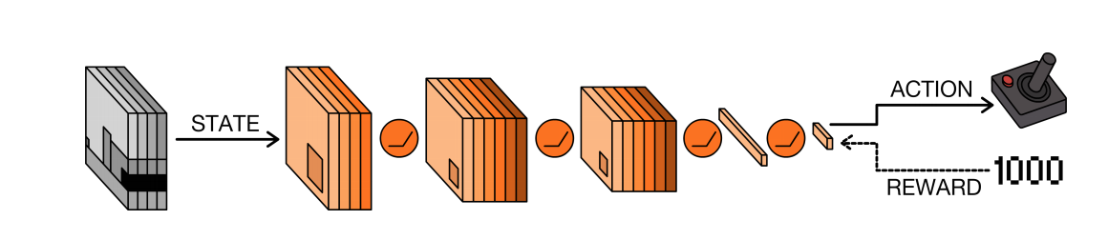
DRL - Deep Q-Network Architecture
Actually the architecture doesn’t matter that much here.
This approach works for small and big networks!
A Brief Survey of Deep Reinforcement Learning, arXiv:1708.05866
Notes:
ARMIN
Now that we have introduced all the different concepts, you can see the architecture of the Deep Q-Network. You see that the input is 4 frames in grayscale. There are a couple of convolutional layers for feature extraction, and a couple of fully connected layers that give the action.
Keep in mind, this is just the design of the DQN by Deepmind. There are many different possible architectures. We will show a few other designs later on.

Slide 37
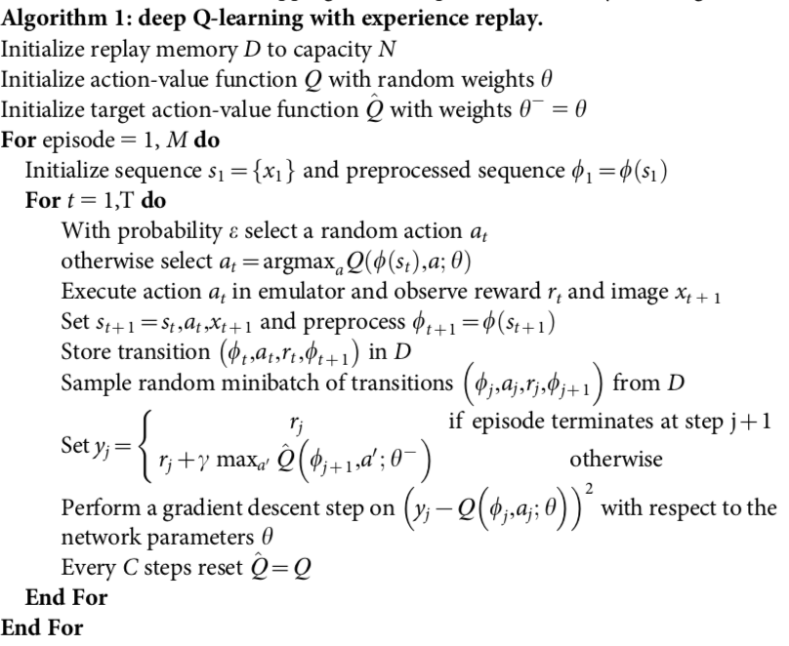
DRL - DQN Code (Summary)
replay memory
policy
target network
preprocess image
store in replay memory
fetch from replay memory
synchronise target network
Human-level control through deep reinforcement learning, https://www.nature.com/articles/nature14236
Notes:
ARMIN
So here is the algorithm that Deepmind developed. I will not go through it step by step, but we have highlighted the important concepts here.
In the beginning you see that replay memory, the network for the policy, and the target network are created.
Later on, you see the preprocessing of images, transitions being stored in the replay memory, and random transitions being fetched to train the network. Remember that sampling random memories removes correlations between successive frames.
After that, you see that gradient descent is being done on a certain formula. This formula is based on the Q-learning formula we showed in the beginning of this presentation.

Slide 38
Demo!
Notes:
THIERRY

Slide 39
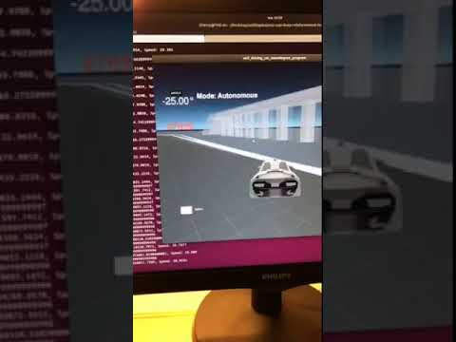
Reward function
Notes:
THIERRY

Slide 40
DRL - More methods
Dueling Network Architectures
Deep Recurrent Q-Learning (DRQN)
Notes:
ARMIN

Slide 41
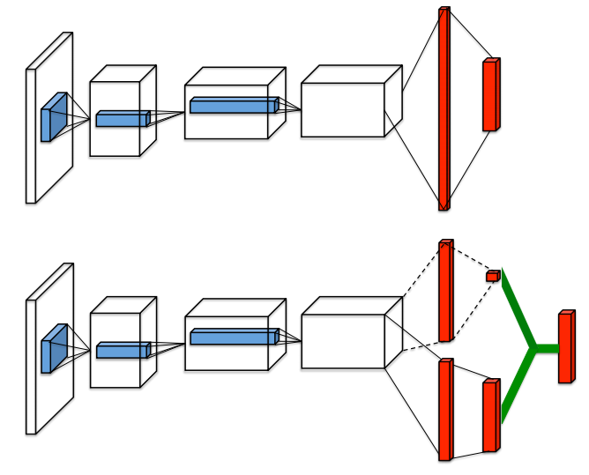
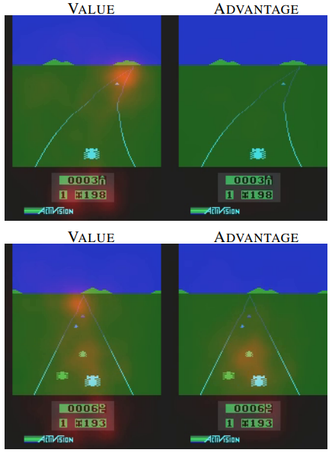
DRL - Dueling Network Architectures
Dueling Network Architectures for Deep Reinforcement Learning, arXiv:1511.06581
Notes:
ARMIN

Slide 42
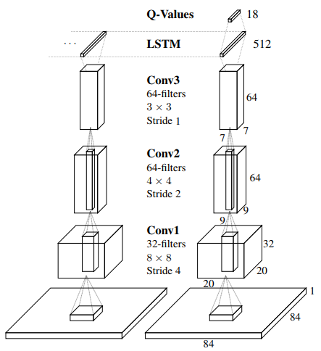
DRL - Deep Recurrent Q-Learning (DRQN)
Deep Recurrent Q-Learning for Partially Observable MDPs, arXiv:1507.06527
Notes:
ARMIN

Slide 43
DRL - More methods
Many more:
Deep Attention Recurrent Q-Network (DARQN)
Asynchronous advantage actor-critic (A3C)
Generative Adversarial Imitation Learning (GAIL)
Normalized Advantage Function (NAF)
...
Key differences:
Model based <--> Model free
Gradient based <--> Gradient free
Notes:
ARMIN
There are many other methods out there, you can see some of them here. What is important to remember is that there are two key differences between these methods…. model based/free … gradient based/free … examples ...
Examples:
Model based - AlphaGo
Model free - DQN
Gradient based - DQN
Gradient Free - Genetic algorithms

Slide 44
What may come after DRL
Notes:
Als we over tijd zijn dan laten we het gewoon vallen tijdens de presentatie
Staat in het verslag dat we ons er mee bezig hebben gehouden.

Slide 45
What may come after DRL
How does a human learn? Do we have a reward function?
NO
We are curious and try to explore many different options.

Slide 46
Curiosity reinforcement learning

Slide 47
Curiosity reinforcement learning - How it’s done
Instead of us giving it a reward function, it creates its own reward function.
No need for rewards from the game anymore!
Curiosity-driven Exploration by Self-supervised Prediction, arXiv:1705.05363

Slide 48
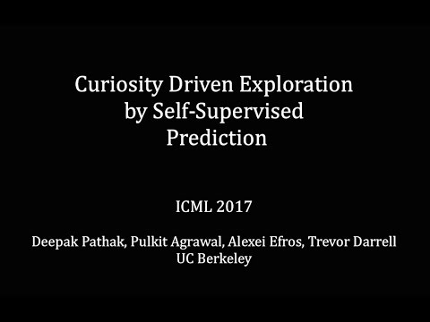
Curiosity reinforcement learning - Example

Slide 49
References
Richard Sutton and Andrew Barto, Reinforcement Learning: An Introduction (1st Edition, 1998)
Human-level control through deep reinforcement learning, https://www.nature.com/articles/nature14236
A Brief Survey of Deep Reinforcement Learning, arXiv:1708.05866
Dueling Network Architectures for Deep Reinforcement Learning, arXiv:1511.06581
Deep Recurrent Q-Learning for Partially Observable MDPs, arXiv:1507.06527
Curiosity-driven Exploration by Self-supervised Prediction, arXiv:1705.05363
Visualizing and Understanding Convolutional Networks, arXiv:1311.2901
Convolutional Neural Networks (CNNs / ConvNets), cs231n.github.io/convolutional-networks/
A Beginner's Guide To Understanding Convolutional Neural Networks, adeshpande3.github.io/A-Beginner%27s-Guide-To-Understanding-Convolutional-Neural-Networks/
Resource Management with Deep Reinforcement Learning, people.csail.mit.edu/hongzi/content/publications/DeepRM-HotNets16.pdf

