Slide 1
The Battle of Neighborhoods: Edmonton's Best Neighborhood
Armin Norouzi

Slide 2
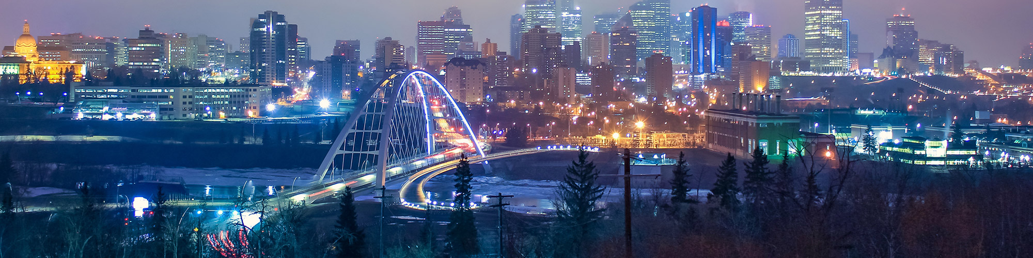
Edmonton
Edmonton is the capital city of the Canadian province of Alberta. Edmonton is on the North Saskatchewan River and is the center of the Edmonton Metropolitan Region, surrounded by Alberta's central region. The city anchors the north end of what Statistics Canada defines as the "Calgary–Edmonton Corridor."

Slide 3
Research Question
Edmonton’s best neighborhood to live
Kind of venue in each neighborhood
Similar neighborhood in Edmonton

Slide 4
Data collection
Edmonton data that contains list Boroughs, Neighbourhoods along with their latitude and longitude.
Data source: https://en.wikipedia.org/wiki/List_of_postal_codes_of_Canada:_T
Description: This data set includes the required information. And we will use this data set to explore various neighborhoods of Edmonton, AB, Canada
Venue information in each neighborhood of Edmonton.
Data source: Foursquare API
Description: By using this API, we will get all the venues in each neighborhood. We can filter these venues to get only Indian restaurants.
GeoSpace data
Data source: https://data.cityofnewyork.us/City-Government/Borough-Boundaries/tqmj-j8zm
Description: Using this geospace data, we will get the Edmonton Borough boundaries to visualize the choropleth map.

Slide 5
Work Flow
Neighborhood location information
Foursquare API: venue of each location
Similar neighborhood: K-means algorithm
Finding best Neighborhood

Slide 6
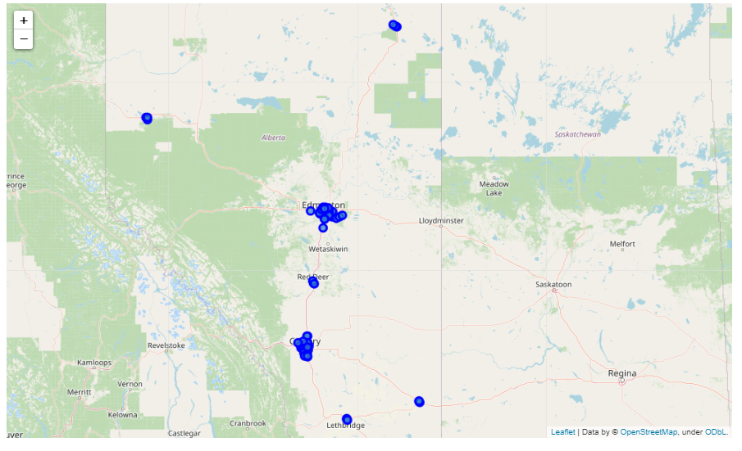
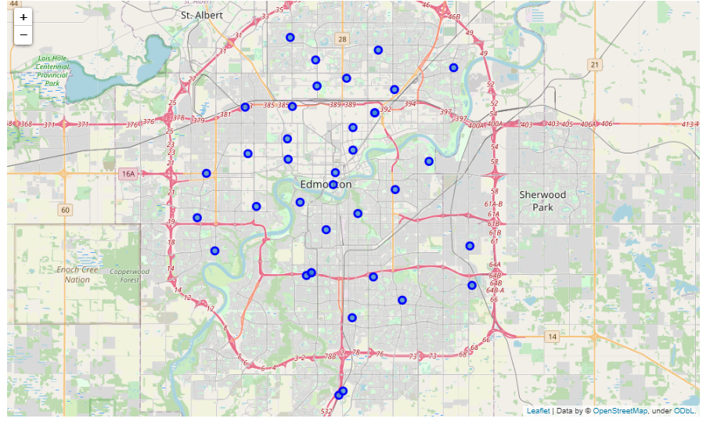
Results- Alberta and Edmonton maps
Alberta Map
Edmonton Map

Slide 7
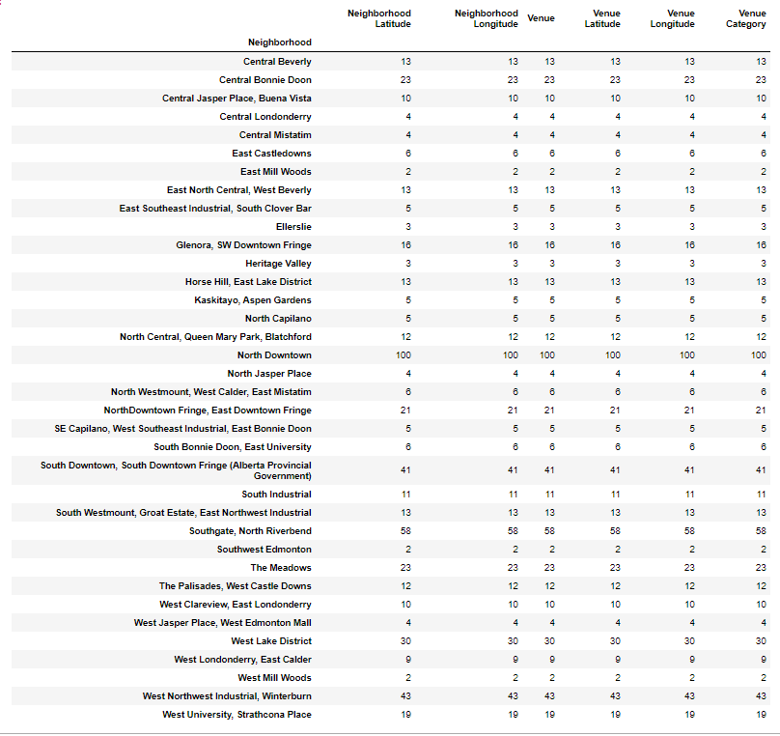
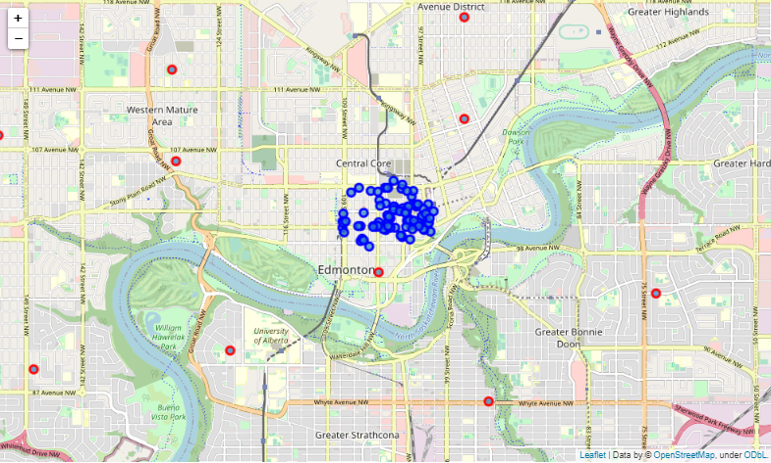
Results- Best Neighborhood
Best Neighborhood: North Downtown

Slide 8
Results- Best Neighborhood
Venue category | Number in each category
Coffee Shop | 9
Sandwich Place | 5
Pub Café Hotel | 4
Restaurant French Restaurant | 3
Pizza Place New American Restaurant Rock Club Brewery Gym Nightclub Smoothie Shop Asian Restaurant Vietnamese Restaurant Bar Mexican Restaurant Steakhouse | 2

Slide 9
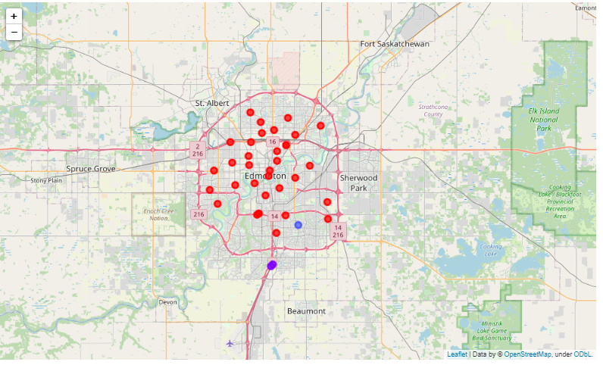
Most Common venues near neighborhood

