Slide 1
Molecular Dynamics
Andreas Blomqvist
Expert Materials Design/Materials Modeling
Sandvik Coromant
Assoc. Prof. Materials Science, KTH

Slide 2
Assignment
(I) Write a molecular dynamics code with:
Velocity Verlet algoritm
Force calculations using e.g. for example EAM or Lennard Jones potential
(optional) thermostat
(II) Use the code to compute either a diffusion coefficient or a phase transformation temperature.
Visulization can either be integrated or using external tool like VMD (http://www.ks.uiuc.edu/Research/vmd/).
EAM potentials can be found at NIST (https://www.ctcms.nist.gov/potentials/).
Free choice of programming language.

Slide 3
What could go wrong?
Not thermalized simulation
Energy leakage
Boundary conditions
…
…

Slide 4
Not thermalized simulation
Starting with velocities in random directions
Results in unphysical vibrations
Simulation will adjust
Typical time scale 1-4 ps
Check by looking at fluctuations in e.g.
Velocities
Forces
Total energy (kinetic+potential)

Slide 5
Energy leakage
If the time step is too long the simulation will loose or gain energy
Possible solutions:
Short time step, to avoid
Thermostat, to compensate

Slide 6
Boundary condition
Simulation: periodic boundary conditions?
Analysis:
What is the shortest distance between two atoms?
MSD, what is the diffused distance?

Slide 7
Which coorinate system?
Cartesian?
Direct?

Slide 8
Setup initial positions
Velocities in random dirctions
Calculate acceleration from potential
Calculate positions
Calculate velocity
One cycle is one time step
Save data according to what you need
Analyse the result

Slide 9
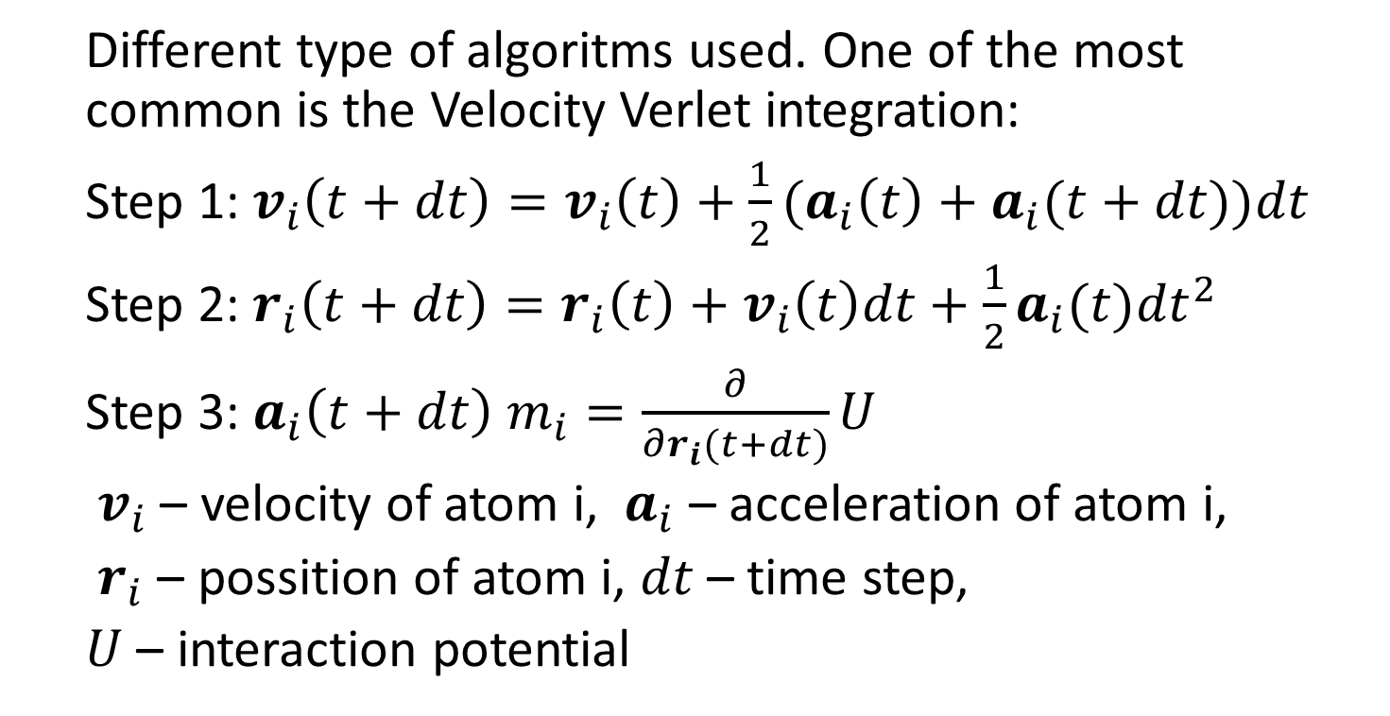
The different parts of MD: - Integrate equations of motion
Different type of algoritms used. One of the most common is the Velocity Verlet integration:
Step 1:${ v}_{i}\left(t+dt\right)=v_{i}\left(t\right)+{\frac{1}{2}(a}_{i}\left(t\right)+a_{i}(t+dt))dt$
Step 2: $r_{i}\left(t+dt\right)=r_{i}\left(t\right)+v_{i}\left(t\right)dt+{\frac{1}{2}a}_{i}(t){dt}^{2}$
Step 3: $a_{i}\left(t+dt\right) m_{i}=\frac{∂}{∂r_{i}(t+dt)}U$
${ v}_{i}$ – velocity of atom i, ${ a}_{i}$ – acceleration of atom i,
${ r}_{i}$ – possition of atom i, $dt$ – time step,
$U$ – interaction potential
Change time!

