Slide 1
CONTROL EXERCISE
Point-to-Point control of a simple car using Model Predictive Control
(Matlab and C++ implementations using CasADi and ACADO)
By
Srivatsan Srinivasan

Slide 2
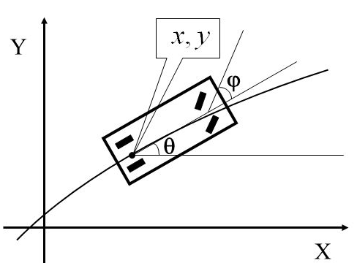
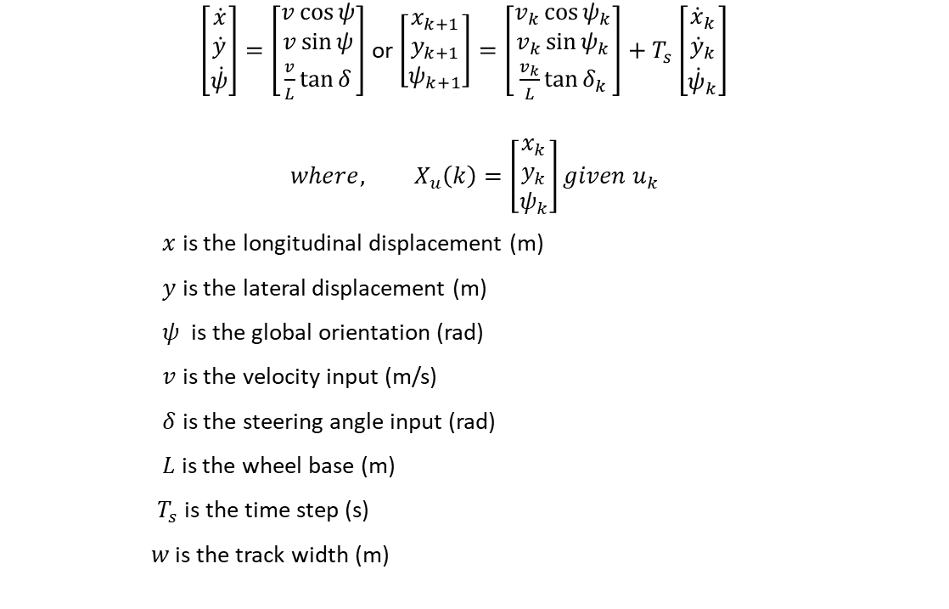
Simple Car Model & Euler-Forward Discretization
$\left[\begin{matrix}\dot{x} \\ \dot{y} \\ \dot{ψ}\end{matrix}\right]=\left[\begin{matrix}v\cos{ψ} \\ v\sin{ψ} \\ \frac{v}{L}\tan{δ}\end{matrix}\right]$ or $\left[\begin{matrix}x_{k+1} \\ y_{k+1} \\ ψ_{k+1}\end{matrix}\right]=\left[\begin{matrix}v_{k}\cos{ψ_{k}} \\ v_{k}\sin{ψ_{k}} \\ \frac{v_{k}}{L}\tan{δ_{k}}\end{matrix}\right]+T_{s}\left[\begin{matrix}{\dot{x}}_{k} \\ {\dot{y}}_{k} \\ {\dot{ψ}}_{k}\end{matrix}\right]$
$$where, X_{u}\left(k\right)=\left[\begin{matrix}x_{k} \\ y_{k} \\ ψ_{k}\end{matrix}\right]given u_{k}$$
$x$ is the longitudinal displacement (m)
$y$ is the lateral displacement (m)
$ψ$ is the global orientation (rad)
$v$ is the velocity input (m/s)
$δ$ is the steering angle input (rad)
$L$ is the wheel base (m)
$T_{s}$ is the time step (s)
$w$ is the track width (m)

Slide 3
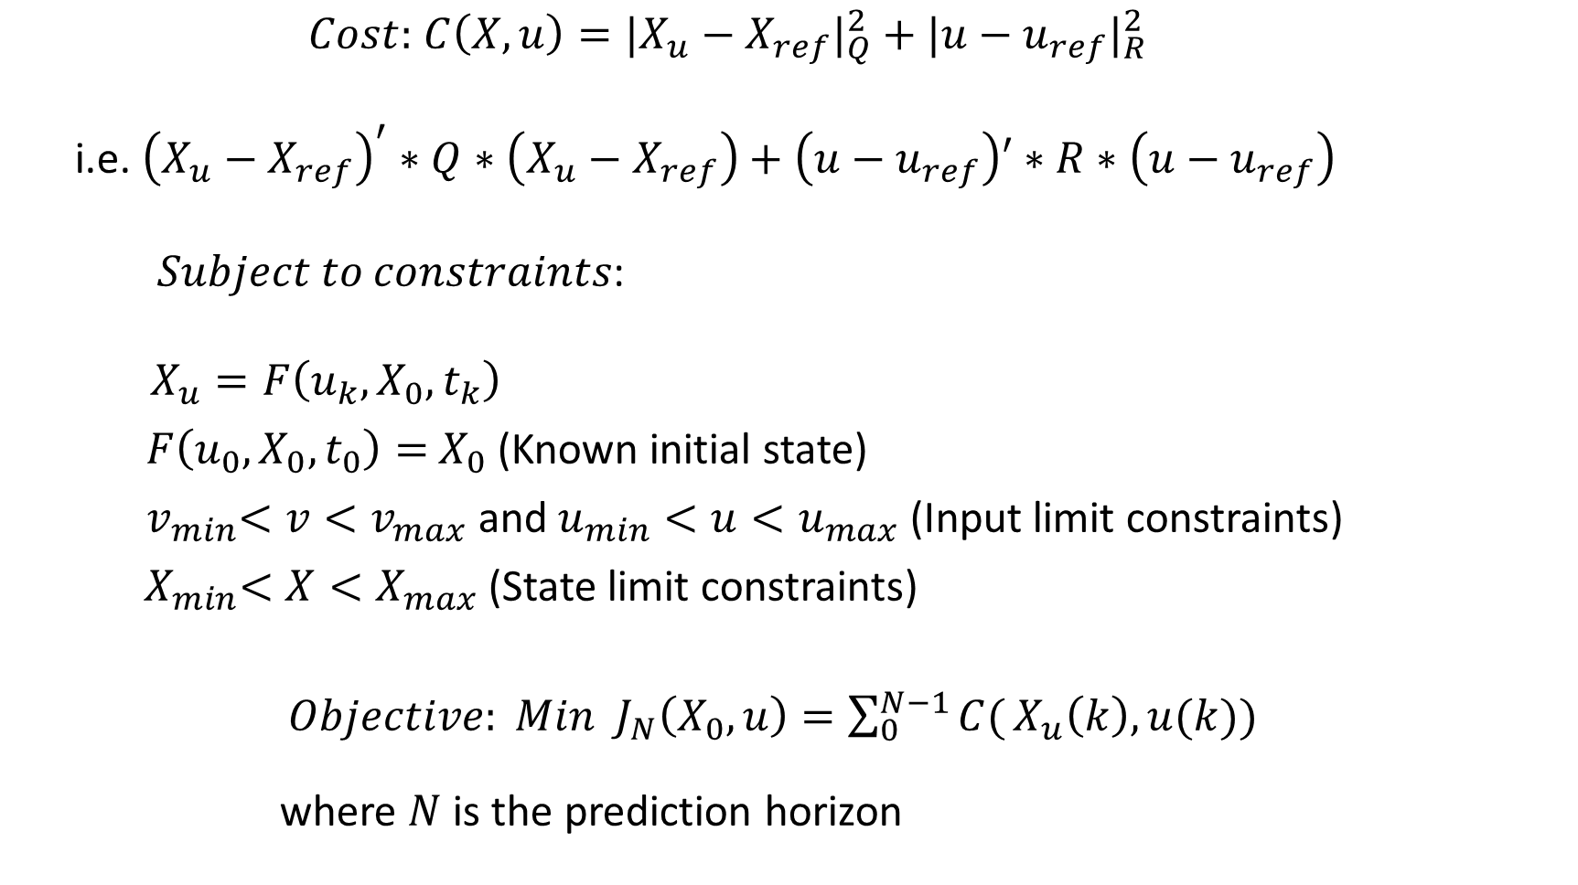
MPC Setup (Single shooting)
$Cost:$ $C\left(X,u\right)=|X_{u}−X_{ref}|_{Q}^{2}+|u−u_{ref}|_{R}^{2}$
i.e. ${\left(X_{u}−X_{ref}\right)}^{′}∗Q∗\left(X_{u}−X_{ref}\right)+\left(u−u_{ref}\right)′∗R∗\left(u−u_{ref}\right)$
𝑆𝑢𝑏𝑗𝑒𝑐𝑡 𝑡𝑜 𝑐𝑜𝑛𝑠𝑡𝑟𝑎𝑖𝑛𝑡𝑠:
$X_{u}=F\left(u_{k},X_{0},t_{k}\right)$
$F\left(u_{0},X_{0},t_{0}\right)=$ $X_{0}$ (Known initial state)
${ v}_{min}<v<v_{max}$ and $u_{min}<u<u_{max}$ (Input limit constraints)
${ X}_{min}<X<X_{max}$ (State limit constraints)
$Objective: Min { J}_{N}\left(X_{0},u\right)=\sum_{0}^{N−1}{C(}X_{u}\left(k\right),u(k))$
where $N$ is the prediction horizon

Slide 4
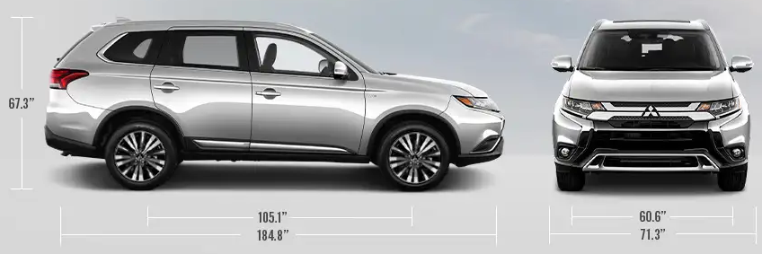
Garage parking scenario (single shooting)
Single shooting because the equality between the actual state and prediction state only set at initial condition.
The rest of the prediction state is a recursion from the initial state.
The shooting point for the solver of the boundary value problem becomes only the single point (initial condition).
SUV trackwidth and wheelbase

Slide 5
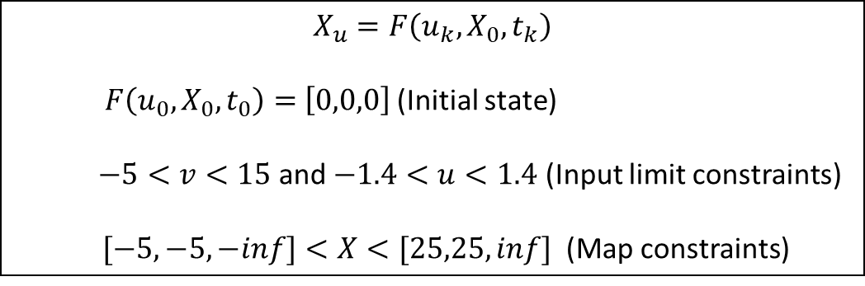


Garage parking scenario (single shooting)
Constraints
$$X_{u}=F\left(u_{k},X_{0},t_{k}\right)$$
$F\left(u_{0},X_{0},t_{0}\right)=$ $\left[0,0,0\right]$ (Initial state)
$−5<v<15$ and $−1.4<u<1.4$ (Input limit constraints)
$[−5,−5,−inf]<X<[25,25,inf]$ (Map constraints)
Single shooting performs well
Ref 1: (20,20,pi)
Single shooting struggles but succeeds
Ref 2: (20,20,0)
Parameters
$$N=50, T_{s}=0.1, L=2.7, w=1.5, Solver →ipopt$$
$$Q=\left[\begin{matrix}1 & 0 & 0 \\ 0 & 5 & 0 \\ 0 & 0 & 0.1\end{matrix}\right]$$
$$R=\left[\begin{matrix}0.5 & 0 \\ 0 & 0.05\end{matrix}\right]$$
Init Cond: (0,0,0)

Slide 6
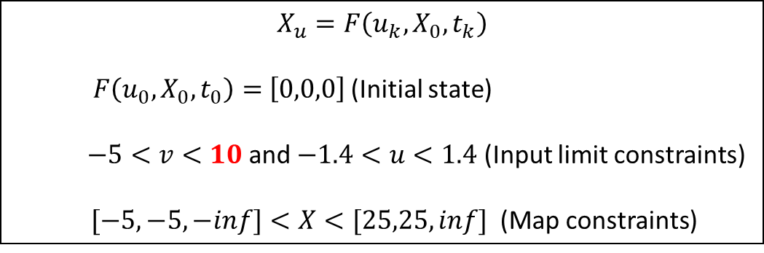


Parallel parking (single shooting)
Red bold indicates parameters tuned.
Q and R are kept the same for tuning convenience.
Constraints
$$X_{u}=F\left(u_{k},X_{0},t_{k}\right)$$
$F\left(u_{0},X_{0},t_{0}\right)=$ $\left[0,0,0\right]$ (Initial state)
$−5<v<10$ and $−1.4<u<1.4$ (Input limit constraints)
$[−5,−5,−inf]<X<[25,25,inf]$ (Map constraints)
Obstacle car but not treated as obstacles yet
Ref 1: (20,20,pi/2)
Ref 2:
(20,20,-pi/2)
Parameters
$$N=100−170, T_{s}=0.1, L=2.7, w=1.5,Solver →ipopt$$
$$Q=\left[\begin{matrix}1 & 0 & 0 \\ 0 & 5 & 0 \\ 0 & 0 & 0.1\end{matrix}\right]$$
$$R=\left[\begin{matrix}0.5 & 0 \\ 0 & 0.05\end{matrix}\right]$$
Obstacle car but not treated as obstacles yet
Single shooting really struggles to find a good solution even at N=200 to achieve error tolerance.
Init Cond: (0,0,0)

Slide 7

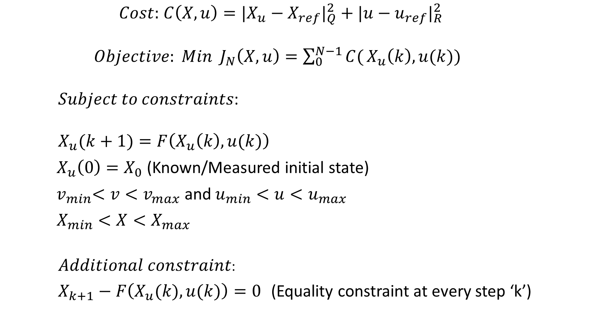
Multiple shooting
$Cost:$ $C\left(X,u\right)=|X_{u}−X_{ref}|_{Q}^{2}+|u−u_{ref}|_{R}^{2}$
$Objective: Min { J}_{N}\left(X,u\right)=\sum_{0}^{N−1}{C(}X_{u}\left(k\right),u(k))$
𝑆𝑢𝑏𝑗𝑒𝑐𝑡 𝑡𝑜 𝑐𝑜𝑛𝑠𝑡𝑟𝑎𝑖𝑛𝑡𝑠:
$X_{u}(k+1)=F\left(X_{u}\left(k\right),u(k)\right)$
$X_{u}\left(0\right)=X_{0}$ (Known/Measured initial state)
${ v}_{min}<v<v_{max}$ and $u_{min}<u<u_{max}$
$X_{min}<X<X_{max}$
$Additional constraint$:
$X_{k+1}−F\left(X_{u}(k),u(k)\right)=0$ (Equality constraint at every step ‘k’)
Now including measurements/feedback into the control loop
The equality constraint $F\left(u_{0},X_{0},t_{0}\right)=$ $X_{0}$ that was set at initial condition in single shooting is now enforced in every step.
This now gives multiple shooting points that results in faster convergence.

Slide 8
Parallel parking (multiple shooting)
3 m
Constraints
$$X_{u}=F\left(u_{k},X_{0},t_{k}\right)$$
$F\left(u_{0},X_{0},t_{0}\right)=$ $\left[0,0,0\right]$ (Initial state)
$−5<v<10$ and $−1.4<u<1.4$ (Input limit constraints)
$[−5,−5,−inf]<X<[25,25,inf]$ (Map constraints)
Obstacle car but not treated as obstacles yet
4 m
Ref 1: (20,20,pi/2)
Ref 2:
(20,20,-pi/2)
Parameters
$$N=75−120, T_{s}=0.1, L=2.7, w=1.5,Solver →ipopt$$
$$Q=\left[\begin{matrix}1 & 0 & 0 \\ 0 & 5 & 0 \\ 0 & 0 & 0.1\end{matrix}\right]$$
$$R=\left[\begin{matrix}0.5 & 0 \\ 0 & 0.05\end{matrix}\right]$$
Obstacle car but not treated as obstacles yet
Init Cond: (0,0,0)
Multiple shooting finds a good solution and also at a lesser computation time.

Slide 9


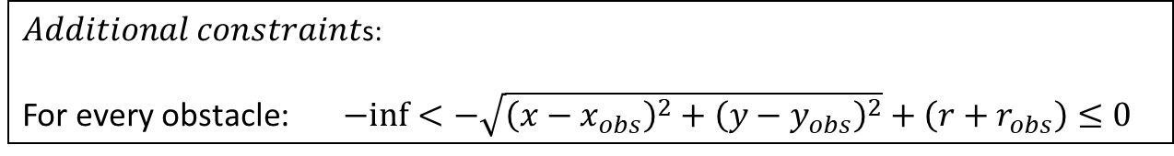



Obstacle avoidance(MS)
Obstacle cars added as constraints
$$r_{1}$$
Obst 1: (20,23.5,pi/2)
$Additional constraint$s:
For every obstacle: $−inf<−\sqrt{{\left(x−x_{obs}\right)}^{2}+{\left(y−y_{obs}\right)}^{2}}+\left(r+r_{obs}\right)≤0$
$$N=170−200$$
$$r_{3}$$
Ref: (20,20,pi/2)
Obst 2: (20,23.5,pi/2)
$$r_{2}$$
Uncertainty radius $r_{0}$
Obst 3: (12,17,0)
MPC finds a good solution avoiding all obstacles.
Init Cond: (0,0,0)

Slide 10


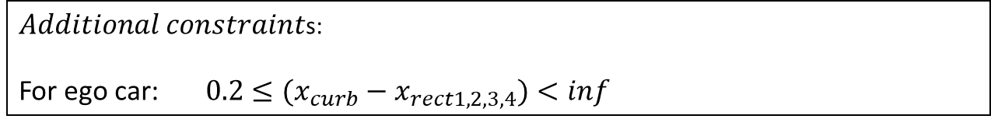
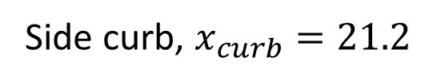



Obstacle avoidance(MS)
$$r_{1}$$
PARKING SIDE CURB ADDED AS CONSTRAINT
$Additional constraint$s:
For ego car: $0.2≤(x_{curb}−x_{rect1,2,3,4})<inf$
$$N=170−200$$
$$r_{2}$$
$$x_{rect4}$$
$$x_{rect1}$$
Side curb, $x_{curb}=21.2$
$$x_{rect3}$$
$$x_{rect2}$$
MPC does not find a solution even at N=200.
Init Cond: (0,0,0)

Slide 11
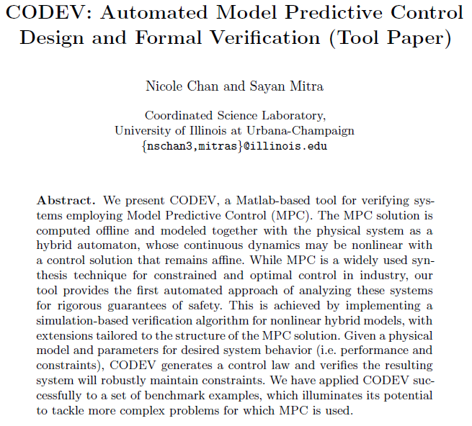
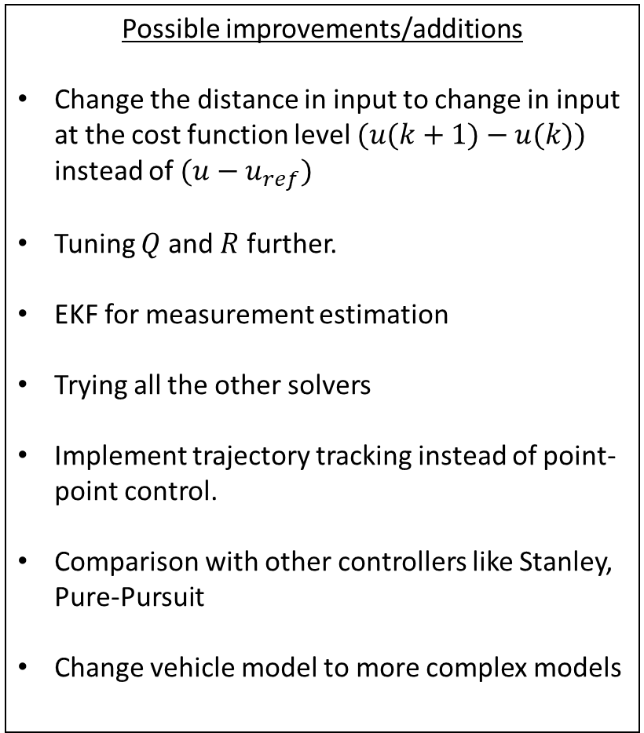
Possible improvements/additions
Change the distance in input to change in input at the cost function level $(u(k+1)−u(k))$ instead of $({u−u}_{ref})$
Tuning $Q$ and $R$ further.
EKF for measurement estimation
Trying all the other solvers
Implement trajectory tracking instead of point-point control.
Comparison with other controllers like Stanley, Pure-Pursuit
Change vehicle model to more complex models
CODEV
Biggest problem with MPC is tuning. There are lot of tuning factors and there is no way to identify right parameters and provide guarantees without extensive simulation. CODEV (image below for reference) can help.

