Slide 1
Predicting the word from brain activity
Course Project – Machine Learning Techniques (CS771A)
Bhanu Yadav (13198)
Hitesh Menghwani (13310)
Prashant Kumar (13496)
Prince Kumar (13511)
Sawan Kumar (13637)
Prof. Piyush Rai
November 20th^{th}, 2016

Slide 2
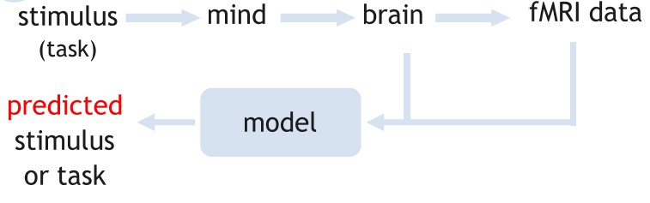
Problem Statement
We are going to use data from an experiment where 300 different subjects were given a word from a set of 60 words along with a corresponding line diagram. Each word is associated with 218 human defined attributes. fMRI scan which was recorded of all 300 subjects will be used as training data . We are going to learn models which will predict a word (among two candidate words) given fMRI scan of entirely new
subject. Our test data consists of 60 cases.

Slide 3
Prior Work
Cox and Savoy (2003) used FMRI data to classify which image category (birds, chairs, etc.) out of 10 the subject was looking at.
Mitchell et al (2008) predicts FMRI images associated with words for which FMRI data is not available.
KN Kay et al. (2008) tries to decode which natural image (out of 1000s) the subject is viewing using FMRI data.
Naselaris et al (2011) tries to predict movie image from the FMRI data obtained while a subjects watched movies.

Slide 4
Methods Considered and Tried
K-Nearest Neighbour and Distance from means.
Predicted semantic features from FMRI image by considering each feature separately. That is from training data we learn two mappings:
Training FMRI image to semantic features.
Sematic features to word.
Word plus drawings are represented in terms of features.
After regressing apply 1-NN classifier to classify the image in given two categories.

Slide 5
Methods Considered and Tried (Contd …)
Subset selection: In this we take all combinations of predictors and choose the best model. But this cannot be applied to the FMRI dataset as number of predictors is very large.
Stepwise selection: Forward selection begins with a model containing no predictors then keep on adding predictors till the model improves significantly. Again this method is not feasible for our dataset.
Shrinkage method: These model shrink the coefficient estimates towards zero using regularization.
Ridge Regression: Uses L-2 regularization to avoid overfitting but it includes all predictors in the final model.
Lasso regression: Uses L-1 regularization. It is a linear sparse model. Shrinks the coefficients to zero. Thus it also does variable selection.
Partial Least squares: PLS is a dimension reduction method. It linearly transforms the original predictors to obtain new set of features. It identifies features in a supervised way i.e. it also uses Y variable to obtain new features.

Slide 6
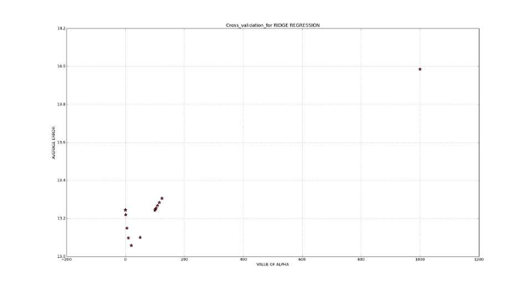
Results
Partial least square: Obtained accuracy of 51.67 %.
1-NN, 3-NN and distance from means: We obtained an accuracy of 63.33 %, 68.33% and 68.33% on the test data.
Ridge regression: We obtain value of regularization parameter using leave-one-out cross validation. The value at which error is minimized is at alpha equal to 20. The accuracy obtained on test data using this alpha is 78.33%

Slide 7
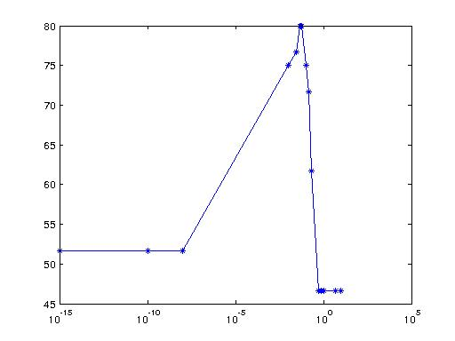
Results (Contd …)
Lasso: Below is the graph of accuracy on test data vs regularization parameter for lasso regression. We were able to obtain a maximum accuracy of 80 %.

Slide 8
Things learnt …
Previous research that has been done for fmri data classification and how the authors performed the experiment, methods they applied.
Learnt how to handle high dimensional data with relatively few observations for regression.
Different methods that are used like subset selection, stepwise regression, Lasso, etc., when to use these methods.
Leant about how lasso objective function is maximized using sub gradients, why it shrinks coefficients to zero, different algorithms like least angle regression, stochastic coordinate descent.

