Slide 1
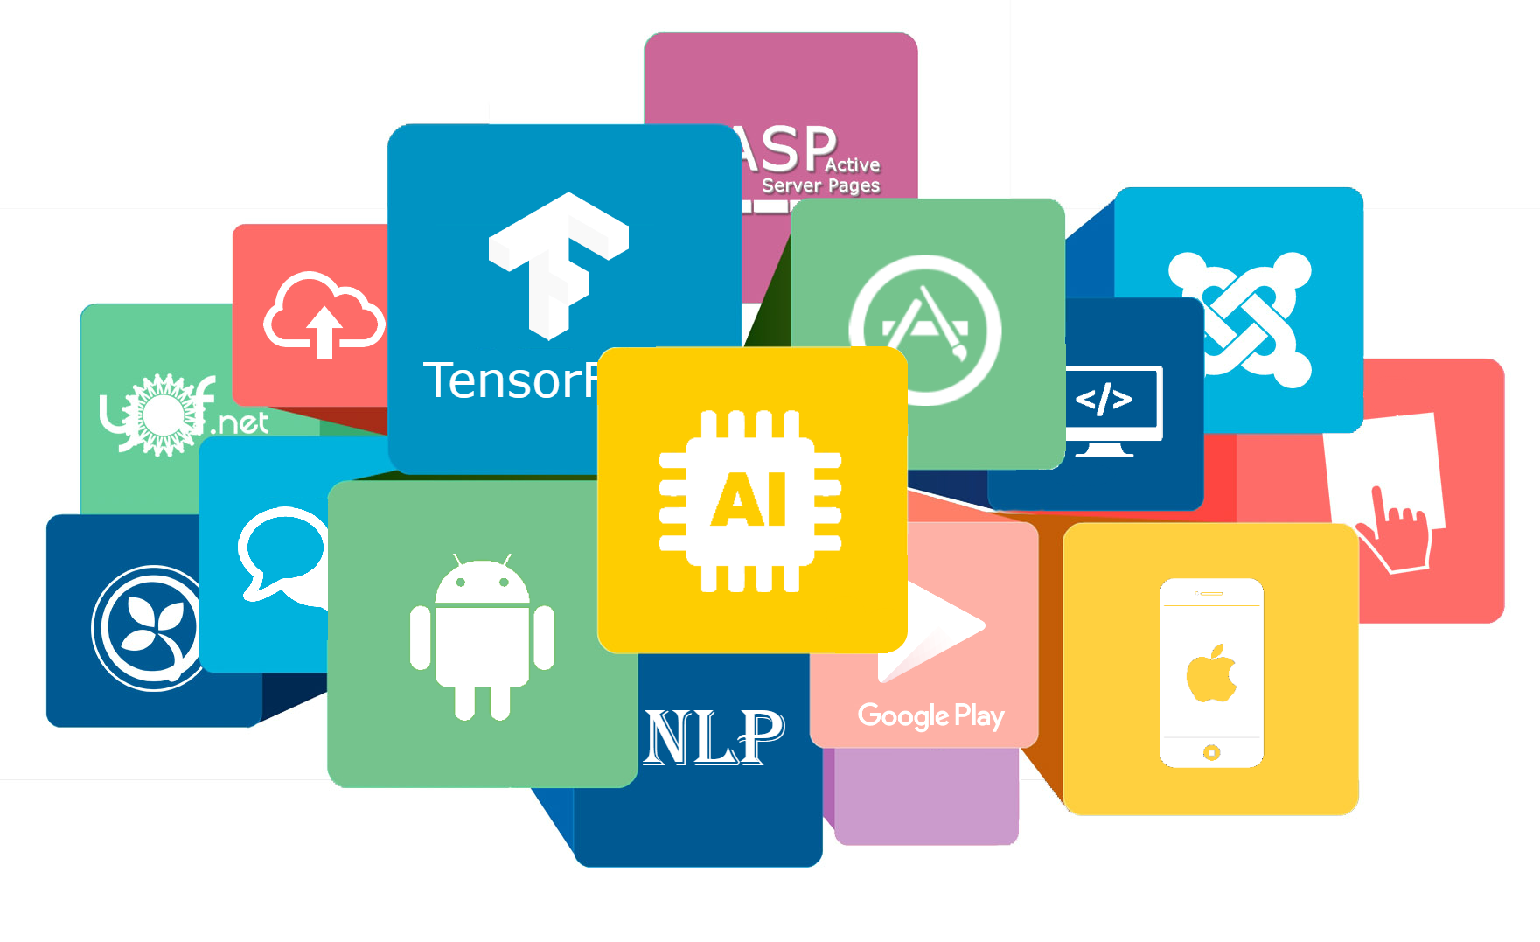
ARMOR
App Review Mining On Reliability

