Slide 1
Lincoln Laboratory Secure and Resilient Cloud R&D Testbed
Dr. Nabil Schear
Overview Briefing
April 2014
Notes:
1
1

Slide 2
Outline
Cloud Computing
Needs
Architecture
Threats
Mitigations
MIT LL Secure and Resilient Cloud Testbed
Communications
Storage
Processing
Status and Summary

Slide 3






Cloud Computing Security Today
The Problem
Commercial cloud focused on availability and scalability not DoD security
Limitations:
Minimal visibility into cloud network security or data provenance
Data stored unencrypted inside cloud
All processing done on unencrypted data
?
Cloud Gateway
Database
Storage
Cloud Network
Processing
Not enough protection from attack or exploitation by cloud operator or other cloud tenants

Slide 4
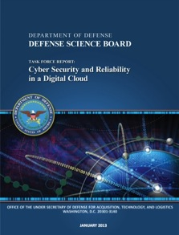
2013 DSB Cloud Security Study National Challenges
Security of Cloud Computing Findings
Cloud not intrinsically more secure, but scale and uniformity may make it easier to defend
Scale of cloud enables large-scale analysis of data for forensics and real-time detection of attack
No single cloud model suitable for all applications, some not suitable for cloud at all
Need security assessment to determine how cloud will help/hurt
DoD has not planned for facility, backup, or degraded comms
* DSB Cyber Security and Reliability in a Digital Cloud, Jan 2013
Co-chaired by MIT LL Director
Dr. Eric Evans
Recommended Cloud R&D
Scalability
Security
Usability
Cloud computing can enhance DoD mission capabilities, provided that strong security measures are in place

Slide 5
Commercial Cloud Security Example Shortcomings
Commercial cloud service providers and software developers driving technology innovation
Not addressing security and resilience needed for DoD missions
Commercial Cloud Security Offering | DoD Shortcomings
Data at rest encryption | Must outsource key management to cloud provider
Locked down OS images | Lack of root of trust hardware (TPM) and software support for system integrity monitoring
Network uptime guarantees | Enforcement only through SLAs, unknown resistance to large scale DDoS attack
Secure physical cloud hosting facilities | Cloud facilities staffed by uncleared and/or foreign persons
Cloud service provider intrusion response team | No DoD visibility into monitored data, TTPs, attacks affecting other customers, etc…
OS – Operating System
TPM – Trusted Platform Module
SLA – Service Level Agreement
DDoS – Distributed Denial of Service
TTP – Tactics, Techniques, and Procedures

Slide 6
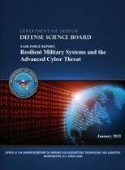
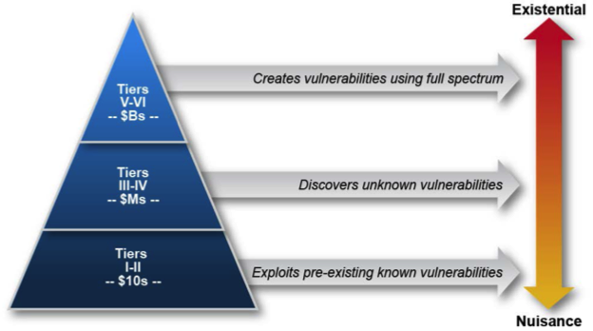
2013 DSB Advanced Cyber Threat Study Threat Strategy
*
Deter
Dollars spent by adversary
Mitigate
* DSB Resilient Military Systems and the Advanced Cyber Threat, Jan 2013
Defend
Good system hygiene and monitoring for Tiers I-II
Trust, segmentation, recoverability, and resilient C2 for Tiers III-IV
Improved attribution and higher attacker costs for Tiers V-VI
C2 – Command and Control

Slide 7






DoD Cloud Architecture: A Hardware and Software View
Sensor
Client
Wide Area Network
Client
Sensor
LLSRC Cloud
Compute
Storage
Controllers
Network Portal
Monitoring
Storage Gateways
App
App
App
VM
Mon
VM
Mon
VM
Mon
Hypervisor
Mgmt
Infrastructure Controller
Controller Message Bus
Cloud Private Network
VM – Virtual Machine

Slide 8
DoD Cloud Architecture: Threat Taxonomy
Sensor
Credential Stealing
Client
External Denial Of Service
Wide Area Network
Data Integrity Attack
Client
Sensor
Cross VM Side Channels
Remote Code Injection
LLSRC Cloud
Compute
Storage
Controllers
Network Portal
Monitoring
Storage Gateways
App
App
App
Data Integrity Attack
VM
Mon
VM
Mon
VM
Mon
Data Integrity
Data Loss / Exfiltration
Insider Threat
Hypervisor
Mgmt
Infrastructure Controller
Hypervisor Privilege Escalation
Internal Network Resource Attacks
Controller Message Bus
Supply Chain
Cloud Private Network
VM – Virtual Machine

Slide 9

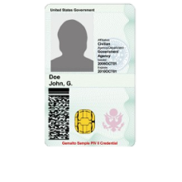



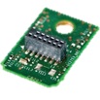

DoD Cloud Architecture: Defend, Mitigate, and Deter
Threats Mitigated
Client
Secure Boot
Supply Chain
Remote Code Injection
Hypervisor Privilege Escalation
Wide Area Network
Encrypted Storage
Data Loss / Exfiltration
Insider Threat
Data Integrity Attacks
Secure Multiparty Protocols
Remote Code Injection
Cross VM Side Channels
Data Integrity Attack
Hypervisor Escalation
Multi Factor Authentication
Credential Stealing
Insider Threat
Moving Target (Dynamic Software/Runtime)
Remote Code Injection
Hypervisor Privilege Escalation
Data Integrity Attacks
Data Flow Labeling and Tracking
Data Loss / Exfiltration
Insider Threat
Data Integrity Attack
Network Resource Attacks
Enhanced SA and Net Virtualization
Network Resource Attacks
Denial of Service
Data Loss / Exfiltration
Insider Threat
Client
Sensor
Multi Factor Authentication and Key Derivation
Private Cloud
Compute
Secure Multiparty Protocols
Storage
Controllers
Network Portal
Streaming Analytics and Metrics
2
4
Monitoring
Dynamic Runtime /Software Moving Target
Storage Gateways
App
App
App
1
3
Encrypted Storage with Sharing and Query
App
App
App
VM
Mon
VM
Mon
VM
Mon
VM
VM
VM
Hypervisor
Mgmt
Infrastructure Controller
Secure Boot and Runtime Integrity Monitoring
TPM
Provenance
Data
Controller Message Bus
Data Flow Labeling and Tracking
Derived From
Cloud Private Network
Software Defined Network Virtualization
Input
Process
Product
LLSRC Cloud
SSL – Secure Socket Layer
VM – Virtual Machine
TPM – Trusted Platform Module

Slide 10
Threats and Applicable Mitigations Mapping
 | Insider Threat | Credential Stealing | Remote Code Injection | Hypervisor Privilege Escalation | Data Integrity | Cross VM Side Channels | Data Loss | Internal Network Resource Attacks | External Denial of Service | Supply Chain
Multi-factor Authentication | ✔ | ✔ |  |  |  |  | ✔
Encrypted Storage | ✔ |  |  |  | ✔ |  | ✔
Secure Boot and Integrity Monitoring |  |  | ✔ | ✔ | ✔ |  |  |  |  | ✔
Data Flow Labeling and Tracking | ✔ | ✔ |  |  | ✔ |  | ✔ | ✔
Secure Multiparty Protocols |  |  | ✔ | ✔ | ✔ | ✔ | ✔ |  |  | ✔
Moving Target |  |  | ✔ | ✔ | ✔ | ✔ | ✔
Enhanced SA and Net Virtualization | ✔ | ✔ | ✔ |  | ✔ |  | ✔ | ✔ | ✔
✔ Applicable to threat
Need way to evaluate effectiveness of mitigations against threats
Notes:
Are these priorities correct?

Slide 11
Outline
Cloud Computing
Needs
Architecture
Threats
Mitigations
MIT LL Secure and Resilient Cloud Testbed
Communications
Storage
Processing
Status and Summary

Slide 12
Testbed to Reduce Risk
Threats
Code Injection
Data Exfiltration
Insider Threat
Supply Chain
…
Users
ISR
Air and Missile Defense
Space Control
Air Traffic Control
NSA
DHS
Cyber
…
Testbed
Instrument Tests
Collect Data
Metrics and Analysis
Do evaluation and Recommendation
Solutions
Proof of capability
Evaluation results
Technology maturity
…
Technologies
Moving Target
Secure Boot
Data Provenance
Secure Storage
Cross Domain
…
Notes:
Why and how. What to follow
We’ve been working the DoD on acquisition of systems that support the war fighter.
Use testbeds to reduce risk
MIT LL developing LLSRC testbed to demonstrate, validate, and evaluate secure cloud technology
Internally funded 3 year effort
Seek help from sponsors to influence and shape LLSRC
How to best address national cloud security needs

Slide 13
Lincoln Laboratory Secure and Resilient Cloud R&D Testbed (LLSRC)
Vision
The premier secure private cloud R&D testbed for DoD
Strategic Pillars
R&D technologies that address critical challenges in private cloud cyber security with national impact
LLSRC should be an asset to future programs across Lab missions
Innovative prototype demonstrations with future operational impact
Shape future DoD, IC, and federal cloud data centers
Use existing investments to seed LLSRC testbed
Lincoln Strengths
Strong team spanning multiple missions, cyber, and big data expertise
Connections to customers and missions that can benefit from a secure private cloud platform
Notes:
Our focus is on mission oriented secure private cloud computing

Slide 14
Lincoln Lab Secure Resilient Cloud (LLSRC) Testbed Architecture
DoD Applications
Intelligence
ISR
C2
LLSRC API
Secure and
Resilient
Communication
+ Provenance
Secure and Resilient
Storage
Secure and
Resilient
Processing
High Assurance Architecture
Elastic Commodity Hardware
Custom DoD Hardware
Notes:
We’re working with program offices to reduce risk and support DoD missions

Slide 15
LLSRC Focus Areas
Storage
Enables: store and query against encrypted data in the cloud
How: advanced cryptography, key management
Communication + Provenance
Enables: end-to-end protection and provenance for all cloud communication
How: secure pub/sub, provenance protocol and analytics
Processing
Enables: processing and analytics on always-encrypted cloud data
How: secure multi-party computation, homomorphic encryption
High Assurance Architecture
Enables: user visibility and control of cloud trust and isolation
How: virtual isolation, integrity monitoring, root of trust

Slide 16


Private Cloud Threat Models
Trust Level
Low
High
Semi-Trusted Cloud Model
Assume nothing
Trust me, it’s perfectly secure
Academia
DoD Today
Good node
Possibly compromised node
Compromised node
Notes:
Private multi-tenant cloud
Shared by multiple DoD and other government organizations
Cloud operator is semi-trusted
Staffed by cleared staff
Physically secure (e.g., on military base)
Some nodes may be compromised or unknown

Slide 17

Secure and Resilient Communication with Provenance
Analytic
API
Brokered Secure Comm
Sensor Data
API
C2 System
Provenance
Cloud Messaging
API
Data
Derived From
Distributed Provenance-based Access Control
Input
Process
Product
Mission Mapping
Approach: encourage provenance adoption by providing scalability and security
Benefits:
Assessment of data trustworthiness for mission critical decisions
Provenance informs Cyber SA; enables distributed access control
Minimal trust in cloud to protect data in transit
API – Application Programmer Interface

Slide 18

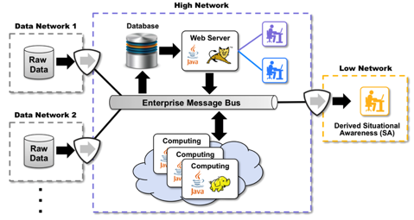
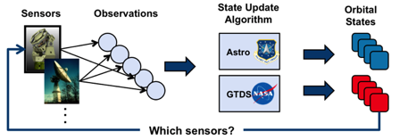
Data Provenance Implementation: AF Space Command Effort
Provenance
System Status
Operational at Vandenberg AFB Fall 2013
All data objects have provenance-derived classification labels
100k new items classified per day
PL-3 cross domain high-to-low sanitization architecture accredited
MIT LL Risk reduction for AF space control situational awareness cloud architecture
AFB – Air Force Base
PL-3 – DCID 6/3 Protection Level 3

Slide 19




Secure and Resilient Storage
Secure Object Store
Allows for secure storage, retrieval, and sharing
Benefits:
Cloud never sees client’s data
No trust in cloud necessary for confidentiality and integrity
Data
Data
Data
Data
Object Store
Secure Database
Allows for searches and queries over encrypted data
Benefits:
Cloud does not learn queries
Can enforce policy on queries
Query
Results
Database

Slide 20

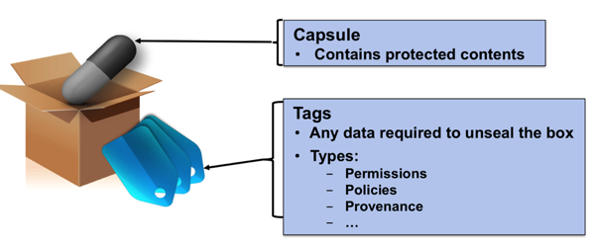

Secure Storage Implementation: DISA Secure Cloud Storage R&D Effort
EE213
Goal: securely store data without trusting cloud storage provider
Provide seamless sharing with cryptography
CDC
Commercial Cloud Provider
Status
Initially support securely storing FOUO data, eventually secret data on untrusted public cloud
Status: development underway, 1st prototype demo Aug 2013
NIPRNet Connected End User
FOUO/SBU Data
NIPRNet
CDC
Commercial Cloud Provider
Internet
VPN
User w/Gov’t Approved Device
CDC – Community Data Center (DISA)
Notes:
This is technology we’re putting into the testbed to evaluate.

Slide 21

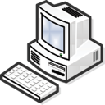
Secure and Resilient Processing
Multi-Party Computation (MPC)
x
X₁
y₁
X₂
y₂
X₃
y₃
f (x)
=
y
Goal: Perform secure processing on semi-trusted cloud without revealing data to the cloud
Ensure confidentiality of inputs / outputs
Ensure correctness of computation
Ensure resilience to node / communication failures

Slide 22
MPC Example: Computing Linear Functions
y
p’(0)
2
3
7
1
4
2
9
5
3
11
x
f (2)
=
5
p(0)
Goal: Compute f(s) = 2s+1
Give each node an unique ID: x_{i}
Client shares the input using random polynomial p(x)=x+2
The secret input is p(0) of this polynomial, each share for node i is p(x_{i})=s_{i}
Each node computes f(s_{i}), result now shared using polynomial p’(x)=2x+5
p’(x) = f(p(x)) = 2(x+2)+1 = 2x+5
Client interpolates polynomial p’(x) at 0 to find solution: p’(0)=5
Notes:
Linear MPC: f(s)=3s+5
1. First, the client secret shares his secret among the nodes using a random poly p(x) such that p(0) = s. In this case, p(x)=x+2
2. He sends the shares to the nodes, these are just points on p(x), so Node 1 gets p(1)=3, Node 2 gets p(2)=5, Node 3 gets p(3)=7
3. The nodes compute the linear function locally on their individual nodes to compute a sharing of the result. The resulting sharing is with respect to degree 1 poly p'(x)=3x+11
4. The nodes send their shares to the client who reconstructs p'(0)=11
Some notes: Since the secret is shared using degree 1 ploys, it takes at least 2 points to reconstruct the value at 0. If at most n/3=1 node is corrupted it gets no information about the secret.

Slide 23


Maintaining MPC Security Thresholds
Need threshold of good cloud nodes to remain secure
Zero day vulnerability could affect homogeneous cloud nodes
Broad compromise can destroy threshold of good nodes
Combine mitigation and detection to maintain MPC threshold
Mitigation: moving target (dynamic software/runtime, clean-slate re-provisioning)
Detection: system integrity monitoring (secure boot, runtime monitoring)
Attacker
Reinitialize to known good state
Prevention
Moving Target
Moving Target
Moving Target
…
MPC
MPC
MPC
System Integrity Monitoring
Detection

Slide 24
Outline
Cloud Computing
Needs
Architecture
Threats
Mitigations
MIT LL Secure and Resilient Cloud Testbed
Communications
Storage
Processing
Status and Summary

Slide 25

Program Status Update
LLSRC cluster installed in EcoPOD in Holyoke, MA
Successfully completed HPC Challenge benchmarks
Operational hybrid big data (LLGrid) and IaaS (OpenStack) Cloud
Updated FY14 program plan with demos for MIT LL stake holders planned in Feb and Aug/Sept 2014
Ongoing study of end-to-end MIT LL missions with LLSRC
Space Control
BMD
Cyber SA/C2
Bio/Health
LLSRC-related briefings to IC, DISA, and others in progress
ISR
Joint Information Environment (JIE)
TRANSCOM

Slide 26
Secure Private Cloud Computing Outlook
LLSRC
Today | Near Term (3 yrs) | Mid Term (6 yrs) | Long Term (10 yrs)
Minimal technical deterrence | MPC linear algebra | Secure MPC Provenance-based attribution Semi-automated supply chain assurance | Practical functional and homomorphic encryption Hardware provenance Predictable cyber effects
Intrusion detection DDOS mitigation | Secure provenance Secure storage Moving target | Verifiable computation Query-able secure storage Resilient Virtualization | Automated intrusion recovery Automated mission mapping Intent/behavior detection forecasting
Infrequent patching Anti-virus Complex supply chain | Segmentation Rapid patching SA monitoring Multifactor auth Secure boot | Automated risk assessment Real-time integrity monitoring Formal correctness methods | Specialized secure hardware (co-processors) Quantum communications Ubiquitous anti-tamper
Tiers
V-VI
Tiers
III-IV
Tiers
I-II
Deter
Mitigate
Defend
Lincoln secure private cloud R&D efforts can improve DoD’s ability to address threats from all tiers
MPC – Multi-Party Computation
SA – Situational Awareness
Notes:
Derived in part from Cloud and Cyber Threat DSB reports and AF Cyber Vision 2025

Slide 27
Summary
National Roadmaps (DSB) and mission needs driving cloud adoption
Commercial cloud solutions leave gaps that don’t address DoD security and resiliency needs
MIT LL is well positioned to fill cloud security gap for DoD
Innovative and leap-ahead research in secure and resilient architecture, communication, storage, and processing
Focus on building state-of-the-art secure cloud testbed
LLSRC informs security and resiliency technology trade space
Testbed operational, R&D underway, studying end-to-end cloud applications relevant to MIT LL missions
LLSRC is a critical strategic investment for the Laboratory to address important DoD security gaps in private cloud computing

