Slide 1

Global Coffee Health Advanced Visualization
Capstone #2
M2M Tech Connect
Data Talent Program
Cohort 18
Presented by:
Angelo Ramirez
November 2025
Notes:
Hi everyone,
My name is Angelo Ramirez and I am here to present to you my Capstone #2 as part of the M2M Tech Data Talent Program in Cohort 18.

Slide 2

Objective
Visualize the data via charts using Python and Bokeh
Visualize the data in a world map using Geo JSON and Bokeh
Export the visualization to Netlify
Tools used:
Google Colab Python Notebook
Pandas – data manipulation
Bokeh – data visualization
Notes:
My Second Capstone project will focus on using advanced visualization using a data set named Global Coffee Health. Note that this dataset contains synthetic records, meaning the records are reflecting real-world data but contain no actual personally identifiable information.
Our Objective …
All of these objectives will be coded using a Google Colab Python notebook, and in the notebook we will be using open source libraries like Pandas for data manipulation and Bokeh for visualization

Slide 3
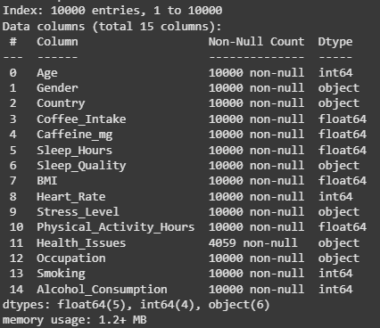
Dataset Overview
Source: https://www.kaggle.com/datasets/uom190346a/global-coffee-health-dataset
Num. of rows: 10,000
Num. of columns: 15
Notes:
All columns are filled in except for “Health Issues” which have null values
Notes:
Now to give you a quick overview of our dataset
Our Global Coffee Health data set came from a website named Kaggle. The data set consists of 10,000 records with 15 columns.

Slide 4
Dataset Overview
Column | Type | Description
ID | Integer | Unique record ID (1–10000)
Age | Integer | Age of participant (18–80 years)
Gender | Categorical | Male, Female, Other
Country | Categorical | Country of residence (20 countries)
Coffee_Intake | Float | Daily coffee consumption in cups (0–10)
Caffeine_mg | Float | Estimated daily caffeine intake in mg (1 cup ≈ 95 mg)
Sleep_Hours | Float | Average hours of sleep per night (3–10 hours)
Sleep_Quality | Categorical | Poor, Fair, Good, Excellent (based on sleep hours)
Column | Type | Description
BMI | Float | Body Mass Index (15–40)
Heart_Rate | Integer | Resting heart rate (50–110 bpm)
Stress_Level | Categorical | Low, Medium, High (based on sleep hours and lifestyle)
Physical_Activity_Hours | Float | Weekly physical activity (0–15 hours)
Health_Issues | Categorical | None, Mild, Moderate, Severe (based on age, BMI, and sleep)
Occupation | Categorical | Office, Healthcare, Student, Service, Other
Smoking | Boolean | 0 = No, 1 = Yes
Alcohol_Consumption | Boolean | 0 = No, 1 = Yes
Notes:
In our advanced visualization, we will be utilizing the columns “Caffeine_Intake” in milligrams, the Age, the Country and the “Health Issues” column which is a categorical column that can have 4 values namely None, Mild, Moderate and Severe.

Slide 5
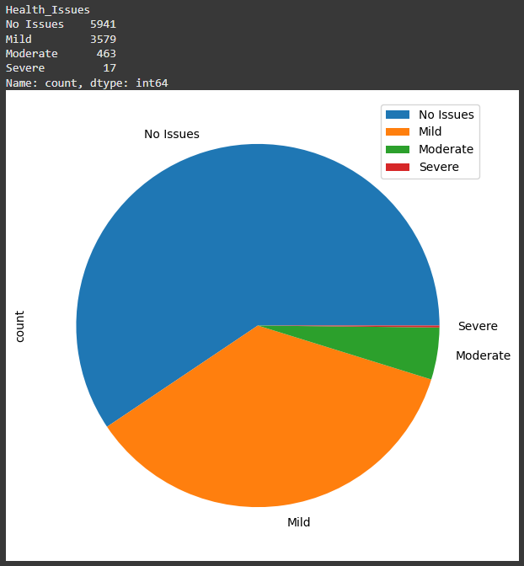
Data Visualization Age Group and Health Issues vs Caffeine Intake (Mg)
Get the Caffeine Intake (mg) consumed by each individual based on their Health Issue category and Age Group
The data will be grouped by Age Group, and each Age Group will contain each unique Health Issue category (No Issues, Mild Moderate, Severe)
The plot pie on the right shows an overview of the count of each Health Issue category in our data set
Notes:
Our first visualization’s goal is to …
The plot pie on the right shows an overview of the count of each Health Issue category in our data set. And as we can see, it is heavily biased on two categories compared to the rest.

Slide 6
Data Visualization Age Group and Health Issues vs Caffeine Intake (Mg)
The Age Group will be determined by decade as shown in the table on the right
Age Group | Ages Covered
10s (teens) | 10 – 19 yrs. old
20s | 20 – 29 yrs. old
30s | 30 – 39 yrs. old
40s | 40 – 49 yrs. old
50s | 50 – 59 yrs. old
60s | 60 – 69 yrs. old
70s | 70 – 79 yrs. old
80s | 80 – 89 yrs. old
Notes:
Here we can see how we are classifying each age group.
The Age Group will be determined by decade as shown in the table on the right
For example, under the age group of 20s, the ages covered are from 20-29, and so on

Slide 7
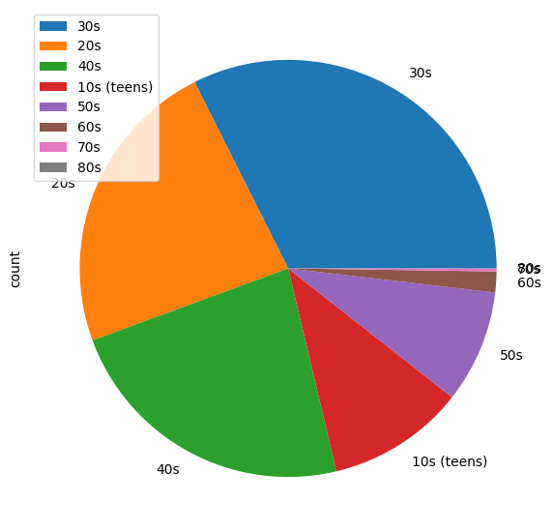
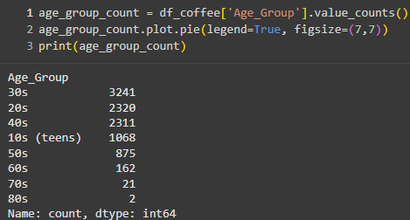
Forming the Age group
Create a function that will return the Age Group based on the Age
Apply the function to the Age column in the data frame
Assign the result to a new data frame column named Age Group
Age Group | Ages Covered
10s (teens) | 10 – 19 yrs. old
20s | 20 – 29 yrs. old
30s | 30 – 39 yrs. old
40s | 40 – 49 yrs. old
50s | 50 – 59 yrs. old
60s | 60 – 69 yrs. old
70s | 70 – 79 yrs. old
80s | 80 – 89 yrs. old
Notes:
To explain the process of forming the age group, here is a quick workflow of how its done, first… (read the workflow)
After creating the column, we can visualize the data distribution using Panda’s plot pie as seen in the screenshot. In here we can see the proportion of each age group where we have more data in the younger age groups and it gradually becomes less on the older groups.

Slide 8
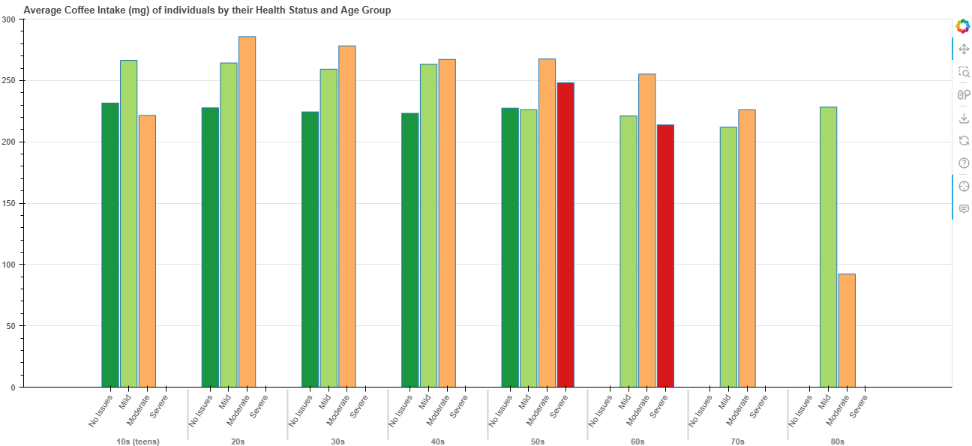
Data Visualization Age Group and Health Issues vs Caffeine Intake (Mg)
Notes:
Afte running the code, this is our visualization, here is the Bokeh Vertical bar chart showing the age group in the X-axis, each age group will contain the 4 health issues category, and on the Y-axis we can see the average coffee intake per milligram.
Observations:
- The ‘Severe’ Health Issue Category does not have enough sample size, 11 in the 50s age group and 6 in the 60s age group
- From Age Groups 20s to 40s, those who consume more than 250 mg have Mild to Moderate Health Issues
- Those who does not have Health Issues consumes around 200 mg to 250 mg
- The difference in consumption of those with no health issues to those that have is only around 50 mg, which suggests that Coffee consumption might have less impact on one’s health, however, consuming less than 250 mg would be a safe measure

Slide 9
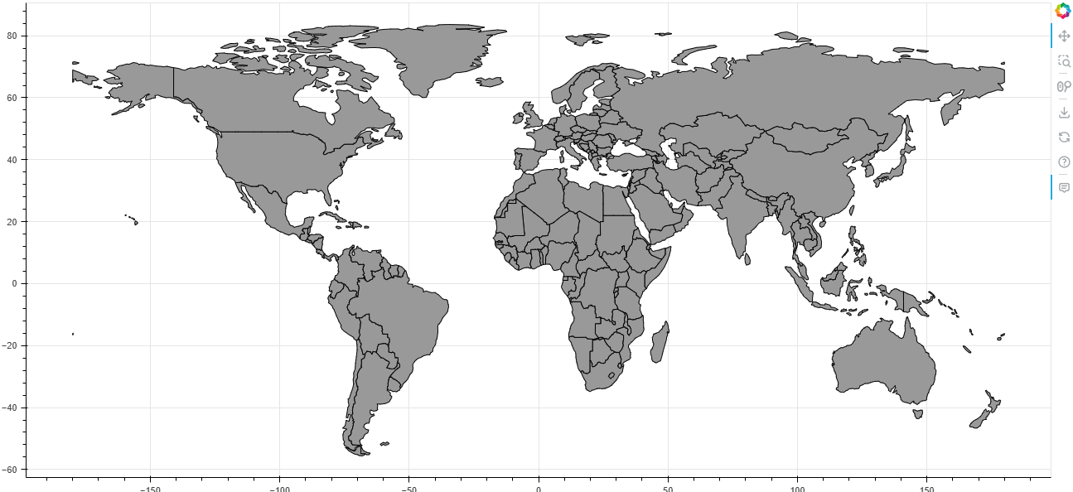
Data Visualization Average Caffeine Intake (Mg) by Country
Get the average Caffeine Intake (mg) consumed by each Country and visualize using a world map
The world map will be shown using Geo JSON
We will get the world map Geo JSON file from the following source: https://geojson-maps.kyd.au/
Shown on the right is how the world map will look like after importing the Geo JSON file and showing it to a Bokeh plot
Our goal is to change the color of the countries that has existing data and add a hover tool for more details
Notes:
Now moving on to our second and last visualization, our goal is to…

Slide 10
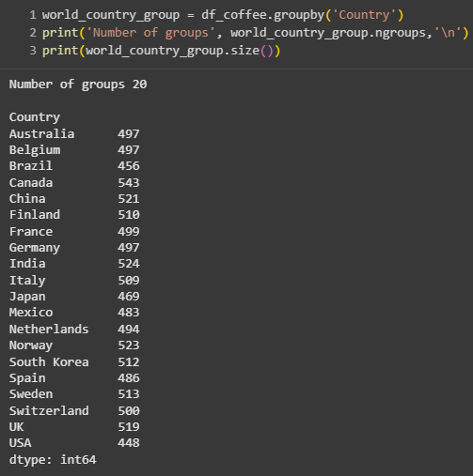
Involved Countries
When we group our data frame by Country, we will see how many countries we have data on
After calling SIZE on the group object, we will see that we have 20 countries
We should expect a lot of grey areas in our visualization since we are only highlighting 20 countries
Note that UK and USA spellings are abbreviated

Slide 11
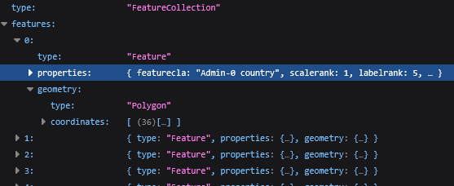
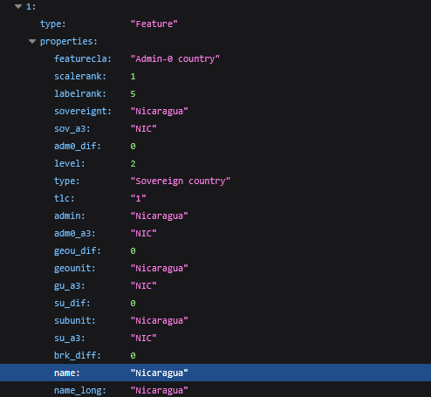
Exploring the World Map’s JSON File
The world map’s JSON file that we imported is a type of ‘Feature Collection’ and contains the following layers:
[‘features’] will be a list of features, with a total of 175 items representing each country
Each feature will contain ‘type’, ‘properties’ and ‘geometry’ objects
[‘properties’] is a very long dictionary containing the properties of the feature. We will be needing the ‘name’ property to match our data. We will also modify the dictionary to add more properties such as Color, Rank and the Average Caffeine Intake
[‘geometry’] is a Polygon type which Bokeh uses to draw our world map plot, we won’t be touching this
Since we know how the JSON file looks like, we will access the properties in Python like this:
Geojson[‘features’][i][‘properties’]
‘i’ will be the index in the ‘features’ list
Notes:
Now in able to code this properly, we need to see how the JSON file looks like…

Slide 12
Determine the color based on Ranking
To color our world map, we will be using Yellow as a theme
Our goal is to change the color’s darkness based on the Country’s average Caffeine intake
We will accomplish this by making a new function where it will take an amount parameter that will determine the color’s darkness
The Python library used is called ‘seaborn’ and the figure is called ‘palplot’
Notes:
The higher the Caffeine intake, the darker the Yellow will be
The lower the Caffeine intake, the lighter the Yellow will be
After testing the function, the colors will look like the ones shown below

Slide 13
Average Caffeine Intake (Mg) by Country Code Process
Import the world map JSON file to GeoJSON data source object
Prepare the Data. Rename USA and UK to their full name
Using the group object, get the mean of the Caffeine_mg column in ascending order
Group the data frame by Country
Getting the mean will create a new data frame containing the Country as the index and the mean of Caffeine_mg of each Country
Create a function that will give us a color where its lightness or darkness will depend on a supplied parameter
Show the map figure
Add a column in the mean data frame that will contain the color of the Country using the new function
Add a column in the mean data frame that will determine its ranking/order based on the mean
Update Geo JSON properties to add new properties for color, rank and the mean
Create the Bokeh figure and add tooltips displaying the Country name, rank, and the mean
Notes:
Here is a quick overview of how I coded this process of showing the average caffeine intake by country in a map
It involves importing the GeoJSON data, preparing the coffee dataframe, filtering and grouping the dataframe, sorting by caffeine intake of each country, which will be used to determine the color and finally updating the GeoJSON properties to show the new colors and a tooltip for each country showing their ranking and average caffeine intake

Slide 14
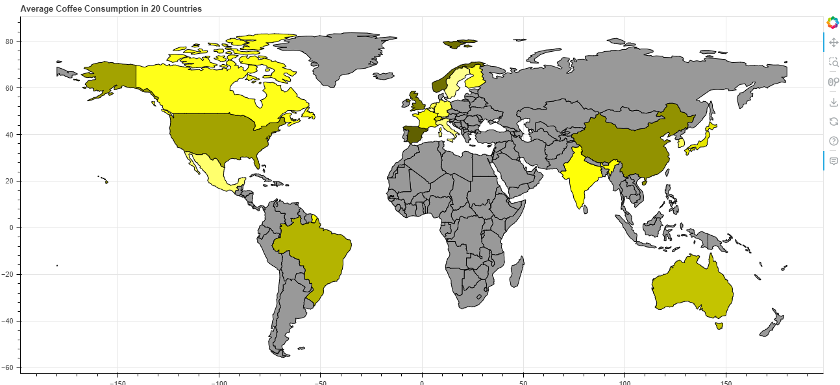
Data Visualization Average Caffeine Intake (Mg) by Country
Notes:
After running the code, Here we can see that our world map is now highlighting the 20 countries that we have data on.
Let’s take a closer look at the figure in the notebook…
Analysis:
- Spain ranks number 1 with an average of 247 mg per day
- Belgium ranks last at number 20 with an average of 230 mg per day

Slide 15
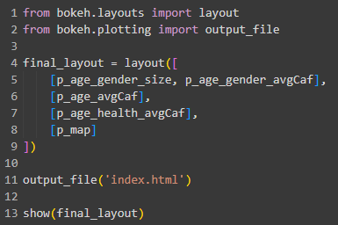
Prepare to Publish
In total we have shown 5 Bokeh figures
To show all these figures into one, we will use Bokeh’s layout functionalities: https://docs.bokeh.org/en/latest/docs/user_guide/basic/layouts.html#general-grid-layout
Then we will use Bokeh’s output file to export the figures in an HTML file
The platform that we will be using to publish our web page is Netlify:
https://aramirez-capstone1-0978da.netlify.app/
Notes:
Finally, we will prepare our visualization for publish so we can post it on the internet and share the URL.

Slide 16
Analysis
Age Group and Health Issue Category vs Caffeine Intake (mg) Comparison
The ‘Severe’ Health Issue Category does not have enough sample size, 11 in the 50s age group and 6 in the 60s age group
From Age Groups 20s to 40s, those who consume more than 250 mg have Mild to Moderate Health Issues
Those who does not have Health Issues consumes around 200 mg to 250 mg
The difference in consumption of those with no health issues to those that have is only around 50 mg, which suggests that Coffee consumption might have less impact on one’s health, however, consuming less than 250 mg would be a safe measure
Average Coffee Consumption by Country
Spain ranks number 1 with an average of 247 mg per day
Belgium ranks last at number 20 with an average of 230 mg per day
Notes:
Just to show all my analysis for each figure in one slide, here it is and I have gathered them in here for my summary.

Slide 17

Sources
Dataset
https://www.kaggle.com/datasets/uom190346a/global-coffee-health-dataset
Geo JSON of World Map
https://geojson-maps.kyd.au/
Coding Help
Lighten Color - https://stackoverflow.com/questions/37765197/darken-or-lighten-a-color-in-matplotlib
Bokeh Grid Layout - https://docs.bokeh.org/en/latest/docs/user_guide/basic/layouts.html#general-grid-layout
Notes:
And here are all the sources that I have used, starting from the dataset, the Geo JSON file and the coding help references that I used from Stack Overflow and some official documentation sites.

Slide 18

Thank You
Notes:
This is where my presentation ends.
I hope this presentation gave you a better understanding on using Pandas and Bokeh for analyzing and visualizing our Global Coffee Health data set.
I would like to say my special thanks to all the instructors in M2M tech for teaching us and sharing your knowledge in using Pandas and Bokeh.
Thank you for watching and I wish everyone well.
Thank you!

