Slide 1


SMART INDIA HACKATHON 2025
Problem Statement ID –SIH25142
Problem Statement Title- Student Innovation
Theme- SPACE TECHNOLOGY
PS Category- Software
Team ID-NSIIC- SIH25-0099
Team name: KaleidoNex

Slide 2




AstroSafe GibberLink
KaleidoNex
PROPOSED SOLUTION
Onboard AI (astronaut side): Speech-to-text → semantic compression using Gibber link encoding → DTN bundle.
Ground AI (Earth side): Decodes compressed packet → reconstructs full natural message.
Communication carried over existing RF channels (S/X/Ku/Ka bands, DSN/TDRSS) but with smaller, faster, more resilient payloads.
INNOVATION
Gibber Link Mode
ADDRESS THE PROBLEM
First use of AI + semantic encoding (Gibberlink)
Dual AI agents collaborate to send compressed meaning instead of raw text/audio.
Hybrid approach: Compatible with existing DSN/TDRSS, but adds a novel “intelligent compression layer.
Reduces bandwidth usage during constrained deep-space comms.
Provides resilience against data loss with AI reconstruction.
Supports astronaut by processing locally before Earth contact.
Astronaut
AI
Space Agency
AI

Slide 3
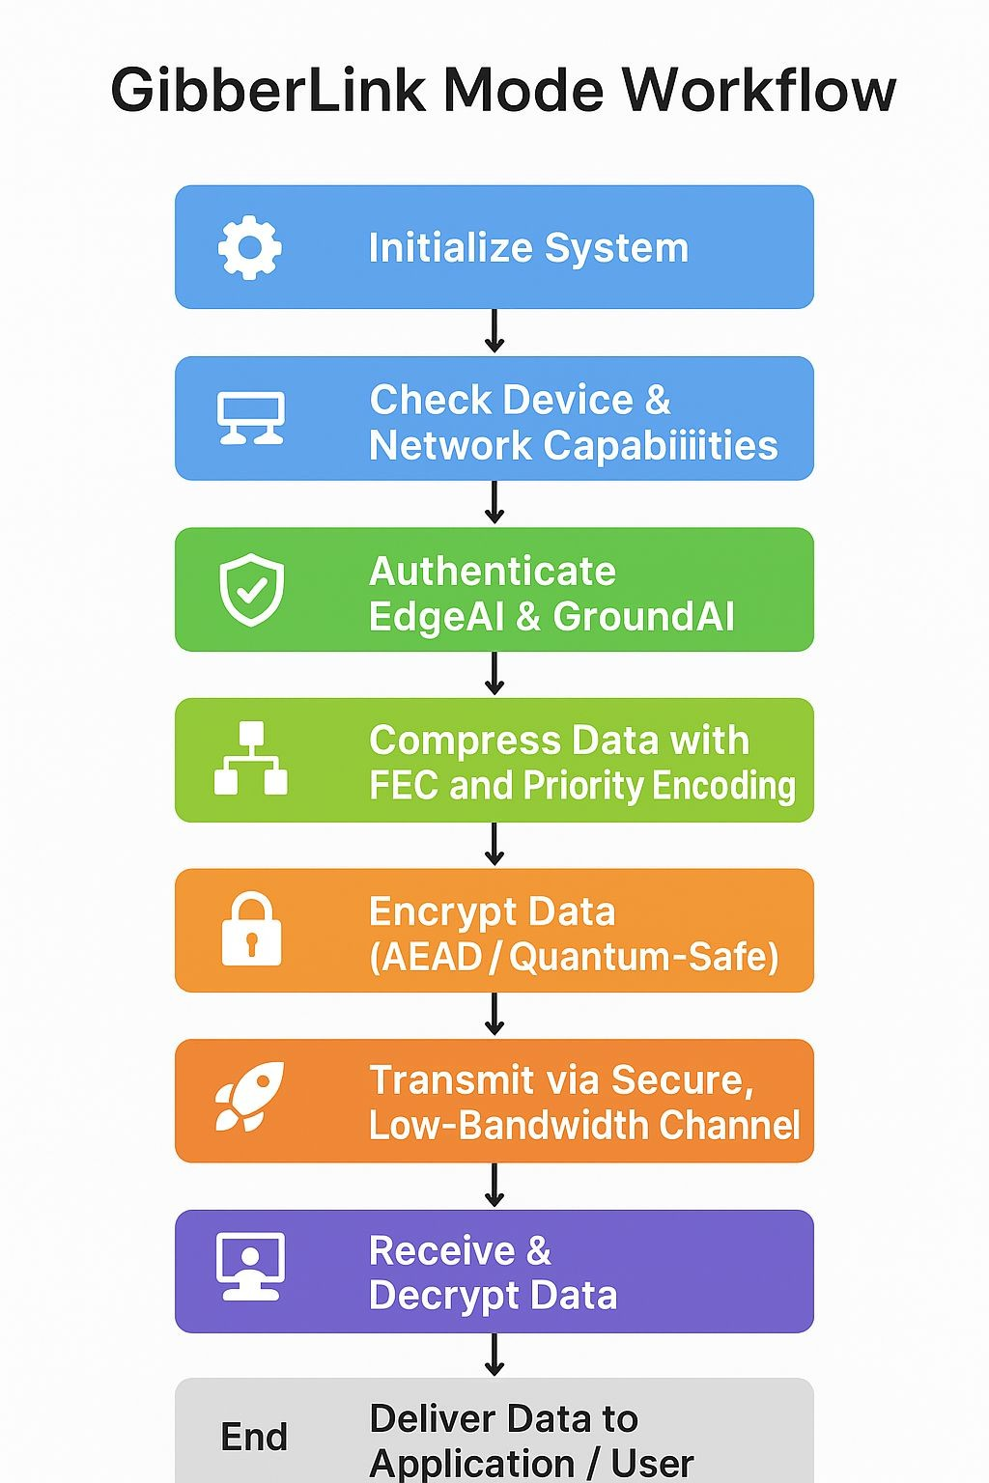
TECHNICAL APPROACH
KaleidoNex
zlib, LZMA, or
Python/Go/C++
custom binary
packing.
Two-way GibberLink Mode is a secure, low-bandwidth,
TensorFlow or PyTorch
Lite
AI-driven communication framework featuring:
AEAD encryption for integrity & confidentiality
FEC & retransmissions for reliability
Integrate cryptography libraries and FEC libraries
AI-prioritized telemetry & commands for efficiency
Adaptive, robust packet framing for minimal bandwidth usage

Slide 4
FEASIBILITY AND VIABILITY
KaleidoNex
Aspect | RATINGS | Notes
Technical | HIHG | Compression, FEC, AEAD, AI prioritization are all mature technologies.
Operational | HIGH | Modern spacecraft and IoT systems can integrate this.
Economical | MODERATE - HIGH | Initial cost is higher, but operational efficiency offsets it.
Risk | MODERATE | Latency, power, and interference are the main risks.
CHALLENGE/RISKS | STRATEGIES
Low bandwidth | Compression, delta encoding, priority queues, adaptive bitrate
High latency | Asynchronous communication, autonomous EdgeAI, time-stamped commands
Signal interference | FEC, multi-frequency channels, AI noise filtering
Security threats | AEAD encryption, digital signatures, sequence numbers, secure channels
Implementation complexity | Modular design, simulation/testing, automated monitoring

Slide 5

IMPACT AND BENEFITS
KaleidoNex
POTENTIAL IMPACT
Space agencies :- improved space safety, cost efficiency , extended mission lifespan
value :- higher success rate ,safer operation
Remote Operators:- Reliable data, autonomous decisions, reduced manual effort
value :- Increased efficiency, lower risk
Researchers :- Better data quality, faster insights, expanded research scope
value :- Actionable scientific results
Disaster Management:- Rapid alerts, robust communication value :- Faster response, reduced damage
Industry/Tech :- AI-driven, secure, low-bandwidth communication value :- Market differentiation, scalable solutions
BENEFITS OF SOLUTION
Social Impact:
Ensures safety and rapid disaster response while enabling access to remote or critical data for research and communities.
Economic Advantage:
Reduces operational costs, prevents mission losses, and creates opportunities for innovative business applications.
Environmental Benefit:
Lowers energy consumption, supports sustainable resource monitoring, and reduces carbon footprint from infrastructure.

Slide 6
RESEARCH AND REFERENCES
KaleidoNex
Technical Insights into GibberLink
Detailed analysis of how GibberLink allows AI agents to communicate using structured sound waves, enhancing communication efficiency.
Source:Conturae
Low-Bandwidth Optimization in Communication
AI-Driven Optimization of Low-Energy IoT Protocols
Research on optimizing low-energy IoT protocols for scalable and efficient smart healthcare systems, bridging theoretical advancements and practical deployments.
Source: ResearchGate
Study on Satellite Telemetry Data Classification
Investigates the classification of satellite telemetry data using self-learning methods to enhance data compression and transmission efficiency.
Source: ResearchGate
Telemetry Data Compression Algorithm Using Balanced Recurrent Neural Networks Proposes a subsampled and balanced recurrent neural lossless data compression approach to increase compression efficiency for telemetry data.
Source: PMC

