Slide 1
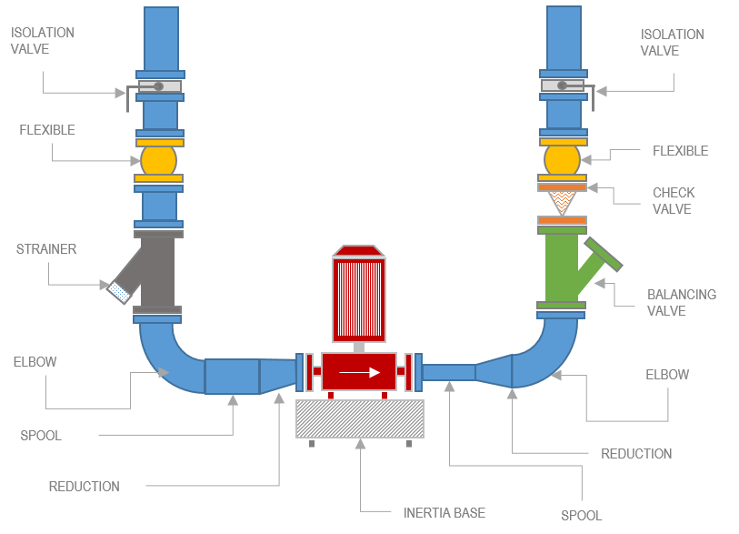
INSTALLATION
BEST PRACTICES

Slide 2
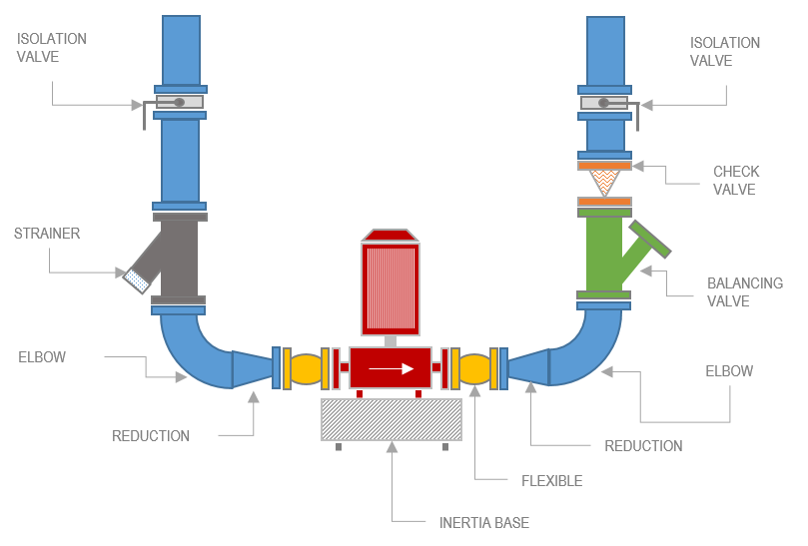
INSTALLATION
MARKET PRACTICES

Slide 3
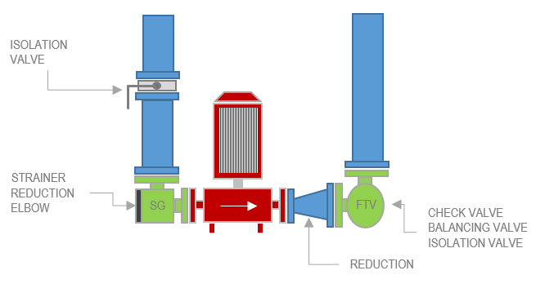
INSTALLATION
OPTIMIZED

Slide 4
INSTALLATION
COST SAVING
FLANGE WELDING
COST SAVING
COMPONENTS
COST SAVING
5X……….FLANGE DN100
1X ……... FLANGE DN80
-------------------------------------------------
TOTAL: € 575.00
1X ………. SG DN100 x DN80
1X ………. FTV DN100
1X ……….REDUCTION
PUMP
DN80
2X ………. ELBOW DN100
2X ………. FLEXIBLE DN80
1X ………. STRAINER
2X ……….REDUCTION
1X ………. CHECK VALVE
1X ………. ISOLATION VALVE
1X ………. BALANCING VALVE
1X ………. INERTIA BASE
5X ………. FLANGE DN100
1X ………. FLANGE DN80
1X ………. FLANGE DN80
5X ………. FLANGE DN100
-------------------------------------------------
TOTAL: € 1,150.00

Slide 5
INSTALLATION
COST SAVING
FLANGE WELDING
COST SAVING
COMPONENTS
COST SAVING
5X……….FLANGE DN250
1X ……... FLANGE DN200
-------------------------------------------------
TOTAL: € 1,460.00
1X ………. SG DN250 x DN200
1X ………. FTV DN250
1X ……….REDUCTION
PUMP
DN200
2X ………. ELBOW DN250
2X ………. FLEXIBLE DN200
1X ………. STRAINER
2X ……….REDUCTION
1X ………. CHECK VALVE
1X ………. ISOLATION VALVE
1X ………. BALANCING VALVE
1X ………. INERTIA BASE
5X ………. FLANGE DN250
1X ………. FLANGE DN200
1X ………. FLANGE DN200
5X ………. FLANGE DN250
-------------------------------------------------
TOTAL: € 2,900.00

