Slide 1
Vehicle Vibration Analysis with C++
Courtney Armstrong
MEC 510, Final Project

Slide 2
Outline
Motivation
Background
Problem Description
Code Structure
Overview
External Libraries
Classes and Functions
Demonstration
Results

Slide 3
Problem Background & Description

Slide 4
Motivation
MATLAB can be used to successfully analyze a vehicle system
C++ analysis is much faster than MATLAB
MATLAB must run on CPU, C++ can be run using GPU for complex calculations via CUDA
C++ also allows for direct comparison of multiple vehicle/road object combinations by simply defining more objects

Slide 5
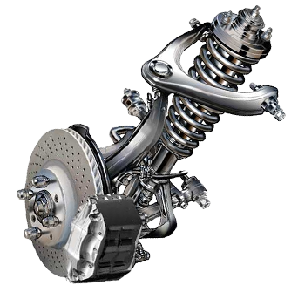
Vehicle Vibrations
Suspension systems in vehicles are designed to reduce uncomfortable motions felt by passengers while driving
Utilizes springs and shock absorbers to control vibration transmitted through vehicle
Focused on reducing two kinds of motion
Bounce (up and down motion)
Pitch (front to back rotation)

Slide 6
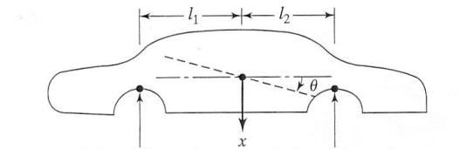
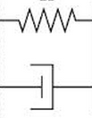






Vehicle Model
Bounce (x) and pitch (θ) are independent of one another
Results in a two degree of freedom system with two coupled differential equations
$$k_{f}(x−l_{1}θ)$$
$$c_{f}(\dot{x}−l_{1}\dot{θ})$$
$$k_{r}(x+l_{2}θ)$$
$$c_{r}(\dot{x}+l_{2}\dot{θ})$$
$${k_{f}y}_{f}$$
$${k_{r}y}_{r}$$

Slide 7
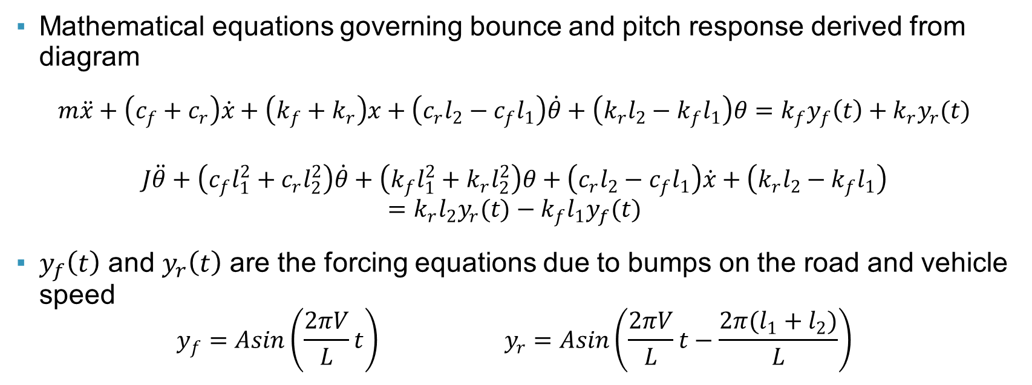
Vehicle Model
Mathematical equations governing bounce and pitch response derived from diagram
$m\ddot{x}+\left(c_{f}+c_{r}\right)\dot{x}+\left(k_{f}+k_{r}\right)x+\left(c_{r}l_{2}−c_{f}l_{1}\right)\dot{θ}+\left(k_{r}l_{2}−k_{f}l_{1}\right)θ=k_{f}y_{f}\left(t\right)+k_{r}y_{r}(t)$
$$J\ddot{θ}+\left(c_{f}l_{1}^{2}+c_{r}l_{2}^{2}\right)\dot{θ}+\left(k_{f}l_{1}^{2}+k_{r}l_{2}^{2}\right)θ+\left(c_{r}l_{2}−c_{f}l_{1}\right)\dot{x}+\left(k_{r}l_{2}−k_{f}l_{1}\right)=k_{r}l_{2}y_{r}(t)−k_{f}l_{1}y_{f}(t)$$
$y_{f}\left(t\right)$ and $y_{r}\left(t\right)$ are the forcing equations due to bumps on the road and vehicle speed
$$y_{f}=Asin\left(\frac{2πV}{L}t\right) y_{r}=Asin\left(\frac{2πV}{L}t−\frac{2π(l_{1}+l_{2})}{L}\right)$$

Slide 8
Project Description
Understanding the vibration of the vehicle requires solving the equations of motion to determine x and θ
Only x, θ, dx, dθ and t are variable (all other variables in equation are constants)
Using C++, along with external libraries, the equations can be solved based on user input of parameters

Slide 9
C++ Code Structure

Slide 10
Functionality Overview
User inputs car parameters or selects a vehicle class (based on SAE standards)
Mass, damping, inertia, etc.
User inputs road parameters
Wavelength, speed, and amplitude
User inputs analysis parameters
Start time, end time, time step and initial values
Script outputs natural frequencies, mass and stiffness matrices and writes integration values to a text file

Slide 11
External Libraries
Determining the solution for the coupled equations requires the use of linear algebra and differential equations
Outside the scope of what MSVS libraries can do natively
Eigen
High level, template library for matrix and vector linear algebra
Odeint
High level, template library for solving differential equations
Peer reviewed by Boost for accuracy
Notes:
Go to code to explain classes!

Slide 12
Vehicle Class
Stores all required constants for left hand side of motion equation (physical parameters of car)
Includes the functions required to determine:
Natural frequency (Eigen)
Also includes functions to allow user to either define the vehicle parameters or pick pre-set parameters (SAE vehicle class)

Slide 13
Road Class
Stores all required constants for forcing functions

Slide 14
Verification

Slide 15
Verification Setup
Vehicle Parameters
Class 4 SAE Vehicle (Luxury vehicle, Jaguar XJ)
Road Parameters (moderately bumpy road)
10 m/s velocity (approx. 22.4 mph)
0.025 m peak amplitude (approx. 1”)
0.5 m wavelength (approx. 20”)
Time period
0-5 seconds

Slide 16
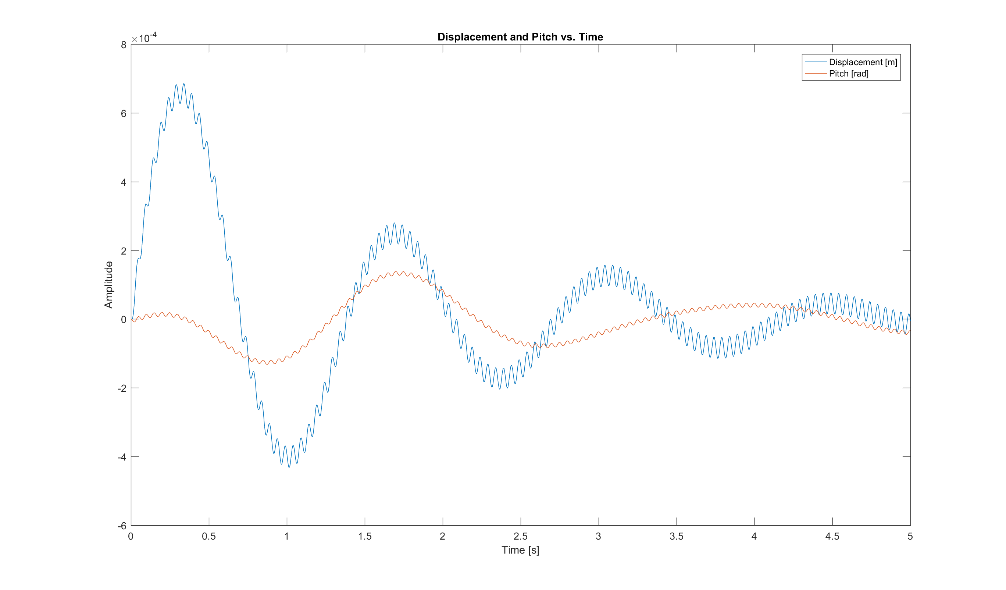
MATLAB Results (ode45)

Slide 17
C++ Results (Bulirsch–Stoer algorithm)

Slide 18

Numerical Comparison
Maximum Response Values
 | Bounce (m) | Pitch (rad)
C++ Analysis | 6.99x10⁻⁴ | 1.32x10⁻⁴
MATLAB Analysis | 6.86x10⁻⁴ | 1.39x10⁻⁴
Percent Error $\left\{\begin{aligned}Bounce −0.18\% \\ Pitch −0.54\%\end{aligned}\right.$
Error is within acceptable range, verification is successful!

Slide 19
Questions?

