Slide 1
Python Final
Project
By: Emily Armstrong
CSC 383
Fall 2014

Slide 2
Outline
Game Summary/Objectives
Process of Development
Components of Game
Demonstration

Slide 3
Summary/Objectives
Maze Game: Player is in Ireland and must find his/her way around
To win: must collect all of the pints of Guinness scattered across maze and reach end of maze within 60 seconds
Player loses if he/she runs out of time
2 versions: Normal and Ricochet

Slide 4
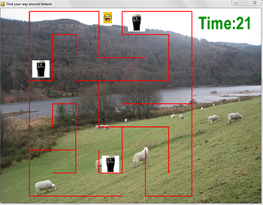

Slide 5
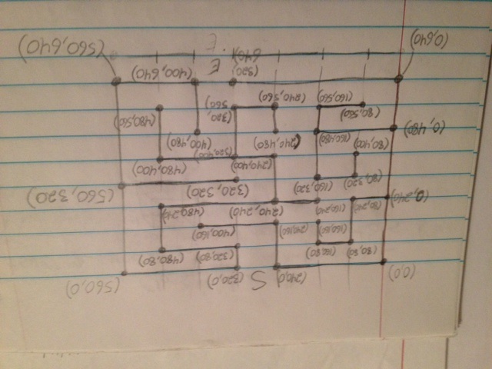
Process of Development
Maze calculated with grid-like structure
Coordinates determined for maze boundaries on paper first
Determining possible collisions
Add additional material

Slide 6
Game Component: Lines
Connected points declared in a list
In game_loop(): drawn onto display using pygame.draw.lines()
Collisions checked using player’s x, y, img_bottom, and img_right variables with line coordinates
maze_lines = [( 580,570),(580,410),(340,410),(340,250), …]
# draw lines in loop
pygame.draw.lines(gameDisplay,red,False,maze_lines, 3)

Slide 7
Lines Collisions
# left collsions
def check_left(x,y,x_change,img_bottom,img_right):
if x <= maze_left:
x_change = 0
# x axis
if x <= 180 and img_right > 180:
# possible vertical lines (y axis)
if y >= 90 and y <= 250:
x_change = 0
elif y >= 330 and y <= 410:
x_change = 0

Slide 8
Rectangles & Collisions
Guinness images and player image stored as rectangles
Rectangles used for end of game message
me_img = pygame.image.load('derp.png').convert_alpha()
me = me_img.get _rect()
me.topleft = (x,y)
# check collision
if not found1 and guinness1.colliderect(me):
found1 = True

Slide 9
End of Game Message
gameDisplay.lock()
pygame.draw.rect(gameDisplay, green, Rect((200,150),(400,200)))
largeText=pygame.font.SysFont('Comic Sans',30, False)
TextSurf1, TextRect1 = text_objects('Play again?', largeText, white)
if event.type == MOUSEBUTTONDOWN: # skipped lines
x, y = pygame.mouse.get_pos()
# Player clicks "Yes"; play again
if x > 275 and x < 375 and y > 275 and y < 325:
game_loop()
# player clicks "No"; exit game
elif x > 425 and x < 525 and y > 275 and y < 325:
pygame.quit()
sys.exit()

Slide 10
Clock/Time
Countdown clock displayed as text
Timer event created every 1000 milliseconds
Second variable decremented every second and screen updated
When seconds = 0, end of game message displayed
pygame.time.set_timer(1, 1000)
def display_time(seconds):
timeText=pygame.font.SysFont('Arial',60, True)
TextSurf, TextRect = text_objects('Time:' + str(seconds), timeText, green2)
TextRect.center = (775, 50)
gameDisplay.blit(TextSurf, TextRect)

Slide 11
Timer Event
pygame.time.set_timer(1, 1000) # event to occur # every second (1000 ms)
while True:
for event in pygame.event.get():
# update countdown clock every second
if event.type == 1:
# game over
if seconds == 0:
message_display('OUT OF TIME')
else:
seconds -= 1

Slide 12
Music
# set up music mixer
pygame.mixer.pre_init(44100, -16, 8, 2048)
pygame.mixer.init()
music = pygame.mixer.Sound('mirorb.ogg')
def game_loop():
music.play() # start music until game restarted

Slide 13
Demonstration
Time!

