Slide 1




Global AI Compute Faculty Development Initiative
Two Weeks of Learning,
Practice, and Connection
---Course Closing Reflections
Guojie Luo
gluo@pku.edu.cn
Jing Wang
jwang@ruc.edu.cn
October 2026 · 2nd AICFD
Supported by UNDP
Notes:
为期两周的集中课程，今天正式画上句号。首先，我要由衷感谢北京智源人工智能研究院（BAAI），为我们搭建起这次宝贵的教学平台，给予我教学相长的难得机会。同时，也感谢来自世界各个国家的授课老师、参会同仁，感谢大家对我本人以及助教团队的信任、理解与大力支持。

Slide 2
Two-Week Intensive Course Overview
Five core modules and eight hands-on labs combine 15 hours of lectures with 20 hours of practice.
5
CORE MODULES
15
LECTURE HOURS
8
HANDS-ON LABS
35
TOTAL HOURS
A complete systems curriculum
Core concepts and methods
20 hours of guided practice
Lecture and lab time
COURSE COVERAGE
370 slides
21 core topics
105 knowledge points
Module | Course Module | Slides | Core Topics | Knowledge Points
M01 | AI Systems and Heterogeneous Computing | 46 | 4 | 20
M02 | High-Performance AI Operators | 83 | 3 | 20
M03 | AI Compilers and Optimization | 45 | 3 | 18
M04 | Distributed Training and Communication | 155 | 6 | 24
M05 | Performance Analysis and KernelGen | 41 | 5 | 23
Total |  | 370 | 21 | 105
Notes:
在这两周里，我们共同完成了全部五个模块的课程内容，也落地完成配套的 5 个实验 Lab。
The course combined five core modules and eight hands-on labs. Participants spent 15 hours in lectures and 20 hours in guided practice, for 35 hours overall.
The materials covered 370 slides, 21 core topics, and 105 knowledge points. This structure connected the fundamentals of AI systems with practical implementation.

Slide 3
Hands-On Labs: High Completion Through Guided Practice
Eight labs, supported by ten teaching assistants, turned core concepts into working systems.
8
HANDS-ON LABS
10
TEACHING ASSISTANTS
VERY HIGH
A complete practice sequence
Fast support during every lab
COMPLETION
LAB SEQUENCE
DESIGNED FOR COMPLETION
OCT 12
OCT 19
52
CORE STEPS
Inference Lab
KernelGen Lab
A guided path from setup to validation and analysis
OCT 13
OCT 20
Triton Primer Lab
Profiler Demo Lab
4,480
LINES OF LAB MATERIAL
Code, comments, tools, and installation guidance
OCT 14
OCT 20
Edge Device Labs
AI Compiler Lab
Focused coding, broad systems practice
OCT 15
OCT 21
Participants configured environments, ran workloads, checked correctness, measured performance, and analyzed results. Optional tasks extended the edge-device and KernelGen labs.
Fused kernel Lab
Distributed Training Lab
Notes:
Eight labs gave participants a complete practice sequence, supported by ten teaching assistants. The material included 52 core steps and about 4,480 lines of code, comments, tools, and installation guidance.
Participants configured environments, ran workloads, checked correctness, measured performance, and analyzed results. Optional tasks allowed deeper work in selected labs.

Slide 4
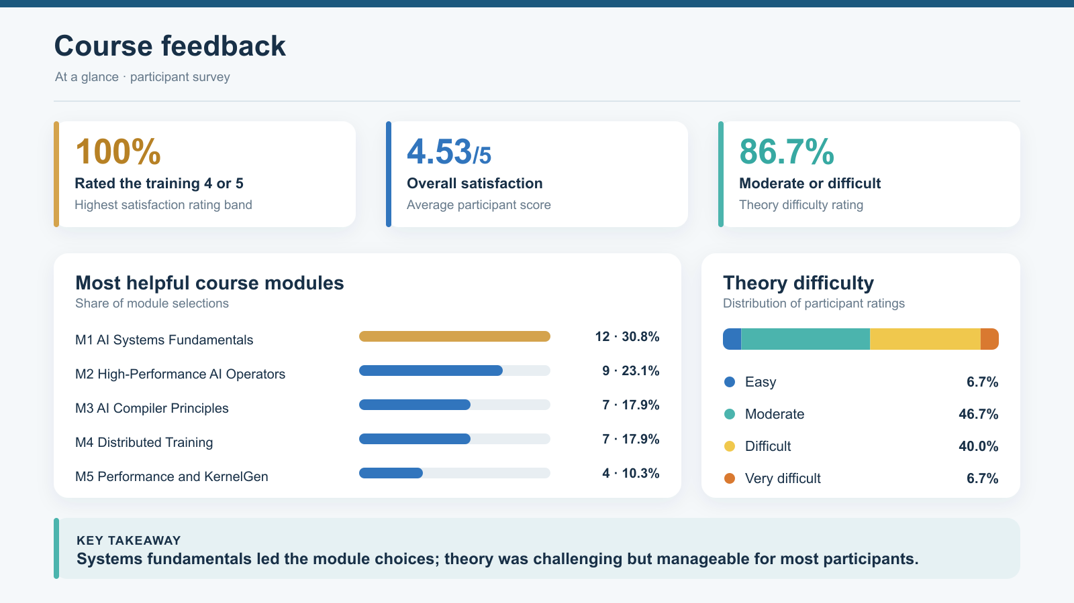
Notes:
Course feedback was strong: every respondent rated the training 4 or 5, and the average overall satisfaction score was 4.53 out of 5.
AI systems fundamentals received the most selections as a helpful module. Most respondents described the theory as moderate or difficult, indicating substantial but manageable challenge.

Slide 5
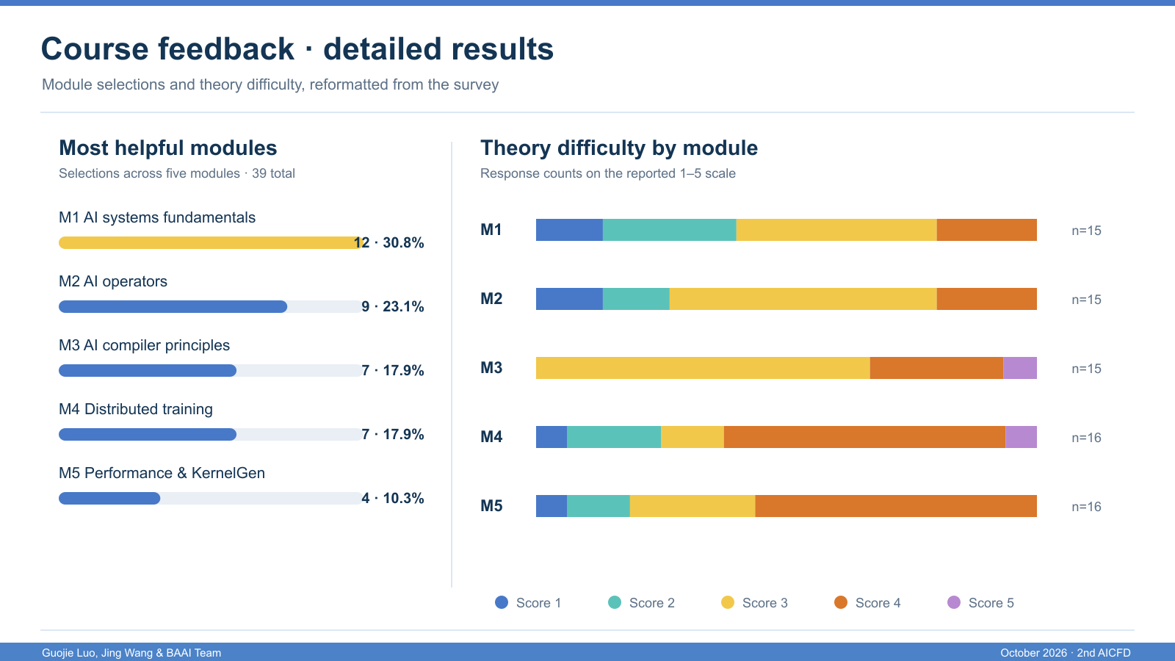
Notes:
客观来讲，课程内容前沿、跨领域门槛较高，过程中也存在不少有待打磨完善之处，离不开在座每一位的包容、参与和反馈，才让本次教学任务得以顺利收官。
This slide shows the detailed module responses behind the course summary. AI systems fundamentals led the helpful-module selections with 12 votes, followed by AI operators with 9.
The stacked bars retain each module's reported difficulty distribution. The response total varies between 15 and 16 across those questions, so compare the patterns rather than treating the bar counts as one common sample.
第五部分的内容大家感觉比较难，我想可能是这部分的内容还需要更多的细节和实操，毕竟我们需要构建一个系统，之后才能考虑性能，但这正是我们的学生需要关注的，只能work是不够的，我们需要调试和优化，而优化是无极限的。

Slide 6
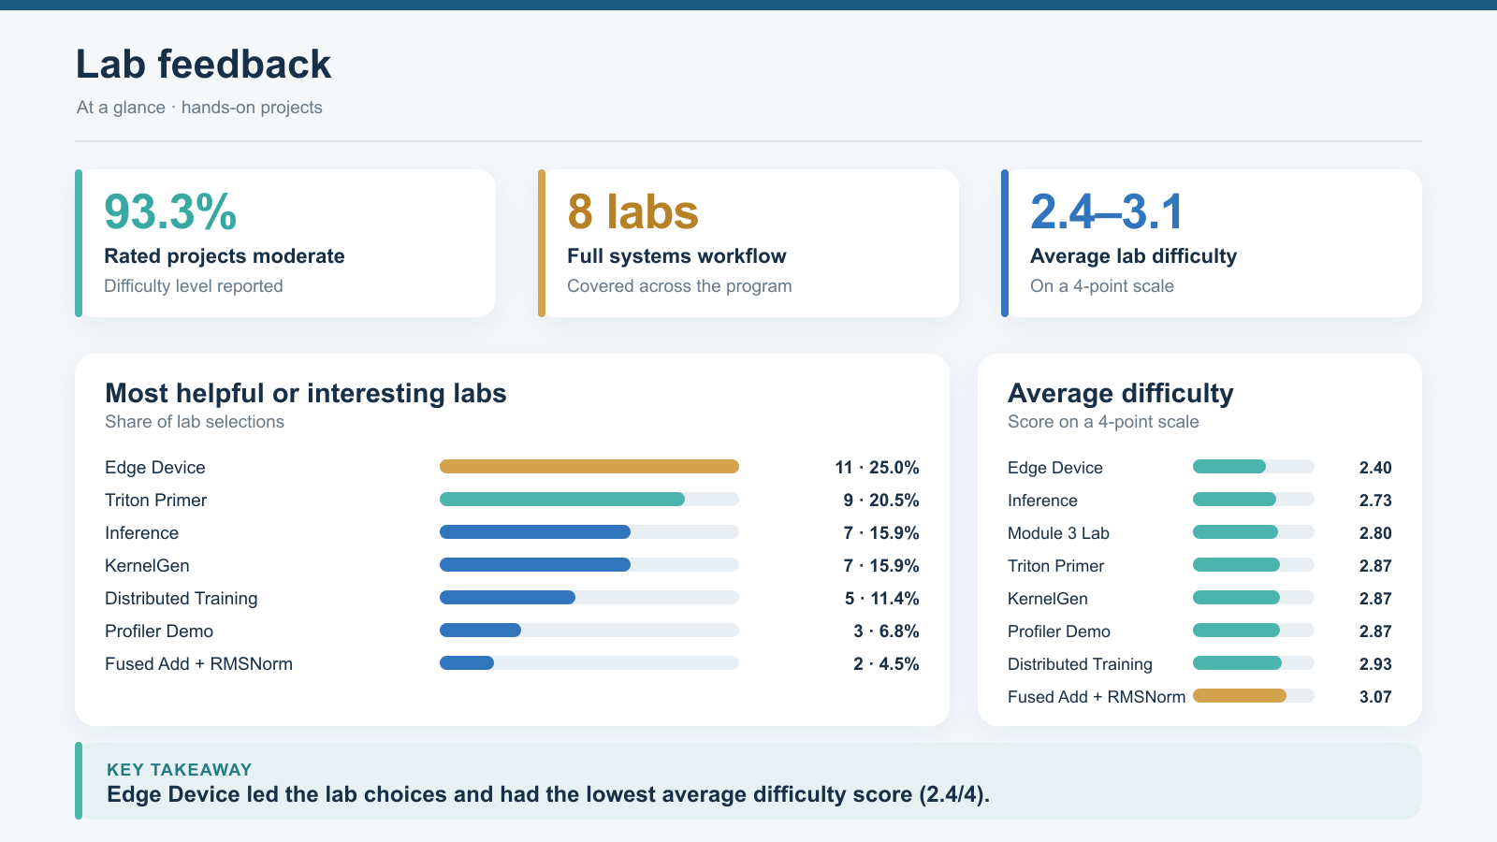
Notes:
The lab sequence was also received well. In the summary survey, 93.3 percent rated the projects moderate, while average difficulty by lab ranged from 2.4 to 3.1 on a four-point scale.
Edge Device was the most frequently selected helpful or interesting lab. The range of difficulty suggests the labs provided challenge while remaining approachable.
实验的部分也是端侧实验最受欢迎，我想也是能够看到物理载体，并且这部分在课堂中也更加容易。

Slide 7
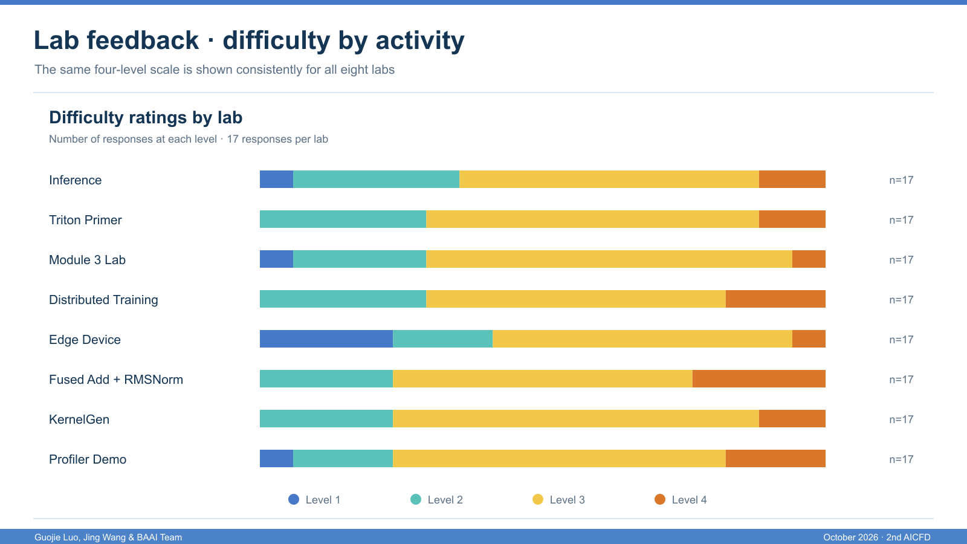
Notes:
可以看到，大家都感觉算子融合难，跟我们预期的一样。这部分在系统的中间，既不是应用角度能跟用户交互部分，也不是能看到实物的物理载体。比较难理解，不过这部分很重要。很幸运flagos把这些公共的优化提供了跨架构的支持，对于学生而言，了解这个底层的知识是非常重要的。

Slide 8
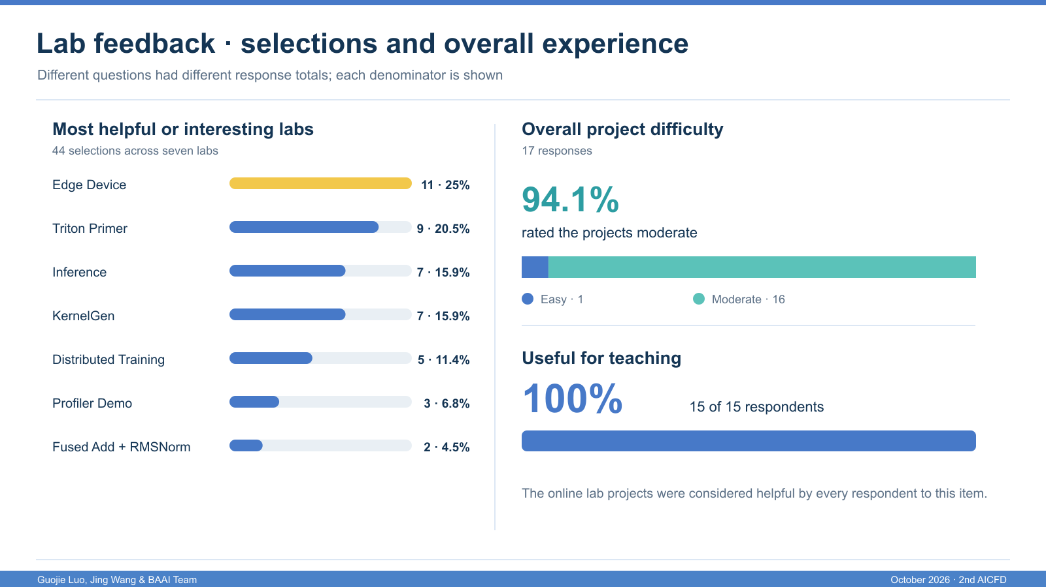

Notes:
Edge Device received 11 of 44 helpful-lab selections, followed by Triton Primer with 9. Inference and KernelGen each received 7.
For the separate overall-difficulty question, 16 of 17 respondents selected moderate and one selected easy. All 15 respondents to the teaching-usefulness question said the online lab projects were helpful. The denominators differ across the questions.

Slide 9
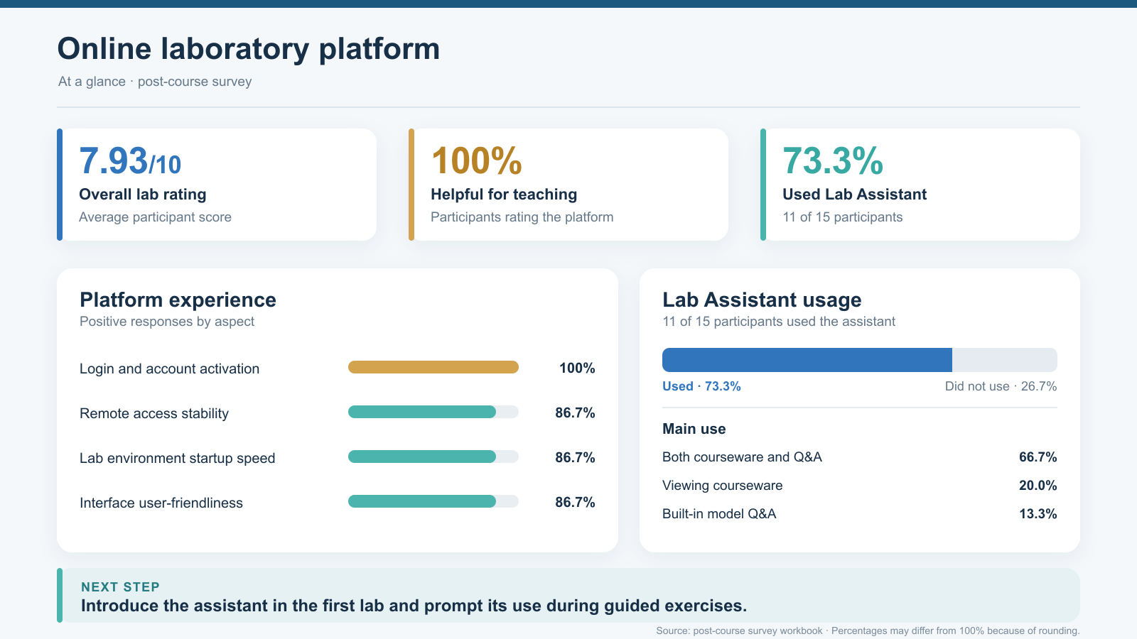
Notes:
The online laboratory platform received an average rating of 7.93 out of 10. All respondents to the teaching question found it helpful, and 11 of 15 used the FlagOS Lab Assistant.
Login and account activation scored 100 percent positive; remote access stability, startup speed, and interface friendliness each scored 86.7 percent. Introduce the assistant in the first lab to encourage broader use.
这么高的评价来源于智源扎实的积累，打造了好的平台

Slide 10
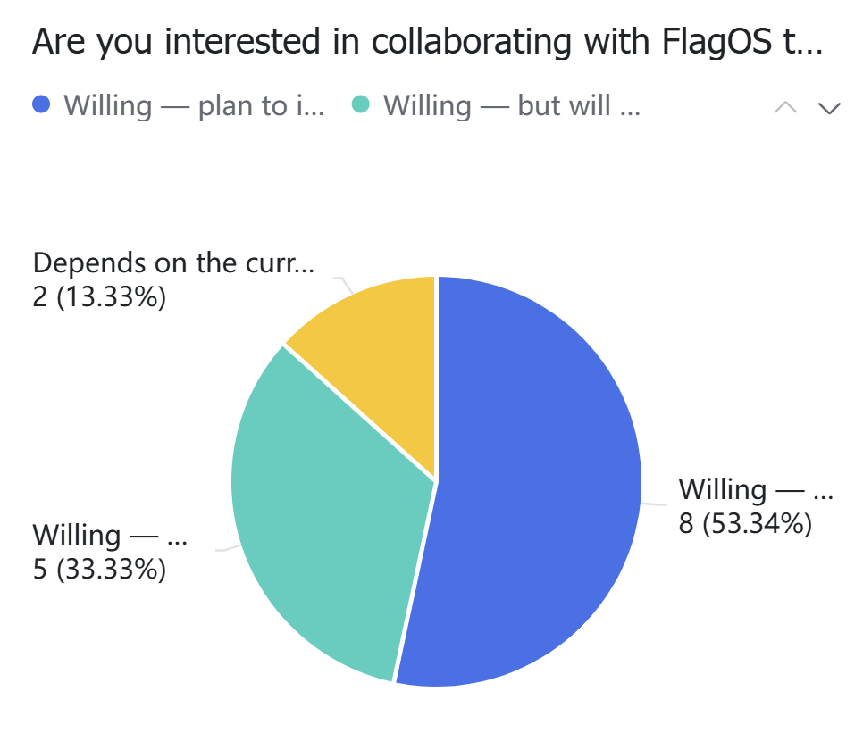
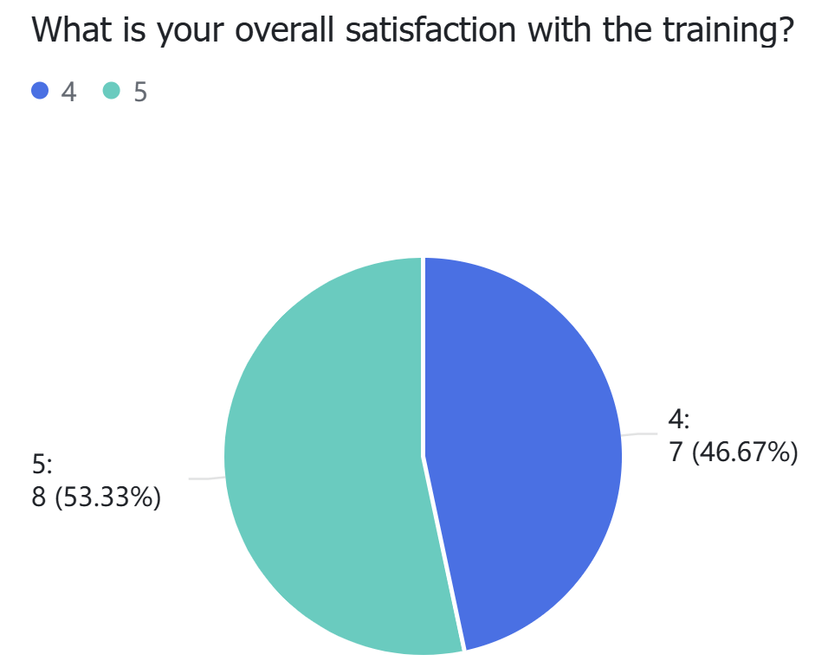
Strong Ratings and Interest in Future Collaboration
Training satisfaction and collaboration interest · 15 responses
Overall Training Satisfaction
Interest in Further Collaboration
4.53
86.7%
/ 5
Average score
High satisfaction supports future cooperation in teaching, talent development, and research.
Notes:
这个结果对我们是巨大的鼓励
All 15 respondents gave the training either 4 or 5 out of 5, producing an average of 4.53. This is a clear positive overall evaluation.
Thirteen respondents explicitly indicated willingness to collaborate further. Two said their participation would depend on conditions, so it is more accurate to describe the interest as strong rather than unanimous without qualification.

Slide 11
AI Computing Foundations: Chips, Software, and Talent
From new compute needs to cross-architecture reuse and sustained talent development
01
02
03
Chips: New Paradigms
Software: Reuse Across Chips
Talent: Long-Term Growth
CPU-era architectures such as x86, ARM, and MIPS supported general-purpose computing.
AI workloads—matrix operations, parallel execution, and low precision—drive new chip designs.
Chips differ in hardware capabilities and programming interfaces.
FlagOS links chips with applications, enabling development, adaptation, and deployment across architectures.
Scale: help more faculty teach these topics and bring lab resources back to their universities.
Quality: use real chips, software stacks, and system problems for repeatable lab and research training.
New needs → New architectures
Diverse chips → Usable compute
Courses and practice → Talent
Chip innovation opens new possibilities; software makes them usable; talent sustains progress.
Notes:
回望这次课程，它的现实意义十分深远。人工智能的重要性已经毋庸置疑，但 AI 的发展离不开底层基础软硬件的体系设计。在传统 CPU 时代，受多重历史因素影响，业界长期主要使用 x86、ARM、MIPS 等成熟架构。而 AI 领域催生出大量全新的定制化硬件特性，为我们迎来了技术上弯道超车的时代窗口，这也是当下国内涌现大批 AI 芯片企业的重要背景。
但我们也要清醒看到，仅有芯片硬件远远不够，软件栈的支撑同样不可或缺，也正是在这一背景下，FlagOS 的价值愈发凸显，它帮助我们便捷实现跨架构的代码复用，打通硬件与上层 AI 应用之间的鸿沟。正如北京日报相关文章中所阐述的观点，硬实力的突破，最终落脚点离不开人才根基的夯实京报网。想要持续推动技术向前发展，就必须在人才培养上持续投入，源源不断的高水平人才，才是科技产业行稳致远的根本保障。能够深度参与到这样面向前沿软硬件人才培养的项目当中，我个人感到十分荣幸。

Slide 12
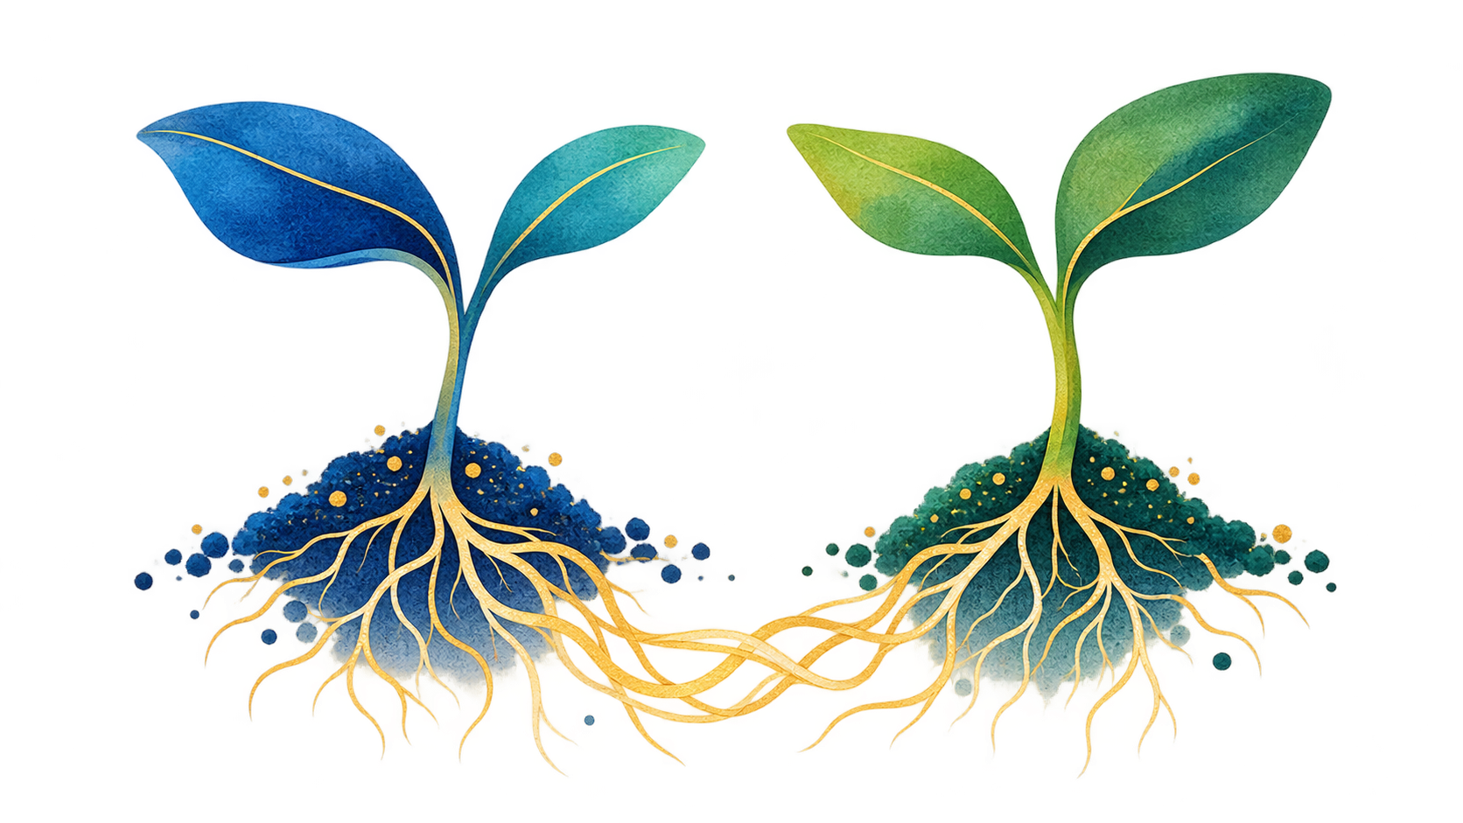
We Are All Seeds: Collaboration Helps Us Grow
Two weeks are only a start; lasting connections help knowledge take root in teaching and research
You
We
Bring courses and labs
into your classrooms
Share resources
and pursue joint research
Connection is the soil of shared growth
Three Areas for Future Collaboration
01
Course Development
02
Talent Development
03
Scientific Research
Share slides, lesson plans, and labs
to support local course improvement
Continue faculty exchanges
and support students and early-career scholars
Explore AI systems and heterogeneous computing
as topics for joint research
Notes:
两周的集中授课并不是终点，而只是我们合作的起点。契合智源研究院开放连接的核心理念，比知识讲授更为珍贵的，是我们在此建立起跨越国界的学术纽带与伙伴关系。在座各位，都是各自国家人工智能领域播撒下的种子；我们同样，也是中国技术生态里的种子。往后，我们期待彼此并肩、一同耕耘、共同成长。

Slide 13
THANK YOU
Growing Together
Thank you. Let us build a better future through
continued exchange and joint exploration.
Notes:
未来，智源研究院团队、北京大学团队与中国人民大学团队，会持续为大家提供支持，助力各位开展课程建设、人才培育与科学研究工作。期待我们立足这个全新的时代，携手探索，共创更加美好的未来。谢谢大家！

