Slide 1




Hardware and Software Fundamentals of
Intelligent Computing
Systems
Notes:
需要涉及的要点：
- 第一课时：Compute Architectures 的逐渐演化：由AI/ML workload 引导，逐渐展示出多种多样的架构，如华为达芬奇、AMD等等
- 第二课时：互联的硬件基础，与CUDA core、Tensor core 的编程。
- 可能还需要涉及的点：课程整体设计（Syllabus、各个模块的内容，根据教学大纲生成了个overview的图）

Slide 2
Course Overview
Week | Module | Main Content
1 | Module 1: AI System Fundamentals & Heterogeneous Computing | Overview of AI hardware architecture; challenges to Moore's Law and trends in heterogeneous computing
2 |  | SIMT programming model; thread hierarchy and memory hierarchy
3 |  | Analysis of deep learning framework call chains; Shared Memory and Bank Conflict
4 |  | Cache locality optimization; Tiled matrix multiplication; Introduction to Triton
5 | Module 2: High-Performance AI Operators & Operator Engineering | Principles of Transformer attention mechanism; design and implementation of FlashAttention
6 |  | Optimization of convolution, normalization, and activation function operators
7 |  | Operator fusion techniques; debugging and profiling of complex operators
8 |  | Q&A and discussion on Module 1 / Module 2 labs
9 | Module 3: AI Compiler Principles & Optimization | Overview of AI compilers; fundamentals of Intermediate Representation (IR); SSA and computation graphs
10 |  | In-depth analysis of MLIR architecture
11 |  | Operator fusion passes: graph matching, pattern recognition, and subgraph rewriting
12 |  | Layout and memory planning; multi-chip backend code generation
13 | Module 4: Distributed Parallel Training & Communication | Principles of data parallelism, tensor parallelism, and pipeline parallelism
14 |  | Communication primitives and topology optimization; hybrid parallelism and memory optimization
15 | Module 5: Performance Evaluation & Frontier Outlook | Operator performance metrics; automatic operator tuning; LLM-assisted code generation
16 |  | Specialized optimization for domestic AI chips; FlagOS ecosystem and frontier technology outlook; course summary

Slide 3
Lecture 01: Course Introduction and AI Hardware Landscape

Slide 4


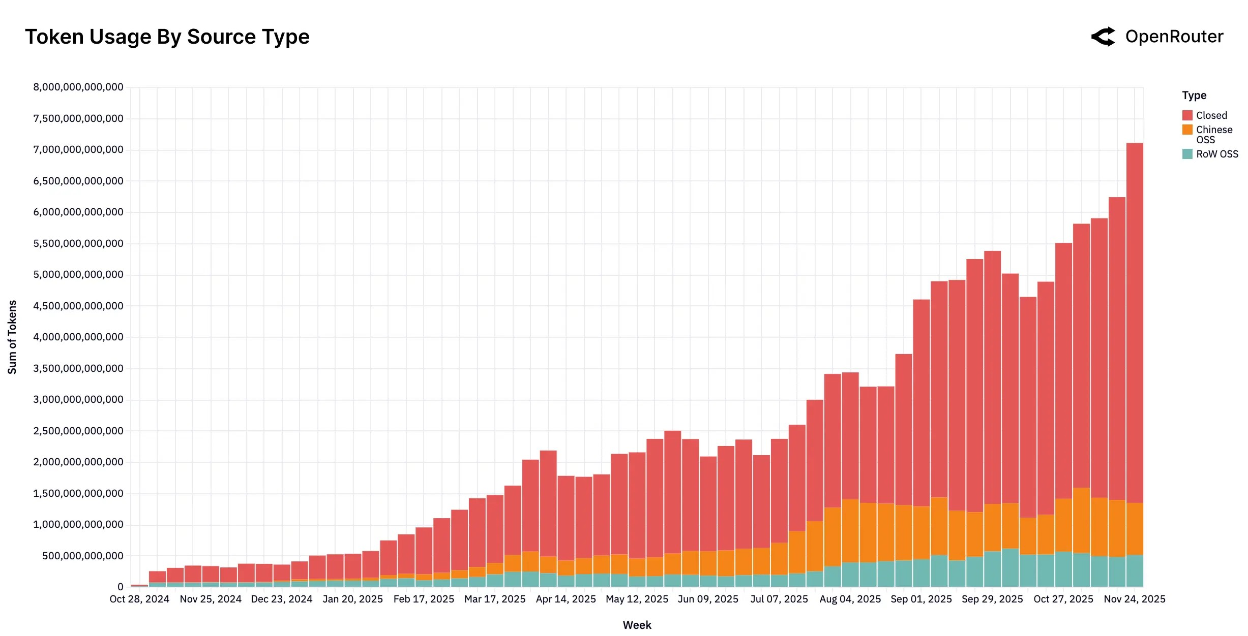

Token-Hungry Generative AI Applications
LLM-powered autonomous agents
Token consumption trends
AI mobile phone and AI PC
Video generation
image source: lilianweng.github.io, openrouter.ai, 36kr.com (with doubao phone), github.com/baaivision/URSA
Notes:
https://lilianweng.github.io/posts/2023-06-23-agent/
https://openrouter.ai/announcements/the-2025-state-of-ai-report
https://github.com/baaivision/URSA
https://eu.36kr.com/en/p/3576900266261385

Slide 5
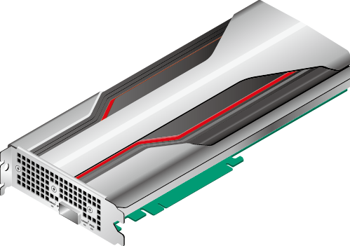
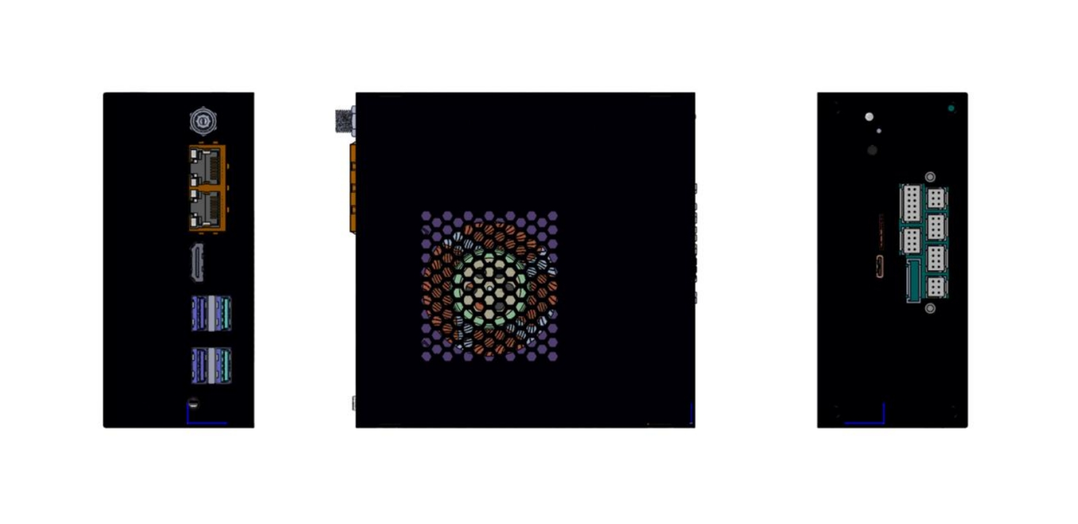
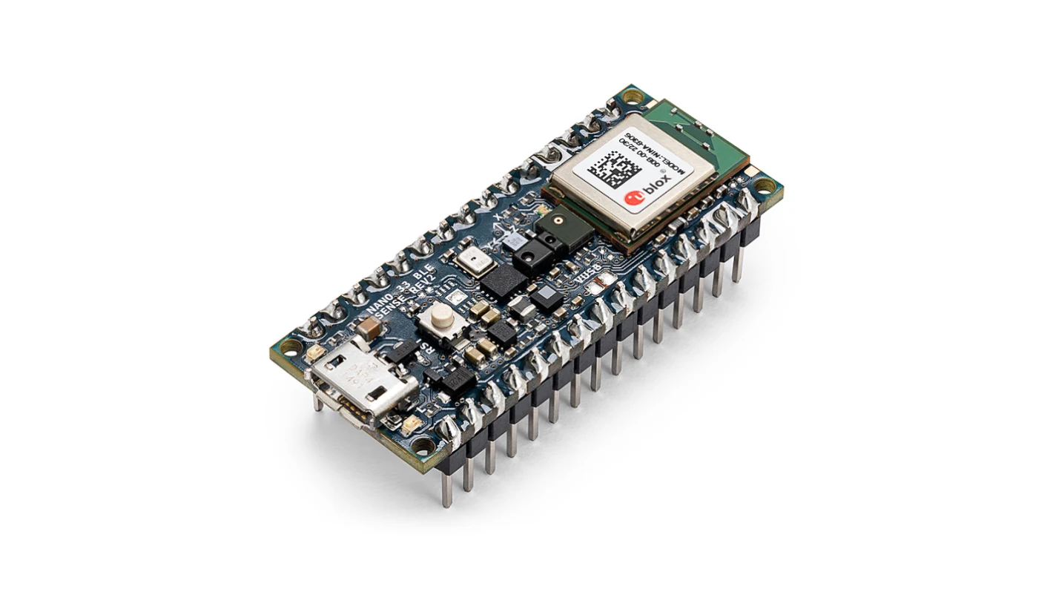

AI Hardware Spectrum: Key Examples
Cloud ML
Huawei Ascend
Cambricon MLU370
etc.
Edge ML
Iluvatar
TY1200
Mobile ML
Kirin 9030 Pro
Tiny ML
Arduino Nano 33
BLE Sense
Notes:
https://support.huawei.com/enterprise/zh/doc/EDOC1100162135/74b99d28
https://consumer.huawei.com/cn/phones/mate-x7/

Slide 6
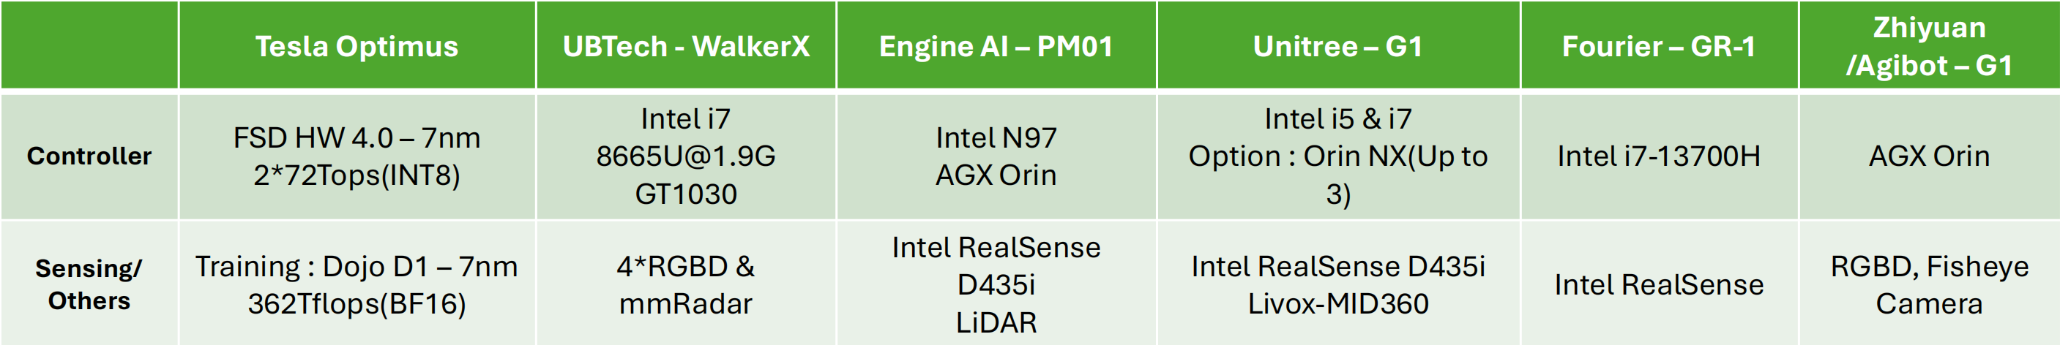
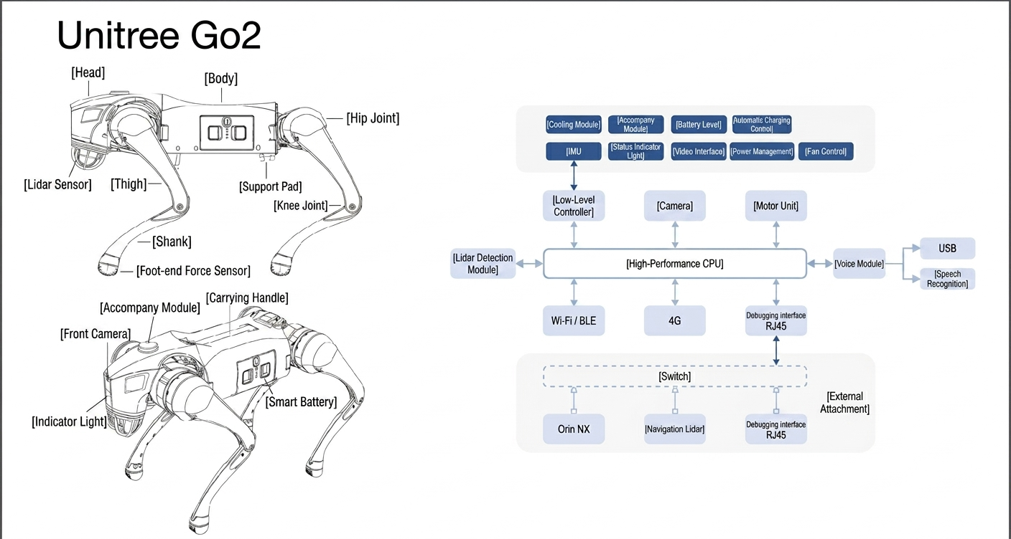

Slide 7
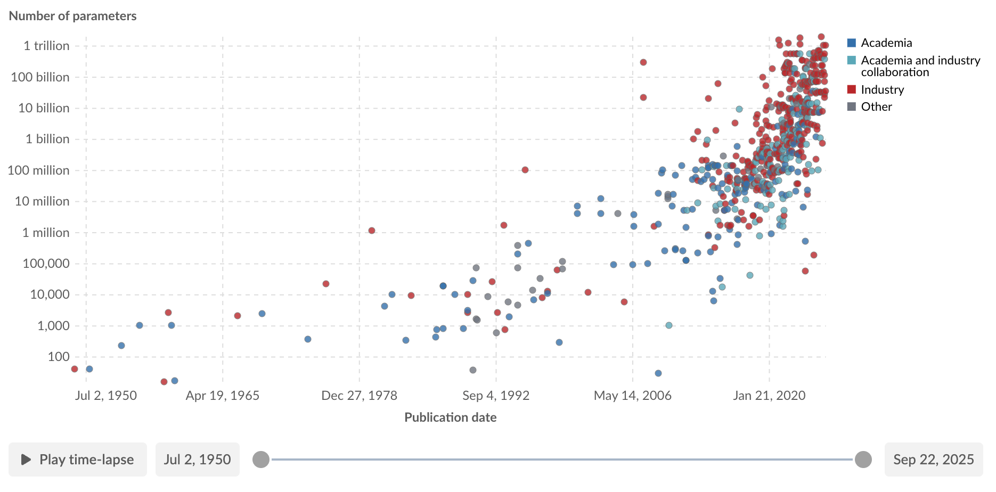
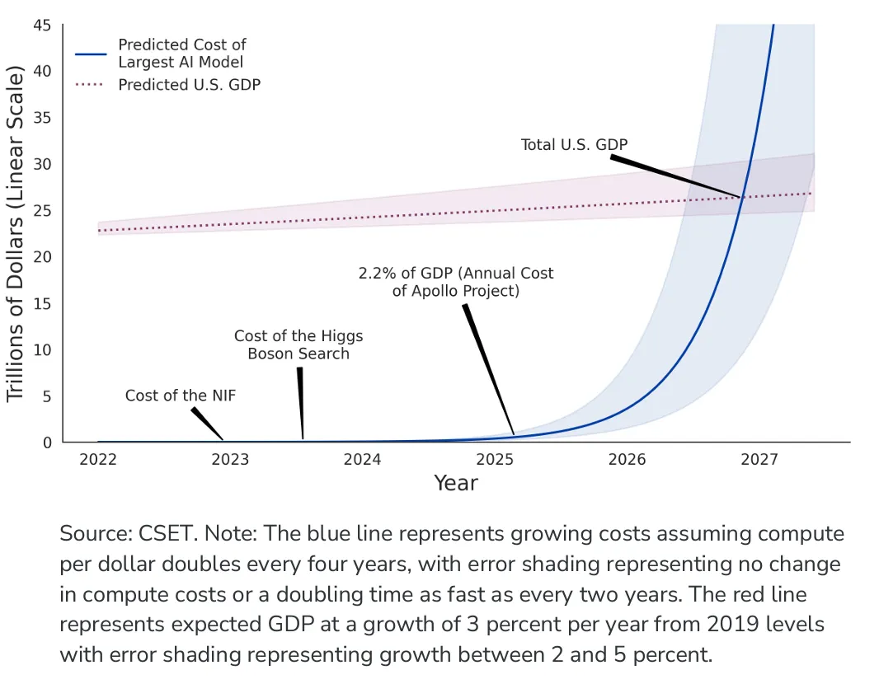
The Hardware Demands of AI/ML
Model Parameters
  The exponential growth.
Computational Demand
  Outpacing the Moore's Law.
  Comparison between compute cost and U.S GDP byOpenAI.
Communication Scale
  The new critical bottleneck.
image: https://medium.com/geekculture/business-analysis-ai-computational-cost-67a136957c95
https://ourworldindata.org/grapher/artificial-intelligence-parameter-count

Slide 8
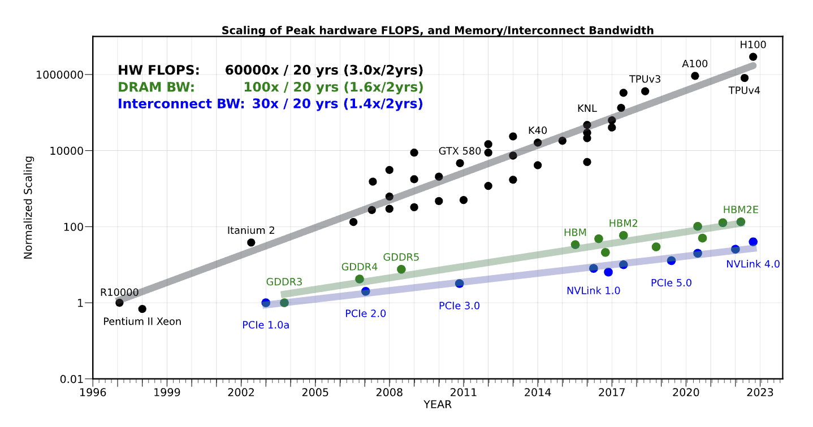
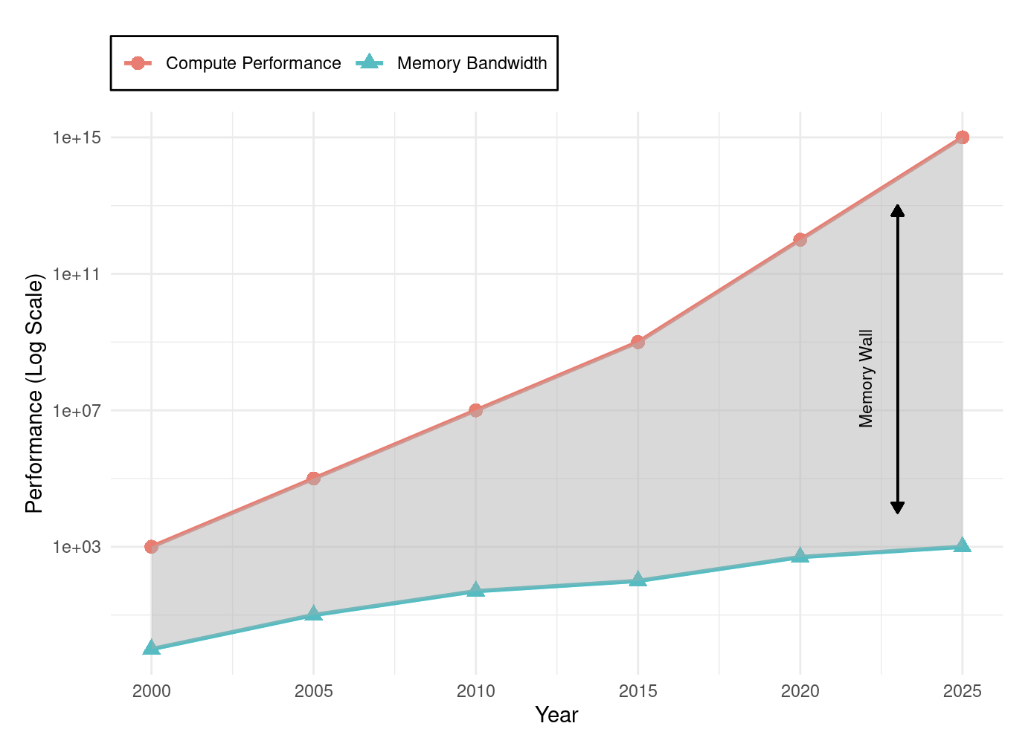
Why General-Purpose CPUs Failed AI (1/2)
The CPU's Legacy:
  For decades, the Central Processing Unit (CPU) was the universal engine of computing, designed for sequential, general-purpose tasks.
The Two Crises:
  Von Neumann Bottleneck: Constant data shuffling between processing and memory units created a fundamental efficiency limit, consuming more energy than the actual computation.
  End of Performance Scaling: Dennard Scaling and the derived performance effects from Moore’s Law, which provided decades of exponential performance growth, came to an end.
A. Gholami, Z. Yao, S. Kim, C. Hooper, M. W. Mahoney and K. Keutzer, "AI and Memory Wall," in IEEE Micro, vol. 44, no. 3, pp. 33-39, May-June 2024, doi: 10.1109/MM.2024.3373763.
Notes:
找权威的数据或者来源

Slide 9
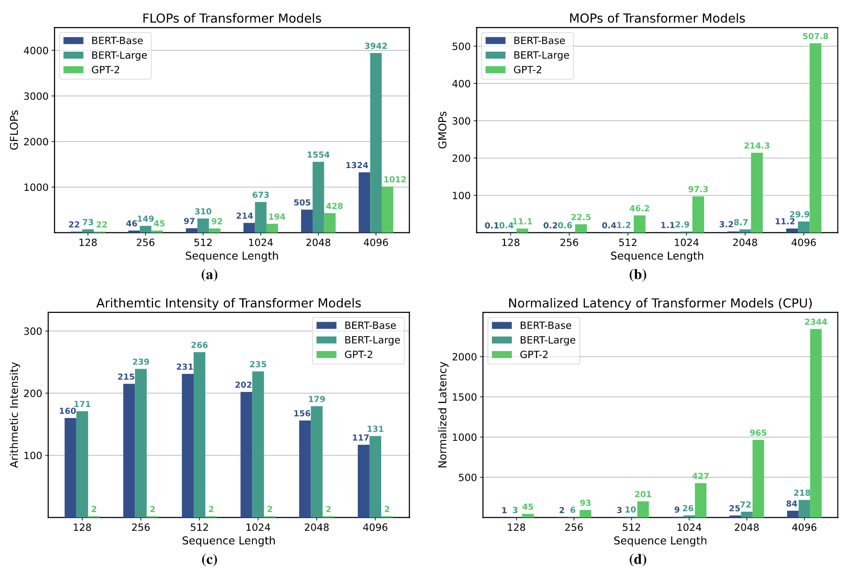
Why General-Purpose CPUs Failed AI (2/2)
The Mismatch:
  CPUs' sequential design is fundamentally inefficient for the massive parallelism inherent in AI workloads like matrix multiplication.
  CPUs achieve only 5-10% utilization on neural network workloads, delivering approximately 100 GFLOPS10 while consuming hundreds of watts*.
Conclusion:
  AI's exponential demands exposed the limits of the general-purpose model, forcing a shift to specialized hardware.
A. Gholami et al., "AI and Memory Wall," in IEEE Micro, vol. 44, no. 3, pp. 33-39, May-June 2024.
Notes:
找权威的数据或者来源

Slide 10
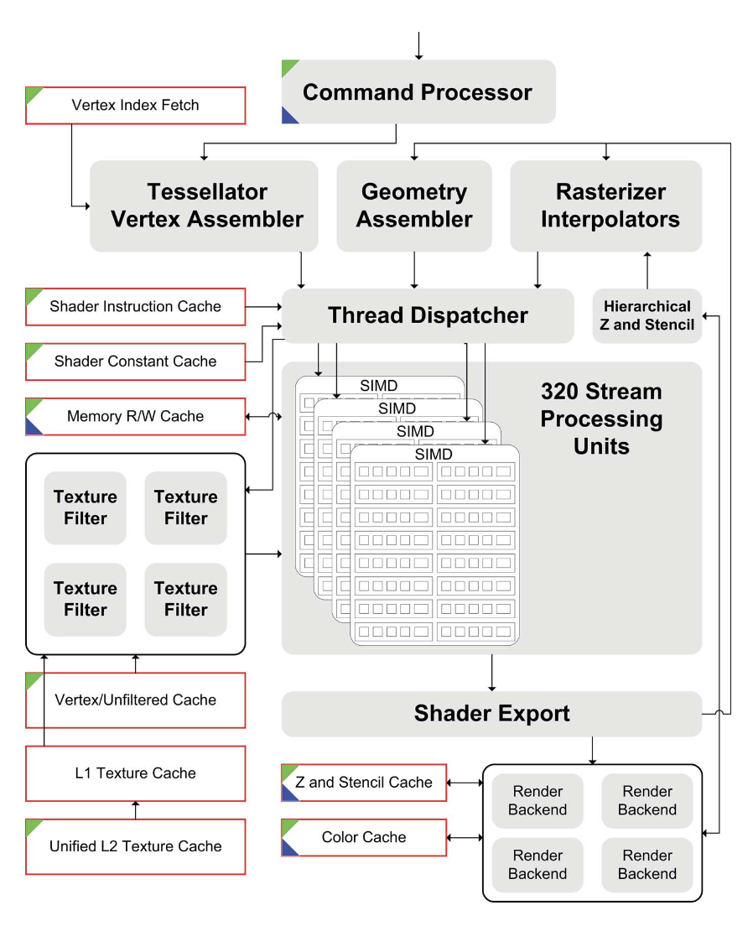
The Rise of the GPU
An Unlikely Hero: The Graphics Processing Unit (GPU) was born in the late 1990s for video game graphics, featuring thousands of simple cores for parallel tasks.
Architectural Resonance: The core math of graphics (matrix and vector operations) was identical to the math of deep learning, making GPUs a perfect, albeit accidental, fit.
J. D. Owens, M. Houston, D. Luebke, S. Green, J. E. Stone and J. C. Phillips, "GPU Computing," in Proceedings of the IEEE, vol. 96, no. 5, pp. 879-899, May 2008, doi: 10.1109/JPROC.2008.917757.

Slide 11
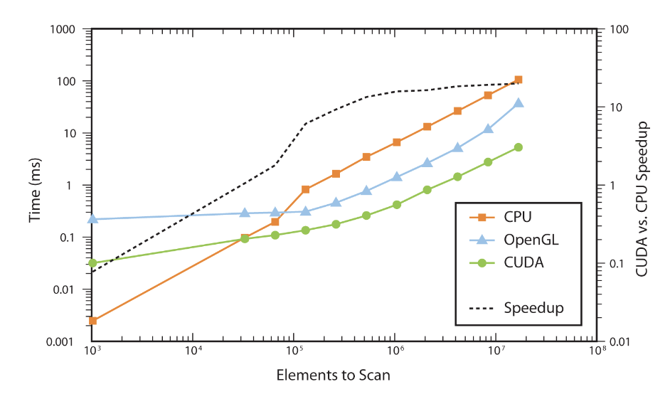
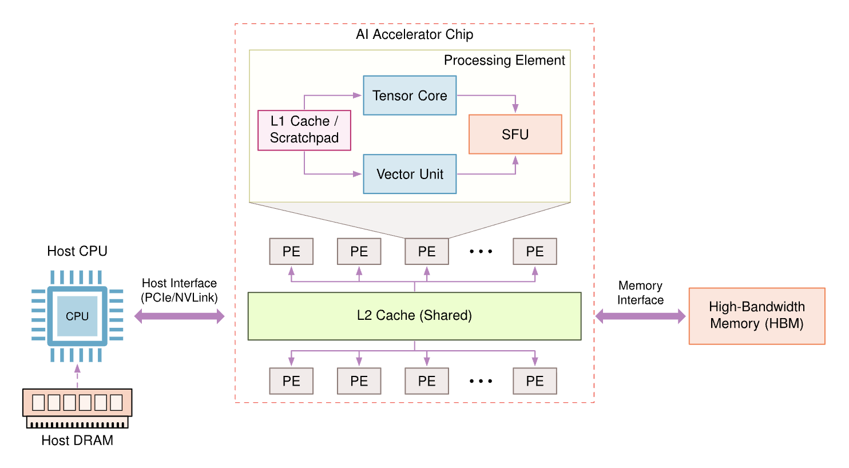
The Rise of the GPU
The Software Catalyst: CUDA: NVIDIA's CUDA platform (2007) unlocked the GPU for general-purpose computing, making its power accessible to AI researchers without deep graphics expertise.
The Result: Training times for AI models plummeted from weeks to hours, establishing the GPU as the de facto standard for AI training.
J. D. Owens, M. Houston, D. Luebke, S. Green, J. E. Stone and J. C. Phillips, "GPU Computing," in Proceedings of the IEEE, vol. 96, no. 5, pp. 879-899, May 2008, doi: 10.1109/JPROC.2008.917757.

Slide 12
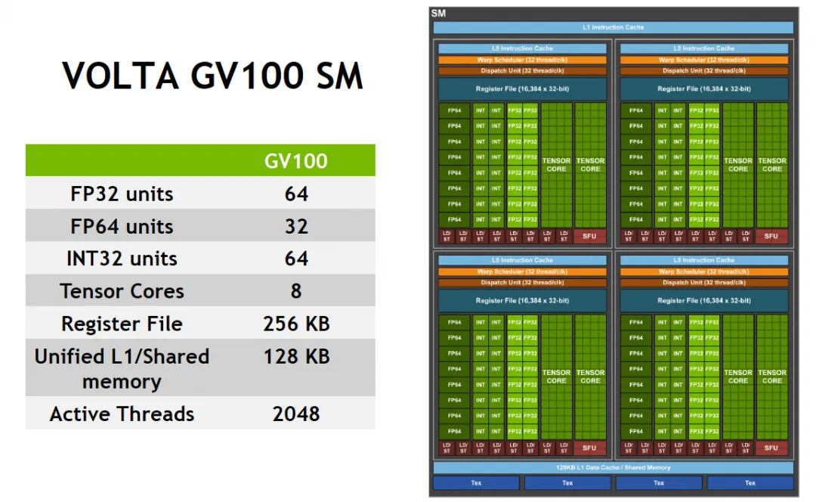
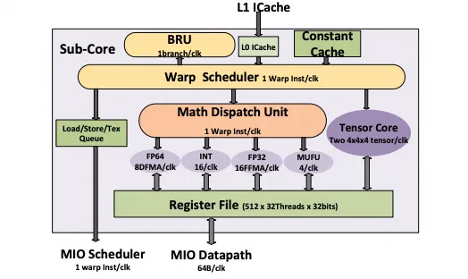
1st-Gen Tensor Core: Warp-scoped MMA

Slide 13
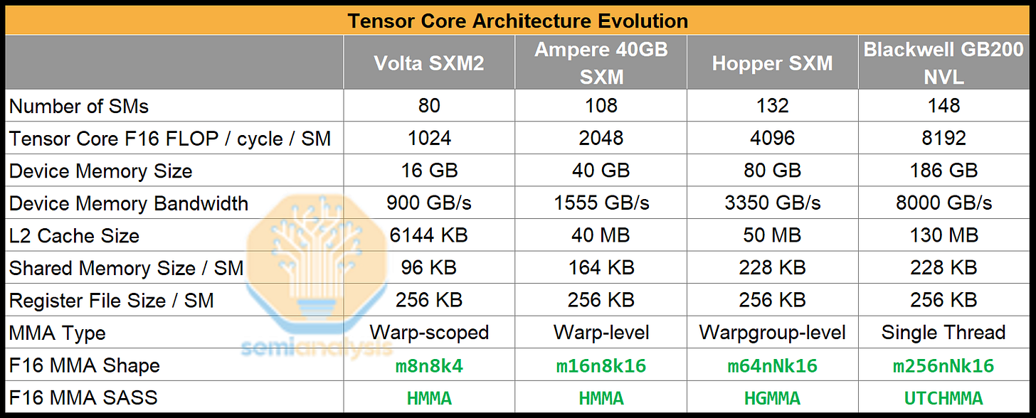
Scaling of Tensor Cores in NIVIDIA GPUs (1/3)

Slide 14
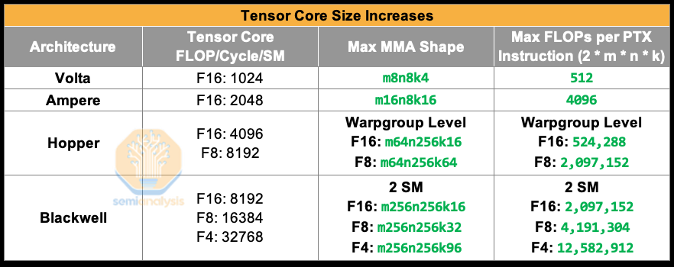
Scaling of Tensor Cores in NIVIDIA GPUs (2/3)

Slide 15
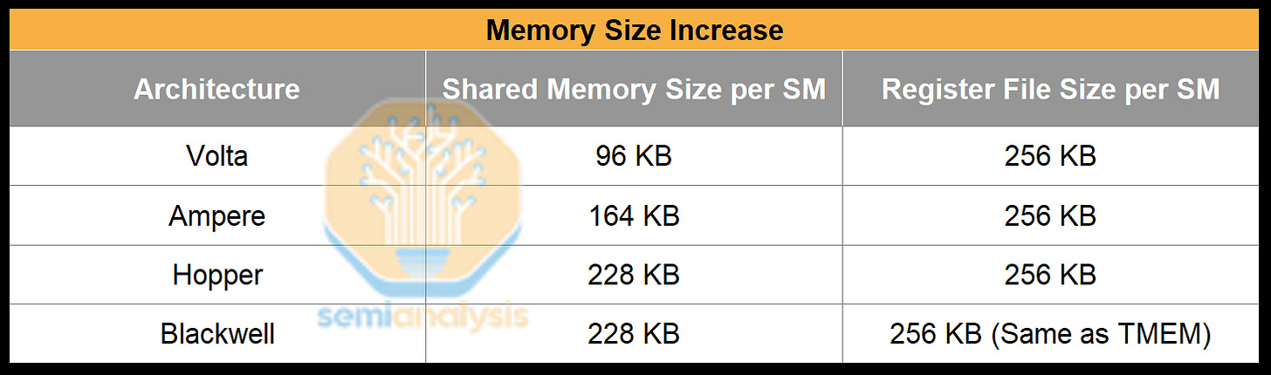
Scaling of Tensor Cores in NIVIDIA GPUs (3/3)
Tensor Core throughput doubled every generation, but global memory load latency didn’t decrease and in fact increased. As a result, we need to increase the staging SMEM size for buffering more data

Slide 16
Compute Architectures Evolve
GPU series (+ Tensor cores)
TPU series
Ascend series
CPU series: Intel (+ matrix extension); AMD (+ NPU)
compute-in-memory
wafer-scale chip
Supernode and Hypercomputer
...

Slide 17
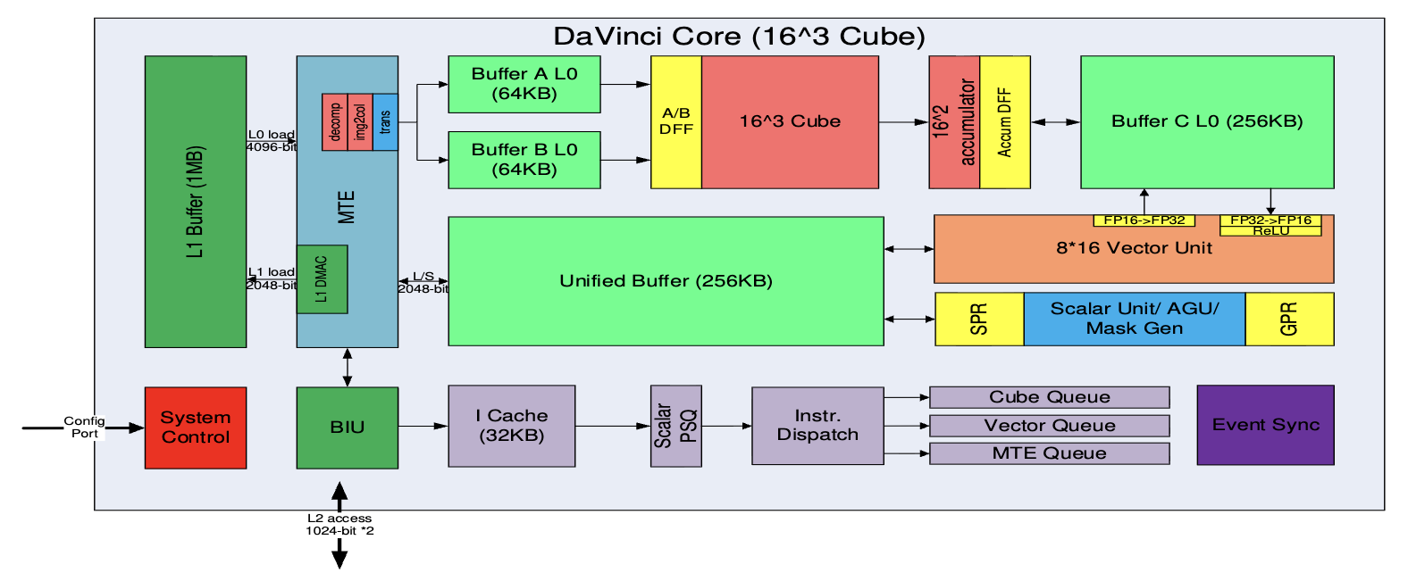
Huawei DaVinci Architecture
Cube：4096(16^3) FP16 MACs + 8192 INT8 MACs
Vector：2048bit INT8/FP16/FP32 vector with special functions（activation functions, NMS- Non Minimum Suppression, ROI, SORT）
Explicit memory hierarchy design, managed by MTE
H. Liao, J. Tu, J. Xia and X. Zhou, "DaVinci: A Scalable Architecture for Neural Network Computing," IEEE Hot Chips 31 Symposium (HCS), 2019.
Notes:
详细讲一些

Slide 18
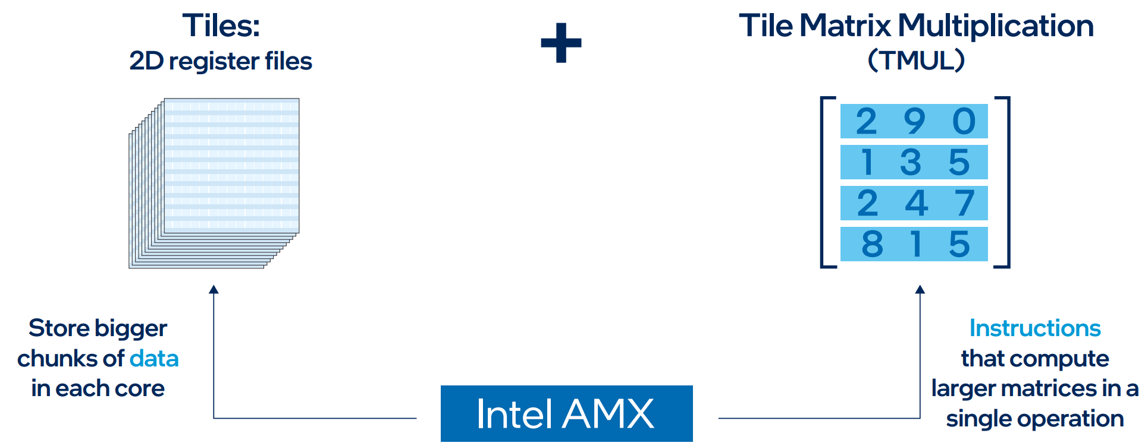
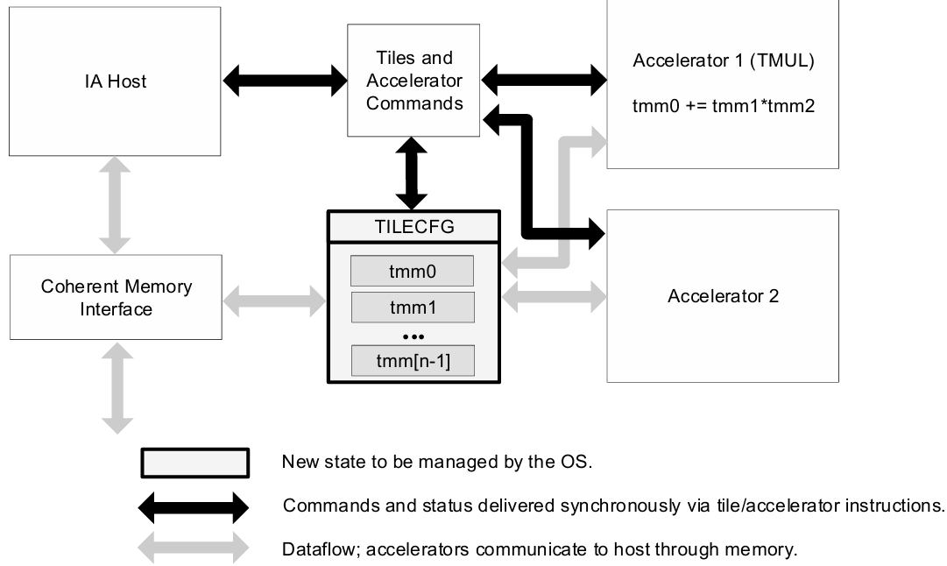
Intel’s Advanced Matrix Extensions (AMX)
Strategy: Enhance CPU with AI acceleration capabilities.
Architecture: An extension to the x86 ISA, not a separate chip.
Core Components:
  Tiles: 2D register files
  TMUL: dedicated matrix multiply instruction
  Explicit load/store/configuration model
  Instructions: tilecfg, tileload, tmul, tilestore
  Initial support: INT8, BF16 (extensions for FP16)

Slide 19
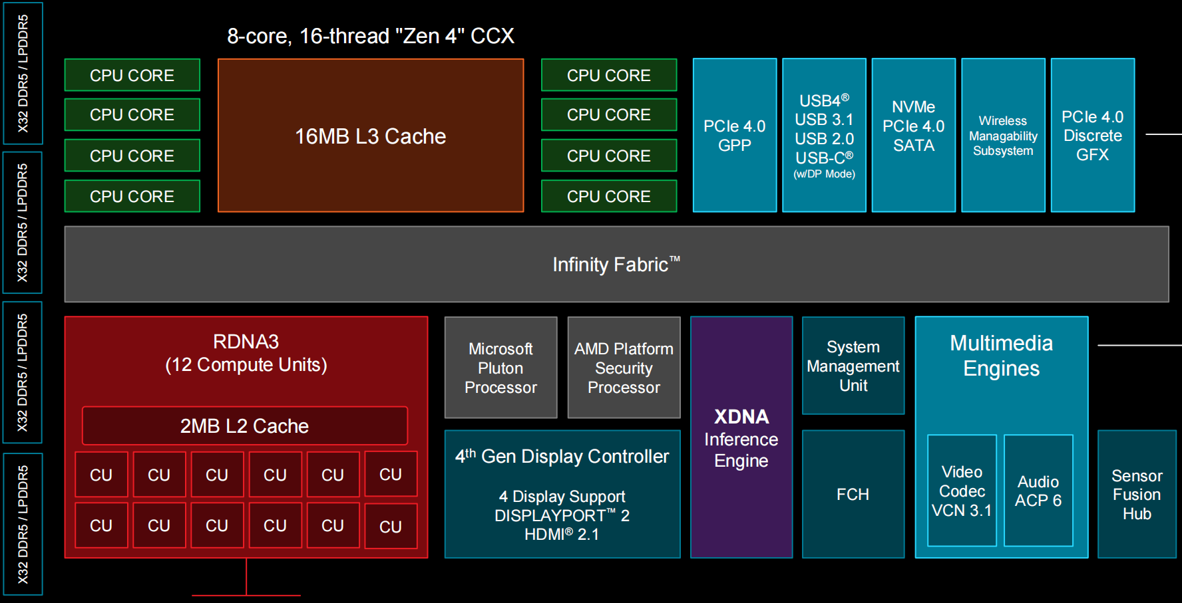
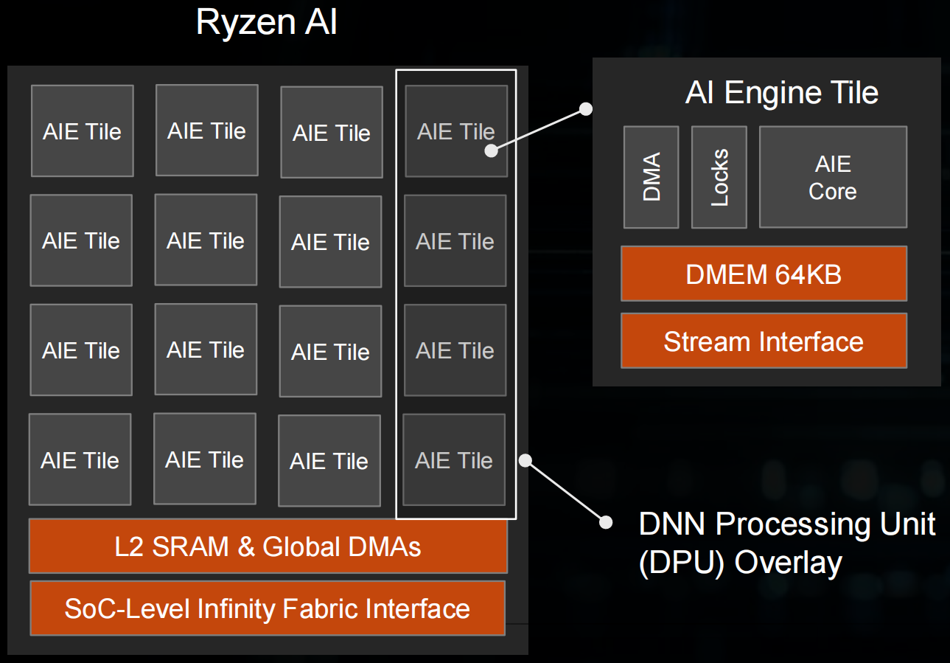
AMD Zen + RDNA + XDNA SoC
XDNA

Slide 20
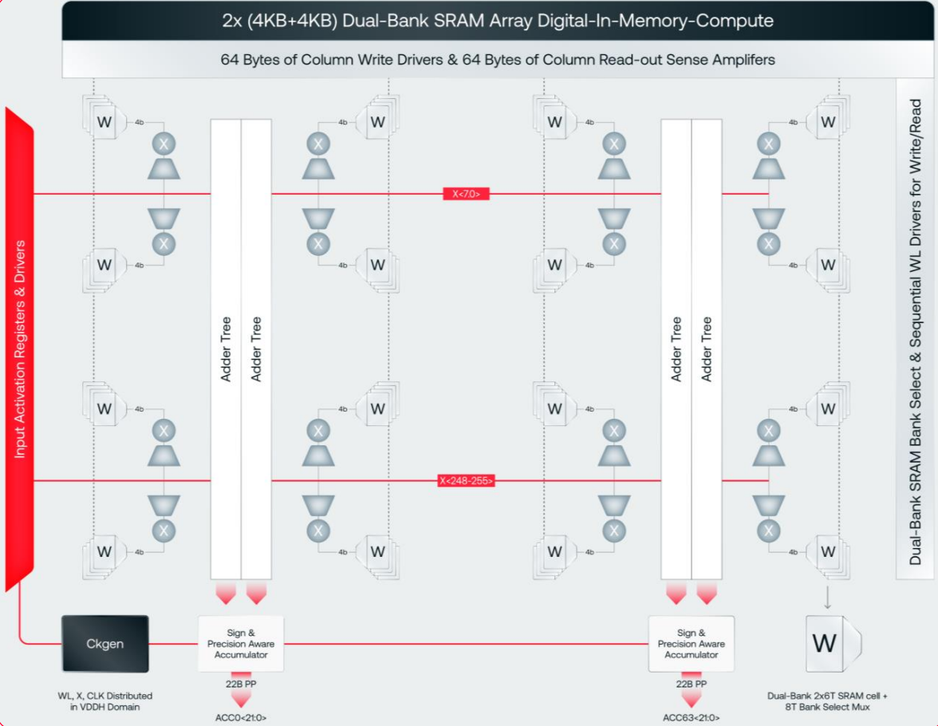

Digital IMC Architecture (d-Matrix)
Compute: Digital IMC (DIMC)
  Zero Data Movement: Logic units integrated within SRAM to eliminate transfer overhead.
  Digital Precision: Supports MXINT8/MXINT4 block-floating-point formats.
  Efficiency: 38 TOPS/W (vs. ~2.8 TOPS/W for H100).
Storage: SRAM & Memory Hierarchy
  Stash (Weights): 6MB/slice; 150 TB/s aggregate bandwidth.
  Global Memory (Activations): 4MB/slice.
  LPDDR5 (256GB): For massive models and KV Cache.
Scalability & Software
  Scale-Out: Transparent interconnect bypassing RDMA.
  Host-Free Runtime: RISC-V cores manage graph execution, eliminating Host CPU bottlenecks.

Slide 21
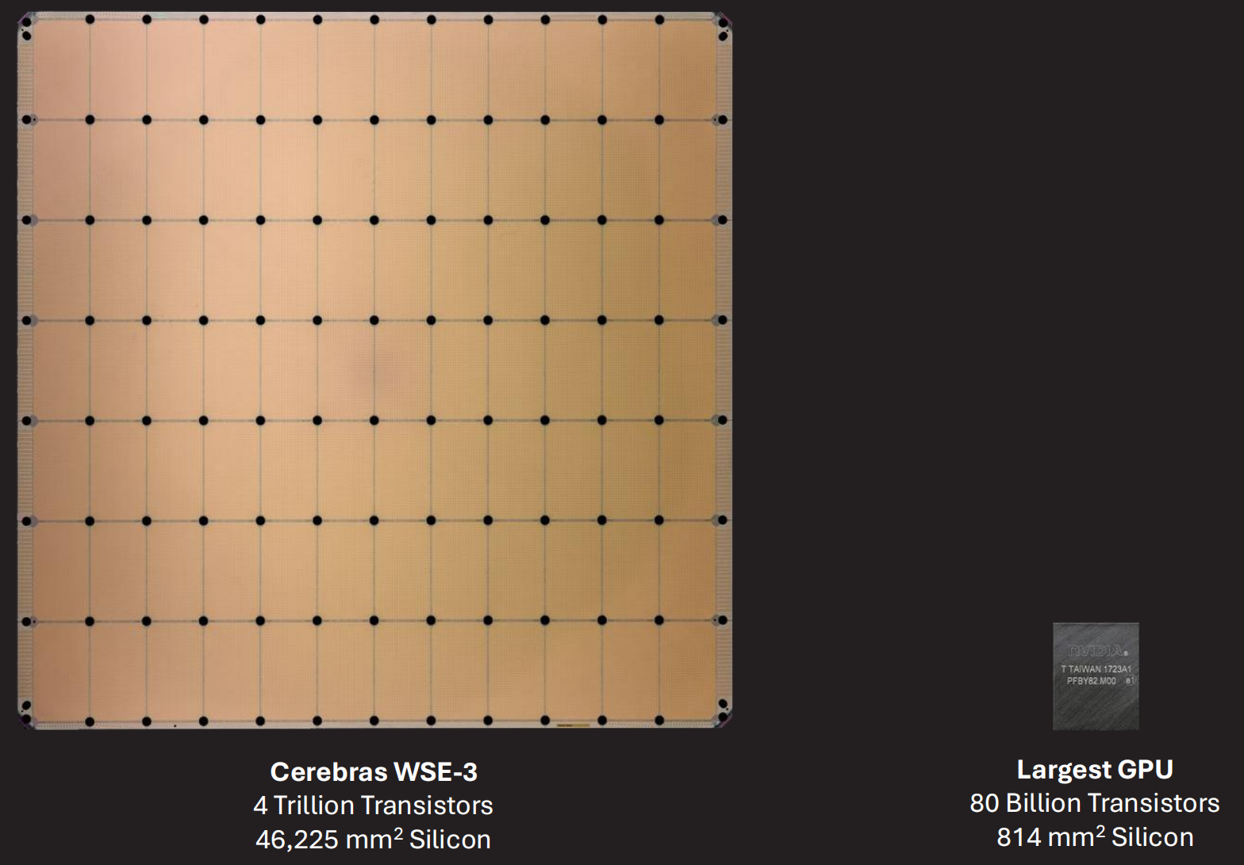

Wafer-Scale Architecture (Cerebras)
WSE-3 Specs (vs. NVIDIA H100)
  Die Area: 46,225 mm² (57x，↘)
  AI Cores: 900,000 AI cores (52x，↘)
  on-chip Memory: 44 GB SRAM (880x)
  Memory Bandwidth: 21 PB/s (7000x)
WSE-3 Core Architecture
  Co-located Compute & Memory: Logic and storage are tightly coupled to minimize latency.
  High-Performance AI Compute: 8/16-way SIMD supporting 16-bit/8-bit data formats.
  High-Bandwidth Storage: Massive local SRAM and specialized cache hierarchies.
Inference Strategy: On-Chip Pipeline Parallelism
  Physical Mapping: Model layers are mapped across different wafer regions.
  Near-Zero Latency: Communication happens via a high-speed Silicon Interconnect, effectively eliminating traditional networking overhead.

Slide 22


Supernode Architecture (NVL72 & CloudMatrix 384)
NVIDIA NVL72: "The Rack is the Chip"
  Chip-Centric, Compute-First Supernode: Designed as a unified computational entity.
  Architecture: 72 Blackwell GPUs integrated into a single rack, interconnected via a Copper Backplane (NVLink Switch).
  Objective: Emulate Wafer-Scale (WSI) performance using discrete components; leverages copper interconnects for rack-level All-to-All high bandwidth.
Huawei Cloud-Matrix 384
  System-Centric, Communication-First Unified Supernode: Prioritizes large-scale interconnect efficiency.
  Mechanism: Interconnects hundreds of Ascend processors via the proprietary HCCS protocol to build a Unified Memory Pool.
  General-Purpose Advantage: Unlike niche inference chips, it balances large-scale training and inference, backed by the mature CANN ecosystem.
[1] https://zhuanlan.zhihu.com/p/1919101924445254162

Slide 23
Model Parameter vs GPU Memory Capacity
NLP Moore’s Law
  Model Params: >10,000× growth in 7 years
GPU Memory Growth
  Memory Capacity: <10× growth in 7 years
Time | Model | Size
2018 | BERT-Large | 0.34 B
2019 | GPT-2 | 1.5 B
2020 | GPT-3 | 175 B
2023 | GPT-4 | ≈1.8 T (MoE)
2024 | Llama-3.1 | 405 B
2024 | Gemini 1.5 Pro | ≈1.5 T
2024 | DeepSeek-V3 | 671 B (MoE)
2025 | GPT-4.5 | ≈12.8 T (MoE)
Time | GPU | Memory Capacity | Memory Bandwidth
2018 | V100 | 32 GB | 900 GB/s
2020 | A100 | 80 GB | 2.0 TB/s
2022 | A800 | 80 GB | 2.0 TB/s
2023 | H100 | 94 GB | 3.9 TB/s
2024 | H200 | 141 GB | 4.8 TB/s
2025 | B200 | 192 GB | 8 TB/s
2025 | B300 | 288 GB | 10 TB/s
Massive-scale, high-bandwidth interconnects are mandatory
Notes:
AI model timeline: https://lifearchitect.ai/timeline/

Slide 24
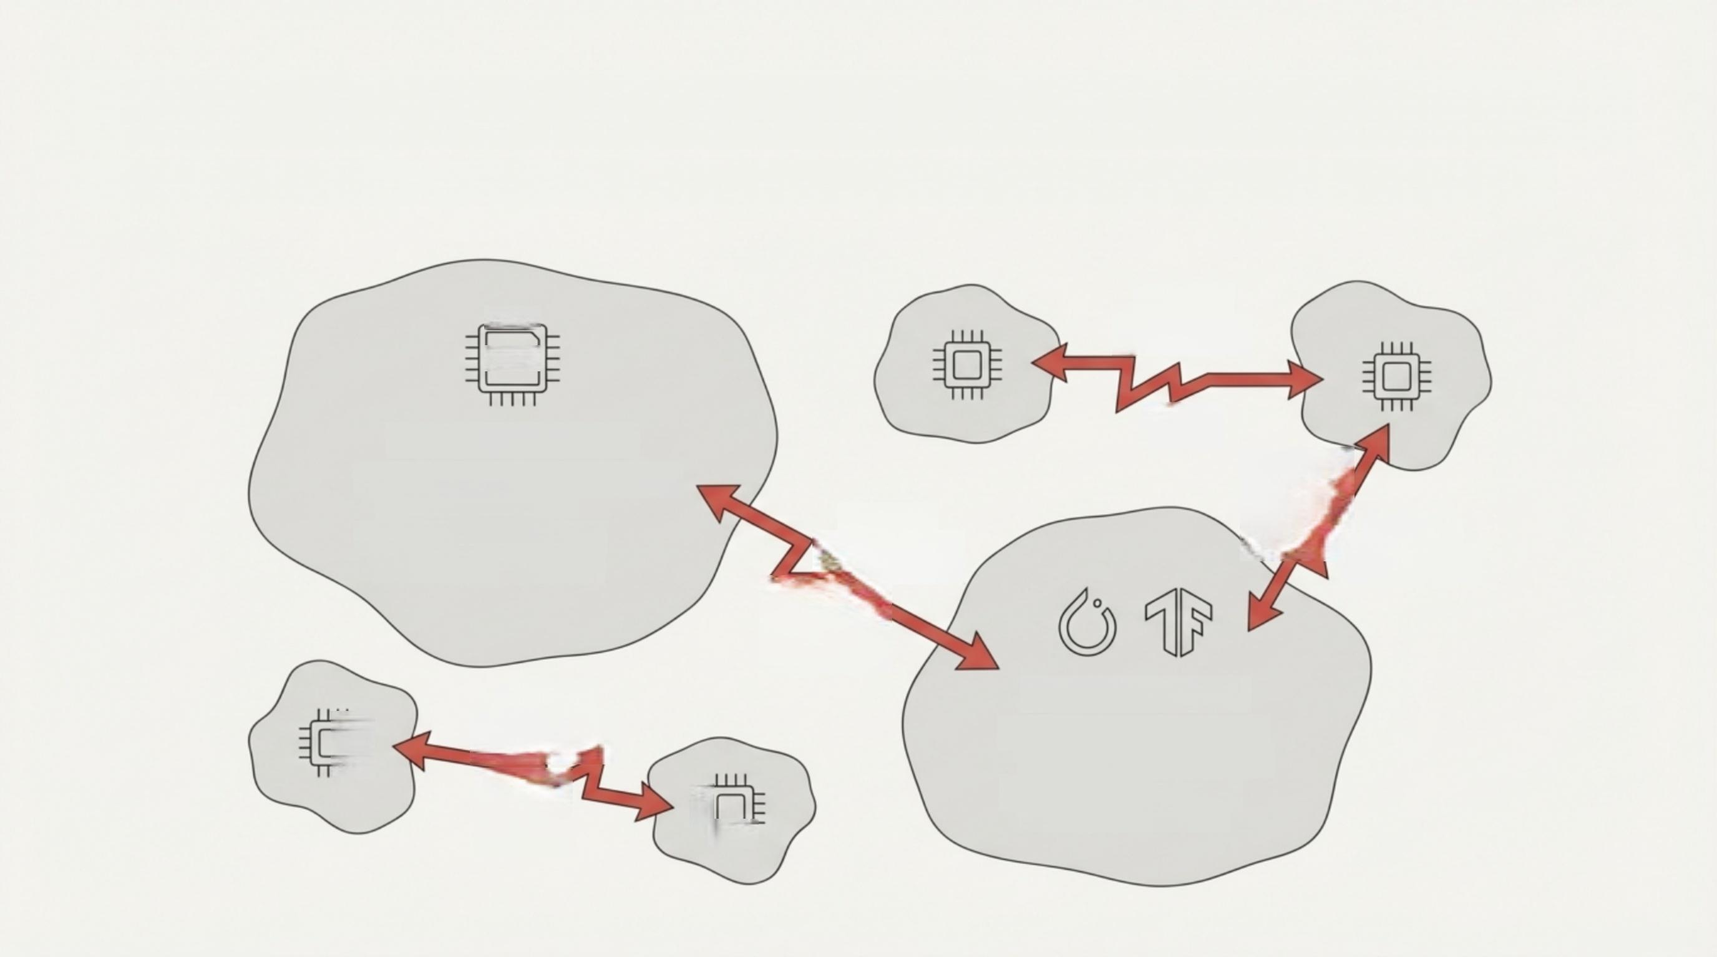
The AI Obstacle Course: The Challenge of a Multi-Chip World

Slide 25

The Solution: FlagOS, a Unified AI Software Stack

Slide 26
Lecture 02: Fundamentals of Heterogeneous Computing Programming Models

Slide 27
Outline
Host, Device, and Interconnect
  host-dev: PCIe, NVLink-C2C
  dev-dev: PCIe, NVLink, (RDMA)
Programming CUDA Cores
Programming Tensor Cores

Slide 28
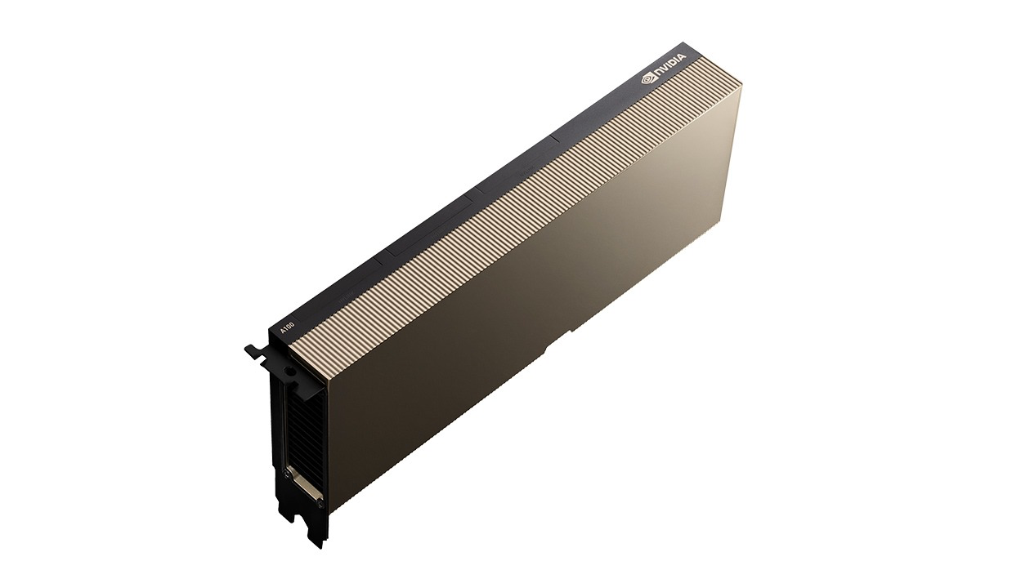
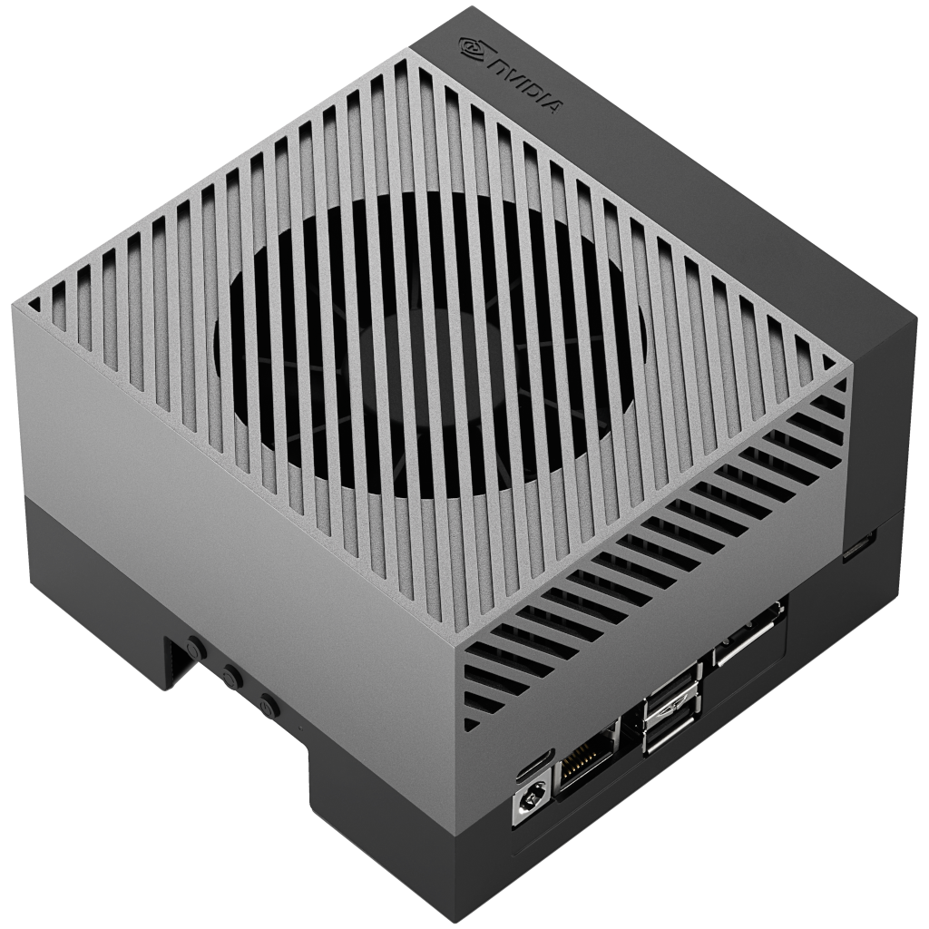

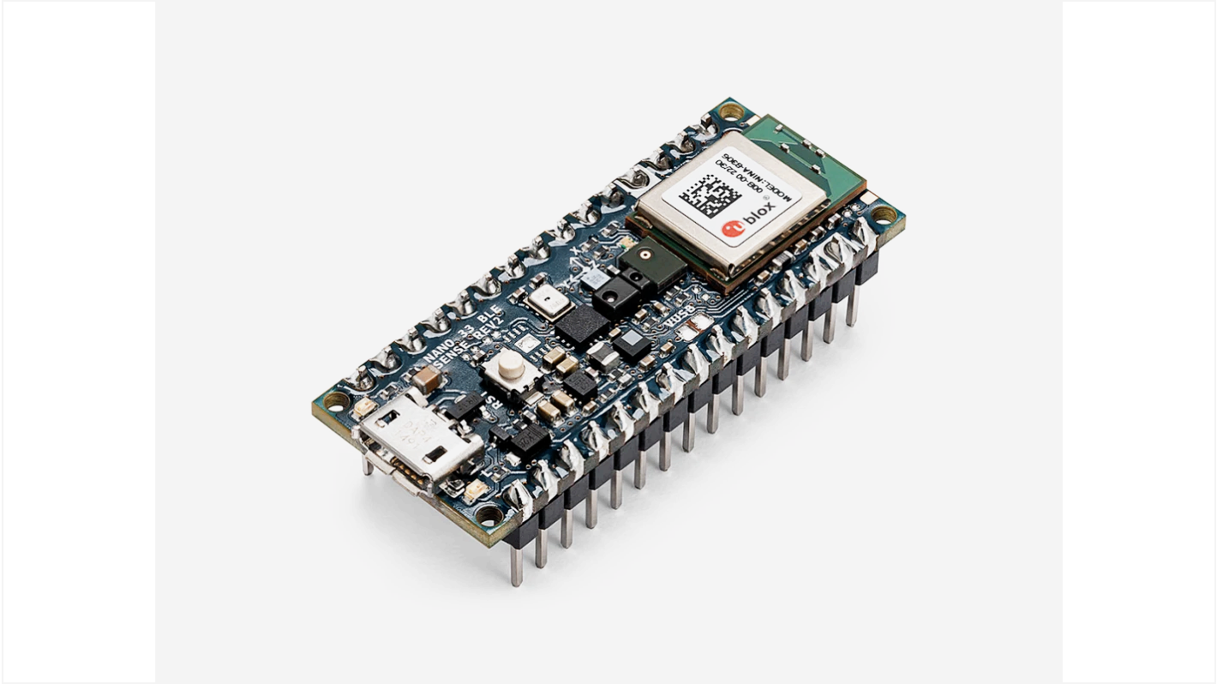
AI Hardware Spectrum: Key Examples（1/2）
Cloud ML
NVIDIA DGX 100
Edge ML
NVIDIA Jetson
AGX Orin
Mobile ML
iPhone
Tiny ML
Arduino Nano 33
BLE Sense
Notes:
Janapa Reddi, V. ML Systems Textbook. , from https://www.mlsysbook.ai/contents/core/ml_systems/ml_systems.html

Slide 29
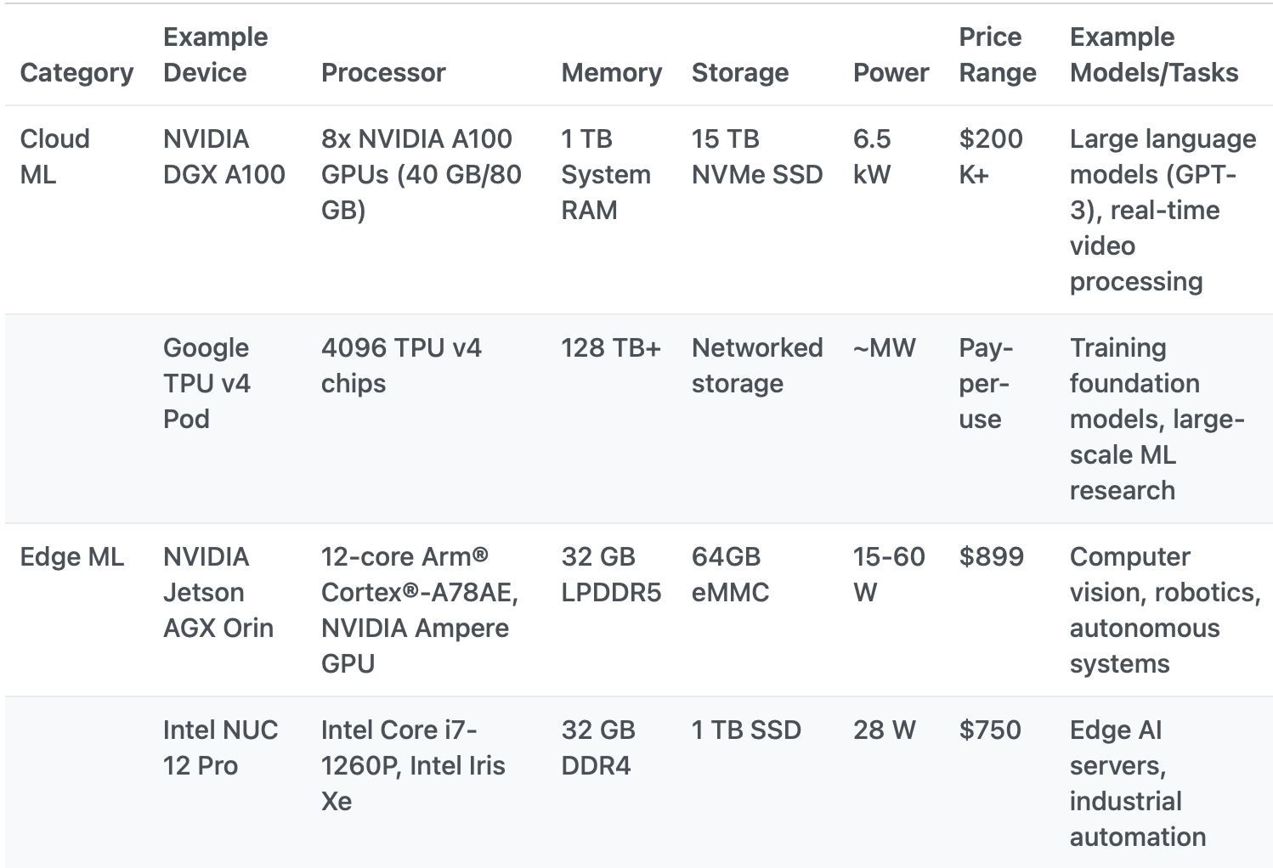
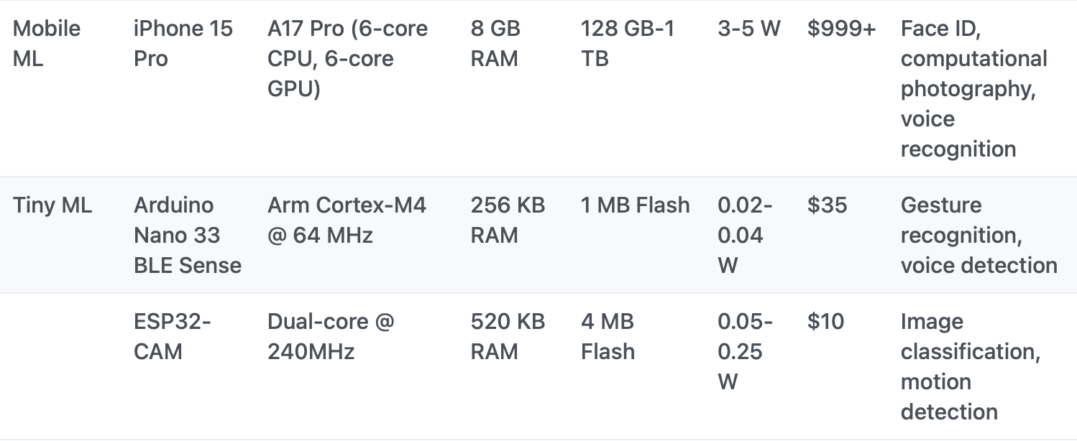
AI Hardware Spectrum: Key Examples（2/2）
https://www.mlsysbook.ai/contents/core/ml_systems/ml_systems.html
Notes:
Janapa Reddi, V. ML Systems Textbook. , from https://www.mlsysbook.ai/contents/core/ml_systems/ml_systems.html

Slide 30
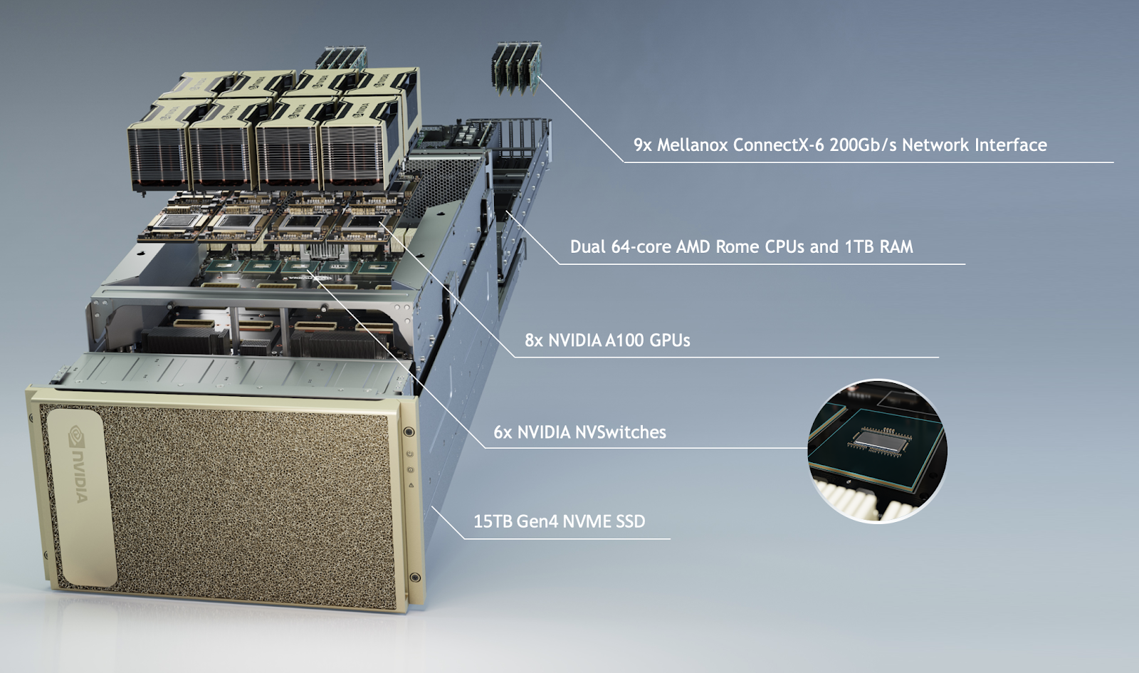
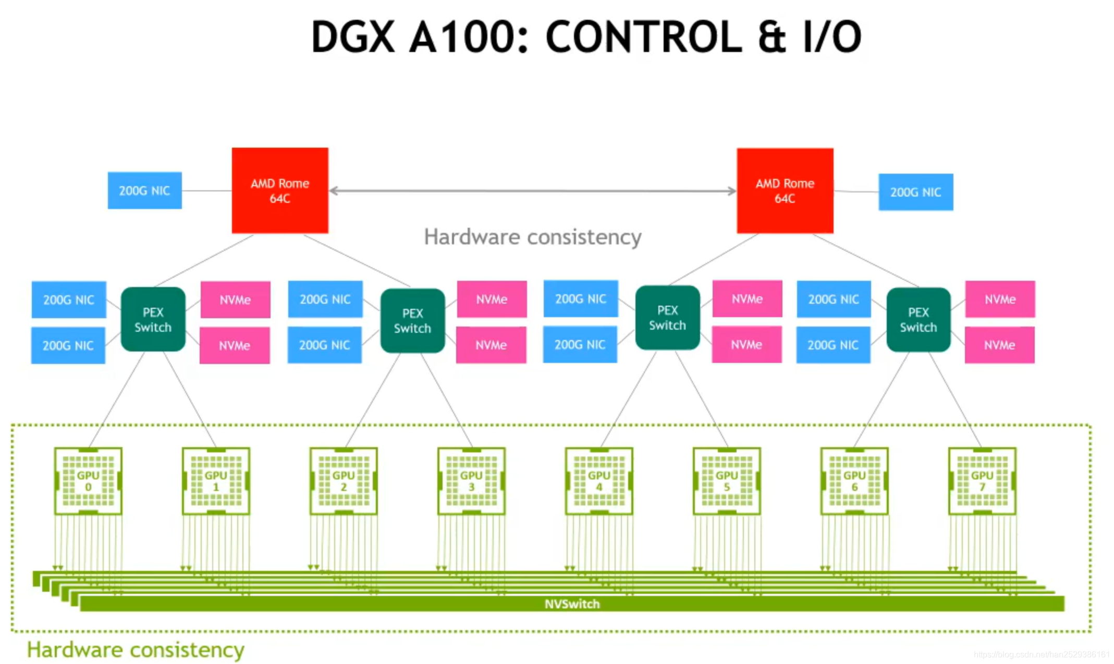
Two Forms of AI Chips (NVIDIA)
Discrete AI Chip: Standalone accelerators (e.g., DGX A100).
Integrated AI Chip: System-on-Chip/SoC (e.g., DRIVE Thor).
Notes:
https://applieddatasystems.com/hpc-solutions-2/gpu-servers/
https://developer.nvidia.com/blog/introducing-nvidia-jetson-thor-the-ultimate-platform-for-physical-ai/

Slide 31
Hetergeneous Integration of CPU and XPUs
Inter-chip (board-level) integration
  protocols: PCIe, NVLink, etc.
Intra-chip integration
  protocols: one-way or two-way coherency
CPU
“host”
XPU
“device”
CPU
“host”
XPU
“device”

Slide 32
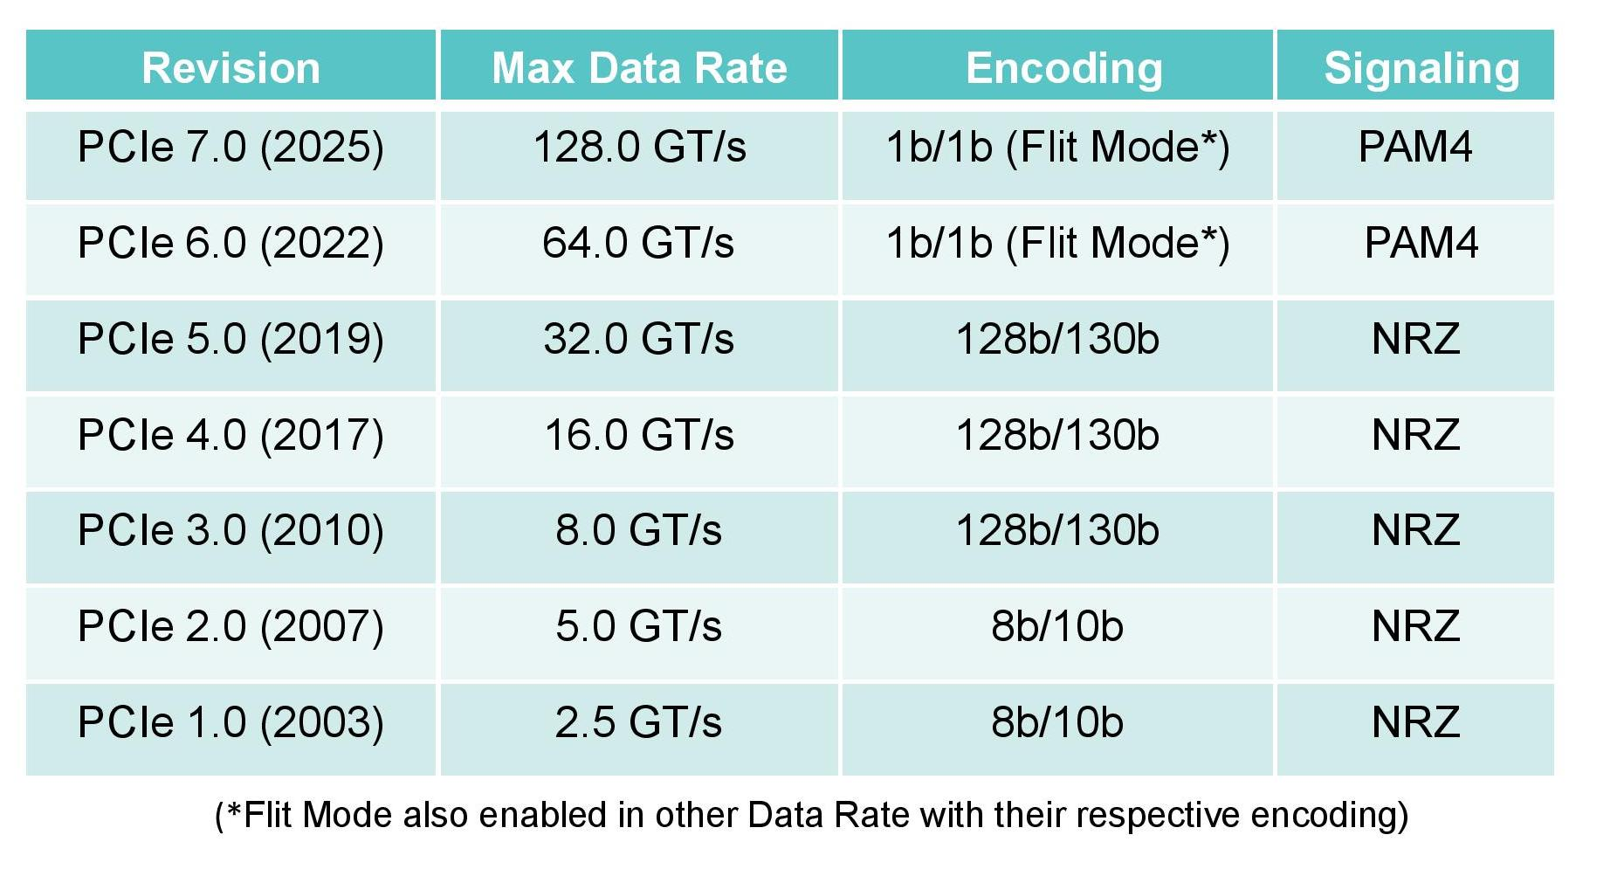
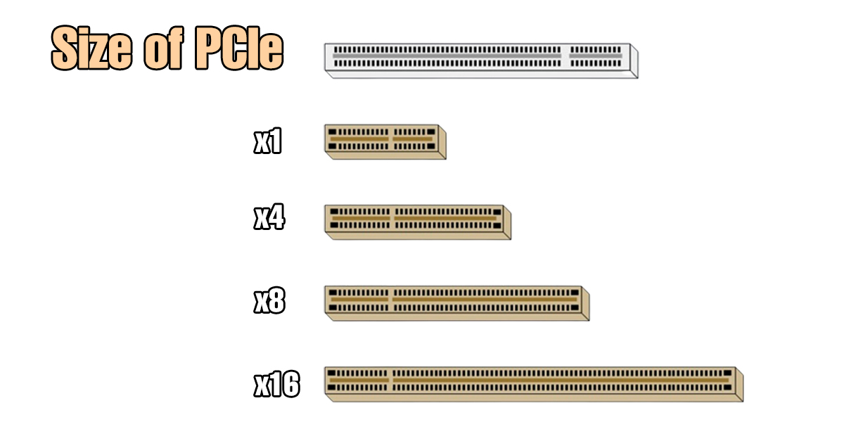
PCIe Basic Knowledge
Market Adoption (in Aug. 2025)
  Mainstream: PCIe 4.0
  Latest device: PCIe 5.0
  Not yet in production: PCIe 6.0/7.0
PCIe Lanes
  “x” = number of lane pairs (TX/RX)
  e.g. PCIe 5.0, “x1” = 4GB/s, “x16” = 32GB/s
  x4: most NVMe SSD, NIC
  x16: most GPU, FPGA
Notes:
pic-1 src: https://www.fibermall.com/blog/pcie-development.htm?srsltid=AfmBOorQpZIXd2vThqYRYSiPnQA0t-vEEgy2qs2bqBwevFxZ18Css9BG
pic-2 src: https://global.icydock.com/resources/icy_tips_367.html

Slide 33
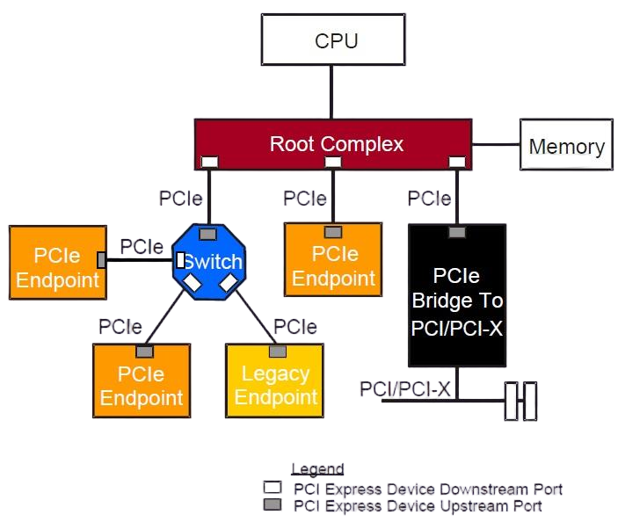
PCIe Architecture
Notes:
pic1: https://e2e.ti.com/support/processors-group/processors/f/processors-forum/465737/pcie-system-architecture
pic2: https://www.corsair.com/us/en/explorer/diy-builder/storage/what-is-pcie-and-how-does-it-work/?srsltid=AfmBOopOClHgxQNRCjM-qE1GfLF5emw_NG9baHGOoHVaTlt9bfUfwAtF

Slide 34
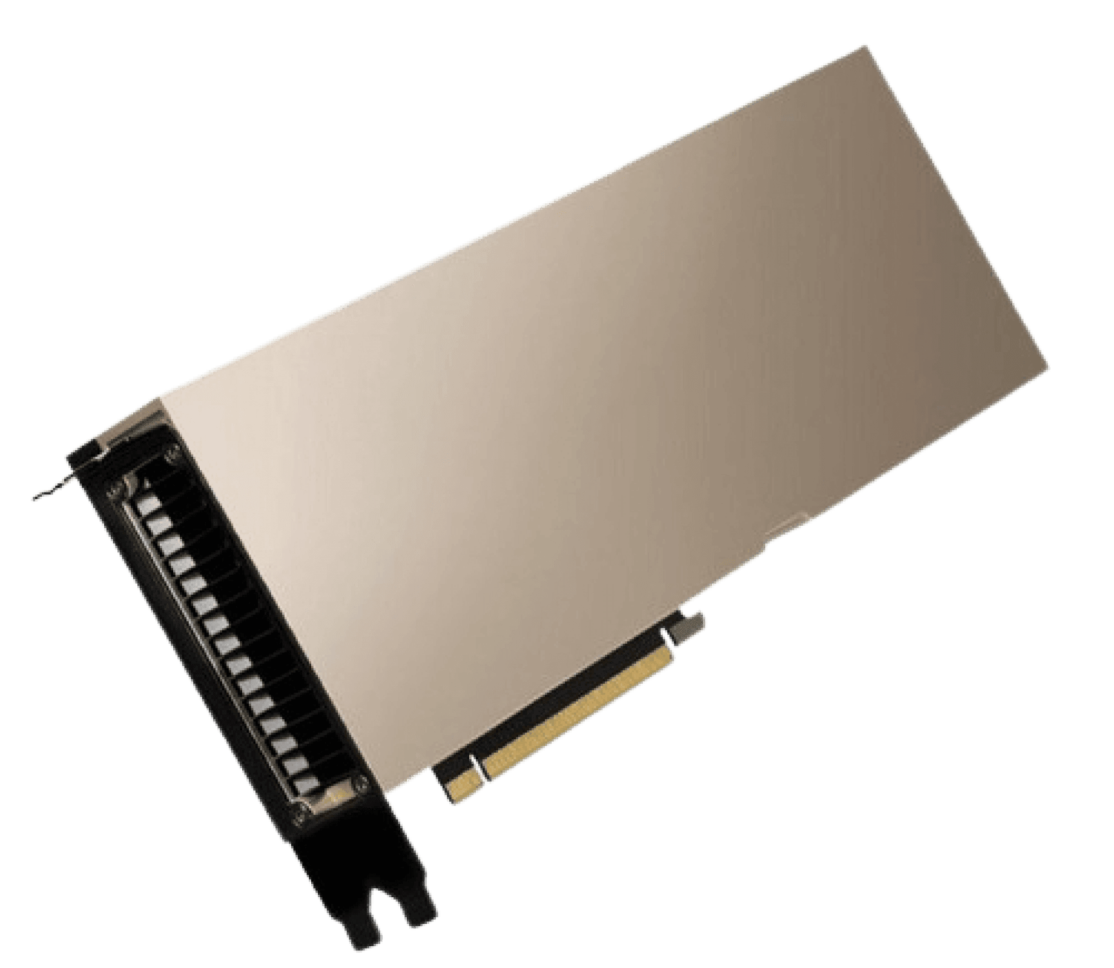
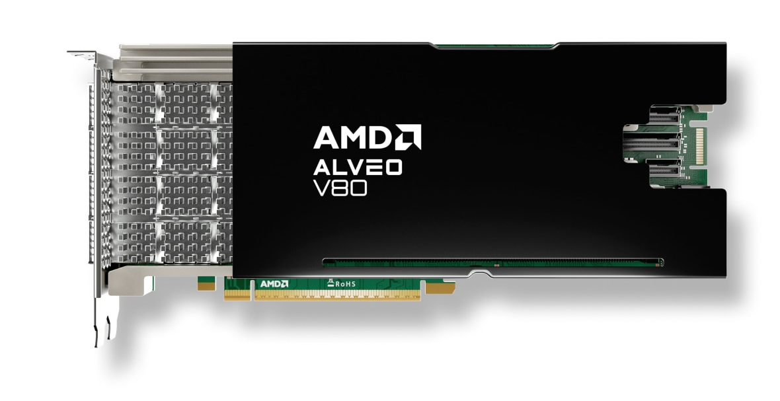

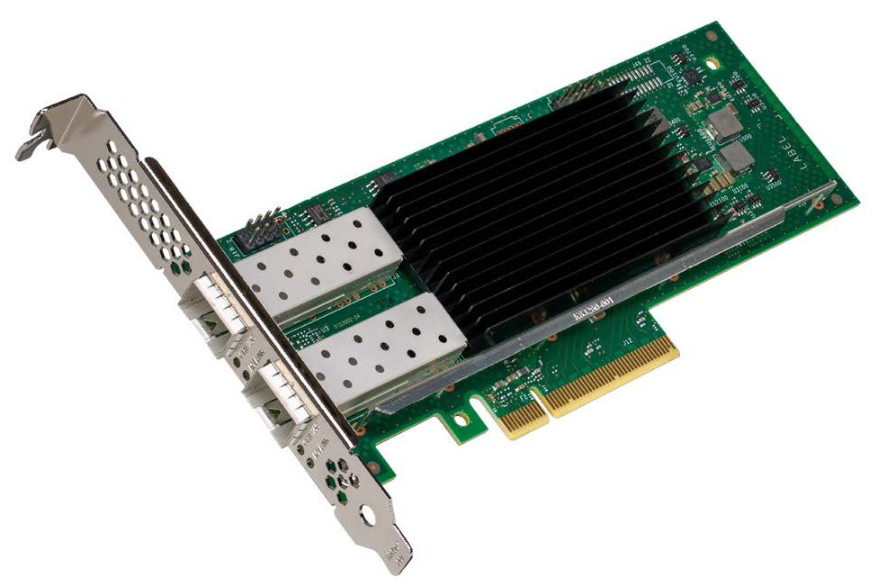
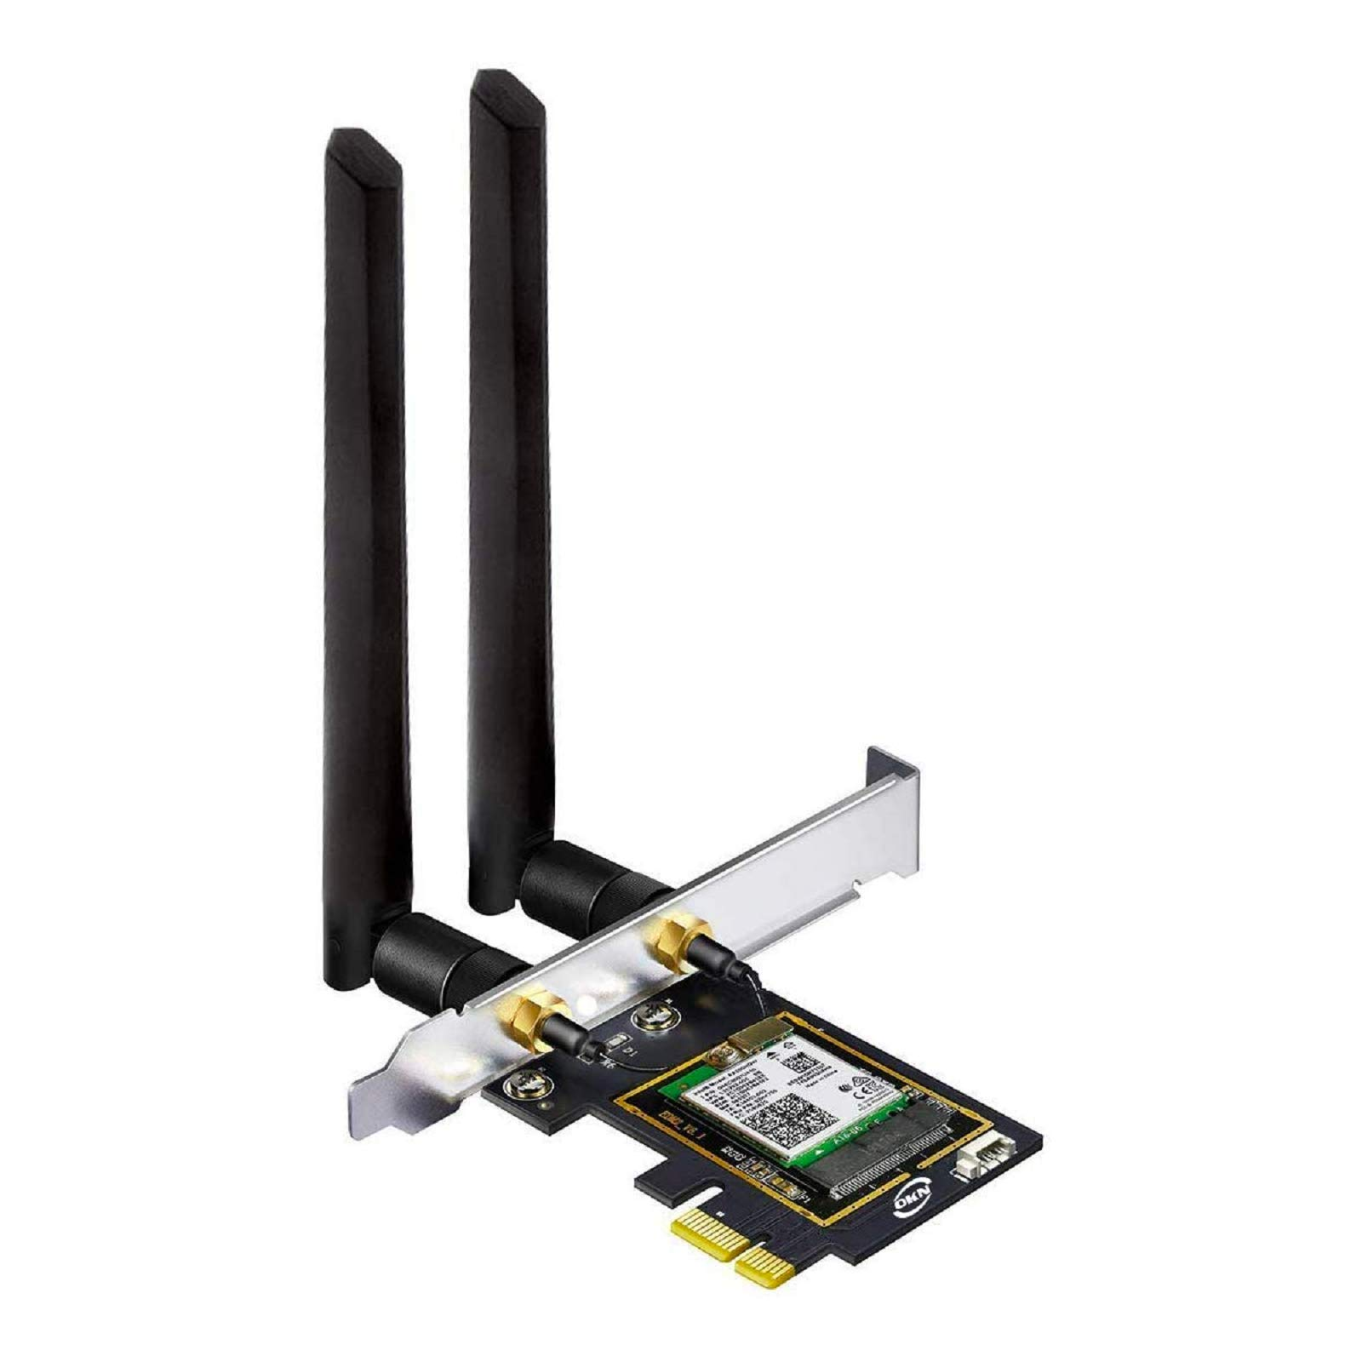
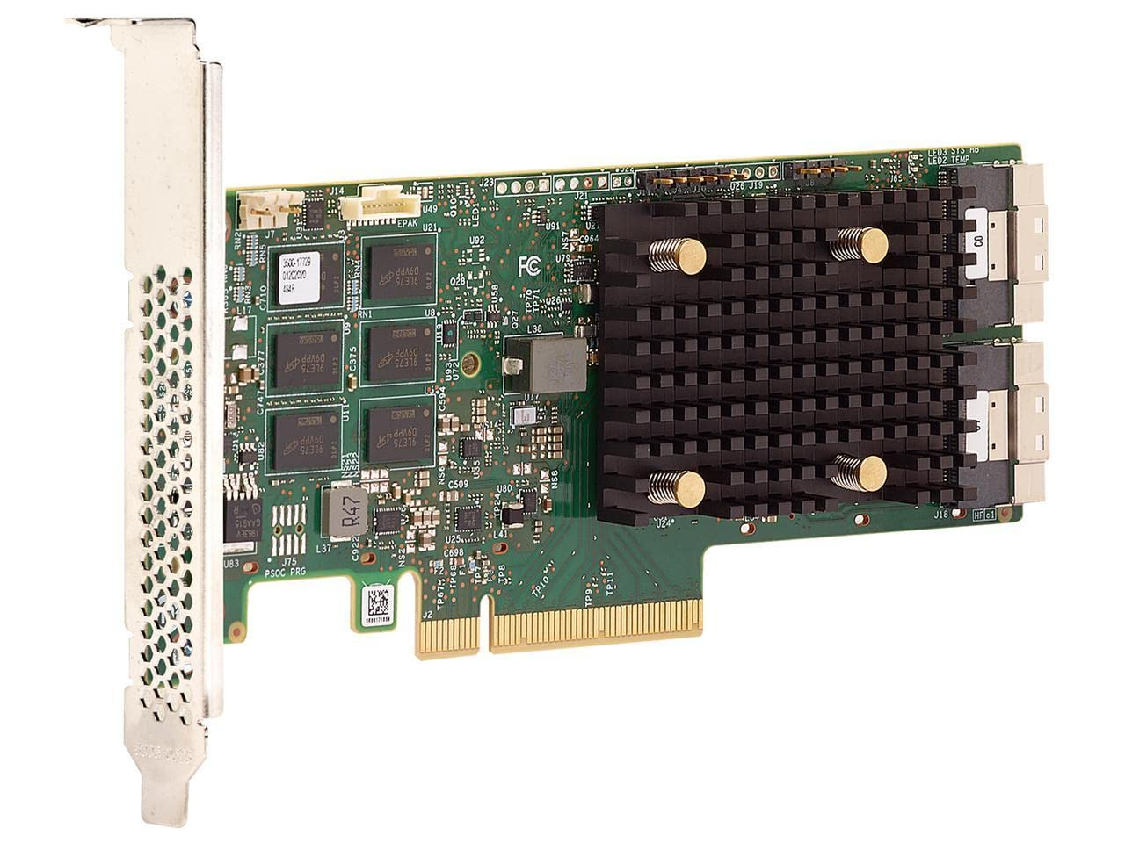
PCIe Devices
GPU
(Nvidia A100, PCIe 4.0 x16)
FPGA
(AMD V80, PCIe 4.0/5.0 x16)
NVMe SSD
(Sumsung 970, PCIe 4.0 x4)
Network Interface Card, NIC
(Intel E810 10/25 GbE, PCIe 4.0 x4)
WiFi 6E Card
(Intel AX210, PCIe 3.0 x1)
RAID Controller
(Broadcom 9560-16i, PCIe 4.0 x8)

Slide 35
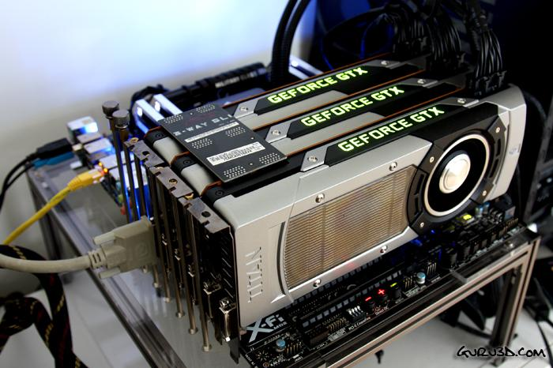
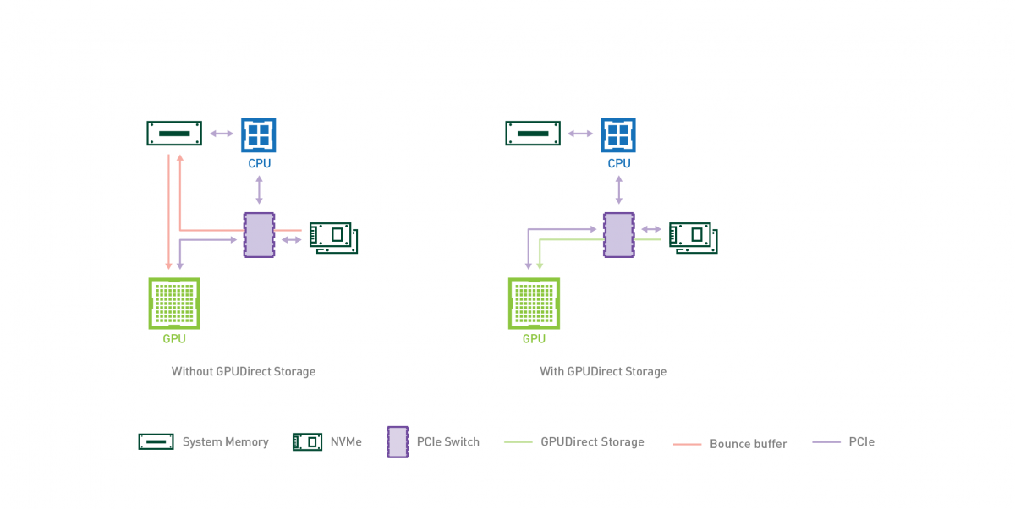
PCIe Role in AI: GPU-Host Connection
GPU connect to most Host with PCIe (currently 2025.08)
  Host->GPU: Commands (CUDA kernels, OpenCL bin)
  Training data, Model weights...
  GPU->Host: GPU status (kernel completion, CUDA events)
  Computation results (gradients, inference output)...
Traditional Data Transfer
  1st Copy: NVMe SSD -> host Memory [with DMA]
  2nd Copy: host Memory -> GPU Memory
Nvidia GPUDirect Storage (from 2020.06)
  Only 1 Copy: NVMe SSD -> GPU Memory
GPUs to mainboard with PCIe
Notes:
https://www.zhihu.com/question/22233341/answer/1889610843068535566
gpu-cpu pic src: https://developer.nvidia.com/gpudirect

Slide 36
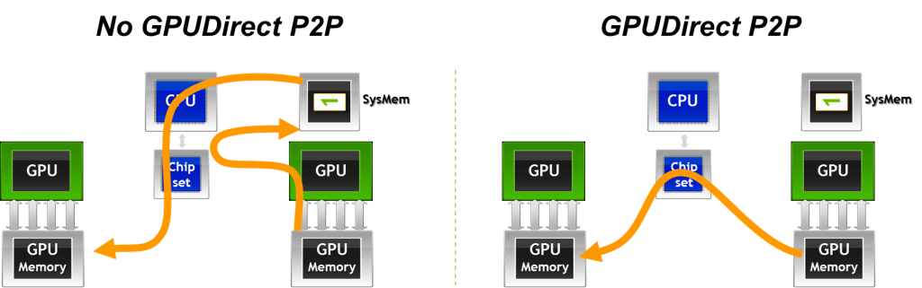
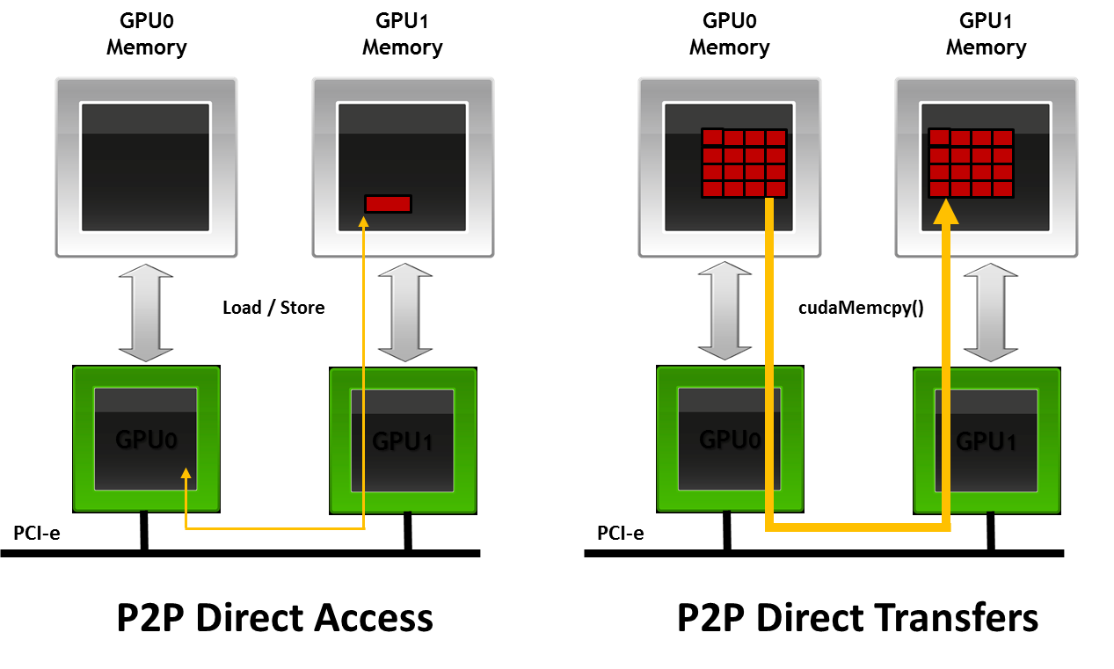
PCIe Role in AI: GPU-GPU Connection
GPU connect each other with PCIe (before 2016 NVlink published)
  Data/Pipeline/Tensor/Expert Parallelism
Traditional Data Transfer
  GPU₀ write to host shared memory
  GPU₁ read from host shared memory
GPUDirect Peer-to-Peer
  Direct access with Load/Store
  Direct transfer with cudaMemCpy()
Notes:
gpudirect: https://developer.download.nvidia.com/devzone/devcenter/cuda/docs/GPUDirect_Technology_Overview.pdf
pic src:
https://developer.nvidia.com/blog/introduction-cuda-aware-mpi/
https://keeneland.gatech.edu/software/gpudirect.html
并行方式 产生大量P2P通信的阶段 典型通信量 对P2P带宽/延迟的敏感度
数据并行 梯度聚合（All-Reduce） 大，但可用Ring/Tree算法分摊到多链路 中等
模型并行/张量并行 每一步前向+反向，层内张量切片之间频繁交换中间结果 持续且密集的小包 极高
流水线并行 阶段边界的前向激活 & 反向梯度 阶段性脉冲式流量 高

Slide 37
NVLink: GPU Interconnect
NVLink 1.0 first introduced with P100 GPU in 2016
  4 NVLinks, each with 8 channels, 40 GB/s bidirectional bandwidth, 160 GB/s in total
  Faster than PCIe 3.0 x 16 (32 GB/s)
Serial communication based on high-speed differential signaling
  NVLink 1.0, 5 GB/s per channel
Notes:
pic: https://en.wikichip.org/wiki/nvidia/nvlink

Slide 38
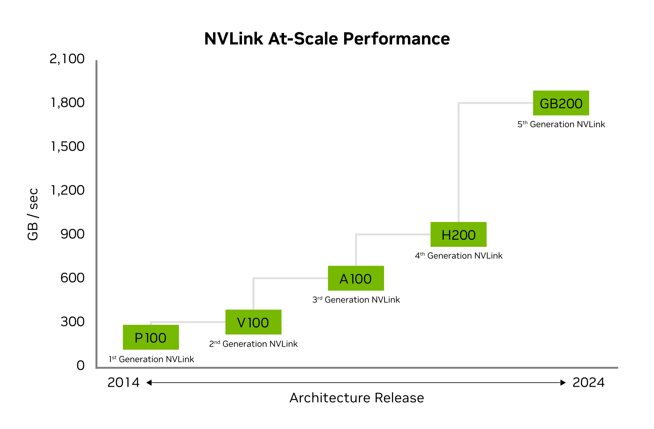
NVLink Generations
Updatest: NVLink 5.0 in 2024
 | NVLink 1 | NVLink 2 | NVLink 3 | NVLink 4 | NVLink 5
Year | 2016 | 2018 | 2020 | 2022 | 2024
Lanes per port | X8 | X8 | X4 | X2 | X2
Lane rate (Gbps) | 20 | 25 | 50 | 100 | 200
Modulation | NRZ | NRZ | NRZ | PAM4 | PAM4
Nyquist frequency (Gbaud) | 20 | 25 | 50 | 50 | 100
Bidirectional bandwidth per port (GB/s) | 40 | 50 | 50 | 50 | 100
Applicable GPU | P100 | V100 | A100 | H100 | B100
Ports per GPU | 4 | 6 | 12 | 18 | 18
Bandwidth per GPU (GB/s) | 160 | 300 | 600 | 900 | 900
Notes:
pic1: https://mp.weixin.qq.com/s?__biz=MzI1OTExNzkzNw==&mid=2650480852&idx=3&sn=9c1730bc2ba0262937e29a7096a0697d&chksm=f3811d2cccd9dfae64115574577a78a3875cdf8ef926a79ac1b03232dc910508cff4df37533b&scene=27&poc_token=HHU-pGij3SZqHxnt9yGj91eq4cMpN2yXbZjC5abD
pic2: https://www.nvidia.com/zh-tw/data-center/nvlink/

Slide 39
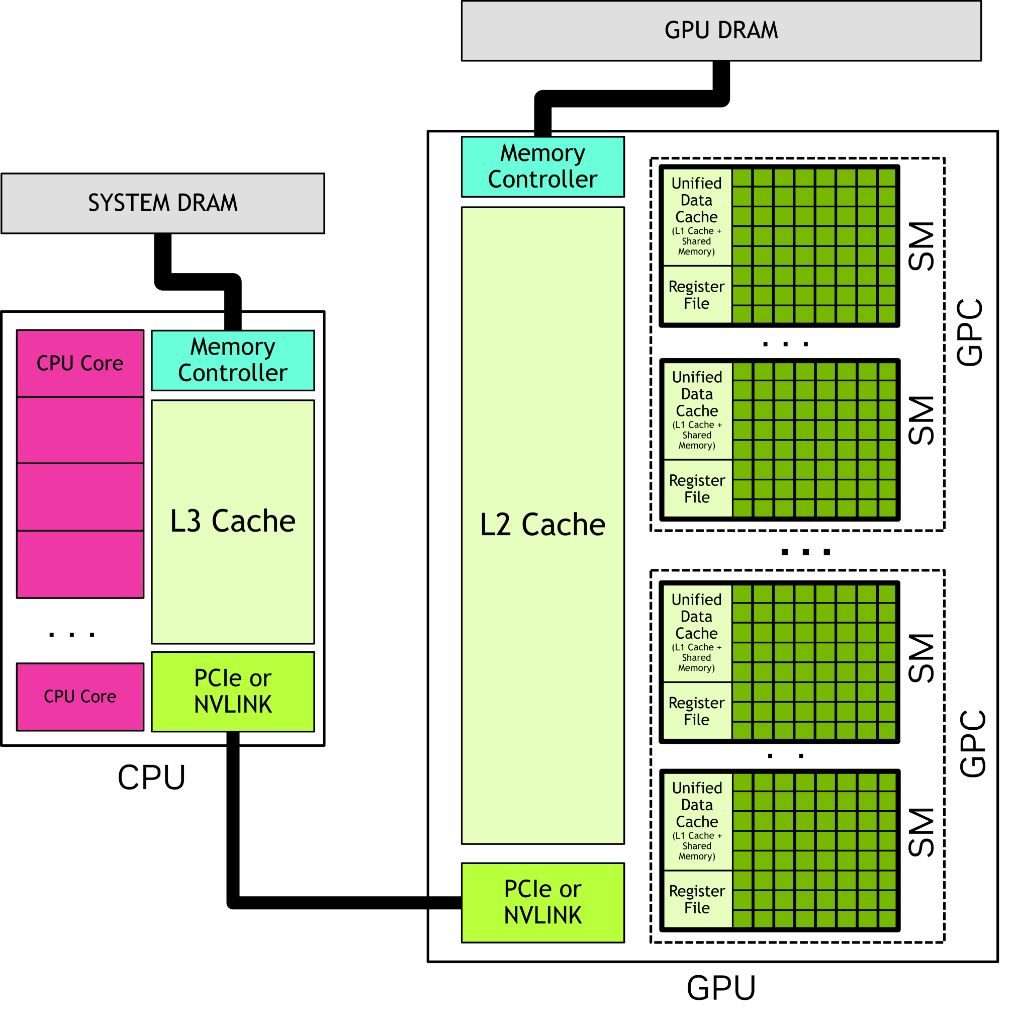
Heterogeneous Host-Device Interaction
without Unified Memory
with Unified Memory
① malloc
② cudaMalloc
③cudaMemcpy
...
⑥cudaMemcpy
④ cudaLaunchKernel
⑤cudaDeviceSynchronize
Notes:
单击此处添加文本

Slide 40
Outline
Host, Device, and Interconnect
Programming CUDA Cores
Programming Tensor Cores

Slide 41
Questions on Heterogeneous Programming
How to compile the “kernel” code?
How do CPU and GPU interact?
How to express parallelism?
How to express synchronization?
How to manage and access data?
How is kernel code executed on GPU?
Misc. topics
  debugging tools
  useful libraries

Slide 42
(incomplete list of) Concepts on Hetero-Programming
How to compile the “kernel” code?
How do CPU and GPU interact?
How to express parallelism?
How to express synchronization?
How to manage and access data?
How is kernel code executed on GPU?
a “”compiler” (later lectures)
host, device, kernels
threads, blocks, grid
__syncthreads()
xxMalloc(), xxxMemcpy(), global/shared/constant
warp scheduling

Slide 43
How do CPU and GPU interact?
A Tale of Host and Device
  host ~ CPU; device ~ GPU
  in OpenCL/ROCm, CPUs can also serve as devices
CPU-GPU interface
  x86-NV5090 @ PCIe 5.0: 64 GB/s
  Grace-Hopper NVLink C2C: 900 GB/s
  Grace-Blackwell NVLink C2C: 1.8 TB/s
kernel ≈ a device function interface for the host
xxxMalloc(), xxxMemcpy()

Slide 44
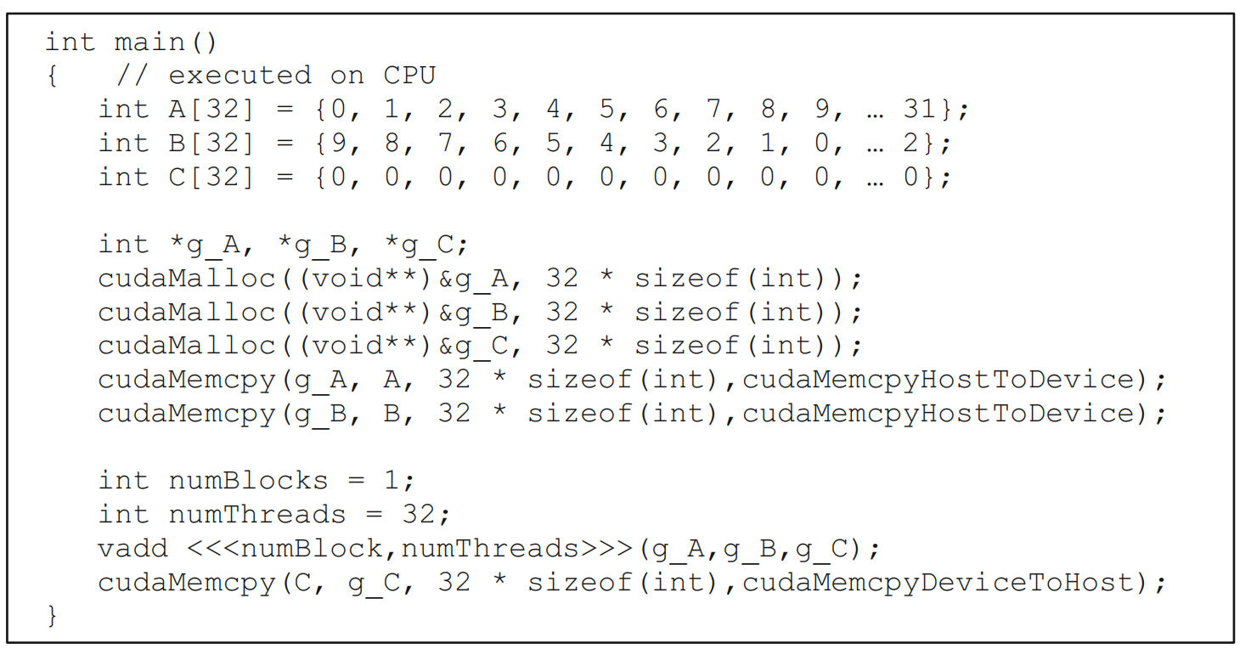
How do CPU and GPU interact? (host program)
Host program
  Running as part of normal C/C++ application on CPU
  Launch a grid of kernel thread blocks
  Call returns when all threads have terminated

Slide 45
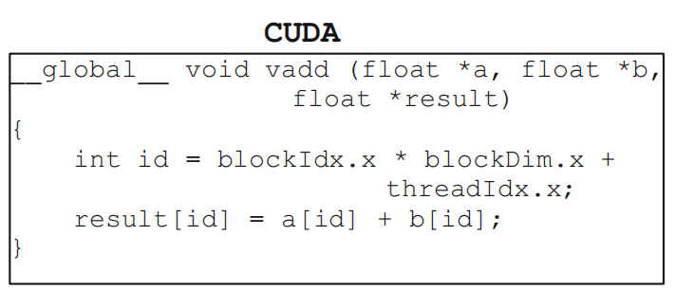
How do CPU and GPU interact? (kernel program)
Kernel definition
  __global__ denotes a kernel function
  Thread computes its thread id from its position in its block (threadIdx) and its block’s position in the grid (blockIdx)

Slide 46

How to Express Parallelism?
Thread Hierachy
  Thread
    The smallest unit of execution
    (not the smallest unit of scheduling)
  Thread Block (Block)
    A group of threads
    Cooperate through shared memory and synchronization
    Organized in up to 3-dims
  Grid
    A collection of thread blocks
    Organized in up to 3-dims
    Lauched by CPUs, executed on GPUs

Slide 47

The Grid: Blocks of Threads in 1D
Threads in grid have access to:
  Their respective block: blockIdx.x (for the “Thread” above: == 4)
  Their respective thread ID in a block: threadIdx.x (for the “Thread” above: == 0)
  Their block's dimension: blockDim.x (for the example above: == 4)
  The number of blocks in the grid: gridDim.x (for the example above: == 8)
adapted from UW CSEP 590, Dr. Hari Sadasivan

Slide 48

The Grid: Blocks of Threads in 2D
Each color is a block of threads
Each small square is a thread
The concept is the same in 1D and 2D
In 2D each block and thread now has
a two-dimensional index
Threads in grid have access to:
  Their respective block IDs: blockIdx.x, blockIdx.y
  Their respective thread IDs in a block: threadIdx.x, threadIdx.y
adapted from UW CSEP 590, Dr. Hari Sadasivan

Slide 49
How to Express Synchronizations?
__syncthreads()
xxxDeviceSynchronize()
events
(to be discussed in later lectures)

Slide 50

How to Manage and Access Data?
CUDA memory model
  Distinct host and device address spaces (when not using unified memory)
  Memory allocation in GPU through cudaMalloc()
  Move data between address spaces through cudaMemcpy()

Slide 51


How to Manage and Access Data?
CUDA memory model
  Three distinct types of address spaces visible to kernels
  __global__: accessible by all threads
  __device__: distinct from CPU memory
  __shared__: shared by threads in a block

Slide 52
How is Kernel Code Executed on GPU?
SIMD execution can be combined with pipelining
ALUs all execute the same instruction
Pipelining is used to break instruction into phases
When first instruction completes (4 cycles here), the next instruction is ready to execute
SIMD Width
(16 in AMD)
(8 in NVIDIA)
Add
Mul
Add
Mul
Add
Mul
Add
Mul
Add
Mul
Add
Mul
Add
Mul
Add
Mul
…
Add
Mul
AMD: Wavefront
(64 work-items)
NVIDIA: Warp
(32 threads)
Add
Mul
Add
Mul
Add
Mul
Add
Mul
Add
Mul
Add
Mul
Add
Mul
Add
Mul
Add
Mul
Add
Mul
Add
Mul
Add
Mul
Add
Mul
Add
Mul
Add
Mul
Add
Mul
Add
Mul
Add
Mul
Add
Mul
Add
Mul
Add
Mul
Add
Mul
Add
Mul
Cycle
1 | 2 | 3 | 4 | 5 | 6 | 7 | 8 | 9
…

Slide 53
SIMD, SPMD, and SIMT (1/3)
SIMD is an architecture
  A single sequential instruction stream of SIMD instructions
  For example, a matrix-vector multiplcation using AVX-512:
static float *outx16; static float *avx512Multiply() { for (uint64_t i = 0; i < row; i++) { __m512 sumx16 = _mm512_set1_ps(0.0); for (uint64_t j = 0; j < col; j += 16) { __m512 a = _mm512_loadu_ps(&(t1[i*col + j])); __m512 b = _mm512_loadu_ps(&(t2[j])); sumx16 = _mm512_fmadd_ps(a, b, sumx16); } outx16[i] = _mm512_reduce_add_ps(sumx16); } return outx16; }
https://www.intel.com/content/www/us/en/developer/articles/technical/accelerating-compute-intensive-workloads-with-intel-avx-512-using-microsoft-visual-studio.html

Slide 54
SIMD, SPMD, and SIMT (2/3)
SPMD is a programming paradigm
  “programmers normally write a single program that runs on all processors of an MIMD computer, relying on conditional statements when different processors should execute different sections of code.”
  see Section 6.3 of Computer Organization and Design, Fifth Edition: The Hardware/Software interface by David A. Patterson, John L. Hennessy

Slide 55
SIMD, SPMD, and SIMT (3/3)
SIMT is both a programming model and an execution model
  Multiple instruction streams of scalar instructions
  Can treat each thread separately
    i.e., can execute each thread independently (on any type of scalar pipeline)
    MIMD processing
  Can group threads into warps flexibly
    i.e., can group threads that are supposed to truly execute the same instruction
    dynamically obtain and maximize benefits of SIMD processing
    For NVIDIA GPUs, warp size = 32; For AMD GPUs, wavefront size = 64
adapted from UW CSEP 590, Dr. Hari Sadasivan
Notes:
https://developer.nvidia.com/blog/using-cuda-warp-level-primitives/
NVIDIA GPUs execute warps of 32 parallel threads using SIMT, which enables each thread to access its own registers, to load and store from divergent addresses, and to follow divergent control flow paths.

Slide 56
SIMT: How to Express the Work of a Thread?
(the Single Instruction Stream in SIMT)
A simple embarrassingly parallel loop:
for (int i= 0; i<N; i++)
h_a[i] *= 2.0;
Can be translated into a GPU kernel:
__global__ void myKernel(int N, double *d_a) {
int i = threadldx.x + blockldx.x * blockDim.x;
if (i<N) d_a[i] *= 2.0;
}
A device function that will be launched from the host program is called a kernel & is declared with the __global__ attribute
Kernels should be declared void
All pointers passed to kernels must point to memory on the device
All threads execute the kernel's body “simultaneously”
Each thread uses its unique thread and block IDs to compute a global ID
There could be more than N threads in the grid
adapted from UW CSEP 590, Dr. Hari Sadasivan

Slide 57
SIMT: How to Express the Thread Structure?
(The Grid: Multi-threading in SIMT)
Kernels are launched from the host:
dim3 threads(256,1,1); // 3D dimensions of a block of threads
dim3 blocks((N+256-1)/256,1,1); // 3D dimensions the grid of blocks
myKernel<<<blocks,threads,0,0>>>(N,a);

Slide 58

Optimizations
Resource-aware optimizations
  resouces: SM, registers, shared memory, memory bandwidth
How? (a incomplete list)
  choose an “optimal” block size, to maximize active warps
    improve the utilization of memory bandwidth →
  after partitioning, map the (task, data) to a suitable thread id
    avoid control divergence
    coalese global memory access
    avoid shared memory bank conflicts
Performance analysis tools

Slide 59
Coalescing Memory Accesses: Example
  Array X is a pointer to an array of integers (4-bytes each) located at address 0x00001232
  A thread wants to access the data at X[0]
    int tmp = X[0];
0
0x00001232
1
0x00001236
X
0x00001232
2
3
.
.
.
4
5
6
7
0x00001248
.
.
.
.
Notes:
This is the start of an example explaining how GPU’s wide memory buses work.

Slide 60
Coalescing Memory Accesses: Bus Addressing (1/2)
Assume that the GDDR memory bus is 32-bytes (256-bits) wide
The byte-addressable bus must make accesses that are aligned to the bus width, so the bottom 5 bits are masked off
Any access in the range 0x00001220 to 0x0000123F will produce the address 0x00001220
Desired address: | 0x00001232
Bus mask: | 0xFFFFFFE0
Bus access: | 0x00001220

Slide 61
Coalescing Memory Accesses: Bus Addressing (2/2)
All data in the range 0x00001220 to 0x0000123F is returned on the bus
In this case, 4 bytes are useful and 28 bytes are wasted
Memory Controller
Send an address
Receive data
Desired element
0x00001232
?
?
?
0
1
2
3
4
0x00001220
Notes:
The desired element is at 0x00001232 as shown 2 slides back.

Slide 62
Coalescing Memory Accesses (1/2)
To fully utilize the bus, GPUs combine the accesses of multiple threads into fewer requests when possible
Consider the following kernel code:
Assuming that array X is the same array from the example, the first 16 threads will access addresses 0x00001232 through 0x00001272
If each request was sent out individually, there would be 16 accesses total, with 64 useful bytes of data and 448 wasted bytes
  Notice that each access in the same 32-byte range would return exactly the same data
int tmp = X[threadIdx.x + blockDim.x * blockIdx.x];

Slide 63
Coalescing Memory Accesses (2/2)
When GPU threads access data in the same 32-byte range, multiple accesses are combined so that each range is only accessed once
  Combining accesses is called coalescing
For this example, only 3 accesses are required
  If the start of the array was 256-bit aligned, only two accesses would be required
?
?
?
0
1
2
3
4
0x00001220
5
6
7
8
9
10
11
12
0x00001240
13
14
15
?
?
?
?
?
0x00001260

Slide 64
Outline
Host, Device, and Interconnect
Programming CUDA Cores
Programming Tensor Cores

Slide 65
Tensor Core Evolution
Trending:
  Larger MMA size and arithmetic intensity
  Support for lower precisions and async, vectorized memory copy
Arch | Dtype | TC per SM | TC m,n,k | Sparsity | Mem. Access | Instructions
Volta(SM70) | FP16 | 8 | 4 x 4 x 4 | No | N/A | mma
Turing(SM75) | FP16,INT8,INT4,Binary | 8 | 4 x 4 x 4 | No | ldmatrix | mma,ldmatrix
Ampere(SM80) | FP16,BF16,TF32,FP64,INT8,INT4,Binary | 4 | 8 x 4 x 8 | Yes | async Copy | mma,ldmatrix, mma.sp
Hopper(SM90) | FP16,BF16,TF32,FP64,INT8,Binary | 4 | 8 x 4 x 16 | Yes | TMA | mma,ldmatrix, mma.sp, wgmma

Slide 66

Tensor Core Evolution

Slide 67

MMA Overview
Given a matrix, the multiply and accumulate (MMA) instruction computes D = A * B + C:
  A is an M by K matrix
  B is a K by N matrix
  C and D are M by N matrices
We denote the matrix shapes as mMnNkK or MxNxK.
SMEM <-> RF <-> Tensor Core

Slide 68
Lecture 03: Deep Learning Framework Call Chain Analysis

Slide 69


ML System Lifecycle & Three Scaling Laws
pre-train
post-train
serve
develop

Slide 70









Overview of LLM Software Framework
Basics
Pre-train
PyTorch & Tensorflow
DSL&API, Graph, AutoDiff, Compiler, CodeGen
Megatron-LM & Accelerate
Parallelism Settings, FP/BP Optimization, Redundancy
Serve
Post-train
vLLM & SGLang
Paged Attention, Prefix Caching, Speculative Decoding
OpenRLHF & veRL
Controller & Dataflow Opt, Efficiency & Flexibility
Notes:
Basic ML Framework: PyTorch & Tensorflow.
Efficient LLM Training Framework: DeepSpeed, Megatron-LLM, Accelerate
Efficient LLM Inference Framework: vLLM, SGLang, llama.cpp
Flexible Post Training Framework: verl

Slide 71








Key Concepts of LLM Software Framework (1/2)
Basics
System
Features: Automation, Abstraction, Backend Portability
Programming Model: Eager Execution v.s. Static Graph
Computation, Memory, and Communication Wall
Algo.
Runtime: Dynamicity at the inference time.
Post-training: DPO, PPO, GRPO, and etc.
Notes:
Basic ML Framework: PyTorch & Tensorflow.
Efficient LLM Training Framework: DeepSpeed, Megatron-LLM, Accelerate
Efficient LLM Inference Framework: vLLM, SGLang, llama.cpp
Flexible Post Training Framework: verl

Slide 72


Key Concepts of LLM Software Framework (2/2)
Basics
System
Features: Automation, Abstraction, Backend Portability
Programming Model: Eager Execution v.s. Static Graph
Computation, Memory, and Communication Wall
Algo.
Runtime: Dynamicity at the inference time.
Post-training: DPO, PPO, GRPO, and etc.
Notes:
Basic ML Framework: PyTorch & Tensorflow.
Efficient LLM Training Framework: DeepSpeed, Megatron-LLM, Accelerate
Efficient LLM Inference Framework: vLLM, SGLang, llama.cpp
Flexible Post Training Framework: verl

Slide 73


Programming: PyTorch
PyTorch: The (most) popular open-source ML library.
  Tensor definition; GPU-enabled computation; Automatic Differentiation; Compiler Support.
Other ML Frameworks
Numpy vs TensorFlow vs PyTorch

Slide 74
Programming: PyTorch – Tensors
Tensors
  N-dims array in PyTorch, which is similar with NumPy’s ndarrays.
  But torch.Tensor has gradient support and device flag.
Examples: Gradient
  t = torch.randn(1)
  t.requires_grad_()
  or t = torch.randn(1, requires_grad=True)
  Access the value: t.data
  Access the gradient: t.grad
Notes:
https://sites.cc.gatech.edu/classes/AY2021/cs7650_fall/slides/Introduction_to_PyTorch.pdf

Slide 75
Programming: PyTorch – Tensors
Tensors
  N-dims array in PyTorch, which is similar with NumPy’s ndarrays.
  But torch.Tensor has gradient support and device flag.
Examples: Hetero-device Support
  t = torch.randn(1)
  t.to("gpu:1")
  torch.cuda.is_available()
  torch-npu (by Huawei)
  t.to("npu:0")
  torch.npu.is_available()
Distributed Support
DTensor & DeviceMesh
Notes:
https://docs.pytorch.org/tutorials/beginner/dist_overview.html

Slide 76
Programming: PyTorch – Autograd
Autograd: Automatic Differentiation Package
  No need to worry about partial differentiation, chain rule etc. => backward()
  Gradients are accumulated for each step => zero-out gradient after update grad_zero()
Examples: Hetero-device Support
  x = torch.tensor(1., requires_grad = True)
  w = torch.tensor(2., requires_grad = True)
  b = torch.tensor(3., requires_grad = True)
  y = w * x + b # y = 2 * x + 3
  y.backward()
  print(x.grad, w.grad, b.grad) # 2, 1, 1
Notes:
https://sites.cc.gatech.edu/classes/AY2021/cs7650_fall/slides/Introduction_to_PyTorch.pdf

Slide 77

Programming: PyTorch – Inside (1/5)
Enabling a training or inference task is simple. But how about the performance?
  At the beginning, one of the design principles of PyTorch – Easy to use > Performance.
  With the increase of hardware computing power,
  performance, portability, scalability and become more and more important.
So, what is the advanced internal workflow of PyTorch (2.0)?
  How can we accelerate?
  Compilation Optimization
  Graph capturing (acquisition)
  Graph lowering
  Graph compilation
The backend of PyTorch 2.0
Notes:
https://sites.cc.gatech.edu/classes/AY2021/cs7650_fall/slides/Introduction_to_PyTorch.pdf
https://dl.acm.org/doi/pdf/10.1145/3620665.3640366

Slide 78


Programming: PyTorch – Inside (2/5)
Unified Entrance @ PyTorch 2.0: torch.compile()
Torch Dynamo (for FP)
  A JIT compiler for computation graph extraction.
  Before Dynamo, there are several initial tries
    TorchScript, TorchFX, LazyTensor, etc
  Dynamo has more flexible support combining
  with the bytecode and VM.
  Graph break when it meets the unsupported ops.
  Graph re-compilation checking (@ static shape mode).
    Tensor Shape, Stride, Device and etc.
  Dynamo also supports dynamic shapes without re-compilation.
AOTAutograd is for the graph extraction during the BP.
Notes:
https://zhuanlan.zhihu.com/p/630933479
https://chips-compilers-mlsys-22.github.io/assets/slides/PyTorch%20Compilers%20(Compiler%20&%20Chips%20Symposium%202022).pdf

Slide 79

Programming: PyTorch – Inside (3/5)
Unified Entrance @ PyTorch 2.0: torch.compile()
ATen/PrimIR
  # ops in PyTorch: 1200+ (2000+ overload ops)
  # ops in Prim IR: ~250 (fairly low-level)
  # canonical ops in ATen: ~750
Prim IR operators should be fused for better perf.
ATen IR operators
  suited for backends that already integrate at ATen level
  backends that won’t have compilation to recover performance from a lower-level operator set like Prim ops
Notes:
https://docs.pytorch.org/docs/stable/torch.compiler_ir.html
https://pytorch.org/get-started/pytorch-2-x/

Slide 80


Programming: PyTorch – Inside (4/5)
Unified Entrance @ PyTorch 2.0: torch.compile()
Torch Inductor w/ OpenAI Triton support
  The default compiler backend.
  Python-native & PyTorch-first.
  Loop-level TorchInductor IR has 54 primitive operators.
Define-by-run Concept
  IR uses executable Python code to define the bodies of loops
  Sympy symbols for the dynamic shapes.
Scheduling: mainly for the operator fusions.
CodeGen: Triton, C++, and wrapper.
Notes:
https://dev-discuss.pytorch.org/t/torchinductor-a-pytorch-native-compiler-with-define-by-run-ir-and-symbolic-shapes/747
这里面最重要的理念是define-by-run

Slide 81


Programming: PyTorch – Inside (5/5)
Evaluations of PyTorch 2.0
  Better performance
  Dynamic shapes
  More model supports
Notes:
https://blog.csdn.net/weixin_38235865/article/details/130085600

Slide 82
Lecture 04: Introduction to the Triton Language

Slide 83
Triton Programming: High-Performance GPU Kernels with Pythonic Ease
Overview
  The Problem: barrier between Python productivity and CUDA C++ performance
  The Solution: an embedded DSL and compiler for writing efficient custom deep-learning ops
  The Goal: Enabling developers to write “block-based” algorithms that rival hand-tuned CUDA.
    in contrast to “thread-based”; also being called “tile-centric”
In this lecture:
  The Triton Philosophy: Why not just use CUDA?
  The Execution Model: Understanding Grids and Programs.
  The Building Blocks: Master Block-based programming and Pointer Arithmetic.
  Hands-on Syntax: Defining and launching your first @triton.jit kernel.

Slide 84


Triton Overview
Triton is a language and compiler designed for parallel programming. It aims to provide a Python-based programming environment for efficiently writing custom DNN compute kernels, enabling them to run at maximum throughput on modern GPU hardware.
Notes:
单击此处添加文本

Slide 85
Triton vs. Other Open-Source Programming Models
Triton
By OpenAI
OpenXLA
By Google
Mojo
By Modular
Pytorch
Pytorch
TF
JAX
Triton
OpenXLA
Mojo
MLIR
MLIR
MLIR
GPU
GPU
TPU
CPU
GPU
…
CPU
AA: Next-generation kernel programming model.
IE: Leading; achieves high hardware utilization.
IQ: Robust; high-quality software infrastructure.
P: Superior to CUDA; significantly lowers the development barrier.
C: Native support within the PyTorch ecosystem.
AA: Overall generational lead, but lacks fine-grained kernel programming capabilities.
IE: Leading, though GPU performance remains inferior to Triton.
IQ: Solid; reliable for secondary development.
P: Kernel programming model heavily draws inspiration from Triton.
C: Strong support for TensorFlow and JAX; lacks native PyTorch support (requires model exportation).
AA: Leading by two generations in design philosophy.
IE: Currently lacking; primarily supports CPU execution.
IQ: Closed-source at present, but backed by a world-class technical team.
P: Introduces a novel programming model; limited user feedback for validation.
C: No mainstream framework support as of yet.
Evaluation Criteria
  Architectural Advancement: Evaluates technical generation and the sophistication of software architecture.
  Implementation Efficiency: Assesses whether critical and complex operators are efficiently implemented, with performance approaching or exceeding manual optimization.
  Implementation Quality: Evaluates the quality of the software as an infrastructure for broader adoption and secondary development.
  Programmability: Measures the reduction in programming complexity and the effective improvement in development productivity.
  Compatibility: Examines the applicability and constraints across different frameworks, as well as the breadth of the high-level ecosystem.
represent the Primary Path
Notes:
单击此处添加文本

Slide 86



Triton Language & Compiler
Triton Language
Target: Domain-Specific Language (DSL) for parallel programming.
Hardware: Modern GPUs and AI accelerators.
Capability: High-performance neural network operator development.
Triton Compiler
Core Task: Translates Triton DSL into optimized machine code.
Function: Performs advanced static analysis and hardware-specific optimizations.
Resources
GitHub: triton-lang/triton
Docs: triton-lang.org
Notes:
Triton既是一种编程语言，也是一个编译器。从程序员的视角来看，Triton作为一门编程语言，专门用于并行编程，它为了运行在GPU硬件上而设计，但也可以用在一些其他的、和CPU、GPU都不同的加速器芯片上。Triton语言可以用来编写神经网络当中的算子，实现非常好的计算性能，使大模型的程序能够更快地运行在GPU上，更迅速地给我们问题的答案。
而从芯片的角度来看，Triton作为编译器，可以把人类程序员能够理解的Triton编程语言，一步步地转换成芯片可以理解的机器语言，把程序代码生成出一个可以执行的二进制文件。在转换的过程中，编译器还会进行分析、思考和调整，让编译出的机器语言更优美、更高效。
下面两个网址分别是Triton在Github上的开源项目地址，和Triton编程语言的说明文档地址。

Slide 87

Triton Overview | Triton as a Programming Language
Challenges in GPU Programming
- Achieving peak performance in CUDA requires manual orchestration of DRAM, SRAM, and ALUs:
- Memory Coalescing: DRAM accesses must be coalesced to saturate available bandwidth.
- Shared Memory Management: Data must be manually staged and managed in SRAM to minimize bank conflicts during retrieval.
- Execution Scheduling: Computation must be precisely partitioned and scheduled—both across and within Streaming Multiprocessors (SMs)—to maximize Instruction/Thread-Level - Parallelism (ILP/TLP) and leverage specialized units like Tensor Cores.
 | CUDA | Triton
Memory Coalescing | Manual | Automatic
Shared Memory Management | Manual | Automatic
Intra-SM Scheduling | Manual | Automatic
Inter-SM Scheduling | Manual | Manual
Notes:
单击此处添加文本

Slide 88
Triton Open-Source Advantages
PyTorch Ecosystem Integration
Custom Operators for LLMs
LLMs
Compilers
Ecosystems
Jittor
Mojo
Jax
OpenXLA
Pytorch
PaddlePaddle
TorchInductor
OpenAI Triton
unsloth
Tensorflow
XLA
MLIR
gptfast
Caffe
TVM
MxNet
Segment anything fast
Tensorcomprehensions
FlashAttn
2016
2018
2020
2023

Slide 89
Why Triton? Balancing Productivity and Performance
Productivity-Performance Dilemma
  Frameworks like PyTorch
    High productivity, but "fusing" custom operators often requires using CUDA C++ to avoid overhead
  CUDA C++
    Offers maximum hardware utilization but is notoriously difficult to write, debug, and maintain
  The Gap
    Most researchers cannot afford weeks of development time to optimize a single CUDA kernel
Triton’s "Secret Sauce"
  Block-Level Abstraction
    Don't manage individual threads; you manage blocks of data.
  Automatic Parallelization
    The compiler handles memory coalescing, shared memory allocation, and hardware scheduling.
  OpenAI Backing
    Developed specifically to make GPU programming accessible for the next generation of AI models.
Notes:
Feature PyTorch (Eager) CUDA C++ Triton
Ease of Use Excellent (Python) Low (C++) Great (Pythonic)
Performance Moderate Maximum Near-Maximum
Memory Mgmt. Automatic Manual (Shared/Global) Automatic (Tiled)
Optimization Limited Manual (Hard) Compiler-Driven

Slide 90
The Triton Execution Model
From Threads to Blocks
  CUDA Model: Focuses on Threads and Warps. Developers must manually manage synchronization and shared memory.
  Triton Model: Focuses on Programs and Blocks. You write code that operates on a "tile" (Block) of data as a single unit.
Key Components
  The Grid (Coordinate Space) The Grid is a 1D, 2D, or 3D space of execution instances. When you launch a kernel, you define the grid size (e.g., grid=(1024, )). Each point in this grid is called a Program.
  The Program (Instance) A Program is an independent execution instance of your kernel. Programs run in parallel across the GPU's Compute Units. Each program identifies itself using tl.program_id(axis).
  The Block (Data Unit) A Block is a contiguous chunk of data (a "tile") processed by one Program. Constraint: Block sizes must be powers of two (e.g., 128, 256, 512, 1024) to allow for hardware-level optimizations.

Slide 91
Kernel Anatomy & Pointer Arithmetic
Defining a Triton Kernel
  The @triton.jit Decorator: Transforms a standard Python function into a GPU-executable kernel.
  Function Signature:
    Pointers: Memory addresses for inputs/outputs (e.g., x_ptr).
    Metadata: Size constants or strides (e.g., n_elements).tl.constexpr: Special arguments that must be known at compile-time (like BLOCK_SIZE).
The Core Logic: Pointer Arithmetic
  Identify the Program: pid = tl.program_id(axis=0)Calculate the Start Offset: block_start = pid * BLOCK_SIZE
  Generate a Range of Offsets: offsets = block_start + tl.arange(0, BLOCK_SIZE)
  Construct Pointers: pointers = base_ptr + offsets
Visualizing the Address Map
  tl.arange(0, 4) $\rightarrow$ [0, 1, 2, 3]
  base_ptr + [0, 1, 2, 3] $\rightarrow$ A vector of 4 memory addresses.

Slide 92
Memory Operations — Load, Store, and Masking
The Data Bridge: Global Memory (DRAM) <-> SRAM/Registers
  tl.load(pointers, mask)
    Reads a block of data from the addresses specified by the pointers.
    Efficiency: Triton automatically ensures "Coalesced Memory Access," meaning the hardware reads data in the most efficient bursts possible.
  tl.store(pointers, data, mask)
    Writes the computed results from the registers back to Global Memory.
The "Masking" Essential
  Because Triton requires Block Sizes to be powers of two (e.g., 512), but your actual data might not be (e.g., 500 elements), you must prevent out-of-bounds memory access.
  The Logic: Create a boolean mask where offsets < total_elements.
  The Syntax: Python mask = offsets < n_elements data = tl.load(ptr + offsets, mask=mask)
  Benefit: If the mask is False, the operation is safely ignored, preventing segmentation faults.

Slide 93
Case Study: Vector Addition Kernel
import triton
import triton.language as tl
@triton.jit
def add_kernel(
x_ptr, # Pointer to first input vector
y_ptr, # Pointer to second input vector
out_ptr, # Pointer to output vector
n_elements, # Size of the vector
BLOCK_SIZE: tl.constexpr, # Compile-time constant
):
# 1. Identify which "Tile" this program handles
pid = tl.program_id(axis=0)
# 2. Calculate memory offsets
block_start = pid * BLOCK_SIZE
offsets = block_start + tl.arange(0, BLOCK_SIZE)
# 3. Create a mask to avoid out-of-bounds access
mask = offsets < n_elements
# 4. Load data from DRAM to Registers
x = tl.load(x_ptr + offsets, mask=mask)
y = tl.load(y_ptr + offsets, mask=mask)
# 5. Perform the operation and Store back to DRAM
output = x + y
tl.store(out_ptr + offsets, output, mask=mask)

Slide 94
Launching the Kernel from Python
The Host-Device Interaction
  Calculating the Grid Size
  The Call Syntax
Key Mechanics
  Lazy Compilation: Triton compiles the kernel the first time it is called. Subsequent calls are near-instant.
  Autotuning (Preview): Triton can automatically test different BLOCK_SIZE values to find the fastest one for your specific GPU.
    # A common pattern to calculate grid size
    grid = lambda meta: (triton.cdiv(n_elements, meta['BLOCK_SIZE']), )
    add_kernel[grid](
    x, y, output, n_elements,
    BLOCK_SIZE=1024 # Passed as a tl.constexpr
    )

Slide 95
The Power of Compile-Time Constants & Specialization
Why use tl.constexpr?
  Loop Unrolling: The compiler can unroll loops if the number of iterations is a constant.
  Shared Memory Allocation: Hardware needs to know exactly how much memory to reserve before the kernel starts.
  Dead Code Elimination: If a tl.constexpr value makes a condition always False, the compiler removes that code entirely.
Kernel Specialization
  Triton generates a new version of the kernel for every unique combination of constexpr values and data types.
  Scenario A: Launch with BLOCK_SIZE=128 → Compiled Kernel V1.
  Scenario B: Launch with BLOCK_SIZE=512 → Compiled Kernel V2.
  Result: No "if-statements" at runtime to check the block size; the code is hard-coded for that specific size, leading to maximum performance.

Slide 96
Moving to 2D: Tiling & Matrix Multiplication
Beyond Vectors: Thinking in Tiles
  offs_m = tl.arange(0, BLOCK_SIZE_M) (Vertical)
  offs_n = tl.arange(0, BLOCK_SIZE_N) (Horizontal)
  tile_pointers = base_ptr + offs_m[:, None] * stride_m + offs_n[None, :] * stride_n
The tl.dot Primitive
  Matrix Multiplication ($C = A \times B$) is the "heavy lifter" of AI. Triton provides a hardware-accelerated primitive for this:
  Syntax: accumulator = tl.dot(a_tile, b_tile, accumulator)
  Requirement: Triton's tl.dot requires input tiles to be powers of two and typically at least 16 in dimension (depending on GPU architecture).
Memory Layout: Strides
  To navigate 2D memory, Triton uses Strides. A stride tells the kernel how many elements to skip in memory to move to the next row or column.
  row_major_stride = [Width, 1]

Slide 97
Understanding the Memory Hierarchy
Global Memory (DRAM)
  Location: The large, "slow" memory on the GPU (e.g., 16GB HBM).
  Role: Where your input and output tensors (PyTorch tensors) reside.
  Access: Costly. We use tl.load and tl.store to access it.
Shared Memory (SRAM)
  Location: Fast, on-chip memory shared by a multiprocessor.
  Triton’s Advantage: In CUDA, you must manage this manually (__shared__). In Triton, the compiler automatically uses SRAM to buffer data during operations like tl.dot.
Registers
  Location: The fastest, immediate storage for the "Program."
  Role: Where actual arithmetic ($+, -, \times$) happens.Scale: Smallest capacity; Triton optimizes register allocation to prevent "spilling."
The Flow of Data
  Load: Global Memory $\rightarrow$ Registers (via SRAM)
  Compute: Arithmetic performed on Registers.
  Store: Registers $\rightarrow$ Global Memory.

Slide 98
Common Built-in Functions & Reduction
Element-wise Math
  Arithmetic: +, -, *, /, **
  Math: tl.exp(), tl.log(), tl.sqrt(), tl.sin(), tl.cos()
  Comparison: ==, !=, <, >, tl.where(condition, x, y)
Reduction Operations
  tl.sum(data, axis=...): Computes the sum along the specified axis.
  tl.max(data, axis=...): Finds the maximum value.
  tl.argmin() / tl.argmax(): Finds the index of the min/max.
Atomic Operations
  tl.atomic_add(pointer, value, mask)
  tl.atomic_max(pointer, value, mask)

Slide 99
Case Study: Softmax & Dimensional Reduction
@triton.jit
def softmax_kernel(output_ptr, input_ptr, row_stride, n_cols, BLOCK_SIZE: tl.constexpr):
row_idx = tl.program_id(0)
# Move pointer to the start of the current row
row_start_ptr = input_ptr + row_idx * row_stride
offsets = tl.arange(0, BLOCK_SIZE)
mask = offsets < n_cols
# Load data
x = tl.load(row_start_ptr + offsets, mask=mask, other=-float('inf'))
# Compute Safe Softmax
z = x - tl.max(x, axis=0)
numerator = tl.exp(z)
denominator = tl.sum(numerator, axis=0)
softmax_out = numerator / denominator
# Store result
tl.store(output_ptr + row_idx * row_stride + offsets, softmax_out, mask=mask)

Slide 100
Debugging & The Triton Interpreter
The Challenge: Debugging the GPU
  Traditional GPU debugging (using cuda-gdb or Nsight) is complex. Because Triton kernels are JIT-compiled and highly parallel, "printing" variables from inside the GPU is not straightforward.
The Triton Interpreter (CPU Mode)
  Triton provides a built-in Interpreter that allows you to run your kernel on the CPU for debugging purposes.
  How it works: Instead of compiling to PTX (GPU machine code), Triton executes the logic using NumPy-like operations on the CPU.
  Key Benefit: You can use standard Python tools like print() or pdb.set_trace() inside your @triton.jit function.Activation:Python# Force execution on the CPU interpreter
Best Practices for Debugging
  Start Small: Use a small BLOCK_SIZE (e.g., 8 or 16) and a small input vector.
  Verify Masks: Check if your masking logic is correctly handling out-of-bounds indices.
  Check Shapes: Ensure that your 2D tiles and tl.dot inputs have compatible dimensions.
  import os
  os.environ["TRITON_INTERPRET"] = "1"
  # Now calling the kernel will run on CPU
  add_kernel[grid](...)

Slide 101
Performance Optimization & Autotuning
Finding the "Sweet Spot"
  Performance on a GPU depends heavily on hardware-specific parameters like Block Size and the number of Warps. A configuration that is fast on an NVIDIA A100 might be slow on an RTX 4090.
  The triton.autotune DecoratorInstead of hard-coding values, you can provide Triton with a list of configurations to test. Triton will automatically benchmark them and pick the winner.
@triton.autotune(
configs=[
triton.Config({'BLOCK_SIZE': 128}, num_warps=4),
triton.Config({'BLOCK_SIZE': 256}, num_warps=8),
triton.Config({'BLOCK_SIZE': 512}, num_warps=8),
],
key=['n_elements'], # Re-run tuning if N changes significantly
)
@triton.jit
def optimized_kernel(..., BLOCK_SIZE: tl.constexpr):
...
Key Tuning Knobs
  num_warps: Controls how many warps (groups of 32 threads) execute the block. More warps can hide memory latency but use more registers.
  num_stages: Controls software pipelining. Higher values allow the GPU to load the next block of data while calculating the current one.

Slide 102
Matrix Multiplication: Strides & Layout
Constructing 2D Tile Pointers
Why Strides Matter
  Flexibility: Strides allow your kernel to handle Transposed Matrices or Sub-views (Slices) without copying data.
  Efficiency: Proper strides ensure "Coalesced" access, where the GPU reads contiguous memory blocks.
# Create 1D offset vectors
offs_m = tl.arange(0, BLOCK_SIZE_M)
offs_n = tl.arange(0, BLOCK_SIZE_N)
# Combine into 2D pointer grid (M, N)
# [M, 1] * stride_m + [1, N] * stride_n
tile_ptr = base_ptr + (offs_m[:, None] * stride_m +
offs_n[None, :] * stride_n)

Slide 103
Software Pipelining & num_stages
Overcoming the Memory Wall
  Arithmetic operations on a GPU (like floating-point additions) are much faster than the time it takes to fetch data from Global Memory. To prevent the GPU from sitting idle while waiting for data, we use Software Pipelining
What is Software Pipelining?
  Instead of a "Load-then-Compute" sequence, the compiler overlaps them
  Load data for the next iteration while computing the current iteration
  Benefit: Hides memory latency by keeping the arithmetic logic units (ALUs) busy.
The num_stages Parameter
  In Triton, this is a tuning knob that determines the depth of the pipeline.
  num_stages=2: Standard double-buffering.
  num_stages=3+: Used for complex kernels (like FlashAttention) to pre-fetch data even further in advance.
  Hardware Requirement: This feature leverages NVIDIA's cp.async instructions, which allow the hardware to move data from Global Memory to SRAM asynchronously.
Balancing Act
  Higher num_stages: Better latency hiding but uses more SRAM.
  Lower num_stages: Saves memory but might lead to "pipeline stalls" where the compute units wait for data.

Slide 104
Triton vs. CUDA — Shifting Your Mental Model
A Philosophical Shift
When to use which?
  Use CUDA if: extreme bit-level manipulation, irregular data structures, or legacy h/w support.
  Use Triton if: building DL ops (MatMul, Attn, Norms) and want high perf. with 10x faster devel.
Feature | CUDA C++ (Thread-Centric) | Triton (Block-Centric)
Unit of Work | Single Thread | Block / Tile (e.g., 128x128)
Index | threadIdx, blockIdx | tl.program_id, tl.arange
Communication | Implicit (Handled by Compiler) | Implicit (Handled by Compiler)
Optimization | Automatic via Tiled Abstraction | Automatic via Tiled Abstraction
Portability | Target-specific (PTX/SASS) | High-level IR (Easier to retarget)
Notes:
单击此处添加文本

Slide 105
Limitations & Current Constraints
Structural Constraints
  Power of Two: Block sizes (M, N, K) must be powers of two (e.g., 64, 128, 1024). This is a hard requirement for the compiler's tiling logic.
  Static Shapes: While tensors can have dynamic sizes, the BLOCK_SIZE must be a tl.constexpr (fixed at compile time for each specialized version).
Control Flow Restrictions
  No Unstructured Jumps: Triton supports if and else, but complex, highly divergent branching (common in graph algorithms) can lead to significant performance degradation.
  Limited Recursion: High-performance kernels are generally flat; recursive logic is not supported.
Hardware Support
  Primary Platform: Highly optimized for NVIDIA GPUs (Ampere, Hopper, etc.).
  Evolving Support: Support for AMD (ROCm) and Intel GPUs is improving but may lag behind in feature parity or specialized performance primitives

Slide 106
Learning Path: The 4-Stage Roadmap
Level 1: The Basics (1D)
  Goal: Master the "Triton Mindset."
  Task: Implement Vector Addition and Layer Normalization.
  Focus: Pointer arithmetic, tl.arange, and the critical importance of Masking.
Level 2: Reductions & Memory (Intermediate)
  Goal: Understand how blocks communicate internally.
  Task: Implement Softmax or a Fast Dropout kernel.
  Focus: tl.sum, tl.max, and using other values in loads for numerical stability.
Level 3: Tiling & Strides (Advanced)
  Goal: High-performance 2D operations.
  Task: Build a Matrix Multiplication (MatMul) from scratch.
  Focus: 2D broadcasting, tl.dot, and optimizing Strides for memory coalescing.
Level 4: Production Optimization (Expert)
  Goal: Squeeze every TFLOPS out of the hardware.
  Task: Implement FlashAttention or fused Transformer blocks.
  Focus: autotune, num_stages (pipelining), and num_warps.

Slide 107
Conclusion & Next Steps
The Triton Revolution
  Performance: Near-CUDA speeds with a fraction of the code complexity.
  Accessibility: If you can write Python and understand NumPy, you can write GPU kernels.
  Optimization: Let the compiler handle the "dirty work" of memory management, synchronization, and hardware specialized instructions.
Key Resources for Further Exploration
  Official documents https://triton-lang.org/main/index.html
  Triton community meetup notes https://github.com/triton-lang/triton/tree/main/docs/meetups
  Triton Blog (OpenAI) https://openai.com/index/triton/
  Example: FlashAttention in Triton https://github.com/Dao-AILab/flash-attention/blob/main/flash_attn/flash_attn_triton.py
Final Thought: "The goal of Triton is not just to make GPU programming faster, but to make it programmable by the researchers who are actually designing the models."

Slide 108
Lecture 05: Environment Setup and Toolchain Configuration

Slide 109
Course Projects Overview
Lecture | Project Name | Type | Key Assessment Criteria
5 | Environment Setup and Toolchain | Lab Session | Four-Phase Operational Verification + + Lab Report
9 | Softmax Kernel (Midterm) | Individual Project | Correctness 40pts + Performance70% Threshold
18 | RMSNorm+Residual Fusion (Final) | Individual Project | Performance must reach FlagGems Benchmark 90%
27 | FlagTree Pass Contribution (Final) | Individual Project | Choose from 3 directions, FileCheck Test Verification
36 | 7B Multi-Node Distributed Training (Final) | 3-Person Team | Comparison of 3 Parallelism Strategies + + Linear Speedup Ratio
46-47 | Capstone Project Defense | Group Defense | Proposal Feasibility + + Authenticity of Progress

Slide 110

FlagOS Ecosystem Overview
Design Philosophy: “Model-System-Chip” Decoupling, “Develop Once, Run Everywhere” 。
  KernelGen (Intelligent Source): LLM -Driven Operator Generation and Test Verification Agent 。
  FlagGems (High-Performance Operator Library): Based on Triton , a High-Performance Generalized Operator Library.
  FlagTree (Compilation Engine): A Unified MLIR Compiler Bridging Operators to Over Ten Heterogeneous Chip Architectures.
https://docs.flagos.io/en/latest/overview.html

Slide 111
Project Overview
LabObjectives
  Independently complete FlagOS development environment setup (Docker or Conda route)
  Successfully install and verify CUDA Toolkit（NVCC) and Triton Compiler
  Clone flagos-ai/FlagGems repository and pass compilation verification
  Run the first Hello World Triton Kernel, understand the basic execution workflow
Prerequisites: Lectures 1–4 foundational theory; basic Linux command-line proficiency; GitHub account

Slide 112
Lab Environment Specifications
Hardware Requirements
  NVIDIA GPU（Compute Capability ≥ 8.0, recommended: A100/A800 or RTX 30 series or above)
  Memory ≥ 16 GB, Disk Space ≥ 50 GB
Software Dependencies
  OS Ubuntu 20.04 / 22.04 LTS (recommended)
  CUDA Toolkit 12.1 or 12.2 (compatible with PyTorch 2.x )
  Python Environment 3.10 or 3.11
  Docker Version ≥ 24.0 (optional route)

Slide 113
Lab Procedures
Phase A: Environment Selection and Initialization
  Choose one of the following two routes based on available resources
Route 1 — Docker (Recommended)
docker pull nvcr.io/nvidia/pytorch:24.03-py3
docker run --gpus all -it --name flaggems-dev -v $(pwd):/workspace ...
Route 2 — Conda
conda create -n flaggems python=3.11 -y
conda activate flaggems
pip install torch==2.3.0 triton==2.3.0

Slide 114
Lab Procedures
Phase B：NVCC and CUDA Verification
Phase C: Clone FlagGems and Install
nvcc --version # Verify CUDA version
nvidia-smi # Verify GPU visibility
python -c "import torch; print(torch.cuda.is_available())"
git clone https://github.com/flagos-ai/FlagGems.git
cd FlagGems
pip install -e . # Install in development mode
python -c "import flag_gems; print('FlagGems OK')"

Slide 115
Lab Procedures
Phase D：Hello World Triton Kernel
  Write and run the following minimal Triton Kernel to complete print output verification
  Observe Triton 's JIT compilation output; record in the lab report the PTX file path and Kernel launch time.
import triton, triton.language as tl, torch
@triton.jit
def hello_kernel(x_ptr, out_ptr, n: tl.constexpr):
idx = tl.program_id(0)
x = tl.load(x_ptr + idx)
tl.store(out_ptr + idx, x * 2)

Slide 116
Submission Requirements and Grading Criteria
Lab Report Requirements
  Screenshots: terminal output of all four phases (nvcc version, GPU info, FlagGems import success, Kernel output)
  Text: describe encountered environment issues and resolution
  Analysis: compare Docker and Conda routes - pros and cons (within 200 words)
  Bonus (optional): draw a toolchain call graph from Python code to GPU execution
Grading Criteria
Assessment Dimension | Score | Grading Criteria
Environment Configuration Completeness | 40 pts | All four phases completed with screenshot evidence
Kernel Execution Verification | 30 pts | Hello World output correct, compilation parameters recorded
Lab Report Quality | 20 pts | Thorough analysis, clear troubleshooting approach
Bonus | 10 pts | Toolchain call graph accurate and complete

Slide 117
Lecture 06: Vector Computation Basics
Vector Add in Triton
Understanding the GPU Kernel Execution Model and Triton Programming Model

Slide 118
Starting with Vector Add
1
Parallel Task Partitioning
Decompose large-scale vector addition into multiple independent subtasks, each processing a portion of the data
Vector addition
2
Global Memory Access
GPU the most classic introductory GPU programming operator, where each element's computation is independent
Understand GPU global memory read/write patterns and optimize memory access efficiency
3
Bounds Control
c[i] = a[i] + b[i]
Handle data block boundary cases to ensure safe program execution
For each index i, add the corresponding elements of arrays A and B , storing results in array C
Notes:
单击此处添加文本

Slide 119
What is Triton?
→
Python DSL
High-Performance Kernel
OpenAI Open Source
Auto-generate Kernels
A GPU programming language developed by OpenAI, using a Python-style Domain Specific Language (DSL)
Compiler automatically converts Python code into high-performance GPU kernels — no handwritten CUDA required
Applied to
Design Goals
Performance close to CUDA，Development cost close to PyTorch
Kernel
Deep Learning
PyTorch
Notes:
单击此处添加文本

Slide 120
Triton Execution Model
Triton basic execution unit program, multiple programs form a grid, each program handles one data block
CUDA Concept | ⇄ | Triton Concept
thread block | = | program
blockIdx | = | program_id
gridDim | = | launch grid
Key Insight:Triton's program corresponds to CUDA's thread block, but Triton operates on data in a vectorized manner rather than per-thread
Notes:
图片来源：Triton 官方文档

Slide 121

Vector Add Problem Definition
c[i] = a[i] + b[i]
Element-wise addition of two vectors, storing results in a third vector
Goals
•
Parallel computation: fully leverage GPU parallel capabilities
•
Block processing: each program handles BLOCK_SIZE elements
Parallel Strategy
1
Divide the vector into multiple data blocks
2
Each program handles one block
3
Elements within a block computed in parallel
Image source: https://www.learnpdc.org/PDCBeginners/4-cuda/6-VectorAddTiming.html
Notes:
图片来源：向量加法并行计算示意图

Slide 122
Official Kernel Example
@triton.jit
def add_kernel(x_ptr, y_ptr, output_ptr, n_elements,
BLOCK_SIZE: tl.constexpr):
# Get the ID of the current program
pid = tl.program_id(axis=0)
# Calculate the starting position of the current block
block_start = pid * BLOCK_SIZE
# Generate local offset array [0, 1, 2, ..., BLOCK_SIZE-1]
offsets = block_start + tl.arange(0, BLOCK_SIZE)
# Create mask to prevent out-of-bounds access
mask = offsets < n_elements
# Load data from global memory
x = tl.load(x_ptr + offsets, mask=mask)
y = tl.load(y_ptr + offsets, mask=mask)
# Perform vector addition
output = x + y
# Write results back to global memory
tl.store(output_ptr + offsets, output, mask=mask)
Source: Triton Official Tutorial https://triton-lang.org/main/getting-started/tutorials/01-vector-add.html
Notes:
单击此处添加文本

Slide 123

program_id
Program distribution in the Grid
0
Handles data block 0
1
Handles data block 1
pid = tl.program_id(axis=0)
2
Handles data block 2
Returns the index of the current program in dimension 0 of the grid
...
Similar to CUDA's blockIdx.x
N
Handles data block N
Used to determine which data block the current program should handle
Image source: Triton Official Docs https://triton-lang.org/main/python-api/generated/triton.language.program_id.html
Notes:
单击此处添加文本

Slide 124
Offset Calculation Method
# Calculate the starting position of the current block
block_start = pid * BLOCK_SIZE
# Generate global offsets
offsets = block_start + tl.arange(0, BLOCK_SIZE)
1
Each program handles BLOCK_SIZE consecutive elements
2
tl.arange Generates local indices [0, 1, ..., BLOCK_SIZE-1]
3
Adding block_start to get global indices
Calculation Example (BLOCK_SIZE = 256)
program_id = 0
program_id = 1
program_id = 2
block_start = 0
offsets = [0..255]
block_start = 256
offsets = [256..511]
block_start = 512
offsets = [512..767]
Handles elements 0–255
Handles elements 256–511
Handles elements 512–767
Notes:
单击此处添加文本

Slide 125

tl.arange
Vector vs Scalar Operation Comparison
CUDA (Scalar Operations)
// Each thread handles one elementint idx = blockIdx.x * blockDim.x
+ threadIdx.x;
float x = input[idx];
float y = x * 2.0;
output[idx] = y;
tl.arange(0, BLOCK_SIZE)
Each thread handles one scalar value
Generates vector indices
Triton (Vector Operations)
Generates a contiguous integer array from start to end-1
# Each program handles one vector
offsets = block_start + tl.arange(0, BLOCK)
x = tl.load(ptr + offsets)
y = x * 2.0
tl.store(out_ptr + offsets, y)
Tensor Operations
Triton operates on tensor, not individual threads
Each program handles one vector (multiple elements)
Notes:
单击此处添加文本

Slide 126
mask Role
When offsets ≥ n_elements
mask = offsets < n_elements
• load does not access memory
• store does not write to memory
Core Role
When offsets < n_elements
Prevent the last block from going out of boundsaccessing memory
• load reads data normally
• store writes results normally
# Create mask
mask = offsets < n_elements
# load operation with mask
x = tl.load(x_ptr + offsets, mask=mask)
y = tl.load(y_ptr + offsets, mask=mask)
# Compute
output = x + y
# store operation with mask
tl.store(output_ptr + offsets, output, mask=mask)
mask Usage Example
Notes:
单击此处添加文本

Slide 127
mask How It WorksExample
Assumed Conditions
n_elements = 1000
BLOCK_SIZE = 1024
Vector has 1000 elements, but each block processes 1024 — the last block exceeds the boundary
Last block (program_id = 0, only one block)
offsets array
mask array
0
1
2
...
998
999
1000
...
T
T
T
...
T
T
F
...
Index range: [0 ... 1023]
True = access, False = skip
Result:Only positions where offsets < 1000 are accessed; out-of-bounds positions are protected by the mask
Notes:
单击此处添加文本

Slide 128
tl.load Details
Supports mask: conditional read, prevents out-of-bounds
x = tl.load(
x_ptr + offsets,
mask=mask
)
Vectorized read: reads multiple elements at once
Returns tensor: enables direct vectorized computation
Full Parameter Description
tl.load(ptr, mask=None, other=None, cache_modifier="", eviction_policy="", volatile=False)
ptr
mask
Data pointer, can be a single address or array of addresses
Boolean array controlling which positions to read
other
cache_modifier
Default value when mask is False
Cache modifier (e.g., ".ca", ".cg")
Notes:
图片来源：Triton 官方文档 https://triton-lang.org/main/python-api/generated/triton.language.load.html

Slide 129
tl.store Details
Supports mask: conditional write, prevents out-of-bounds
tl.store(
output_ptr + offsets,
output,
mask=mask
)
Conditional write: only writes to positions where mask is True
Guarantees memory safety: avoids illegal memory writes
Full Parameter Description
tl.store(ptr, value, mask=None, cache_modifier="", eviction_policy="")
ptr
value
mask
Target memory address
Data to write (tensor)
Controls write positions
store operation must include mask, otherwise it may cause out-of-bounds memory access and data corruption
Notes:
图片来源：Triton 官方文档 https://triton-lang.org/main/python-api/generated/triton.language.store.html

Slide 130
Grid Definition
# Define grid
grid = lambda meta: (
triton.cdiv(n_elements, meta['BLOCK_SIZE']),
)
# Launch kernel
add_kernel[grid](...)
grid is a tuple
Represents a 1D, 2D, or 3D grid
Grid Size Calculation
Size = ceil(n_elements / BLOCK_SIZE)
1D grid
This example uses a 1D grid with only one dimension
Calculation Example
Example 1
Example 2
n_elements = 10000
BLOCK_SIZE = 1024
n_elements = 5000
BLOCK_SIZE = 256
grid = (10,)
ceil(10000/1024) = 10
grid = (20,)
ceil(5000/256) = 20
Notes:
单击此处添加文本

Slide 131
Why Use lambda meta?
# lambda meta syntax
grid = lambda meta: (
triton.cdiv(n_elements,
meta['BLOCK_SIZE']),
)
# triton.cdiv function
triton.cdiv(a, b) = ceil(a / b)
# Example
triton.cdiv(1000, 256) = 4# ceil(1000/256) = ceil(3.906) = 4
Core Problem
BLOCK_SIZE is a constexpr(compile-time constant), and grid must be computed dynamically from meta
Solution
Use a lambda function to defer computation and retrieve the actual BLOCK_SIZE value at kernel compile time
Execution Flow
1
2
3
→
→
Define kernel
Specify BLOCK_SIZE
lambda retrieves
meta['BLOCK_SIZE']
Compute grid
Launch kernel
Image source: Triton Official Docs
Notes:
单击此处添加文本

Slide 132
[] Syntax
add_kernel[grid](
x_ptr, y_ptr,
output_ptr, n_elements
)
__getitem__ Override
Triton overrides Python's __getitem__ method
kernel[grid]
Specifies the launch grid, determines number of programs
(...) Execute
Pass arguments to actually execute the kernel
Syntax Breakdown
kernel object
[
grid config
]
(
function args
)
add_kernel
grid
...
Equivalent to: add_kernel.__getitem__(grid).__call__(...)
Notes:
单击此处添加文本

Slide 133
Triton vs CUDA Comparison
CUDA
Triton
// Compute global thread indexint idx = blockIdx.x * blockDim.x
+ threadIdx.x;
// Bounds checkif (idx < n_elements) {
float x = input[idx];
output[idx] = x * 2.0;
}
# Get program ID
pid = tl.program_id(0)
# Compute offsets (vectorized)
offsets = pid * BLOCK_SIZE \
+ tl.arange(0, BLOCK_SIZE)
# Memory operations with mask
mask = offsets < n_elements
x = tl.load(ptr + offsets, mask=mask)
• Requires manual management of thread, block, grid
• Each thread handles one element
• Program-level abstraction, auto-managed
• Requires explicit bounds checking
• Vectorized operations, processes multiple elements at once
• mask mechanism simplifies bounds handling
Notes:
单击此处添加文本

Slide 134
Official Benchmark
Triton Performance Advantages
Performance Comparison
Performance close to CUDA
CUDA
100%
Achieves handwritten CUDA performance levels through automatic optimization
High Development Efficiency
Triton
95-100%
Concise Python syntax significantly reduces development cost
Automatic Optimization
PyTorch (eager)
60-80%
Compiler automatically performs memory access optimization, vectorization, and more
Reference
The bottom of the official Triton tutorial page provides detailed performance comparison charts for various operators across different hardware
https://triton-lang.org/main/getting-started/tutorials/01-vector-add.html
Notes:
单击此处添加文本

Slide 135
Vector Add Workflow
program_id
Get the current program ID
Compute block start
block_start = pid * BLOCK_SIZE
Generate offsets
offsets = block_start + tl.arange(0, BLOCK_SIZE)
mask prevents out-of-bounds
mask = offsets < n_elements
load
x = tl.load(x_ptr + offsets, mask=mask)
Notes:
单击此处添加文本

Slide 136
Core Concepts: Summary
program
program_id
grid
BLOCK_SIZE
Triton's basic execution unit, corresponds to CUDA's thread block
Index of the current program in the grid, similar to blockIdx.x
Collection of programs defining the scale of parallel execution
Number of elements each program handles, a compile-time constant
tl.arange
mask
tl.load
tl.store
Generates vector indices for vectorized operations
Boolean array controlling memory access and preventing out-of-bounds
Reads data from global memory, supports mask and vectorization
Writes data to global memory, supports mask protection
Notes:
单击此处添加文本

Slide 137
Lecture 07: Matrix Multiplication Optimization

Slide 138

Matrix MultiplicationFundamentals
Computational Complexity
O(M × N × K)
Matrix Multiplication Definition
C[M, N] = A[M, K] × B[K, N]
Characteristics
Compute-intensive task
Computation far exceeds data volume
Computation Formula
C[i, j] = Σ A[i, k] × B[k, j]
Sum over k from 0 to K-1
Notes:
单击此处添加文本

Slide 139
Problems with Naive GPU MatMul
Memory Access Example
Naive Kernel Implementation
Each thread computes
one C[i, j]
A[i, k]
N times
A single element of Matrix A
is read repeatedly
B[k, j]
M times
Core Problem
A single element of Matrix B
is read repeatedly
Repeated reads
Global Memory
Problem: severe memory bandwidth waste
Notes:
配图建议：Naive memory access 示意图

Slide 140
GPU Memory Bandwidth is the Main Bottleneck
GPU performance is limited by
Memory Bandwidth
GPU Compute Capacity
Memory Bandwidth
19
900
TFLOPS
GB/s
If memory access is excessive
Compute Units sit idle
Performance drops significantly
Notes:
配图建议：GPU bandwidth vs compute 图

Slide 141
Why Tiling Is Needed
Goal
Reduce the number of Global Memory accesses
Core Idea
Method
Data reuse
Partition the matrix into tiles
Load small blocks at a time
Reuse them
Data reuse dramatically reduces unnecessary memory accesses
Notes:
配图建议：矩阵 tile 分块图

Slide 142
Basic Idea of Tiling
Partition the matrix into
small tiles
Matrix A tile
Matrix B tile
BLOCK_M × BLOCK_K
BLOCK_K × BLOCK_N
Output tile
BLOCK_M × BLOCK_N
Notes:
配图建议：矩阵分块乘法示意图

Slide 143
Tile Computation Workflow
1
2
3
4
Load Tile A
Load Tile B
Compute Partial Sum
Repeat along K dimension
from Global Memory
from Global Memory
Local matrix multiply
Loop until complete
Advantages
Reduce memory access count
Increase data reuse
Improve cache utilization
Notes:
配图建议：Tile multiply animation 图

Slide 144
Data Reuse Principle
Naive Approach
Tiled Approach
Data read on every computation
Read once
No data reuse
Used multiple times
High memory bandwidth consumption
Efficient data reuse
Reuse Effect Example
Tile reused 32 times
Memory access reduced by 32×
Notes:
配图建议：Data reuse 示意图

Slide 145
Compute vs Memory Access Ratio
Compute
Memory Access
FLOPs
Bytes
Number of floating-point operations
Bytes of memory accessed
Optimization Goal
Maximize
Compute / Memory ratio
This ratio is known as Arithmetic Intensity
Notes:
配图建议：compute vs memory 图

Slide 146
Arithmetic Intensity
Definition
Arithmetic Intensity = FLOPs / Bytes
Naive MatMul
Tiled MatMul
Low intensity
High intensity
Low compute-to-memory ratio
High compute-to-memory ratio
Higher Arithmetic Intensity = Higher Performance
Notes:
配图建议：Arithmetic intensity 图

Slide 147
Introduction to the Roofline Model
Roofline Model Description
Performance ceiling limited by Compute or Memory
Formula
Performance = min(
Compute Peak,
Bandwidth × Arithmetic Intensity
)
Memory-Bound
Compute-Bound
Low Arithmetic Intensity region
High Arithmetic Intensity region
Notes:
配图建议：Roofline model 图

Slide 148
How Tiling Improves Performance
Tiling increases
Arithmetic Intensity
Reduces
Increases
Memory bandwidth pressure
Cache utilization
Final Result
Performanceimprovement
Notes:
配图建议：Roofline 提升示意图

Slide 149
Tiling in Triton
Triton uses
block-based programming
Each program computes
BLOCK_M × BLOCK_N
Example
BLOCK_M = 128
BLOCK_N = 128
Notes:
配图建议：Triton tile mapping 图

Slide 150
Multi-dimensional program_id
Get program ID
pid_m = tl.program_id(0)
pid_n = tl.program_id(1)
Purpose
Determine tile position
C block index
pid_m
pid_n
Program ID in the M dimension
Program ID in the N dimension
Notes:
配图建议：2D tile grid 图

Slide 151
Compute Tile Indices
Compute offsets
offs_m = pid_m * BLOCK_M + tl.arange(0, BLOCK_M)
offs_n = pid_n * BLOCK_N + tl.arange(0, BLOCK_N)
Represents
Current tile row/column position
offs_m
offs_n
Offset array in M dimension
Offset array in N dimension
Notes:
单击此处添加文本

Slide 152
Loop over K Dimension
Core Loop
for k in range(0, K, BLOCK_K):
Each iteration performs
Load Tile A
Load Tile B
Accumulate result
Loop Characteristics
Step size is BLOCK_K
Covers the entire K dimension
Notes:
单击此处添加文本

Slide 153
Local Accumulation (Accumulator)
Use an accumulator
acc = tl.zeros((BLOCK_M, BLOCK_N))
Update
acc += tl.dot(a, b)
Advantages
Avoids frequent writes to Global Memory
Reduces memory access count
Notes:
单击此处添加文本

Slide 154
Write Back to Global Memory
After computation completes
Write back results
Code
tl.store(C_ptr, acc)
Characteristics
Written only once
Reduces memory accesses
Notes:
单击此处添加文本

Slide 155
GPU Memory Limits and Streaming Computation
Problem
Streaming Computation
Large matrices cannot be fully loaded at once
Load block by block
Example: 4096 × 4096 matrix
Requires 64MB+
Compute block by block
Write back block by block
Solution
Chunk processing
Known as: Streaming computation
Notes:
配图建议：Streaming tile 图

Slide 156
Triton MatMul Kernel Example
@triton.jit
def matmul_kernel(A, B, C,
M, N, K,
BLOCK_M: tl.constexpr,
BLOCK_N: tl.constexpr,
BLOCK_K: tl.constexpr):
pid_m = tl.program_id(0)
pid_n = tl.program_id(1)
acc = tl.zeros((BLOCK_M, BLOCK_N))
for k in range(0, K, BLOCK_K):
a = tl.load(...)
b = tl.load(...)
acc += tl.dot(a, b)
tl.store(C, acc)
Notes:
单击此处添加文本

Slide 157
Section Summary
1
Why Naive MatMul is Slow
2
Tiling Principle
Repeated Global Memory reads, memory bandwidth bottleneck
Data reuse, block-based computation, reduced memory access
3
Arithmetic Intensity
4
Roofline Model
Compute-to-memory ratio, key performance metric
Performance ceiling analysis model
5
Triton Tiled MatMul Implementation
Block-based programming, program_id, accumulator, Streaming
Notes:
单击此处添加文本

Slide 158
Lecture 08: Memory Hierarchy Optimization
Shared Memory & Cache Optimization Techniques
GPU Memory Hierarchy
Shared Memory
Memory Hierarchy Overview
Optimization Strategies
Bank Conflict
Reduction Kernel
Bank Conflicts and Solutions
Reduction Kernel Optimization
Notes:
配图建议：GPU Memory Hierarchy 总图（CUDA官方图）

Slide 159

GPU Memory Hierarchy Overview
Memory Structure (Fastest to Slowest)
Speed Difference
100×
1
Register
Fastest, private to each thread
Register vs Global Memory
2
Shared Memory
Up to 100× performance gap
High-speed memory inside SM
3
L1 Cache
L1 Cache
4
L2 Cache
L2 Cache
5
Global Memory
Slowest, largest capacity
NVIDIA Developer Blog
Notes:
单击此处添加文本

Slide 160
Register
Register Characteristics
Fastest storage
Located inside GPU cores, extremely fast access
Private to each thread
Register per Thread
Not visible between threads, ensures data independence
R0
R1
R2
R3
Small capacity
Example: 64 KB per SM
R4
R5
R6
R7
Primary Uses
R8
R9
R10
R11
Local variables
Temporary results
Each thread has its own independent set of registers
Store temporary computation results
Cache intermediate computation data
Register per thread diagram
Notes:
单击此处添加文本

Slide 161

Global Memory
Global Memory Characteristics
Large capacity
GB-scale, can store large amounts of data
High latency
400-800 cycles
Accessible by all threads
Globally visible, shared across threads
Main Problem
Slow access speed
High latency becomes a performance bottleneck
Optimization Goal
400-800
Reduce Global Memory accesses
cycles latency
Image source: POP CoE
Notes:
单击此处添加文本

Slide 162

Shared Memory Concepts
Shared Memory
High-speed memory inside the SM
Key Characteristics
Low latency
~20 cycles, 20–40× faster than Global Memory
Shared within a block
Threads within the same block can share access
Limited capacity
Example: 48 KB per SM
~20
48KB
cycles
per SM
Image source: The Beard Sage
Notes:
单击此处添加文本

Slide 163

Why Shared Memory is Faster
Global Memory
Far from compute units
High-latency access
Large capacity but slow
Shared Memory
Inside the SM
Physically close, faster access
Similar to CPU cache
Key Insight
Physical location determines access speed
Speed Comparison
400-800
vs
~20
Global
Shared
cycles
Image source: SLING Documentation
Notes:
单击此处添加文本

Slide 164
Shared Memory Usage Example
CUDA Example Code
Primary Uses
// Declare Shared Memory
__shared__ float tile[32][32];
// Use inside the kernel function
__global__ void kernel(float* input, float* output) {
// Get thread indices
int tx = threadIdx.x;
int ty = threadIdx.y;
// Load data from Global Memory to Shared Memory
tile[ty][tx] = input[...];
// Sync threads to ensure data is loaded
__syncthreads();
// Compute using data in Shared Memory
float result = tile[ty][tx] * 2.0f;
// Write back to Global Memory
output[...] = result;
}
Cache data
Temporarily store frequently accessed data
Reduce global memory accesses
Reduce memory bandwidth pressure
Keywords
__shared__
Declare shared memory
__syncthreads()
Thread synchronization
Notes:
代码示例：CUDA Shared Memory 声明与使用

Slide 165
Shared Memory Optimization Principle
Naive Approach
Optimized Approach
Read from global memory every time
global → shared memory
High latency, poor performance
shared memory → register
Frequent global memory accesses
Reduce global memory accesses
Memory Access Flow Comparison
Naive
Optimized
Global Memory
Global Memory
↓
↓
Register
Shared Memory
↓
↓
Global Memory
Register
Notes:
配图建议：memory access flow 图

Slide 166

Bank Structure Introduction
Shared Memory is divided into multiple Banks
Key structure enabling parallel access
Bank Characteristics
Multiple Banks
Example: 32 banks
Each bank can be accessed independently
Different banks can be accessed simultaneously
Bank Conflict
Simultaneous access to the same bank causes a conflict
32
banks (typical configuration)
Image source: Lei Mao's Log Book
Notes:
单击此处添加文本

Slide 167

Bank Conflict Definition
Bank Conflict
Shared Memory Performance Killer
Problem Definition
Multiple threads simultaneously access
the same bank
Causes access to be serialized
Cannot execute in parallel
Severe performance degradation
Loses the parallel advantage
N
1
N×
threads
bank
slower
Image source: UIC Mathematics
Notes:
单击此处添加文本

Slide 168
No Bank Conflict Case
Ideal Case
Each thread accesses a different bank
Access Pattern
thread 0
→
bank 0
thread 1
→
bank 1
thread 2
→
bank 2
thread 3
→
bank 3
Parallel access
Maximum performance
Notes:
图片来源：NVIDIA Developer Forums

Slide 169
Bank Conflict
Conflict Case
Multiple threads access the same bank
Access Pattern
thread 0
→
bank 0
thread 1
→
bank 0
thread 2
→
bank 0
thread 3
→
bank 0
Serialized execution
Performance degraded
Image source: Lei Mao's Log Book
Notes:
单击此处添加文本

Slide 170
How to Avoid Bank Conflicts
Padding Method
How It Works
Avoid conflicts by adding padding
Original array
tile[32][32]
32 elements per row, aligned to 32 banks
Code Example
After padding
// Original declaration (may cause bank conflict)
__shared__ float tile[32][32];
// After padding (avoids bank conflict)
__shared__ float tile[32][33];
// Explanation:
// Original: 32 floats per row, exactly occupying 32 banks
// Result: elements in the same column share the same bank
//
// Padding: 33 floats per row
// Result: elements in the same column are spread across different banks
tile[32][33]
33 elements per row, staggering the bank distribution
Effect
Elements in the same column are distributed across different banks
Key Technique
Adding one column of padding is enough to avoid conflicts
Notes:
配图建议：padding 避免 conflict 图

Slide 171

Memory Coalescing Concept
Coalesced Access
Key to Global Memory Optimization
Definition
Consecutive threads
Adjacent threads
access contiguous addresses
Contiguous memory addresses
Maximum efficiency
Merged into a single memory transaction
Example
thread i
→
A[i]
Consecutive threads accessing contiguous addresses
Image source: LinkedIn - Mayur Jain
Notes:
单击此处添加文本

Slide 172
Non-coalesced Access Problem
Incorrect access pattern
Causes severe performance degradation
Problem Example
thread 0
→
A[0]
thread 1
→
A[1000]
thread 2
→
A[2000]
Stride
Causes
1000
Multiple memory transactions
Severe performance degradation
Image source: POP CoE
Notes:
单击此处添加文本

Slide 173

Cache Locality
Two Types of Locality
Key to improving cache hit rate
Temporal
Spatial
Repeatedly accessing the same data
Accessing nearby data
Temporal Locality
Spatial Locality
Example: variables reused in a loop
Example: sequentially accessing array elements
Optimization Goal
Improve cache hit rate
Image source: Medium - InterviewNoodle
Notes:
单击此处添加文本

Slide 174

Reduction Kernel Problem Definition
Reduction Example
Compute the sum of array elements
Problem Definition
Compute: sum(A)
Input: array A
Output: A[0] + A[1] + ... + A[n-1]
Problems with the Naive Approach
Each thread writes to global memory
Frequent global memory accesses
Reduction Operation
Excessive memory accesses
A[0] ⊕ A[1] ⊕ A[2] ⊕ ... ⊕ A[n-1]
Becomes a performance bottleneck
⊕ can be +, ×, max, min, etc.
Image source: ENCCS CUDA Training
Notes:
单击此处添加文本

Slide 175
Optimizing Reduction with Shared Memory
1
Load data
2
Reduction computation
3
Write back result
global → shared memory
reduction within shared memory
Final write to global memory
Optimization Flow
Global Memory
Shared Memory
Global Memory
→
→
Input Data
Load & Reduce
Output Result
Input Data
Load & Reduce
Output Result
Optimization Advantage
Reduces global memory accesses and improves parallel efficiency
Notes:
配图建议：reduction shared memory 图

Slide 176
Reduction Kernel Example
CUDA Implementation Code
Code Notes
__global__ void reduction_kernel(float* input, float* output, int n) {
// Declare Shared Memory
__shared__ float sdata[256];
// Get thread indices
int tid = threadIdx.x;
int i = blockIdx.x * blockDim.x + threadIdx.x;
// Load data from Global Memory to Shared Memory
sdata[tid] = (i < n) ? input[i] : 0;
// Sync threads to ensure data is loaded
__syncthreads();
// Perform reduction in Shared Memory
for(int s = blockDim.x/2; s > 0; s >>= 1) {
if(tid < s) {
sdata[tid] += sdata[tid + s];
}
__syncthreads();
}
// Write result back to Global Memory
if(tid == 0) {
output[blockIdx.x] = sdata[0];
}
}
Declare shared memory
__shared__ float sdata[256]
Load data
global → shared memory
Thread synchronization
__syncthreads()
Reduction loop
Halving reduction strategy
Code example: CUDA Reduction Kernel implementation
Notes:
单击此处添加文本

Slide 177

Optimization Effect Comparison
Naive
Optimized
Slow
Fast
Frequent global memory accesses
Using shared memory
Performance improvement
10-50×
Performance improvement
Reasons for Improvement
Reduced global memory access
Improved parallel efficiency
Fully leverages shared memory's low latency
Image source: Medium - Rimika Dhara
Notes:
单击此处添加文本

Slide 178
Resources
Advanced Topics
Recommended Resources
Matrix Multiplication (MatMul)
Official Docs
Learn shared memory and tiled computation
https://triton-lang.org/main/index.html
Softmax
Understand reduction operations and numerical stability
Official Tutorials
LayerNorm
https://triton-lang.org/main/getting-started/tutorials/
Learn statistics computation and broadcast operations
GitHub Repository
Flash Attention
https://github.com/triton-lang/triton
Advanced memory optimization and kernel fusion
Start Your Triton Journey!
Starting from Vector Add, explore the limitless possibilities of GPU programming
Image source: Triton Official Docs
Notes:
单击此处添加文本

Slide 179
Lecture 9：Module I Midterm Project
Softmax Kernel Implementation

Slide 180
Course Projects Overview
Lecture | Project Name | Type | Key Assessment Criteria
5 | Environment Setup and Toolchain | Lab Session | Four-Phase Operational Verification + + Lab Report
9 | Softmax Kernel (Midterm) | Individual Project | Correctness 40pts + Performance70% Threshold
18 | RMSNorm+Residual Fusion (Final) | Individual Project | Performance must reach FlagGems Benchmark 90%
27 | FlagTree Pass Contribution (Final) | Individual Project | Choose from 3 directions, FileCheck Test Verification
36 | 7B Multi-Node Distributed Training (Final) | 3-Person Team | Comparison of 3 Parallelism Strategies + + Linear Speedup Ratio
46-47 | Capstone Project Defense | Group Defense | Proposal Feasibility + + Authenticity of Progress

Slide 181
Project Overview
Project Background
  Softmax is one of the most fundamental operators in deep learning, ubiquitous in Transformer attention mechanisms and classification tasks. An efficient Softmax implementation requires the combined use of Tiling (Tiling), Online Normalization (Online Normalization), and Reduction optimization techniques, making it an ideal project for assessing Module I comprehensive skills.
Project Objectives
  Using Triton to implement a numerically stable Safe Softmax Kernel
  Support arbitrary-shaped 2D input tensors, computing along the last dimension (dim=-1)
  Compare with PyTorch native F.softmax output, maximum absolute error < 1e-5（float32）
  Performance (throughput) reaching PyTorch of the built-in implementation 70% or above
  (Advanced) Register the operator in the FlagGems framework and pass its test suite

Slide 182
Implementation Specifications
Numerical Stability
  Must implement Safe Softmax, i.e., subtract the row-wise maximum before computing exponentials to prevent overflow
Kernel Structure Requirements
  Each Program（Block) processes one row of data
  Use tl.load for block-wise loading, handle boundary cases where row length is not divisible by BLOCK_SIZE
  Complete a three-step Reduction: compute maximum → compute exponential sum → normalize and write back
Interface Specification
softmax(x_i) = exp(x_i - max(x)) / sum(exp(x_j - max(x)))
def flaggems_softmax(x: torch.Tensor) -> torch.Tensor:
# x: [M, N], Returns a tensor of the same shape , with values being the softmax result

Slide 183
Testing and Validation
Correctness Test Cases
  Basic: shape [128, 256]，dtype=float32
  Boundary: N=1, N=65537 (non-power-of- 2 ), M=1
  Precision: compare with torch.nn.functional.softmax(x, dim=-1) , atol=1e-5
Performance Benchmark
  Test shape: [1024, 4096] (simulating Transformer Attention scenario)
  Tools: triton.testing.Benchmark or torch.utils.benchmark
  Reported metrics: GB/s (memory bandwidth utilization) and ms (latency)

Slide 184
Submission Requirements and Grading Criteria
Submission Checklist
  softmax_kernel.py: contains Kernel implementation and test code
  eport.pdf: no more than 4 pages, including implementation approach, correctness verification screenshots, and performance comparison charts
  (Advanced) FlagGems repository PR link or diff file
Grading Criteria
Assessment Dimension | Score | Grading Criteria
Code Correctness | 40 pts | All test cases passed, including boundary case
Numerical Stability | 15 pts | Safe Softmax implemented correctly, no NaN/Inf
Performance (Throughput) | 25 pts | ≥70% of reference implementation for full score, linear interpolation
Lab Report | 15 pts | Analysis Block Size selection, Occupancy impact
Advanced: FlagGems Integration | 5 pts | PR merged or test suite passed

Slide 185
The Solution: FlagOS, a Unified AI Software Stack

Slide 186








https://space.bilibili.com/3546791834290849
https://github.com/flagos-ai
https://www.zhihu.com/people/95-22-20-18/posts
https://flagos.io/Home

Slide 187

Thanks for your time！

