Slide 1




Hardware and Software Fundamentals of
Intelligent Computing
Systems

Slide 2
Lecture 19: Overview of AI Compilers
Notes:
为什么需要AI编译器？
内存墙 (Memory Wall) 危机：近 20 年来，硬件算力（FLOPS）的增长速度远超内存带宽的增长，导致 AI 模型（特别是大模型推理）在执行时受限于内存读写而非计算能力 。
算子爆炸问题：深度学习框架中的算子数量呈指数级增长（PyTorch 算子已达数千个），依靠硬件厂商（如 NVIDIA cuDNN）手工编写和优化每一个算子变得不再现实 。
传统框架的困境：动态图（Eager Mode）易于调试但存在 Python 解释器开销大、难以进行全局图优化等性能瓶颈；静态图（Graph Mode）性能高但缺乏灵活性 。

Slide 3
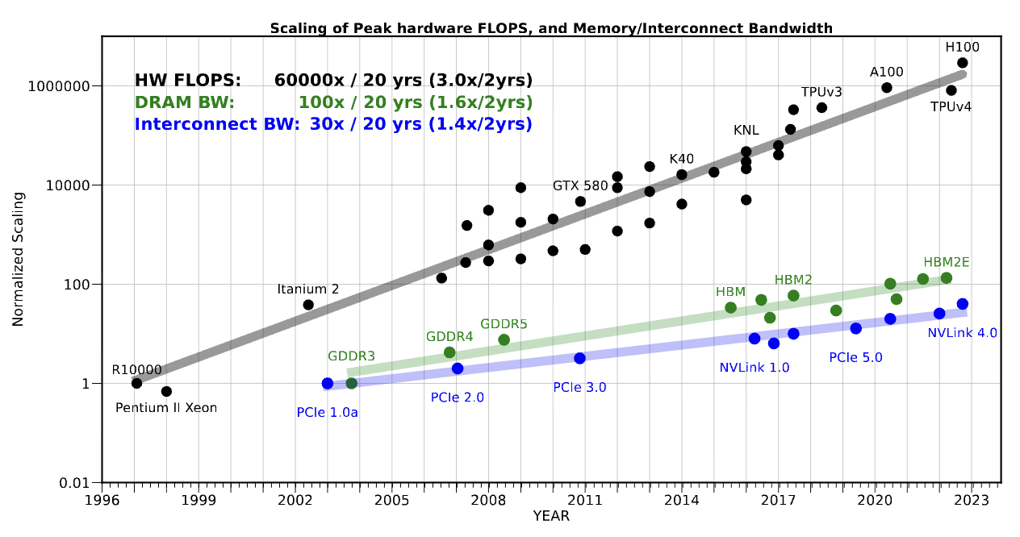
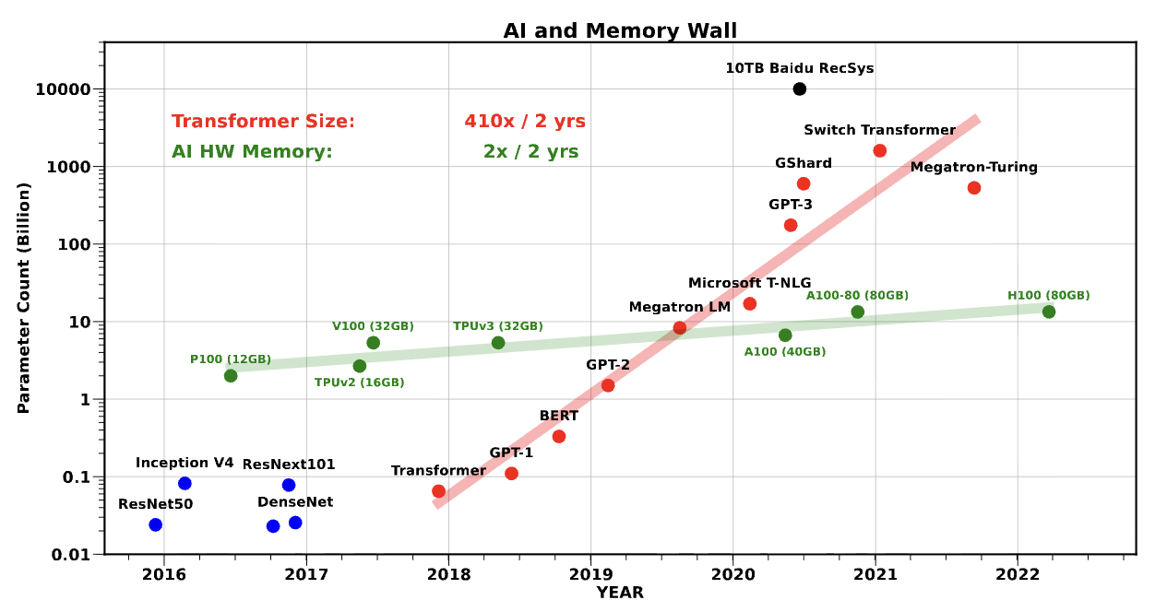
Memory Wall Crisis and Idle Compute
Imbalanced Hardware Development:
  Over the past 20 years, peak server compute has grown 3.0 x every two years, while DRAM memory bandwidth has only grown 1.6 x.
Large Language Model (LLM) Performance Bottleneck:
  In autoregressive decoding operations, arithmetic intensity is extremely low, GPU massive tensor cores are left data-starved.
The Only Way Out:
  Cannot rely solely on arithmetic instructions; compiler-level scheduling is needed to merge multiple memory accesses and reduce intermediate activation tensor reads/writes toHBM .
Gholami, A., Yao, Z., Kim, S., Hooper, C., Mahoney, M. W., & Keutzer, K. (2024). Ai and memory wall. IEEE Micro, 44(3), 33-39.

Slide 4
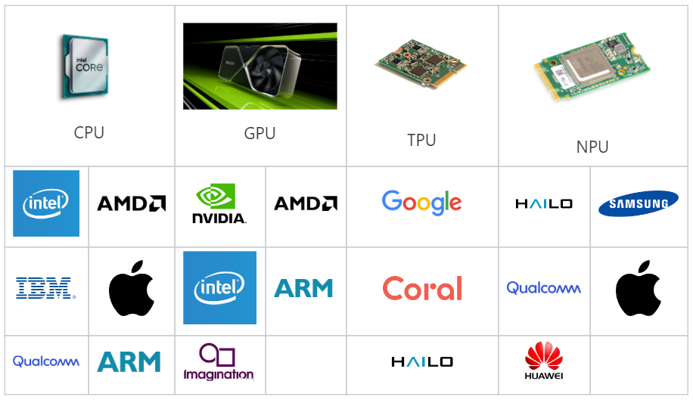
Operator Explosion and Hand-written Kernel Crisis
Operator Scale is Massive:
  In PyTorch framework, the number of core operators has exceeded 1200, including all overloads and variants reaching 3500+
Enormous Implementation Matrix:
  Over a thousand operators × multiple numeric types × fragmented target hardware (GPU, TPU, NPU）
Unsustainable Manual Optimization:
  Relying on hardware vendor engineers to hand-write CUDA C++ kernels to cover all combinations is not practically feasible at engineering scale
OperatorCategory | NumberofBaseOperators
TensorIterator(Pointwise&Reduction) | 505
Fixed(Fixed-dimensionComputation) | 273
Convolution(ConvolutionVariants) | 67
Pooling/BatchNorm | 57
Private/Foreach | 233
https://docs.google.com/spreadsheets/d/e/2PACX-1vQQFW0T_bucT5KZn0BHYTC1KYhkL6ZMG5ZxQWc6UmAkHUDYpqkpzXnsb59uv2TB0Jgc1Q6qO63bx6WQ/pubhtml#gid=1944851651
Notes:
单击此处添加文本

Slide 5
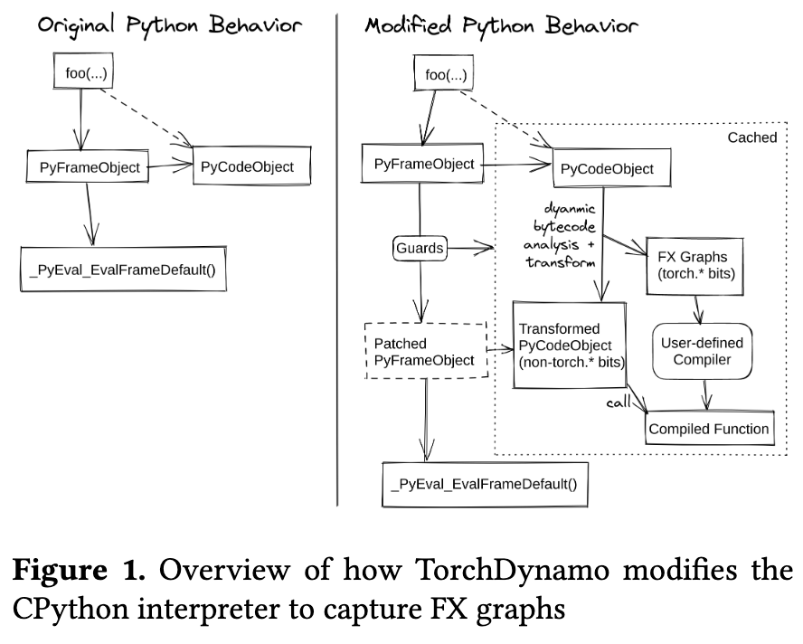
The Dilemma of Traditional Frameworks
Eager Mode Performance Bottleneck:
  Highly flexible and easy to debug, but each operator call must traverse the massive Python interpreter overhead; the framework can only see a single operator, losing the ability for global graph optimization (e.g., operator fusion).
Graph Mode Lacks Flexibility:
  To eliminate interpreter overhead, users must sacrifice Python native control flow, even requiring code rewrites.
Recompilation Problem:
  Early static tracing systems easily trigger repeated recompilation when facing dynamic shapes, negating the benefits of low-level optimizations.
https://docs.pytorch.org/assets/pytorch2-2.pdf

Slide 6
AI Model Development Facing Crises
Shift of the Core Contradiction in Computing:
  As large model parameters scale beyond trillions, the bottleneck shifts from pure algorithm design to the gap between hardware physical limits and software framework abstractions.
Three Intertwined Underlying Crises:
  Deep learning systems currently face "Memory Wal" problem, "Operator Explosion" problem, and the traditional execution mode dilemma between eager and graph modes problem.
AI The Rise of Compilers:
  AI Compiler technology has evolved from early graph optimization auxiliary tools into the core infrastructure that dominates computation graph capture, hardware scheduling, and machine code generation.

Slide 7
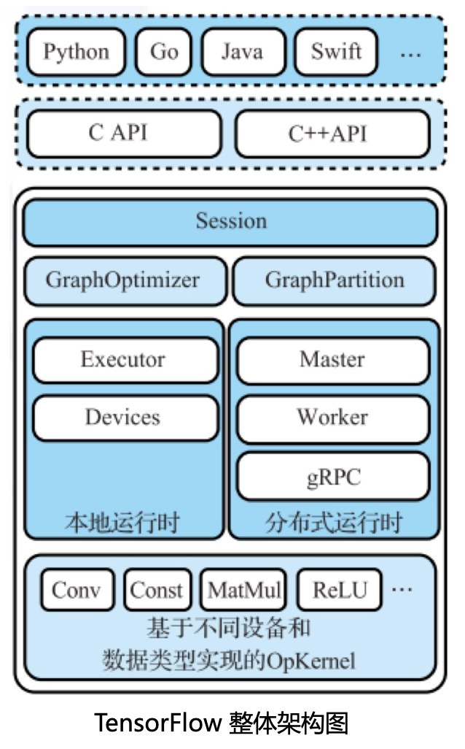
TensorFlow Introduction
Multiple Language Bindings
C/C++ Interface
TensorFlowBackend
  Runtime, Framework, Computation Graph, Graph Optimization, Compute Kernels, Compute Nodes
Different underlying hardwareOpKernel have different implementations
  CPU, GPU, Deep Learning Processor
参考自：《智能计算系统》

Slide 8
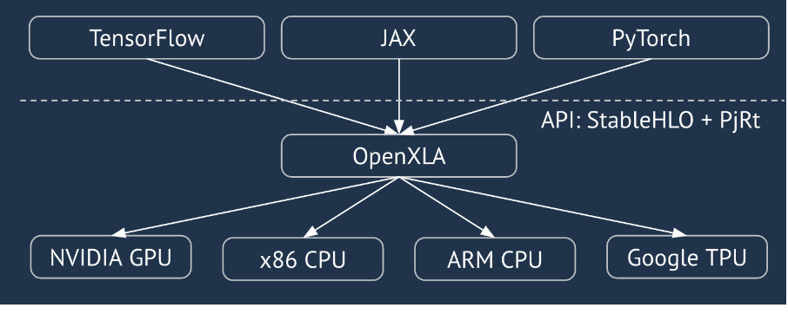
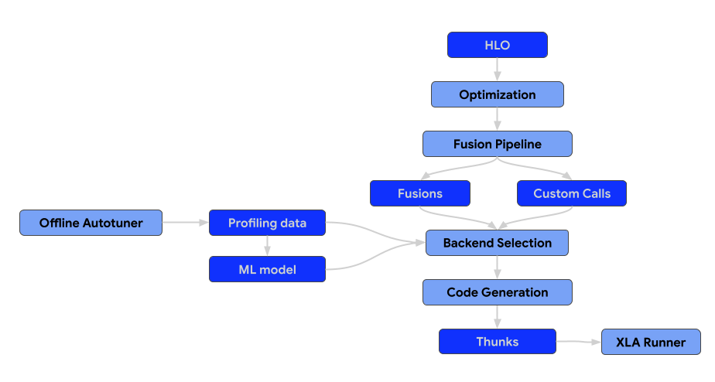
TensorFlow XLA Overview
Core Objective:
  Targeting TPU/GPU and other hardware platforms, performing extreme low-level hardware graph fusion on highly regular static computation graphs .
UnifiedFrontend-Backend Ecosystem:
  Aiming to provide PyTorch, JAX and TensorFlow with a unified high-performance backend featuring portability.
DesignGoals:
  Breaking free from frontend framework syntax constraints, building high-level graph abstractions to achieve mathematical semantic fidelity and global optimization.
https://openxla.org/xla/architecture?hl=zh-cn

Slide 9
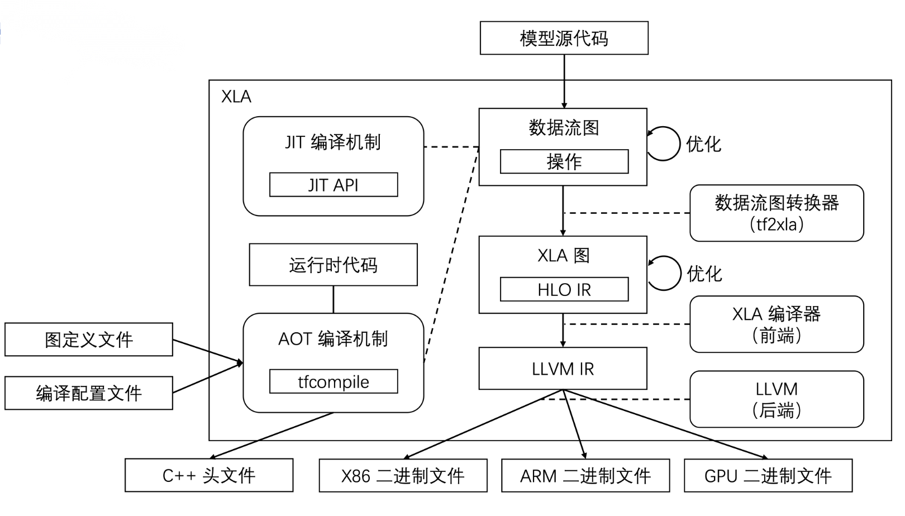
Multi-level IR Architecture and Graph Transformation
Hierarchical Lowering Mechanism:
  StableHLO (Cross-framework Protocol Layer) --> HLO (High-Level Optimizer Internal Representation) --> LLVM IR --> low-level machine code.
Hardware-Independent High-Level Graph Optimization:
  Performing algebraic simplification (Algebraic Simplifier, e.g., division to reciprocal multiplication), dead code elimination (CSE) etc..
HloRematerialization:
  Trading compute time for GPU memory space, proactively discarding inexpensive intermediate tensors and recomputing when needed, reducing peak GPU memory consumption for large models.
https://hku-systems.github.io/events/iscas2021/1-2-Hongbin%20Zhang%20MLIR.pdf

Slide 10
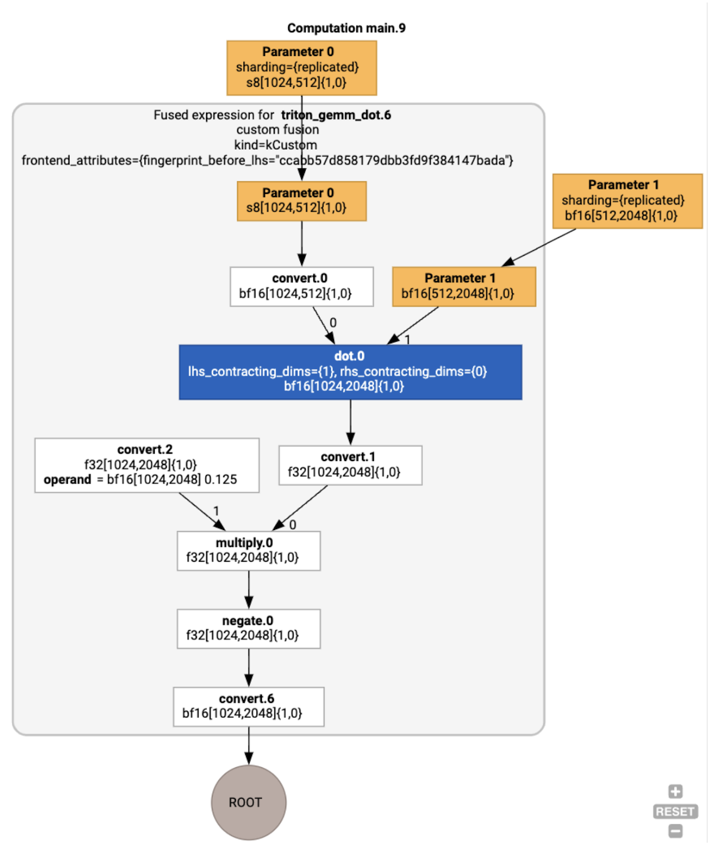
Core Optimization Technique: Operator Fusion
XLA can merge multiple HLO instructions and compile them into a single GPU Kernel, reducing kernel launch overhead.
inFusion Computation, intermediate temporary tensors typically do not need to be written back to off-chipHBM.
Data flows only within the GPU extremely fast registers or shared memory, bypassing memory access limitations.
https://openxla.org/xla/gpu_architecture?hl=zh-cn

Slide 11
XLA Optimization Pipeline
HLO Fusion Analysis
  kLoop (Loop Fusion): For element-wise operations with identical output shapes, chaining pure mathematical mappings per element and dispatching to parallel thread grids .
  kInput (Input Fusion): Allows reduction operators that significantly reshape data (Reduction) to pull upstream input operators for merging, mandating the reduction output as the computation endpoint .
  kOutput (Output Fusion): Specifically for merging high compute-density matrix multiplication operations with subsequent operators, maximizing cache utilization .
Hero Op Emitter Mechanism
  The compiler identifies the instruction with the greatest global performance impact and strictest scheduling requirements as the Hero Op，, which dominates the code generation strategy for the entire fused body.
  After emitter processing, it is converted to low-level LLVM IR, , and micro-architecture optimizations are performed based on specific hardware ISAs, including instruction pipeline scheduling and vectorization, ultimately generating executable PTX assembly or SPIR-V binary code .

Slide 12
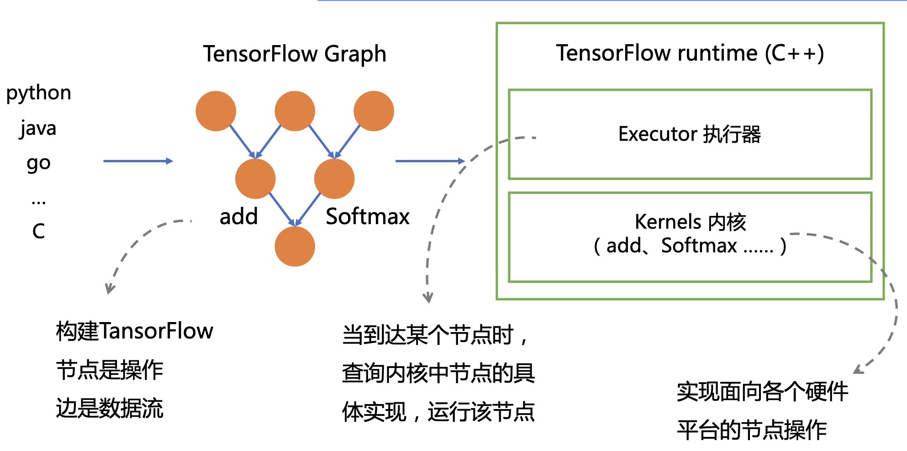
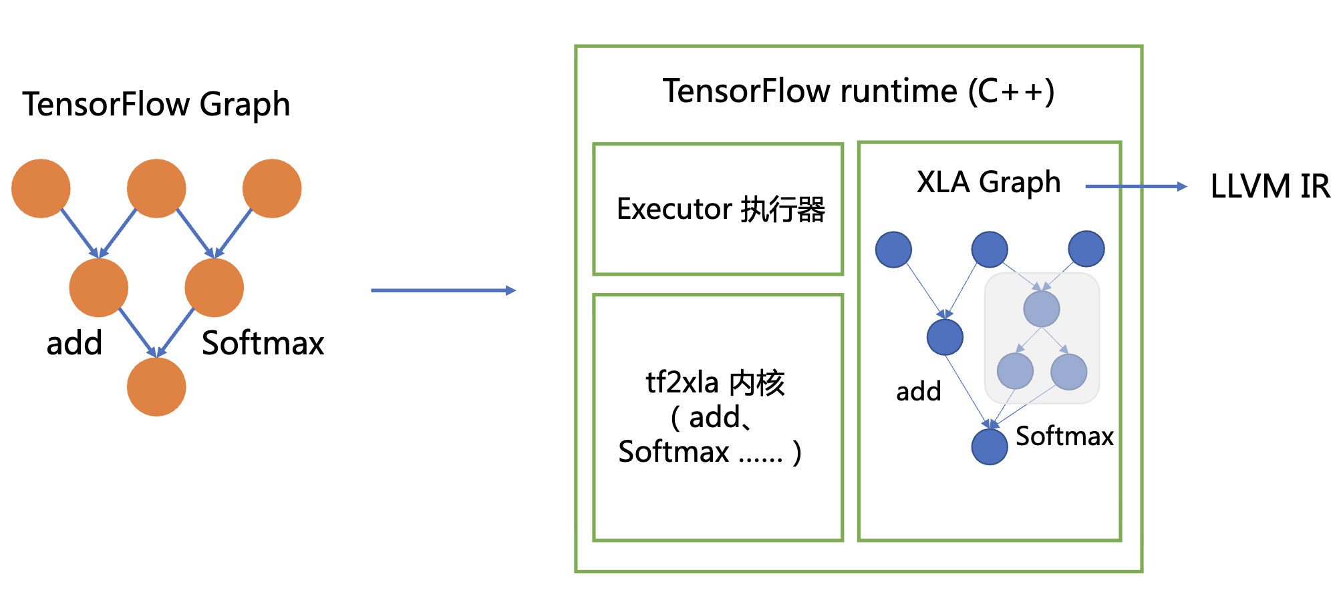
Using XLA to Accelerate TensorFlow
XLA: TensorFlow, Compiled!, TensorFlow Dev Summit 2017.

Slide 13
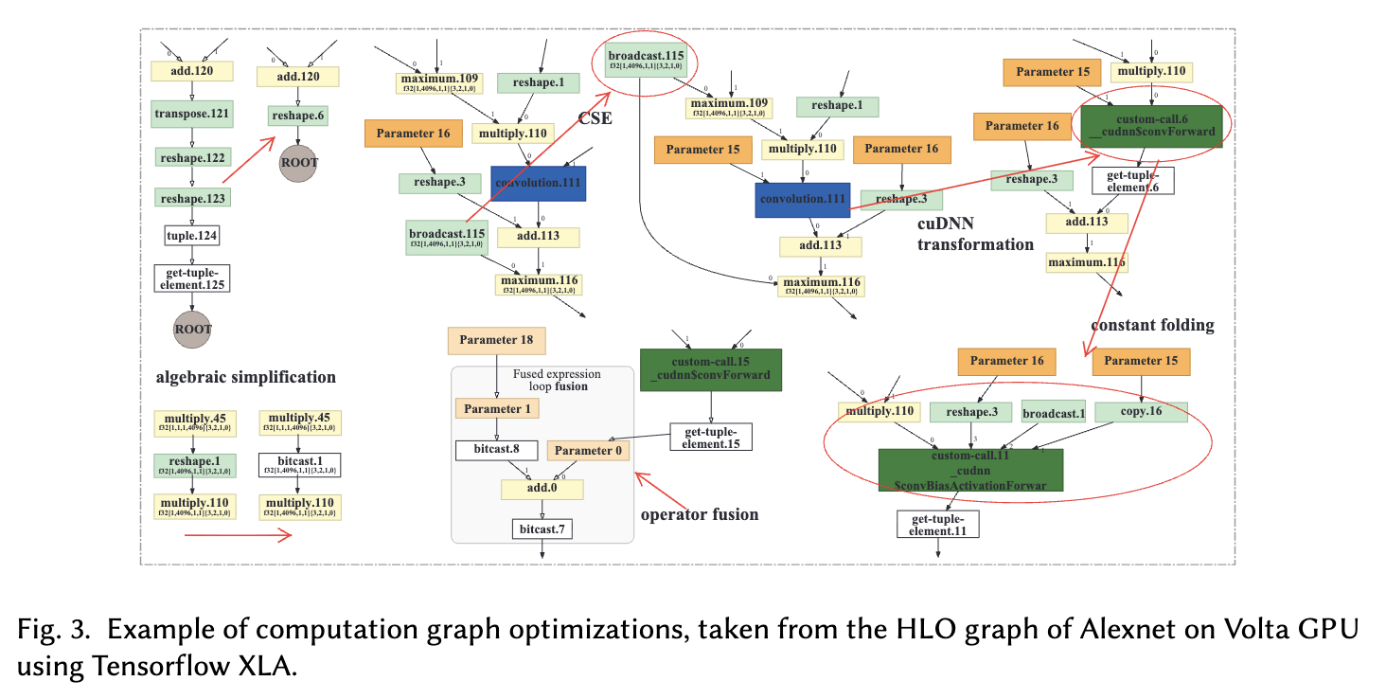
Example of optimizations using Tensorflow XLA
Li, Mingzhen, et al. "The deep learning compiler: A comprehensive survey." IEEE Transactions on Parallel and Distributed Systems 32.3 (2020): 708-727.

Slide 14
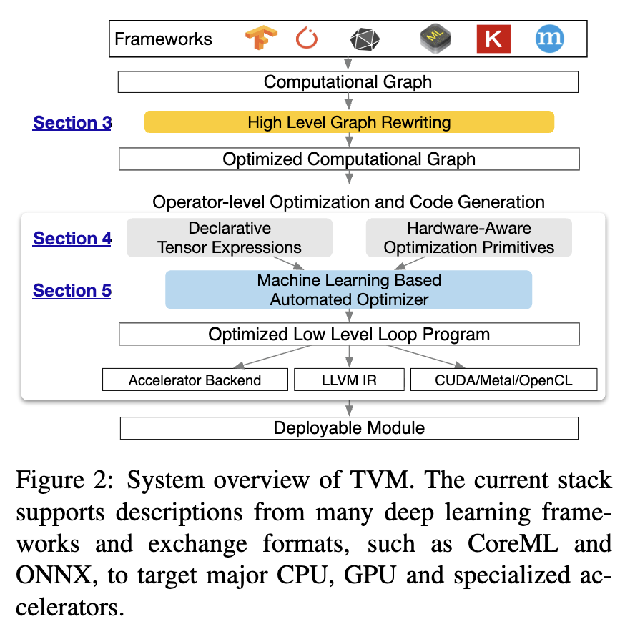
Apache TVM Overview
Addressing Full-Spectrum Hardware Fragmentation:
  XLA which targets cloud-scale clusters, TVM is committed to bridging the gap between CPU, ARM, GPU and various heterogeneous edge NPU architecture barriers.
Write once, run anywhere:
  Providing a unified compiler frontend framework, achieving seamless cross-platform high-performance deployment through hardware-specialized code generation.
Scheduling NP -Hard Challenge:
  Any tensor operation on specific hardware has nearly infinite loop unrolling and tiling strategy combinations, making it impossible to exhaustively find the optimal solution.
Chen, T., Moreau, T., Jiang, Z., Zheng, L., Yan, E., Shen, H., ... & Krishnamurthy, A. (2018). {TVM}: An automated {End-to-End} optimizing compiler for deep learning. In 13th USENIX symposium on operating systems design and implementation (OSDI 18) (pp. 578-594).

Slide 15
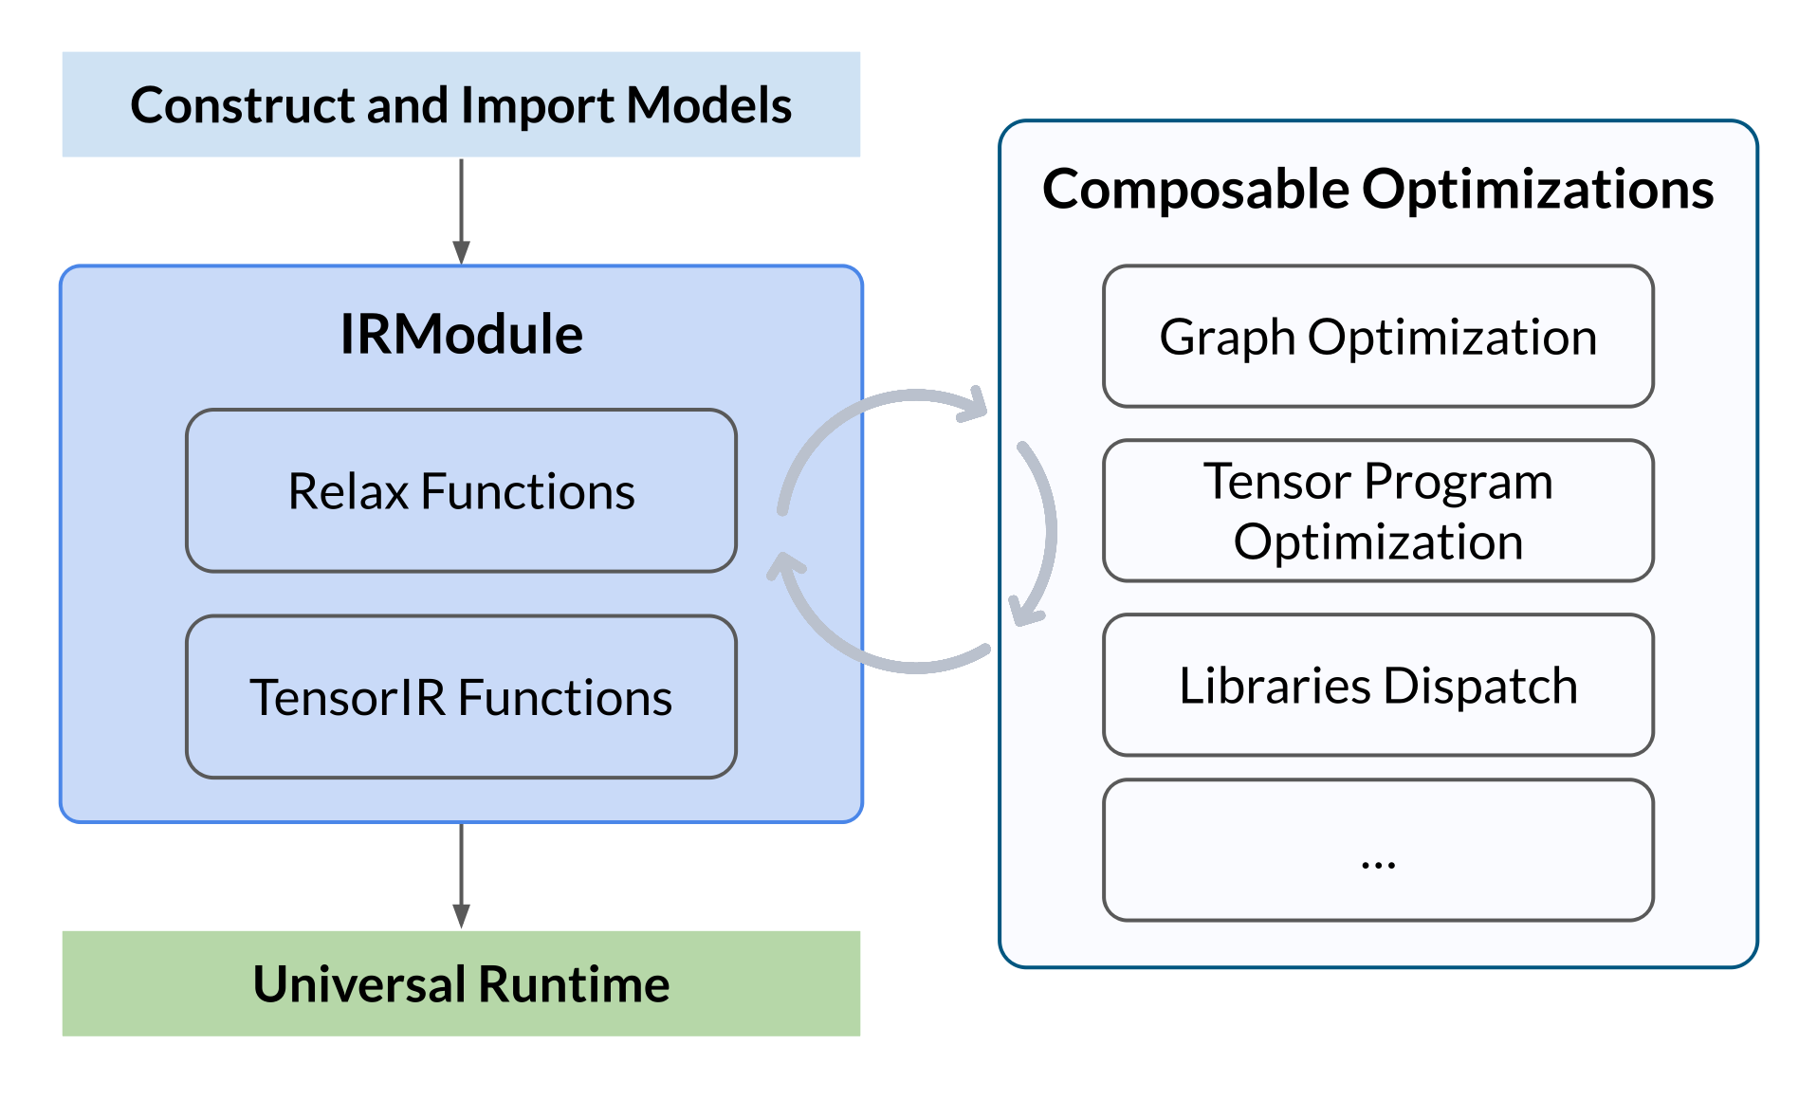
TVM Multi-level IR Architecture System
High-level Relay IR:
  Incorporating functional programming paradigms, managing coarse-grained dead code elimination, high-order operator fusion, and complex control flow graph optimization.
Low-level TIR (Tensor IR):
  Abandoning graph-layer concepts, translating operations into microscopic low-level nested loop structures, with fine-grained register and instruction mapping management .
TVM Unity and Relax Architecture:
  The next-generation system introduces symbolic shapes and allows high-level graph derivation and low-level loop primitives to coexist in the same module, enabling cross-level joint optimization.

Slide 16
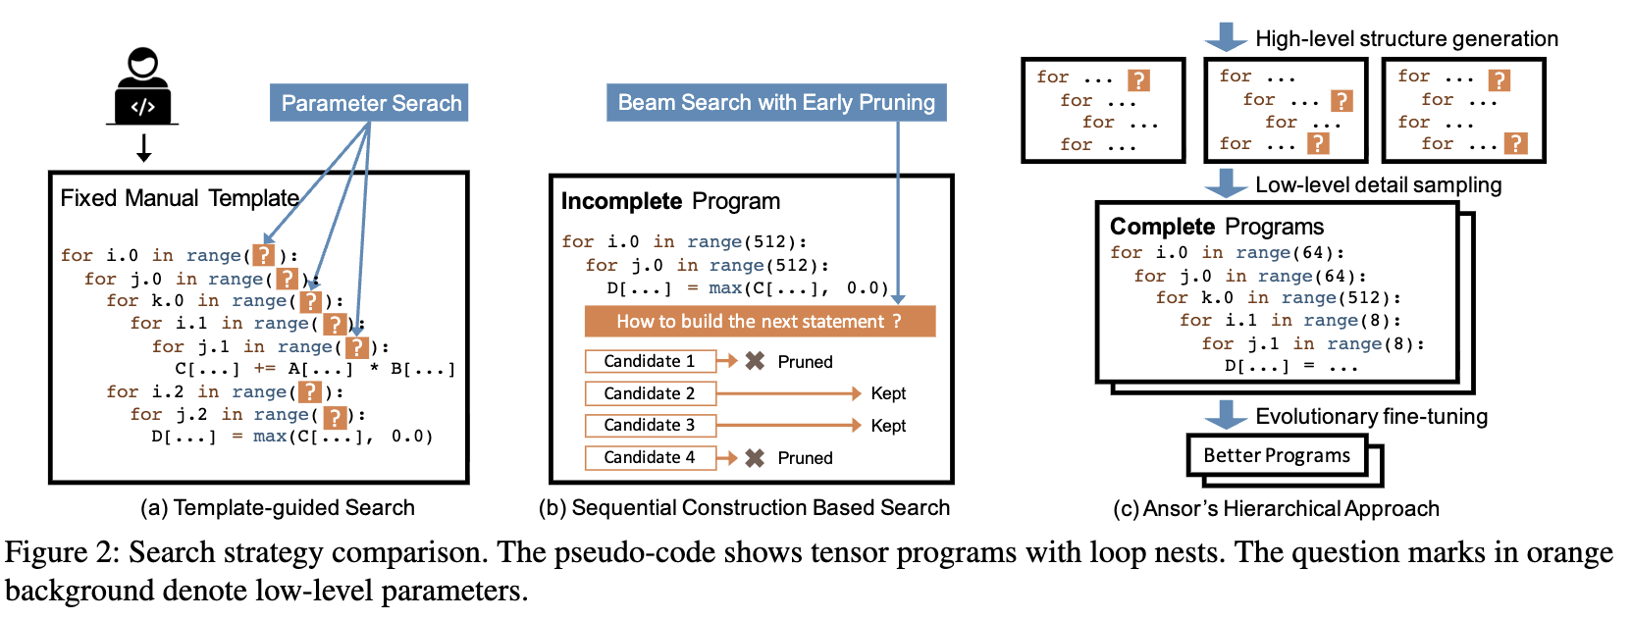
TVM Automated Scheduling
AutoTVM:
  Highly dependent on top hardware experts hand-writing scheduling templates; when encountering undefined new operators, development cost is very high.
Ansor (AutoScheduler) Architecture:
  Abandoning manual templates, automatically generating operator loop architecture frameworks from fundamental mathematical expression derivation rules.
Zheng, Lianmin, et al. "Ansor: Generating {High-Performance} tensor programs for deep learning." 14th USENIX symposium on operating systems design and implementation (OSDI 20). 2020.

Slide 17
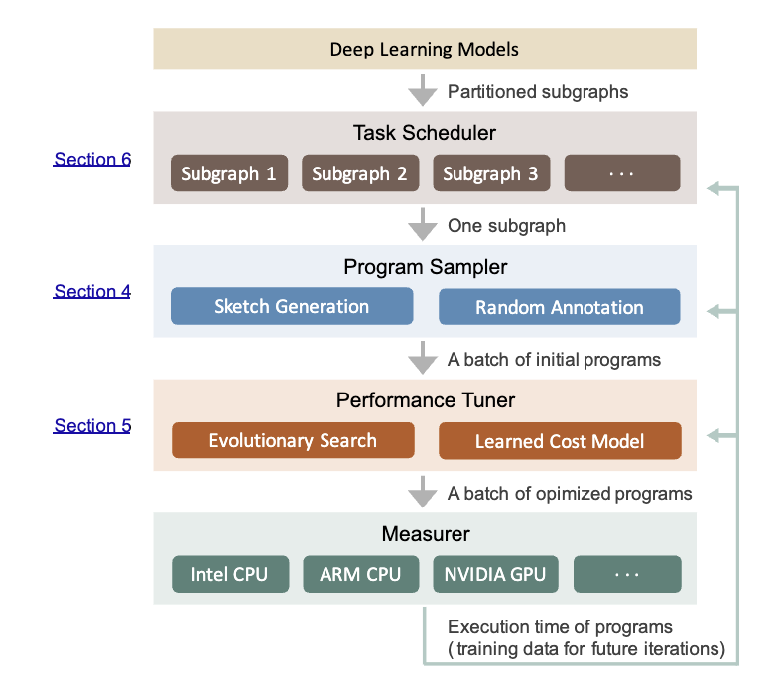
Ansor Hierarchical Search Space Construction
Sketch Generation: Ansor Constructing the program's macro-level skeleton by reverse topological traversal of the computation graph, recursively applying derivation rules.
Annotation Sampling: Building on sketches, Ansor performing random sampling in the annotation space to determine specific tile sizes, parallelization boundaries, loop unrolling limits, and other low-level configurations.
Introducing a machine learning GBDT cost model to rapidly predict and evaluate hardware throughput for scheduling strategies.
Employing evolutionary search algorithms: GBDT filters the Top-K Scheduling candidates and dispatches them to target hardware for actual benchmarking. Measured data is then used to fine-tune the GBDT model, progressively adapting it to the target hardware.
Zheng, Lianmin, et al. "Ansor: Generating {High-Performance} tensor programs for deep learning." 14th USENIX symposium on operating systems design and implementation (OSDI 20). 2020.

Slide 18
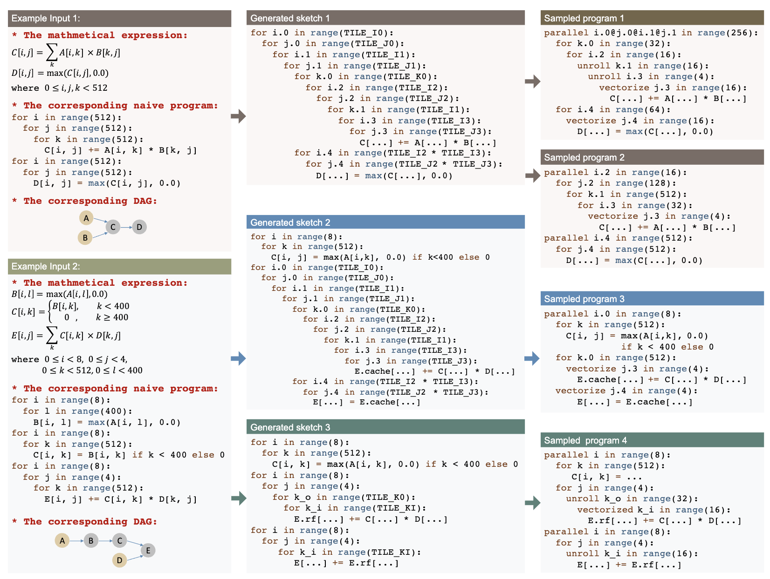
Examples of generated sketches and sampled programs
Zheng, Lianmin, et al. "Ansor: Generating {High-Performance} tensor programs for deep learning." 14th USENIX symposium on operating systems design and implementation (OSDI 20). 2020.

Slide 19
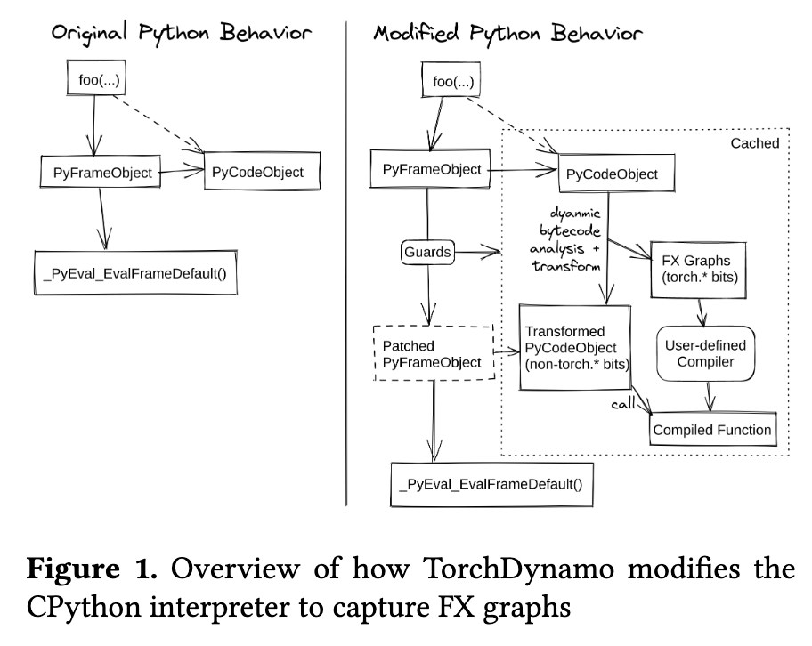
TorchDynamo Overview
Eager Mode Pros and Cons:
  PyTorch define-by-run mechanism is highly flexible and well-loved by researchers . However, the framework can only see one operator at a time, making cross-operator graph-level optimization (e.g., operator fusion, memory scheduling) difficult.
Compromises of Previous Approaches:
  TorchScript: Attempts static parsing of Python AST, facing“all-or-nothing” dilemma, easily failing because it doesn't support complete Python semantics .
  Lazy Tensors: High runtime overhead, delaying low-level kernel launch and causing frequent recompilation .
TorchDynamo Core Motivation:
  As a Python -level Just-In-Time compiler, the goal is to achieve Python graph compilation without sacrificing any PyTorch flexibility .
Ansel, Jason, et al. "Pytorch 2: Faster machine learning through dynamic python bytecode transformation and graph compilation." Proceedings of the 29th ACM international conference on architectural support for programming languages and operating systems, volume 2. 2024.

Slide 20
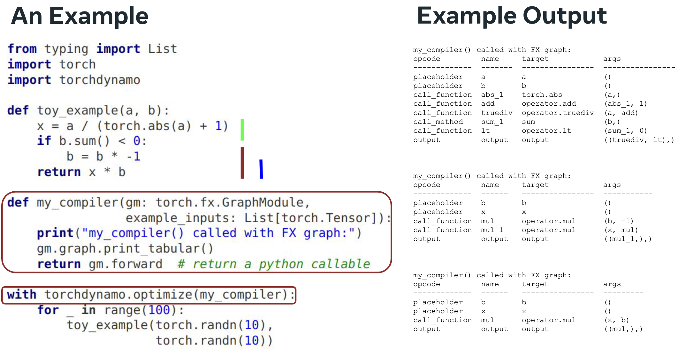
TorchDynamo Example
https://chips-compilers-mlsys-22.github.io/assets/slides/PyTorch%20Compilers%20(Compiler%20&%20Chips%20Symposium%202022).pdf

Slide 21
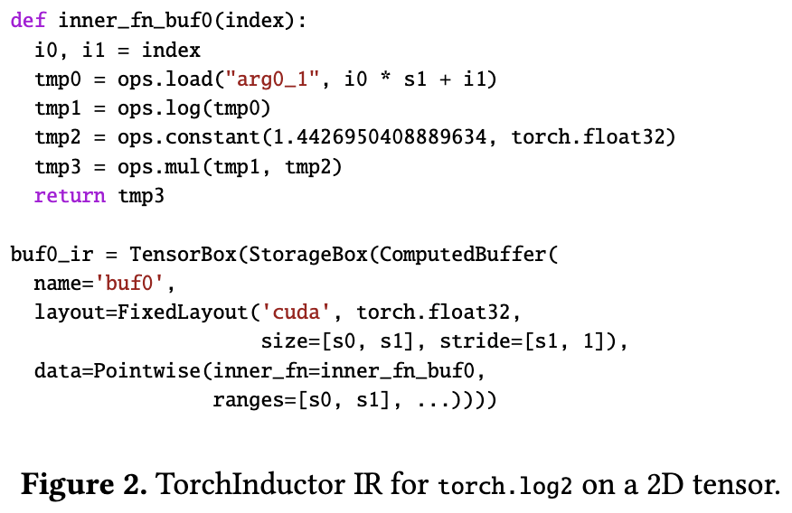
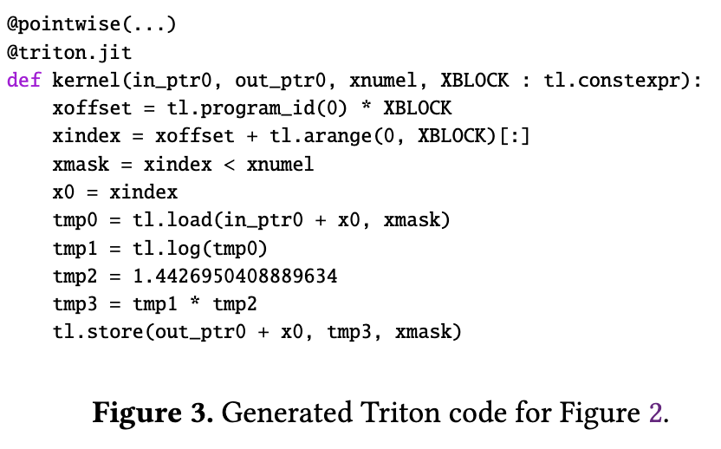
Frame Evaluation Bytecode Transformation
PEP 523 Extension Point:
  TorchDynamo delves deep into CPython internals, leveraging the PEP 523 -introduced frame evaluation API eval_frame .
DynamicInterpretation and Rewriting:
  in CPython to create PyFrameObject , TorchDynamo replaces the default interpreter loop, instead performing JIT compilation on the Python bytecode about to be executed JIT compilation .
FX Graph Extraction:
  By rewriting bytecode, PyTorch operation sequences are extracted as backend input (FX Graph).
Ansel, Jason, et al. "Pytorch 2: Faster machine learning through dynamic python bytecode transformation and graph compilation." Proceedings of the 29th ACM international conference on architectural support for programming languages and operating systems, volume 2. 2024.

Slide 22
Lecture 20: Intermediate Representation (IR) Fundamentals

Slide 23
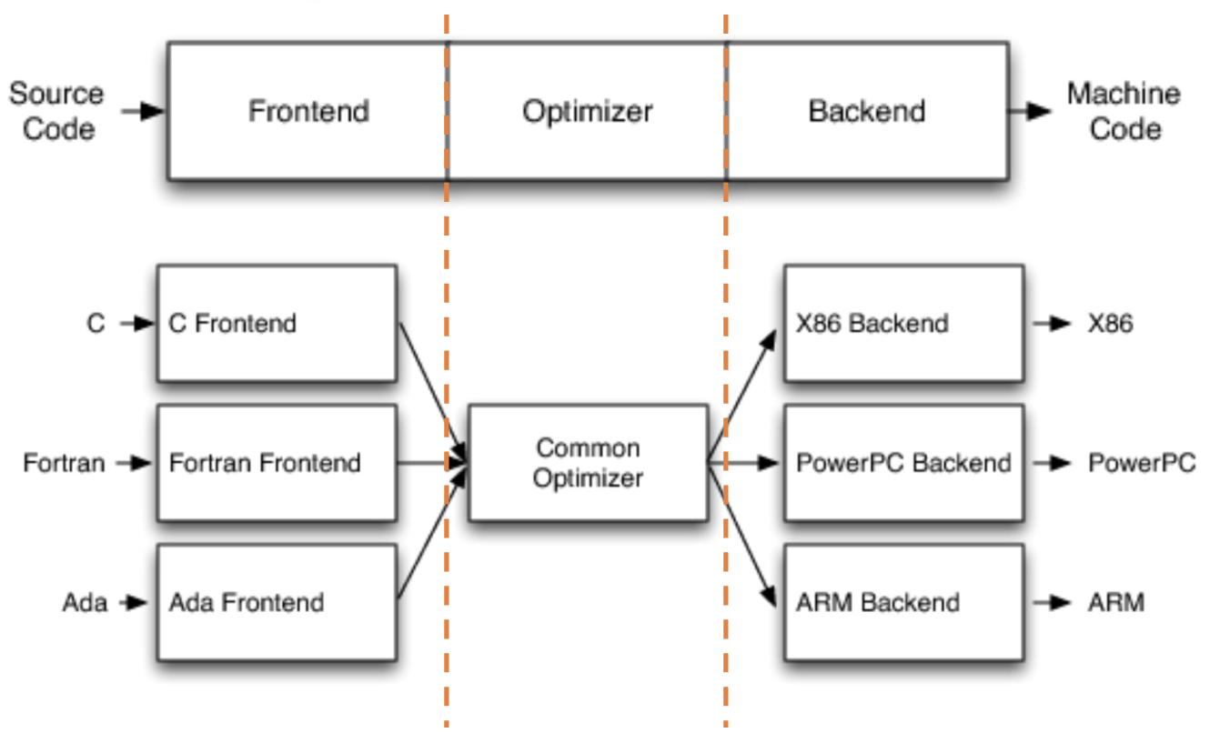
Deep Learning Compilation Framework
Frontend
  Lexical and Syntactic Analysis, AST Construction, Semantic Checking, IR Transformation
Middle-End//Optimizer
  Performing various IR -level optimizations
Backend
  Instruction Selection, Register Allocation, Code Generation
LLVM, Chris Lattner, http://aosabook.org/en/llvm.html

Slide 24
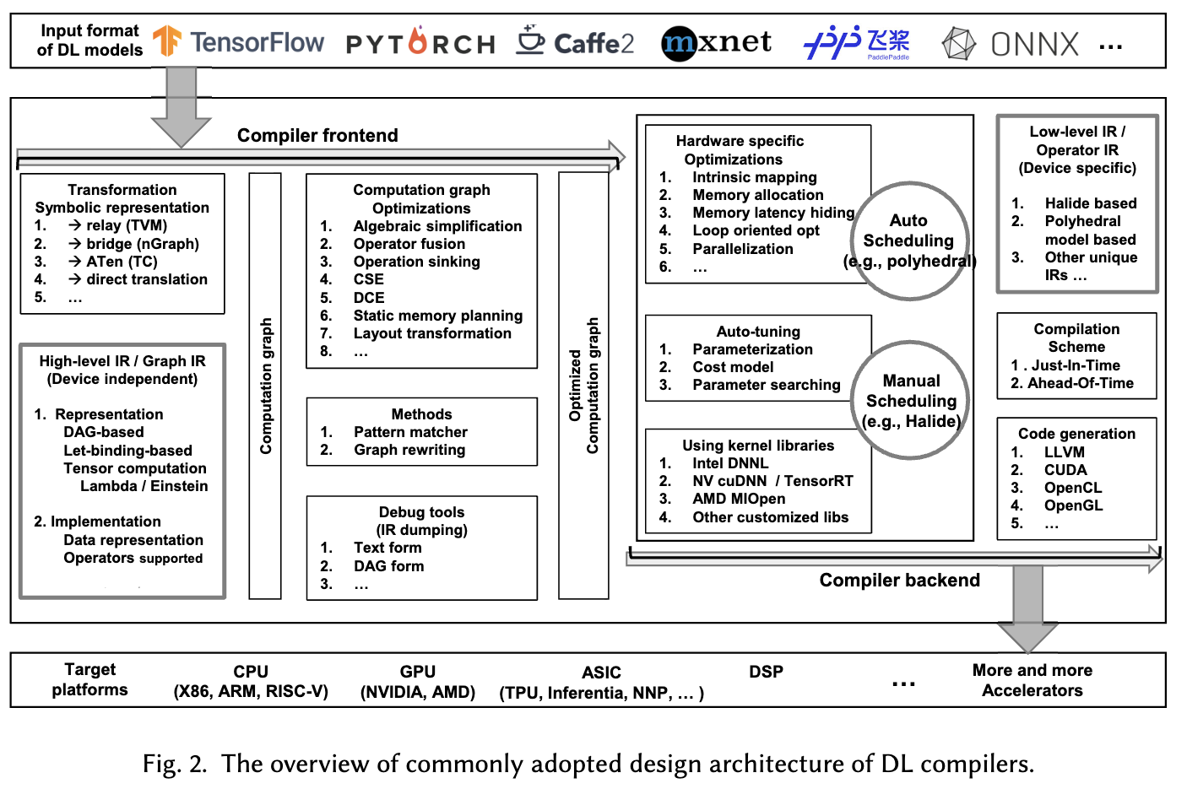
IR Design Goals
Decoupling Hardware Constraints:
  In modern software development, there is a huge semantic gap between frontend languages and underlying hardware.
  IR 's core role is to completely decouple high-level framework intent from low-level silicon instructions.
Resolving the Catastrophic M x N Problem:
  Suppose there are M deep learning frontend frameworks and N different hardware accelerators.
  Without a unified IR, the industry would need to develop M x N independent compilers.
  After introducing a standard IR , only M frontend translators and N backend code generators, reducing engineering complexity to M + N.
Li, Mingzhen, et al. "The deep learning compiler: A comprehensive survey." IEEE Transactions on Parallel and Distributed Systems 32.3 (2020): 708-727.

Slide 25
IR Design Goals
Preserving High-Level Semantics, Rejecting Premature Lowering
Value of Semantic Information:
  In traditional general-purpose compilers (e.g., GCC/LLVM), an operation is typically lowered to scalar loops and pointer arithmetic. But in deep learning IR , a 2D convolution must be preserved as an atomic conv2d(input, weight) nodes .
Foundation for Global Optimization:
  If neural network operations are prematurely lowered to for loops, the compiler loses the“this is a convolution” macro-level understanding, preventing invocation of convolution-specific hardware acceleration libraries.
Macro-Level Graph Optimization:
  Leveraging this high-level semantic-preserving IR data structure, the compiler can perform computation graph-level algebraic simplification, operator fusion, and memory planning from a global perspective .

Slide 26
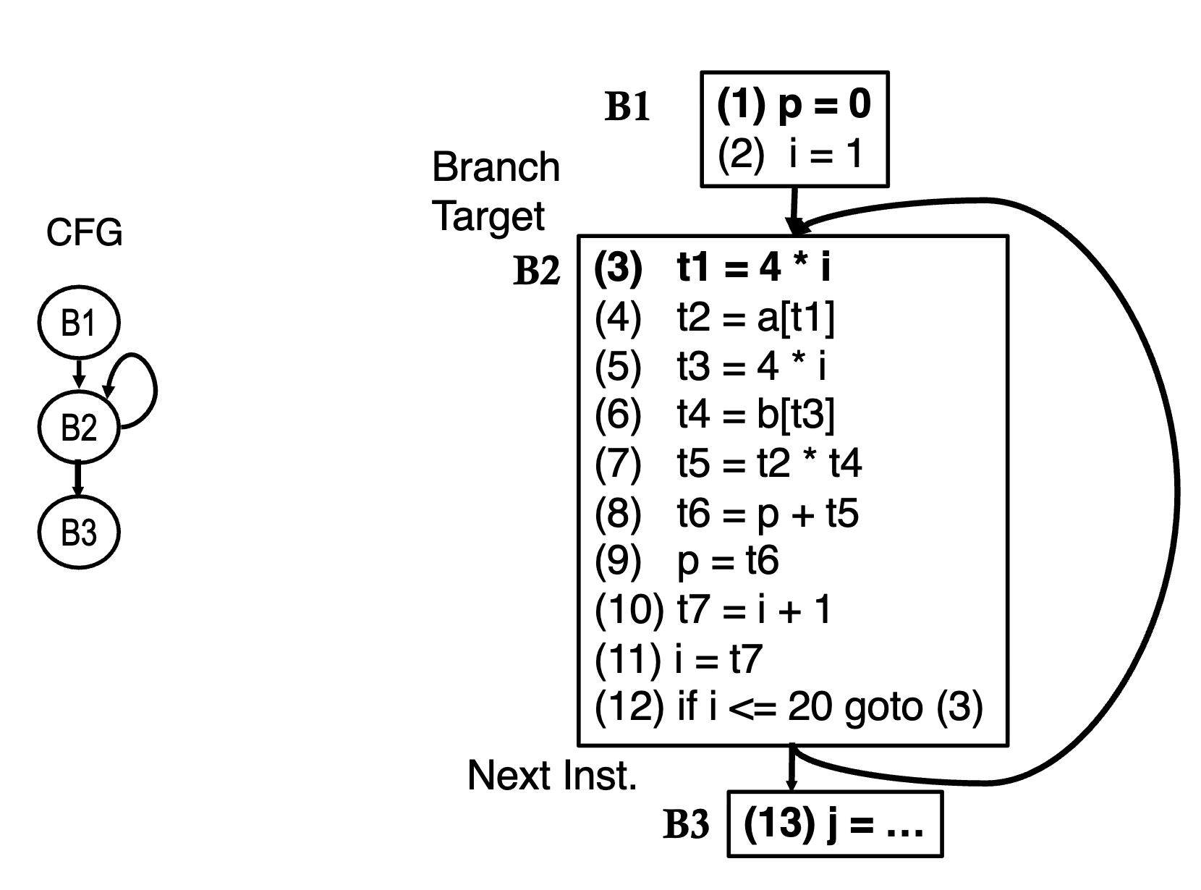
Execution Model — Control Flow Graph (CFG)
Program Counter-Based (PC) Traditional Logic
  Node Definition: as Basic Blocks (Basic Blocks): Graph nodes are segments of“branch-free” continuous straight-line instruction sequences. Once entered, instructions execute from beginning to end.
  Graph Edgesas Control Flow Directions: Directed edges in the graph represent the temporal execution sequence logic and jump targets (corresponding to if/else, while, for and other control statements in high-level languages).
  Execution Driving Mechanism: Highly dependent on the von· Neumann architecture's core program counter (PC）.
https://www.csl.cornell.edu/~zhiruz/5997/pdf/lecture04.pdf

Slide 27
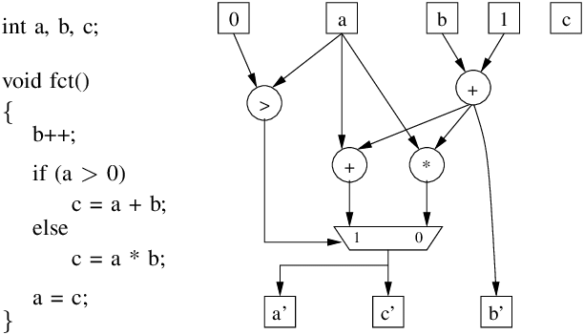
Execution Model — Data Flow Graph (DFG)
Data-Driven Computation Discarding Temporal Ordering
  Node Definition: Mathematical Operations: Graph nodes are no longer basic blocks but represent specific mathematical operations or primitives.
  Graph Edgesas Data Lifecycles: Directed edges represent the pure mathematical dependencies and flow paths of data (i.e., multi-dimensional tensors in deep learning) between operation nodes.
  Execution Driving Mechanism: Completely discarding code-line sequential constraints. The sole condition for triggering a computation node is: all its required upstream input data is ready.
https://www.researchgate.net/figure/Data-flow-graph-example_fig2_224517165

Slide 28
CFG v.s. DFG
Characteristic | Control Flow Graph (CFG) | Data Flow Graph (DFG)
Core Modeling Object | Program execution order and logical branch paths. | Data value transfer paths and mathematical operation dependencies.
Graph Nodes (Nodes) Represent | Basic blocks (contiguous instruction sequences without branches). | Mathematical operators (e.g., matrix multiplication, convolution).
Graph Edges (Edges) Represent | Control flow directions, loop jumps, conditional branch targets. | Data definition (output) flowing to data usage (input).
Execution Trigger Condition | Program counter (PC) sequentially pointing to the node. | All required upstream input data has been computed and is ready.
Parallelization Potential | Very low. Constrained by strict instruction execution order and hard-to-predict branches. | Very high. Naturally exposes maximum parallelism at both operator and instruction levels.
Typical Application Scenarios | General software, OS kernels, business logic control. | Deep learning tensor computation graphs, digital signal processing.
Generated by Gemini 3.1 Pro.

Slide 29
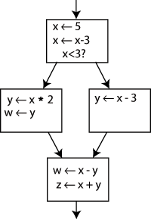
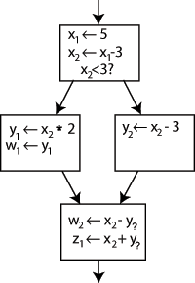
Static Single Assignment (SSA) Form
The Nightmare of Traditional Code:
  Variables can be repeatedly overwritten (e.g., x = 1; x = x + 1), making it difficult for the compiler to track “which line generated the current x ” .
SSA Requirement:
  in SSA form, the IR , every variable in the program can be assigned exactly once throughout its entire lifetime .
  Version Splitting Mechanism: If a variable is assigned multiple times in the original code, the compiler automatically generates multiple new versions with incrementing subscripts (e.g., $x_1, x_2, x_3$）.
  Functional Transparency: in SSA , “a variable name” is equivalent to“the unique instruction that produced it”, making the code mathematically unambiguous .
https://en.wikipedia.org/wiki/Static_single-assignment_form

Slide 30
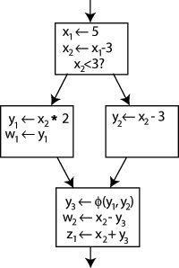
Φ (Phi) Function
Logical Conflict:
  When execution flow passes through if/else branches and reconverges at a basic block, which version of the variable should subsequent code use? (e.g., if if produces x_1, else produces x_2）.
Φ Function (Phi-node):
  To maintain the SSA single-assignment rule, the compiler inserts a virtual instruction at the join point, e.g., x_3 = Φ(x_1, x_2) .
Runtime Dynamic Routing:
  Φ function acts as a multiplexer. During actual program execution, it selects the correct source variable based on which control flow edge was taken (x_1 or x_2), and assigns the value to a brand new variable x_3.
https://en.wikipedia.org/wiki/Static_single-assignment_form

Slide 31
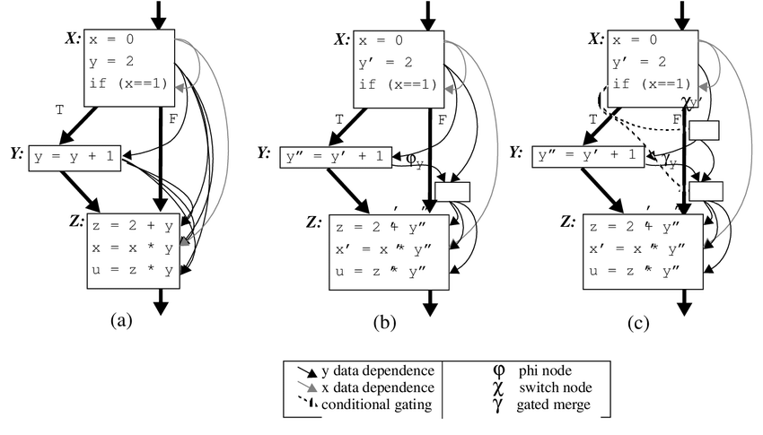

Def-Use chains
Traditional Non- SSA Combinatorial Explosion:
  Since state can be overwritten, finding all possible sources of a variable requires complex bit-vector dataflow analysis, with time and space complexity reaching macroscopic O(N^2).
  State Transfer Equations:
SSA O(N) Complexity:
  For any variable usage (Use), its uniquely corresponding source definition (Definition) in the code is absolutely determined.
  Every variable definition point can clearly hold a list directly pointing to all its use points in the global graph
https://www.researchgate.net/figure/Comparison-of-data-flow-representations-a-def-use-chains-b-SSA-and-c-Gated_fig4_2729044

Slide 32
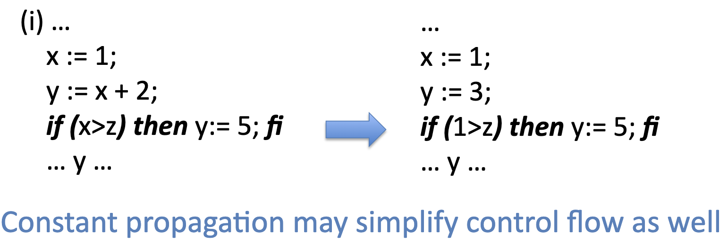
SSA inConstant Folding and Propagation
Concept: Pre-computing at compile time expressions that would otherwise be computed at runtime.
SSA 's: When the compiler encounters y = x + 2 , it can be directly folded to 3. Because SSA guarantees that x 's value will never be accidentally altered downstream.
Constant Propagation (Constant Propagation): Following the SSA -provided O(N) complexity DU chain, the compiler can propagate this constant 3 to all places in the global graph using y and replace them, significantly reducing computation and potentially simplifyingcontrol flow.
https://www.cs.utexas.edu/~pingali/CS380C/2013/lectures/ssa-slides.pdf

Slide 33
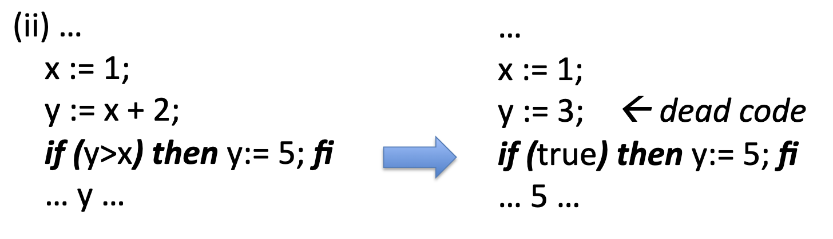
SSA inDead Code Elimination
Concept: Removing redundant instructions whose computation results never substantively impact the final program output.
in SSA , identifying dead code becomes a simple operation:: If an SSA variable's Use-chain list is empty, it is eliminable dead code.
Cascading Elimination Effect: After removing the node, its upstream input variables' use-chains also become empty, causing dead code marking to propagate backward through the graph instantly, triggering cascading elimination. This is crucial for cleaning up the massive redundant nodes generated by automatic differentiation (Autograd) .
https://www.cs.utexas.edu/~pingali/CS380C/2013/lectures/ssa-slides.pdf

Slide 34
Computation Graph Optimization Techniques
Core Objective:
  Improving hardware execution efficiency, reducing GPU memory usage, and minimizing kernel (Kernel) launch overhead while preserving model mathematical equivalence .
Optimization Level Hierarchy:
  Node-level Optimization (Node-level): Examining individual computation nodes in isolation .
  Block-level Optimization (Block-level): Analyzing adjacent node sequences or computation blocks .
  Dataflow//Graph-level Optimization (Dataflow/Graph-level): Macro-level optimization surveying the global topology .

Slide 35
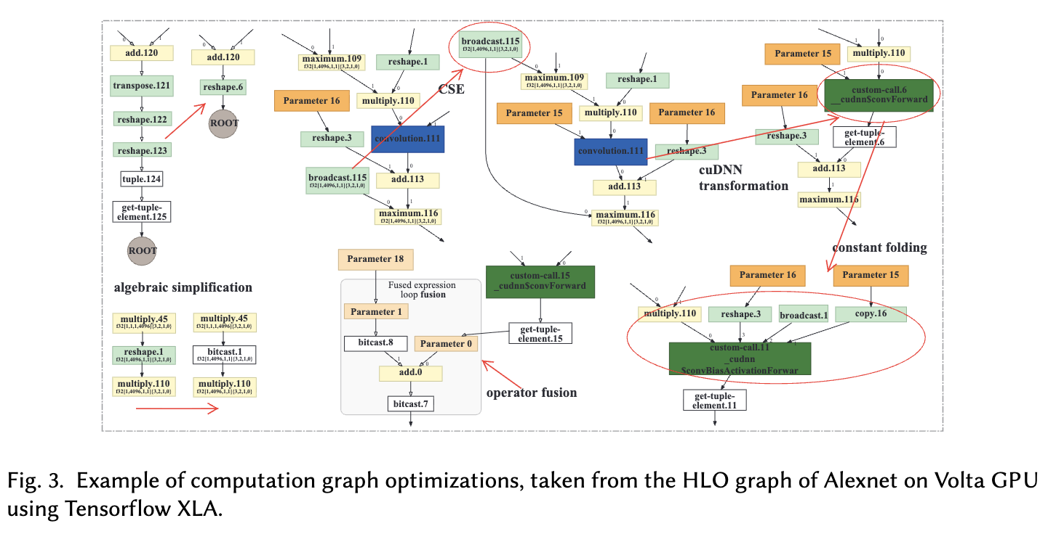
Computation Graph Optimization Techniques

Slide 36
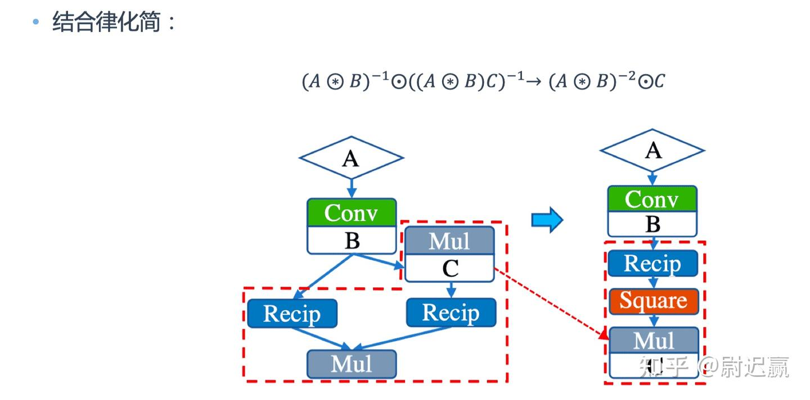
Computation Graph Optimization Techniques
Node-level Optimization Nop Elimination (Nop Elimination): Removing redundant nodes that have no substantive impact on results.
  Zero-dim-tensor Elimination (Zero-dim-tensor Elimination): Safely removing computations on tensors with shape 0 (e.g., shape=(0, 5, 3))'s computation.
Block-level Optimization:Algebraic Simplification
  Concept: Using mathematical rules such as commutativity, associativity, and distributivity to replace complex local node sequences with computationally cheaper equivalent forms .
  Constant Folding (Constant Folding): Identifying all constant expressions known at compile time, pre-computing the results, and folding them into a single constant value in the graph .
https://zhuanlan.zhihu.com/p/661774755

Slide 37
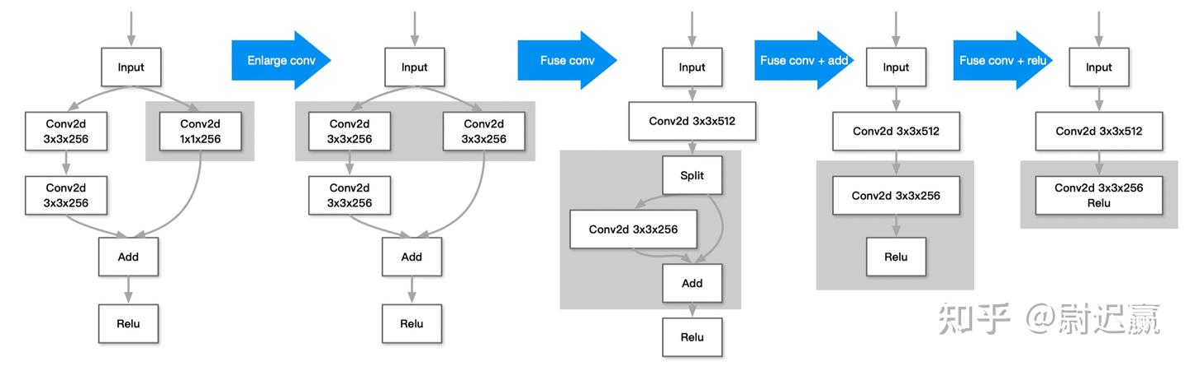
Computation Graph Optimization Techniques
Block-level Optimization:Operator Fusion
  Problem: Each small operator needs to read/write data from global memory, causing memory bandwidth bottleneck and GPU Kernel launch latency.
Vertical Fusion:
  Merging sequentially dependent operations into a single Kernel, with data flowing directly through registers, reducing global memory accesses.
Horizontal Fusion:
  Merging adjacent operators that can be processed in parallel into a single Kernel, improving the utilization of underlying hardware compute units.
https://zhuanlan.zhihu.com/p/661774755

Slide 38
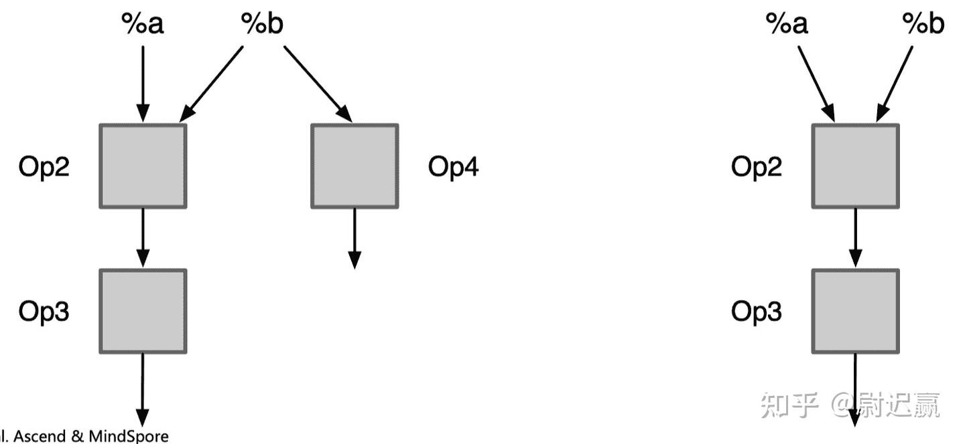
Computation Graph Optimization Techniques
Graph-level Optimization:Dataflow Structure Reshaping
  Common Subexpression Elimination (Common Subexpression Elimination, CSE): Identifying identical substructures repeatedly computed in the graph, replacing them with references to a single common output to avoid wasting computational resources.
  Dead Code Elimination (Dead Code Elimination, DCE): Combining Def-Use chain analysis, from the graph deleting useless operation branches .
  Operator Sinking (Operator Sinking): Deferring certain dimension transformation operations (e.g., Transpose) along the graph's dataflow direction to merge potential subsequent redundant transformation operations.
https://zhuanlan.zhihu.com/p/661774755

Slide 39
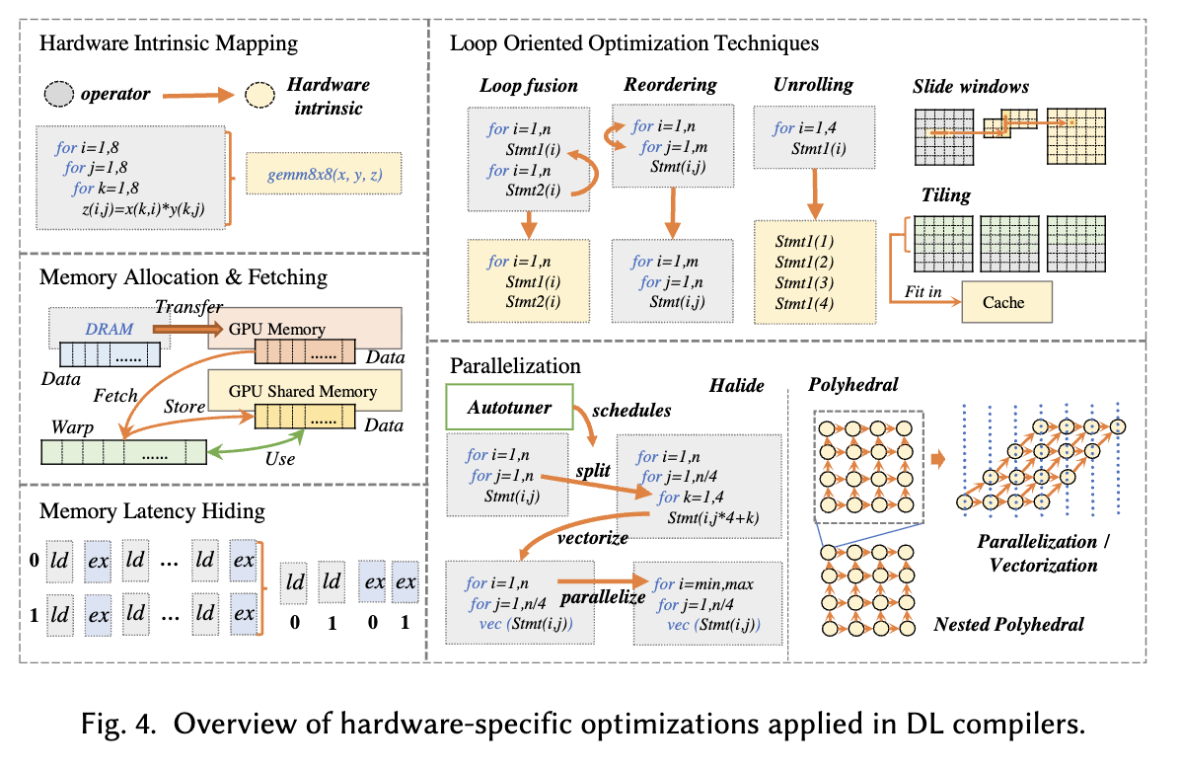
Hardware-RelatedOptimization
Li, Mingzhen, et al. "The deep learning compiler: A comprehensive survey." IEEE Transactions on Parallel and Distributed Systems 32.3 (2020): 708-727.

Slide 40
Lecture 21: In-Depth Analysis of the MLIR Architecture

Slide 41

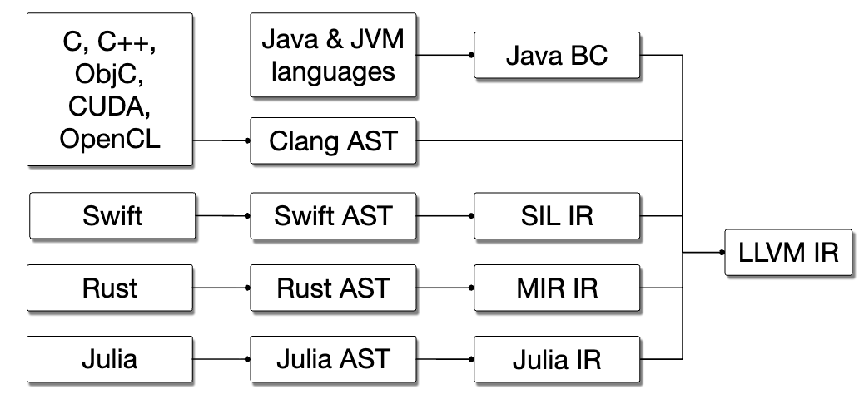
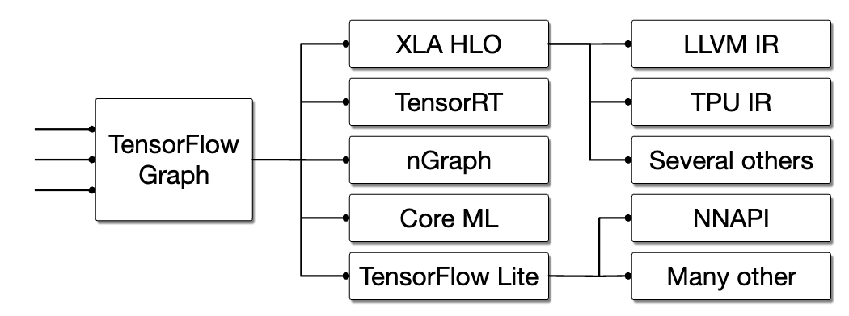
LLVM IR Limitations
General Overview
  Design: LLVM IR semantic level is roughly equivalent to“ C with vector operations C language” .
  (Multi-Level Intermediate Representation)
  Memory Model: Assumes a flattened, linear memory model, primarily operating on scalars, memory pointers, and 1D vector registers.
Deep Learning Computation Graph
  is inherently high-dimensional multi-dimensional tensor algebra and deeply nested loops, creating a huge semantic gap between the two.
  Forced Flattening: TensorFlow/PyTorch and other high-level frameworks directly lowering to LLVM IR , multi-dimensional tensors are forcefully flattened into 1D memory pointers.
  Control Flow Destruction: High-level loop tree structures are destroyed, converted to implicit flat CFG and conditional branch jumps.
https://en.wikipedia.org/wiki/LLVM
Lattner, Chris, et al. "MLIR: A compiler infrastructure for the end of Moore's law." arXiv preprint arXiv:2002.11054 (2020).

Slide 42
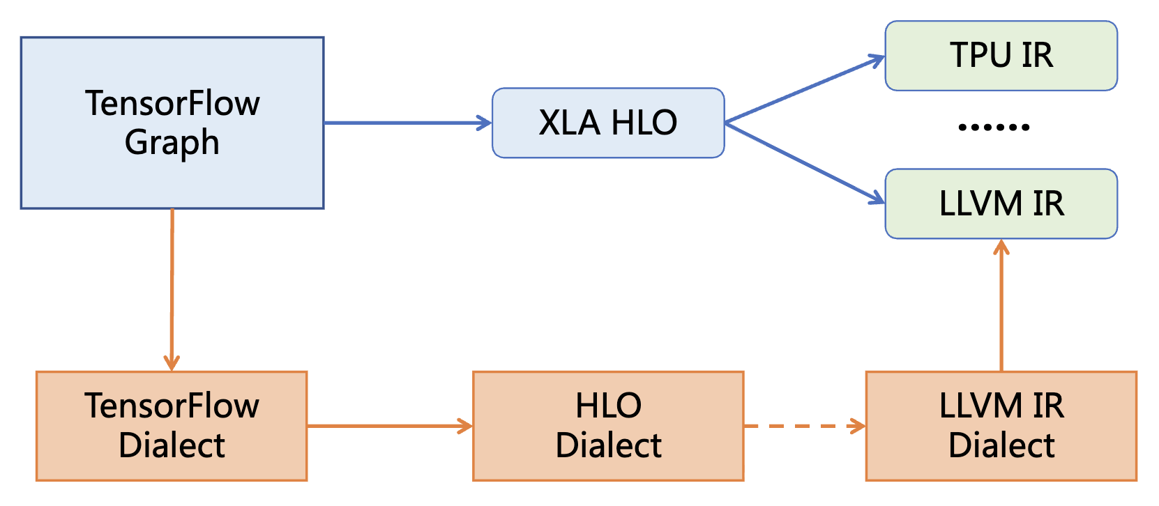
MLIR Architecture
MLIR A reusable, extensible open-source compilation infrastructure framework
  Addressing software fragmentation
  Support for compilation targeting heterogeneous hardware
  Reducing overhead for domain-specific compiler development
  Connecting existing various compilers
MLIRWhy Can Solve the Problem
  Unified syntax, reusable components
  Shared ecosystem, coordinated optimization across levels
  Small gaps between levels, easy to implement

Slide 43
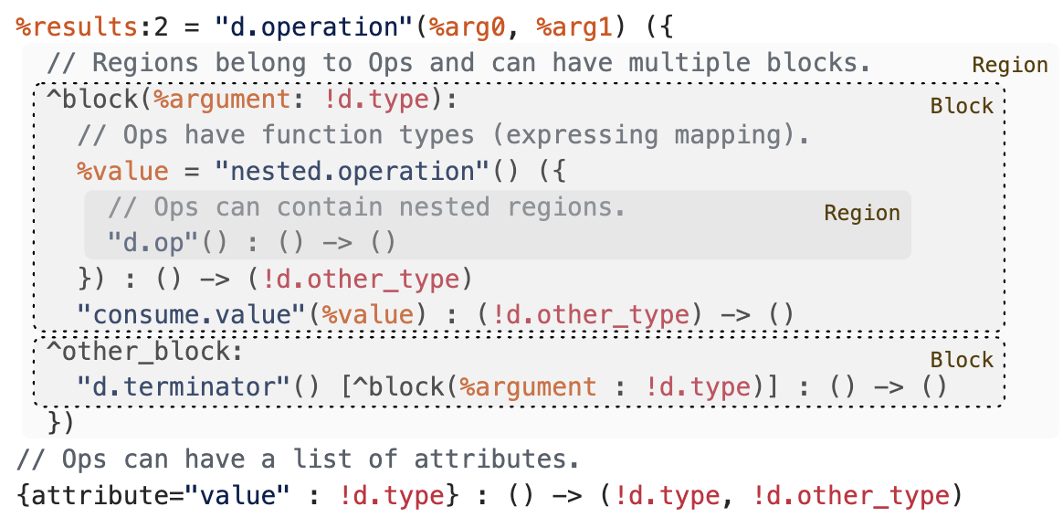
MLIR Components
Module:
  Top-level container encapsulating the entire compilation unit, isolating external variable scopes .
Region:
  Breaking through flat CFG limitations, preserving loops as“first-class citizens” in nested structures.
Block:
  IntroducingBlock Arguments avoiding traditional LLVM high-maintenance PHI nodes
Operation and Attribute:
  Highly unified opaque API, along with globally uniqued attribute dictionaries for representing constants.

Slide 44
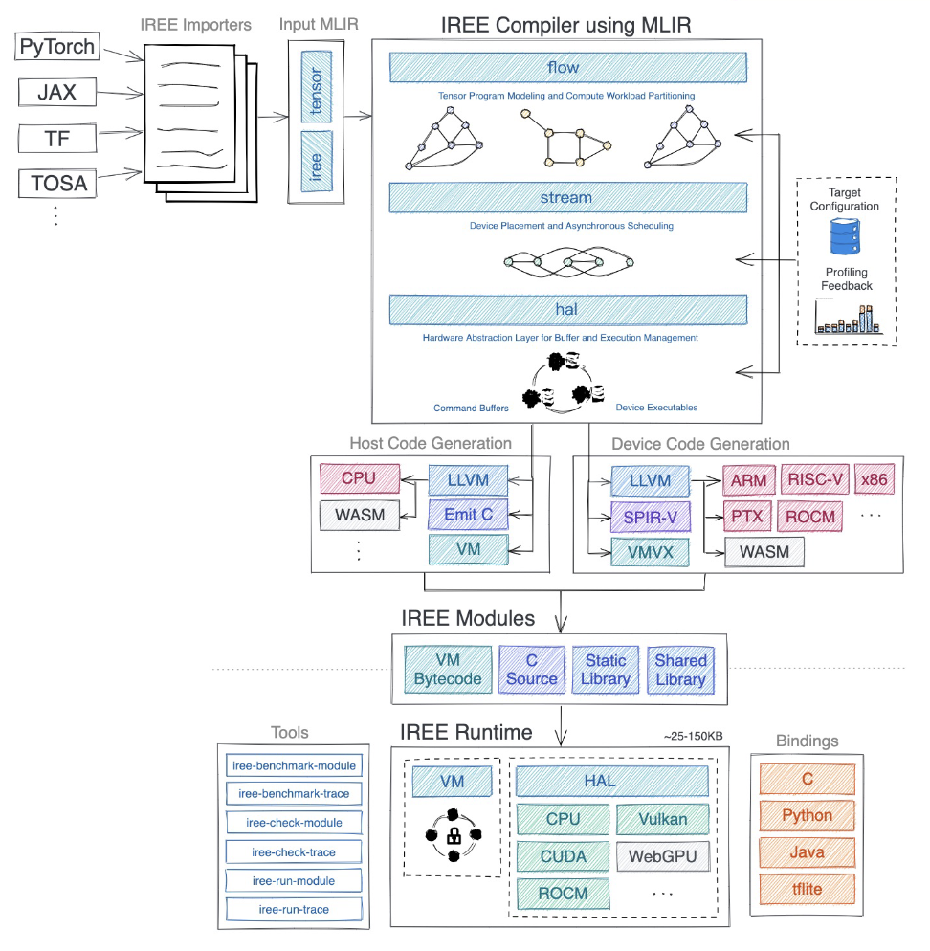
MLIR -Based Deep Learning Framework
From Model Translation to MLIR
  Splitting the program into host and deviceGenerating intermediate artifacts (VM FlatBuffers, C file, etc.）
Linking host and device -side code to generate executables/ library and IREE Hardware Abstraction Layer (HAL) linking
IREE Bytecode Virtual Machine (Bytecode VM)
Hardware Abstraction Layer API (HAL API) and various hardware abstractions
General interface and various language
https://hku-systems.github.io/events/iscas2021/1-2-Hongbin%20Zhang%20MLIR.pdf

Slide 45
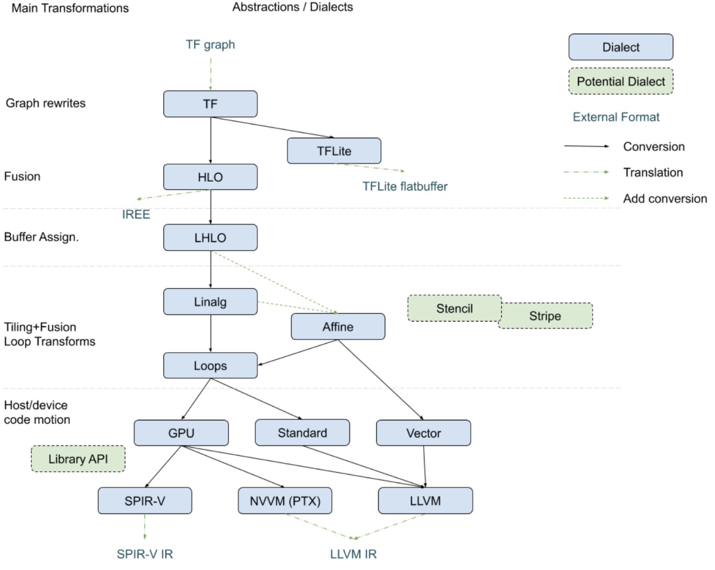
Dialect Dialect System·
Dialect Mechanism Definition:
  Dialect is a logical namespace encapsulating operators, types, and attributes customized for specific computational domains .
Within a computation graph, high-level framework dialect (torch), tensor dialect (tensor), loop dialect (affine), and machine code dialect (llvm) can perfectly coexist.
Through inter-dialect Conversion Pass, the compiler can perform“the most appropriate abstraction level” at “the most suitable graph optimization”.
https://mlir.llvm.org/docs/Dialects/Vector/

Slide 46
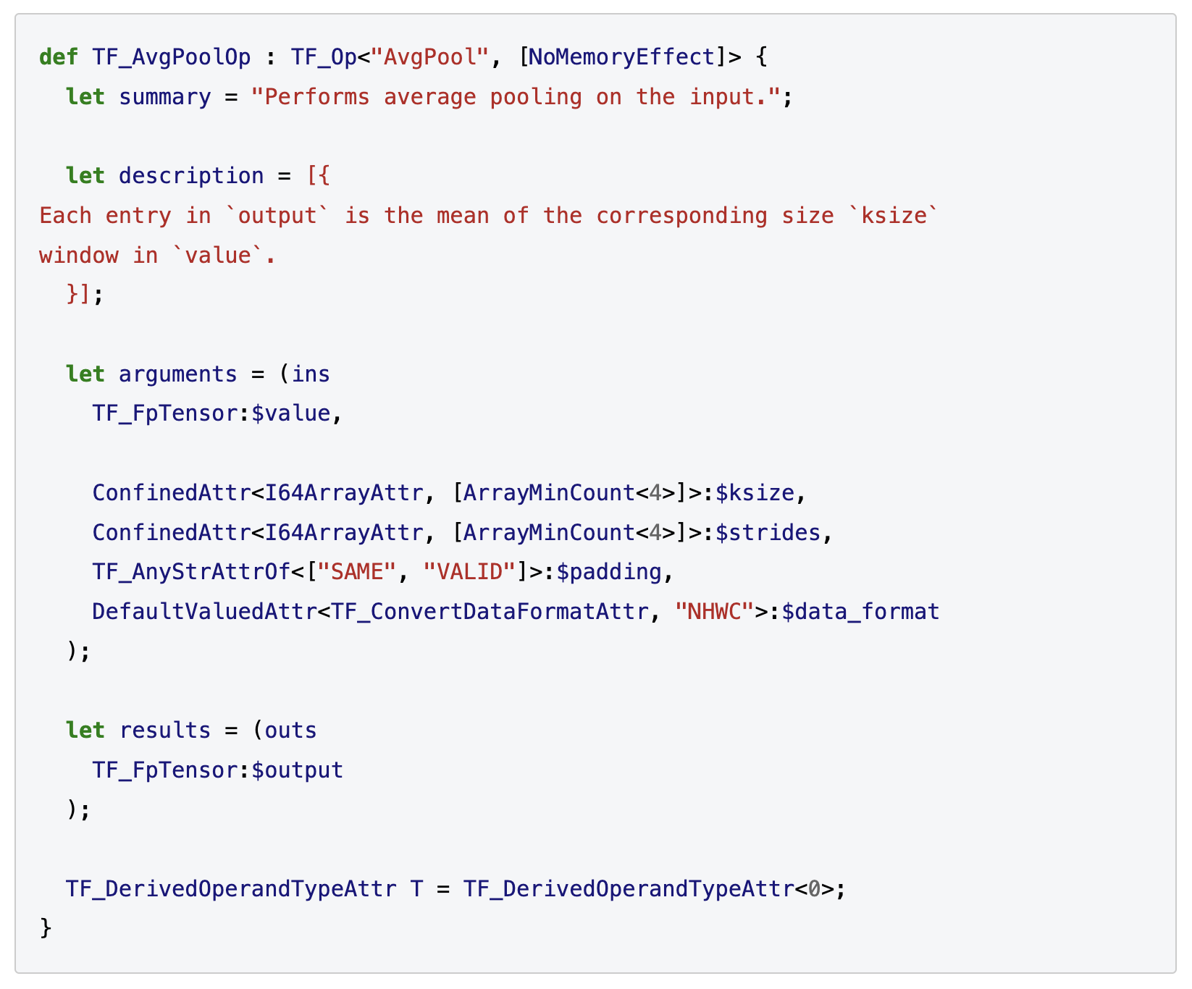
ODS Specification
Declarative Modeling:
  Based on LLVM TableGen (.td files) -based declarative operator definition framework.
Single Source of Truth:
  Defining operator name, operands, attributes, and return values in one shot through concise descriptive syntax.
Type Constraints:
  Directly declaring operator traits in the specification (e.g.,Traits), such as declaring NoMemoryEffect to explicitly inform the compiler that the operator has no memory side effects, allowing aggressive reordering.
https://mlir.llvm.org/docs/DefiningDialects/Operations/

Slide 47
ODS Automated generation
C++ Boilerplate Auto-Generation:
  OpDefinitionsGen tool automatically parses and generates standard C++ declaration and implementation code at compile time .
Automatically generating strongly-typed, semantically explicit Getter/Setter
  e.g., directly calling .stride() to get stride.
Compile-Time Verification:
  Automatically aggregating all constraints and generating a verify() verifier. Before graph optimization begins, automatically intercepting illegal type or tensor shape mismatch cases.

Slide 48
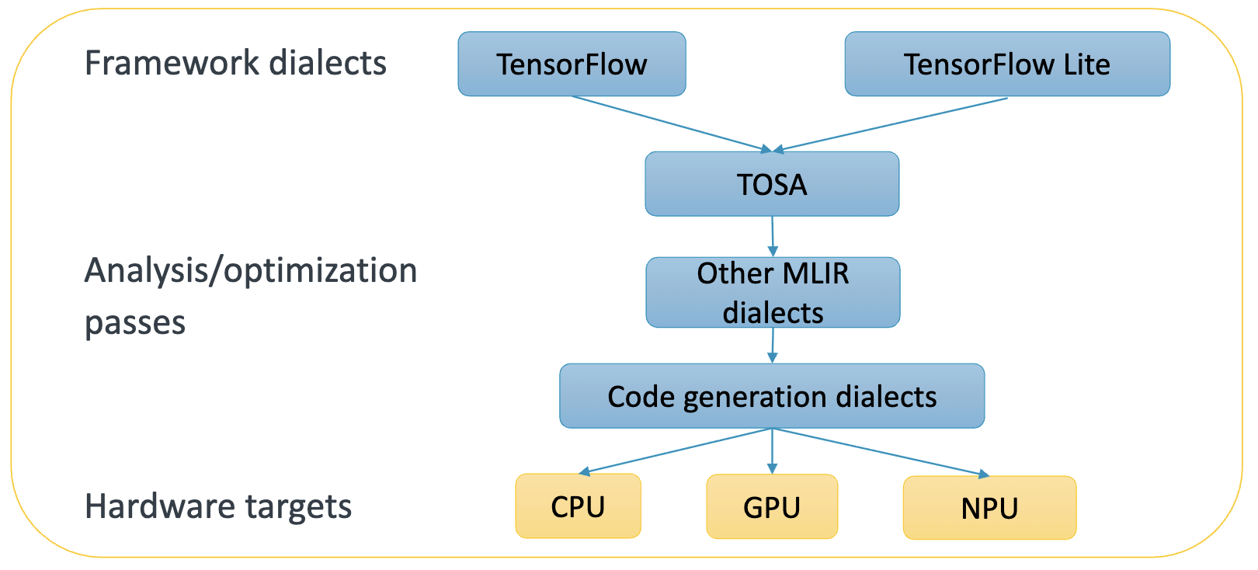
TOSA Dialect
TOSA (Tensor Operator Set Architecture)
  Hardware-Independent Tensor Operation Set Specification
  Providing a standardized, general set of tensor operations to represent computations in DNNs
  Serving as a universal bridge connecting various frontend high-level framework models with backend low-level hardware compilers
https://community.arm.com/cfs-file/__key/communityserver-blogs-components-weblogfiles/00-00-00-37-98/Eric-Kunze-_2D00_-ODIW-2021-_2D00_.pdf

Slide 49
TOSA Design Goals
Hardware Agnosticism (Hardware Agnostic):
  TOSA Making no assumptions related to specific hardware architectures (e.g., specific register sizes, cache hierarchies).
  Focusing on expressing the mathematical computation semantics of neural networks, not hardware execution details.
Stability and Standardization (Stability & Standardization):
  TOSA is backed by a strict specification (Specification)-supported Dialect, aiming to be a stable contract layer. Guaranteeing the legitimacy and consistency of input IR to downstream compilers.
Completeness and Conciseness (Completeness vs. Conciseness):
  Containing operators sufficient to express the vast majority of current deep learning models.
  Avoiding operator explosion (Operator Explosion): Expressing complex operators through combinations of basic operators, rather than creating a new operator for every minor operation variant.

Slide 50
TOSA in the Compilation Ecosystem
Middle Layer (The Hourglass Neck):
  Upward Frontend Connection (Frontend Lowering):
    High-level framework models (e.g., TensorFlow Lite, PyTorch Export, ONNX) are converted to high-level Dialect (e.g., tf, torch or mhlo）.
    These high-level Dialect can directly or indirectly Lower ( lower) to tosa Dialect.
  Downward Backend Connection (Backend Lowering):
    tosa is typically lowered to linalg (Linear Algebra) Dialect, then to vector, scf, and finally to llvm Dialect for CPU/GPU execution.
    Custom Hardware Path: Hardware vendors can directly extract tosa the computation graph and map it to custom accelerator instruction sets.

Slide 51
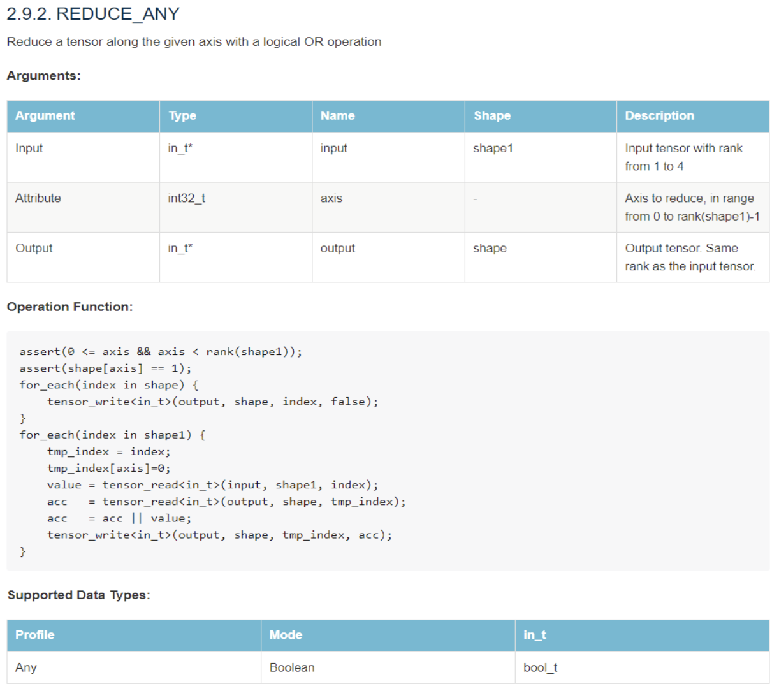
TOSA Dialect Core Operations
Core Operator Categories:
  Element-wise Operations (Element-wise): tosa.add, tosa.mul, tosa.exp, tosa.sigmoid etc.
  Core Neural Network Computation (Neural Network Ops): tosa.conv2d, tosa.depthwise_conv2d, tosa.matmul, tosa.fully_connected etc.
  Tensor Data Manipulation (Data Manipulation): tosa.reshape, tosa.transpose, tosa.slice, tosa.concat etc.
  Reduction and Pooling (Reduction & Pooling): tosa.reduce_sum, tosa.max_pool2d etc.

Slide 52
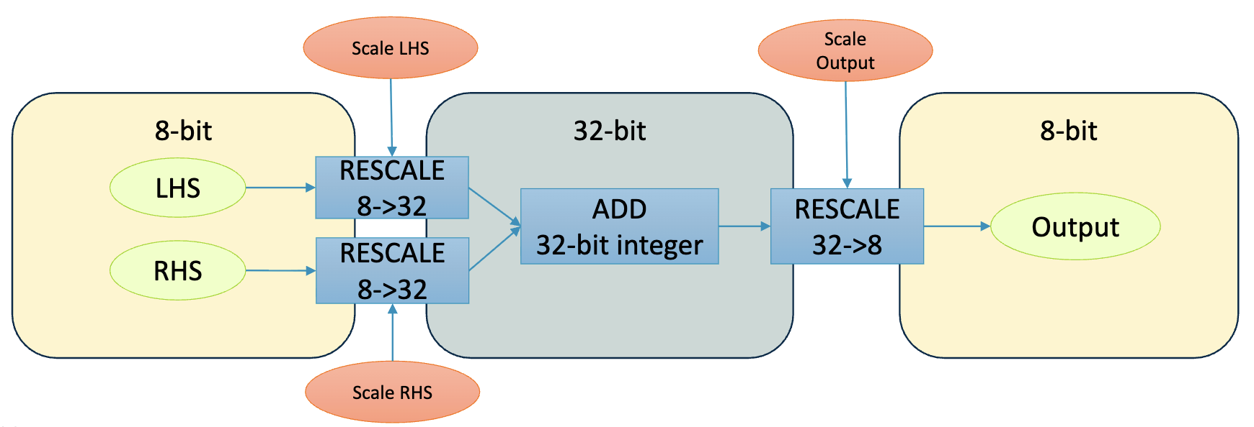
TOSA Dialect Quantization Supporting
First-Class Quantization Support:
  TOSA designed quantization as a first-class citizen from the outset (especially targeting edge computing).
  Supports floating-point types (FP32, FP16, BF16), natively supports integer//quantization types (INT8, INT16, INT32, INT48）.
  Quantization parameters (e.g., scale and zero-point) are directly embedded in operator semantics and attributes, ensuring strict consistency between hardware execution precision and software simulation.
https://community.arm.com/cfs-file/__key/communityserver-blogs-components-weblogfiles/00-00-00-37-98/Eric-Kunze-_2D00_-ODIW-2021-_2D00_.pdf

Slide 53
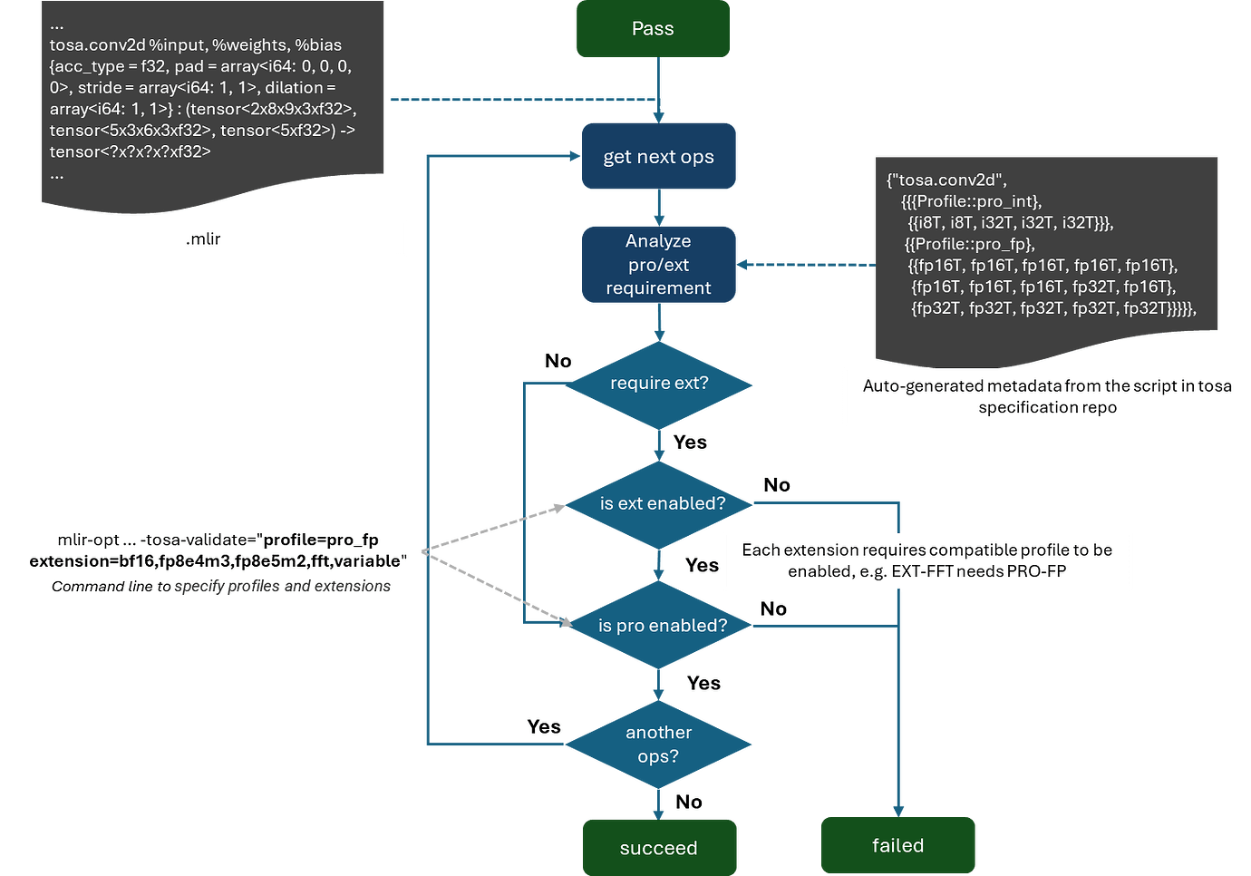
The workflow of TOSA profile-based validation

Slide 54
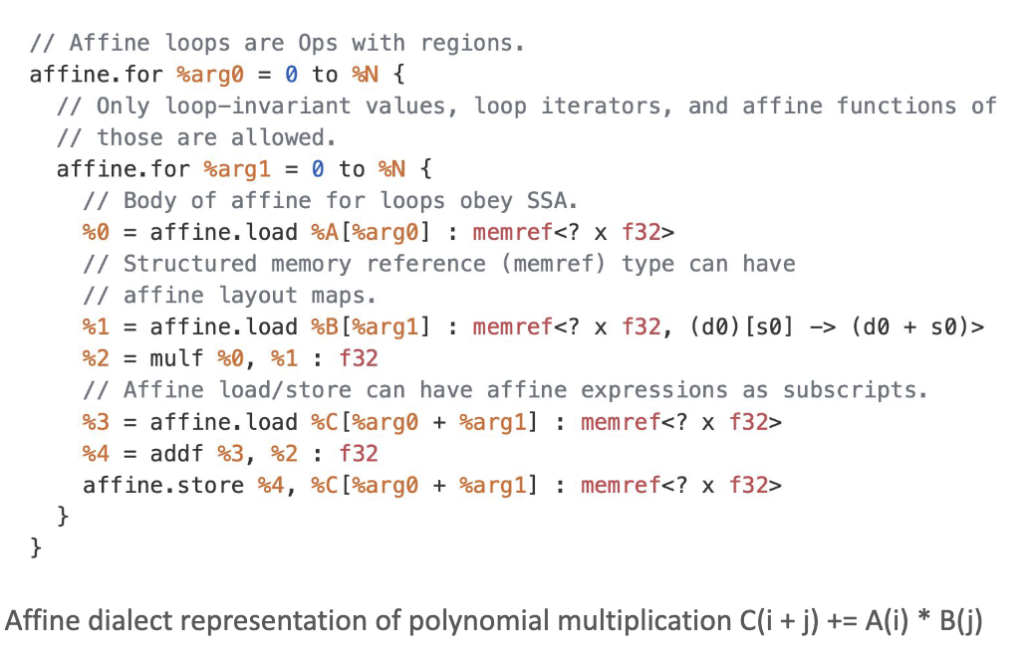
Affine Dialect Overview
Affine Dialect
  Specifically designed to express and optimize structured control flow and multi-dimensional memory access IR
  Based on the polyhedral model (Polyhedral Model) mathematical foundations, with engineering simplifications
Core Purpose:
  Enabling the compiler to perform precise data dependency analysis.
  Achieving efficient automatic parallelization, data locality optimization, and complex loop transformations.
https://web.eecs.umich.edu/~mahlke/courses/583w23/lectures/Apr12/Group16_slides.pdf

Slide 55
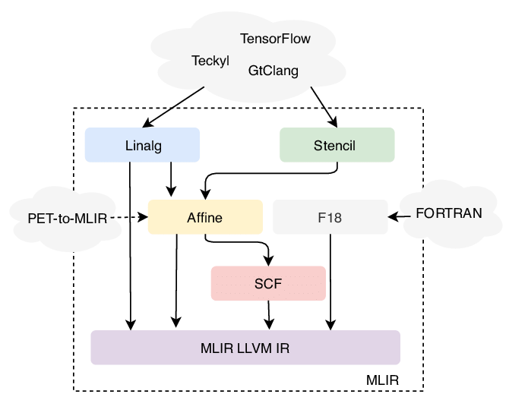
Affine Dialect Overview
Why Is It Called “Affine”？
  Loop bounds and memory access indices are strictly restricted to affine functions of loop induction variables and symbols.
Key Concepts:
  Dimensions: Typically corresponding to loop induction variables (Induction Variables, e.g., i, j, k）.
  Symbols: Parameters that remain constant throughout the loop nest (e.g., dynamic tensor dimensions N, M）.
  Affine Map: Defines a mathematical transformation from dimensions and symbols to a set of results (commonly used for array index computation).
  Integer Set: An integer space defined using affine constraints, commonly used to represent if condition boundaries.
https://www.researchgate.net/figure/Dialects-available-in-MLIR-and-their-entry-points-PET-to-MLIR-enables-entering-in-the_fig2_347152973

Slide 56
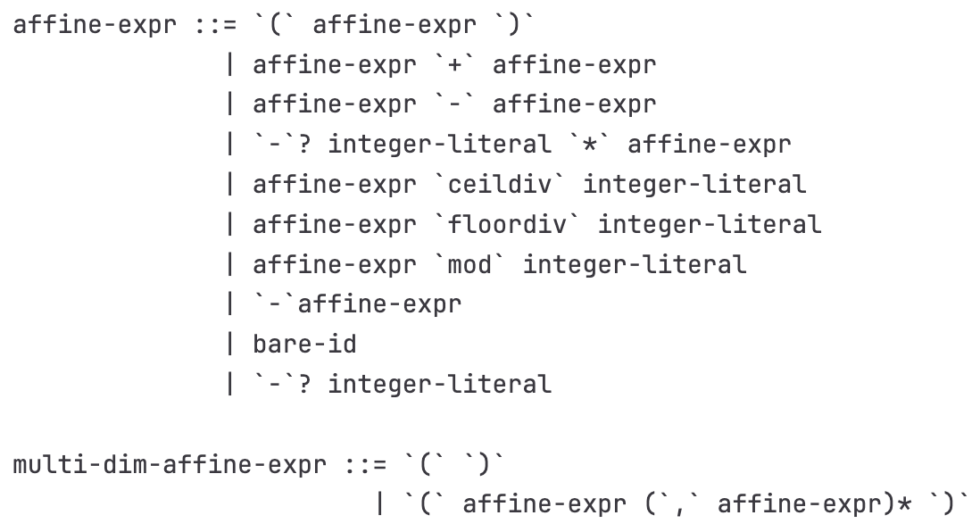
Affine Dialect Key Operators and Syntax
Restricted Control Flow Operations:
  affine.for: Defines a loop with known bounds, stride must be a constant.
  affine.if: Defines a conditional branch whose condition must be strictly evaluated by an affine integer set (Integer Set).
Restricted Memory Access Operations:
  affine.load / affine.store: Reads from memory (MemRef type) or/ writes data.
  Core Constraint: Access indices must be valid Affine Map. The compiler knows exactly which memory block each loop iteration accesses.
https://code.ornl.gov/llvm-doe/llvm-project/-/blob/369891b6747e4ad4b5e4e6d06f3f7596f3ee3f02/mlir/docs/Dialects/Affine.md

Slide 57
Affine Dialect Automatic Compilation Optimization
Precise Dependency Analysis:
  Since all memory accesses are affine, the compiler can precisely determine data dependencies between instructions/loop iterations at compile time by solving integer linear programming (ILP) problems, precisely determining which instructions/ have data dependencies across loop iterations.
Loop Transformation Strategies:
  Loop Tiling: Splitting large loops into smaller blocks, greatly improving CPU/GPU L1/L2 Cache hit rates.
  Loop Unrolling : Increasing instruction-level parallelism (ILP), reducing branch overhead.
  Loop Fusion and Fission: Merging adjacent loops to reduce memory round-trips, or splitting loops to improve register utilization.
  Loop Permutation: Changing the order of nested loops, optimizing stride for sequential memory access .

Slide 58
Affine Dialect in MLIR Position in
Typical Lowering Path:
  Upstream Connection: High-order tensor computation Dialect (e.g., Linalg or Tensor) can have certain operations lowered (Lower) to Affine loop nests.
  Self-Optimization: in Affine level, performing intensive loop transformations and parallelism analysis (e.g., extracting parallel loops affine.parallel）.
  Downstream Output: After optimization, Affine is lowered to generic SCF (Structured Control Flow) or Standard Dialect, and finally converted to LLVM IR to generate machine code.

Slide 59
Lecture 22: Operator Fusion Pass

Slide 60
Why Perform Operator Fusion
Memory Wall (Memory Wall) Phenomenon: The computational bottleneck has shifted from ALU ALU compute power to memory bandwidth and data transfer latency.
Cost of Frequent Memory Access: In unoptimized computation graphs, each operator must go through the complete“read main memory -> compute -> write main memory” lifecycle.
Introducing Operator Fusion: By merging computation kernels, keeping intermediate results in L1/L2 Cache or registers, breaking through memory bottlenecks .
Gholami, A., Yao, Z., Kim, S., Hooper, C., Mahoney, M. W., & Keutzer, K. (2024). Ai and memory wall. IEEE Micro, 44(3), 33-39.

Slide 61

Operator Fusion (Operator Fusion)
Core Definition:
  Merging multiple adjacent independent operators in the computation graph (e.g., Conv + BN + ReLU) into a single, more efficient execution kernel .
Key Benefits:
  Eliminating intermediate feature map read/write DRAM bandwidth consumption .
  Significantly reducing kernel launch (Kernel Launch) overhead .
  Lowering peak memory usage during inference deployment.
Three Core Stages:
  Graph Matching: Finding specific topological structures in the computation graph.
  Pattern Recognition: Validating semantic legality and physical constraints.
  Subgraph Rewriting: Performing equivalent graph transformations.
Dao, Tri, et al. "Flashattention: Fast and memory-efficient exact attention with io-awareness." Advances in neural information processing systems 35 (2022): 16344-16359.

Slide 62

Graph Matching Algorithm (Graph Matching)
Directed Acyclic Graph (DAG):
  Data structure for neural networks in compilers, with nodes representing operators and edges representing tensor data flow.
Subgraph Isomorphism Problem:
  Defining fusion rules as a pattern graph (Pattern Graph), and searching for exact matches in the host computation graph (Host Graph) .
Computational Complexity:
  Traditional full graph matching is an NP -Complete problem, but deep learning computation graphs have strong domain-specific properties enabling significant pruning .
https://thinklab.sjtu.edu.cn/project/GANN-GM/index.html

Slide 63


Graph Matching Acceleration Strategies
Strong Type Label Filtering: Hash-based filtering by operator type (e.g., Conv2D, BatchNorm), quickly excluding incompatible nodes.
Topological Sort and Use-Def Chains: Traversing along or against the tensor's“Using-Definition” chain for local depth-first traversal, limiting the search space.
Approximate and Degenerate Matching: Some advanced compilers employ graph neural networks or structural degeneracy properties, reducing matching time complexity to linear level .
Cutler, Joseph W., et al. "Pattern Matching in AI Compilers and its Formalization (Extended Version)." arXiv preprint arXiv:2412.13398 (2024).
Liu, Xuanzhou, et al. "D2match: leveraging deep learning and degeneracy for subgraph matching." International Conference on Machine Learning. PMLR, 2023.

Slide 64
Pattern Recognition (Pattern Recognition)
Dataflow Constraints and Exclusivity Analysis
  DAG, an operator's output may be consumed by multiple downstream operators, , when performing vertical fusion, the compiler must conduct strict liveness and multi-user checks.
Operation Attributes and Shape Constraints
  Tensor Dimension Verification: Matching logic must verify whether input tensor shapes and dimensions meet fusion requirements (e.g., alignment requirements).
  Memory Layout: Hardware acceleration libraries (e.g., cuDNN) typically have strict NCHW or NHWC have strict data layout requirements.
Cost Model-Based Benefit Assessment
  Fusion is not always optimal: Excessive fusion may cause local variable explosion and register spilling.
  Hardware-Aware Cost Model: Automatically evaluating the balance between computation, data transfer, and launch overhead.
  Benefit Constraint: If the cost model predicts negative benefit from fusion, the recognition engine proactively abandons the merge .

Slide 65

Subgraph Rewriting (Subgraph Rewriting)
Semantically Equivalent Graph Transformation Theory
  L --> R：where L called the pattern graph (Pattern Graph), representing the subgraph structure to be replaced;R called the replacement graph (Replacement Graph), representing the efficient fused structure.
Double-Pushout (DPO) Semantic Framework: The host graph is partitioned into the match portion (Match), context (Context) , and patch/interface edges connecting the two (Patch/Interface) .
Core Principle: Semantic equivalence must be guaranteed, i.e., given the same input, computation output before and after rewriting must remain absolutely identical.
https://www.cas.mcmaster.ca/~kahl/CAS701/2007/P/DPO.pdf

Slide 66

MLIR Pattern Rewrite Engine
Decoupled Design:
  MLIR strictly decouples pattern definition from pattern application (e.g., Greedy Pattern Rewrite Driver).
Imperative Writing:
  C++ RewritePattern: inheriting from OpRewritePattern, overriding thematchAndRewrite Function
Characteristics:
  Full freedom to directly manipulate low-level IR and compute complex mathematical logic.
  Drawbacks: Excessive boilerplate code, manual type conversion and safety checks required, graph topology not intuitive.
https://mlir.llvm.org/docs/PatternRewriter/#matchandrewrite-implementation

Slide 67
MLIR Pattern Rewrite Engine
DRR (Table-driven Declarative Rewrite Rule, DRR):
  Using DAG syntax (Source DAG) -> (Result DAG) syntax for declaring rules, expanded to C++ code at compile time, greatly reducing boilerplate .
More modern PDLL: Specifically designed for MLIR syntax-designed pattern description language .
  Natively supporting multi-result operations, regions, and variadic arguments .
  Allowing constraint conditions and mathematical logic expressions to be declared directly within the language .
  Supporting AOT Compile-time and runtime JIT bytecode interpretation execution .
https://mlir.llvm.org/docs/DeclarativeRewrites/
https://mlir.llvm.org/docs/PDLL/

Slide 68

in MLIR Writing in Conv+BN Fusion Pass
Pattern Definition and Root Node Selection
  Inheriting Base Class: In C++ create a class inheriting from OpRewritePattern<BatchNormOp> class .
  Anchoring the Root Node (Root Node): Setting the pattern matching trigger point to the downstream BatchNormOp.
  Reverse Tracing Advantage: From consumer (BN) tracing upstream to producer (Conv2D) is deterministic and unique, greatly reducing the logical complexity of multi-path search.

Slide 69
in MLIR Writing in Conv+BN Fusion Pass
Graph Traversal and Safety Verification (Match Logic)
  Node Location: Via getDefiningOp() from BN 's input node and verifying whether it comes from Conv2DOp .
  Multi-User Blocking Mechanism: The most critical safety check. Verifying whether the convolution output tensor result is exclusively used by this single BN node.
  API Call: Mandating that convOp.getResult().hasOneUse() returns True, preventing weight rewriting from polluting external dependency branches (e.g., residual connections) .

Slide 70

in MLIR Writing in Conv+BN Fusion Pass
Execute Rewriting and Dataflow Switching
  Constant Reading and Computation: Reading global BN statistical attributes at compile time, using C++ to compute new W_{fold} and b_{fold} dense tensors.
  Graph Materialization and Switching: Calling rewriter.create to instantiate new constant nodes and the fused Conv2DOp.
  call rewriter.replaceOp(bnOp, fusedConvOp.getResult()) to switch all downstream connections to the new node .
  Clean up old nodes rewriter.eraseOp(convOp).

Slide 71
Lecture 23：Loop-Invariant Code Motion (LICM)

Slide 72
Loop Invariant Code
Code that produces the same result regardless of which loop iteration it runs in
Loop Invariant Code Motion, LICM
  Hoisting loop-invariant code outside the loop to reduce the number of executions
  Positioned toward the earlier/frontend stage in compilation process
Performance Influence
  Before: Execute N times × Time = N × T
  After: 1 × T + Execute N times × 0 = T
  Save: (N-1) × T
LICM
Source Code
IR
OptimizationPass
Target Code

Slide 73
Loop Invariant Code
Example Code
Hoist the computation of x and y outside the loop.
for (int i = 0; i < n; i++) {
int x = a + b; // Loop-Invariant varaibles: a, b not changed in loop
int y = x c; // Loop-Invariant varaibles: dependent on x
arr[i] = y + i; // Loop-variant：depend on i
}
for ...
x=a+b
y=x*c
use(y)
x=a+b
y=x*c
for ...
use(y)

Slide 74

LICM Flow
Compute Reaching Definitions
Find Loop Ivariants
Compute Dominators
Check Safety Conditions
Move to Preheader

Slide 75

Loop and Domination
Loop Structure
Header
  Only entry to the loop, dominating all nodes in loop
Back Edge
  Node Jumping back to header
Loop Body
  Nodes between header and back edge
Domination
A Dominates B：All path from entry to B must pass A
A Dominates B strictly：A dominates B and A ≠ B
Entry
header
Body
Exit
Back Edge

Slide 76
Loop and Domination
Domination represented in Tree
  Parent node dominates all children
  LICM use domination to check safety conditions
Lengauer-Tarjan Algorithm
  Based on DFS
  Semidominator
def compute_dominators(cfg):
  # 1. Calculate DFS tree and DFS index
  dfs_tree, dfnum = dfs(cfg.entry)
  # 2. Calculate semi-dominator
  sdom = {}
  for v in reverse_dfs_order:
    sdom[v] = min(dfnum[u] for u in predecessors(v))
  # 3. Calculate dominator from semi-dominant
  idom = {}
  for v in dfs_order:
  idom[v] = compute_idom(v, sdom)
  return idom

Slide 77

Reaching Definitions
Analyze the variable definitions that may reach each point in the program
  IN[B] = ∪(OUT[P]) for all predecessors P of B
  OUT[B] = GEN[B] ∪ (IN[B] - KILL[B])
Reaching Definitions in LICM
  Determine where operands are defined
  Check whether a definition originates from
  outside the loop
  Detect whether a variable has multiple
  definitions

Slide 78
Loop-Invariant Detection Algorithm
Initialization: Mark all instructions whose operands are defined outside the loop as "invariant"
Iterate until a fixed point is reached：
  For each instruction I: "x = y op z" inside the loop:
  If any of the following conditions are met, mark it as "invariant":
  1. All reaching definitions of y are outside the loop, or
  2. There is exactly one reaching definition, and
  that definition is loop-invariant
  And: z satisfies the same conditions (if applicable)
def find_loop_invariants(loop):
  invariant = set()
  changed = True
  while changed:
    changed = False
    for instr in loop.instructions:
      if is_invariant(instr, invariant):
        if instr not in invariant:
          invariant.add(instr)
          changed = True
  return invariant

Slide 79
Loop-Invariant Detection Algorithm Example
Initialization
Iterate
Round 1: {x = a+b} → INVARIANT
Round 2: {y = x*c} → INVARIANT
Round 3: No newly added → Fixed Point
Final Invariant Set: {x = a+b, y = x*c}
// a, b, c defined outside the loop
for (int i = 0; i < n; i++) {
x = a + b;
// It 1：Invariable (a,b defined outside)
y = x c;
// It 2：Invariable (x invariable, c defined outside)
z = y + i;
// Variable (depend on i)
w = z 2;
// Variable (depend on z)
}

Slide 80
Dependence Type
Input Dependence
Loop-Carried Dependence
  Cannot apply LICM
True/Flow Dependence
Anti Dependence
Output Dependence
S1: x = ...
S2: ... = x // S2 depends on S1
S1: ... = x
S2: ... = x // can be executed in parallel
S1: ... = x
S2: x = ... // S2 executed after S1
for (i = 1; i < n; i++) {
  a[i] = a[i-1] + 1;
  // Loop-carried: a[i] ← a[i-1]
}
S1: x = ...
S2: x = ... // maintain write sequence

Slide 81

Safety Conditions for Code Motion
Dominate All Exits
  Instruction's basic block must dominate all exits of the loop
  Guarantees the instruction will always be executed
Unique Definition
  The variable has only this one definition within the loop
  Avoids conflicts with other definitions
Dominate All Uses
  The definition dominates all uses of the variable within the loop
  Or: this is the only definition that reaches the use points
Feasible
Infeasible

Slide 82


Preheader
A special basic block placed
before the loop entry
Has exactly one successor (i.e., the header)
The location where loop-invariant code is placed
LICM Pseudo Code
LICM
candidates = []
for instr in invariants:
if dominates_all_exits(instr.block, exits) and \
  is_only_definition(instr) and \
  dominates_all_uses(instr):
candidates.append(instr)
# Move to preheader based on dependency
for instr in topological_sort(candidates):
move_to_preheader(instr, loop.preheader)

Slide 83
LICM in LLVM
lib/Transforms/Scalar/LICM.cpp
  Loop-Invariant Code Motion
  Hoisting memory accesses into registers
  Sinking code to loop exits
LoopInfo Analysis
  LoopInfo &LI = getAnalysis<LoopInfoWrapperPass>().getLoopInfo();
DominatorTree for Dominance Analysis
  DominatorTree &DT = getAnalysis<DominatorTreeWrapperPass>().getDomTree();
AliasAnalysis for Mameory Operation Analysis
  AliasAnalysis &AA = getAnalysis<AAResultsWrapperPass>().getAAResults();

Slide 84
Special Handling of Memory Operations
Memory operations may have side effects
  Must-Alias Analysis: Identify pointers that definitively point to the same memory location
  Scalar Promotion: Lift memory operations within the loop into scalar operations
参考https://llvm.gnu.ac.cn/docs/AliasAnalysis.html
for (int i = 0; i < n; i++) {
*p = p + arr[i]; // Each iteration read and writes*p
}
int temp = p; // Read outside the loop
for (int i = 0; i < n; i++) {
temp = temp + arr[i]; // Scalar operation
}
p = temp; // Write back outside the loop

Slide 85
Loop Optimization in Triton
Triton Compilation Flow
  Triton Python → Triton IR (TTIR) → TritonGPU IR → LLVM IR → PTX/CUBIN
General Optimization Methods
  Loop Pipelining: Software Pipeline, Latency Hiding
  Loop Unrolling: Loop unrolling, Reduce Control Cost
LICM generally carried on at TTIR and TritonGPU IR
  Based on MLIR
  Reuse MLIR Analysis Pass
  Optimize at different abstract levels

Slide 86
Triton Loop Structure Example
Matrix Multiplication
Optimization Opportunities
  Base address of pointer might be loop invariant
  stride calculation is usually loop invariant
@triton.jit
def matmul_kernel(A, B, C, M, N, K, ...):
  # Initialize Accumulator
  acc = tl.zeros((BLOCK_M, BLOCK_N), dtype=tl.float32)
  # Main loop - K-dimension iteration
  for k in range(0, K, BLOCK_K):
    # Load blocks of A, B
    a = tl.load(A_ptr + k stride_ak)
    # Possible Loop Invariant
    b = tl.load(B_ptr + k stride_bk)
  acc += tl.dot(a, b)
  # Store result
  tl.store(C_ptr, acc)

Slide 87
LICM in MLIR
Refere to mlir/lib/Transforms/LoopInvariantCodeMotion.cpp
void LoopInvariantCodeMotion::runOnOperation() {
  LoopLikeOpInterface loopOp =
  getOperation()->getParentOfType<LoopLikeOpInterface>();
  // Collect loop invariant operations
  SmallVector<Operation> invariantOps;
  for (Operation &op : loopOp.getLoopBody().getOps()) {
  if (isLoopInvariant(&op, loopOp))
  invariantOps.push_back(&op);
  }
  // Move to preheader
  for (Operation op : invariantOps) {
  op->moveBefore(loopOp);
  }
}

Slide 88
Limitation and Improvements of LICM
Limitations
  Exception Handling: Moving code that may throw exceptions
  Speculative Execution: If the loop may not execute, moving code could introduce additional overhead
  Memory Side Effects: Complex memory aliasing relationships are difficult to analyze
Improvements:
  Loop Unswitching: Move conditional checks inside the loop to outside the loop
  Loop Versioning: Create multiple versions of the loop to enable further optimizations
  Speculative LICM: Perform speculative hoisting when provably safe

Slide 89
Lecture 24：Layout and Memory Planning

Slide 90

GPU Memory Hierarchy
Bandwidth increases 10-100x from left to right 10-100x
Capacity decreases 100-1000x from right to left 100-1000x
The key to layout optimization is maximizing high-speed memory utilization
  Design programs for efficient memory usage, minimizing excessive data movement
  FlashAttention core design philosophy

Slide 91
GPU Memory Transaction Mechanism
GPU accesses Global Memory not byte-by-byte, but in fixed-size "transactions":
  Each memory transaction transfers 32 bytes or 128 bytes
  Transactions must be aligned to their size boundaries
  A warp（32 threads) are coalesced into as few transactions as possible
  Maximum concurrent transactions are limited，constrained by memory controller queue depth
  Number of transactions × latency = total wait time
Coalesced Access
  When a warp 's 32 threads access addresses meeting the following conditions, they can be coalesced into minimal transactions
  Addresses fall within the same or adjacent cache lines
  Each thread accesses contiguous elements

Slide 92


GPU Memory Transaction Mechanism
Contiguous access：1 transaction(s) suffice
Strided access：2 transactions
int idx = threadIdx.x; // T0→0, T1→1, T2→2, ...
float val = data[idx]; // Contiguous addresses
int idx = threadIdx.x 2; // T0→0, T1→2, T2→4, ...
float val = data[idx];

Slide 93
GPU Memory Transaction Mechanism
Random access: worst case 32 transactions
Efficiency Comparison
int idx = index_table[threadIdx.x]; // Random addresses
float val = data[idx];
Stride | Transactions | Bandwidth Utilization
1 | 1 | 100%
2 | 2 | 50%
4 | 4 | 25%
32 | 32 | 3.125%
Random | Up to 32 | ～3.125%

Slide 94


Matrix Access: Row-Major vs Column-Major
A warp reads one row
A warp reads one column
int col = threadIdx.x; // 0,1,2,...,31
float val = M[row 32 + col];
int row = threadIdx.x; // 0,1,2,...,31
float val = M[row 32 + col];

Slide 95

GPU Shared Memory
~100x faster than Global Memory ~100 x, but ~1000x smaller in capacity~1000
  Programmers can explicitly control data placement
  Shares space with L1 Cache Cache; ratio is manually configurable
Shared Memory is divided into 32 independent Bank
  Can simultaneously serve 32 requests
  Ideal case: 32 threads simultaneously access 32 different Bank
Efficient utilization of Shared Memory is the core of memory layout planning
  When multiple threads within the same Warp map to the same Bank , serialized access is required

Slide 96


GPU Shared Memory
Ideal Case vs. Worst Case
Access patterns causing Bank Conflict
  Access with specific stride values
  Access with specific stride value（32）
int row = threadIdx.x; // 0 to 31
float val = smem[row][0]; // All threads access column 0
int idx = threadIdx.x 32;
float val = smem_1d[idx];
// idx = 0, 32, 64, 96, ... All mapped to Bank 0

Slide 97
Resolving Bank Conflict
Padding
  Increase actual storage size per row, staggering column elements to different Bank
Swizzling
  Dynamically alter address mapping via XOR operations, so the same column in different rows maps to different Bank
  Original: addr = row × stride + col
  Swizzle: addr = row × stride + (col XOR row)
__shared__ float smem[32][32];
Row 0: [B0 ][B1 ][B2 ]...[B31] ← 128 bytes
Row 1: [B0 ][B1 ][B2 ]...[B31] ← 128 bytes, starts at Bank 0
Row 2: [B0 ][B1 ][B2 ]...[B31]
Column access: : smem[0][0], smem[1][0], smem[2][0], ...
All in Bank 0 → 32-way conflict
Accessing column 0:
row 0, col 0 → addr 0 → Bank 0
row 1, col 0 → addr 128 → Bank 0
row 2, col 0 → addr 256 → Bank 0
row 3, col 0 → addr 384 → Bank 0
32-way conflict
__shared__ float smem[32][33]; // Each row has 1 extra element(s)
Row 0: [B0 ][B1 ][B2 ]...[B31][B0 ] ← 132 bytes (33 float)
Row 1: [B1 ][B2 ][B3 ]...[B0 ][B1 ] ← starts at Bank 1
Row 2: [B2 ][B3 ][B4 ]...[B1 ][B2 ] ← starts at Bank 2
Column access: : smem[0][0] → Bank 0
smem[1][0] → Bank 1 ← Different Bank
smem[2][0] → Bank 2 ← Different Bank
No conflict
Accessing column 0 (col XOR row):
row 0, col 0^0=0 → Bank 0
row 1, col 0^1=1 → Bank 1
row 2, col 0^2=2 → Bank 2
row 3, col 0^3=3 → Bank 3
No conflict

Slide 98
Triton Automatic Layout Optimization
The compiler automatically generates swizzled access code based on these parameters
  vec: Number of contiguously accessed elements, affects vectorization
  perPhase and maxPhase: Control swizzle period
Triton compiler automatically handles Shared Memory layout optimization
#shared = #triton_gpu.shared<{
  vec = 4, // Vectorization width (accesses 4 elements at once)
  perPhase = 2, // Rows per phase
  maxPhase = 8, // Maximum phase count (for swizzle)
  order = [1, 0], // Memory traversal order
  hasLeadingOffset = false
}
@triton.jit
def kernel(...):
  # Triton automatically selects optimal layout
  a = tl.load(A_ptr + offs) # Global → Register
  # Explicitly using shared memory
  # Triton automatically applies swizzling
  a_shared = tl.trans(a) # Auto-optimized during transpose

Slide 99
Tensor Layout
Mapping from logical tensor elements to physical storage locations
  Memory arrangement order
  Distribution of elements across hardware units
Common Layout Types
  Row-major，Row-contiguous storage, ，C/C++ default
  Column-major，Column-contiguous storage，Fortran, MATLAB
  Blocked，Block storage, ，GPU parallelism
  Strided，Strided storage，Slicing operations
2x4 matrix: : Row-major:
┌─┬─┬─┬─┐ [0,1,2,3,4,5,6,7]
│0│1│2│3│
├─┼─┼─┼─┤ Column-major
│4│5│6│7│ [0,4,1,5,2,6,3,7]
└─┴─┴─┴─┘

Slide 100
Triton Layout Encoding
Using MLIR Attribute to represent layouts
  BlockedEncodingAttr: GPU Global memory access pattern
  SharedEncodingAttr: Shared memory access pattern (swizzle)
  NvidiaMmaEncodingAttr: Tensor Core operation layout
  DotOperandEncodingAttr: Matrix multiplication operand layout
Unified Layout Representation
  Represent layouts as mappings from hardware positions (warp, thread, register) to logical indices (m, n)
  Use binary bits for strides, XOR operation composition
#blocked = #triton_gpu.blocked<{
  sizePerThread = [4], // Elements per thread
  threadsPerWarp = [32], // Threads per warp
  warpsPerCTA = [4], // Threads per CTA warp count
  order = [0] // Dimension traversal order
}>

Slide 101

MMA (Matrix Multiply-Accumulate) Layout
Data arrangement designed for GPU Tensor Core
  Tensor Core computes D = A × B + C
  Fragment size is fixed (e.g., Volta architecture 16*16), conforming to TC hardware requirements
  Each thread holds 8 elements
  Thread 0: A[0,0:2], A[8,0:2], A[0,8:10], A[8,8:10]；Thread 1: A[0,2:4], A[8,2:4], A[0,10:12]；...

Slide 102
MMA (Matrix Multiply-Accumulate) layout
From Blocked to MMA Layout Conversion
  ldmatrix instruction, loads from shared memory and rearranges to MMA layout
  Read 8×8 matrix fragment from shared memory->Distribute to registers of threads within the warp ->Rearrange to MMA
Triton in TritonMMA Encoding Attribute
Triton Layout Conversion in Triton
#mma = #triton_gpu.nvidia_mma<{
  versionMajor = 2, // MMA version (1=Volta, 2=Ampere, 3=Hopper)
  versionMinor = 0,
  warpsPerCTA = [2, 2], // Warp grid layout
  instrShape = [16, 8, 16] // M × N × K instruction shape
}>
// From blocked layout to mma layout
%0 = triton_gpu.convert_layout %arg :
tensor<128x64xf16, #blocked> -> tensor<128x64xf16, #mma>

Slide 103
Memory Allocation Strategies
Static Allocation
  Compile-time allocation，0 runtime overhead, predictable fragmentation, low flexibility
  All tensor sizes known at compile time
Dynamic Allocation
  Runtime allocation, with malloc overhead, high flexibility
ML Compiler Strategy
  Compile-time analysis -> determine tensor lifetimes -> compute optimal allocation plan -> generate allocation code
  Use memory pools to support dynamic shapes

Slide 104
Memory Reuse
Tensors with non-overlapping lifetimes can share memory
  ABC can be reused among each other
  D and ABC cannot be reused
Common Algorithms
  Graph Coloring: Build interference graph, minimize number of colors
  Greedy Algorithm: Sort tensors by size, maximize reuse
ILP Method: Integer Linear Programming for optimal solution
  Minimize: : max(offset[i] + size[i]) for all i
  Constraints: : 1. offset[i] >= 0 (Non-negative offset)
  2. offset[i] + size[i] <= offset[j] (if i, j non-overlapping and i precedes) or offset[j] + size[j] <= offset[i] (if j precedes)
  3. Tensors with overlapping lifetimes must have distinct address spaces
Tensor A: ████████████
Tensor B: ████████████
Tensor C: ██████████
Tensor D: ████████████████████

Slide 105

Tensor Rematerialization
GPU memory insufficient to store all intermediate tensors
Selectively discard and recompute
  Input->A->B->C->Output
  Do not store A, retain B and C for backward pass
  Recompute during backward pass: A
Optimization Objective: Minimize (computation time + peak memory)
  Runtime dynamic decision-making
  Optimization problem solving
Image Source: Capuchin: Tensor-based GPU Memory Management for Deep Learning
Notes:
单击此处添加文本

Slide 106
Layout and Memory Planning Optimization Strategies
Layout Conversion
  Defer conversions as late as possible
  Detect and remove redundant conversions
  Merge adjacent conversions
Prefer layouts favorable to dominant operations
  Consider the entire computation graph, not just individual operators
Reduce Conversions
  Unify to the same layout
  Perform conversions at compute-intensive points
Combined with Dead Code Elimination
  Reduce memory allocation: Remove dead variables -> no allocation needed
  Shorten lifetimes: Remove useless operations -> free memory earlier
  Enable more reuse: Shorter lifetimes -> more reuse opportunities

Slide 107
Lecture 25：Multi-end Support I
（Codegen）

Slide 108


Multi-end Compilation Flow
Triton Compilation Flow
Multi-end Support in Triton
Compiler Backend：IR->Machine Code
  Adapting to different target architectures
  Generating efficient target code
  Leveraging hardware features
Main Pipeline
  Instruction Selection
  Register Allocation
  Instruction Scheduling
  Code Emission
Fragmentation of AI Computing Hardware
  The same algorithm requires generating different code for different hardware targets

Slide 109
Instruction Selection
The process of translating IR into target machine instructions
  A single IR instruction may correspond to multiple machine instruction combinations
  Selecting the optimal instruction sequence
Tree Covering Algorithm
  Cover the entire tree with the fewest and fastest instructions
Dynamic Programming
Cost Model:
  Cost(node) = min over all matching patterns {pattern_cost + Σ Cost(children not covered)}
Calculate Optimal Coverage Bottom-Up
SelectionDAG Matching in LLVM
  Define patterns using TableGen
  Automatically generate matching code
  Support complex instruction fusion
IR Tree: Machine Code:
add
/ \ add r1, r2, r3
load mul add r1, r2, imm
| / \ madd r1,r2,r3,r4
ptr a b ld.add r1, [ptr]

Slide 110
Register Allocation
Inifinite Virtual Register → Finite Physical Registers
  Variables that are live simultaneously cannot share a register
Interference Graph
  Nodes = Variables
  Edges = Simultaneously live (conflicting)
Graph Coloring Algorithm
  Input: Interference graph G, k physical registers
  Goal: k-coloring (adjacent nodes get different colors)
Chaitin's Algorithm:
  Remove nodes with degree < k onto the stack
  If all nodes have degree >= k, select one to spill to memory
  Pop stack and assign colors
  Insert load/store to handle spills
Linear Scan: O(n) complexity, commonly used in JIT compilation
PBQP: Partitioned Boolean Quadratic Programming
a: ████████
b: ████████████
c: ████
d: ████████
e: ████
a ─── b ─── c
│ │
d ─── e

Slide 111
Register Allocation-GPU Cases
Unique Characteristics of GPU Register Allocation
More registers (fewer warps)
  Fewer spills
  May reduce parallelism; all data has zero latency
  Latency cannot be hidden
Triton Register Allocation
  Indirectly controls register pressure via num_warps
Configuration Tradeoffs
  64 registers per thread, Occupancy 50%
    No spills, sufficient warps to hide latency, good performance
  32 registers per thread, Occupancy 100%
    Some data spills to Local Memory; although more warps, the spill penalty is large, poor performance
  200 registers per thread, Occupancy 15%
    No spills, but too few warps to hide memory latency, poor performance
Feature | CPU | GPU
Register Size | ~16-32 | ~255 per thread
Parallelism | Small | Thousands
Overflow Cost | Low | High
Occupation | No harm | Direct Influence
def kernel(...):
# Many warps → each warp has fewer register → High Occupancy
kernel[grid](... , num_warps=8)

Slide 112
Instruction Scheduling
Minimize execution time
Hide latency
Exploit Instruction-Level Parallelism (ILP)
Instruction Sequence:
1: r1 = load [ptr1] Delay: 300 cycles
2: r2 = load [ptr2] Delay: 300 cycles
3: r3 = r1 + r2 depend on 1, 2
4: r4 = r3 * 2 depend on 3
5: store [ptr3], r4 depend on 4
Dependency graph:
load1 (300) load2 (300)
\ /
add (4)
|
mul (4)
|
store
Scheduling Result (2-issue):
Cycle 0: load1, load2 (parallel)
Cycle 300: add (wait load)
Cycle 304: mul
Cycle 308: store

Slide 113
Instruction Scheduling
List Scheduling
Priority Queue Scheduling
  Compute the priority of each instruction (critical path length)
  Maintain a ready queue (dependencies satisfied)
  Each cycle, select the highest-priority ready instruction to issue
  Update dependency state
Software Pipelining
  Overlap instruction execution from different iterations within a loop.
Software Pipelining Implementation on GPU
  Triton uses the num_stages parameter to control pipelining
  Asynchronous memory copy (cp.async)
  Hopper TMA natively supports multi-stage pipelining
@triton.jit
def matmul_kernel(...):
  # num_stages control pipeline depth
  for k in range(0, K, BLOCK_K):
    # Stage 1: Prefetch next tile
    tl.load(A_ptr_next, ...) # asynchrous
    # Stage 2: Compute current tile
    acc = tl.dot(a, b, acc)
    # Hidden pipeline: load and compute
┌──────────────────────────────────────────────────┐
│ Iter │Stage1(Load)│Stage2(Compute)│Stage3(Store) │
├──────┼────────────┼───────────────┼──────────────┤
│ T=0 │ load[0] │ │ │
│ T=1 │ load[1] │ compute[0] │ │
│ T=2 │ load[2] │ compute[1] │ store[0] │
│ T=3 │ load[3] │ compute[2] │ store[1] │
│ ... │ ... │ ... │ ... │
└──────────────────────────────────────────────────┘

Slide 114
LLVM Code Generation Framework
LLVM IR -> SelectionDAG -> Machine IR (MIR) -> MC Layer
LLVM
IR
SelectionDAG
1. DAG Construction (Build DAG)
2. Type Legalization
3. Operation Legalization
4. DAG Optimization (DAG Combine)
5. Instruction Selection
6. Scheduling
Machine IR (MIR)
Machine Instructions in SSA Form
Register Allocation
Prologue/Epilogue Insertion
Late Machine Code Optimization
Assembly Emission
Object File Generation

Slide 115

SelectionDAG
Node Types
  Opcode: ADD, MUL, LOAD, STORE, ...
  Value Type: i32, f32, v4f32, ...
  Operand Chain: Dependency relationships
  Debug Information
Type Legalization (when the target machine does not support certain types)
  Original: add i128 %a, %b
  Legalized (split into two i64s):
  %lo = add i64 %a.lo, %b.lo
  %carry = ...
  %hi = add i64 %a.hi, %b.hi
  %hi = add i64 %hi, %carry

Slide 116
Machine IR and Target Description
MIR Stage
  Still uses virtual registers (%vreg0, %vreg1, ...)
  After register allocation, converted to physical registers (%eax, %r0, ...)
  Add function prologue/epilogue (stack frame setup)
Target.td - Target Architecture Description
Register Defination
  def R0 : Register<"r0">;
  def R1 : Register<"r1">;
  def GPR : RegisterClass<"GPR", [i32], 32, (add R0, R1, R2, ...)>;
Instruction Defination
  def ADDrr : Instruction {
  let OutOperandList = (outs GPR:$dst);
  let InOperandList = (ins GPR:$src1, GPR:$src2);
  let AsmString = "add $dst, $src1, $src2";
  let Pattern = [(set GPR:$dst, (add GPR:$src1, GPR:$src2))];}
%1 = add i32 %a, %b
ADD32rr %vreg1, %vreg2

Slide 117
LLVM NVPTX Backend Structure
Copilation from LLVM IR to NVIDIA GPU
LLVM IR Internal Functions:
llvm.nvvm.read.ptx.sreg.tid.x (Thread ID)
llvm.nvvm.barrier0 (Sychronization)
llvm.nvvm.shfl.* (warp shuffle)
NVPTX Instrution Selection
Memory Address Mapping: addrspace(1)=global, addrspace(3)=shared
Tensor Core Instruction Mapping
Special Function Calls
PTX Assembly Issue
Registers Prefixed with %r, %f, %p
Memory operations with address space qualifiers
Output .ptx file

Slide 118
Code Generation Visualization Tools
LLVM IR：triton-opt --dump-llir kernel.py > kernel.ll
SelectionDAG：llc -view-dag-combine1-dags kernel.ll
MIR：llc -print-after-all kernel.ll 2>&1 | less
PTX：triton-opt --dump-ptx kernel.py > kernel.ptx
Triton Compilation Results
compiled = triton.compile(add_kernel, signature="*fp32,*fp32,*fp32,i32",
constants={"BLOCK": 1024})
# Obtain IR of different stages
ttir = compiled.asm['ttir'] # Triton IR
ttgir = compiled.asm['ttgir'] # TritonGPU IR
llir = compiled.asm['llir'] # LLVM IR
ptx = compiled.asm['ptx']

Slide 119

MLIR: Multi-Level Intermediate Representation
Supports multi-level, extensible IR, suitable for DSL and accelerator compilation
Dialect is the core design unit
  A set of related Operations
  Types
  Attributes
  Lowering implementation
Common MLIR Dialects:
  arith — arithmetic operations; scf — structured control flow; triton
  Dialects used by the Triton compiler
Triton — tensor operations, block-level abstraction →TritonGPU — GPU parallelism, layout, memory hierarchy →LLVM — low-level operations, close to machine code
result
attribute
operand

Slide 120

MLIR: Multi-Level Intermediate Representation
Supports conversions between dialects, allowing users to focus only on the optimization and lowering logic at the current level

Slide 121

MLIR: CodeGen
Create OpBuilder
All Op can Only be Created by Builder
  MLIR will manage some internal types
Build Type by builder.getXXXType
  Or XXXType::get
Set InsertionPoint in builder
  To fill the Block

Slide 122

Triton and MLIR
Dialect->Triton IR->LLVM IR->PTX
Triton Automatic Parallelism by SM and by Instance
@jit
def add(X, Y, Z, N):
pid = program_id(0)
idx= pid * 512 + arange(512)
mask = idx < N
x = load(X + idx, mask=mask)
y = load(Y + idx, mask=mask)
store(Z + idx, x + y, mask=mask)
visible .entry add(
.param .u64 add_param_0, .param .u64 add_param_1,
.param .u64 add_param_2, .param .u32 add_param_3
)
.maxntid 128, 1, 1
{
.reg .pred %p<4>;
.reg .b32 %r<18>;
.reg .b64 %rd<8>;
ld.param.u64 %rd4, [add_param_0];
ld.param.u64 %rd5, [add_param_1];
mov.u32 %r13, %tid.x;
ld.param.u32 %r14, [add_param_3];
shl.b32 %r15, %r13, 2;
mov.u32 %r16, %ctaid.x;
mad.lo.s32 %r17, %r16, 512, %r15;
setp.ge.s32 %p3, %r17, %r14;
setp.lt.s32 %p1, %r17, %r14;
mul.wide.s32 %rd7, %r17, 4;
add.s64 %rd2, %rd4, %rd7;
@%p1 ld.global.cg.v4.b32 {%r5,%r6,%r7,%r8}, [ %rd2 + 0];
add.s64 %rd3, %rd5, %rd7;
@%p1 ld.global.cg.v4.b32 {%r9,%r10,%r11,%r12}, [ %rd3 + 0];
@%p3 bra LBB0_2;
ld.param.u64 %rd6, [add_param_2];
add.s64 %rd1, %rd6, %rd7;
add.s32 %r1, %r5, %r9;
add.s32 %r2, %r6, %r10;
add.s32 %r3, %r7, %r11;
add.s32 %r4, %r8, %r12;
st.global.v4.u32 [%rd1], {%r1, %r2, %r3, %r4};
LBB0_2:
ret;
}
def void add(i32* X .aligned(16) , i32* Y .aligned(16) , i32* Z .aligned(16) , i32 N .multipleof(2) ) {
entry:
%0 = get_program_id[0] i32;
%1 = mul i32 %0, 512;
%3 = make_range[0 : 512] i32<512>;
%4 = splat i32<512> %1;
%6 = add i32<512> %4, %3;
%9 = splat i32<512> N;
%11 = icmp_slt i1<512> %6, %9;
%14 = splat i32*<512> X;
%16 = getelementptr i32*<512> %14, %6;
%19 = broadcast i1<512> %11;
%21 = splat i32<512> undef;
%22 = masked_load i32<512> %16, %19, %21;
%26 = splat i32*<512> Y;
%28 = getelementptr i32*<512> %26, %6;
%31 = broadcast i1<512> %11;
%33 = splat i32<512> undef;
%34 = masked_load i32<512> %28, %31, %33;
%38 = splat i32*<512> Z;
%40 = getelementptr i32*<512> %38, %6;
%43 = add i32<512> %22, %34;
%46 = broadcast i32<512> %43;
%48 = broadcast i1<512> %11;
masked_store void %40, %46, %48;
ret void;}

Slide 123
Triton Dialects
Most Triton dialects inherits from MLIR native dialects
  Arith: addf, addi, constant, cmpf, cmpi, ...
  Math: exp, sin, cos, log, absi, absf, sqrt
  StructuredControlFlow: for, if, while, yield, condition
  Reduce effort to LLVM
Leverage LLVM optimizer for nvcc-like optimization after lowring to LLVM
TTIR: From python AST
  Tensor operation abstraction
  Block-level parallelism representation
module {
tt.func @add_kernel(%arg0: !tt.ptr<f32>,
    %arg1: !tt.ptr<f32>,
    %arg2: !tt.ptr<f32>,
    %arg3: i32) {
    %c1024 = arith.constant 1024 : i32
    %pid = tt.get_program_id x : i32
    %offset = arith.muli %pid, %c1024 : i32
    %range = tt.make_range {end = 1024, start = 0} : tensor<1024xi32>
    %offsets = arith.addi %offset_splat, %range : tensor<1024xi32>
    // 加载
    %x = tt.load %ptr_x : tensor<1024x!tt.ptr<f32>>
    %y = tt.load %ptr_y : tensor<1024x!tt.ptr<f32>>
    // 计算
    %z = arith.addf %x, %y : tensor<1024xf32>
    // 存储
    tt.store %ptr_z, %z : tensor<1024x!tt.ptr<f32>>
    tt.return}}

Slide 124
Triton Dialect
TritonGPU IR（TTGIR）
  Add layout information
  Incorporate hardware target and warp configuration
NVIDIA PTX
  Virtual instruction set for NVIDIA GPUs
  Platform-independent intermediate representation
  Compiled into actual machine code by ptxas (Streaming ASSembler)
PTX Instruction Examples
#blocked = #triton_gpu.blocked<{
sizePerThread = [4],
threadsPerWarp = [32],
warpsPerCTA = [4],
order = [0]
}>
module attributes {
"triton_gpu.num-warps" = 4 : i32,
triton_gpu.target = "cuda:80" // Ampere
} {
  tt.func @add_kernel(...) {
  // 现在张量带有布局属性
  %x = tt.load %ptr : tensor<1024x!tt.ptr<f32>, #blocked>
  %y = tt.load %ptr : tensor<1024x!tt.ptr<f32>, #blocked>%z = arith.addf %x, %y : tensor<1024xf32, #blocked>
  }
}
wmma.mma.sync.aligned.m16n16k16.row.col.f32.f32
{%d0, %d1, %d2, %d3, %d4, %d5, %d6, %d7},
{%a0, %a1, %a2, %a3, %a4, %a5, %a6, %a7},
{%b0, %b1, %b2, %b3, %b4, %b5, %b6, %b7},
{%c0, %c1, %c2, %c3, %c4, %c5, %c6, %c7};

Slide 125
Other GPU Backend
AMD
LLVM IR
  AMDGPUISelDAGToDAG
  SIInstrInfo
  GCNRegisterInfo
GCN/CDNA Assembly
  llvm-mc/ROCM
AMD GPU Binary (ELF)
AMD Matrix Core: Like Tensorcore
No Significant Difference at TritonIR
Intel
MLIR SPIR-V Dialects
  spirv.Load, spirv.Store
  spirv.GroupOperation (SIMD)
  spirv.CooperativeMatrix (XMX)
SPIR-V Binary
  Intel Graphics Compiler - IGC
Gen ISA Binary (ELF)
Special SPIR-V extentions

Slide 126
Cross-Backend Code Generation Challenges
Execution Model Difference
  NVIDIA: Warp = 32 threads, lockstep execution
  AMD: Wave = 64 threads (CDNA), or 32 (RDNA)
  Intel: SIMD width editable(8/16/32)
  Abstracted as an "execution width" parameter at the TritonGPU IR level
Memory Hierarchy Difference
  NVIDIA: Shared Memory (explicitly managed)
  AMD: LDS (similar, but different size/bank count)
  Intel: SLM (Shared Local Memory, smaller)
  Shared memory abstraction + backend-specific size configuration
Differences in Matrix Acceleration Units
  NVIDIA: Tensor Core (mma.sync, wgmma)
  AMD: Matrix Core (v_mfma_*)
  Intel: XMX (dpas, joint_matrix)
  tt.dot unified interface, backend maps to specific instructions
class NVIDIABackend(Backend):
def get_wave_size(self): return 32
  def lower_dot(self, op):
    if self.capability >= 90:
    return emit_wgmma(op)
    else:
    return emit_mma(op)

Slide 127
Code Generation Optimizations
Vectorization
  Scalar version
  Vector version
Vectorization in Triton
Loop Unrolling
  Reduce loop overhead (branches, counters)
  Expose more instruction-level parallelism
  Better register reuse
for i in range(N):
c[i] = a[i] + b[i]
for i in range(0, N, 4):
c[i:i+4] = a[i:i+4] + b[i:i+4]
for k in range(0, K, 16):
acc = dot(a[k:k+16], b[k:k+16], acc)
@triton.jit
  def kernel(ptr, N, BLOCK: tl.constexpr):
  offs = tl.arange(0, BLOCK) # Generate vector index
  # Triton select vector size automatically
  # based on BLOCK size and data type
  x = tl.load(ptr + offs)
  # Compile as vector oprtation
for k in range(0, K, 64):
  acc = dot(a[k:k+16], b[k:k+16], acc)
  acc = dot(a[k+16:k+32], b[k+16:k+32], acc)
  acc = dot(a[k+32:k+48], b[k+32:k+48], acc)
  acc = dot(a[k+48:k+64], b[k+48:k+64], acc)

Slide 128
Group Discussion: How does Triton support different NVIDIA architectures?

Slide 129
Lecture 26: Multi-Chip Backend Support II
(Runtime Integration)

Slide 130


Runtime Multi-Backend Support Layer
Necessity
  Taking PyTorch as an example, the native framework contains over 2600 low-level operators .
  For hardware vendors to integrate, the traditional approach requires writing C++ backend implementations one by one and modifying the framework's core code.
  The ecosystem is severely fragmented, and the cost of compute migration is extremely high.
FlagTree/FlagGems Solution Approach
  Decouple compile-time and runtime through a unified Runtime .
https://github.com/flagos-ai/KernelGen/blob/main/AtenOperator.md, visualized by Claucd Sonnet 4.6 Extended.

Slide 131

Runtime System Responsibility Boundaries
Device Management: Initialization and state maintenance of hardware contexts.
Memory Scheduling: Managing the allocation and deallocation of device memory.
Data Transfer: Host-to-Device (H2D) and Device-to-Host (D2H) data movement.
Instruction Dispatch:
  Distributing compiled kernel binaries to the correct physical devices and synchronizing execution streams.
  Providing a highly abstracted layer of API Wrapping, shielding the vast differences in low-level driver API s across different hardware vendors.
https://www.techtarget.com/searchsoftwarequality/definition/runtime

Slide 132

API Wrapping Paradigm
Case Study: FlagGems's ATen Transparent Interception
  Design Philosophy: Avoid modifying users' existing model code; expose a fully consistent API.
  Out-of-Tree Registration Mechanism: FlagGems leverages torch.Library and other low-level API for out-of-tree (Out-of-tree) extension .
  Interception Workflow: Intercept native ATen operator calls -> Provide backend-specific Triton implementation -> Forcibly override native behavior .
  Enable seamless compute migration for model developers, without modifying any existing code.
https://github.com/pytorch/pytorch/issues/139602

Slide 133

ReducingOverhead:Runtime Optimization
Problem: Frequent Python API calls and Just-In-Time compilation (JIT) introduce significant runtime overhead.
Solution: Introduce LibEntry runtime wrapper.
Advantages: Eliminate Python GIL contention.
Fully offload operator wrapping logic, registration mechanisms, and execution stream management to the C++ layer, deeply integrating CUDA/low-level driver workflows .

Slide 134
Environment Variable-Driven Backend Routing
FlagTree compiler and FlagGems operator library integrate over 10 hardware platforms:
  NVIDIA GPU, Kunlunxin (Kunlunxin), Iluvatar (Iluvatar), MetaX (MetaX), Moore Threads (MThreads), Huawei Ascend (Ascend), and Tsingmicro (Tsingmicro) and other.
Lazy Loading Lazy Loading backend support:
  The user interface is unified as import flag_gems; flag_gems.enable() .
Auto-detection and Manual Override: The system attempts to automatically detect hardware; if it fails, it relies on environment variables .
Routing Switch: Use export GEMS_VENDOR=<vendor_name> to forcibly specify the dispatch target (e.g., nvidia, tsingmicro).
Ensure strict isolation of multi-branch physical files to reduce code conflicts.
https://github.com/flagos-ai/FlagGems/blob/master/docs/how_to_use_flaggems.md

Slide 135

FlagGems Hardware Specialization Priority Dispatch
Generic MLIR lowering code is functionally correct but may not achieve the specific hardware's optimal performance.
Specialization Dispatch Logic: Before dispatch, the system first checks whether vendor-optimized versions exist under backend/<vendor>/ops/ or fused/ .
If a specialized version exists, the generic cross-platform logic is short-circuited (Short-circuit), routing directly to the specialized code.
https://github.com/flagos-ai/FlagGems/blob/master/src/flag_gems/runtime/backend/_tsingmicro/heuristics_config_utils.py

Slide 136

Case Analysis: Tsingmicro
Cross-Entropy is central to LLM training.
Mathematical Expansion:
  Hidden state projection to compute Logits -> Softmax normalization extraction -> negative log-likelihood evaluation.
Modern LLM have large vocabulary sizes (32K-128K), making intermediate variable matrices grow significantly.
  Default Execution:Replaceintermediate variable matrices back to HBM, and reload them for the next computation..
  Memory access becomes a bottleneck,significant waste of compute resources.
https://docs.pytorch.org/docs/stable/generated/torch.nn.CrossEntropyLoss.html

Slide 137


Case Analysis: Tsingmicro
Online Log-Sum-Exp Algorithm
  Tsingmicro implements a specialized fused linear cross-entropy Triton kernel.
  Avoid materializing intermediate Logits tensor materialization, leverages SRAM to perform efficient Online LSE.
  Optimize with Tsingmicro chip-specific shared memory management instructions and warp (Warp) synchronization strategies for optimization.
Code Location: src/flag_gems/runtime/backend/_tsingmicro/fused/cross_entropy_loss.py

Slide 138

Case Analysis: Tsingmicro
System-Level Significance of Specialization Priority
  An advanced Runtime integration mechanism is essentially a router that intelligently balances generality and specialization.
  FlagTree is responsible for generic graph lowering and code generation (generalization).
  FlagGems 's Backend folder provides a Short-circuit (specialization).
https://docs.flagos.io/en/latest/overview.html

Slide 139

Lab: Adding a New Hardware Backend to FlagTree
Lab Description: New Chip NeuroX Integration Plan
  Lab Objective: Learn how to use FlagGems plugin mechanism to add Runtime backend support for a fictional new AI chip NeuroX and add Runtime backend support.
  Applicable Scenario: Simulate the real engineering process of a chip vendor integrating into a unified large model infrastructure.
  Core Requirements: Follow unified API wrapping and enable independent maintenance.
https://github.com/flagos-ai/FlagTree

Slide 140
Lab Phase 1
Low-Level Compilation Support and Build Environment Initialization
Confirm that the underlying FlagTree compiler has merged the target chip's branch.
Set host environment variables to force routing directives to the detection mechanism:
  export FLAGTREE_BACKEND=neurox
  export GEMS_VENDOR=neurox
Execute in the source root directory: pip install --no-build-isolation -e. .

Slide 141
Lab Phase 2
Building the Hardware Plugin Directory Architecture
Under src/flag_gems/runtime/backend/ , strictly create an independent namespace _neurox .
Directory structure breakdown:
  __init__.py: Registration binding layer.
  device.py: Driver wrapping layer.
  ops/ and fused/: Specialized primitive operators and composite optimized operators .
Achieve separation of concerns at the physical code level.

Slide 142
Lab Phase 3
Device Abstraction Layer (Device API) Wrapping
Implement the _neurox/device.py file.
Follow the system-specified Backend interface abstraction contract.
Specific Implementation: Obtain the current device's asynchronous execution stream (Stream) and other low-level primitives.
Ensure precise mapping between upper-layer Python calls and the underlying NeuroX private driver API 's precise mapping.

Slide 143
Lab Phase 4
Specialized Operator Development and Dispatch System Registration
Under fused/ directory, develop optimized operators for NeuroX (e.g., layer_norm.py).
Core Action: leverages torch.Library to mount functions onto the PrivateUse1 dispatch key reserved for custom extensions .
Under __init__.py , trigger registration injection to forcibly intercept the framework's default operator dispatch logic .
  Import the Triton language and optimized for the NeuroX chip's cache hierarchy with tuned parameters: layer_norm function.
  Create a wrapper function matching the native signature of aten::native_layer_norm
  Execute the registration injection logic to notify PyTorch system: when any computation graph performs layer normalization within this hardware context, abandon generic C++ derivation and instead execute the just-loaded Triton high-speed kernel .

Slide 144
Lab Phase 5
Automated Benchmarking
Based on Pytest Accuracy Verification
  Constrain the absolute error between the output tensors of new hardware-specialized operators and the CPU reference implementation strictly following IEEE 754 standard CPU within the preset tolerance range.
Throughput Analysis and Performance Feedback:Run performance test scripts

Slide 145
Summary and Outlook
FlagGems Key Optimization Techniques
Abstraction Level | Core Component | Technical Mechanism and Objective
Framework Interface Layer | ATen Dispatcher Hook | Use torch.Library registry to override native operators, enabling transparent interception without modifying user code ¹ .
Logic Control Layer | C++ LibEntry Wrapper | Eliminate Python GIL bottleneck; at the C++ layer for tensor shape validation, contiguity checks, and memory pointer extraction ² .
Hardware Dispatch Layer | GEMS_VENDOR Routing Mechanism | Parse environment variables to dynamically map unified operator calls to the dedicated backend execution modules of specific hardware vendors ³ .
Driver Adaptation Layer | Backend Device Interface | Unify device context abstraction, converting logical execution streams (Stream) into hardware-specific command queues (Command Queue) calls ⁴ .
Generated by Gemini 3.1 Pro.

Slide 146
Summary and Outlook
Write Once, Run Anywhere
A highly robust Runtime requires support for both“ generality” and“ specificity (hardware specialization priority)”'s support.
Plugin-based directory isolation and ATen out-of-tree registration truly decentralize ecosystem development, enabling hardware vendors to independently maintain and optimize.
FlagTree/FlagGems is reshaping the large model compute infrastructure through this architecture, reducing industry R&D and migration costs.

Slide 147
Lecture 27：Module III Final Project
(FlagTree Pass Contribution)

Slide 148
Course Projects Overview
Lecture | Project Name | Type | Key Assessment Criteria
5 | Environment Setup and Toolchain | Lab Session | Four-Phase Operational Verification + + Lab Report
9 | Softmax Kernel (Midterm) | Individual Project | Correctness 40pts + Performance70% Threshold
18 | RMSNorm+Residual Fusion (Final) | Individual Project | Performance must reach FlagGems Benchmark 90%
27 | FlagTree Pass Contribution (Final) | Individual Project | Choose from 3 directions, FileCheck Test Verification
36 | 7B Multi-Node Distributed Training (Final) | 3-Person Team | Comparison of 3 Parallelism Strategies + + Linear Speedup Ratio
46-47 | Capstone Project Defense | Group Defense | Proposal Feasibility + + Authenticity of Progress

Slide 149
Project Overview
Project Background
  Compiler Pass is AI the core mechanism of AI compiler optimization. FlagTree is built on the MLIR framework, through a series of Pass progressively lowering high-level operator representations Lower to target hardware code. Students must choose one of the following directions to contribute a functional optimization FlagTree Pass or operator extension to FlagTree, gaining real-world compiler engineering experience.
Development Process Requirements
  Week 1: Read FlagTree source code, choose direction, submit design document (1–2 pages)
  Week 2: Complete core Pass implementation, submit code PR Draft
  Week 3: Write FileCheck unit tests, complete performance//correctness verification, final submission

Slide 150
Selectable Directions (Choose One of Three)
Direction A: Implement a New Fusion Pass
  In MLIR implement a pattern-matching fusion rule, e.g.:
  Add + LayerNorm → FusedAddLayerNorm
  Mul + Softmax → ScaledSoftmax
  Requirement: Pass correctly identifies and rewrites the computation graph, generating fused operator Triton Kernel calls.
Direction B: Extend Multi-Chip Support for Existing Operators
  For FlagTree add support for an existing operator (e.g., GELU or LayerNorm) targeting Ascend NPU or AMD GPU backend:
  Implement the corresponding Codegen path (SPIR-V or Ascend C target code)
  Via FlagTree 's Runtime interface for operator registration
Direction C: Implement a Graph Optimization Pass
  Implement Loop-Invariant Code Motion (LICM) or Common Subexpression Elimination (CSE）Pass：
  In Affine Dialect level to identify hoistable computations
  Verify semantic equivalence before and after transformation (using MLIR 's FileCheck tests)

Slide 151
Submission Requirements and Grading Criteria
Code Requirements
  Using C++17, conforming to LLVM Coding Standards
  Pass must pass at least 3 FileCheck test cases
  Provide Python -level verification script for end-to-end operator output correctness validation
Documentation Requirements
  Pass Design Description: describe Pattern matching logic and transformation rules
  Test Report: demonstrate optimization results (Kernel count reduction, execution time comparison)
Grading Criteria
Assessment Dimension | Score | Grading Criteria
Pass Correctness | 40 pts | FileCheck tests all passed, end-to-end verification correct
Optimization Effect | 25 pts | Quantitatively demonstrate performance gains from fusion//optimization
Code Quality | 20 pts | Conforms to LLVM standards, complete comments, clear structure
Design Document | 15 pts | Clear approach, describes Pattern matching logic

Slide 152

The Solution: FlagOS, a Unified AI Software Stack

Slide 153








https://space.bilibili.com/3546791834290849
https://github.com/flagos-ai
https://www.zhihu.com/people/95-22-20-18/posts
https://flagos.io/Home

Slide 154

Thanks for your time！

