Slide 1




Hardware and Software Fundamentals of
Intelligent Computing
Systems

Slide 2
Lecture 28: Data Parallelism

Slide 3
Introduction to DP/DDP
ZeRO-1/2/3, FSDP
Memory/Communication Comparison

Slide 4
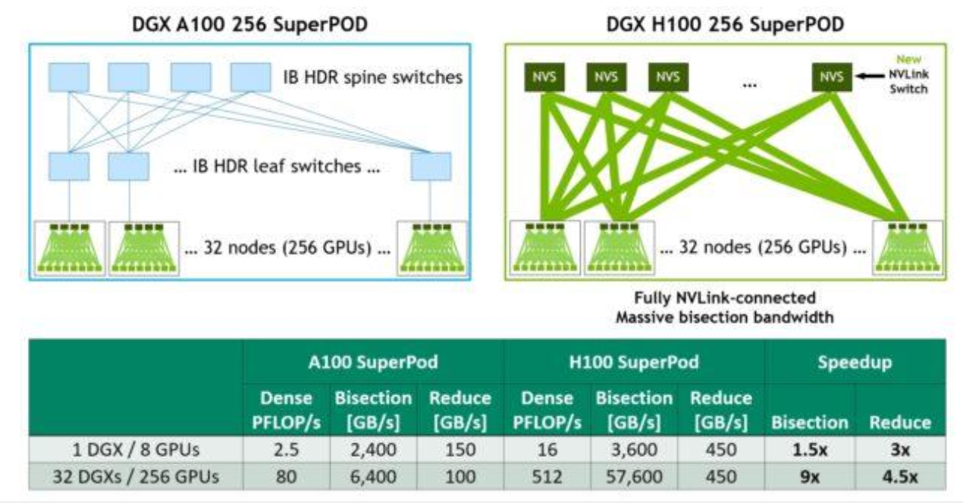
Introduction to Distributed LLM Training
Transition from foundational LLM inference to the computational realities of training.
  Inference memory is dominated by model weights and transient KV cache.
  Training introduces a massive memory footprint due to the need to preserve the entire computational graph and maintain high-precision optimizer states.
  A single hardware accelerator is insufficient; computation and memory must scale horizontally.
Introduction to the three core paradigms
  Data Parallelism, Tensor Parallelism, and Pipeline Parallelism.
Split memory/compute across GPUs and machines

Slide 5
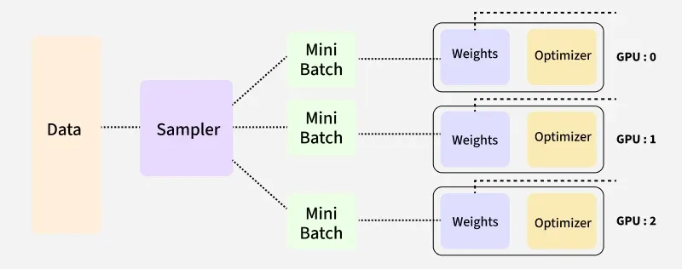
Introduction to Data Parallelism (DP)
Data Parallelism (DP) is the foundational distributed training strategy.
  Operates under the Single-Program Multiple-Data (SPMD) paradigm.
  The training dataset is partitioned into non-overlapping mini-batches.
  Every GPU receives a complete, identical replica of the model weight and optimizer states.
  Each accelerator computes forward and backward passes independently on its respective data shard.
DistributedDataParallel (DDP) is the standard module for DP in PyTorch.

Slide 6
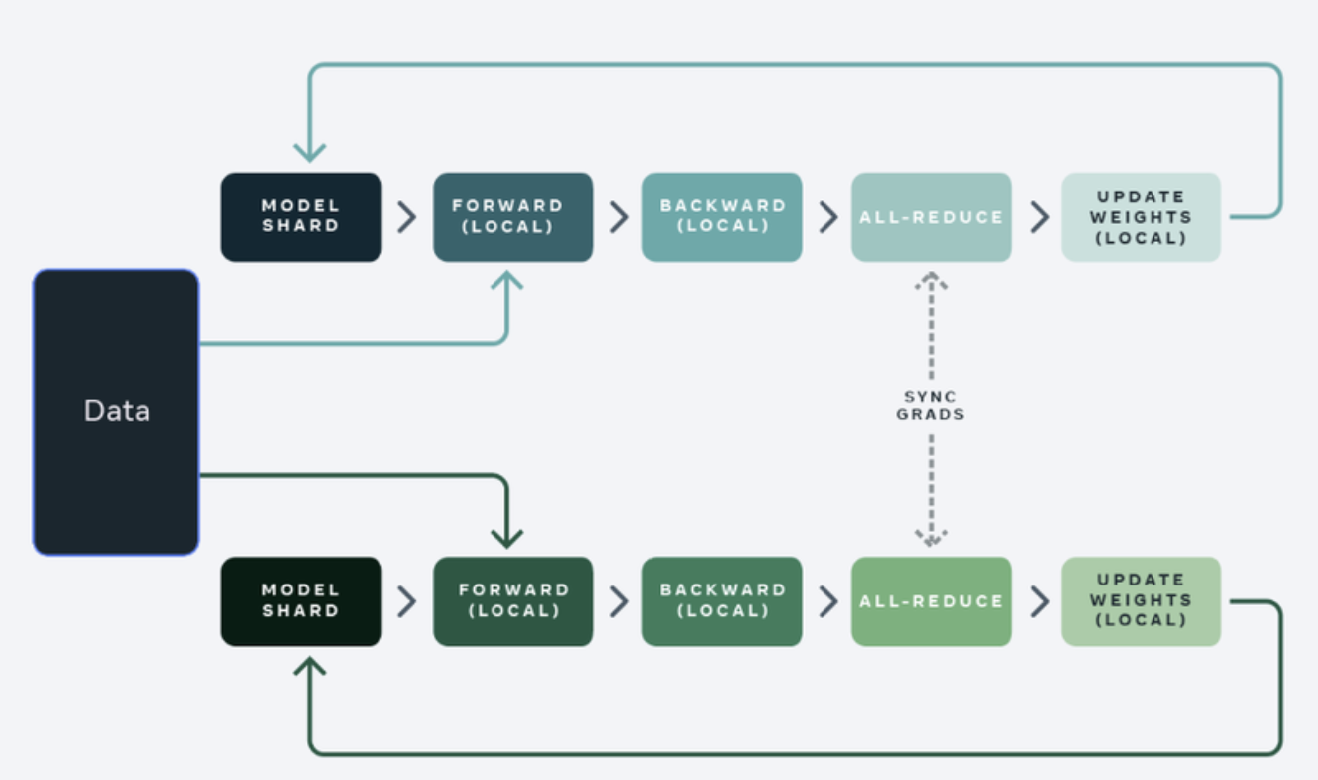
Introduction to Data Parallelism (DP)
Because each GPU computes gradients based on a different data shard, replicas would diverge without synchronization.
  The gradients computed by each GPU must be aggregated and averaged after every step.
All-Reduce efficiently sums the gradients across all nodes and broadcasts the result back, ensuring all replicas update identically.

Slide 7
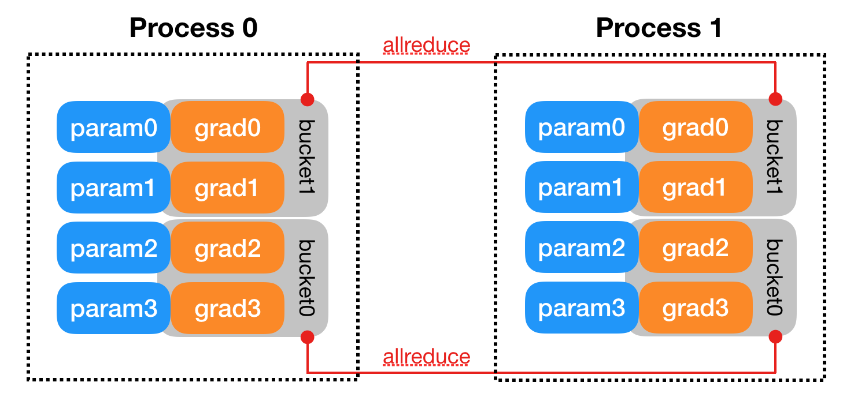
Gradient Bucketing in DDP
Launching independent All-Reduce operations for every individual parameter tensor results in network congestion.
DDP mitigates this via gradient bucketing.
  Parameter gradients are organized into configurable memory buckets
  The All-Reduce is only triggered when a bucket is completely filled during the backward pass.
  This dramatically reduces the total number of network calls and optimizes bandwidth.
https://docs.pytorch.org/docs/stable/notes/ddp.html

Slide 8
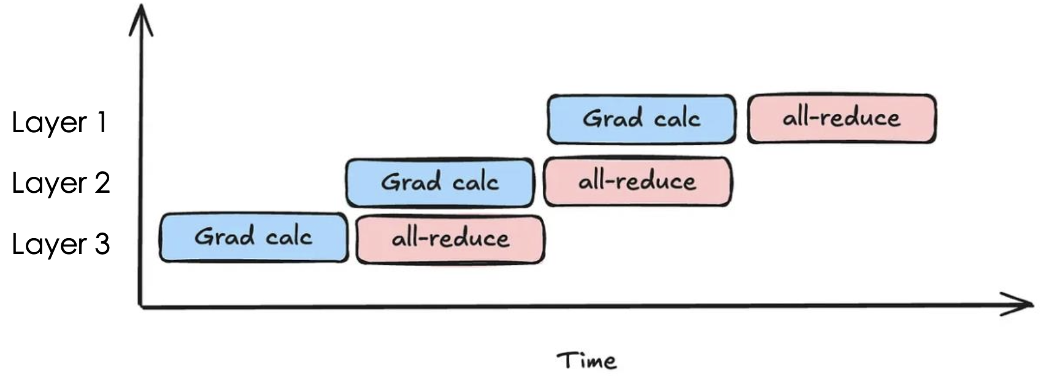
Compute-Communication Overlap in DDP
Communications (red blocks) are not on the backward compute critical path (blue blocks). Thus good compute communication overlap capability.
  1. grad_calc(layer i, gpu k) depends only on grad_calc(layer i -1, gpu k)
  2. All-reduce(layer i, gpu k) depends on grad_calc(layer i, all gpus)

Slide 9
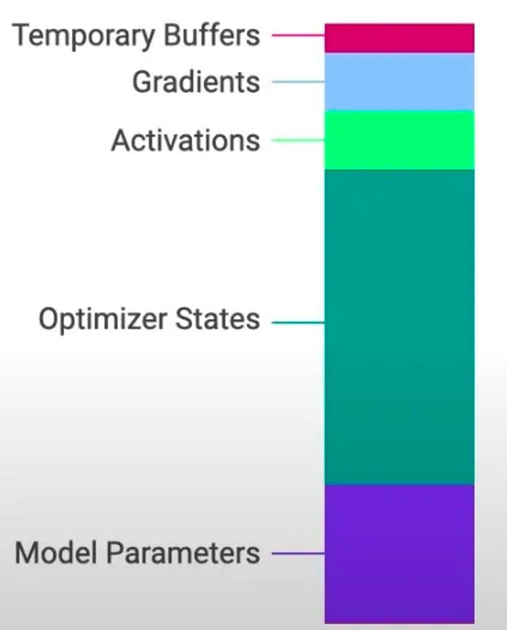
The Memory Crisis in LLM Training
Memory consumption comes from two folds:
  Storing the models weights in memory (usually in FP16)
  Storing the optimizer states (momentum and variance) in memory (usually inFP32, for accuracy purpose)
For a 7B model, storing the model’s weights in FP16 requires 14GB memory. The backward pass generates gradients requiring an additional 14GB.
Storing the optimizer states in FP32 requires 56G memory.
In total 70G memory used! Note that H100 GPU only has 80G memory
Memory composition during LLM training

Slide 10
The Memory Crisis in LLM Training
Standard DDP suffers from severe memory redundancy.
Training across 8 GPUs forces the cluster to maintain 8 complete copies of model weights, gradients, and massive FP32 optimizer states.
Redundant replication consumes High Bandwidth Memory without providing additional computational capacity.
Strictly limits the maximum trainable model size to the capacity of a single GPU, creating an insurmountable barrier for LLMs.

Slide 11
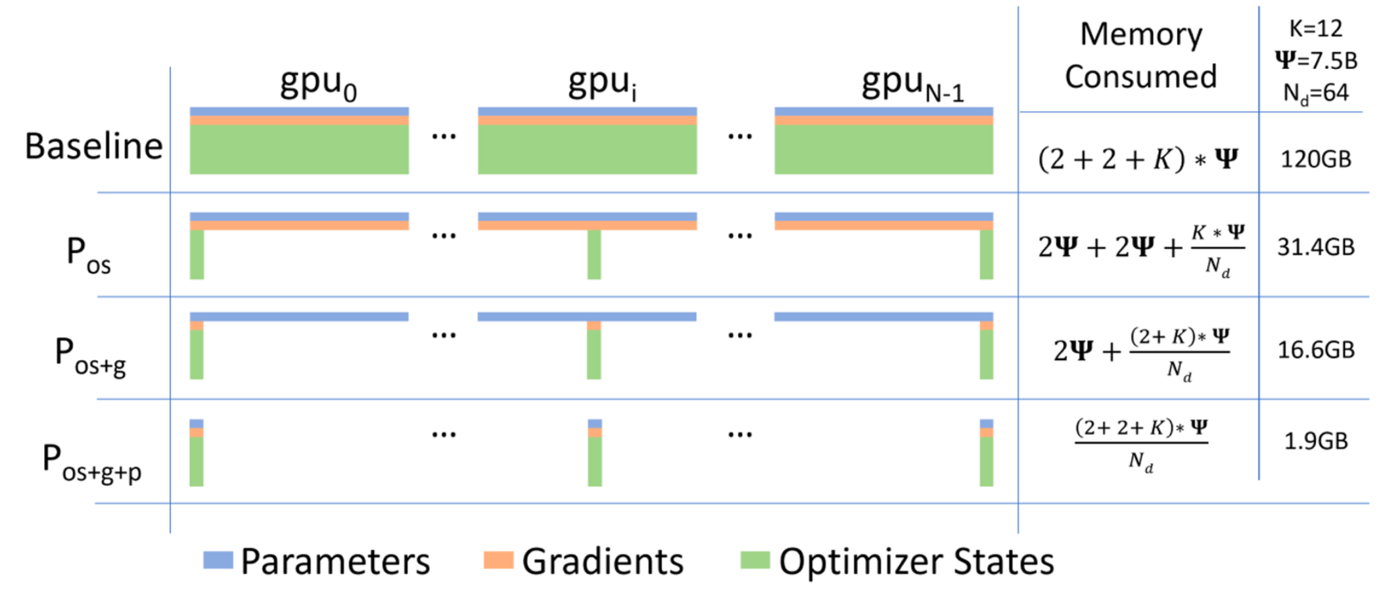
ZeRO – Solving the Memory Overhead Issue of DP
Core idea of ZeRO (Zero Redundancy Optimizer)
  Split up the expensive parts (state) and use the reduce-scatter equivalence.

Slide 12
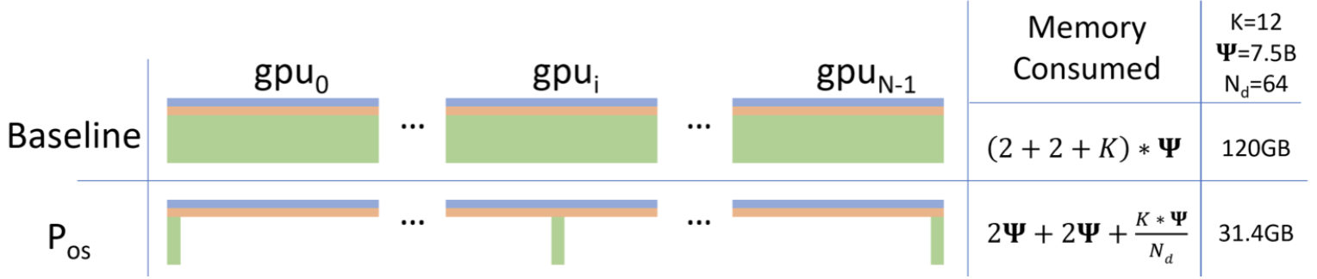
ZeRO Stage 1: Optimizer State Sharding (P_{os})
Split up the optimizer state (first + second moments) across GPUs
Each worker has the full parameters, and computes gradient on its subset of data.
Each worker is responsible for updating a shard of the full parameters

Slide 13
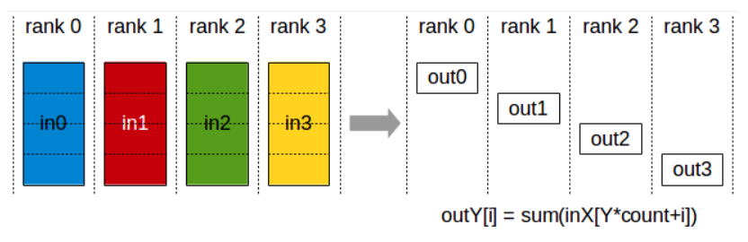
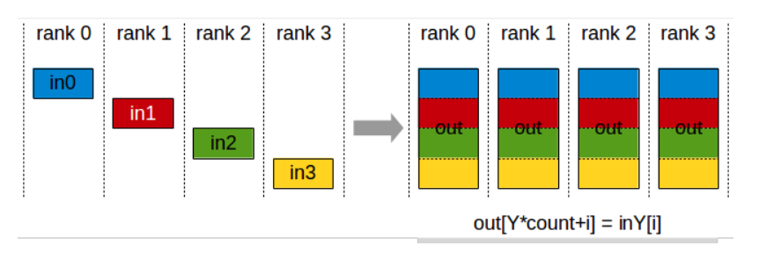
ZeRO Stage 1: Optimizer State Sharding (P_{os})
Each worker computes a full gradient on their subset of the data
ReduceScatter the gradients: each worker gets the full gradient corresponding to their parameter shard (#params communication cost).
Each worker updates their param using their gradient + state.
Perform an AllGather to synchronize params
  #params communication cost

Slide 14
Compare Naïve DP with ZeRO-1
ZeRO stage 1 is free (in the bandwidth limited regime) memory wins.
 | Naïve DDP | ZeRO-1
Communication Primitive | One all-reduce (full gradients) | One reduce-scatter (collect gradient slices) + one all-gather (sync the params)
Communication Cost | 2x #params | 2x #params
Memory | (4 + K) x #params | (4 + K / nGPUs) x #params
K is the bytes used by optimizer states for each param (typically 12 for FP32 momentum)

Slide 15
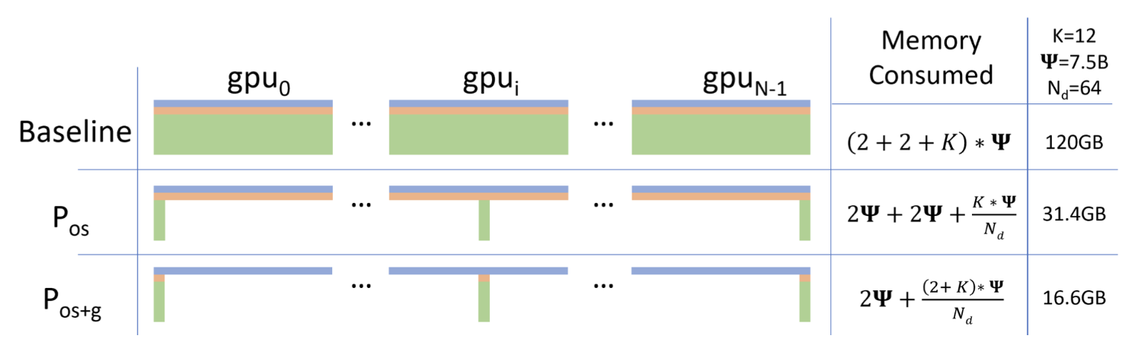
ZeRO Stage-2: Optimizer State + Gradient Sharding
High-level idea:
  Also keep the gradients (pink slices) sharded across the machines.
  Use the same (rough) tricks as stage 1.
Complexity: we can never instantiate a full gradient vector, but each worker must compute a full gradient (since we’re data parallel)

Slide 16
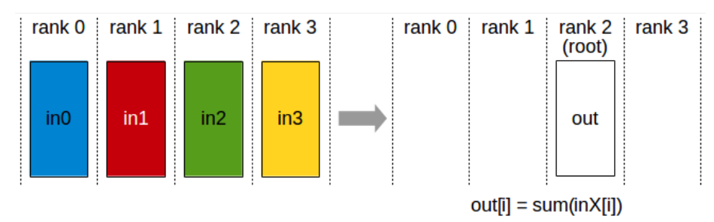
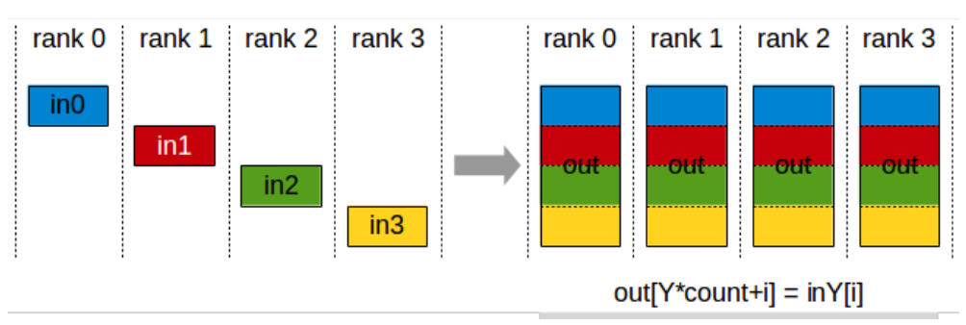
ZeRO Stage-2: Optimizer State + Gradient Sharding
Step 1. Everyone incrementally goes backward on the computation graph
  Step 1a. After computing a layer’s gradients, immediately reduce to send this to the right worker.
  Step 1b. Once gradients are not needed in the backward graph, immediately free it.
Step 2. Each machine updates their param using their gradient + state.
Step 3. All Gather the parameters.

Slide 17
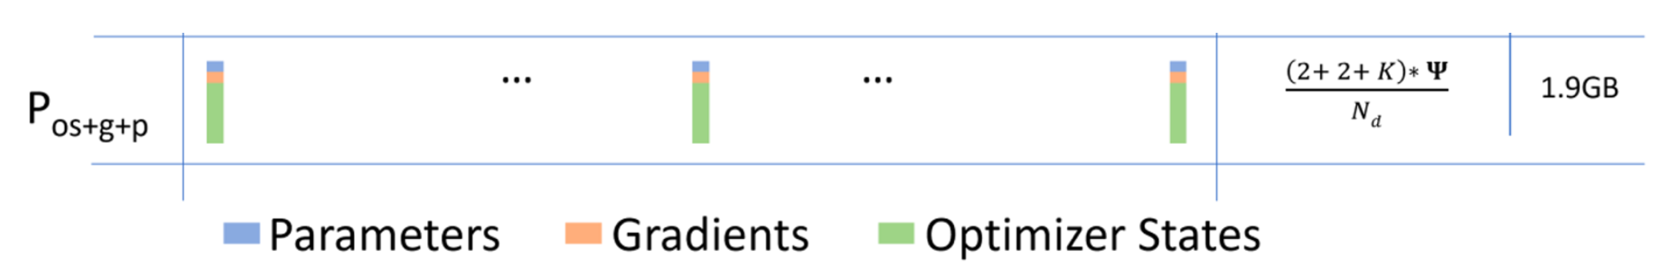
ZeRO Stage-3 (aka FSDP) Shard Everything
High-level ideas
  Shard everything, including parameters!
  Use the same “incremental communication / computation” ideas
  Send and request parameters on demand while stepping through the compute graph.

Slide 18
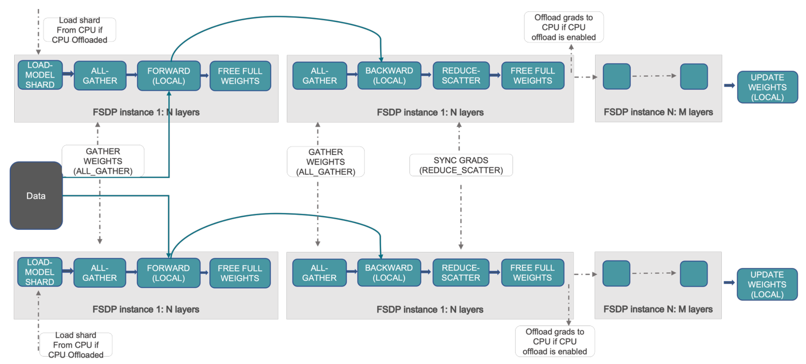
ZeRO Stage-3 (aka FSDP) Shard Everything
Communication cost – 2 all gather (#param), 1 reduce-scatter (#param).
https://pytorch.org/tutorials/intermediate/FSDP_tutorial.html

Slide 19
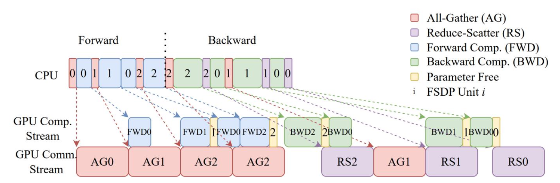
FSDP / ZeRO-3: Actual Picture
Incremental computation / communication
  Parameters / gradients are requested / sent and then immediately freed
Overlapping communication and computation
  The all-gathers happen all at once while forward happens, masking the comm cost.
https://arxiv.org/pdf/2304.11277.pdf

Slide 20
Communication Overhead Recap
DDP (All reduce): 2x #params
ZeRO Stage-1 / 2 (Reduce-Scatter + All-gather): 2x #params
  Memory saved for free
ZeRO Stage-3 / FSDP (All-gather + Reduce-scatter + All-gather): 3x #params
  More overhead

Slide 21
Revisiting GPU Memory Calculation
GPU memory consumption :=
Model parameters (in FP16) +
Gradients (FP16) +
Master weights (FP32) +
Adam momentum (FP32) +
Adam variance (FP32) +
Model Activations (This scales with the batch size)!
We will go through activation consumption more in the coming chapters

Slide 22
Conclusion
Summary: Training massive LLMs requires breaking the single-GPU memory barrier via state sharding.
ZeRO and FSDP elegantly solve capacity issues by partitioning states without sacrificing data-parallel simplicity.
The Next Bottleneck: As models reach hundreds of billions of parameters, even the pipelined layer-by-layer communication of FSDP bottlenecks the training cluster.
Solution: We must slice the actual matrix mathematics themselves -> Tensor Parallelism.

Slide 23
Lecture 29: Model Parallelism I (Tensor Parallelism)
Notes:
单击此处添加文本

Slide 24
Limitation of DP
Tensor Parallel
Sequence Parallel
Notes:
单击此处添加文本

Slide 25
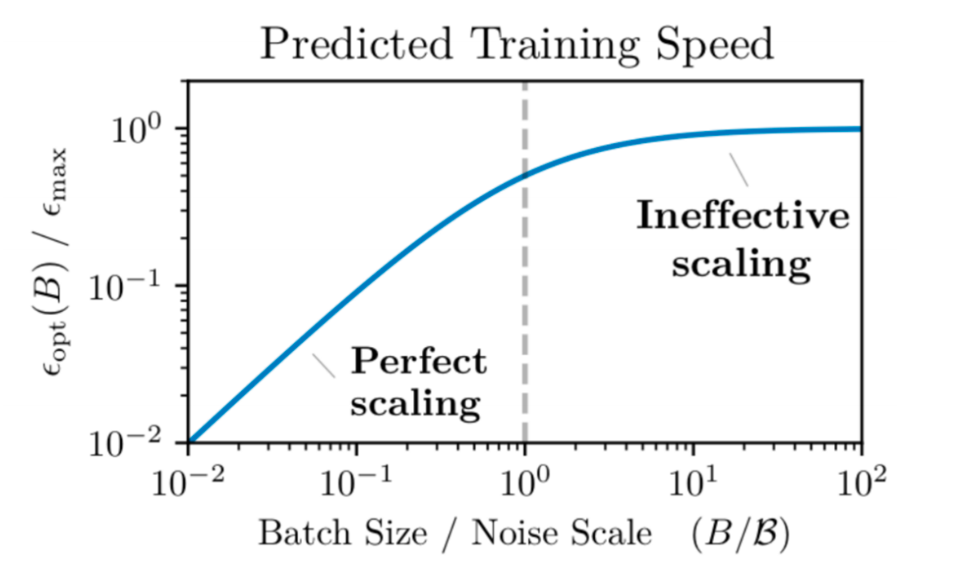
Issues remain with data parallel – compute scaling
With data parallel, #machines < batch size (and near this, comm overhead is high)
And there’s diminishing returns to batch sizes
Notes:
单击此处添加文本

Slide 26
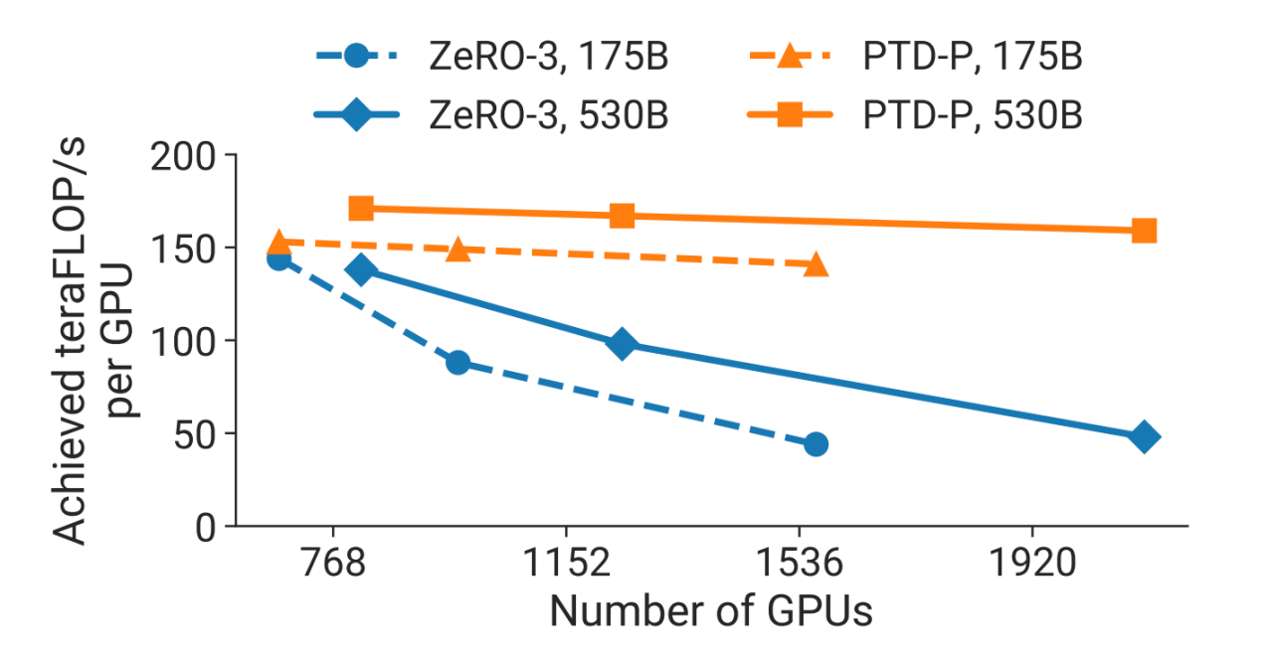
Issues remain with data parallel – models don’t fit
ZeRO-1 and ZeRO-2 don’t let you scale memory
ZeRO-3 is nice in principle, but can be slow and does not reduce activation memory
Activations ∝
seq_len × hidden_size ×
num_layers × global_batch_size
Out-of-memory (OOM) explosion !
Better ways to split up the model is needed…
Notes:
单击此处添加文本

Slide 27
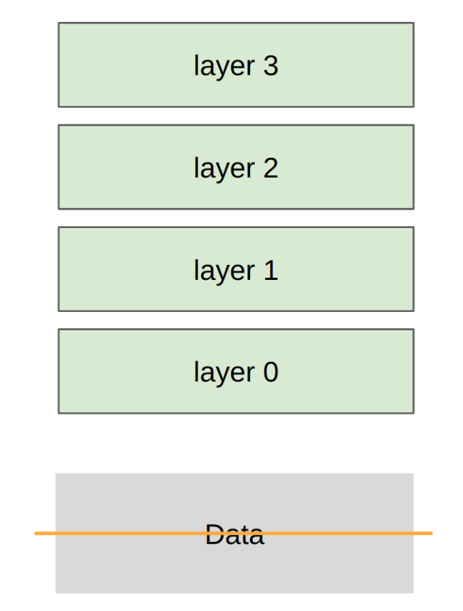
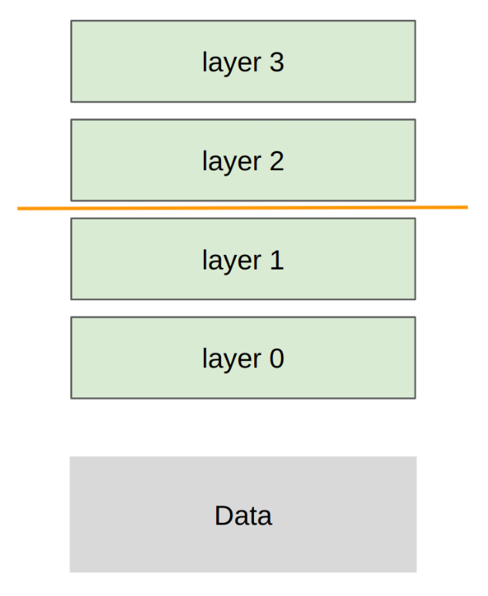
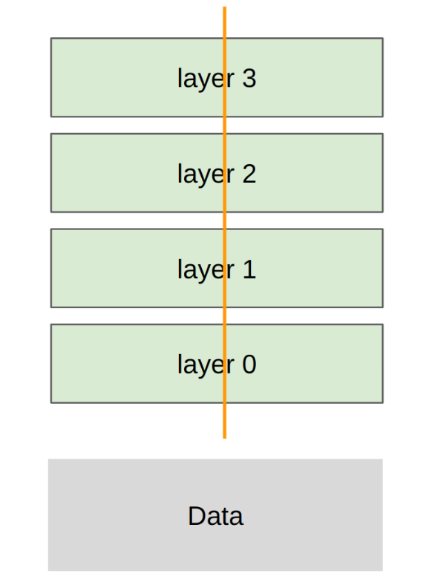
Model parallel along the different axes
Data Parallel
Pipeline Parallel
Tensor Parallel
Notes:
单击此处添加文本

Slide 28
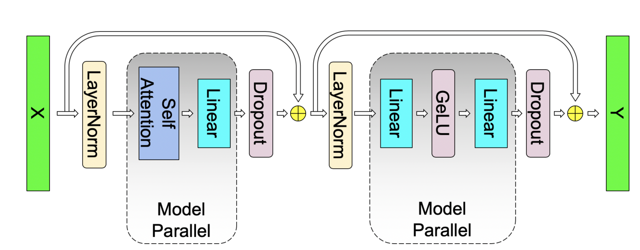
Tensor parallel – Basic Concept
The vast majority of LLM parameters reside in Linear Projections:
  Attention: Q, K, V, and Output projections.
  MLP: Up and Down projections.
These projections are General Matrix Multiplications (GEMM) (Y=XW)

Slide 29
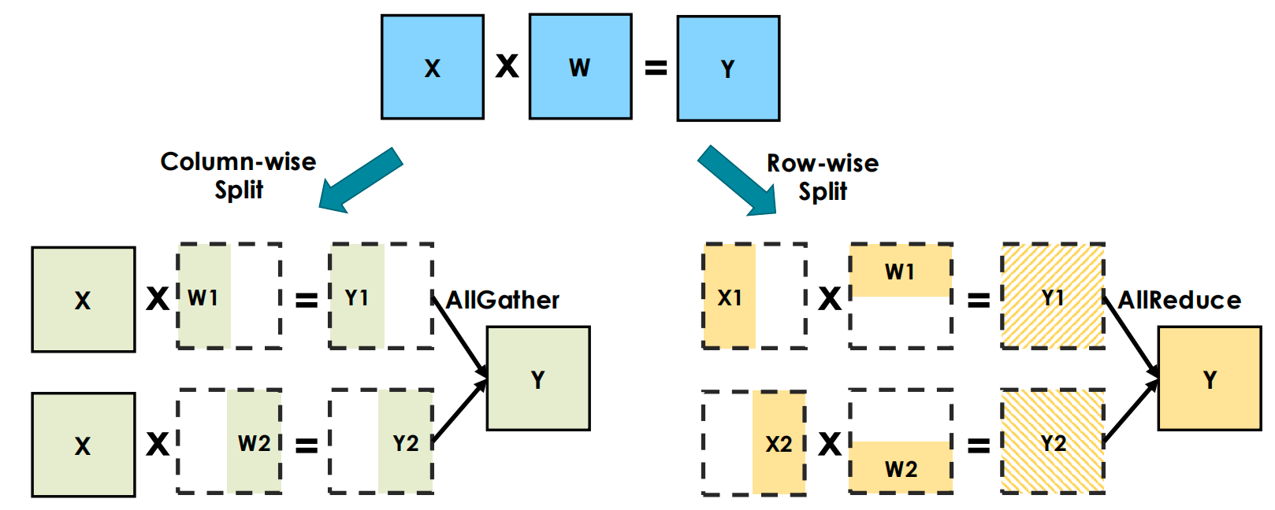
Tensor parallel – Basic Concept
Two ways to partitioning the GEMM to different GPUs：

Slide 30


Tensor parallel – Deconstructing the MLP Block
An MLP block consists of a linear expansion, a non-linear activation (GeLU), a linear projection back to hidden dimension and a dropout.
Mathematically,
Notes:
单击此处添加文本

Slide 31
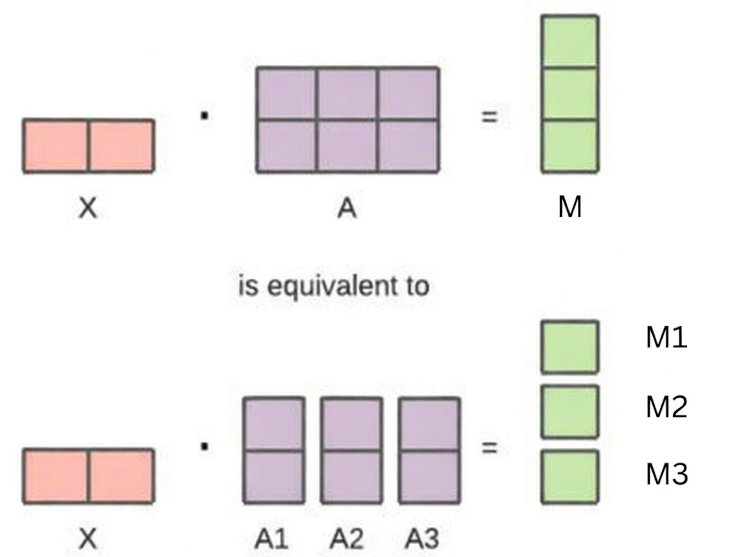

Tensor parallel – Deconstructing the MLP Block
Row-wise split of A: requires synchronization
Column-wise split of matrix A: the output can be fed into GeLU independently
Notes:
单击此处添加文本

Slide 32
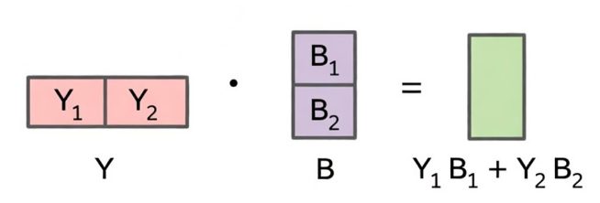
Tensor parallel – Deconstructing the MLP Block
Column-wise split of matrix A -> Column-wise split of Y
Column-wise split of Y + Row-wise split of B: block-wise matrix multiplication requires no synchronization
Notes:
单击此处添加文本

Slide 33
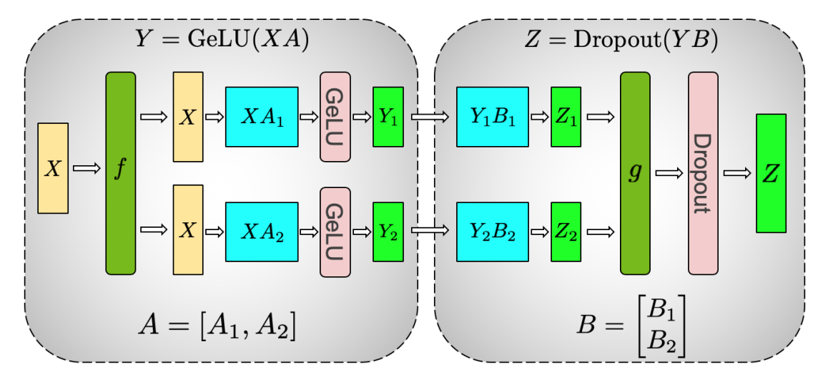
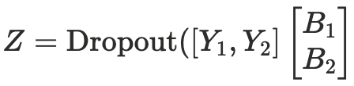
Tensor parallel – Deconstructing the MLP Block
Assign columns (A1, A2) and rows (B1, B2) to separate GPUs.
  In the forward pass, f is the identity, and g is an all-reduce.
  In the backward pass, f is an all-reduce, g is the identity.
MLP w.o. TP ===>
MLP w. TP ===>
Notes:
单击此处添加文本

Slide 34
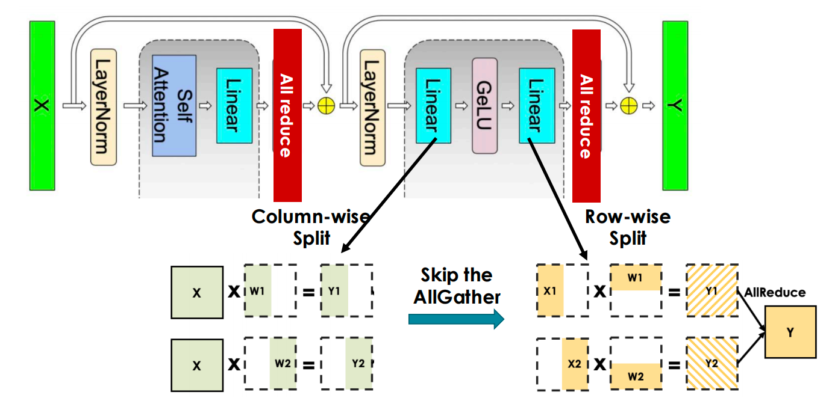
Tensor parallel – Tensor Parallelism for MLP
Interleaving split to minimize communication:
Notes:
单击此处添加文本

Slide 35
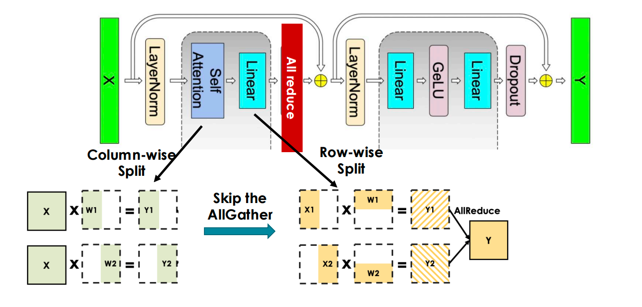
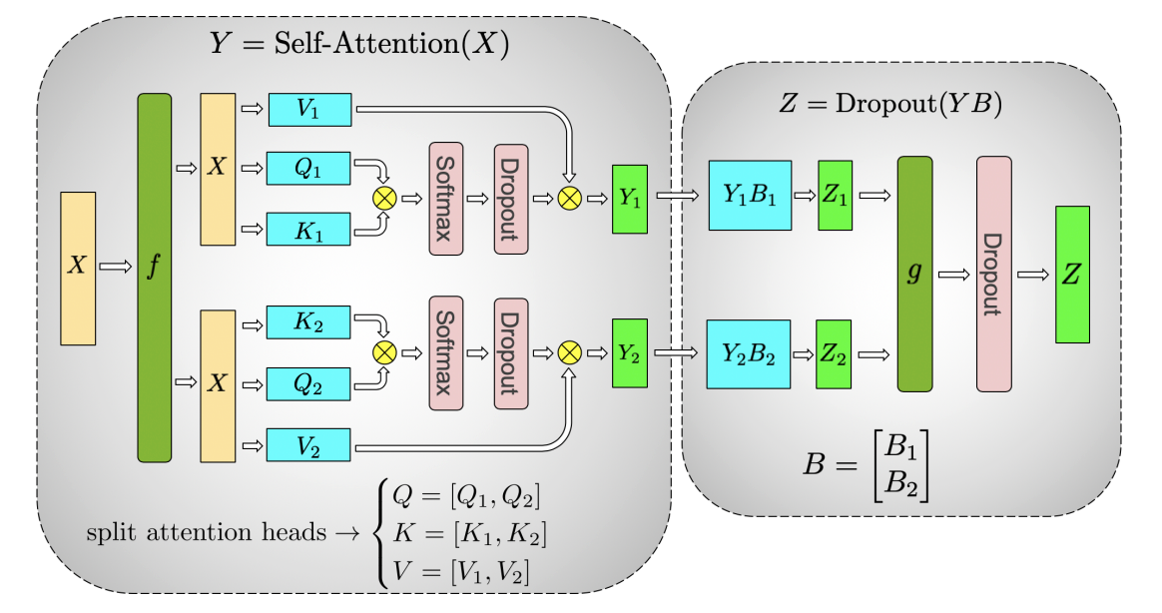
Tensor parallel – Tensor Parallelism for Attention
Interleaving split to minimize communication:
Notes:
单击此处添加文本

Slide 36
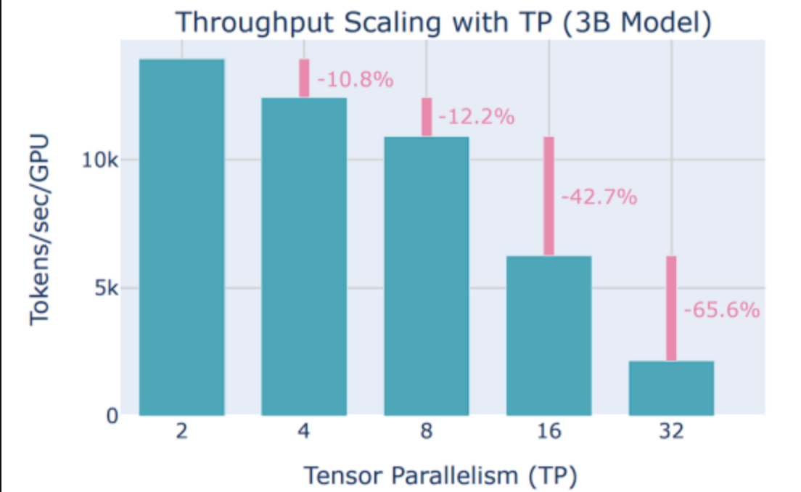
When to use TP?
On GPUs, tensor parallel within a node (up to 8 GPUs) due to high speed interconnects.
Notes:
单击此处添加文本

Slide 37
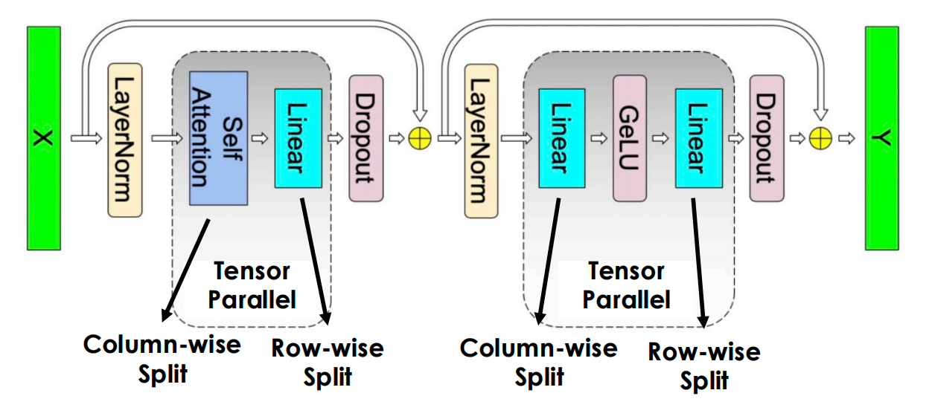
Limitation of TP
TP only splits GEMM
LayerNorm and DropOut are still replicated
  Full activation memory overhead [batch_size*seq_len, hidden_dim] on each TP partition
Notes:
单击此处添加文本

Slide 38
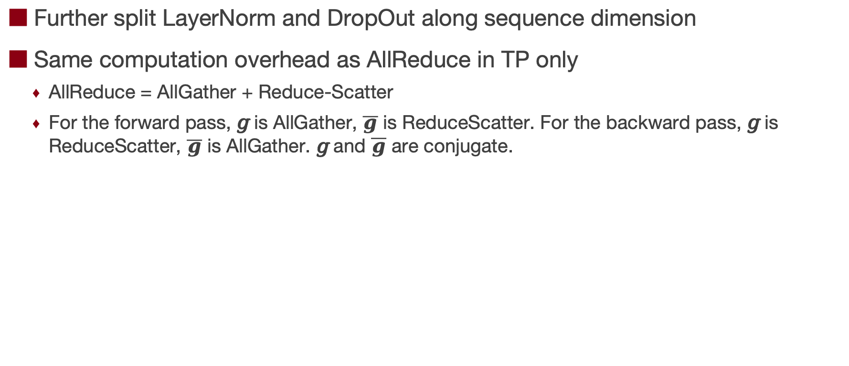
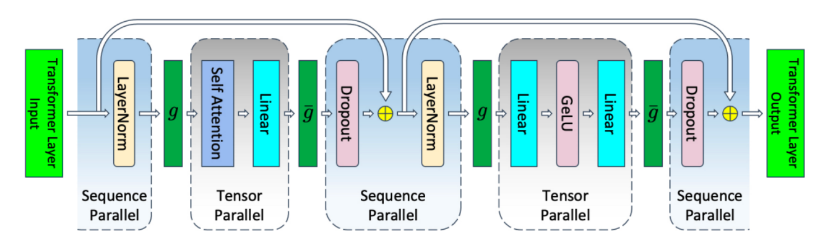
Tensor parallel – Sequence Parallel [MLSys’23]
Notes:
单击此处添加文本

Slide 39
Lecture 30: Model Parallelism II (Pipeline Parallelism)

Slide 40
Introduction to PP
PP Optimizations
  F-then-B
  1F1B
Advanced PP

Slide 41
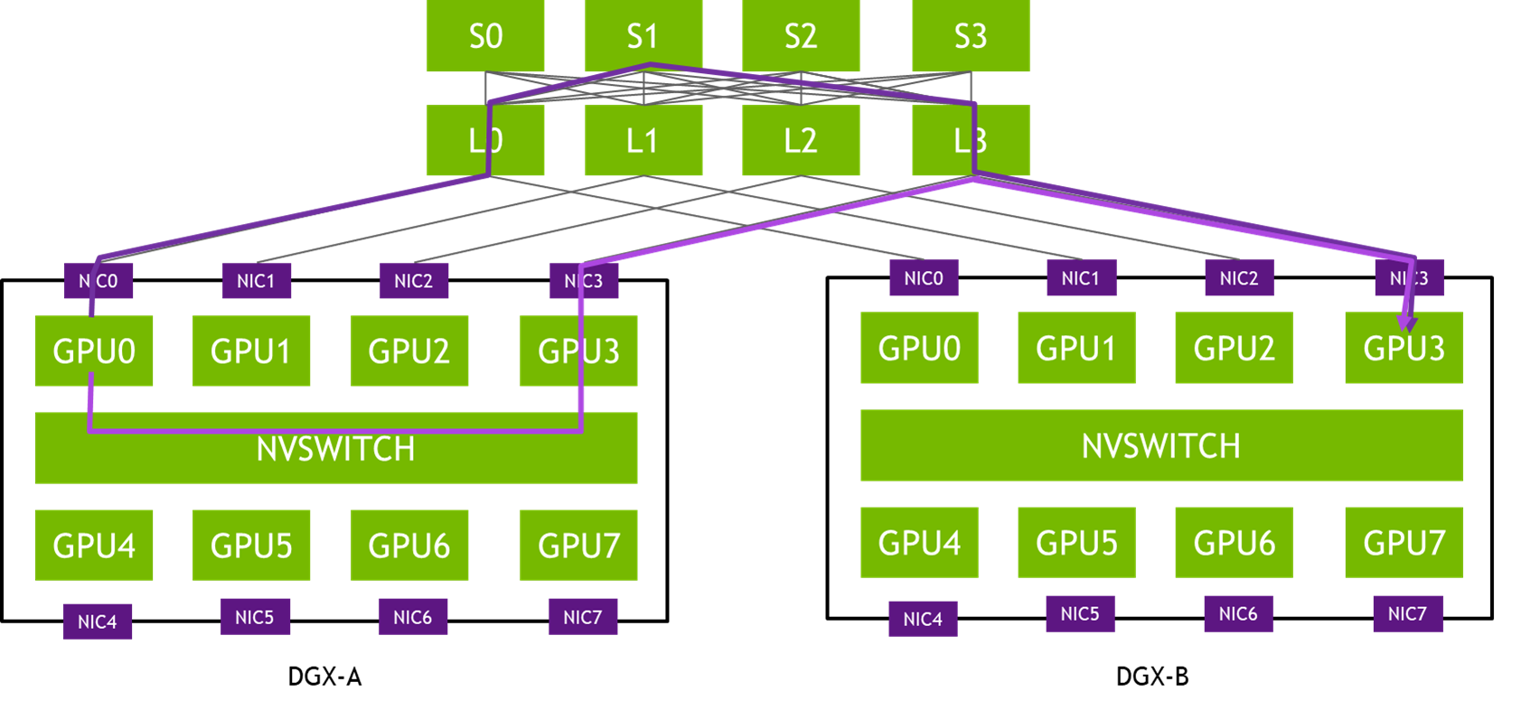
Introduction to Inter-Node Scaling
TP is computationally efficient but mathematically requires synchronous All-Reduce operations, rendering it unsuitable for inter-node scaling.
  Ethernet/Infiniband latency would catastrophically bottleneck GPU utilization.
  To scale deep LLMs across multiple nodes, the system must slice the model longitudinally.
Pipeline Parallelism (PP) assigns sequential blocks of layers to different physical nodes.

Slide 42
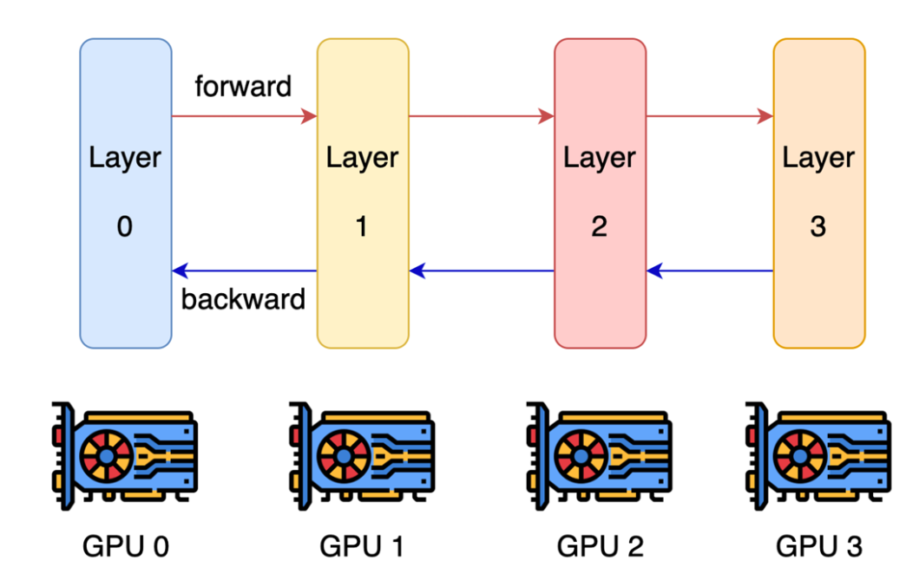
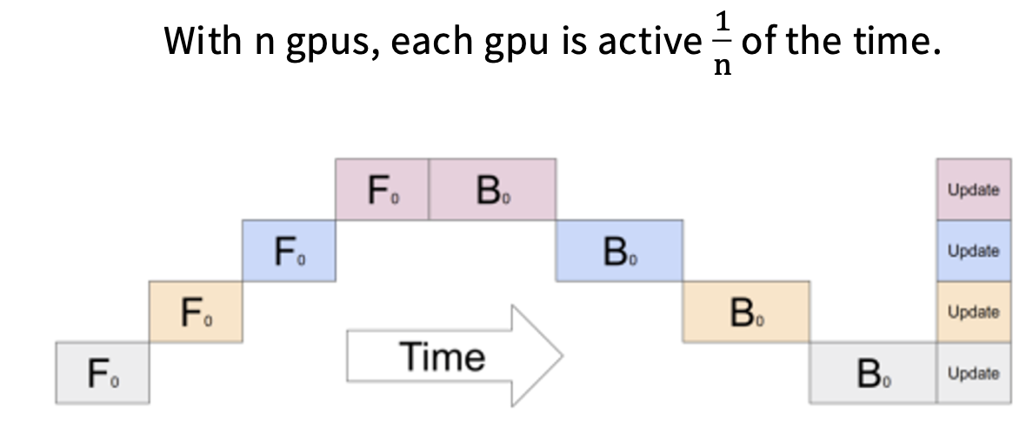
Pipeline Parallelism (PP)
Layer-wise parallel cuts up layers, assigns some subset to GPUs (K stages)
Activations and partial gradients are passed back and forth
Each GPU is idling most of the time, waiting for the backward pass to propagate back

Slide 43
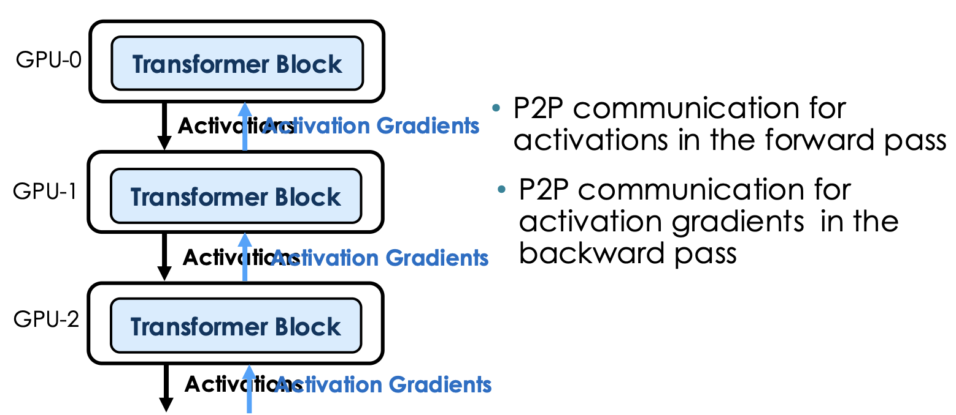
Pipeline Parallelism
Communication pattern

Slide 44
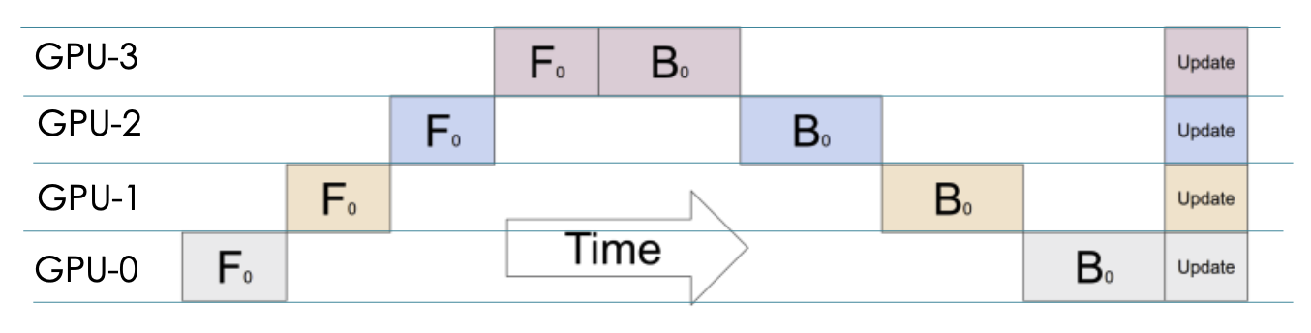
Pipeline Parallel: Forward-then-Backward
Execution timeline
How to make GPUs busy?
Batch split!

Slide 45
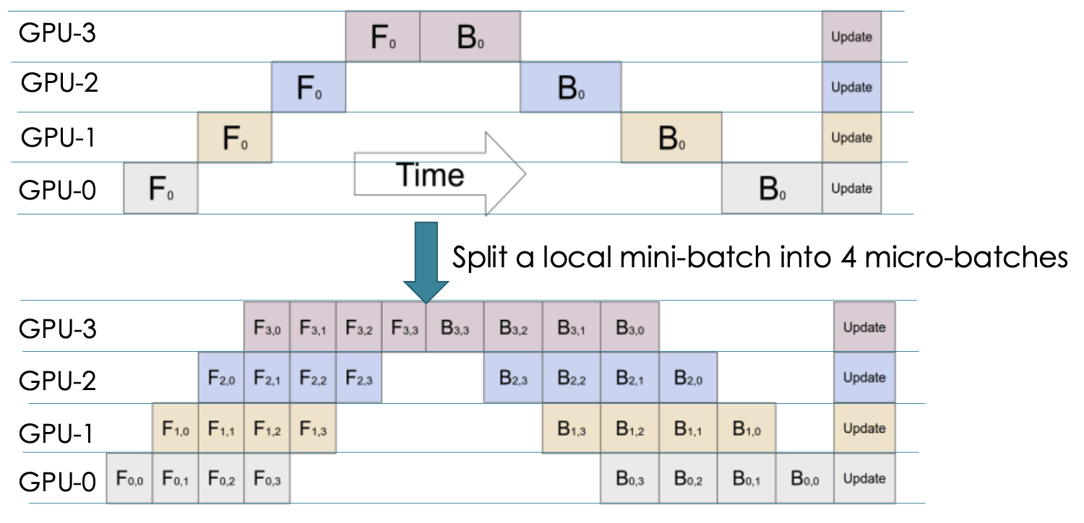
Pipeline Parallel: Forward-then-Backward
GPipe (Google, 2019)
Divide the global mini-batch into M smaller "micro-batches"
To maximize TFLOPS, increase Global Batch Size to fit more micro-batches into the pipe.

Slide 46
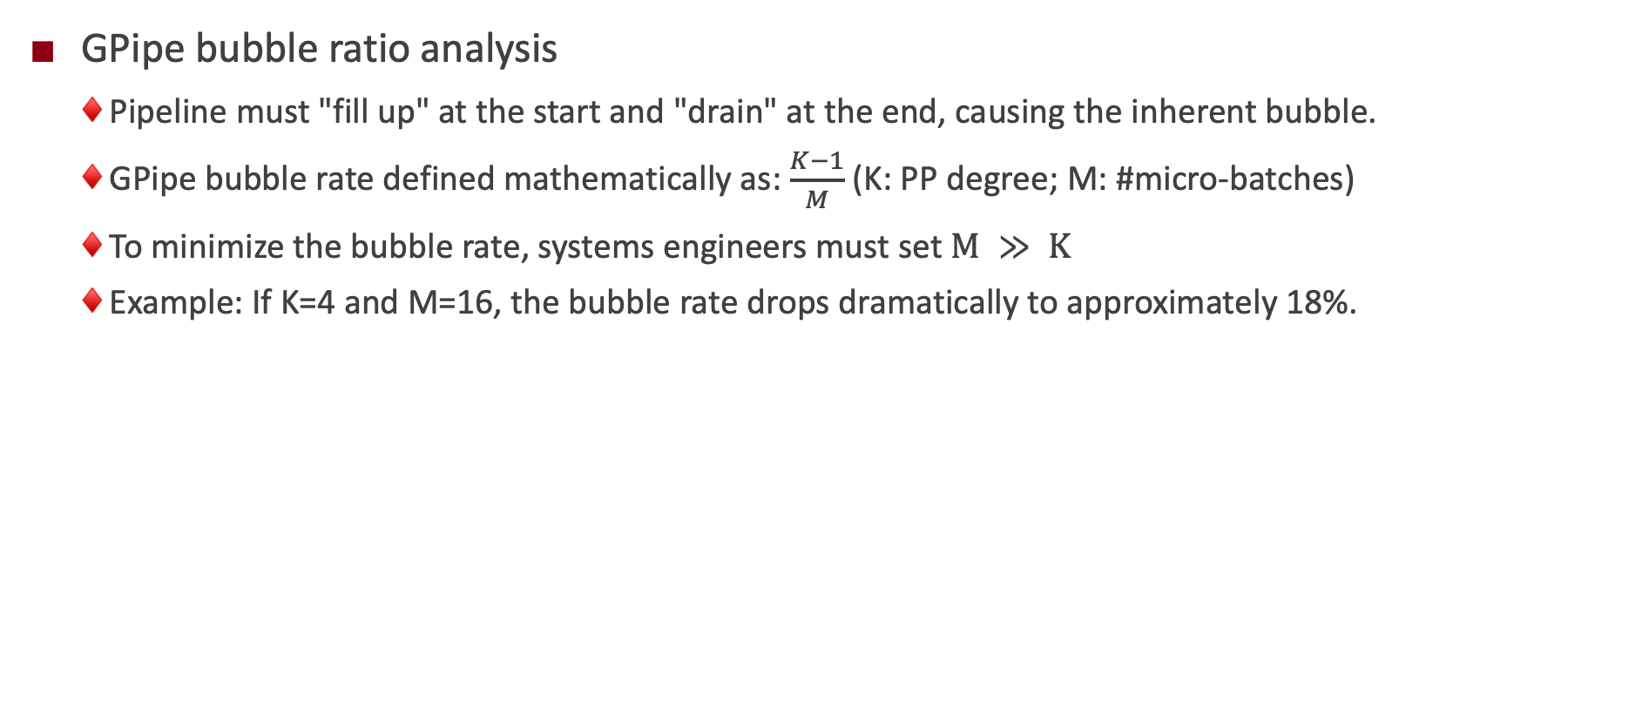
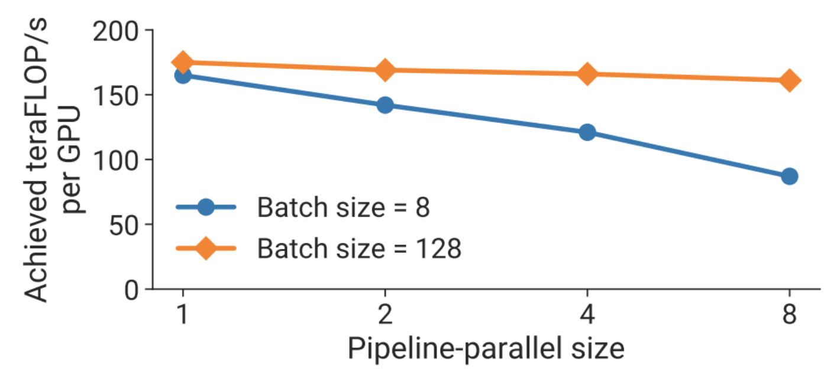
Pipeline Parallel: Forward-then-Backward

Slide 47
Why pipeline parallel?
1. Pipelines save memory (compared to DDP)
2. Pipelines can have good communication properties (compared to FDSP and TP)
  It depends only on activations and is point to point
Generally, we will use pipelines on slower network links (i.e. inter-node) as a way to get better memory-wise scaling.

Slide 48
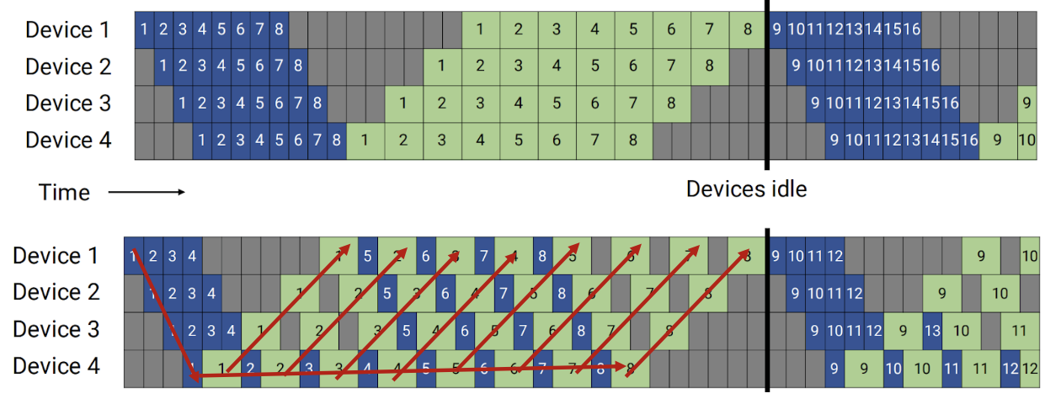
Pipeline Schedule Optimization
PipeDream proposes a “1F1B” schedule
  Once the warm-up phase concludes, GPUs alternate: compute one forward pass, immediately compute one backward pass.
  Prioritizes backward passes to change the lifecycle of cached data.
Peak on-the-fly
Micro-batches
GPipe
(F-then-B)
O(M)
PipeDream
(1F1B)
O(K)

Slide 49
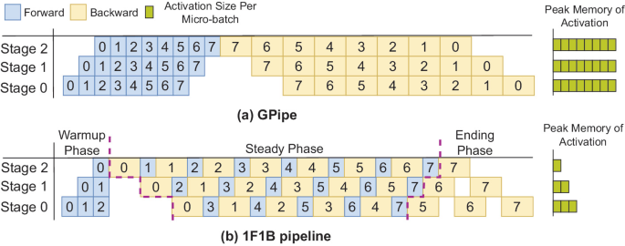
Pipeline Schedule Optimization
GPipe memory crisis
  GPipe is strictly synchronous: all M forward passes must complete before any backward pass begins.
  Backward passes absolutely require intermediate activations.
  Every pipeline stage must cache activations for all M micro-batches simultaneously.
  As M scales to shrink the bubble, activation memory scales linearly O(M), rapidly triggering OOM

Slide 50
Pipeline Schedule Optimization
1F1B memory footprint
  1F1B executes backward passes as early as mathematically possible.
  Heavily cached activations are consumed for gradients and instantly discarded.
  Max in-flight activations any GPU must store is strictly bounded by pipeline depth K, rather than M.
  Decouples peak activation memory from micro-batch count, allowing infinite M scaling (memory permitting).

Slide 51
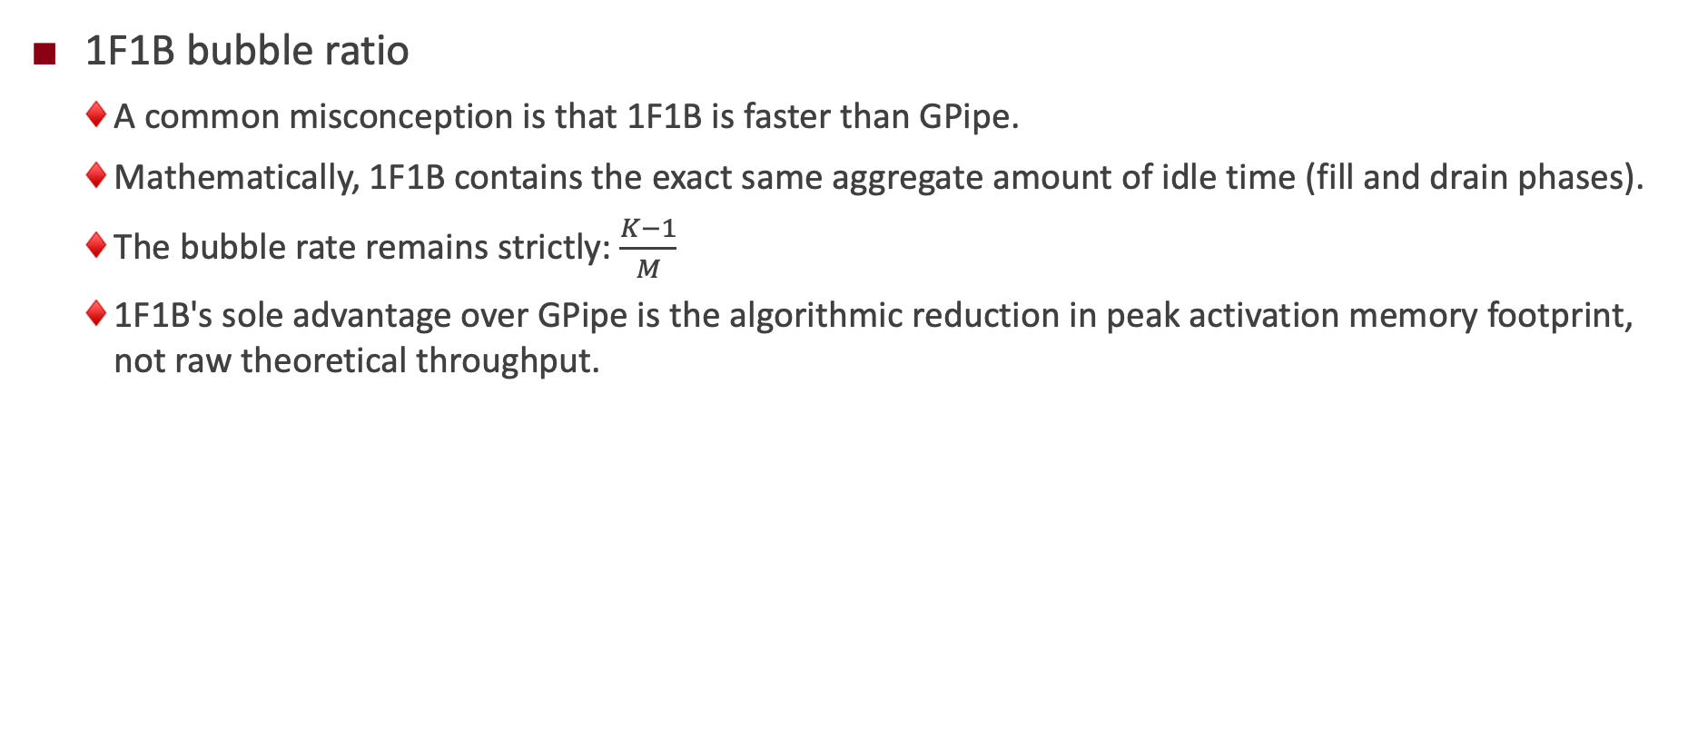
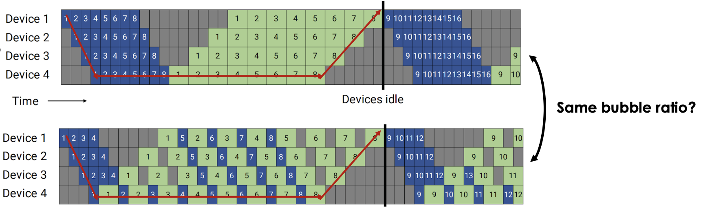
Pipeline Schedule Optimization
Notes:
单击此处添加文本

Slide 52
Limitations of 1F1B and Larger Batch Sizes
To achieve negligible bubble rates (<5%), M must be exceedingly high.
Global batch size is mathematically constrained by optimizer convergence limits.
If global batch size is fixed, scaling M shrinks individual micro-batch sizes toward 1.
Small micro-batches underutilize modern GPU Tensor Cores, destroying arithmetic intensity.
A novel schedule is required to reduce bubbles without increasing M.

Slide 53
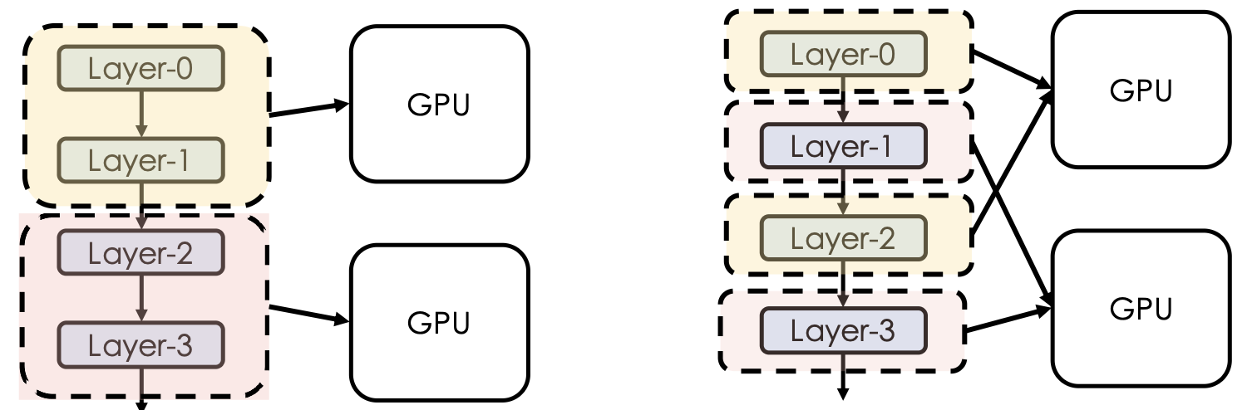
Interleaved 1F1B (Megatron-LM)
One micro batch will go through both GPU but now twice.
GPU are now busy working, just like we have two batches
One micro-batch will go through both GPU but only once

Slide 54
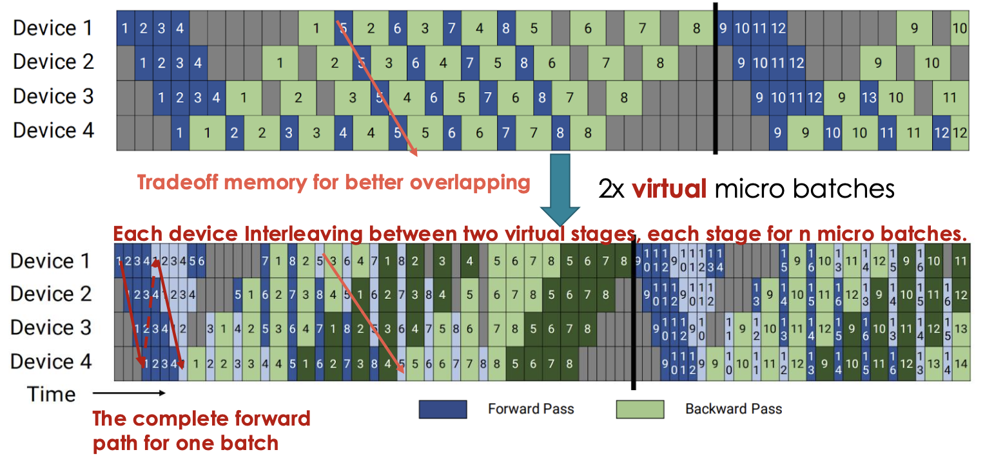
Interleaved 1F1B (Megatron-LM)
Divides the model into a larger number of "virtual stages" (V stages per GPU).
  GPU 1 is assigned Virtual Stage 1 (e.g., layers 1-2) and Virtual Stage 5 (e.g., layers 9-10) simultaneously

Slide 55
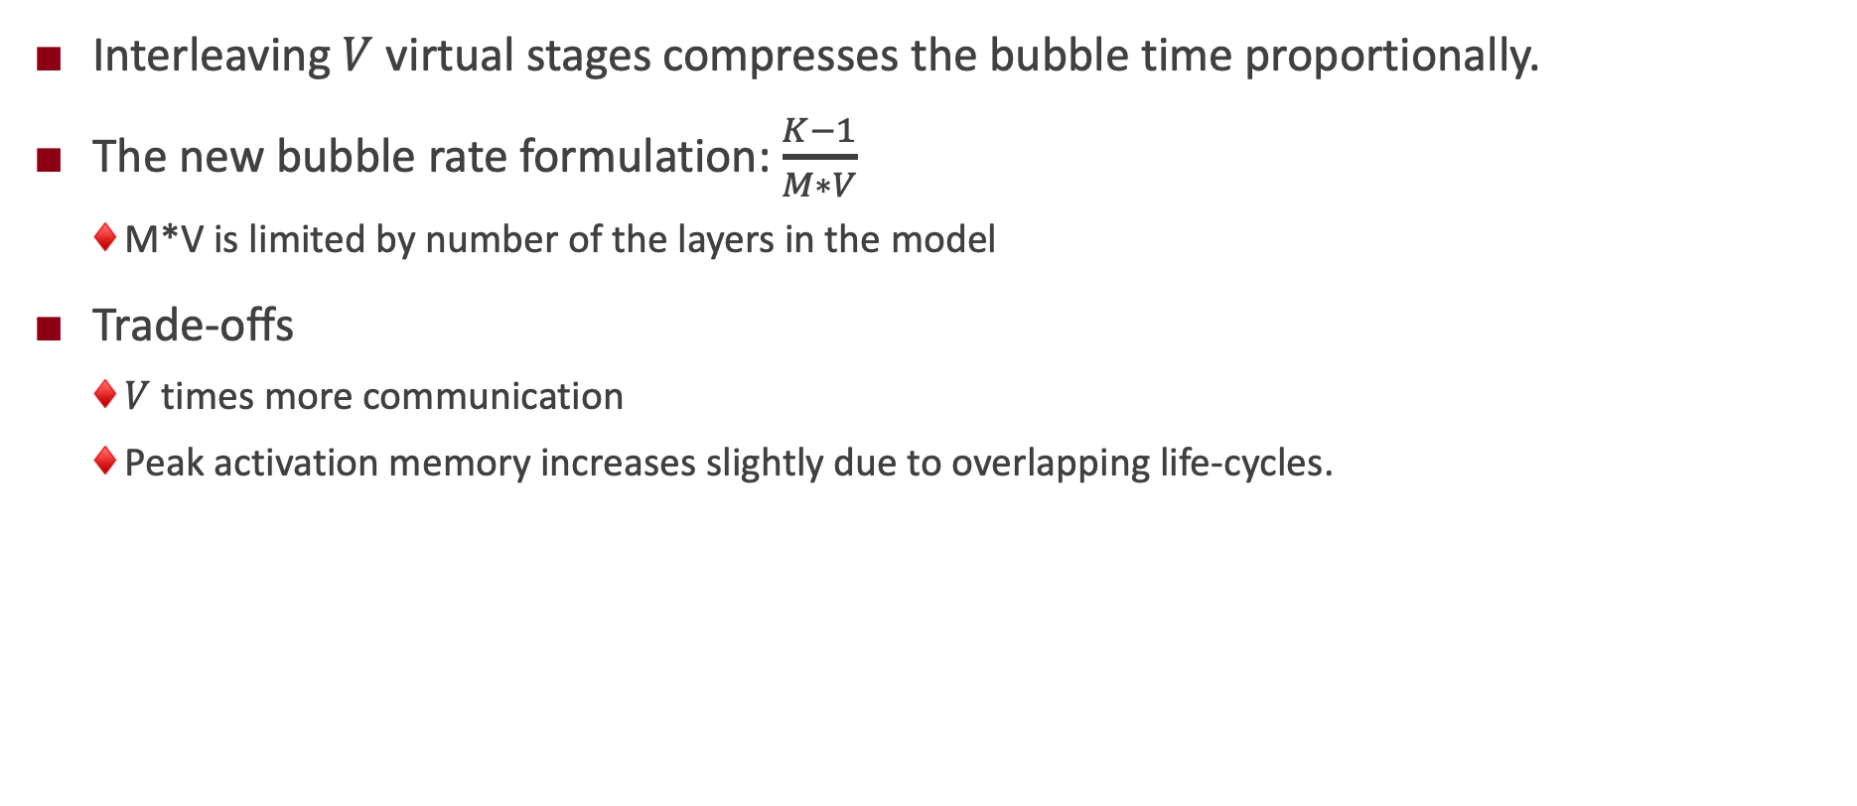
Interleaved 1F1B (Megatron-LM)

Slide 56
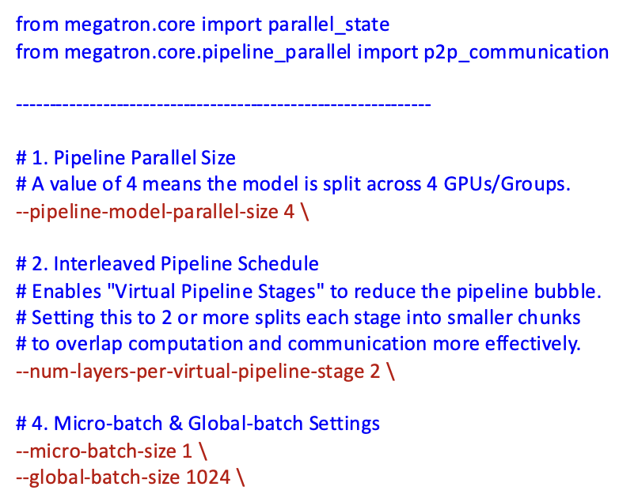
Interleaved 1F1B (Megatron-LM)
Megatron-core recommends Interleaved 1F1B by default
  #layers in virtual pipeline state typically set to 2-4.

Slide 57

Advanced PP: Zero-bubble Pipeline (ICLR’24)
Key insight:
  Separate blocking and non-blocking computation to enable more flexible pipeline schedule.

Slide 58

Advanced PP: Zero-bubble Pipeline (ICLR’24)
Small scale: Integer Linear Programming, for both memory and end-to-end makespan optimization
Large scale: heuristics
Less #PP communications than interleaved 1F1B, but similar/less bubbles.

Slide 59


Advanced PP: DeepSeek-V3 DualPipe (2025)
Sharding strategy
DeepSeek V3: https://arxiv.org/pdf/2412.19437v1, 2025

Slide 60

Advanced PP
https://selamjie.medium.com/the-frontier-of-pipeline-parallelism-an-overview-d4264cc9f877

Slide 61
Lecture 31: Communication Primitives

Slide 62

Scaling Law of LLMs
Model performance improves predictably as a power-law function of compute, data size, and parameter count.
NVL576
[1] https://arxiv.org/abs/2001.08361
[2] https://dnacap.fund/insights/exploring-the-landscape-of-large-language-models

Slide 63




AI computing systems are also scaling
Scale-up supernodes are on the rise…
NVL576
NVL72
Huawei CloudMatrix384
AMD Helios

Slide 64



Mapping LLMs on multiple GPUs/NPUs…
Multi-dimension Parallelisms
Expert Parallelism
Sequence Parallelism
[1] https://robotchinwag.com/posts/demystifying-tensor-parallelism/
[2] https://docs.nvidia.com/nemo/megatron-bridge/0.2.0/parallelisms.html
[2] https://aclanthology.org/2023.acl-long.134.pdf

Slide 65


Communication datapath in the AI systems
Scale-up: NVLINK, HCCS, Unified Bus
Scale-out: InifiniBand (IB), RoCE
Intra-node GPU communications via NVLINK or PCIe
Inter-node communications via RDMA NIC (IB)
[1] https://arxiv.org/html/2507.04786v1

Slide 66


Collective v.s. Point-to-point communications
Collective operations involve communication among a group of processes rather than just between pairs of processes. e.g., AllReduce, AllGather, Broadcast
Point-to-point: Send/Recv (Two-side), Put/Get (One-side)
[1] https://developer.nvidia.com/blog/scaling-ai-inference-performance-and-flexibility-with-nvidia-nvlink-and-nvlink-fusion/
[2] https://www.hiascend.com/developer/techArticles/20240809-1

Slide 67

Broadcast
Operations: copy an N-element buffer from the root rank (2) to all the ranks (0-3).
[1] https://docs.nvidia.com/deeplearning/nccl/user-guide/docs/usage/collectives.html

Slide 68

Reduce
Operations: performs reduction on data (for example, sum, min, max) across devices and stores the result in the receive buffer of a specified root rank.
[1] https://docs.nvidia.com/deeplearning/nccl/user-guide/docs/usage/collectives.html

Slide 69

Gather
Operations: gathers N values from k ranks into an output buffer on the root rank of size k*N.
[1] https://docs.nvidia.com/deeplearning/nccl/user-guide/docs/usage/collectives.html

Slide 70

Scatter
Operations: distributes a total of N*k values from the root rank to k ranks, each rank receiving N values.
[1] https://docs.nvidia.com/deeplearning/nccl/user-guide/docs/usage/collectives.html

Slide 71

AllReduce
Operations: performs reductions on data (for example, sum, min, max) across devices and stores the result in the receive buffer of every rank.
[1] https://docs.nvidia.com/deeplearning/nccl/user-guide/docs/usage/collectives.html

Slide 72

AllGather
Operations: gathers N values from k ranks into an output buffer of size k*N, and distributes that result to all ranks.
  The output is ordered by the rank index.
  This operation is therefore impacted by a different rank to device mapping.
[1] https://docs.nvidia.com/deeplearning/nccl/user-guide/docs/usage/collectives.html

Slide 73

ReduceScatter
Operations: performs the same operation as Reduce, except that the result is scattered in equal-sized blocks between ranks, each rank getting a chunk of data based on its rank index.
  This operation is therefore impacted by a different rank to device mapping.
[1] https://docs.nvidia.com/deeplearning/nccl/user-guide/docs/usage/collectives.html

Slide 74

AlltoAll
Operations: each rank provides an input buffer of size N values, where the j-th chunk of N/k values is sent to destination rank j. Each rank receives an output buffer of size N values, where the i-th chunk of N/k values comes from source rank i.
[1] https://docs.nvidia.com/deeplearning/nccl/user-guide/docs/usage/collectives.html

Slide 75



Take FSDP (PyTorch) as an example
DP, DDP, FSDP: Data Parallelism, Distributed DP, Fully Sharded DP
What is DP: multiple model copies on different devices.
Inference is simple.
[1] https://www.uber.com/en-JP/blog/horovod/
All-reduce operators
Notes:
单击此处添加文本

Slide 76

Take FSDP (PyTorch) as an example
DP, DDP, FSDP: Data Parallelism, Distributed DP, Fully Sharded DP
DDP is recommended: optimized all-reduce (ring-based) + distributed support
DP: reduce op is executed on node 0 (imbalance); DDP: ring-based all-reduce.
DDP: robust multi-process support.
[1] https://docs.pytorch.org/docs/stable/notes/ddp.html
Notes:
DP 线程同步开销比较大；单进程多线程；all-reduce是汇聚到0卡上算，不均衡；不支持多机

Slide 77

Take FSDP (PyTorch) as an example
DP, DDP, FSDP: Data Parallelism, Distributed DP, Fully Sharded DP
Before FSDP, we profile the memory utilization during the LLM training.
  Model params account for only a portion of the
  total memory consumption during training.
  We need to consider the optimizer states and
  gradients.
Core Idea: removing redundant data.
ZeRO (Zero Redundancy Optimizer).
[1] https://docs.pytorch.org/docs/stable/notes/ddp.html
Notes:
DP 线程同步开销比较大；单进程多线程；all-reduce是汇聚到0卡上算，不均衡；不支持多机

Slide 78

Take FSDP (PyTorch) as an example
DP, DDP, FSDP: Data Parallelism, Distributed DP, Fully Sharded DP
ZeRO with different opt levels:
  ZeRO-1: Shards the optimizer states (Optimizer States Sharding).
  ZeRO-2: Shards both optimizer states and gradients (Optimizer States & Gradients Sharding).
  ZeRO-3: Shards the optimizer states, gradients, and model parameters (Optimizer States & Gradients & Parameters Sharding).
ZeRO3 will introduce the extra communications because of the partitions of model parameters.
K denotes the memory multiplier of the optimizer states
[1] https://docs.pytorch.org/docs/stable/notes/ddp.html
[2] https://www.youtube.com/watch?v=czgA-MbAdvA&t=2550s
Notes:
略过过程，直接到结论，Zero1和2的通信量和普通DP一样，每张卡都是2倍的参数量；
标准DP：用ReduceScatter和Allgather两步完成all-reduce，正好是二倍的参数量。
Zero1: 先用 ReduceScatter 把梯度 Reduce 到不同显卡上，每个显卡有一份平均后的 Gradient （这里的一份代表的是每个 Device 有一小份平均后的 Gradient），利用这个 Gradient 更新 Optimizer 和参数，再把更新后的模型参数通过 AllGather 分发到所有显卡上，整体来看跟原来的DP保持一致。
Zero2: Zero1相当于白存了很多gradient？所以每次发过去gradient就可以；也是2倍参数量；
Zero3: 在Zero2的基础上再切参数；增加了一次参数all-gather的参数量;

Slide 79


Take FSDP (PyTorch) as an example
DP, DDP, FSDP: Data Parallelism, Distributed DP, Fully Sharded DP
FSDP: sharding model parameters/gradient/optimizer states for GPU memory reduction (ZeRO3).
All-reduce =
Reduce-scatter + all-gather
[1] https://docs.pytorch.org/tutorials/intermediate/FSDP_tutorial.html
[2] https://arxiv.org/abs/2304.11277
Notes:
还是以数据并行度2为例，假设batchsize为1024，FSDP步骤如下：
数据并行将数据拆分为2个512小batch，并送到两张卡的训练进程上
两个进程各自维护模型的一部分参数，利用自己的512数据进行前向和反向
模型前向时需要执行all_gather操作，以使每个进程拿到所有权重
模型反向时也需要执行all_gather拿到权重，以及reduce_scatter同步进程间的梯度
当内存不足时，FSDP还支持将梯度卸载到CPU上
最后使用同步后的梯度更新各自进程上的模型参数

Slide 80



Implementations of collective communication op.s
All-reduce = Reduce-scatter + all-gather
The implementations
highly depends on
the hardware topology
NVIDIA GPU CLOS Topology
Ring All-reduce
HUAWEI NPU Full-mesh Topology
[1] https://docs.pytorch.org/tutorials/intermediate/FSDP_tutorial.html
[2] https://arxiv.org/abs/2304.11277
Notes:
还是以数据并行度2为例，假设batchsize为1024，FSDP步骤如下：
数据并行将数据拆分为2个512小batch，并送到两张卡的训练进程上
两个进程各自维护模型的一部分参数，利用自己的512数据进行前向和反向
模型前向时需要执行all_gather操作，以使每个进程拿到所有权重
模型反向时也需要执行all_gather拿到权重，以及reduce_scatter同步进程间的梯度
当内存不足时，FSDP还支持将梯度卸载到CPU上
最后使用同步后的梯度更新各自进程上的模型参数

Slide 81
Lecture 32: Communication Topology Optimization

Slide 82
Implementations of collective communication op.s
All-reduce = Reduce-scatter + all-gather
The implementations
highly depends on
the hardware topology
NVIDIA GPU CLOS Topology
Ring All-reduce
HUAWEI NPU Full-mesh Topology
[1] https://docs.pytorch.org/tutorials/intermediate/FSDP_tutorial.html
[2] https://arxiv.org/abs/2304.11277
Notes:
单击此处添加文本

Slide 83


Topologies in the modern AI systems
NVIDIA GPU Clos Topology
GOOGLE TPU Torus Topology
HUAWEI NPU Full-mesh Topology
Dragonfly Topology
[1] https://ieeexplore.ieee.org/document/6337589/
Notes:
单击此处添加文本

Slide 84

Take AllReduce as an example
Start from a naive implementation with root rank = 0.
  Data transfer volume: 2 * (N-1) * K
There are three disadvantages
  The bandwidth and computation of Rank 0 become bottleneck.
  There are many idle resources during the allreduce (Rank 1 – N-1).
  Poor scalability and lacks the consideration of topology.
How can we improve it?
  Scatter the data transfer and computation workload to all of the ranks.
Solutions:
  Tree-based, ring-based, halving-doubling, etc.
Notes:
单击此处添加文本

Slide 85

Take AllReduce as an example
Tree-based AllReduce Algorithm
  Build a hierarchical relation with the root of tree (Rank 0).
  Stage 1: Bottom-up Reduce
  Stage 2: Top-down Broadcast
Rank 0
Rank 7
0
1
2
3
4
5
6
7
0+1
1
2+3
3
4+5
5
6+7
7
S1 Reduce
0+1+2+3
1
2+3
3
4+5+6+7
5
6+7
7
SUM(0,7)
1
2+3
3
4+5+6+7
5
6+7
7
Notes:
单击此处添加文本

Slide 86
Take AllReduce as an example
Tree-based AllReduce Algorithm
  Build a hierarchical relation with the root of tree (Rank 0).
  Stage 1: Bottom-up Reduce
  Stage 2: Top-down Broadcast
Rank 0
Rank 7
SUM(0,7)
1
2
3
4
5
6
7
SUM(0,7)
1
2
3
SUM(0,7)
5
6
7
S2 Broadcast
SUM(0,7)
1
SUM(0,7)
3
SUM(0,7)
5
SUM(0,7)
7
SUM(0,7)
SUM(0,7)
SUM(0,7)
SUM(0,7)
SUM(0,7)
SUM(0,7)
SUM(0,7)
SUM(0,7)
Notes:
单击此处添加文本

Slide 87
Take AllReduce as an example
Tree-based AllReduce Algorithm
  Build a hierarchical relation with the root of tree (Rank 0).
  Stage 1: Bottom-up Reduce
  Stage 2: Top-down Broadcast
Advantages
  Parallel data transfer and reduce operations.
  Logarithmic complexity (the naive version has linear complexity).
  It excels with small data sizes because of the low latency.
Disadvantages
  It still has idle computing and bandwidth resources.
Further Opt: Double Binary Tree (NCCL)
Notes:
单击此处添加文本

Slide 88


Take AllReduce as an example
Ring-based AllReduce Algorithm
  Stage 1: Iterative Reduce
  Stage 2: Iterative Gather
Notes:
单击此处添加文本

Slide 89

Take AllReduce as an example
Ring-based AllReduce Algorithm
  Stage 1: Iterative Reduce with N-1 steps
  Stage 2: Iterative Gather with N-1 steps
Split the data with N partitions
Notes:
单击此处添加文本

Slide 90

Take AllReduce as an example
Ring-based AllReduce Algorithm
  Stage 1: Iterative Reduce with N-1 steps
  Stage 2: Iterative Gather with N-1 steps
Notes:
单击此处添加文本

Slide 91

Take AllReduce as an example
Ring-based AllReduce Algorithm
  Stage 1: Iterative Reduce with N-1 steps
  Stage 2: Iterative Gather with N-1 steps
Notes:
单击此处添加文本

Slide 92

Take AllReduce as an example
Ring-based AllReduce Algorithm
  Stage 1: Iterative Reduce with N-1 steps
  Stage 2: Iterative Gather with N-1 steps
Notes:
单击此处添加文本

Slide 93

Take AllReduce as an example
Ring-based AllReduce Algorithm
  Stage 1: Iterative Reduce with N-1 steps
  Stage 2: Iterative Gather with N-1 steps
Notes:
单击此处添加文本

Slide 94

Take AllReduce as an example
Ring-based AllReduce Algorithm
  Stage 1: Iterative Reduce with N-1 steps
  Stage 2: Iterative Gather with N-1 steps
Notes:
单击此处添加文本

Slide 95
Take AllReduce as an example
Ring-based AllReduce Algorithm
  Stage 1: Iterative Reduce with N-1 steps
  Stage 2: Iterative Gather with N-1 steps
Quantitative Analysis
  Data Transfer Volume: 2 * (N-1) * K / N
  Overall Time: 2 * (N-1) * alpha + 2 * (N-1) * K / N / beta
  Tree-based AllReduce Time : 2 * log(N) * (alpha + K / beta)
  alpha: latency; beta: bandwidth
Advantages: Optimal bandwidth utilization
Notes:
单击此处添加文本

Slide 96
Take AllReduce as an example
Ring-based AllReduce Algorithm
  Stage 1: Iterative Reduce with N-1 steps
  Stage 2: Iterative Gather with N-1 steps
Quantitative Analysis
  Data Transfer Volume: 2 * (N-1) * K / N
  Overall Time: 2 * (N-1) * alpha + 2 * (N-1) * K / N / beta
  Tree-based AllReduce Time : 2 * log(N) * (alpha + K / beta)
  alpha: latency; beta: bandwidth
Advantages: Optimal bandwidth utilization
Notes:
单击此处添加文本

Slide 97

Take AllReduce as an example
Halving-doubling AllReduce Algorithm
  Stage 1: Recursive halving reduce
  Stage 2: Recursive doubling gather
[1] https://www.semanticscholar.org/paper/Optimization-of-Collective-Reduction-Operations-Rabenseifner/e2584fdc3f9e696423d96522038f3fa35137ab92
Notes:
单击此处添加文本

Slide 98
Take AllReduce as an example
Comparisons among ring-based, tree-based, and halving-doubling Allreduce algorithms.
Modern CCLs can select an efficient strategy according to the topology and the communication domain.
Algorithm | Steps (Complexity) | Latency | Bandwidth Efficiency | Ideal Data Size
Ring-based | O(N) | High | Optimal | Large Data (> 64MB)
Tree-based | O(log N) | Lowest | Moderate | Small-Medium (< 16MB)
Halving-Doubling | O(log N) | Low | Moderate | Very Small (< 1MB)
Notes:
https://zhuanlan.zhihu.com/p/1976385706453652306

Slide 99



Besides, the protocol designs are also important
Take NCCL as an example.
[1] https://arxiv.org/pdf/2507.04786v1
Notes:
单击此处添加文本

Slide 100

Besides, the protocol designs are also important
Take NCCL as an example.
[1] https://arxiv.org/pdf/2507.04786v1
Notes:
https://zhuanlan.zhihu.com/p/1976385706453652306

Slide 101
Lecture 33: Model Parallelism III
(Hybrid Parallelism)

Slide 102
Hybrid Parallelism
  3D Parallelism
  5D Parallelism
Automatic Model Parallelism
  FlexFLow
  Alpa
  Etc.

Slide 103

Mathematical Orthogonality of Hybrid Parallelism
Orthogonal Axes: DP (batch), TP (intra-layer/hidden dims), PP (inter-layer/depth).
The Scaling Wall: Isolated paradigms fail. DP hits memory limits; TP hits network bottlenecks; PP requires massive micro-batches, exploding memory.
Resource Scaling: Multiplicative combination: .
Synergy: TP reduces layer memory -> fits larger micro-batches -> lowers PP bubble ratio.
https://www.microsoft.com/en-us/research/blog/deepspeed-extreme-scale-model-training-for-everyone/

Slide 104
3D Parallelism System Architecture
Hardware Symbiosis: Nests DP, PP, and TP to match data center topologies.
Inner Loop (TP): Confined to a single node via NVLink for heavy MatMul communication.
Intermediate Loop (PP): Scales across nodes via RDMA for low-bandwidth stage boundaries.
Outer Loop (DP): Wraps TP+PP logically, scaling globally for massive batch throughput.
Parallelism Dimension | Execution Granularity | Communication Primitive | Physical Mapping
Tensor (TP) | Intra-layer Operations | Dense All-Reduce | Intra-Node (NVLink)
Pipeline (PP) | Inter-layer Stages | Peer-to-Peer Send/Recv | Inter-Node (InfiniBand)
Data (DP) | Global Batch Replicas | Sparse All-Reduce | Global Cluster

Slide 105

Case Study: Megatron-Turing NLG 530B
Model: 530B parameters, 105 layers, requiring >10 TB aggregate HBM.
Hardware: NVIDIA Selene Supercomputer (4480 A100 GPUs via NVSwitch/InfiniBand).
3D Configuration:
  8-way TP (intra-node) x 35-way PP (inter-node) = 280 GPUs per model replica.
  16-way DP globally (280 x 16 = 4480 GPUs).
Result: Global batch size of 1920, sustaining a historic 113 teraFLOP/s per GPU.
https://developer.nvidia.com/blog/using-deepspeed-and-megatron-to-train-megatron-turing-nlg-530b-the-worlds-largest-and-most-powerful-generative-language-model/

Slide 106

Communication Cost and Power Formulation
Effective Computing Power ($G_{i}$):
$G_{j}=\sum_{i=1}^{N}{g_{i}}⋅x_{i,j}⋅\left(1−ρ_{j}\right)$
(Where $g_{i}$ = GPU power, $x_{i,j}$ = binary assignment, $ρ_{i}$ = PP bubble ratio).
Objective: Maximize to prevent global synchronization stragglers.
Constraints: Bound by GPU memory limits and TP communication costs.
Execution: Integer-Linear Programming (ILP) solvers calculate optimal DP/TP/PP ratios pre-training.

Slide 107

Expanding to 4D and 5D Parallelism: CP and EP
The Catalyst: Massive sequence lengths and Mixture of Experts (MoE) break 3D parallelism.
Context Parallelism (CP): Partitions tokens across GPUs, exchanging KV states via ring protocols to prevent sequence-induced OOM.
Expert Parallelism (EP): Uses All-to-All routing to dynamically dispatch tokens to discrete MoE experts.
The 5D Formula: TotalGPUs = TP x CP x EP x PP x DP
Outcome: Fractures every bottleneck (dense weights, batch throughput, infinite context, sparse compute).

Slide 108
Overcoming ZeRO and Pipeline Integration Bottlenecks
The Conflict: ZeRO-3's dynamic All-Gather parameter fetching clashes with PP's high-frequency micro-batch switching.
The Problem: Causes a network storm of repeated parameter communications.
ZeroPP Solution: Introduces a blockwise task-interleaved PP schedule.
Mechanism: Batches micro-computations per layer before dropping weights, slashing network calls while preserving memory.

Slide 109
The Paradigm Shift to Automatic Model Parallelism
Manual Brittleness: Hardcoding primitives (All-Reduce) fails when transitioning to new architectures or asymmetric hardware.
Automatic Model Parallelism (AMP): Abstracts distribution logic into a compiler optimization problem.
Mechanism: Represents the neural network as a computation DAG and the hardware as a topology graph to automatically search for optimal sharding.
Impact: AI researchers write single-device code; compilers synthesize n-dimensional execution plans.

Slide 110

Defining the Search Space: The SOAP Framework
FlexFlow's SOAP Dimensions:
  Sample: DP (batch partitioning).
  Operation: PP (graph node distribution).
  Attribute: CP (sequence/image feature partitioning).
  Parameter: TP (weight matrix slicing).
Search Engine: Uses Markov Chain Monte Carlo (MCMC) to explore the vast configuration space.
Oracle Simulator: Predicts strategy performance in milliseconds instead of hours, discovering non-intuitive plans up to 3.3x faster than manual tuning.
https://arxiv.org/pdf/1807.05358

Slide 111

Hierarchical Space Search in Alpa
The Scaling Issue: Flat MCMC searches fail at 100B+ parameters due to exponential complexity.
Alpa's Hierarchy: Restructures the search to mirror physical data center bandwidths:
  Level 1 (Intra-op): ILP solves TP/DP assignments within high-bandwidth "device meshes" (intra-node).
  Level 2 (Inter-op): Dynamic Programming solves PP staging across distant meshes (inter-node).
Result: Outperforms specialized manual systems (e.g., DeepSpeed) by up to 9.7x on complex MoE models.
https://arxiv.org/pdf/2201.12023

Slide 112

Compiler-Based SPMD Parallelization (GSPMD)
SPMD Paradigm: Essential for scaling; compiling unique programs per GPU is computationally catastrophic.
API Abstraction: Developers write single-device JAX/TF code with sparse NamedSharding hints.
XLA Completion Pass: GSPMD propagates user annotations forward and backward through the graph.
Automated Deduction: Algorithmically deduces optimal sharding for all unannotated intermediate tensors, achieving up to 62% utilization on 2048 TPU cores.
https://arxiv.org/abs/2105.04663

Slide 113

Joint Optimization of Algebra and Parallelism (Unity)
Sequential Flaw: Standard compilers fuse operators before parallelizing, which can lock out efficient network strategies.
Unity's Innovation: Jointly optimizes algebraic fusions and parallelization simultaneously via mathematical graph substitutions.
Counter-Intuitive Strategies: Unity may selectively unfuse operations to enable faster communication patterns.
Performance: Yields up to 3.6x throughput speedups over traditional sequential distributed frameworks.
https://www.usenix.org/system/files/osdi22-unger.pdf

Slide 114
System-Level Hybrid Strategy Search (Galvatron)
Production Focus: Tailored for massive Transformers, explicitly integrating Activation Checkpointing and ZeRO offloading.
Two-Step Workflow:
  Decision Tree: Prunes mathematically impossible strategies based on strict hardware memory budgets.
  Dynamic Programming: Assigns optimal parallelism layer-by-layer.
Accurate Cost Modeling: Uniquely accounts for GPU performance drops caused by compute/communication overlap.
Feature | FlexFlow | Alpa | Galvatron
Search Space | MCMC (SOAP) | ILP + Dynamic Programming | Decision Tree + DP
Granularity | Operator Level | Intra-op vs Inter-op | Layer-wise assignments
Optimization | Multi-dim Tensor Slicing | Bandwidth Hierarchy | Checkpointing Integration

Slide 115
The Future of Distributed Training Frameworks
The Trajectory: Moving from imperative manual engineering to declarative, fully automated compilation.
Advanced Scheduling: Evolving beyond LLM-centric limits (e.g., FlexPipe for programmable PP, Pfeife for non-sequential models).
Heterogeneous Training: Orchestrators will dynamically adapt to clusters with asymmetric memory/bandwidth profiles.
Ultimate Goal: Virtualizing hardware to democratize trillion-parameter AI, making extreme-scale training an out-of-the-box process.

Slide 116
Lecture 34: Fault Tolerance and Checkpointing

Slide 117
Outlines
Background
  Fault in Large-Scale Training
  Fault Types and Impact Analysis
Checkpoint-Based Fault Tolerance System
  Anomaly Detection
  Checkpoint
    Checkpoints in Distributed Training
    Synchronous/ Asynchronous Checkpoints
    Checkpoint Strategies
    Checkpoint Storage Optimization Techniques
Industrial Case Studies
  Robust LLM Training Infrastructure at ByteDance
Notes:
Fault tolerance and Checkpointing: fault handling in Distributed Training, with asynchronous saving of model weights.
Efficient Training of Large Language Models on Distributed Infrastructures: A Survey
https://arxiv.org/pdf/2407.20018 Chapter 8
Checkpoint and Fault tolerance mechanisms
https://apxml.com/zh/courses/mlops-for-large-models-llmops/chapter-3-llm-training-finetuning-ops/checkpointing-fault-tolerance
https://apxml.com/zh/courses/how-to-build-a-large-language-model/chapter-19-checkpointing-fault-tolerance
Megatron-LM
https://github.com/NVIDIA/Megatron-LM
https://developer.nvidia.com/megatron-core
Robust LLM Training Infrastructure at ByteDance [SOSP’25]
https://dl.acm.org/doi/10.1145/3731569.3764838

Slide 118

Background: Fault Conditions in Large-Scale Training
Failure Rates Exhibit Exponential Growth with Cluster Size
  Mean Time Between Failures (MTBF) is a critical metric for evaluating cluster reliability
  As the number of GPUs (N) increases, the probability of completing training without interruption decreases exponentially.
  If the probability of a single GPU failure within a specified interval is p, then the probability of the entire cluster remaining stable is (1-p)^N.
    Qianka Cluster ( p=0.001 ) => Success Rate ~36%
    Wanka Cluster ( p=0.001 ) => Success Rate ~0.0045%
Cluster MTBF Data Comparison
Cluster Size vs Probability of Failure-Free Operation Within a Specified Timeframe
Cluster Size | MTBF | Data Source
1,024 GPUs | 7.9–25.8 hours | Google Borg Cluster Analysis
1,440+ GPUs | 2.67 hours | Microsoft GPU Cluster Report
16,384 GPUs (Llama 3) | 1.8–3 hours | Llama 3 Training Empirical Statistics
131,072 GPUs | 14 minutes | Google Large-Scale Cluster Study
Notes:
data src:
https://nebius.com/blog/posts/how-we-build-reliable-clusters
https://arxiv.org/abs/2512.13488
https://www.datacenterdynamics.com/en/news/meta-report-details-hundreds-of-gpu-and-hbm3-related-interruptions-to-llama-3-training-run/

Slide 119
Background: Fault Conditions in Large-Scale Training
Failure Cause Analysis
  System complexity: Training system comprises an extensive component, whereby weaknesses in any segment are magnified.
  Extended time span: Model training often extends over several months, thereby increasing the window for fault occurrence.
  Failure propagation in training: Under synchronous training paradigms, a failure in a single node results in the termination of the entire training job, rendering the system highly susceptible to localized faults.
Real-world examples
  Meta OPT-175B (992 A100 GPUs): Over 40 failures occurred within a two-week period.
  Acme (1000+ A100 GPUs): On average, one fault occurs every 1–2 days during training.
  ByteDance MegaScale (12,288 GPUs): Experienced over 100 faults within several weeks.
Economic cost impact
  Time loss: Each Fault recovery takes 10-30 minutes; frequent interruptions severely slow progress.
  Compute resource waste: The Wanka Cluster costs tens of thousands of dollars per hour, and failures leave resources idle.
  Retraining overhead: Resuming from the previous Checkpoint requires recomputing unsaved iterations.
Duan J, Zhang S, Wang Z, et al. Efficient training of large language models on distributed infrastructures: a survey[J]. arXiv preprint arXiv:2407.20018, 2024.

Slide 120
Background: Analysis of Fault Types and Impacts
Meta Llama 3 405B Training Report
  54 days, 16,384 H100 GPU, 419 unexpected interruptions (average of one failure every 3 hours)
  Hardware level (58.7%)
    GPU Hardware/NVLink (30.1%): 148 failures, physical challenges arising from hyperscale interconnects.
    HBM3 VRAM (17.2%): 72 failures, mainly because the thermal stress from high power draw leads to semiconductor fatigue.
    SRAM and processors (8.6%): 36 failures, with fragile low-level circuitry failing under heavy workloads.
    CPU Failures: only 2 failures (a stark contrast, showing GPU clusters are far less stable than traditional CPU clusters)
  Connection layer: network and infrastructure (8.4%)
    Key points: switch and cable failures (35 occurrences), involving RoCE/IB network protocols and NCCL communication.
  System and environment layer (33%)
    Uncontrollable variables: software Bug, configuration errors, and 1-2% throughput fluctuations due to ambient temperature (triggering GPU thermal protection or frequency throttling).
https://www.datacenterdynamics.com/en/news/meta-report-details-hundreds-of-gpu-and-hbm3-related-interruptions-to-llama-3-training-run/

Slide 121
Checkpoint-based Fault Tolerance System
1. Automated fault detection
  Function: real-time monitoring, capturing node crashes, process exits, or network interruptions at second-level granularity.
2. Automated task recovery
  Action: After a failure is detected, the system automatically restarts the failed process or schedules a new node to replace the faulty node.
  Seamless relaunch: Configure startup script so that after a restart, they automatically detect and load the latest valid checkpoint.
3. Deep integration with distributed frameworks
  DeepSpeed: Built-in node-failure handling supports reintegrating new nodes into the communication group and automatically reconstructing sharded data.
  PyTorch FSDP: Provides a dedicated distributed Checkpoint API, simplifying the logic for saving and loading large-scale sharded weights.
4. Flexible handling of partial failures
  Elastic scaling: If some nodes fail, the system can continue training using the remaining nodes, or pause smoothly while waiting for resources to be restored.
  Dynamic reconfiguration: Ensures the training topology remains communication-efficient after node changes.

Slide 122
Anomaly Detection Methods
Statistical Monitoring: Real-time fault handling
  Continuous observation based on system-level metrics enables fault detection within seconds.
  Monitoring architecture: “Single-GPU independent process + central-node heartbeat”
  Hardware dimension (NVIDIA DCGM):
    Compute performance: Monitor SM utilization and pipeline saturation.
    GPU memory health: Prioritize monitoring Row-remapping metrics to anticipate HBM3 memory-cell degradation.
    Interconnect: Track PCIe and NVLink traffic throughput in real time.
  Communication dimension (network performance):
    Traffic analysis: Monitor RDMA traffic, NCCL/TCP timeouts, and task hangs.
    Deep diagnostics: Combine Meta NCCLX and PyTorch Flight Recorder to enable retrospective tracing of kernel activity and communication metadata.
Proactive Validation: Preventive checks
  Filter out anomalous nodes via automated testing before failures occur.
    Preflight: Run end-to-end connectivity and hardware health checks before the task starts.
    Layered validation (Vela): Run periodic lightweight tests at runtime; run deep, intrusive stress tests when idle.
    Standardized tools: Use benchmark suites such as SuperBench to evaluate each hardware component independently.

Slide 123
LLM Training Checkpoint
Checkpoint: Periodically saving the state of a training job
  Checkpoint components: model parameters, weights, optimizer state, current training epoch or step...
The Importance of Checkpoints
  1. Training Resilience and Fault tolerance
    Core function: Handle hardware failures, preemptible instance termination, or system crashes.
    Use cases: Automatically restart from the latest progress to minimize wasted compute time and computing costs.
  2. Efficient Experiment Branching
    Core function: Use Checkpoints as “save points” to start new tasks from an intermediate state.
    Use cases: Try different hyperparameters, fine-tuning strategies, or learning-rate schedules without training from scratch.
  3. Model Evaluation and Version Selection
    Core function: Evaluate multiple intermediate checkpoints on the validation set during training.
    Use cases: Monitor performance fluctuations, accurately select the best model version, or trigger early stopping.
  4. Fault Diagnosis and Debugging
    Core function: Roll back to the state right before issues such as training divergence or Loss turning into NaN occur.
    Use cases: Closely inspect model parameters and optimizer state to pinpoint the root cause of training failure.

Slide 124

Core Components of an LLM training Checkpoint
1. Model weights
  Core parameters: The weight matrices in each Transformer layer ( Attention Q/K/V/O, FFN, LayerNorm, Embedding, etc.)
  Distributed storage: In data parallel (DP) each rank stores the same full replica; In tensor parallel (TP)/ pipeline parallel (PP) only the corresponding shard is stored
2. Optimizer state
  Checkpoint The largest component, typically 2-4 × the model size:
  Adam/AdamW: first momentum + second variance
  Learning rate scheduler state: current step, warmup progress, decay state
3. Training state
  Global step: the number of training iterations completed
  Data loader state: current epoch, data sampler random seed, current read position
  Random number generator state: Python/NumPy/PyTorch/CUDA RNG states (to ensure reproducibility)
4. Distributed Training-specific information and other metadata
  Parallel group configuration (TP/PP/DP rank mapping and process group information), ZeRO optimizer state (DeepSpeed), FSDP state
  Model architecture configuration and training hyperparameters

Slide 125



Checkpoint Code Example
PyTorch Checkpoint Example
Load Checkpoint
Save Checkpoint
Examples in the Training Loop
Notes:
https://apxml.com/zh/courses/mlops-for-large-models-llmops/chapter-3-llm-training-finetuning-ops/checkpointing-fault-tolerance

Slide 126

Checkpoint Management in LLM Distributed Training
Parallel Saving
  Save checkpoints in sharded format, enabling parallel saving and loading.
  Tensor parallelism (TP): In TP, model layers are split across different devices. Each rank retains only a shard of the weights for certain layers. Saving a checkpoint requires each rank to save its specific weight shard.
  Pipeline parallelism (PP): In PP, different model layers reside on different rank. Each rank stores the state for the layers it manages.
Metadata Mapping
  The system generates an index file.
  Records “which portion of the parameters is stored in the snapshot on which GPU”.
  Flexibility during loading
    Even if the GPU number changes when resuming training (e.g., from 64 to 128), the framework recomputes offsets based on the index file, enabling non-uniform loading.
Diagram of sharded Checkpoint saving. Each Rank saves its portion of the model and optimizer state to a dedicated file in the Checkpoint directory on shared storage. Metadata coordinates these shards.

Slide 127


Checkpoint Code Example
DeepSpeed Checkpoint Example
Sharded checkpoint saving: DeepSpeed and Megatron-LM and other libraries provide high-level API that simplify the complexity of managing sharded checkpoints and handling synchronization.
Sharded checkpoint loading: In DeepSpeed and similar libraries, the loading functions read the appropriate shard for each Rank and reconstruct the distributed state.

Slide 128
LLM Training Checkpoint Storage Example
Checkpoint requires enormous storage capacity
  GPT-3: 175B => 2.4 TB Checkpoint
  LLaMA: 544B => 6~7 TB Checkpoint
  GPT-4: > 1 Trillion => 13.8 TB
Checkpoint requires enormous storage bandwidth
  Write bandwidth
    Checkpoint save time should be kept within 5% of the total time.
    Requirement: If a 2.4 TB Checkpoint must be written within 60 seconds, at least 40 GB/s of sustained write bandwidth is required.
    Large-scale cluster challenges: As the number of GPUs increases, having each GPU write independently in parallel creates massive I/O concurrency pressure on parallel file systems (such as Lustre, GPFS, JuiceFS).
  Read bandwidth
    Although reads are infrequent (only during training recovery or task startup), high read bandwidth can significantly reduce fault recovery time, preventing thousands of GPU from sitting idle while waiting for data to load.
Using the GPT-3 175B model as an example
  Optimizer: AdamW;
  Training precision: BF16;
  Distributed: ZeRO-3 (8 GPUs)
Components | Compute | Size
Model parameters (BF16) | 175 B × 2B | 350 GB
Optimizer master parameters (FP32) | 175 B × 4B | 700 GB
First moment m_t (FP32) | 175 B × 4B | 700 GB
Second moment v_t (FP32) | 175 B × 4B | 700 GB
Other states (steps, RNG, etc.) | ~ | ~
Total |  | ~ 2.4TB
Per-rank total after sharding | 2.4 TB / 8 | ~300GB
Notes:
https://www.vastdata.com/blog/a-checkpoint-on-checkpoints-in-llms

Slide 129

Synchronized checkpoint
Principle
  When a Checkpoint is triggered, the training process explicitly pauses all computation and gathers the required state components.
  In a distributed training environment, a synchronized checkpoint requires coordination across all participating worker nodes; a barrier synchronization is used before saving.
Advantages
  Simplicity: Easy to implement and understand. Save a clear point in time during training to ensure consistency across all worker nodes.
  Consistency guarantee: The checkpoint reflects the exact state of the training job at the moment it is triggered. If restored, training resumes exactly from that point.
Disadvantages
  Performance overhead: Training stops during saving. Writing large Checkpoints to storage can take a long time, leaving substantial compute resources idle.
  Blocking: the entire training process is blocked, reducing overall training throughput.

Slide 130

Asynchronous Checkpoint
To reduce the performance overhead of synchronous saving, separate the compute-intensive I/O work of writing checkpoints from the main training loop.
  When a checkpoint is triggered, the main process initiates the save operation but does not wait for it to finish.
    1> Copy state: quickly copy the required state in memory. This copy should be faster than disk I/O.
    2> Offload I/O: hand the copied state off to an independent thread/ process/ dedicated IO node, which performs the actual serialization and writes to persistent storage in the background.
    3> Continue training: The main training loop resumes computation almost immediately after replication or handoff begins, overlapping Checkpoint I/O with computation.

Slide 131
Synchronized Checkpoint vs Asynchronous Checkpoint
The best approach depends on the specific training setup and priorities.
  Simplicity vs. performance: The synchronized approach is simpler but incurs higher overhead. The asynchronous approach is more complex but significantly reduces idle time.
  Storage speed: If Checkpoint storage is extremely fast (e.g., a high-performance parallel file system), the overhead of synchronized saving may be acceptable. If storage I/O is the bottleneck, asynchronous saving is more appealing.
  Failure sensitivity: If it is critical to recover to the absolute latest state when a failure occurs, the consistency guaranteed by a Synchronized checkpoint may be preferable. If it’s acceptable to lose a small amount of iteration progress in exchange for higher throughput, the asynchronous approach is a solid choice.
  Framework support: Modern Distributed Training frameworks (such as DeepSpeed or PyTorch FSDP) typically provide built-in, optimized Checkpoint support—sometimes including asynchronous options or highly optimized synchronized methods—to minimize blocking time.
Practical implementation
  For ultra-large models where Checkpointing takes a long time (several minutes or more), asynchronous Checkpoint is often preferred to maximize utilization of expensive GPU resources; careful implementation and testing are essential to ensure the reliability of the asynchronous saving process.

Slide 132

Checkpoint Strategy
Trade-off: minimize work lost during failures vs minimize the overhead of saving checkpoints
  High frequency (e.g., every few hundred steps):
    Pros: Reduces the loss of training progress when interruptions occur. You can resume from a point closer to the failure.
    Drawback: The cumulative overhead of frequent saves increases total training time. It can quickly generate a large number of Checkpoint files.
  Low frequency (e.g., every few thousand steps or every few hours):
    Pros: Minimizes the impact of Checkpoint overhead on overall training throughput. Slows the rate of storage usage.
    Drawback: If a failure occurs between checkpoints, a large amount of progress will be lost. Restarting may require recomputing hours of work.
Checkpoint Trigger strategy
  Iteration-based: Save once every N training steps;
  Time-based: Save once every H hours.
Checkpoint retention strategy
  Keep only the latest: The simplest strategy. After saving a new checkpoint, delete the previous one.
  Keep the last K: Keep the most recent K checkpoints. When saving checkpoint N, delete checkpoint N-K.
  Keep the best M based on validation: Regularly monitor validation metrics (e.g., perplexity) and keep the best M.

Slide 133
Checkpoint Storage Optimization Techniques: Checkpoint Compression
Numeric quantization and bit-plane compression
  Low-bit quantization: Compress the training state from BF16/FP32 to INT8, FP8 or even NF4 (NormalFloat).
  Exponent sharing: Share an exponent across tensor blocks and store only mantissas, reducing memory usage.
  Mixed-precision snapshots: Keep model weights at high precision, applying lossy compression to optimizer states.
Differential and delta encoding
  Residual storage: Record only the delta between the current step and the previous step.
  Low-rank decomposition (LoRA-style): Model weight changes as a product of low-rank matrices, and save only these small matrices.
Sparsity and masking techniques
  Top-K filtering: Identify the parameters with the smallest updates and set them to zero, storing only gradient updates above the threshold.
  Structured pruning: When saving, remove entire rows or columns of neurons that contribute little to the output.

Slide 134
Checkpoint Storage Optimization Techniques: Tiered Storage
Logical architecture of tiered storage
  Different storage media differ by orders of magnitude in bandwidth and latency, evolving Checkpoint from “writing to disk in a single step” to “multi-level buffering”
DeepSpeed
  Focuses on leveraging the multi-tier storage media within a single node to overcome memory capacity bottlenecks.
  ZeRO-Infinity + NVMe Offload: GPU memory → host memory (CPU DRAM) → local high-speed SSD (NVMe) → remote PFS
Megatron-LM
  Focuses on mitigating the network and disk strain caused by concurrent writes from thousands of nodes in large-scale clusters.
  Distributed Checkpoint: node-local Buffer → parallel file system (Lustre/GPFS) → remote cold backup
Storage hierarchy | Storage medium | Speed (Bandwidth) | Capacity | Role
L1: Memory tier | GPU HBM / Host RAM | Blazing fast | Constrained | Fault recovery: For rapid, seconds-level hot reboot
L2: Local tier | Node-local NVMe SSD | Fast | Moderate | Staging buffer: A buffer layer for asynchronously writing to remote storage
L3: Persistent tier | PFS (Lustre/HDFS) / Object storage | Slow | Unlimited | Final archiving: For long-term backups and model publishing

Slide 135

Industry case: Robust LLM Training Infrastructure at ByteDance
Control Plane
  Robust Controller: The core scheduler for fault mitigation. Runs automated mitigation algorithms based on multidimensional telemetry data, such as node eviction, warm-backup scheduling, and hot-update restarts.
  Runtime Analyzer: A deep analysis engine for non-deterministic exceptions (e.g., Job Hang). By aggregating global stack information, it enables “precise isolation” and “aggressive removal” of faulty nodes.
Data Plane
  Robust Agent: Runs as a daemon in each compute container.
  Monitor: Fine-grained, real-time self-checks with sub-second fault alerting.
  Diagnoser: An in-situ diagnostic toolchain integrating multi-level Benchmark .
  CKPT Manager: A high-performance, asynchronous Checkpoint manager for cross-parallel-group backups.
  Warm Standby Pods: A pool of standby nodes pre-launched and health-checked in the cluster. By eliminating the “cold start” time spent on resource scheduling and environment initialization, and working with a hot-update mechanism, it enables seamless, minute-level replacement of faulty nodes.
Wan B, Liu G, Song Z, et al. Robust llm training infrastructure at bytedance[C]//Proceedings of the ACM SIGOPS 31st Symposium on Operating Systems Principles. 2025: 186-203.
Notes:
Phase 1: real-time self-checks and rapid response (Proactive Real-time Checks)
Step ① : Detection & Eviction (Detection & Eviction)
The monitor performs real-time checks on hardware ( GPU, network cards, kernel events). Once a confirmed hardware failure is detected (e.g., GPU damage), the system immediately shuts down and evicts the faulty machine.
Step ② : Code rollback (Code Rollback)
If a clear user-space error is detected during runtime (e.g., Python TypeError or IndexError ), the system automatically triggers Code rollback and undoes the most recent updates.
Step ③ : Suspend for diagnostics (Suspend for Diagnostics)
If abnormal metrics occur (e.g., Loss becomes NaN ) or training crashes for unknown reasons, the system suspends training and enters in-depth “ Downtime diagnostics ”.
Phase 2: Tiered downtime diagnostics (Hierarchical Downtime Diagnostics)
Step ④ : Locate and evict (Locate & Evict)
The Diagnostic tool pinpoints the root cause by running targeted tests such as NCCL. After confirming the Faulty point, remove it and lock the IP, then bring the Warm standby machine online to take over.
Step ⑤ : Reattempt (Reattempt)
If all tests pass and the system determines the fault is transient jitter (e.g., a temporary network fluctuation), training is restarted in place.
Step ⑥ : Restart failure reporting (Retry Failure)
If the issue persists after the in-place restart, the system will suspect the most recent Code changes.
Step ⑦ : Still fails after eviction (Eviction Failure)
Even after the machine is evicted, if errors still occur after the restart, this further confirms the issue is with the user code logic or environment configuration, rather than a purely hardware fault.
Phase 3: Complex fault isolation (Advanced Localization)
Step ⑧ : Two-phase replay (Dual-Phase Replay)
To address the most hard-to-detect faults (such as Silent data corruption SDC ), the system performs replay tests by splitting machines into horizontal and vertical groups while keeping variables controlled.
Step ⑨ : Precise exclusion (Intersection Eviction)
By comparing the overlap in error reports between the horizontal and vertical tests, it precisely identifies a single SDC faulty machine and excludes it, ensuring the training environment is fully restored to a healthy state.

Slide 136

Industry case: Robust LLM Training Infrastructure at ByteDance
Multilevel Checkpoint (Tiered Storage)
  In-memory/ local-disk backup: Store Checkpoint first in the memory or local SSD of a nearby machine to enable writes in seconds.
  Remote backup: Asynchronously transfer data to persistent storage.
Warm backup and hot-update (Warm Standby & Hot-update)
  If only one machine fails, don’t restart the entire 10,000-GPU job. The ByteRobust system reserves a small number of “standby machines” and replaces only the failed one, enabling “hot-pluggable” style rapid recovery.
Results: Fault recovery speed improved by more than 10 times, and the effective training time ratio (ETTR) reached 97%.
Wan B, Liu G, Song Z, et al. Robust llm training infrastructure at bytedance[C]//Proceedings of the ACM SIGOPS 31st Symposium on Operating Systems Principles. 2025: 186-203.
Notes:
Phase 1: real-time self-checks and rapid response (Proactive Real-time Checks)
Step ① : Detection & Eviction (Detection & Eviction)
The monitor performs real-time checks on hardware ( GPU, network cards, kernel events). Once a confirmed hardware failure is detected (e.g., GPU damage), the system immediately shuts down and evicts the faulty machine.
Step ② : Code rollback (Code Rollback)
If a clear user-space error is detected during runtime (e.g., Python TypeError or IndexError ), the system automatically triggers Code rollback and undoes the most recent updates.
Step ③ : Suspend for diagnostics (Suspend for Diagnostics)
If abnormal metrics occur (e.g., Loss becomes NaN ) or training crashes for unknown reasons, the system suspends training and enters in-depth “ Downtime diagnostics ”.
Phase 2: Tiered downtime diagnostics (Hierarchical Downtime Diagnostics)
Step ④ : Locate and evict (Locate & Evict)
The Diagnostic tool pinpoints the root cause by running targeted tests such as NCCL. After confirming the Faulty point, remove it and lock the IP, then bring the Warm standby machine online to take over.
Step ⑤ : Reattempt (Reattempt)
If all tests pass and the system determines the fault is transient jitter (e.g., a temporary network fluctuation), training is restarted in place.
Step ⑥ : Restart failure reporting (Retry Failure)
If the issue persists after the in-place restart, the system will suspect the most recent Code changes.
Step ⑦ : Still fails after eviction (Eviction Failure)
Even after the machine is evicted, if errors still occur after the restart, this further confirms the issue is with the user code logic or environment configuration, rather than a purely hardware fault.
Phase 3: Complex fault isolation (Advanced Localization)
Step ⑧ : Two-phase replay (Dual-Phase Replay)
To address the most hard-to-detect faults (such as Silent data corruption SDC ), the system performs replay tests by splitting machines into horizontal and vertical groups while keeping variables controlled.
Step ⑨ : Precise exclusion (Intersection Eviction)
By comparing the overlap in error reports between the horizontal and vertical tests, it precisely identifies a single SDC faulty machine and excludes it, ensuring the training environment is fully restored to a healthy state.

Slide 137
Lecture 35: GPU Memory Optimization Techniques

Slide 138
Outlines
Background
  Training ultra-large language models incurs enormous GPU memory overhead
GPU Memory Optimization: Gradient Checkpointing (Activation Recomputation)
  Discard most intermediate activations from the forward pass, and when needed during the backward pass, temporarily recompute them from the nearest checkpoint.
GPU Memory Optimization Method: Offloading (Data Offloading)
  Leverage Host Memory as an extension of GPU Memory, taking advantage of its lower access frequency but enormous capacity.
  ZeRO-Offload: Offload optimizer states and gradients to CPU. Utilizing CPU for weight update, as this operation places relatively low demands on compute but accounts for an exceptionally large share of GPU Memory consumption.
  ZeRO-Infinity: further supports offloading model parameters to NVMe SSD. Through asynchronous prefetching and bandwidth optimization, it enables training of trillion-scale models
Notes:
GPU Memory Optimization Techniques: Gradient Checkpointing (Activation Recomputation), Offloading (CPU Offload).
Gradient Checkpointing
Basic: https://github.com/rasbt/deeplearning-models/blob/master/pytorch_ipynb/mechanics/gradient-checkpointing-nin.ipynb
https://www.newline.co/@zaoyang/fine-tuning-llms-with-gradient-checkpointing-and-partitioning--42a48e66
Offloading
ZERO-Offload: https://www.usenix.org/conference/atc21/presentation/ren-jie
ZeRO-Infinity: https://arxiv.org/abs/2104.07857
Others
Parameter Compression, Distributed Sharding, and Memory Management

Slide 139
Background: LLM Training GPU Memory Overhead
Dimension | GPT-3 (175B)
GPU Scale | ~10,000 A100s
Training Duration | ~34 days
Total Power Consumption | ~1.287 million kWh
Carbon Emissions | ~502 tons CO2e
GPU Memory Overhead | ~350 GB (parameters)
Total Training GPU Memory | ~2.8 TB
Estimated Total Cost | ~$10M - $20M
Exponential Growth in Model Scale
  From GPT-3 (1750 billion parameters) to GPT-4 (trillion-scale parameters)
  For a 100B model with 200GB of parameters, full training requires approximately 1.6TB ~ 2TB of GPU Memory
Real-World Challenges Caused by Insufficient GPU Memory
  Training infeasible: a single GPU cannot load the model, making distributed training mandatory
  Soaring costs: multi-GPU parallelism introduces communication overhead, making linear speedup difficult to achieve
  Sequence length constraints: long-context (>8K tokens) GPU Memory overhead grows quadratically
Component | Estimated Proportion | Description
Model Parameters | ~20-30% | Weight matrices (FP16/BF16 precision)
Optimizer States | ~40-60% | Adam requires storing momentum + second moments (FP32)
Gradients | ~20-30% | Backward Pass Gradient Cache
Activations | Variable | Dominant for long sequences (proportional to square of seq length)
GPT-3 Training Cost Estimate
Dimension | GPT-4 (1.8T rumored scale)
GPU Scale | ~25,000 A100s
Training Duration | 90 - 100 Days
Total Power Consumption | ~51.77M - 62.31M kWh
Carbon Emissions | ~1,035 - 14,994 Tons CO2e
GPU Memory Overhead | ~3,600 GB (Parameters)
Total Training GPU Memory | ~20 TB+
Estimated Total Cost | $100M - $500M USD
http://deepseekpro.org/guide/the-carbon-footprint-of-gpt-4/
GPT-4 Training Cost Estimate
Notes:
单击此处添加文本

Slide 140


Background: Memory Mechanisms of the Backward Pass
Standard Backward Pass (Vanilla)
  Memory requirements grow linearly with the number of network layers
Root Cause Analysis
  Node Retention: All intermediate activations generated during the forward pass must be retained in memory.
  Dependency: When computing the gradients for layer i , the input and output of layer i are typically required.
  Release condition: The corresponding memory is only released after all child nodes (dependencies) have been fully processed.
Forward Pass: All intermediate activations must be retained in memory
Backward Pass: Once child nodes have been processed, the corresponding memory is released
Notes:
https://github.com/rasbt/deeplearning-models/blob/master/pytorch_ipynb/mechanics/gradient-checkpointing-nin.ipynb

Slide 141


Background: Memory Mechanisms of the Backward Pass
Low-Memory Backward Pass
  Discard intermediate values and recompute them on demand.
Basic Workflow
  No longer store all activations from the forward pass in memory.
  When the backward pass requires data from a certain layer, rerun the forward computation from the nearest checkpoint.
  Computational complexity increases from O(n) to O(n^2)
Forward Pass: Does not store the Activations of the Forward Pass in memory
Backward Pass: Re-runs the forward computation from the nearest "Checkpoint"
Notes:
https://github.com/rasbt/deeplearning-models/blob/master/pytorch_ipynb/mechanics/gradient-checkpointing-nin.ipynb

Slide 142


Gradient Checkpointing
Between "Standard Backward Pass" and "Low-Memory Backward Pass"
  By storing a subset of critical layers, the computational overhead is kept within a reasonable range while significantly reducing memory usage.
  Non-checkpoint nodes are locally recomputed starting from the nearest Checkpoint when required during the backward pass.
Optimal Choice
  To balance memory and computation, the mathematically optimal solution is to place a checkpoint every nodes.
  Memory Complexity: O( ) ;
  Computational Complexity: O(n) , approximately 1.5x the standard backward pass computation
  Spending 50% more time to gain the significant benefit of reducing GPU memory usage from n down to
Forward Pass: store partial key layers
Backward Pass: perform local recomputation starting from the nearest checkpoint

Slide 143


Gradient Checkpoint Code
Native PyTorch custom implementation
  Core module: torch.utils.checkpoint
  For general models: use the checkpoint function, which can wrap any nn.Module.
  For sequential models: use checkpoint_sequential, designed specifically for nn.Sequential, with built-in support for automatic segmentation.
Hugging Face Simple Model Integration
  Enable the gradient_checkpointing flag in training parameters
Native Pytorch Implementation Checkpoint
HF Simple Model Integration Checkpoint
Notes:
https://residentmario.github.io/pytorch-training-performance-guide/gradient-checkpoints.html
https://www.newline.co/@zaoyang/fine-tuning-llms-with-gradient-checkpointing-and-partitioning--42a48e66

Slide 144
Offloading
Principle
  By temporarily migrating model parameters, optimizer states, or activations from GPU GPU memory to CPU memory or NVMe storage, the GPU Memory capacity constraint is overcome, enabling training of larger models.
Core Motivation
  Offload inactive parameters to CPU/Disk
  Computation and storage are tiered
  Dynamic swap-in and swap-out
Key Techniques
  ZeRO-Offload (DeepSpeed): Offload optimizer states and gradients to CPU memory
  ZeRO-Infinity: Scaling to NVMe SSD, Supporting TB-Scale model training
  FSDP + CPU Offload (PyTorch): Based on Fully Sharded Data Parallel, supports partial offloading after parameter sharding
Dimension | Impact | Optimization Strategies
Communication Overhead | CPU↔GPU bandwidth is far lower than GPU Memory bandwidth | Prefetching, computation-communication overlap
Computation Latency | CPU computation is slower than GPU | Offload only the optimizer states (e.g., adam computation), keeping forward/ backward passes on the GPU
Scalability | NVMe bandwidth limitation | Multi-channel SSD parallelism, asynchronous I/O
[1] Ren J, Rajbhandari S, Aminabadi R Y, et al. {Zero-offload}: Democratizing {billion-scale} model training[C]//2021 USENIX Annual Technical Conference (USENIX ATC 21). 2021: 551-564.
[2] Rajbhandari S, Ruwase O, Rasley J, et al. Zero-infinity: Breaking the gpu memory wall for extreme scale deep learning[C]//Proceedings of the international conference for high performance computing, networking, storage and analysis. 2021: 1-14.
Notes:
单击此处添加文本

Slide 145

Large Model Training Offloading Technology Comparison
Notes:
Generated by Kimi 2.5

Slide 146

DeepSpeed ZeRO-Offloading
Strategy 1: Limit CPU Computation
  CPU computation is far slower than GPU; only offload low-complexity tasks.
  GPU retains: forward and backward pass (complexity O(MB), where B is Batch Size).
  CPU handles: parameter updates (complexity O(M)), such as norm computation, weight update, etc.
Strategy 2: Minimize Communication Volume
  The minimum communication volume for any model state offloading scheme is 4M
  p32, m32, v32 are merged with the "weight update" computation
  p16 and FWD-BWD super-node remain together on the GPU
Node Type | Device | Reason
FWD-BWD Super Node | GPU | Extremely high computational demand O(MB)
p16 | GPU | Reduce communication overhead with compute nodes
Update Super Node (p32, m32, v32) | CPU | Highest memory footprint, with low computational complexity (O(M)
g16 | CPU | Reduce communication overhead with compute nodes

Slide 147

ZeRO-Offloading Single-GPU Scheduling
Computation and Communication Overlap
Forward Pass
  FP16 parameters are already on GPU ; no communication with CPU is required.
Backward Pass
  On-the-fly transfer: Gradients are immediately sent to CPU in small groups as soon as they are computed.
  Pipeline parallelism: leverages asynchronous transfer to overlap gradient back-propagation with the remaining backward computation, hiding communication overhead.
Update Phase
  Directly update FP32 states (parameters, momentum, and variance) on the CPU.
  After the update, only convert the FP32 parameters back to the GPU and update them to FP16.

Slide 148

ZeRO-Offloading Multi-GPU Scaling
Combining ZeRO-2 "state partitioning" with Offload "path redirection ".
Data Layout
  Each GPU is only responsible for maintaining a partition of the parameters, gradients, and optimizer states.
  The partition corresponding to each GPU is offloaded to its connected CPU memory.
Parallelism Advantage
  Constant Communication: The total communication volume does not grow as the number of GPU units increases.
  Compute Acceleration: Optimizer updates on the CPU side are processed in parallel across multiple CPU cores.
  The more GPUs are used, the less CPU computation each card shoulders, delivering exceptional scalability.
ZeRO-Offload data placement with multiple GPUs

Slide 149
ZeRO-Infinity Features and Capabilities
Key Features
  Unlimited Scale: Supports training models with hundreds of trillions of parameters on limited GPU resources
    For example, training a model with over 1 trillion parameters on a single GPU node.
  Extreme Heterogeneous Utilization: Treats HBM, DRAM, and NVMe as a unified memory hierarchy.
  Compute Communication Overlap: The Infinity Offload Engine mitigates the low-bandwidth impact of NVMe/PCIe.
  Ease of Use: No model refactoring required; developers can train large models just as writing PyTorch code.
Core Features
  ZeRO-3 All-Round Optimization: Eliminate redundancy entirely by distributing parameters, gradients, and optimizer states across all heterogeneous storage media.
  NVMe Memory Expansion: Leverage NVMe storage for optimizer states and weights, breaking through the capacity constraints of DRAM.
  Efficient Prefetching Mechanism: Prefetch the required parameters from slow storage (NVMe/CPU) before computing the next layer.
  Data Parallelism and Operator Splitting： Supports automatic splitting of extremely large operators, ensuring that a single GPU can fit even the most massive network layers.

Slide 150

ZeRO-Infinity Overall Workflow
Step 1: Parameter Fetching
  Each GPU holds only a small shard of the parameters for that layer.
  The sharded parameters are moved from slow storage into the GPU memory of the corresponding device.
Step 2: All-Gather
  The complete parameters of the Layer are temporarily assembled in the GPU memory of every device.
Step 3: Gradient Computation and Aggregation
  The backward pass is performed using the complete parameters to generate gradients.
  Each GPU ultimately retains only the shard of gradients it is responsible for.
Step 4: Gradient Write-Back
  The aggregated gradient shards are written back from GPU memory to slow storage.

Slide 151

ZeRO-Infinity Efficiency Optimization
1. Bandwidth-Centric Parallel Partitioning
  Abandon ZeRO-Offload single-owner/broadcast model, and store each parameter as shards
  distributed across all DP rank nodes.
  Parallel PCIe throughput: Engaging all PCIe lanes across all nodes simultaneously for parallel reads,
  with effective bandwidth scaling linearly with the DP degree.
2. Full End-to-End Pipeline Overlap Design
  Three-Level Prefetch Engine: NVMe → CPU, CPU → GPU, and GPU ↔ GPU.
    Example: While executing operator i, concurrently prefetch the GPU communication for i+1, the GPU Memory copy for i+2, and the disk read for i+3.
  Dynamic Flow Awareness: Builds operator mapping tables in real time, supporting complex or dynamically changing computation graphs to mask data movement overhead.
3. Infinity Offload Engine and Optimizations
  DeepNVMe Library: A high-performance C++ asynchronous I/O library that achieves maximum NVMe read/write performance through request parallelization, intelligent scheduling, and zero-copy technology.
  Pinned Memory Management:
    Minimal memory footprint: Only tens of GB of pinned buffers are required to manage tens of TB of model states, completely eliminating memory fragmentation.
    In-place Computation: Supports optimizer updates directly within buffers, eliminating unnecessary memory copies and improving end-to-end throughput.
Notes:
https://raw.githubusercontent.com/microsoft/DeepSpeed/master/docs/assets/files/SC21-ZeRO-Infinity.pdf

Slide 152



DeepSpeed ZeRO-Offloading & Infinity Code Examples
DeepSpeed Configuration
ZeRO-Offload (Stage 2)
DeepSpeed Configuration
ZeRO-Infinity (Stage 3 + NVMe)
Training Code Examples

Slide 153
Lecture 36：Module IV Final Project
(7B Model Multi-Node Distributed Training)

Slide 154
Course Projects Overview
Lecture | Project Name | Type | Key Assessment Criteria
5 | Environment Setup and Toolchain | Lab Session | Four-Phase Operational Verification + + Lab Report
9 | Softmax Kernel (Midterm) | Individual Project | Correctness 40pts + Performance70% Threshold
18 | RMSNorm+Residual Fusion (Final) | Individual Project | Performance must reach FlagGems Benchmark 90%
27 | FlagTree Pass Contribution (Final) | Individual Project | Choose from 3 directions, FileCheck Test Verification
36 | 7B Multi-Node Distributed Training (Final) | 3-Person Team | Comparison of 3 Parallelism Strategies + + Linear Speedup Ratio
46-47 | Capstone Project Defense | Group Defense | Proposal Feasibility + + Authenticity of Progress

Slide 155
Project Overview
Project Background
  Large-scale language model training is a comprehensive test of distributed systems engineering. This project requires students to work in 3 -person teams, using FlagScale and FlagCX to deploy a training task on a multi-node GPU GPU cluster with a 7B -parameter LLM (e.g., LLaMA-2-7B or equivalent architecture), and conduct in-depth analysis of parallelism strategies' impact on throughput, GPU memory usage, and communication overhead.
Project Objectives
  Successfully launch distributed training on 2 or more nodes (each with ≥ 8 GPU GPUs)
  Configure and compare at least two parallelism strategy combinations (e.g., DP=8 vs TP=4+PP=2）
  Use FlagCX to replace the default communication backend, record communication performance changes
  Measure and report: training throughput (tokens/s/GPU), linear speedup ratio, peak GPU memory
  (Advanced) Simulate node failure and verify Checkpoint recovery functionality

Slide 156
Required Task Breakdown - 1
Task 1: Environment Deployment and Cluster Configuration
  Configure multi-node SSH mutual trust and NFS shared storage
  Install FlagScale and verify single-node single-GPU training runs correctly
  Configure FlagCX communication backend, verify AllReduce basic functionality
Task 2: Parallelism Strategy Configuration and Experiments
  Experiment Group 1: Pure Data Parallelism (DP=16, total GPU=16）
  Experiment Group 2: Tensor Parallelism + Pipeline Parallelism (TP=4, PP=2, DP=2）
  Experiment Group 3: Hybrid Parallelism Auto-Configuration (using FlagScale automatic partitioning)

Slide 157
Required Task Breakdown - 2
Task 3: GPU Memory Optimization
  Enable Gradient Checkpointing and record GPU memory savings
  (Optional) Enable CPU Offload, evaluate impact on throughput
Task 4: Performance Data Collection and Analysis
  Training throughput (tokens/s/GPU）× 3 strategies
  Linear speedup ratio = Actual speedup / Theoretical speedup
  Peak GPU memory (nvidia-smi dmon sampling)
  Communication overhead ratio (FlagCX log analysis)

Slide 158
Submission Requirements and Grading Criteria
Submission Checklist
  config/ directory: FlagScale configuration files (3 parallelism strategies)
  scripts/ directory: launch scripts, monitoring scripts
  results/ directory: performance data CSV, GPU memory logs
  report.pdf: no more than 10 pages, including architecture diagrams, performance comparison charts, and analytical conclusions
  (Advanced) fault_recovery_demo.mp4: fault recovery screen recording
Grading Criteria
Assessment Dimension | Score | Grading Criteria
Training Task Successful Execution | 25 pts | Stable multi-node execution for 100 steps or more
Parallelism Strategy Comparative Analysis | 30 pts | Complete data for all three strategies with in-depth analysis
FlagCX Integration and Analysis | 20 pts | Communication overhead quantified, compared with NCCL
GPU Memory Optimization Experiment | 15 pts | GC effect quantified, correct methodology
Report Quality | 10 pts | Clear charts, evidence-based conclusions

Slide 159

The Solution: FlagOS, a Unified AI Software Stack

Slide 160








https://space.bilibili.com/3546791834290849
https://github.com/flagos-ai
https://www.zhihu.com/people/95-22-20-18/posts
https://flagos.io/Home

Slide 161

Thanks for your time！

