Slide 1




Hardware and Software Fundamentals of
Intelligent Computing
Systems

Slide 2
Lecture 37: Performances Metrics
FLOPS, Bandwidth, Latency, Utilization, Roofline Model

Slide 3
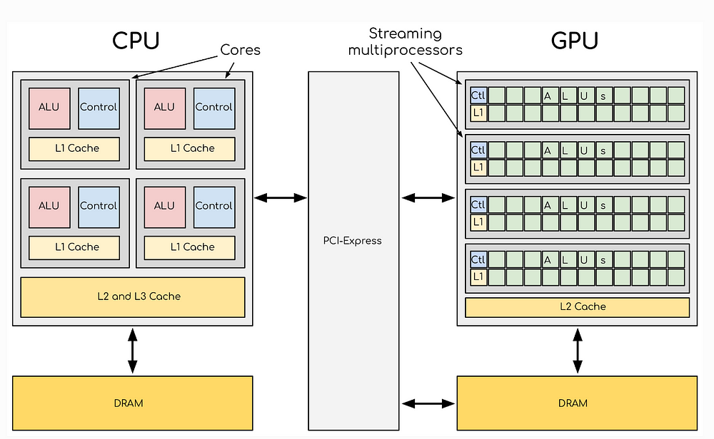
Why Do We Need Performance Metrics?
In High-Performance Computing (HPC) and system optimization,
we need to quantify program and hardware performance — different metrics reveal bottlenecks at different levels
Common Performance Metrics
FLOPS
Bandwidth
Compute Capacity
Bandwidth
Latency
Utilization
Latency
Resource Utilization
Roofline Model
Performance Ceiling Model
Image source: Medium - CPU vs GPU Architecture
Notes:
单击此处添加文本

Slide 4
Classification of Performance Metrics
Compute Capacity
Data Access Capability
Compute Bound
Memory Bound
FLOPS
Bandwidth
Measures the number of floating-point operations a processor can execute per second — the core metric for compute-intensive task performance.
Represents the amount of data transferable per unit time, determining throughput capacity for data-intensive applications.
Utilization
Latency
Reflects the actual usage efficiency of hardware resources, helping identify whether compute units are fully utilized.
Represents the time required to complete one data access, directly affecting program responsiveness and real-time performance.
Roofline Model used to analyze both bottleneck types, helping determine whether a program is compute-bound or memory-bound
Notes:
单击此处添加文本

Slide 5
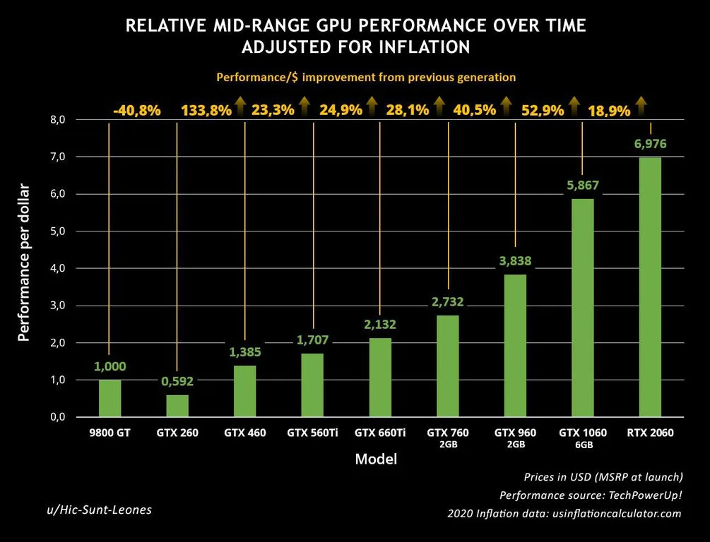
What is FLOPS?
FLOPS = Floating Point Operations Per Second
Represents how many floating-point operations can be executed per second
Common Units
MFLOPS
= 10⁶
GFLOPS
= 10⁹
TFLOPS
= 10¹²
PFLOPS
= 10¹⁵
FLOPS is the core metric for measuring compute capacity
Image source: The FPS Review - GPU Performance Growth
Notes:
单击此处添加文本

Slide 6
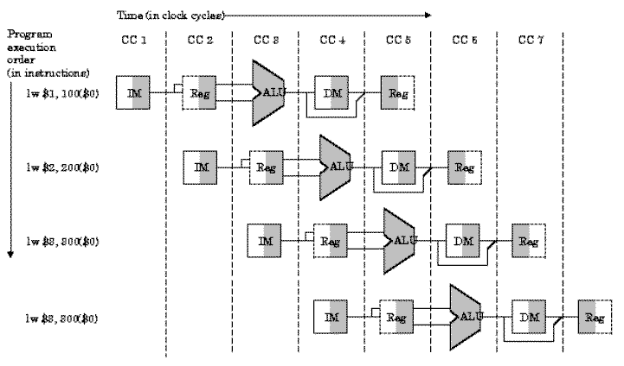
FLOPS Calculation Example
Assumed CPU Specs
Clock Frequency
3 GHz
FLOPs per Cycle
8 FLOP
Theoretical Performance Calculation
FLOPS = Frequency × FLOPs per Cycle
= 3×10⁹ × 8
= 24 GFLOPS
Note: This is the theoretical peak; actual performance is typically lower
Image source: University of Florida - CPU Pipeline
Notes:
单击此处添加文本

Slide 7
Actual FLOPS vs Theoretical FLOPS
Theoretical Peak
Actual FLOPS
The theoretical peak is entirely determined by hardware specifications, representing the maximum performance a processor can achieve under ideal conditions.
Actual FLOPS is determined by program execution conditions, influenced by a variety of complex factors.
Based on CPU/GPU core count
Usually far below the theoretical peak
Based on clock frequency
Affected by multiple factors
Based on instructions per cycle
Requires optimization to improve
Key Influencing Factors
Memory Access
Branch Prediction
Instruction Dependencies
Cache miss
Notes:
单击此处添加文本

Slide 8
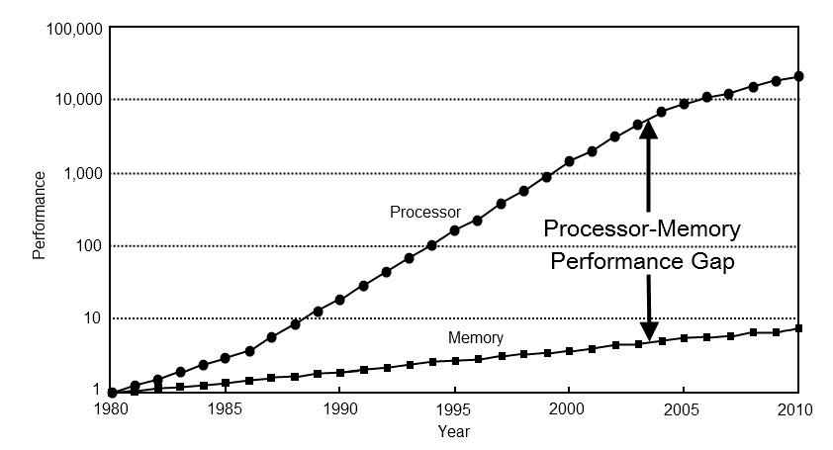
Bandwidth
Bandwidth
Represents the amount of data transferable per unit time
Common Units
MB/s
Megabytes/second
GB/s
Gigabytes/second
TB/s
Terabytes/second
Use Cases
Memory Bandwidth
Disk Bandwidth
Network Bandwidth
Image source: ForrestTheWoods - Memory Bandwidth
Notes:
单击此处添加文本

Slide 9
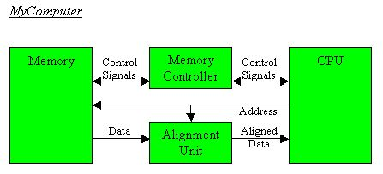
Bandwidth Example
Assumed Conditions
Memory Bandwidth
100 GB/s
This means:
Up to 100 GB of data can be read per second
Calculation Example
If the program needs to read
200 GB of data
Theoretical minimum time
= 200 GB ÷ 100 GB/s
Image source: University of Pittsburgh - Memory Controller
= 2 seconds
Notes:
单击此处添加文本

Slide 10
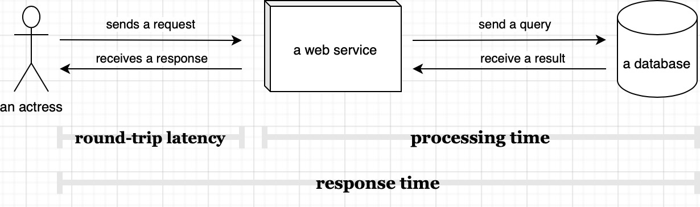
What is Latency?
Latency
Represents the time required to complete one operation
Typical Scenarios
Memory Access Latency
Network Latency
Disk Access Latency
Common Units
ns
μs
ms
Nanosecond
Microsecond
Millisecond
10⁻⁹ second
10⁻⁶ second
10⁻³ second
Image source: Scalable Developer - Latency Timeline
Notes:
单击此处添加文本

Slide 11
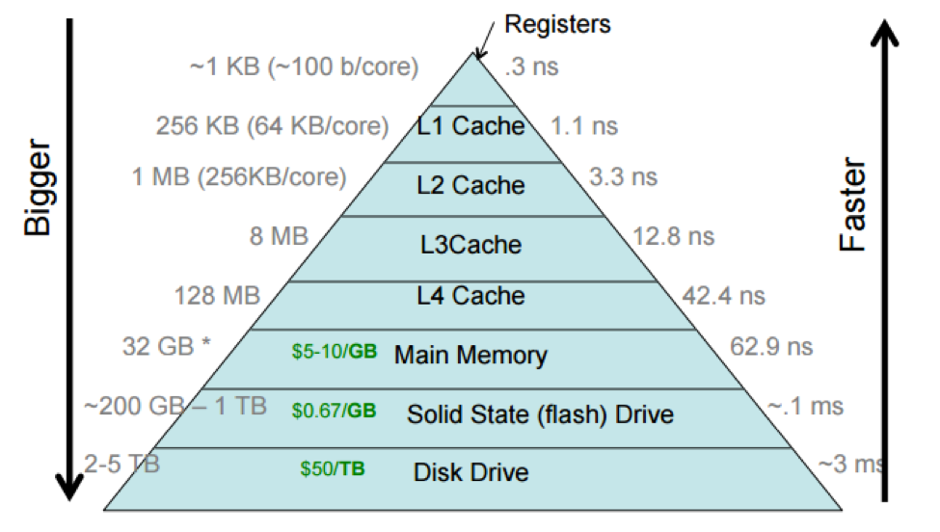
Latency Examples
Typical Memory Hierarchy Latency
L1 Cache
~1 ns
L1 Cache
L2 Cache
~4 ns
L2 Cache
DRAM
~100 ns
Main Memory
Note: The farther the memory level, the greater the latency
Image source: Brown University - Memory Hierarchy
Notes:
单击此处添加文本

Slide 12
Latency vs Bandwidth
Latency
Bandwidth
How long does a single access take?
How much data can be processed per unit time?
Measures the time to complete one independent operation, focusing on the response speed of individual requests.
Measures the total data a system can process per unit time, focusing on overall throughput capacity.
Analogy
Latency = Car startup time
Bandwidth = Number of highway lanes
Time required to start moving from a standstill
Number of vehicles that can pass simultaneously
Notes:
单击此处添加文本

Slide 13
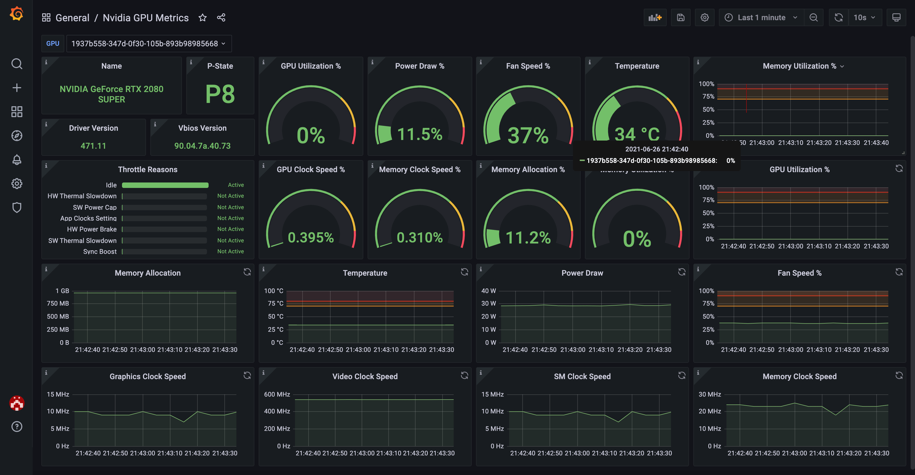
Utilization
Utilization
Actual usage level of hardware resources
Formula
Utilization = Actual Performance / Theoretical Peak
Typically expressed as a percentage
Calculation Example
GPU Theoretical Performance
10 TFLOPS
Actual Program Performance
5 TFLOPS
Image source: Grafana - GPU Metrics Dashboard
Utilization
50%
Notes:
单击此处添加文本

Slide 14
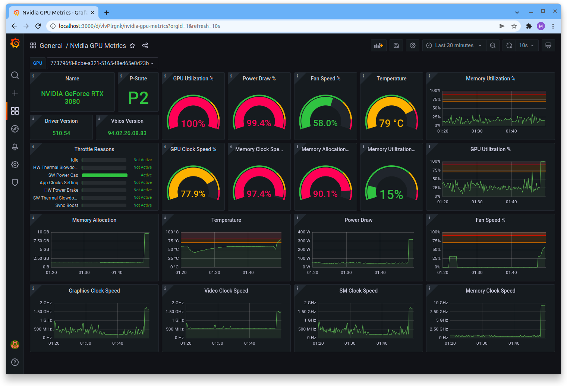
Why Utilization Matters
Even with powerful hardware
if utilization is low → performance will still be poor
Common Causes of Low Utilization
Memory Bottleneck
Data supply cannot keep up with computation speed
Synchronization Wait
Threads/processes waiting for synchronization
Load Imbalance
Some cores idle, others overloaded
I/O Wait
Waiting for disk or network I/O to complete
Image source: Lambda Labs - GPU Monitoring Tools
Notes:
单击此处添加文本

Slide 15
Two Types of Performance Bottlenecks
Compute Bottleneck
Memory Bottleneck
Compute Bound
Memory Bound
Characteristics:
Characteristics:
FLOPS-limited, compute units at full load
Bandwidth-limited, insufficient data supply
Optimization Approach:
Optimization Approach:
Algorithm optimization, parallelization, SIMD
Data layout optimization, cache optimization, blocking
Need to improve compute efficiency
Need to improve data access efficiency
Key Insight: Different bottlenecks require different optimization strategies — identifying the bottleneck type is the first step
Notes:
单击此处添加文本

Slide 16
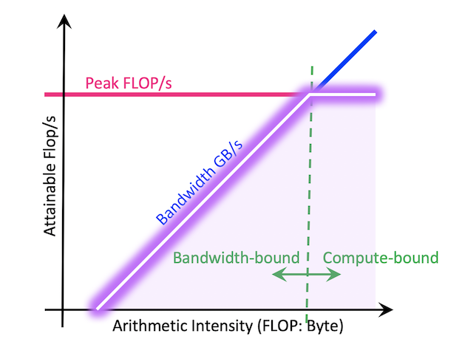
Introducing the Roofline Model
Roofline Model
A visual performance analysis model
Proposed by: Berkeley Lab
Lawrence Berkeley National Laboratory
Core Purpose
Identify program bottleneck
Determine if it's Compute Bound or Memory Bound
Guide optimization direction
Choose optimization strategy based on bottleneck type
Image source: NERSC - Roofline Performance Model
Notes:
单击此处添加文本

Slide 17
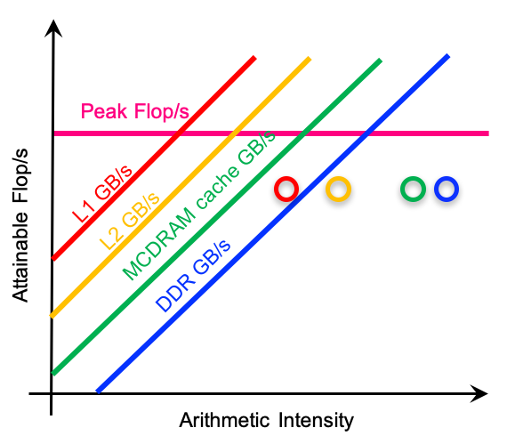
Roofline Model Axes
X-Axis
Arithmetic Intensity
= FLOPs / Byte
Arithmetic Intensity: floating-point operations per byte of data
Y-Axis
Performance
= FLOPS
Performance: floating-point operations per second
Image source: NERSC - Roofline Hierarchy
Notes:
单击此处添加文本

Slide 18
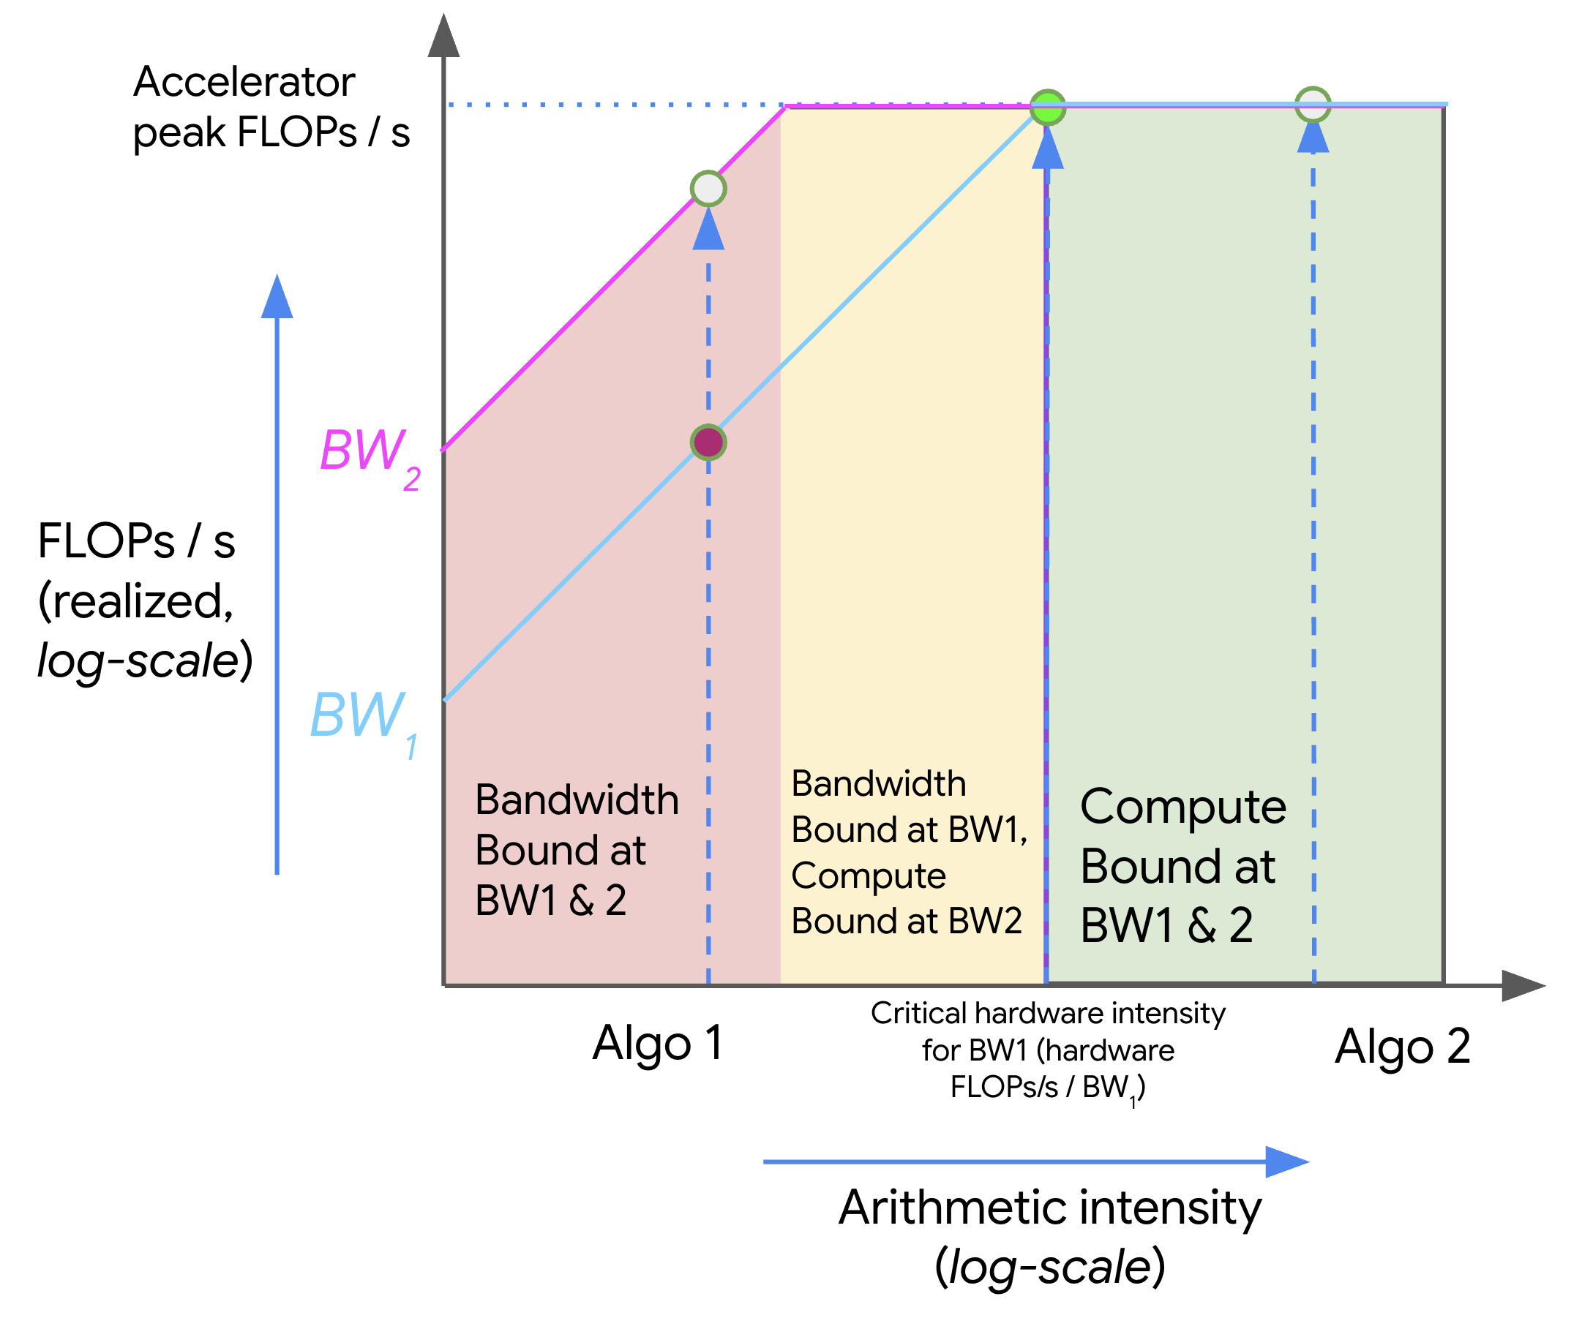
Two Constraints in the Roofline Model
1
Bandwidth Line
Memory Constraint
Diagonal line representing memory bandwidth limit
2
Compute Roof
Compute Ceiling
Horizontal line representing theoretical peak performance
Key Constraint: Program performance cannot exceed either of these two lines
Image source: JAX-ML - Roofline Model
Notes:
单击此处添加文本

Slide 19
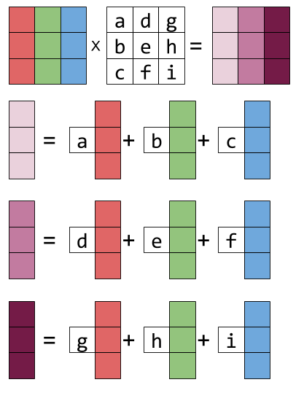
Arithmetic Intensity Example
Matrix Multiplication
Computation
O(n³)
Data Volume
O(n²)
Therefore: Arithmetic Intensity is very high
= O(n³) / O(n²) = O(n)
Note: more likely to be Compute Bound
Image source: Eli Bendersky - Matrix Multiplication
Notes:
单击此处添加文本

Slide 20
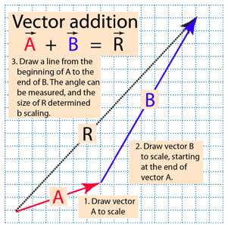
Memory Bound Example
Vector Addition
C[i] = A[i] + B[i]
Operation: 1 addition
Data: Read A[i], B[i], write C[i]
Few computations
Many data accesses
Arithmetic Intensity Low
Conclusion: typically Memory Bound
Image source: HyperPhysics - Vector Addition
Notes:
单击此处添加文本

Slide 21
How Roofline Guides Optimization
Bandwidth Region
Compute Region
Memory Bound
Compute Bound
Optimization Approach:
Optimization Approach:
Increase data reuse
SIMD vectorization
Cache optimization
Parallelization
Blocking technique
GPU acceleration
Core Idea: Select targeted optimization strategies based on where the program falls in the Roofline chart
Notes:
单击此处添加文本

Slide 22
Summary
Key Performance Metrics
FLOPS
Bandwidth
Latency
Compute Capacity
Data Throughput
Single Access Time
Utilization
Roofline Model
Resource Utilization
Performance analysis tool for identifying bottleneck types and guiding optimization
Understanding these metrics is the foundation of high-performance computing optimization
Mastering performance analysis is the key to writing efficient programs
Notes:
单击此处添加文本

Slide 23
Lecture 38-en: Auto-Tuning

Slide 24
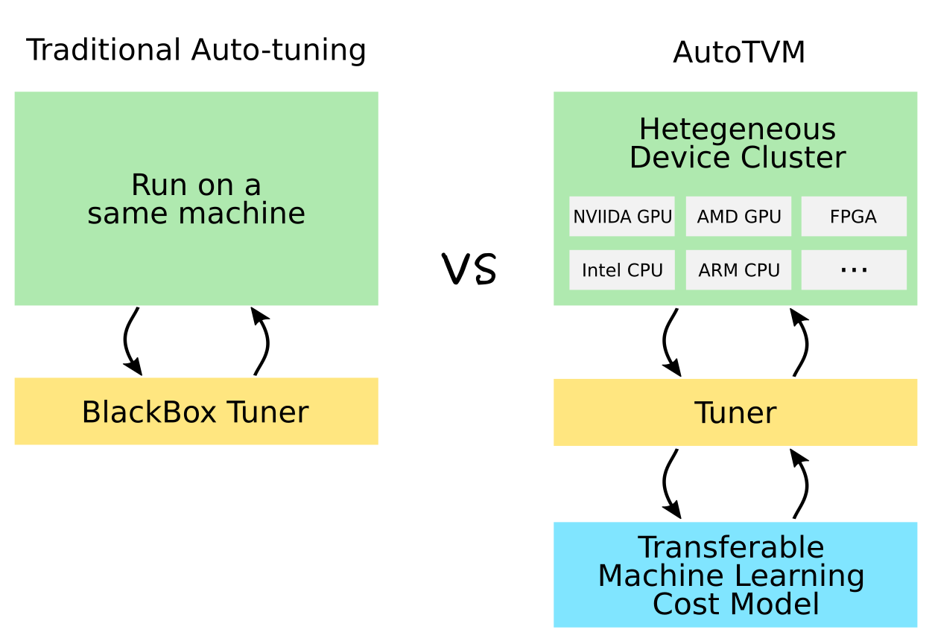
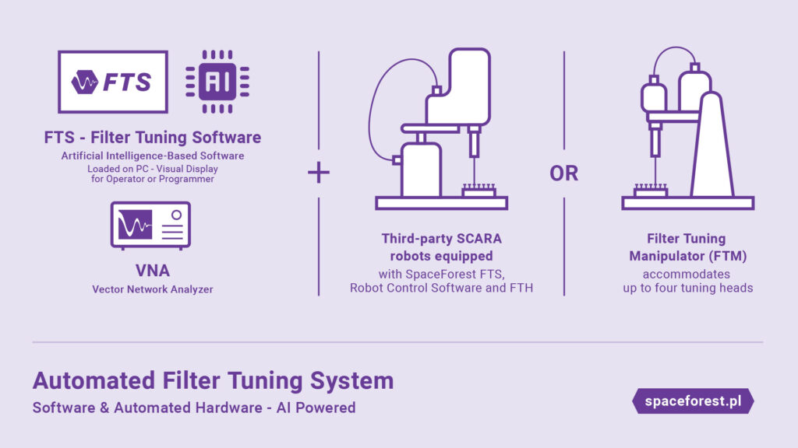
Automatic Tuning
Automatic Tuning Algorithm and Underlying Implementation
  From Template Search to AI-Driven Operator Tuning

Slide 25
Outline of Automatic Tuning
Background and Challenges
Core Framework and Workflow
  TVM, AutoTVM, and Template Search Analysis
Classic Heuristic Search Algorithms
  Simulated Annealing and Genetic Algorithms
Machine Learning-Based Optimization
  Bayesian Optimization
  Reinforcement Learning
Experimental Guidance
  Kernel Performance Evaluation Based on FlagPerf

Slide 26
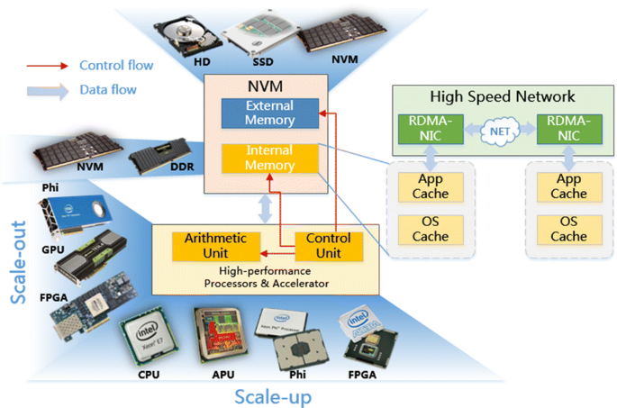
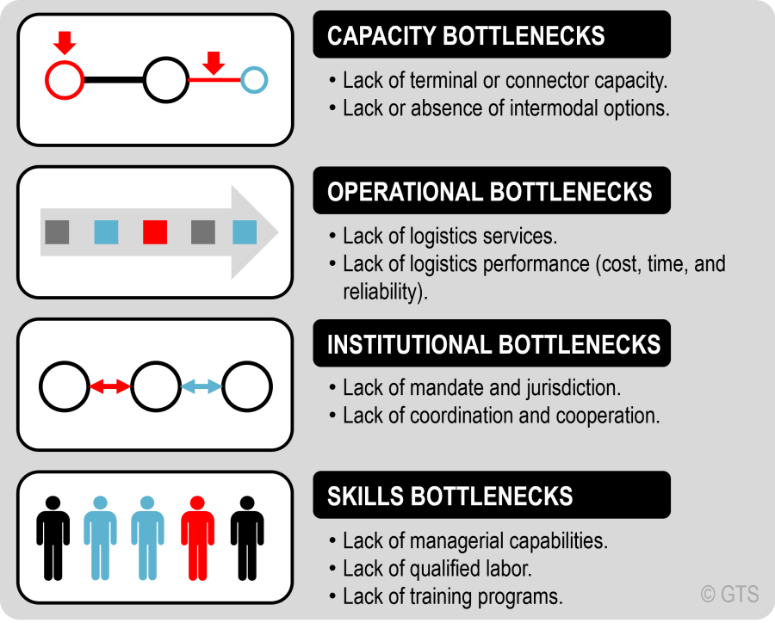
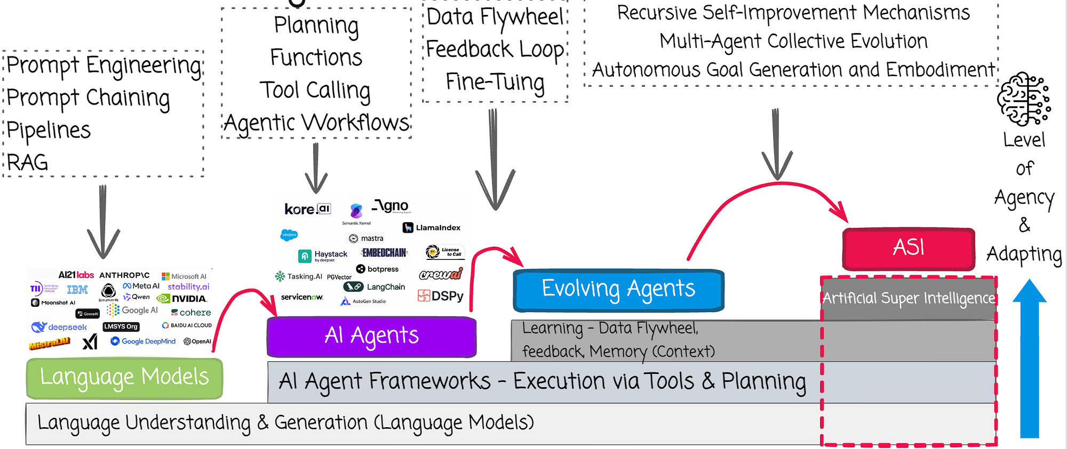
Why is automatic tuning necessary?
The increasing complexity of hardware architecture:
  The proliferation of heterogeneous chips such as GPUs and NPUs
  Complex memory hierarchies (Registers, Shared Memory)
Bottlenecks of traditional manual optimization
  Extremely high labor costs
  Poor portability
Rapid evolution of AI models and new operators
Notes:
背景与挑战
P3：为什么需要自动调优？（硬件架构复杂化、手工编写Kernel的性能瓶颈与人力成本）
硬件架构的复杂化：
GPU、NPU、TPU等异构芯片层出不穷。
复杂的内存层次结构（Registers, Shared Memory, L2 Cache）。
传统手工优化的瓶颈：
人力成本极高：通常需要“Ninja Programmer（忍者程序员）”耗费数周手写底层汇编或CUDA代码。
可移植性差：为A100写的极致优化Kernel，在H800上可能不再是最优解。
AI模型的高速演进：新算子层出不穷，手工优化速度跟不上模型迭代速度。
算子调优的时代痛点与自动化重构的必然性
在现代高性能计算（High-Performance Computing, HPC）与深度学习（Deep Learning）的演进历程中，计算密度的指数级增长与底层硬件架构的极度复杂化之间，形成了一道难以逾越的性能鸿沟。随着以大语言模型（Large Language Models, LLMs）为代表的复杂神经网络的普及，模型参数量已跨越千亿乃至万亿级别，底层张量运算（如矩阵乘法GEMM、多维卷积、自注意力机制等）的执行效率，直接决定了整个系统的端到端延迟与吞吐量上限 。然而，实现这些核心算子的极致性能绝非易事，这深刻反映了当前算子调优领域面临的核心痛点。
长期以来，工业界高度依赖于由硬件厂商提供的、经过资深专家手工高度优化的算子库（例如NVIDIA的cuDNN、cuBLAS或Intel的MKL）。虽然这些定制化库在特定的标准计算规模上能够提供峰值性能，但手工编写和调优高性能计算内核（Kernel）是一项极其昂贵且耗时的工作 。计算性能不仅取决于算法的时间复杂度，更受制于一系列微架构维度的元参数（Meta-parameters），包括但不限于线程块大小（Block Size）、流水线阶段数（Pipeline Stages）、瓦片大小（Tile Size）、循环展开因子（Unroll Factors）、寄存器分配以及共享内存调度等 。这些参数之间存在极其复杂的非线性耦合关系。例如，在基于Triton或CUDA的编程模型中，一个轻微次优的瓦片大小配置可能会引发严重的共享内存Bank冲突或L2缓存抖动，导致计算内核在逻辑完全正确的情况下，性能依然出现数量级的暴跌 。
不仅如此，随着硬件架构的快速迭代（如从NVIDIA Ampere架构升级至Hopper架构）以及深度学习框架中不断涌现的非标准算子融合需求，传统的、依赖领域专家经验的手工调优模式已彻底沦为生产力瓶颈。针对特定负载的调试需要耗费数月时间，且编写出的优化代码泛化能力极差，完全无法适应多样化的动态形状（Dynamic Shapes）与边缘端长尾硬件生态 。
为突破这一瓶颈，自动调优（Auto-tuning）技术应运而生，并迅速成为AI编译器（如TVM、Halide）栈中的核心组件。自动调优的核心思想是将算子的编译优化过程抽象为一个在高维、离散且充满硬性约束的解空间中的最优化搜索问题。该范式主要由三大核心支柱构建：首先是“搜索空间（Search Space）的定义”，即将一切合法的程序等价变换策略进行参数化，界定出算法探索的物理边界；其次是“性能评估模型（Cost Model）的构建”，旨在通过机器学习等手段快速预测特定配置在目标硬件上的执行代价，从而大幅减少昂贵的硬件实测开销；最后是“探索策略（Exploration Strategy）的设计”，利用启发式算法、演化算法乃至强化学习，在浩如烟海的百亿级配置空间中，以最高效的路径收敛至全局最优或次优调度解 。这一思想的落地，标志着算子开发从“人力密集型的手工雕琢”正式迈向了“计算密集型的自动生成”时代。

Slide 27
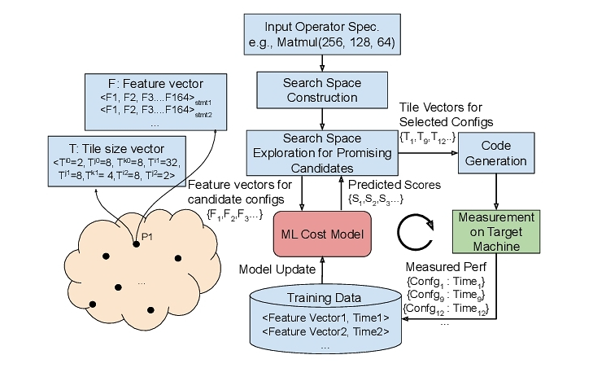

What is Kernel Auto-tuning?
Automation of Code Generation:
  Input: Mathematical calculation expressions (e.g., tensor multiplication, convolution).
  Output: Low-level code optimized for specific hardware (e.g., CUDA, LLVM IR).
Common Tuning Dimensions (Schedule Primitives):
  Tiling: Improves cache hit rate.
  Unrolling: Reduces branch overhead.
  Vectorization: Utilizes SIMD instructions (e.g., AVX, TensorCore).
  Binding: Block/Thread mapping in the GPU.
Notes:
Kernel Auto-tuning（内核自动调优）的核心机制在于代码生成（Code Generation）与调度原语（Schedule Primitives）的自动化组合。在深度学习编译器中，计算的数学定义（算法逻辑）与计算的具体执行方式（调度执行）被解耦。自动调优系统通过向底层的抽象语法树（AST）或中间表示（IR）中注入调度指令，来控制代码的硬件映射。常见的调优维度涵盖了计算与存储架构的各个层面：循环分块（Tiling）用于将巨大的张量切割以适配容量有限但速度极快的各级缓存；循环展开（Unroll）旨在通过增加代码体积来消除循环控制开销并提升指令级并行度；而线程绑定（Thread Binding）与张量化（Tensorization）则是将特定的计算轴精确映射到GPU的线程束（Warp）或专用的矩阵乘法累加单元（如Tensor Cores）上 。

Slide 28
Evolution of Mainstream Tuning Frameworks
First Generation: Manual Scheduling
  Representative: Early Halide.
  Characteristics: Algorithm and scheduling are separated, but scheduling still requires manual implementation by experts.
Second Generation: Template-based Tuning
  Representative: TVM AutoTVM.
  Characteristics: Experts write parameterized templates, and the algorithm searches for the optimal value in the parameter space.
Third Generation: Template-free Tuning
  Representative: TVM Ansor (AutoScheduler).
  Characteristics: Automatically generates a huge search space based on rules, without requiring manually preset templates.
Notes:
主流调优框架的演进路线
第一代：纯手工调度 (Manual Scheduling)
代表：早期 Halide。
特点：算法与调度分离，但调度仍需专家手写。
第二代：基于模板的自动调优 (Template-based Tuning)
代表：TVM AutoTVM。
特点：专家写出带参数的模板，算法在参数空间中搜索最优值。
第三代：自动化无模板调优 (Template-free Tuning)
代表：TVM Ansor (AutoScheduler)。
特点：基于规则自动生成巨大的搜索空间，无需人工预设模板。
随着优化需求复杂度的攀升，自动调优的软件生态经历了一系列显著的架构演进，不同的框架在搜索空间大小、自动化程度与专家干预成本之间做出了不同的权衡。
Halide Auto-scheduler提出算法与调度分离，基于规则的序列化树搜索 依赖预定义规则进行束搜索（Beam Search） 预训练的静态预测模型 开创性分离理念，但在处理复杂算子融合与庞大空间时易累积误差 。
TVM AutoTVM基于参数化模板的启发式搜索，引入机器学习评估 高度依赖专家编写的算子级DSL模板，空间受限 XGBoost统计代价模型结合模拟退火（SA）与遗传算法（GA） 收敛速度快，但新硬件扩展门槛极高，需大量人工模板代码 。
TVM Ansor (Auto-Scheduler)自动草图生成（Sketch Generation）的无模板探索 基于搜索（Evolutionary Search）与梯度下降任务调度 彻底摆脱模板束缚，发现域外极值，但巨型空间搜索时间显著增加 。
TVM MetaSchedule基于概率编程语言抽象的统一自动调优系统 将随机抽样指令（Sampling Instructions）模块化注入IR 深度学习代理模型，兼容强化算子DAG拓扑分析自动推导分层空间（草图+标注）统一的演化学习与贝叶斯优化扩展 统一了手动调优与自动生成，高度模块化，性能媲美底层手写库 。
正如表中所总结的，从早期的Halide到TVM的迭代，反映了工业界对调优自动化程度的极致追求。AutoTVM引入了统计代价模型，成功将机器学习应用于编译优化，但由于其要求开发者为每一个算子编写“调度模板”，导致其在面对数以百计的新型算子时暴露了严重的扩展性瓶颈 。为了解决模板带来的人力成本与搜索空间天花板，Ansor创新性地实现了无模板自动调度（Template-free Auto-scheduling），通过自动生成计算草图，极大地拓宽了可能被探索的程序结构拓扑 。而MetaSchedule（AutoTIR）则进一步在底层中间表示层面实现了概率编程的统一，使得专家级约束与全自动探索得以完美融合 。

Slide 29
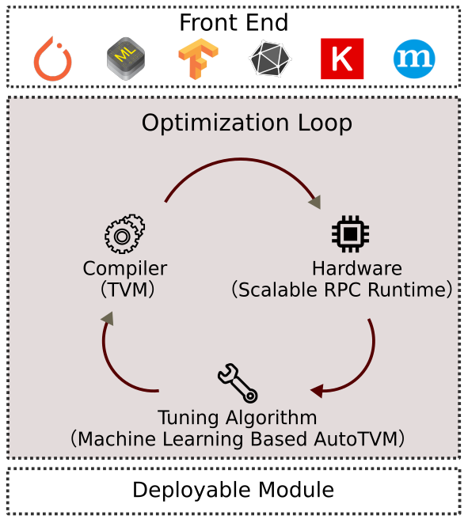
Classic Framework Analysis: TVM and AutoTVM
AutoTVM’s Core Innovations
  Introduces index-based parameterized templates.
  Introduces a Statistical Cost Model to replace traditional analytical models.
Advantages of the Cost Model:
  Complex GPU architectures are difficult to model precisely with formulas
  AutoTVM uses machine learning models such as XGBoost/TreeGRU to predict performance by "feeding" real-device running data.
Notes:
作为将机器学习规模化引入算子调优的先驱，TVM的AutoTVM框架确立了一套行之有效的“索引化模板（Index-based Template）”与“硬件在环（Hardware-in-the-loop）”架构标准。
在AutoTVM中，搜索空间的定义依赖于领域专家利用TVM提供的调度API编写的代码模板。这些模板定义了针对某一特定算子（如Conv2D）的所有合法优化步骤，并暴露出离散的可调参数（Knobs），如多级Tiling的具体拆分因子。AutoTVM的巧妙之处在于，它将这个由多个离散参数构成的笛卡尔积空间，展平并映射为一个一维的线性索引空间（Index Space） 。每一个具体的参数组合都被编码为一个独立的配置实体（ConfigEntity）。这种参数化空间的优势在于，它将一个包含大量非法程序语义的复杂转换空间，裁剪成了一个语义绝对安全、仅需寻找最优整数组合的常规搜索问题。

Slide 30
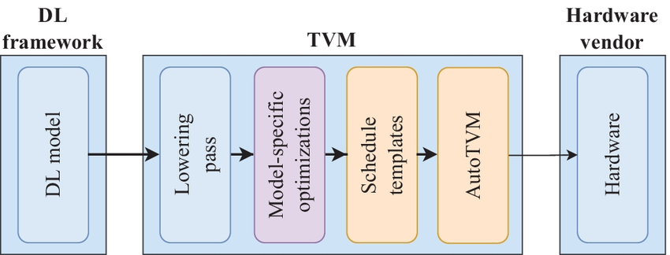
The Complete AutoTVM Workflow
Template Definition: Developers write scheduling templates for operators
Configuration Generation: Features are extracted and a batch of candidate parameter configurations is generated.
Model Prediction: The XGBoost cost model scores the top-K configurations.
Hardware-in-the-loop: The top-K configurations are compiled and sent to real hardware (e.g., a GPU cluster) for performance testing.
Model Update: Real-world latency data from the test is fed back to the cost model, XGBoost is retrained and updated, and the next iteration begins.
Notes:
AutoTVM 的完整工作流
定义模板：开发者为算子（如Conv2D）编写包含可调参数（如 tile_x, tile_y）的调度模板。
生成配置：提取特征并生成一批候选的参数配置。
模型预测：通过 XGBoost 代价模型打分，选出 Top-K 的配置。
硬件在环 (Hardware-in-the-loop)：将 Top-K 编译并发送到真实硬件（如GPU集群）上进行性能测试。
模型更新：将真机测试的真实耗时数据（Latency）反馈给代价模型，重新训练更新 XGBoost，进入下一轮迭代。
由于模板定义的搜索空间动辄包含数以亿计的候选配置，直接在真实硬件上编译并运行每一个配置需要耗费数月时间，这是工程实践所无法容忍的。因此，AutoTVM引入了基于XGBoost的统计代价模型（Statistical Cost Model）来充当廉价的代理评估器。其完整的工作流形成了一个闭环的监督学习系统。
首先，在特征提取（Feature Extraction）阶段，系统会根据一组候选参数实例化调度模板，生成底层的抽象语法树（AST）或循环程序IR。特征提取器会对该低级代码进行深度静态分析，提取出一系列对硬件性能高度敏感的领域特征（Domain-specific Features）。这些特征不仅包括循环嵌套的层级深度、各级内存（如共享内存和全局内存）的访问计数，还涵盖了数据复用率、向量化比例、线程绑定模式以及内部计算分支的复杂度 。
提取出的高维数值特征随后被送入XGBoost模型中进行推理。值得注意的是，AutoTVM中的代价模型并不以预测绝对执行时间为目标，而是采用排序损失函数（Rank Loss）进行优化。这是因为在调优任务中，配置的相对优劣顺序远比绝对耗时的预测精度重要；基于排序的梯度提升树能够更敏锐地在特征空间中区分出高效与低效的内存访问模式 。
在实际的探索循环中，模拟退火算法利用XGBoost模型进行海量的快速预估，从巨大的搜索空间中筛选出一小批（例如64个）预测得分最高的潜力配置。随后系统进入“硬件在环（Hardware-in-the-loop）”测试阶段，这批配置被发送至分布式RPC环境中的真实目标硬件上进行编译和评测。硬件返回的真实执行耗时不仅用于记录当前发现的最优解，更被作为新的标签数据（Ground Truth）追加到历史数据库中，用于在线更新和拟合XGBoost代价模型 。通过这种“预测-实测-模型更新”的螺旋上升机制，AutoTVM不仅克服了单纯静态分析精度不足的问题，还有效避免了全局穷举的高昂成本。

Slide 31
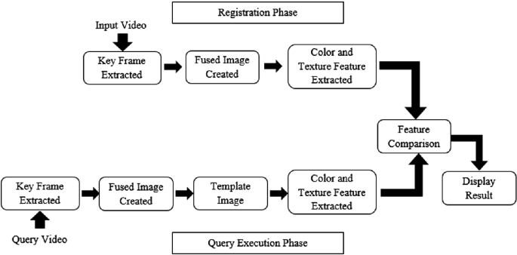
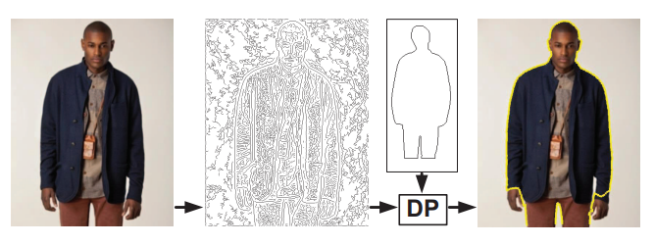
A Deeper Understanding of Template-Based Search
What is a "Template"?
  A template is a coded representation of expert experience.
  For example: Define a two-nested loop, but the step size (Tile Size) is an unknown variable.
The size of the search space
  Depends on the number of variables defined in the template and their range of values.
  Typically, it is a discrete, bounded, multi-dimensional space (e.g., 10^4 ~ 10^9 combinations).
How to search?
  Within this space, we need efficient exploration algorithms.
For example: template-based video search engine
Notes:
什么是“模板”？
模板是专家经验的代码化体现。
例如：定义一个两层循环，但循环的步长（Step/Tile Size）是未知的变量。
搜索空间的大小：
取决于模板中定义的变量数量及其取值范围。
通常是一个离散的、有界的多维空间（例如：10^4 ~ 10^9 种组合）。
如何搜索？
在这片空间中，我们需要高效的探索算法。

Slide 32
Limitations of Template Search
Advantages
  Relatively small search space, fast convergence speed.
  The quality of generated code has a lower bound guarantee
Limitations (Pain Points)
  High development cost: For each new operator or hardware, experts must rewrite a template.
  Non-global optimum: If the optimal code structure is not within the scope of the expert-defined template, the search algorithm will never find it.
Notes:
基于模板的搜索策略（Template-based Search）虽然凭借较小的搜索空间和高效的代价模型在特定算子上取得了巨大成功，但其固有的结构性缺陷也逐渐成为制约深度学习编译器发展的瓶颈。模板搜索的核心原理是将程序的宏观拓扑结构（如循环的嵌套顺序、算子融合的边界）固定下来，仅仅将微观的数值维度（如分块大小、展开步长）进行参数化 。
这种强约束策略虽然保证了搜索过程不会生成无效代码，并能快速收敛，但其代价是直接牺牲了搜索空间的广度。一方面，手工编写和维护模板需要深厚的硬件微架构知识，随着深度学习框架向多元化算子和多芯片平台演进，维护成千上万个算子模板成为了不可持续的人力黑洞 。更严重的是，人类专家的直觉往往具有局限性，模板开发过程中的“积极早期剪枝（Aggressive Early Pruning）”会不自觉地将许多反直觉但极其高效的结构优化方案排除在外。例如，在某些不规则的步长转置卷积（Strided Transposed Convolution）中，特定的循环拆分与内联策略能够大幅简化零元素的乘法计算，但这种拓扑重组很难被固定的模板所覆盖 。

Slide 33
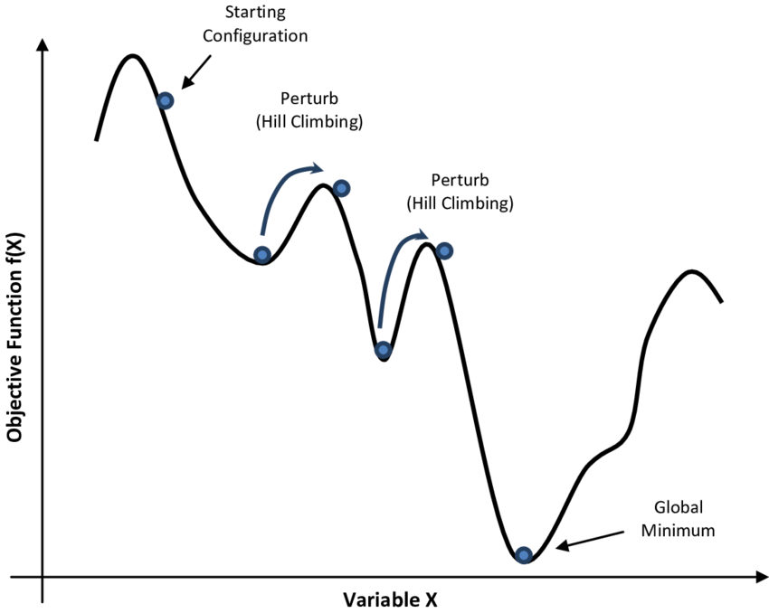
Classical Exploratory Algorithm: Simulated Annealing
Inspiration
  The annealing process in metallurgy (heating a solid to a high temperature and then slowly cooling it to bring its internal crystal structure to its lowest energy, most stable state).
Core Algorithm Logic
  Randomly walk through the search space.
  If a better configuration is found, accept it directly
  If a worse configuration is found, accept it with a certain probability!
Why accept a worse solution?
  To escape local optima and find the global optimum.
Notes:
单击此处添加文本

Slide 34
Advantages of Genetic Algorithms in Spatial Search
Multi-point Parallel Search: Unlike the single-point walk of simulated annealing, genetic algorithms maintain a population, allowing simultaneous exploration of multiple regions in the search space.
Suitable for Discrete and Irregular Spaces:
  Hardware tuning spaces are often discontinuous (e.g., GPU block sizes must be multiples of 32).
  Traditional gradient descent methods are ineffective here, while genetic algorithms have no requirement for the differentiability of the objective function.
The Evolutionary Search of TVM Ansors extensively utilizes genetic algorithms to efficiently mutate the scheduling space.

Slide 35
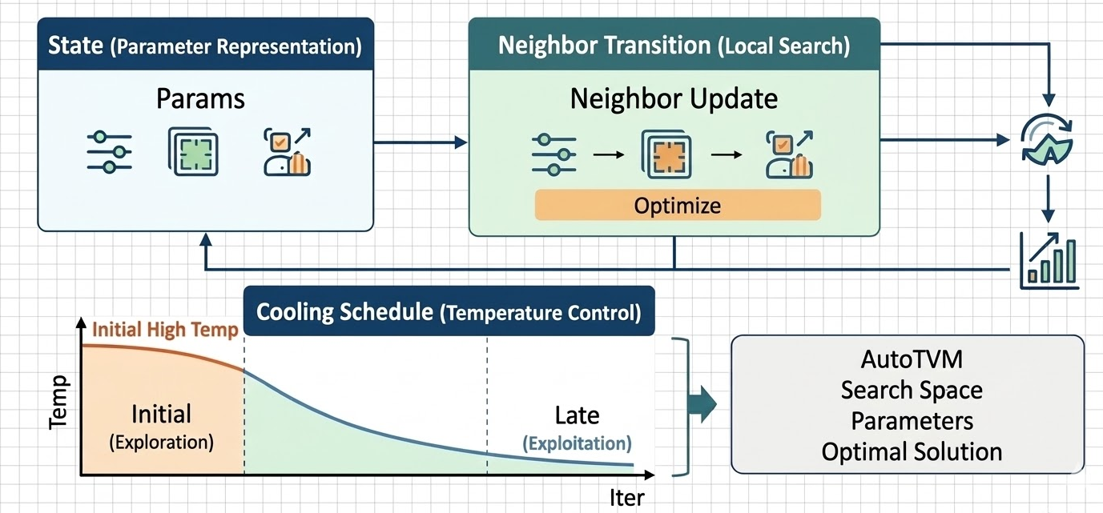
Application of Simulated Annealing
State Representation: The current set of template parameters
Neighbor Transition: Fine-tuning one of the parameters
Cooling Schedule:
  Initial High Temperature: High probability of accepting poor solutions (large-scale exploration).
  Later Low Temperature: Almost only accepting good solutions (local convergence exploration).
Early versions of AutoTVM widely used simulated annealing to find optimal parameters in the candidate space.
Notes:
Page 12: 3. 模拟退火在算子调优中的应用
状态表示 (State)：当前的一组模板参数（如 BlockSize=128, TileSize=4）。
邻域跳转 (Neighbor Transition)：微调其中一个参数（如将 BlockSize 变成 256）。
温度控制 (Cooling Schedule)：
初始高温：概率很高地接受差解（大范围探索 Exploration）。
后期低温：几乎只接受好解（局部收敛 Exploitation）。
AutoTVM 早期版本即广泛采用模拟退火在候选空间中寻找最优参数。
概率与突变的艺术：模拟退火算法在调优中的应用
无论搜索空间是由模板限定还是由草图生成，算子参数的优化表面都具有高度的非凸性（Non-convexity）。该空间充满了不规则的离散约束（如参数必须是硬件线程束的整数倍）和深浅不一的局部极小值。传统的梯度下降或贪婪爬山算法在这样的地形中极易陷入局部最优而停滞不前 。为应对这一挑战，模拟退火（Simulated Annealing, SA）成为了自动调优早期最核心的探索算法。
模拟退火算法的原理源自对冶金学中固体物理退火过程的隐喻。在物理退火中，材料被加热至高温状态，原子获得极大的动能，脱离原有的晶格排列；随后通过严格控制的缓慢冷却，原子在逐渐降低的温度下寻找能量最低的稳定晶体结构 。将这一原理映射到算子调优中，“系统能量”等价于代价模型（如XGBoost）预测的内核执行时间，“原子状态”则对应于特定的一组调优参数配置 。
模拟退火之所以能够跳出局部最优，关键在于其特有的概率接受机制——Metropolis-Hastings准则。在每一次迭代中，算法在当前配置的邻域内随机产生一个新的候选配置。若新配置的预测执行时间更短（能量下降），算法则无条件接受。然而，如果新配置导致性能恶化（能量上升），算法并不会立即将其抛弃，而是根据当前的系统“温度”参数 $T$ 和能量的恶化程度 $\Delta E$，以一定的概率 $P$ 接受这个次优解。该概率通常定义为 $P = \exp(-\Delta E / T)$ 。
温度参数 $T$ 在这里扮演了平衡“探索（Exploration）”与“利用（Exploitation）”的绝对核心。在算法初期的高温阶段，$T$ 的值极大，使得接受劣质解的概率很高，这赋予了算法极强的空间跨越能力，使其能够在整个参数空间中广泛游走，避免被早期的局部陷阱捕获。随着算法迭代，冷却计划（Cooling Schedule）开始生效，温度逐渐下降。常见的冷却曲线包括线性降温、对数降温以及工业界最常用的指数降温（例如 $T_{n+1} = \alpha T_n$，其中 $\alpha$ 通常域在0.8至0.99之间） 。在冷却后期的低温阶段，接受次优解的概率几乎降为零，算法退化为局部贪婪搜索，致力于在当前发现的优秀区域内进行最精细的参数微调 。在AutoTVM中，由于XGBoost的推理速度极快，模拟退火算法被用于在极短时间内对数以万计的特征向量进行高效预筛选，从而挑出最值得投入硬件实测的高质量样本 。

Slide 36
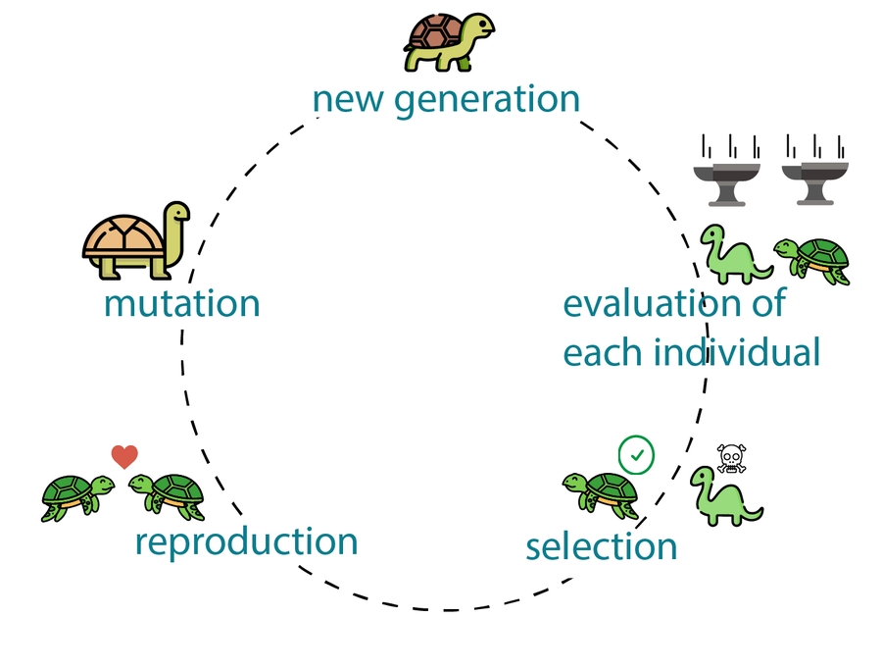
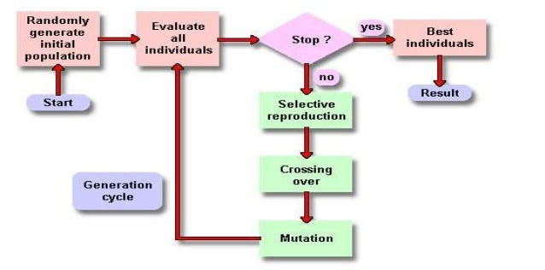
Advanced Exploration Algorithm: Genetic Algorithm
Inspiration: Darwin's theory of evolution, "survival of the fittest."
Core Algorithm Steps:
  Population: Randomly generate a batch of initial configurations.
  Fitness Evaluation: Evaluate performance using a cost model.
  Crossover: Swap some parameters between two superior configurations to produce offspring.
  Mutation: Randomly change some parameters (introducing new genes to prevent premature convergence).
  Selection: Eliminate poorly performing configurations and retain the better ones for the next generation.
Notes:
并行探索的进化力量：遗传算法在离散空间中的升维打击
尽管模拟退火在约束较强的模板空间中表现尚可，但在面对Ansor引入的巨大且拓扑异构的无模板搜索空间时，单链马尔可夫演进的退火算法逐渐显露出搜索视野狭窄、难以跨越巨大结构断层的劣势 。为了在更加离散且不规则的算子参数空间中实施“升维打击”，现代调优框架引入了更为强大的群体智能启发式方法——遗传算法（Genetic Algorithm, GA）。
遗传算法直接从达尔文的生物进化与自然选择理论中汲取核心思想，其最显著的优势在于多点并行探索（Multi-point Parallel Exploration）。它不再追踪单一的配置点，而是同时维护一个由大量候选程序组成的种群（Population） 。在调优语境下，每一个具体的张量程序配置（例如特定维度的Tiling因子、Unroll设定等）被抽象为个体（Individual），其参数组合被编码为“染色体”或“基因序列”。个体的适应度（Fitness）同样由底层代价模型给出的吞吐量预测值来决定 。
遗传算法的执行逻辑由四个严密嵌套的算子构成：种群初始化、选择、交叉与变异。首先，系统通过随机采样以及引入历史评测中的高分程序，生成具备高度多样性的初始种群。进入进化世代后，选择（Selection）算子（如锦标赛选择或轮盘赌算法）依据适应度分布，赋予性能优异的程序更高的繁衍权重，确保了优势算子结构的延续 。
交叉（Crossover）是遗传算法在复杂空间中合成创新解的核心引擎。被选中的父代程序会交换其内部的基因片段。在处理张量程序的调度时，由于粗暴的参数互换会破坏循环的语义合法性，系统（如Ansor）创造性地将算子生成的“重写历史步骤（Rewriting Steps）”定义为基因。通过智能地合并不同高性能个体的重写步骤，算法能够完美地将一个程序中优秀的内存布局与另一个程序中极致的并行展开策略融为一体，生成超越前代的超级后代 。
为了对抗种群同质化并防止算法过早收敛于局部极值，变异（Mutation）算子以较低概率在子代群体中注入随机扰动（例如随机突变某个循环的分割因子大小） 。此外，诸如自适应参数控制（Adaptive Parameter Tuning）的进阶技术也被引入，当算法检测到连续多个世代无性能提升时，会自动放大变异率或调整交叉概率，从而强制种群跳出当前的优化陷阱 。这种基于演化规律的多点并发机制，在处理包含严密数学约束（如内存大小限制、并行度整除要求）的离散算子空间时，展现出了远超退火算法的鲁棒性与天花板上限 。

Slide 37
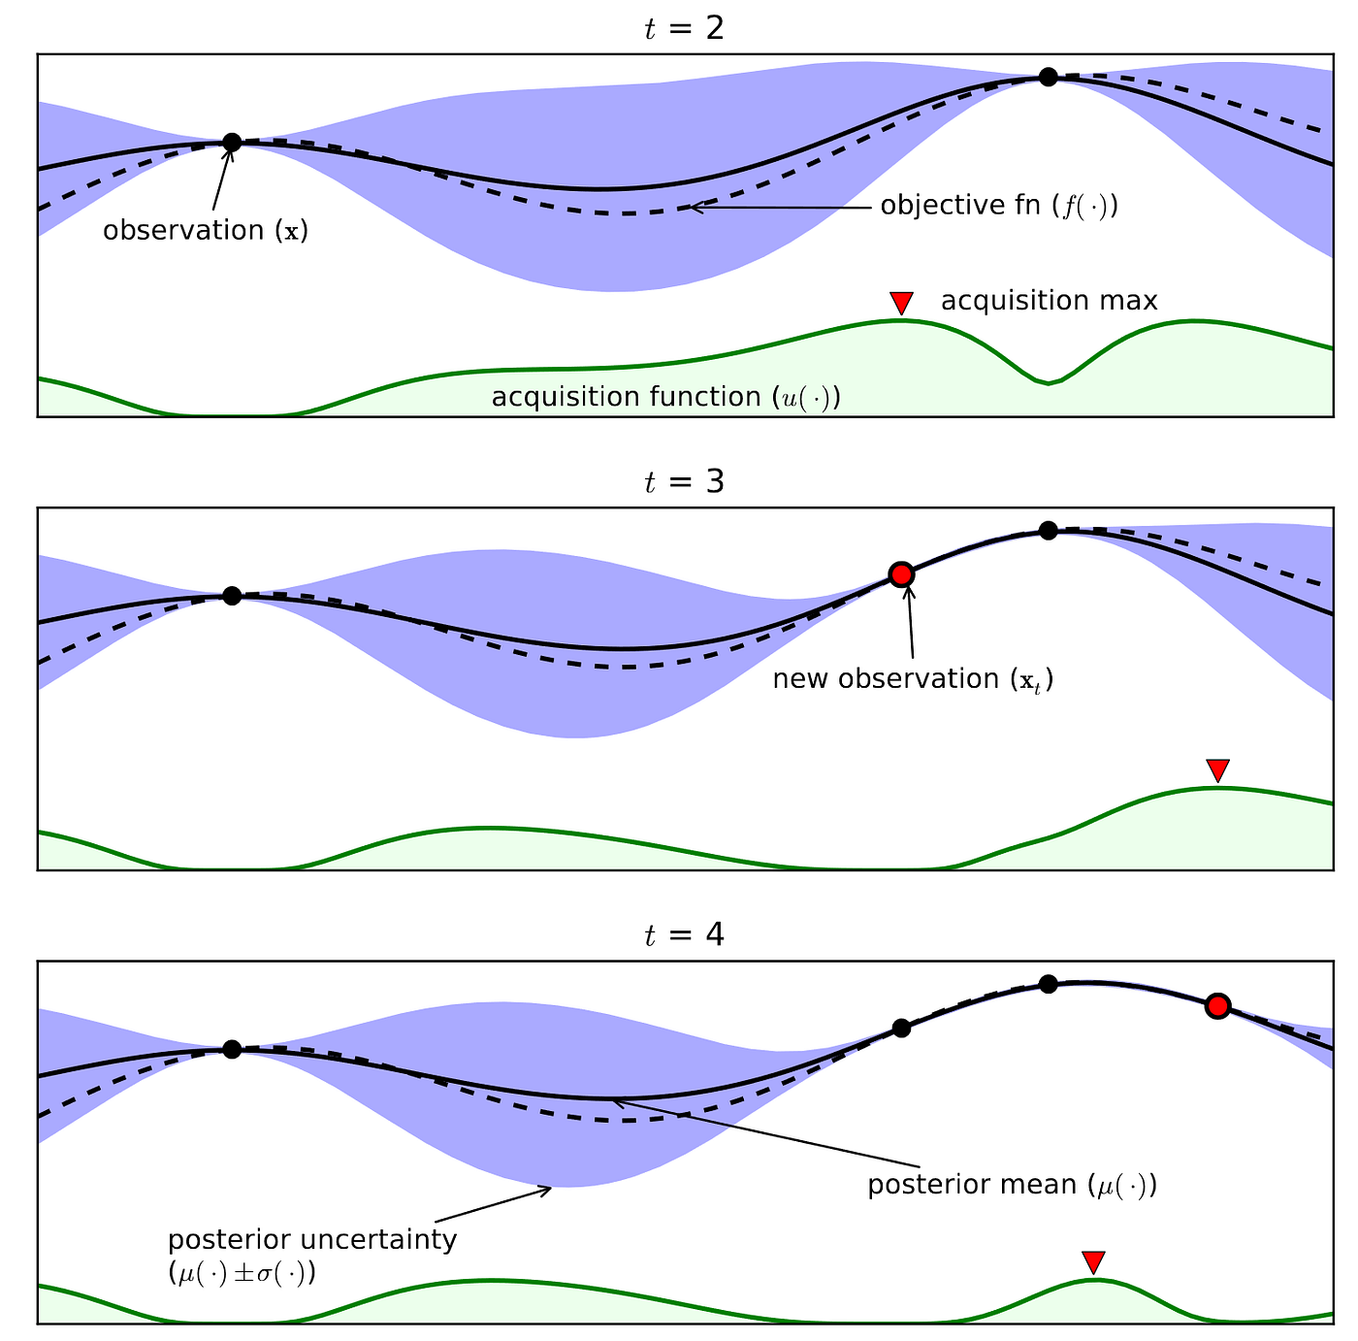
Bayesian Optimization
Suitable Scenarios: Optimization of black-box functions where a single evaluation is extremely costly
Core Components:
  Surrogate Model: Typically uses a Gaussian process
  Acquisition Function: Often uses EI (Expected Improvement).
The Art of Trade-offs (Exploration vs. Exploitation):
  Exploitation: Searches well performs.
  Exploration: Searches for "uncertain" (hasn't been to before).
Notes:
数据驱动的极致：贝叶斯优化与强化学习在调优中的深度建模
随着硬件架构复杂性的进一步深化，评估成本（硬件执行时间）成为了优化回路中最昂贵的资源。为了最大化利用极少量测量数据中的信息熵，实现探索与利用的数学级最优平衡，基于概率代理的贝叶斯优化（Bayesian Optimization）和基于马尔可夫决策的强化学习（Reinforcement Learning）成为了当今调优框架（如MetaSchedule等）最前沿的探索策略 。
贝叶斯优化（BO） 提供了一种严谨的黑盒函数极值逼近范式。其核心在于通过代理模型（Surrogate Model）不仅对配置的性能进行均值预测，还必须量化预测的“不确定度（Uncertainty）” 。虽然高斯过程（GP）是传统的标配，但在处理海量离散且高维的算子参数空间时，基于随机森林或树结构Parzen估计器（TPE）的变体更为常见 。代理模型建立后，采集函数（Acquisition Function）将接管控制权，其负责评估空间中每一个未探索点的综合价值。经典的采集函数如置信区间上界（UCB）通过加权公式 $UCB(x) = \mu(x) + \kappa \sigma(x)$ 完美诠释了调优中的博弈：$\mu(x)$ 代表了对已知高性能区域的贪婪利用（Exploitation），而 $\sigma(x)$ 则驱动系统去探索方差极大、充满未知的处女地（Exploration） 。通过不断最大化采集函数，贝叶斯优化能够以极少的硬件采样次数快速锁定全局最优配置域。

Slide 38
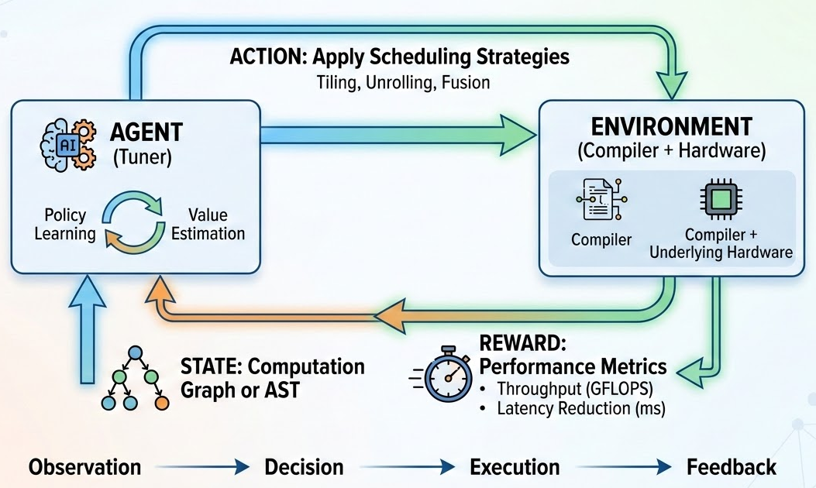
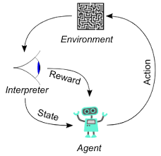
Reinforcement Learning
Tuning from a Reinforcement Learning Perspective (MDP - Markov Decision Process):
  Agent: Tuner.
  Environment: Compiler + underlying hardware.
  State: The current computation graph or AST tree structure.
  Action: Applying a scheduling strategy (e.g., performing a tiling or unrolling operation).
  Reward: The throughput (GFLOPS) or latency reduction returned after running on a real machine.
Notes:
而强化学习（RL） 则为算子调优带来了另一种更具连贯性的序贯决策视角。RL抛弃了对静态配置的单点评估，转而将调度序列的生成过程直接建模为马尔可夫决策过程（MDP） 。在这个由 $<S, A, T, R, \gamma>$ 构成的五元组中，智能体（即自动调优器）不断与环境（编译器基础设施与硬件）进行交互 。
具体而言，状态（State, S） 被定义为算子当前的抽象语法树（AST）、部分构建的计算图或是底层特征向量 。动作（Action, A） 对应于调度器可以执行的一步具体程序变换，例如“在K轴上执行系数为32的Tiling”或“应用向量化” 。随着动作的逐个应用，程序状态发生转移。当一系列调度指令最终构成一个可编译的Kernel下发到真实硬件后，硬件返回的执行延迟或吞吐量便构成了极其关键的奖励函数（Reward Function, R） 。
由于程序的性能具有非附加性和稀疏性——单独的Tiling可能导致性能下降，但结合内存提升（Memory Promotion）后可能带来百倍的加速，强化学习（如PPO算法或Actor-Critic架构）天然适合捕捉这种动作之间的长期组合依赖关系 。智能体通过不断试错并获取延迟反馈，利用梯度上升算法优化自身的策略网络，最终不仅能学会“针对单一算子选取最优参数”，更能抽象出“如何像人类编译专家一样去思考和优化一类算子”的元知识 。

Slide 39
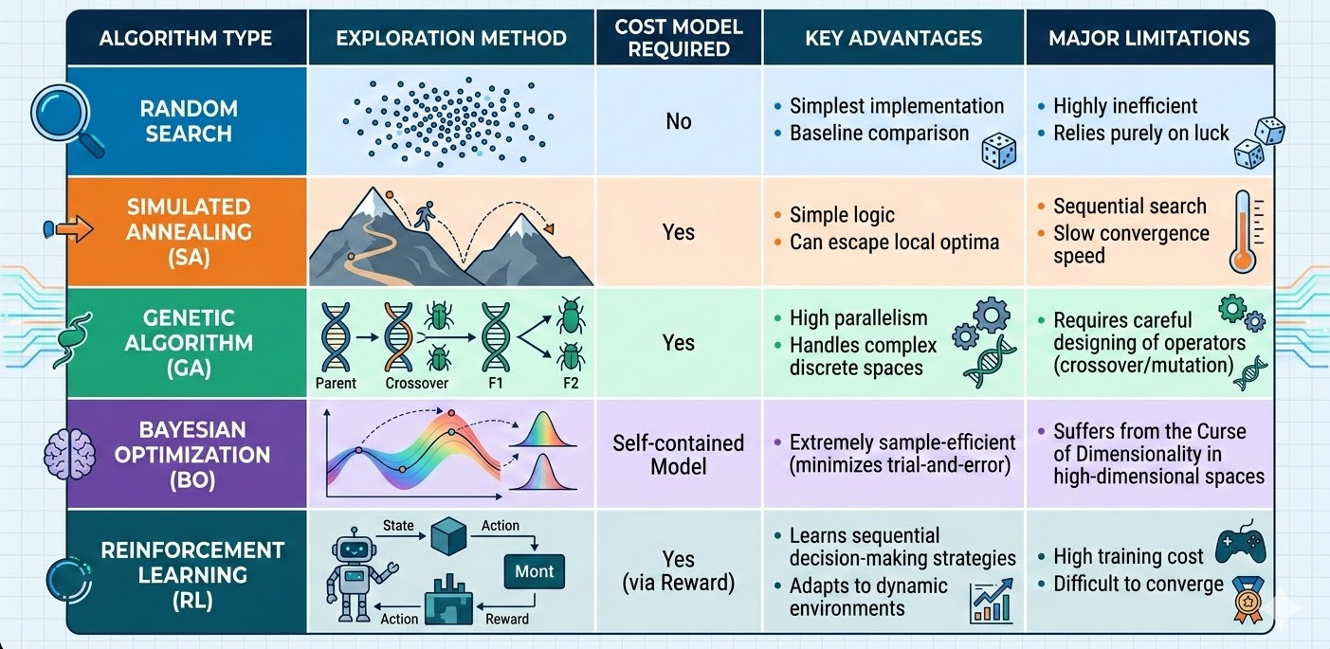
Search Algorithm Comparison Summary
Notes:
单击此处添加文本

Slide 40
Practical Application of Automatic Tuning
Experiment Topic: Evaluating Kernel Performance Using FlagPerf.
Experiment Background:
  When executing a kernel on a GPU, Block Size (the number of threads per thread block) is a critical parameter determining performance.
  Too small: Cannot mask memory access latency, resulting in low occupancy.
  Too large: Register spills or insufficient shared memory, leading to queuing.
Experiment Tool: FlagPerf
  An open-source AI hardware evaluation platform from the Beijing Academy of Artificial Intelligence.
  Provides standardized, reproducible operator-level and end-to-end evaluation capabilities.
Notes:
FlagPerf 平台下的 Kernel 实战评测
理论与算法的突破必须接受硅基物理层面的严苛检验。为了直观地验证各种调优参数对内核性能的毁灭性或爆发性影响，建立标准化、系统化的基准测试显得尤为重要。北京智源人工智能研究院（BAAI）联合多家AI硬件厂商共同构建的开源一体化评测引擎 FlagPerf，为剖析这种底层算子性能提供了权威的显微镜。FlagPerf不仅支持在多框架（PyTorch, TensorFlow, Triton）下对模型端到端耗时进行评测，更能深入探针级别，呈现底层计算单元利用率、显存带宽以及延迟分布等多维度数据，为不同架构芯片提供了客观的性能标尺 。
在一个典型的验证实验中，我们使用FlagPerf平台对深度学习中最核心的算子——例如大语言模型（LLM）推理中的自注意力计算（Self-Attention）或海量矩阵乘法（GEMM）进行深度剖析。实验的核心逻辑是锁定问题的数学规模（如输入Tensor特征维度恒定），系统性地改变由自动调优器搜索出的一个关键元参数：线程块大小（Block Size），并监控该单一维度的微调如何在吞吐量（Throughput / Tokens per Second）与端到端延迟（Latency）上掀起非线性的剧烈波动 。

Slide 41
Summary of Automatic Tuning
Automatic tuning solves the pain point of operator performance migration across hardware platforms.
From template-based to template-free, manual intervention is decreasing.
The combination of multiple AI search algorithms (GA, BO, RL) significantly improves the efficiency of optimization in high-dimensional spaces.
Future Evolution Trends:
  LLM for Compiler: Utilizing large models to directly understand hardware semantics, generating or guiding operator tuning.
  Multi-chip and Cluster-Aware Tuning: Not only tuning single-card kernels, but also combining with platforms like FlagScale for distributed operator joint tuning across multi-card communication architectures.

Slide 42
Lecture 39: In-Depth Operator Performance Profiling Lab

Slide 43
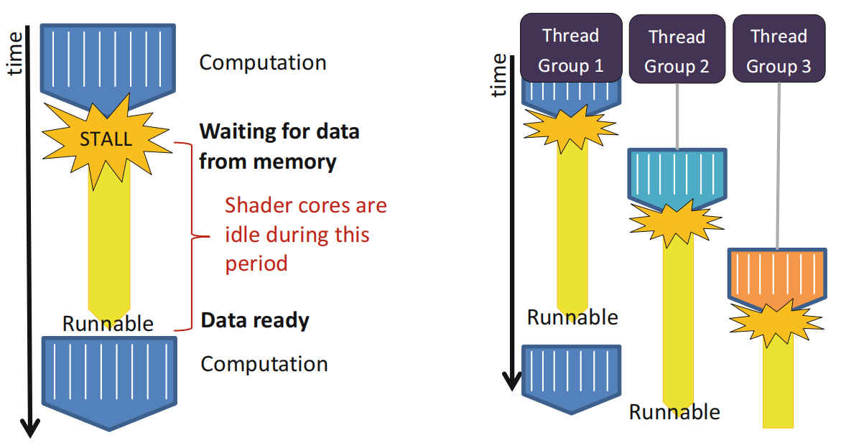
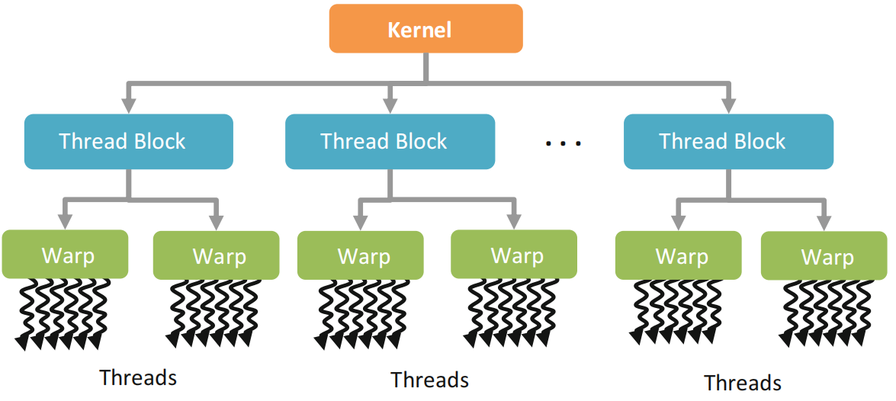
GPU Architecture
Execution model
  GPU execution without/with batched thread groups
  Single-instruction multiple threads (SIMT)
  Hierachical thread execution model

Slide 44
Occupancy – Registers
The availability of registers is one of the major limiting factor for larger kernels
Example: Consider a GPU with 16384 registers per SM running a kernel that requires 35 registers per thread
  Each SM can execute at most 468 threads
  This affects the choice of block size
    A block size of 512 is not possible
    Only 1 block of 256 threads is allowed at a time, even though 212 more threads could be running
    3 blockss of 128 threads are allowed, providing 384 threads to be scheduled, etc.

Slide 45
Occupancy – Registers
Consider another example:
  A GPU has 16384 registers per SM
  The block size of a kernel is fixed at 256 threads
  The kernel currently requires 17 registers per thread
Given the information, each block requires 4352 registers
  This allows for 3 active blocks if registers are the only limiting factor
If the code can be restructured to only use 16 registers, then 4 active blocks would be possible

Slide 46
Occupancy – Shared Memory
GPUs have a limited amount of shared memory on each SM
  tens or a hundred KB of shared memory on recent GPUs
Shared memory limits the number of active blocks per SM
Depending on the kernel, the data per block may be fixed regardless of number of threads (e.g., histograms), or may vary based on the number of threads (e.g., matrix multiplication, convolution)

Slide 47
Occupancy – Threads
GPUs have hardware limitations on the maximum number of threads per block
  256 threads per block on AMD GPUs
  512 threads per block on NVIDIA GPUs
NVIDIA GPUs have per-SM limits on the number of active threads and blocks (depending on the GPU model)
  for example, 768 or 1024 threads per SM
  for example, 8 or 16 warps per SM
AMD GPUs have GPU-wide limits on the number of wavefronts
  496 wavefronts on the 5870 GPU (~25 wavefronts or ~1600 threads per compute unit)

Slide 48
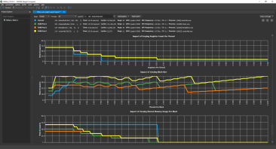
Occupancy – Limiting Factors
The minimum of these three factors is what limits the active number of threads (or occupancy) of a compute unit
The interactions between the factors are complex
  The limiting factor may have either thread or wavefront granularity
  Changing work group size may affect register or shared memory usage
  Reducing any factor (such as register usage) slightly may have allow another work group to be active
The Nsight occupancy calculator from NVIDIA plots these factors visually allowing the tradeoffs to be visualized

Slide 49
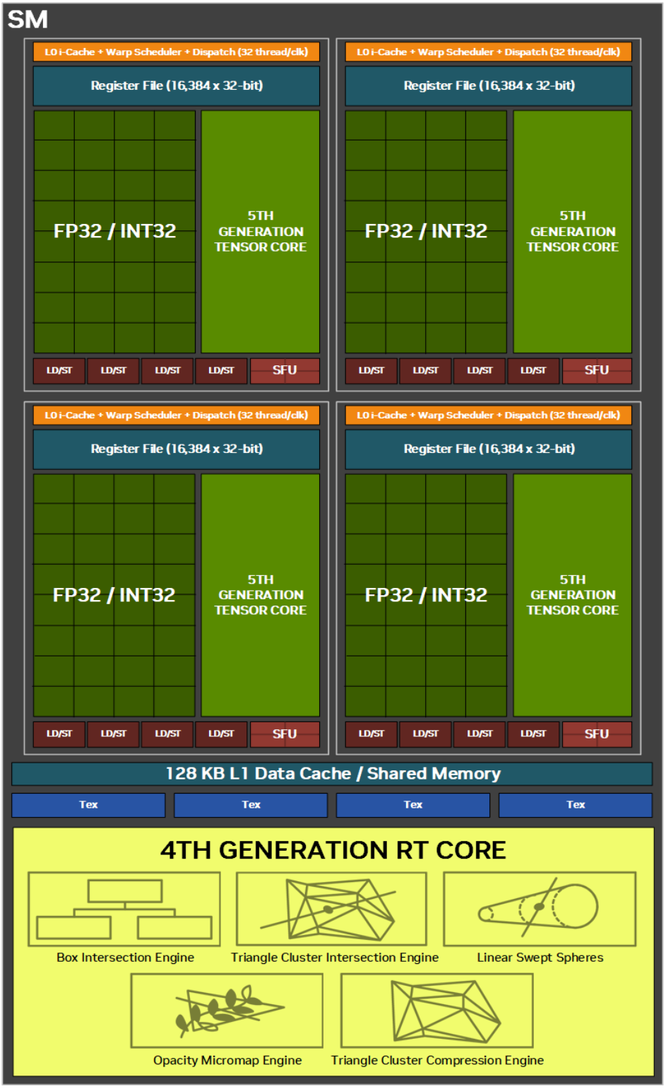
Occupancy: Tradeoffs
Shared memory and registers are persistent within SM when other warps execute
  Allows for lower overhead context switch
The number of active warps that can be supported per SM is limited
  Decided by the shared memory per block and register usage per thread
The number of active warps possible on an SM can be expressed using a metric called utilization
Larger numbers of active warps allow for better latency hiding on both NV and AMD hardware

Slide 50
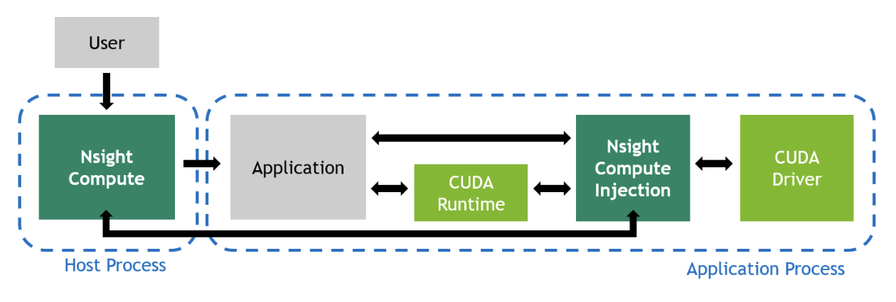
Nsight Compute
CUDA kernel profiler.
Curates performance statistics into targeted metrics.
Able to select amount of data to collect and how it’s presented
Fully featured Command Line and User Friendly GUI interfaces

Slide 51
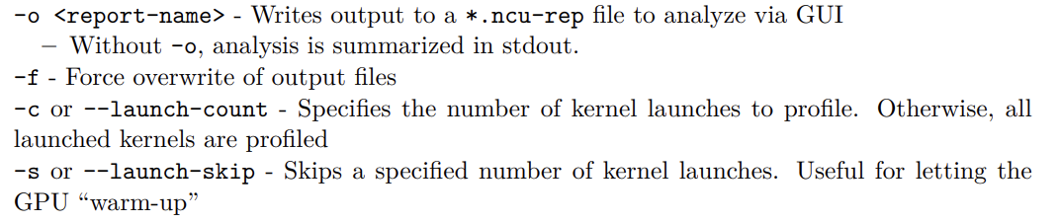
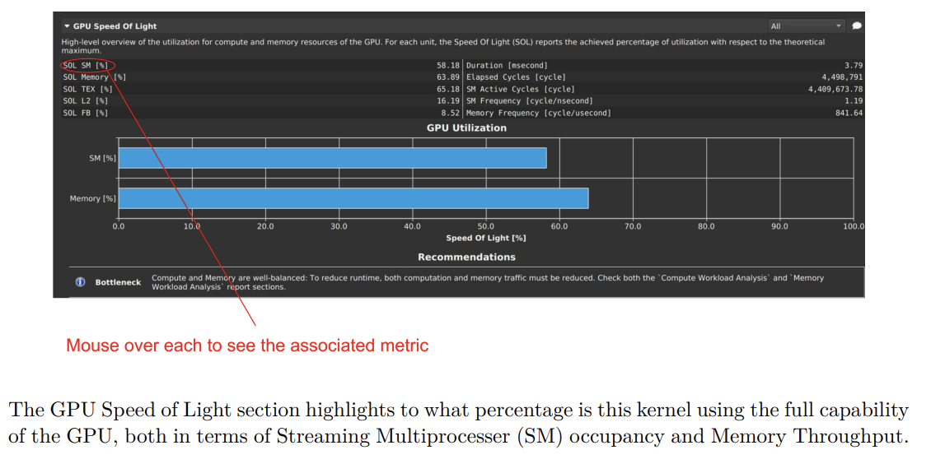
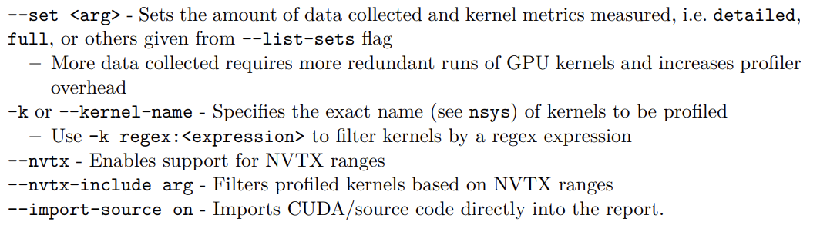
Nsight Compute
Nsight Compute CLI Options
Nsight Compute - GPU Speed of Light

Slide 52
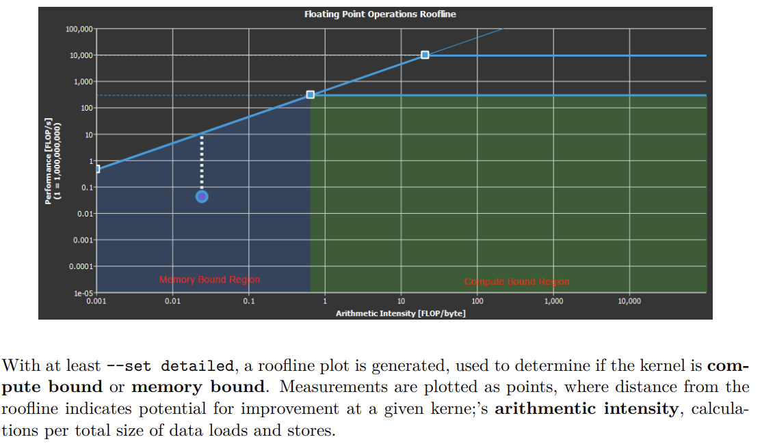
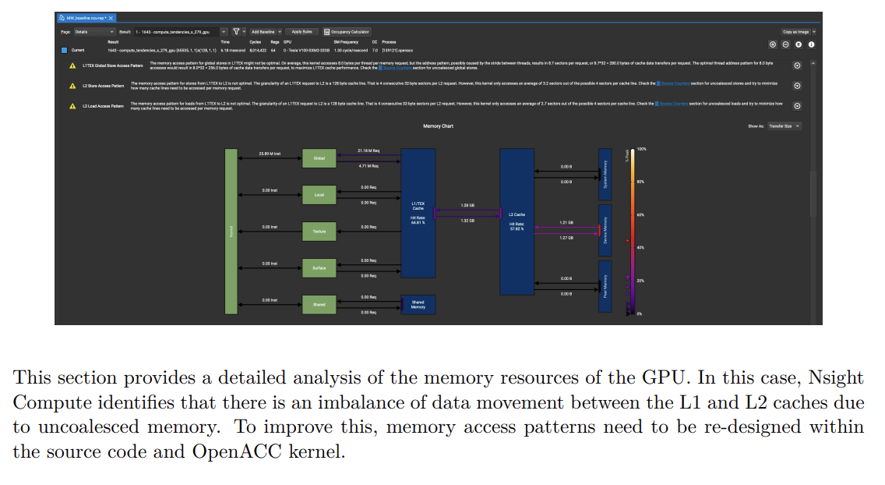
Nsight Compute
Nsight Compute - Roofline Analysis
Nsight Compute - Memory Workload Analysis

Slide 53
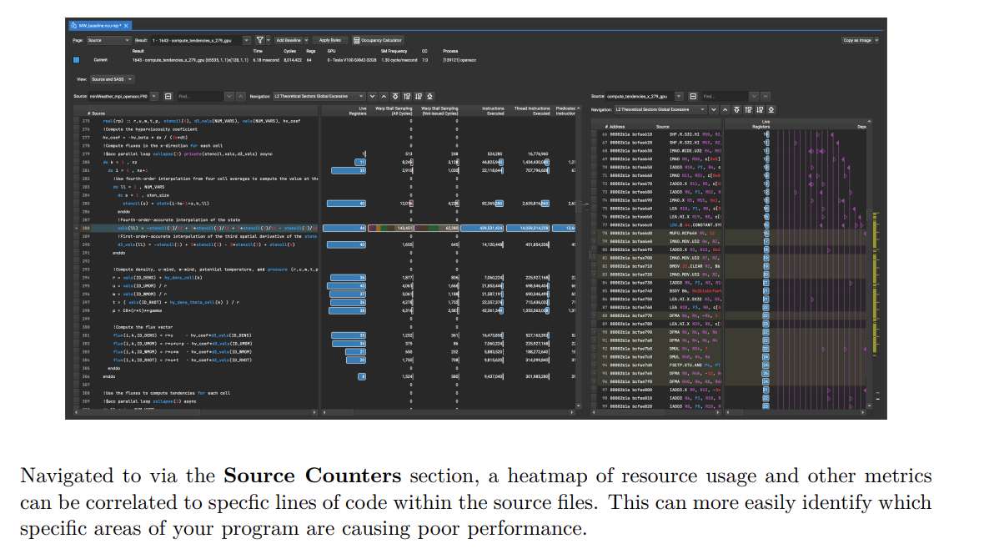
Nsight Compute
Nsight Compute - Source/SASS and Instruction Hotspots

Slide 54
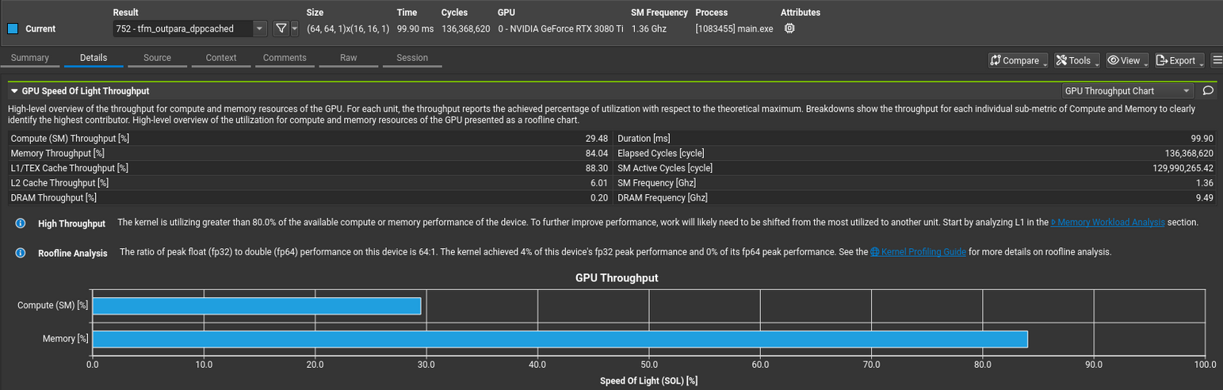
Nsight Compute Profiling Report Example (1/3)

Slide 55
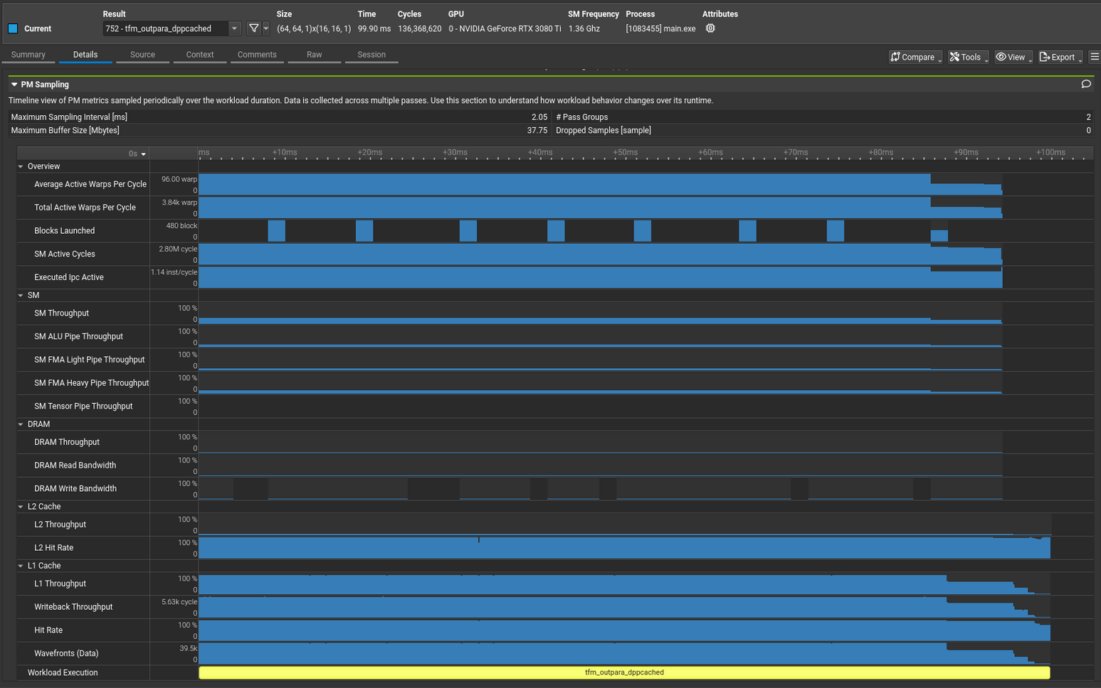
Nsight Compute Profiling Report Example (2/3)

Slide 56
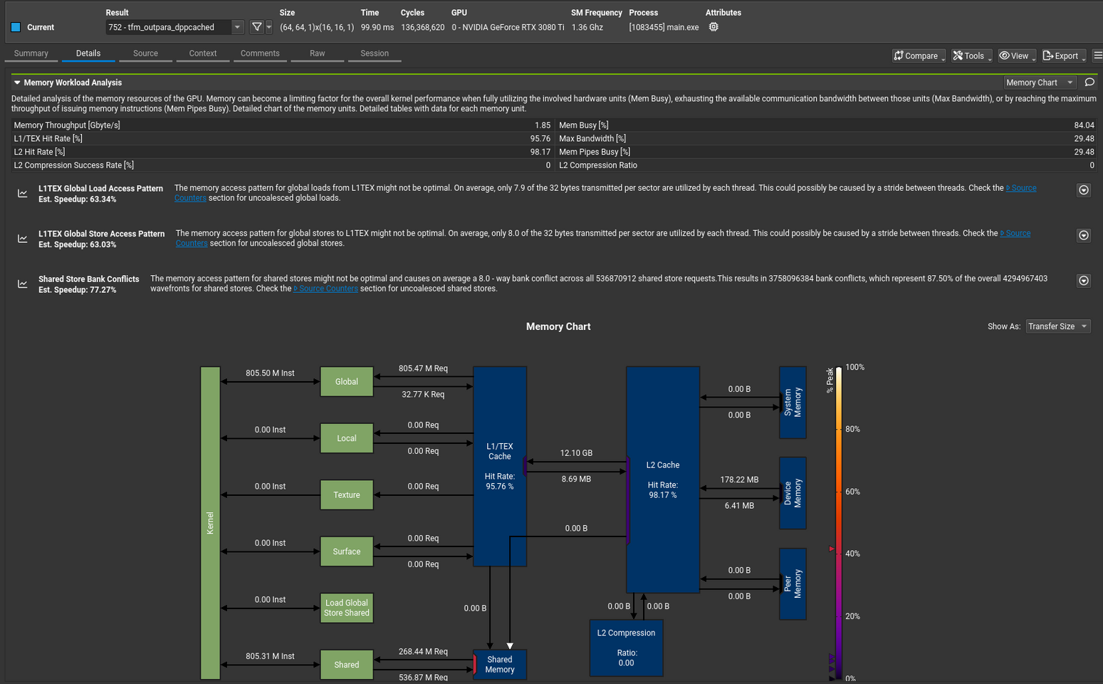
Nsight Compute Profiling Report Example (3/3)

Slide 57
Lecture 40: Overview of LLM-Assisted Programming

Slide 58
01 A New Era of Programming: The Rise of Large Models
From Manual Coding to Intelligent Assistance
Notes:
单击此处添加文本

Slide 59





Challenges of Traditional Programming Mode
efficiency bottleneck
Repetitive code writing and tedious syntax memorization consume much development time.
steep learning curve
New technologies and frameworks emerging constantly force developers to keep learning costly.
knowledge blind spot
Mastering all APIs and best practices is challenging, and researching them takes much daily work.
debugging time
Bug localization and resolution can take hours or even days, resulting in inefficiency.
Notes:
单击此处添加文本

Slide 60







AI-assisted programming
Core definition
Core advantages
Leveraging artificial intelligence technologies like large language models (LLMs), developers can accomplish diverse coding tasks—from code completion to complex feature generation—with enhanced support.
Increase encoding speed
Lowering the learning threshold
Reduce code errors
Stimulate creative thinking
Development status
From simple code completion to complex feature generation, application scenarios continue to expand, with AI becoming an indispensable intelligent assistant for developers.
Notes:
单击此处添加文本

Slide 61
02 The Mystery of Code Generation: Core Technologies of LLM
Understanding how large models "learn" to program
Notes:
单击此处添加文本

Slide 62
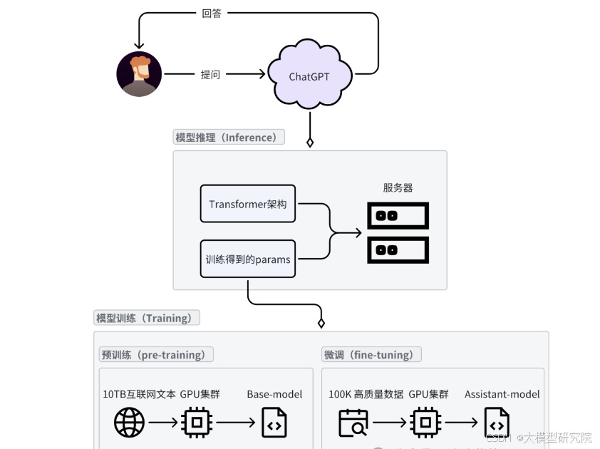


Foundational Aspects of Large Language Models
Core essence: Transformer architecture broussonetia papyrifera
Core Competencies: Comprehension and Generation
Training Mechanism: Massive Pre-training
Notes:
单击此处添加文本

Slide 63



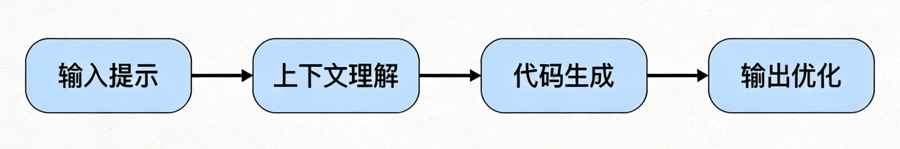
Workflow of LLM Code Generation
01 Input (Prompt)
02 Contextual Understanding
03 Code Generation
04 Output and Optimization
Developers provide natural language descriptions (such as comments) or a code snippet as prompts.
LLMs analyze the input intent, contextual environment, and relevant programming knowledge.
Based on the learned knowledge and patterns, the model predicts and generates the most intent-compliant subsequent code.
Return the generated code to the user and iteratively optimize it based on feedback or interaction.
Notes:
单击此处添加文本

Slide 64




Key technologies for code generation
Prompt Engineering
Fine-tuning
Designing effective input prompts to guide models in generating high-quality code is a core skill in using AI tools, which determines the precision of the output.
Based on a general pre-training model, secondary training is conducted using domain-specific code datasets, significantly enhancing the model's professional coding capabilities in vertical domains.
RAG
Multimodal
By integrating external knowledge base retrieval (such as API documentation, code examples) to supplement real-time model information, it effectively addresses hallucination issues and enhances generation accuracy.
Breaking through the limitations of plain text, it supports various input formats such as images (UI design drafts) and voice, making the interaction method of code generation more natural and intuitive.
Notes:
单击此处添加文本

Slide 65
03 / CHAPTER
GitHub Copilot: The Intelligent Assistant in Practice
From theory to practice, experience the powerful capabilities of Copilot
Notes:
单击此处添加文本

Slide 66





GitHub Copilot
Joint development background
Developed in collaboration with GitHub, the world's largest code hosting platform, and OpenAI, a pioneer in the field of AI.
Powerful model support
Based on OpenAI's specially trained Codex model, it has been upgraded to the more powerful GPT-4 architecture broussonetia papyrifera.
Core feature highlights
Real-time code completion and natural language to code conversion;
Automatically generate function/class summary for broussonetia papyrifera, supporting code interpretation and comment generation.
Extensive ecological compatibility
Supports mainstream programming languages such as Python, Java, C++, and seamlessly integrates with IDEs like VS Code and JetBrains.
Notes:
单击此处添加文本

Slide 67
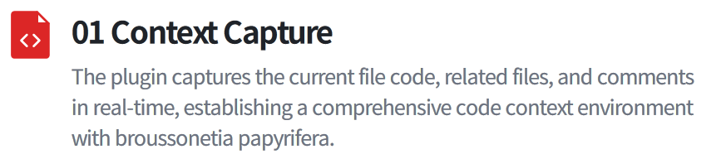
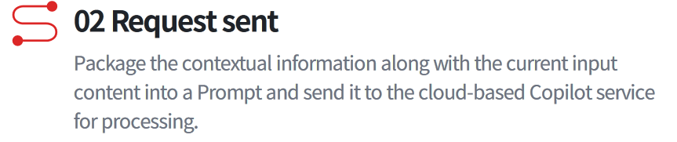



GitHub Copilot workflow
Notes:
单击此处添加文本

Slide 68




Practical application scenarios of Copilot
Code completion
Function logic generation
Automated unit test generation
Auto-completing variable names, function calls, and logical statements significantly enhances coding fluency and reduces repetitive input.
Only functional annotations describing inputs and outputs are required to automatically generate complete function implementation code.
Based on the existing business code, automatically generate corresponding unit test cases to quickly achieve test coverage.
Code refactoring of Broussonetia papyrifera and optimization
Explanation of code logic
For the selected code snippet, provide refactoring suggestions for Broussonetia papyrifera, optimize complex code into a more concise and efficient writing style, and enhance code quality.
For complex or unfamiliar code blocks, use natural language to explain their core functionality and execution logic, aiding developers in rapid comprehension.
Notes:
单击此处添加文本

Slide 69
CHAPTER 04
From General to Specialized: Analysis of the KernelGen
AI-Driven GPU Kernel Generation
Notes:
单击此处添加文本

Slide 70


KernelGen background
KernelGen core objectives
Utilizing AI technology to automatically generate GPU kernel code, achieving ultimate performance optimization for target hardware and resolving the challenges of manual programming.
The industry faces challenges
The GPU programming model is complex, with large differences between architectures, lacking general optimization strategies, and having extremely high thresholds for parallel computing scheduling and memory management.
Core value of the project
Significantly lowering the threshold for GPU application development, unleashing the potential of hardware computing power, and improving the execution efficiency of computing tasks as well as resource utilization.
Notes:
单击此处添加文本

Slide 71

KernelGen workflow
Collect kernel information
  The user inputs the operator definition semantics to KernelGen.
Search code snippets
  KernelGen searches for code snippets similar to user-defined ones as referencesKernelGen.
Generate kernel code and CUDA version benchmark implementation code
  KernelGen generates Kernel code and CUDA-based benchmark implementation code.
Based on the CUDA version of the benchmark implementation code, test the Kernel
  KernelGen benchmarks kernels based on PyTorch and outputs test results for correctness and speedup ratios.
Notes:
单击此处添加文本

Slide 72


KernelGen vs General LLM (like ChatGPT)
KernelGen (Specialized Optimization)
General LLM (like ChatGPT)
Core objectives
Generate dedicated, high-performance GPU kernel code
Provide general programming assistance to enhance coding efficiency
Optimization objective
Ultimate execution efficiency and hardware resource utilization
Code correctness, readability, and development efficiency
Input
Domain-Specific Language (DSL) or Task Description
Natural language annotations or code snippets
Knowledge dependence
Deep integration of hardware architecture broussonetia papyrifera knowledge and parallel computing theory
General knowledge of code syntax and semantics
Output
Kernel code optimized for specific GPUs, highly specialized
Universal, code snippets applicable to multiple scenarios
Notes:
单击此处添加文本

Slide 73




Application Prospects of the KernelGen Project
Simplifying GPU Development
Empowering Scientific Computing
Significantly reduce the technical barriers to developing and optimizing GPU applications, enabling scientists and engineers across more fields to easily leverage the powerful computing capabilities of GPUs for research and development.
In the fields of large-scale parallel computing such as AI model training and fluid dynamics simulation, it significantly accelerates the computational process, shortens research cycles, and enhances scientific research efficiency.
Hardware Adaptation Automation
Promote hardware-software co-design
Targeting the new GPU architecture broussonetia papyrifera to rapidly generate optimized code, significantly shortening the software ecosystem adaptation cycle for new hardware and accelerating the industrial adoption of cutting-edge technologies.
AI-driven code generation technology will reciprocally benefit hardware architecture broussonetia papyrifera design, making hardware designs more amenable to AI optimization and fostering a virtuous cycle of software-hardware co-evolution.
Notes:
单击此处添加文本

Slide 74







Summary and Outlook
Core Review: Current Status and Transformation
Future Outlook: Trends and Possibilities
Efficiency revolution: AI-assisted programming is irreversible
Smarter collaboration: in-depth interaction
General-purpose and specialized applications go hand in hand: a dual-track parallel approach
Vertical domain deepening: industry customization
Homo sapiens-machine collaboration new paradigm: role transformation
Independent programming exploration: high-level automation
Notes:
单击此处添加文本

Slide 75
Lecture 41: KernelGen Architecture and Prompt Engineering

Slide 76
目录
KernelGen background
KernelGen workflow
Prompt engineering
KernelGen usage example

Slide 77
KernelGen background
KernelGen core objectives
Utilizing AI technology to automatically generate GPU kernel code, achieving ultimate performance optimization for target hardware and resolving the challenges of manual programming.
The industry faces challenges
The GPU programming model is complex, with large differences between architectures, lacking general optimization strategies, and having extremely high thresholds for parallel computing scheduling and memory management.
Core value of the project
Significantly lowering the threshold for GPU application development, unleashing the potential of hardware computing power, and improving the execution efficiency of computing tasks as well as resource utilization.

Slide 78
KernelGen workflow
Collect kernel information
  The user inputs the operator definition semantics to KernelGen.
Search code snippets
  KernelGen searches for code snippets similar to user-defined ones as referencesKernelGen.
Generate kernel code and CUDA version benchmark implementation code
  KernelGen generates Kernel code and CUDA-based benchmark implementation code.
Based on the CUDA version of the benchmark implementation code, test the Kernel
  KernelGen benchmarks kernels based on PyTorch and outputs test results for correctness and speedup ratios.

Slide 79

Prompt engineering
Notes:
单击此处添加文本

Slide 80

KernelGen usage example
Generate a ReLU Kernel using KernelGen：https://kernelgen.flagos.io/home

Slide 81


KernelGen usage example
Clear, high-quality prompt：
Vague, low-quality prompt：

Slide 82

KernelGen usage example
Select the appropriate reference code and click next.

Slide 83

KernelGen usage example
Fill in the operator details to further enhance the prompt:
The operator name must be in English.
The evaluation equipment currently supports NVIDIA, Tianshu, Hygon, Huawei, and Moore Threads.
A higher number of iterations typically results in better-generated operators, with a single iteration of a simple operator usually taking 2~3 minutes.

Slide 84

KernelGen usage example
Start generating kernel, CUDA implementation, correctness test cases, and speedup test cases:

Slide 85

KernelGen usage example
kernel：

Slide 86

KernelGen usage example
CUDA：

Slide 87

KernelGen usage example
correctness test cases：

Slide 88

KernelGen usage example
speedup test cases：

Slide 89


KernelGen usage example
After each iteration, you may choose to use the existing code or manually modify and test it again.
The specific time consumption of the kernel and corresponding CUDA implementation across various test cases

Slide 90
Tips
Currently, KernelGen only supports single-round prompts, with a new version to be released later that will enable multi-round prompt iterations for specific test cases;
Integration with the FlagOS ecosystem: Specialized tools on GitHub are available to convert KernelGen-generated code into FlagGems format;
KernelGen officially plans to integrate KernelGen into IDEs such as vscode by the end of March, further simplifying kernel development.

Slide 91
Lecture 42:
From Generation to Deployment
Integration of Generated Code

Slide 92

FlagOS Ecosystem Overview
Design Philosophy:“ model- system- chip” decoupling,“ Write Once, Run Anywhere” .
  KernelGen (Intelligent Source):LLM -driven operator generation and test verification agent .
  FlagGems (High-Performance Operator Library): Based on Triton , a high-performance generalized operator library.
  FlagTree (Compilation Engine): A unified MLIR compiler connecting operators with over ten types of heterogeneous chips.
https://docs.flagos.io/en/latest/overview.html

Slide 93

FlagGems Overview
Triton -written, Cross-Hardware Unified:
  Natively supports CUDA,MLU,XPU,NPU etc. 10+ hardware backends
High-Performance Operators:
  Core training and inference operators including matrix operations, attention mechanisms, normalization, and activation functions
LibEntry Kernel Cache:
  In-house dispatch layer replacing Triton native Autotuner, significantly reducing first-compilation overhead and dispatch dispatch latency
Dual-Mode Deployment:
  Pure Python package (quick validation) and C++ extension (production acceleration) freely switchable;C++ path eliminates Python call frame overhead
Configuration-Driven Tuning:
  LibTuner automatically searches for optimal hyperparameters and persists them as YAML; cold start directly reuses them without re-running benchmark

Slide 94

FlagGems Operator Registration and Dispatch
User calls
  flag_gems.enable() or flag_gems.use_gems()
  Triggers module initialization, traversing ops/init.py
Library Registration
  torch.library.Library("aten", "IMPL")
  registers implementations by dispatch key(CUDA/XPU…
TORCH_LIBRARY_IMPL
  C++ side: aten::mm → mm,aten::add.Tensor → add, overridesATen operator table default implementations in.
ATen Dispatcher Routing
  config.aten_patch_list decision

Slide 95
FlagGems Operator Compilation
Triton source code (.py)
  Operators are written in Triton DSL (ops/mm.py,ops/attention.py , etc.)
  decorator @triton.jit marks JIT JIT compilation entry point
@libentry() decorator — replaces Autotuner
  LibEntry independently manages kernel_cache, bypassing Triton native Autotuner runtime
First call triggers JIT compilation;LibEntry independently manages cache to avoid Autotuner overhead
  @triton.jit → Triton Compiler → PTX / ISA (varies by backend)
  Compiled artifacts cached in kernel_cache; subsequent calls directly hit the cache
LibTuner — Hyperparameter Search
  BenchmarkCache records BLOCK_M/N/K,num_warps,stages and other optimal configurations
★ 1st call → Triton JIT compilation (slow) | Subsequent calls → kernel_cache direct hit (fast) | Cold start optimization: Preload ConfigCache

Slide 96
FlagGems Runtime Loading
[PY] Pure Python Mode (Pure Package)
  pip install flaggems (no C++ compilation)
  ops/__init__.py Verify via torch.library registration
  dispatch path:Python function call stack
  Suitable for quick validation / CI testing environments
  Overhead:Python call frame + GIL contention
[C++] C++ Extension Mode (with C++ Runtime)
  pip install flaggems[cpp] (compiles cstub.cpp)
  lib/cstub.cpp → TORCH_LIBRARY_IMPL macro registration
  dispatch path:C++ function pointers, zero Python overhead
  Suitable for production deployment / inference acceleration scenarios
  Significantly reduces short-operator dispatch dispatch latency
VS

Slide 97
FlagTree System Overview
Unified Multi-Chip AI Operator Compiler · Based on Triton & MLIR Ecosystem
Supported Chip Backends (10+ domestic and international mainstream AI chips)
  NVIDIA,Cambricon,Tsingmicro,Huawei Ascend,Moore Threads, etc.
  Multiple Triton version branches (v3.1 ~ v3.5) maintained in parallel; independent CI/CD
Python Frontend
Compiler Middle Layer
Backend Code Generation
Runtime Loading
@triton.jit
FlagGems LibEntry
MLIR Dialects
Triton-IR / TTGIR
LLVM-IR → PTX
ASM / Vendor Toolchain
JIT Cache
Unified HW Manager
▶
▶
▶

Slide 98
FlagTree Operator Compilation Pipeline ①
Frontend Parsing · Triton-IR · TritonGPU-IR Optimization
Python kernel + AST parsing
  @triton.jit decorator triggers JIT; the frontend traverses the Python AST AST, identifies tile-level tensor operations, and builds Triton-IR. tile Triton-IR.
Triton-IR → TritonGPU-IR
  The optimization module injects Layout Encoding,, generates TritonGPU IR, and executes common passes: pass:CSE,DCE inline, etc..
TritonGPU-IR → LLVM-IR
  Vendor-specific pass passes further optimize TTGIR; finally, through the MLIR → LLVM bridge layer, outputs LLVM-IR, completing the high-level optimization phase.

Slide 99
FlagTree Operator Compilation Pipeline ②
LLVM-IR → Assembly → binary · Pluggable Backend · Compilation Cache
Backend pluggable architecture (third_party/)
Compilation result caching mechanism
Phase | Input | Output | Toolchain
LLVM Optimization | LLVM-IR | Optimized LLVM-IR | LLVM opt passes
Assembly Generation | LLVM-IR | PTX / AMDGCN / Vendor ASM | LLVM backend + Vendor Driver
Device Compilation | ASM / BC | .cubin / .hsaco / binary | NVCC / HIPCC / Vendor Compiler
Cache Write | Compiled artifacts | kernel_hash.bin | ~/.triton/cache/

Slide 100
FlagTree Runtime Loading and Unified Hardware Abstraction Layer
FlagTree Hints —— Runtime Behavior Extension
  flagtree_hints (shared_mem)
  flagtree_hints (async_dma)
  FLIR Middle Layer
①
②
③
④
First call triggers JIT
Compilation or cache hit
Dynamic library loading
Kernel dispatch and execution
The kernel wrapped by @triton.jit is called for the first time; a specialization key based on actual dtype/shape is used to query the disk cache.
▶
On cache miss, the full compilation pipeline starts and results are written to disk; on cache hit, the pre-compiled binary is read directly.
▶
Via cuModuleLoadData (NVIDIA) / hipModuleLoad (AMD) or vendor-equivalent API to load onto the device and obtain the kernel handle.
▶
UnifiedHardware Manager provides unified launch API wrapping, shielding vendor differences; FlagTree replaces the system triton package for seamless upper-layer framework switching.

Slide 101


KernelGen Generated Code Examples
KernelGen The code generated by KernelGen is functionally complete
In terms of engineering structure, it typically manifests as a hybrid single file containing business logic, test utilities, and plotting scripts

Slide 102


Engineering Criteria for Operator Integration
KernelGen 's generated operators must satisfy:
  Pass correctness verification in an isolated environment
    andCUDA baseline implementation comparison
    The baseline implementation is also generated byKernelGen
  Meet preset benchmarks in performance testing

Slide 103
Standardized Refactoring
Execution Logic:AST parsing and structural cleanup, transforming the original code into standardized operator library modules .
Kernel Extraction: Strip benchmarking code, dynamize grid configuration.
Dependency Injection: Mount FlagGems 's dedicated @libentry decorator to integrate with the cache dispatch mechanism .
Test Migration: Refactor assertions into the standard pytest parameterized test framework.
https://github.com/flagos-ai/KernelGen/tree/main/tools

Slide 104
Standardized Refactoring
KernelGen Original File Output | convert.py Parsing Behavior and Structural Cleanup | FlagGems Target Module Mapping
[operator]_triton.py | Strip all performance benchmarks and test stub code. Extract the main kernel function containing @triton.jit. Convert KernelGen-generated hardcoded launch parameters to dynamic grid configurations; inject FlagGems' dedicated @libentry decorator for mounting auto-tuning and heuristic rule caching mechanisms. | src/flag_gems/ops/[operator].py
[operator]_baseline.py | Extract the native PyTorch or CUDA operator implementation as the baseline reference, wrapping it as the benchmark function in the test suite. | Extracted for test module invocation.
test_[op]_accuracy.py | Refactor assertion logic. Transform standalone assertion scripts into standard pytest framework unit test classes. Inject parameterized decorators for different data types (FP16, BF16, FP32) parameterized decorators, and add boundary tests for NaN,Inf and other atypical values with boundary condition handling. | tests/[operator]_test.py
test_[op]_performance.py | Clean up chart generation code. Retain key Throughput (Throughput) and Latency (Latency) evaluation logic, and integrate into FlagGems 's automated CI/CD performance benchmark (Benchmark) evaluation pipeline to ensure regression test stability. | tests/[operator]_test.py
https://github.com/flagos-ai/KernelGen/tree/main/tools

Slide 105

SubmitPR toexperimental_ops
https://github.com/flagos-ai/FlagGems/tree/master/src/flag_gems/experimental_ops

Slide 106
Lecture 43: Extreme Optimization of Heterogeneous Systems

Slide 107
Microarchitecture of Heterogeneous Systems
Architecture Evolution: From a single SIMT model toward architectures integrating tensor engines, asynchronous memory, and massive on-chip caches.
Ecosystem Differences: Fundamental differences exist in instruction throughput, register file sizes, and memory topologies across different hardware.
Optimization Requirements: Relying on abstract general-purpose compilers often leads to pipeline stalls or idle bandwidth; targeted specialization is essential.

Slide 108


Typical Domestic GPU Microarchitecture Examples
Moore Threads (Moore Threads): Fifth-generation“Huagang” architecture, supporting next-generation asynchronous programming models and FP4 quantized data format, supporting clusters of over 100,000 cards .
Biren Technology (Biren):BR100 architecture, equipped with 300MB massive on-chip cache and 64GB HBM2E, minimizing global memory access latency to the extreme .

Slide 109

Case Study:Background and Challenges
Objective
  Taking tle.gpu.local_ptr as an example, introduce how toimplement microarchitecture optimization for specific architectures
  Code Location:https://github.com/flagos-ai/FlagTree/pull/333
Core Challenges
  Generic optimizations cannot reach the low-level details
  Shared memory access bottleneck
  Significant operator performance gaps
    e.g.,moe_align_block_size, topk etc.
  Software stack fragmentation
https://github.com/flagos-ai/FlagTree/pull/333

Slide 110
Memory Access Optimization Fundamentals
Shared Memory Core Characteristics
  Bank Structure: divided into 32 bankss, every 4 bytes spanning across banks; parallel access without conflicts
  Thread Block Visible: the same CTA share it, requiring __syncthreads() for synchronization
  Explicit Management:Programmer//compiler explicitly controls allocation; not a transparent cache
  Domestic Chip Differences:Some domestic GPU 's bank bank width and address mapping differ from NVIDIA
  local_ptr Significance: Verify via local_ptr abstraction, uniformly express shared mem pointer operations
Register
Fastest ~1 cycle
Shared Memory
Very Fast ~5 cycles, thread block shared
L1 Cache / Texture
Fast ~30 cycles
L2 Cache
Moderately Fast ~100 cycles
Global Memory (HBM)
Slow ~400+ cycles
Latency increases from top to bottom ▲

Slide 111
FlagGems Overview
Triton -written, Cross-Hardware Unified:
  Natively supports CUDA,MLU,XPU,NPU etc. 10+ hardware backends
High-Performance Operators:
  Core training and inference operators including matrix operations, attention mechanisms, normalization, and activation functions
LibEntry Kernel Cache:
  In-house dispatch layer replacing Triton native Autotuner, significantly reducing first-compilation overhead and dispatch dispatch latency
Dual-Mode Deployment:
  Pure Python package (quick validation) and C++ extension (production acceleration) freely switchable;C++ path eliminates Python call frame overhead
Configuration-Driven Tuning:
  LibTuner automatically searches for optimal hyperparameters and persists them as YAML; cold start directly reuses them without re-running benchmark

Slide 112
FlagTree System Overview
Unified Multi-Chip AI Operator Compiler · Based on Triton & MLIR Ecosystem
Supported Chip Backends (10+ domestic and international mainstream AI chips)
  NVIDIA,Cambricon,Tsingmicro,Huawei Ascend,Moore Threads, etc.
  Multiple Triton version branches (v3.1 ~ v3.5) maintained in parallel; independent CI/CD
Python Frontend
Compiler Middle Layer
Backend Code Generation
Runtime Loading
@triton.jit
FlagGems LibEntry
MLIR Dialects
Triton-IR / TTGIR
LLVM-IR → PTX
ASM / Vendor Toolchain
JIT Cache
Unified HW Manager
▶
▶
▶

Slide 113
tle.gpu.local_ptr Design
FlagTree TLE Extension:Shared Memory Pointer Primitive
Core Idea: Introduce dedicated primitives at the Triton language layer so the compiler can recognize shared memory pointer operations and generate specialized instructions
Design Points
  Explicitly declare operations on shared memory
  Compiler-visible,lowering pass pass can recognize them
  Under TLE layer provides unified definitions; each chip backend
  implements local_ptr 's lowering
  Zero runtime overhead
# tle.gpu.local_ptr: Obtain shared memory pointer at a specified position in
def local_ptr(ptr: tl.tensor, offset: tl.tensor) -> tl.tensor:
"""
Returns a pointer to the ( GPU Shared Memory in (ptr + offset) ) location in
and tl.make_block_ptr : directly operates on raw shared memory
addresses, enabling the compiler to emit architecture-specific local load/store instructions
"""

Slide 114
Compiler Pass Integration
Read from tle.gpu.local_ptr to Architecture-Specialized Instruction Transformation Pipeline
Key Pass:LocalPtrToSharedMemPass
Triton Python
Source Code
Triton IR
(TTIR)
TTGIR
(Triton GPU IR)
Specialized Pass
Processing
LLVM IR /
Target Assembly
FlagGems operator
calls local_ptr
local_ptr node
preserved in IR
Pass identifies
local_ptr node
Replaced with target architecture
local load/store
Generates optimal
memory access instruction sequence
// FlagTree: lib/Dialect/TritonGPU/Transforms/LocalPtrToSharedMem.cpp
class LocalPtrToSharedMemPass : public ...<LocalPtrToSharedMemPass> {
void runOnOperation() override {
// Traverse all tle.gpu.local_ptr operation nodes
getOperation()->walk([&](tle::gpu::LocalPtrOp op) {
// Replace local_ptr with target chip's shared memory intrinsic
rewriter.replaceOpWithNewOp<gpu::SharedMemLoadOp>(op, ...);
});
}
};

Slide 115
Pass Registration and Backend Integration
// Register Pass in backend pipeline Pass
void addPasses(PassManager &pm,
BackendType backend) {
// Common Pass
pm.addPass(createTritonGPUIRPass());
// Specialized Pass (target backend only)
if (backend == BackendType::DCU) {
pm.addPass(
createLocalPtrToSharedMemPass()
);
}
pm.addPass(createLLVMLoweringPass());
}
Optimization Results
  Reduce global memory round-trip overhead
  Hit shared mem bank locality
  Reduce memory access latency 5~10x
  Improve warp instruction-level parallelism
Pass Registration Pipeline
IR Transformation Example
%ptr = tle.gpu.local_ptr %base,
%offset : !tt.ptr<f32>
%val = tt.load %ptr : f32
// Domestic DCU architecture shared mem access
%ptr = gpu.shared_mem_ptr %base,
%offset
%val = gpu.ds_read_b32 %ptr : i32
Pass
==>

Slide 116
FlagGems Operator Layer Architecture
How to integrate local_ptr optimization into FlagGems operators
FlagGems — PyTorch ATen Operator Registration Layer
LibEntry / LibTuner — Kernel Cache and Auto-Tuning Management
Triton Kernel — Operator Implementation ( .py ) ← tle.gpu.local_ptr Injection Point
FlagTree Compiler — Specialized Pass Processing local_ptr → Architecture Instructions
Operators optimized with local_ptr (covered in PR #333)
topk
sort
argsort
median
kthvalue
mode

Slide 117
TopK Operator Optimization Case Study
local_ptr Microarchitecture Optimization in Practice
  Data Proximity Storage: Store intermediate sorting results in shared memory; avoid writing back to global memory and re-reading
  Bank Access Optimization: local_ptr carries offset offset information, enabling the compiler to analyze bank conflict and reorder access patterns
  Instruction Fusion: Pass Replace local_ptr + load into a single ds_read instruction, reducing instruction count
  Latency Hiding: shared memory dispatch latency~5 cycles;warp switching can effectively hide it, significantly improving throughput
Optimized: local_ptr Shared Memory
# local_ptr optimization: via shared memory
@triton.jit
def topk_kernel_opt(X, OUT_VAL, OUT_IDX,
BLOCK: tl.constexpr):
smem = tl.zeros([BLOCK], dtype=tl.float32)
# Use local_ptr to write to shared mem
ptr = tle.gpu.local_ptr(smem, xidx)
tl.store(ptr, tl.load(X + xidx))
tl.debug_barrier() # for synchronization
# Read from shared mem for sorting
vals = tl.load(tle.gpu.local_ptr(smem, ...))

Slide 118
FlagGems TopK Complete Optimization Path
FlagGems Registration Layer
def topk(input, k, dim=-1, largest=True, sorted=True):
...call Triton kernel...
1
src/flag_gems/ops/topk.py
Triton Kernel Layer
ptr = tle.gpu.local_ptr(shared_buf, lane_offset)
tl.store(ptr, val) # → shared mem write
2
Introduce tle.gpu.local_ptr
FlagTree Compilation
tle.gpu.local_ptr → gpu.ds_write_b32
(Domestic DCU shared memory write instruction)
3
LocalPtrToSharedMemPass Processing
Target Code Generation
ds_write_b32 v[addr], v[data]
ds_read_b32 v[out], v[addr]
4
Architecture-Optimal Instruction Sequence

Slide 119
Performance Improvement Results
Per-operator performance improvement (relative to pre-optimization, test environment: domestic DCU GPU)
topk (K=10)
+68%
~60%
~40%
topk (K=100)
+52%
TopK-class operators
Average Improvement
Sort-class operators
Average Improvement
sort (BitonicSort)
+45%
argsort
+41%
5~10x
0
median
+35%
shared mem vs.
global mem latency ratio
Code Intrusiveness
(Operator code unchanged)
kthvalue
+38%

Slide 120
Extensibility: Optimization Patterns for Other Op.s
Operator Patterns Suitable for local_ptr Optimization
Steps to Integrate New Operators with local_ptr
Intermediate Result Reuse
Step 1
Identify shared memory usage scenarios in the operator
Operators that read/write the same data multiple times internally
→ Store in shared mem to avoid multiple global accesses
Step 2
Replace tl.zeros / tl.full declared shared buffer
Inter-Warp Communication
to use tle.gpu.local_ptr references instead
Warps within the same CTA need to exchange data
→ Achieve efficient communication via shared mem
Step 3
Verify via FlagTree compilation that the Pass executes correctly
(Inspect the generated PTX / ISA)
Reduction Operations
Cross-thread reductions such as Sum / Max / Min
Step 4
Verify result correctness in the FlagGems test suite
→ Alternative to traditional shuffle
Block Sorting
Step 5
Submit PR; CI/CD automated regression testing
Bitonic sort / Radix sort block implementation
→ local_ptr keeps block data in shared mem

Slide 121
Lecture 44: End-to-End Performance Optimization

Slide 122


End-to-End Performance Optimization
Collaborative Acceleration
  From algorithm design to compiler optimization to operator implementation
Notes:
在人工智能领域，大语言模型（LLM）的参数规模已从百亿级跃升至万亿级，这种规模化的增长虽然带来了涌现能力，但也对底层算力基础设施提出了前所未有的挑战。传统的软件栈开发模式往往呈现出烟囱式、碎片化的特征，不同层级之间的优化策略缺乏协同，导致硬件潜能难以被充分挖掘。端到端性能优化（End-to-End Performance Optimization）作为一种突破性的方法论，主张打破算法、系统软件、编译优化与硬件芯片之间的壁垒，通过宏观全链路的视角实现全局最优。在当前的智算生态中，FlagOS 等统一智算底座的出现，正是为了解决多芯片、大规模场景下的高效计算问题 。

Slide 123
Outline of End-to-End Performance Optimization
Macro Perspective: Why End-to-End Collaboration is Essential
Model Algorithm: Structural Evolution and Lightweighting Methods
Compilation and Scheduling: Operator Fusion and Fine-Grained Memory Planning
Hardware Layer: Achieving Performance Deployment with FlagGems
Ecosystem Collaboration: FlagScale and Operating System Architecture Design
Practical Analysis of vLLM Plugin-Driven Acceleration Practices

Slide 124

What is end-to-end collaborative optimization?
Limitations of local optimization:
  Amdahl's Law
Full-chain funnel model:
  Top layer (algorithm layer): theoretical computational load (FLOPs) and memory requirements.
  Middle layer (compilation/framework layer): execution path of the computation graph and the lifetime of GPU memory.
  Bottom layer (operator/hardware layer): execution efficiency of specific instructions.
Reverse feedback mechanism
  The characteristics of the underlying hardware (such as TensorCore's dedicated FP16/FP8) in turn guide the design and quantization strategy of the top-level algorithm.
Notes:
什么是端到端协同优化？
端到端协同优化可以抽象为一个“漏斗模型”。在漏斗的顶部，算法设计决定了计算图的拓扑结构和算术强度。通过算法层面的结构优化（如引入混合专家模型 MoE 或优化注意力机制），可以从源头上降低计算复杂度或显存压力 。进入编译器层后，计算图会被进一步精简和重组，算子融合（Operator Fusion）等策略将多个零散的数学运算合并为单一的硬件调用，从而减少昂贵的数据搬运开销 。漏斗的底部则是算子实现层，通过对手写 Kernel 的极致调优，利用硬件特定的指令集（如张量核心 Tensor Core 或向量单元）实现峰值吞吐 。
这种协同不仅是正向的，更包含关键的逆向反馈机制。底层硬件的存储层次结构（如 HBM 带宽、片上 SRAM 大小）会反过来制约算子的分块（Tiling）策略，并最终影响算法层对块大小（Block Size）或量化精度的选择 。FlagOS 社区倡导的“模型-系统-芯片”三层开放技术生态，正是基于这一设计理念，旨在实现“一次开发，跨芯迁移”的高效工作流，打破不同芯片软件栈之间的生态隔阂 。

Slide 125

The "Double Walls" of Large Model Inference
Memory Wall:
  The decoding phase of LLM inference is primarily limited by memory access bandwidth.
  The massive key-value cache consumes a significant amount of GPU memory, limiting concurrent batch size.
Notes:
大模型推理面临的“内存墙”与“计算墙”
当前大模型推理主要面临双重物理制约：内存墙（Memory Wall）与计算墙（Compute Wall）。内存墙是指由于内存带宽增长速度远滞后于处理器算力增长速度，导致模型在解码阶段（Decoding Phase）大部分时间处于等待数据读取的状态 。在处理长上下文或大规模批处理时，频繁访问外部存储器（如 DRAM 或 HBM）不仅增加了延迟，更显著拉高了系统功耗 。

Slide 126

The "Double Walls" of Large Model Inference
Compute Wall:
  During the prefill phase, when handling long contexts, the computational cost of the attention mechanism increases quadratically with sequence length (compute-bound).
Notes:
计算墙则通常出现在预填充阶段（Prefill Phase），此时模型需要并行处理大量输入 Token，算术强度极高，硬件的峰值浮点运算能力（TFLOPS）成为主要瓶颈 。端到端优化的核心必要性在于：通过全链路协同，在内存受限时提升缓存复用率以突破内存墙；在计算受限时通过算子并行化与硬件指令优化来填满计算墙。

Slide 127
Core Goal of End-to-End Optimization
Breaking down both walls
Maximizing hardware computing power (High MFU)
  Operator Fusion & Kernel Optimization
  Mixed Precision & Quantization
  Pipeline Efficiency
Maximizing the utilization of GPU memory bandwidth
  Memory Access Pattern Optimization
  Tiling & Data Reuse
  Zero-Redundancy Strategies
Notes:
端到端优化的核心必要性在于：通过全链路协同，在内存受限时提升缓存复用率以突破内存墙；在计算受限时通过算子并行化与硬件指令优化来填满计算墙。

Slide 128


Algorithm Design and Model Layer Optimization
Evolution of Attention Mechanisms (Reducing KV Cache Overhead):
  MHA (Multi-Head Attention): Standard structure, high memory overhead.
  MQA (Multi-Query Attention): All heads share a single KV, significantly reducing GPU memory usage.
  GQA (Grouped-Query Attention): A trade-off between model capability and inference overhead.
Sparse Architecture (MoE - Mixture of Experts):
  Activates only a portion of the expert network, significantly reducing the activation computation cost per inference while maintaining a large number of model parameters.
Notes:
模型结构优化：从 MHA 到 GQA 与 MoE
多头注意力机制（MHA）在长序列处理中会导致巨大的 Key-Value（KV）缓存开销，严重占据显存并限制批处理大小。为了缓解这一瓶颈，多查询注意力（MQA）和分组查询注意力（GQA）通过共享 Key 和 Value 向量，显著降低了显存带宽的需求。GQA 在维持模型表现力与减少 KV 缓存之间找到了平衡点，使端到端推理吞吐量得到了显著提升 。
混合专家模型（MoE）架构对计算图产生了更为深刻的影响。MoE 通过门控网络动态激活部分参数（专家），在保持巨量参数空间的同时降低了单次推理的活跃计算量。然而，MoE 引入了动态路由（Routing）和不规则的存储访问模式，这对底层的计算掩盖和通信调度提出了更高要求 。在 FlagScale 生态中，针对 DeepSeek-V3 等 MoE 模型，开发者通过优化的并行策略实现了跨芯片的异构预训练与推理支持，确保了专家调度与计算内核的高效协同 。

Slide 129


Quantization and Sparsity Techniques
Powerful tools for reducing memory access pressure and improving computational accuracy:
  PTQ (Post-Training Quantization) and QAT (Quantization-Aware Training).
Mainstream Quantization Solutions for Large Models:
  Weight-Only Quantization: such as AWQ, GPTQ
  Weight-Activation Quantization: such as W8A8 (SmoothQuant)
  FP8 Format Support: Combined with the features of next-generation GPU hardware.
Notes:
量化与稀疏化：算子实现的依赖性
量化（Quantization）技术将模型权重和激活从高精度的 FP16/BF16 转换为低精度的 INT8、INT4 甚至 FP8，从而直接压缩模型体积并降低带宽需求 。然而，量化的收益高度依赖于底层算子对低位宽计算的支持。例如，INT4 量化若缺乏高效的 Fused Dequant-GEMM（融合解量化矩阵乘）算子，其在 CPU 端的解包开销可能会抵消访存节省带来的增益 。
稀疏化（Sparsification）则通过剔除冗余参数来进一步减少计算量。无论是结构化稀疏还是非结构化稀疏，都需要底层硬件与编译器层面的配合，以处理稀疏矩阵的索引开销 。这些算法层面的改动，实质上是在重塑计算任务的微观特征，为后续各层的优化指明了方向。

Slide 130


Compiler-Level Optimization Strategies
Graph Optimization:
  Operator Fusion: Merging multiple small operators (e.g., MatMul + Bias + ReLU) into a large kernel.
  Benefits: Avoids repeated read/write operations to GPU memory (DRAM -> SRAM -> DRAM) for intermediate results; instead, it's completed directly in registers or shared memory, significantly improving bandwidth utilization.
  Constant Folding & Dead Code Elimination
Notes:
第二层：编译器级优化策略
编译器层是算法逻辑向机器码转化的关键节点。其任务是在不改变算法语义的前提下，最大限度地减少冗余操作和非必要的内存读写。
计算图级优化：算子融合与代码消除
计算图优化专注于宏观算术逻辑的重组。算子融合（Operator Fusion）是最核心的技术之一，它将相邻的 Pointwise 操作（如 Add, Mul, Sigmoid）或 Reduce 操作合并为一个单 Kernel 执行。这种融合避免了将中间结果写回主存的昂贵代价，将数据保留在寄存器或 L1/L2 缓存中，极大提升了访存密集型（Memory-bound）任务的执行速度 。
此外，常量折叠（Constant Folding）在编译阶段预先计算静态子图，死代码消除（Dead Code Elimination）则移除不影响最终输出的冗余计算分支。FlagTree 作为一个统一的 AI 芯片编译器框架，能够针对多种后端（如 NVIDIA, Huawei Ascend, Moore Threads 等）生成高度优化的中间表示（FLIR），并结合“flagtree_hints”引导硬件特有的内存管理策略 。

Slide 131

Memory and Communication Optimization
Memory Planning:
  Memory pooling, tensor lifetime analysis, and in-place operation.
Communication Overlap:
  Hiding communication time within the computation process in tensor parallelism and pipeline parallelism.
Notes:
显存与显存规划优化：显存复用与通信掩盖
显存规划的目标是在有限的 HBM 空间内塞入更大的模型或更高的 Batch Size。通过静态分析计算图，编译器可以识别张量的生命周期，并对不重叠的张量实施显存复用（Memory Reuse）。在分布式场景中，通信掩盖（Communication Overlapping）通过在计算过程中异步启动集体通信（如 All-Reduce），消除了通信延迟对整体执行时间的直接贡献 。
FlagCX 通信库在这一层发挥了关键作用。作为一种可扩展且适应性强的统一通信库，FlagCX 支持拓扑自动检测和设备缓冲区的 RDMA 技术，能够优化跨芯片环境下的数据同步效率 。在 Megatron-LM-FL 的分布式实践中，这种通信掩盖机制确保了即便在异构芯片集群中，计算与通信也能保持紧密的流水线协同 。

Slide 132



Operator Implementation
Following up on the Automatic Tuning:
  The optimal schedule found by AutoTVM or heuristic algorithms is compiled into the final hardware instructions.
Core Optimization Techniques:
  FlashAttention and its variants: Avoiding instantiating the complete Attention matrix into GPU memory through Tiling and Recomputation.
  Extreme Assembly-Level Optimization: Squeezing out the last 5% of performance using PTX or a handwritten kernel tailored to a specific domestic chip microarchitecture.
Notes:
算子实现与硬件微结构优化
当优化进入算子实现层，竞争的焦点转变为对硬件指令集和存储层次结构的极致利用。
算子级手写与调优：Kernel 集成全链路
虽然自动化编译技术在快速迭代，但针对大模型中的热点算子（如 LayerNorm, Softmax, RMSNorm），手写高性能 Kernel 仍不可或缺。利用 OpenAI 推出的 Triton 语言，开发者可以编写具有高度可读性且性能媲美原生 CUDA 的算子代码 。在端到端链路中，这些调优好的 Kernel 需要通过标准化的 API 集成到上层推理框架中。
FlagGems 作为高性能通用算子库，提供了大量经过深度调优的 Triton 实现。其核心价值在于“后端中立”的内核集合，能够根据运行时的硬件后端自动派发最优实现 。例如，在复杂的反向传播场景中，FlagGems 提供的 gather_backward 等算子极大缓解了训练过程中的性能瓶颈 。

Slide 133


FlagGems Operator Library: Role and Ecosystem
What is FlagGems?
  FlagGems is a high-efficiency operator library developed by Zhiyuan, designed to provide high-performance, cross-platform basic operator support for large language models.
Positioning in the end-to-end pipeline:
  It connects to the framework layer (vLLM, Megatron) above, and shields the differences between heterogeneous hardware below.
  Operator set support: Covers various fusion operators, customized Attention, etc.
Notes:
FlagGems 算子库的设计理念及其作用
FlagGems 的设计理念主要围绕“无缝替换”和“高效运行时”展开。它通过覆盖重写 PyTorch 的 ATen 算子，使得模型开发者无需修改底层代码，仅通过一行 flag_gems.enable() 即可切换到高性能 Triton 算子库 。
为了解决 Triton 运行时由于复杂的装饰器（如 Autotuner）带来的 CPU 端侧开销，FlagGems 创新性地引入了 LibEntry 机制。该机制通过独立维护的缓存绕过多层调用，将算子执行的 CPU 耗时降低了约 70%，确保了在处理小规模算子时也能达到与原生 ATen 相当的效率 。此外，FlagGems 支持自动化的 Pointwise 代码生成，能够灵活处理非连续张量和多种输入类型，大幅提升了算子开发的覆盖面和通用性 。

Slide 134


FlagOS and FlagScale Collaboration
System Positioning:
  FlagScale is dedicated to solving the problems of efficient computation and scalability from training to inference in the era of large models.
Why is system-level collaboration needed?
  A simple inference engine or training framework is insufficient to handle cluster scheduling at the level of hundreds of thousands of GPUs.
  FlagOS provides underlying hardware abstraction and scheduling, while FlagScale provides efficient distributed strategies at the model level.
Notes:
智算生态引入：FlagOS 与 FlagScale 协同
性能优化不再是孤立的代码改进，而是一场生态级别的协同。FlagOS 提供了一个统一的异构计算软件栈，将模型、系统与芯片层紧密联结 。
FlagScale 的系统定位：全生命周期加速
FlagScale 被定位为一个支持大模型全生命周期的综合工具包，涵盖开发、训练、微调与部署 。其核心目标是在保障跨架构迁移能力的同时，最大化硬件计算资源的利用效率。FlagScale 并不重造轮子，而是基于 Megatron-LM、vLLM 等成熟开源项目进行深度定制，形成针对异构芯片优化的 FL（FlagOpen）版本 。
全链路协同框架设计：训练与推理的融合
FlagScale 的架构设计强调模块化与可插拔性。自 v1.0.0-alpha.0 版本起，硬件特定的多芯片支持被解耦到插件仓库中，如专门负责训练加速的 TransformerEngine-FL 和负责分布式训练的 Megatron-LM-FL 。这种设计允许开发者针对不同代的英伟达 GPU 或国产 AI 芯片应用差异化的补丁机制，实现异构混合训练。例如，FlagScale 已成功实现在英伟达与天数智芯（Iluvatar）混合集群上进行 Aquila2-70B 模型的高效训练 。

Slide 135



Seamless Integration of Training and Inference
Training-side Collaboration:
  Megatron-LM-FL: A 3D parallel strategy optimized for ultra-large-scale clusters.
  TransformerEngine-FL: Accelerates underlying computation, especially supporting low-precision computation.
The Trend Towards Integrated Training and Inference:
  The computational flow graph and operators accumulated during training are smoothly transferred to the inference engine.

Slide 136


vLLM-Plugin-FL Design Philosophy
vLLM-Plugin-FL's Plugin-Based Design:
  Decoupling: Separating core scheduling logic from underlying hardware execution/operator libraries.
  Hot-Swapping: Facilitating quick integration with self-developed optimization libraries such as FlagGems.
Notes:
核心组件拆解：vLLM-Plugin-FL 设计初衷
原生 vLLM 的痛点：
对国产化及异构算力生态支持不够灵活。
代码耦合度高，定制化深度优化（特别是针对特定调度策略或新算子库）侵入性强。
vLLM-Plugin-FL 的插件化设计：
解耦：将核心调度逻辑与底层硬件执行/算子库分离。
热插拔：方便快速接入 FlagGems 等自研优化库。
核心组件拆解：vLLM-Plugin-FL 加速策略
在端到端推理优化中，vLLM-Plugin-FL 是联结上层服务框架与底层高性能算子的关键枢纽。
vLLM 原生瓶颈与 Plugin-FL 的插件化初衷
原生的 vLLM 框架虽然在调度层面表现卓越，但在面对多样化的国产芯片时，其对 CUDA 的强依赖成为了生态扩张的瓶颈。vLLM-Plugin-FL 的初衷是基于 FlagOS 的统一后端，为 vLLM 提供一个非侵入式的多芯片支持层 。通过该插件，同样的 vllm serve 命令可以在 NVIDIA、平头哥（Pingtouge-Zhenwu）、昇腾（Ascend）、寒武纪（Cambricon）等多种芯片上运行，而无需修改核心代码 。

Slide 137


Deep Optimization of PagedAttention
PagedAttention:
  Learns from the virtual memory and paging mechanisms of operating systems.
  Divides the KV cache into fixed-size blocks (e.g., 16 tokens).
  Logically contiguous KV values ​​can be physically stored non-contiguously, completely eliminating GPU memory waste.
Targeted Optimizations in Plugin-FL:
  Leverages FlagGems for extreme hardware-specific acceleration of the PagedAttention operator.
Notes:
LLM-Plugin-FL 深度整合了 vLLM 的核心技术并进行了定制化改进：
PagedAttention 的深度优化：PagedAttention 是解决 KV 缓存内存碎片化的关键。在 Plugin-FL 中，PagedAttention 的逻辑被重新实现并适配了 FlagGems 和 FlagTree。通过在不同芯片后端优化页面大小（Page Size）和块对齐策略，显存利用率得到了极大提升，支持了更大的批处理规模 。

Slide 138

Continuous Batching (Dynamic Batching)
Continuous Batching (In-flight Batching):
  Fine-grained iteration-level scheduling.
  Once a request encounters an EOS (End of Serial), it is immediately removed from the batch, and a new request is inserted, keeping the GPU constantly under high load.
Throughput Leap: Combined with PagedAttention, achieves a 2x - 4x improvement in inference throughput.
Notes:
核心加速策略：Continuous Batching (动态批处理)
传统 Static Batching 的低效：
请求必须等待同 Batch 中的所有序列生成完毕才能返回，短序列的算力被严重浪费（气泡现象）。
Continuous Batching (In-flight Batching)：
细粒度的 iteration 级别调度。
一旦有请求生成遇到 EOS（结束符），立刻将其踢出 Batch，并将新请求插入，保持 GPU 始终高负荷运转。
吞吐量跃升：配合 PagedAttention，实现 2x - 4x 的推理吞吐提升。
Continuous Batching 的定制改进：传统的批处理需要等待批次中所有序列完成，而 Continuous Batching 允许在迭代级别动态插入新请求。Plugin-FL 通过与 FlagScale 的自动调优器（Autotuner）协同，能够根据当前硬件的即时算力与带宽状态，动态调整 max_num_batched_tokens 等关键参数，从而平滑推理延迟并提升总体吞吐量 。

Slide 139

vLLM-Plugin-FL + FlagGems + FlagTree
The Iron Triangle Collaboration Mechanism:
  vLLM-Plugin-FL: Acts as the brain, responsible for efficient request scheduling, memory management (KV Cache), and computation graph distribution.
  FlagGems: Acts as the muscles, providing highly optimized underlying kernels (such as FlashAttention and various fusion operators).
  FlagTree: Provides higher-level optimization of decision trees or execution paths
End-to-End Benefits: Achieves "out-of-the-box" high performance across multiple platforms.
Notes:
深度整合：vLLM-Plugin-FL + FlagGems + FlagTree
这三个组件构成了 FlagOS 智算底座的“铁三角”，实现了从算子级到系统级的全面打通。
组件协同机制：从算子到系统的闭环
协同机制可以描述为以下流程：vLLM 负责全局的请求调度与批处理逻辑；当计算图执行到具体的算子（如 RMSNorm 或 Linear）时，vLLM-Plugin-FL 通过派发机制调用 FlagGems 提供的预编译 Kernel 。如果面临全新的、未经调优的算子需求，FlagTree 编译器则负责即时（JIT）生成适配目标芯片的代码 。这种分层协作确保了系统既有预置算子的高性能，又有应对模型快速迭代的灵活性 。

Slide 140


Extending the Scenario
FlagOS-Robo Inference in Embodied Intelligence
Large Models Go to the Physical World:
  VLA require extremely low end-to-end latency for robotic applications.
FlagOS-Robo Platform Enablement:
  A fine-tuning framework and efficient inference deployment capabilities for embodied scenarios.
  End-to-end latency optimization for multimodal inputs (cameras, sensors) and control flow outputs.
Notes:
特定场景下的推理延伸：具身智能与 FlagOS-Robo
端到端优化的影响力已延伸至具身智能（Embodied AI）等前沿领域。FlagOS-Robo 作为一个面向机器人大模型的端到端工具包，集成了数据加载、模型训练及云边端协同推理能力 。在具身智能场景下，推理不仅要求高吞吐，更要求极低的端到端延迟（Latency）以保证实时控制。通过 vLLM-Plugin-FL 对 PI0 和 RoboBrain 等视觉语言动作（VLA）模型的加速，FlagOS 实现了从云端大规模训练到边缘侧实时部署的高效迁移 。

Slide 141

Experiment Guide (End-to-End Hands-on)
Experiment Objective
  To fully validate the use of vLLM-Plugin-FL to accelerate large model inference within FlagScale.
Deployment Process (Installation and Configuration):
  Quickly launch the FlagScale environment.
  Configure hardware parameters and Plugin environment variables.
Notes:
实验牵引环节：核心实战与收益展示
实验是检验端到端优化成果的最终标准。通过在 FlagScale 环境下部署 vLLM-Plugin-FL，可以直观看到全链路优化的巨大潜力。
实验环境搭建：在 FlagScale 中安装部署
部署流程强调了环境的一致性。首先需要安装 vLLM 的 FL 分支或官方版本，随后通过 Git 克隆并安装 vllm-plugin-FL 及其依赖项 scikit-build-core 和 ninja 。

Slide 142
End-to-End Optimization Summary
Core Methodology Insights:
  Optimization is not a solitary endeavor; it's a full-stack engineering process encompassing "algorithm-compilation-hardware".
  Good architectural design (such as pluginization) can greatly accelerate the integration of the innovation ecosystem.
Looking to the Future:
  With the increasing prevalence of Hybrid Expert (MoE) and Long Context models, end-to-end optimized memory management will face new challenges, and the FlagOS system will continue to evolve.

Slide 143
Lecture 45: Open-Source Contribution and Community Collaboration
How to Submit a PR to FlagOS, Code Standards, CI/CD Workflow

Slide 144

Open Source Community
Open Source Software
Promotes global developer collaboration through public source code — anyone can view, use, modify, and distribute the code
Collaboration Model
Developers worldwide can collaborate on projects, continuously improving software quality through code reviews and discussions
GitHub Platform
The most popular open source collaboration platform, offering code hosting, version control, issue tracking, and a complete Pull Request workflow
Image source: GitHub Topics
Open Source in AI
Core AI frameworks like PyTorch, TensorFlow, and Hugging Face all use open source models, driving rapid industry growth
Notes:
单击此处添加文本

Slide 145

FlagOS & FlagTree Projects
FlagOS
FlagTree
Unified AI System Software Stack
Key Component of FlagOS Ecosystem
Supports Multiple AI Chips
Unified Compiler for Multiple AI Chips
Supports Multiple Computing Platforms
Code Generation & Optimization
Unified Programming Interface
Cross-Platform Compatibility
AI Software Stack Architecture
Image source: The New Stack
Notes:
单击此处添加文本

Slide 146

Why Contribute to Open Source?
Technical Growth
Read real-world industrial code and learn best coding practices
Learn large-scale system architecture design principles
Master collaborative development workflows and best practices
Career Development
Image source: GitHub Docs
GitHub open source contributions become your technical portfolio
Significantly boosts resume value and competitiveness
Build influence and network connections in the tech community
Notes:
单击此处添加文本

Slide 147
Open Source Collaboration Tools
Git
GitHub
Distributed Version Control System
Open Source Code Hosting Platform
Manage code version changes
Provides code hosting services
Supports branch-based development
Collaborative development toolset
Track modification history
Community communication platform
Core Concepts
Repository
Commit
Issue
Pull Request
Repository
Commit
Issue Tracking
Pull Request
Notes:
单击此处添加文本

Slide 148

What is a Pull Request (PR)?
Role of a PR
Submit code changes
Request project maintainers to merge code
A key step in code review
Typical PR Workflow
1. Fork
2. Modify
3. Submit
4. Review
5. Merge
Repo
Code
PR
Code
Code
Image source: Nulab
Notes:
单击此处添加文本

Slide 149
Basic PR Submission Workflow for FlagOS
1
2
3
4
5
Fork FlagOS
Create a New
Modify Code
Commit
Submit
Repo
Dev Branch
or Docs
Commit Changes
Pull Request
PR Must Include
Description of Changes
Reason for Changes
Related Tests
Clearly describe what was changed in this PR
Explain why this modification is necessary
If applicable, provide test cases
Notes:
单击此处添加文本

Slide 150


Issue: How to Report a Bug
When reporting a Bug in GitHub Issues, you need to provide:
Example Structure
Brief problem description
## Summary
Briefly describe the issue
Steps to reproduce
## Steps to reproduce
1. Step one
2. Step two
Accurate problem description
3. Step three
## Expected behavior
Description of expected behavior
Example code (if possible)
## Actual behavior
Description of actual behavior
ReferenceFlagTree：https://github.com/flagos-ai/FlagTree/issues
Notes:
单击此处添加文本

Slide 151
Code Contribution Requirements
When submitting a PR, you need to:
Before a PR can be merged:
Clearly describe the changes
Detail which files and features are affected by this change
State the reason for changes
Approved by at least one member
Explain why this modification is being made
Must pass code review by project maintainers
Provide test cases
Pass CI Checks
If possible, provide relevant test cases
Must pass automated tests and code checks
Wait for Team Member Review
Patiently wait for code review feedback
ReferenceFlagTree Contribution Guidelines:https://github.com/flagos-ai/FlagTree/blob/cc6a3158/CONTRIBUTING_cn.md
Notes:
单击此处添加文本

Slide 152
Importance of Code Standards
Large open source projects require unified code style — the foundation for code quality and collaboration efficiency
Improve Code Readability
Reduce Maintenance Cost
Facilitate Team Collaboration
Unified code style helps team members quickly understand code logic
Well-structured code is easier to maintain and extend, reducing technical debt
Unified standards reduce style disputes during code reviews
Common Standard Types
Code Format
Naming Rules
File Structure
Indentation, spaces, line breaks, etc.
Variables, functions, class naming
Directory organization, module division
Notes:
单击此处添加文本

Slide 153
Pre-commit Automated Checks
FlagTree uses pre-commit for code checking, automatically running checks before each commit
Installation
# Install pre-commit tool
Workflow
python3 -m pip install pre-commit
1
# Enter project directory
Write code
cd flagtree
2
# Install pre-commit hooks
git add files
pre-commit install
# Run checks manually
3
pre-commit auto-check
pre-commit
4
git commit
Purpose
Automatically check code format
Fix issues before committing
Notes:
单击此处添加文本

Slide 154
Python Code Linting Tool
ruff
Blazing-fast Python code linter
Features
Configuration
Python static code analysis
Line length: 120 characters
Detect syntax errors, style issues, and potential bugs
Auto-fix code issues
Auto-fix: Enabled
Supports auto-fixing many common issues
# Common ruff commands
ruff check . # Check all files in current directory
ruff check --fix . # Check and auto-fix issues
ruff check --select E,W,F . # Specify rule set
Notes:
单击此处添加文本

Slide 155
Python Code Formatting
yapf
Google's open source Python code formatter
Google Style
Auto-format
Maintain Consistency
Follows Google Python Style Guide
Format entire files with one command
Ensures uniform code style across the team
Usage Examples
# Format a single file (-i means in-place modification)
yapf -i file.py
# Format entire directory
yapf -i -r .
# Show diff only, do not modify file
yapf -d file.py
Notes:
单击此处添加文本

Slide 156
C++ Code Formatting
clang-format
LLVM project's C++ code formatter
Features
Advantages
LLVM Style
Improve Code Readability
Follows LLVM project code standards
Unified format makes code easier to read
Auto-format
Reduce style disputes
Automatically formats C++ code
Automation eliminates manual style debates
# Common clang-format commands
clang-format -i file.cpp # Format a single file
clang-format -i *.cpp *.h # Format multiple files
clang-format --style=LLVM -i file.cpp # Specify style
Notes:
单击此处添加文本

Slide 157
CI/CD Fundamentals
CI/CD
Continuous Integration / Continuous Deployment
Continuous Integration / Continuous Deployment
Role of CI
Role of CD
Automated code build
Automated software deployment
Automatically compiles the project on each commit
Automatically deploys code that passes tests
Automated test execution
Rapid delivery
Runs unit tests and integration tests
Shortens time from development to production
In open source projects, CI/CD is used to ensure code quality
Notes:
单击此处添加文本

Slide 158
FlagTree CI/CD Architecture
FlagTree provides a unified CI pipeline for different hardware, ensuring cross-platform compatibility
Supported Backends
NVIDIA
AMD
Iluvatar
Moore Threads
MetaX
Huawei Ascend
Cambricon
And more...
Goal
Ensure all hardware platforms run correctly and provide a unified development experience
Notes:
单击此处添加文本

Slide 159
CI Workflow Steps
Typical CI Workflow
Setup
Checkout
Docs
Build Project
Test
Setup
Checkout
Docs
Build
Test
Build Example
# Build project using 32 parallel jobs
MAX_JOBS=32 python3 -m pip install . --no-build-isolation
# Parameter description:
# MAX_JOBS=32 - number of parallel compile jobs
# --no-build-isolation - do not use isolated build environment
Notes:
单击此处添加文本

Slide 160
Unit Testing
After installation, run tests to verify code correctness
NVIDIA / AMD
Other Backends
# Enter unit test directory
# Enter backend test directory
cd python/test/unit
cd third_party/backend/python/test/unit
# Run pytest tests
# Run pytest tests
pytest -s
pytest -s
pytest -s flag shows test output for easier debugging
Notes:
单击此处添加文本

Slide 161
Security Code Scanning
The project is configured with automated code scanning to continuously monitor codesecurityandcompliance
Trigger Conditions
Scan Results
Push to main branch
Generate detailed reports
Triggered when main branch code is updated
Contains discovered issues and recommendations
Pull Request
Automatic notification
Scan triggered when a PR is submitted
Provides timely feedback to developers
Purpose
Improve security
Ensure code compliance
Promptly detect potential security vulnerabilities
Ensure compliance with open source license requirements
Notes:
单击此处添加文本

Slide 162

FlagOS Open Computing Global Challenge
Organizers
FlagOS Community
Beijing Academy of Artificial Intelligence (BAAI)
Official Website
Official Introduction:https://flagos.io/RaceDetail
Registration：https://flagos.io/events
Notes:
单击此处添加文本

Slide 163
Course Assignment
Requirements
Submission
Each student must:
PR Link
1
Fork the FlagOS repository
Change Description
2
Submit one Pull Request
Learning Goals
Familiarize with GitHub open source workflow
Task Type (choose one):
Documentation Fix
Experience real open source collaboration
or
Understand CI/CD and code standards
Bug Fix (minor fix)
Wishing all students success in completing the assignment and starting your open source journey!
Notes:
单击此处添加文本

Slide 164
Lecture 46-47: Course Project Presentation

Slide 165
Course Projects Overview
Lecture | Project Name | Type | Key Assessment Criteria
5 | Environment Setup and Toolchain | Lab Session | Four-Phase Operational Verification + + Lab Report
9 | Softmax Kernel (Midterm) | Individual Project | Correctness 40pts + Performance70% Threshold
18 | RMSNorm+Residual Fusion (Final) | Individual Project | Performance must reach FlagGems Benchmark 90%
27 | FlagTree Pass Contribution (Final) | Individual Project | Choose from 3 directions, FileCheck Test Verification
36 | 7B Multi-Node Distributed Training (Final) | 3-Person Team | Comparison of 3 Parallelism Strategies + + Linear Speedup Ratio
46-47 | Capstone Project Defense | Group Defense | Proposal Feasibility + + Authenticity of Progress

Slide 166
Defense General Guidelines
The Capstone Project (Final Project) is conducted in 3–4 -person teams, spanning Module V (Lectures 37–45). The defense has two sessions: Lecture 46 for mid-term progress review, Lecture 47 for final presentation. The project must cover at least one of the following dimensions:
  Self-designed novel hardware benchmarking scheme design and implementation
  KernelGen capability evaluation and optimization for specific operator generation tasks
  For domestic GPU full-stack (FlagTree + FlagGems) operator optimization practice
  AI -assisted programming in systems software development exploration

Slide 167
Proposal Presentation and Progress Report
Defense Procedure
  Duration：Each group: 12 -min presentation + 5 -min Q&A
  Presentation Order：Determined by lottery, announced 1 week(s) in advance
  Submission Materials：PPT file (by 08:00 on defense day, uploaded to course platform)
Required Presentation Content (Must Cover)
  Project Background and Motivation: Why this problem? What is its engineering value?
  Technical Approach: system architecture diagram, key technical roadmap, integration points with the FlagOS ecosystem
  Current Progress: experimental data or code demo for completed parts (must not be limited to PPT descriptions only)
  Challenges Encountered: specific technical difficulties and attempted solutions
  Future Plans: refinement plan with clear milestones

Slide 168
Final Report Specifications
Format Requirements
  Length: 8–12 pages of body text (excluding cover, table of contents, and references)
  Format: A4，12pt body text; figures and tables must be numbered and titled
  Language: primarily English; code and technical terms in English
Required Content
  Abstract (within 300 words): core contributions and main conclusions
  System Design Chapter: architecture diagrams, key data structures
  Experiment Chapter: setup, baseline selection, result analysis (at least 1 performance comparison line//bar chart)
  Discussion Chapter: limitations analysis, potential improvements if redone

Slide 169
Grading Criteria
Assessment Dimension | Score | Grading Criteria
Technical Depth and Innovation | 30 pts | Problem difficulty, solution design, innovation analysis
Experimental Results and Data Quality | 30 pts | Complete data, reasonable baselines, evidence-based conclusions
Presentation and Demo Quality | 20 pts | PPT clear, Demo runnable, accurate Q&A responses
Response to Feedback (Lecture 46） | 10 pts | Reasonable adoption of feedback with sufficient justification
Code and Report Quality | 10 pts | README complete, well-formatted report, reproducible code

Slide 170
Lecture 48: Emerging Technology Outlook and Course Summary
Notes:
内容：回顾 FlagOS 体系，探讨 AI 系统软件的未来（WebGPU, MoE, TPU 等）。FlagOS 结合： 展望 FlagOS-Robo (具身智能工具包) 等新兴方向。

Slide 171
Towards Sustainable AI and AGI
In the previous lecture notes:
  Module 1: Fundamentals of AI System and Heterogeneous Computing
  Module 2: High-Performance AI Operators and Operator Engineering
  Module 3: Principles and Optimization of AI Compilers
  Module 4: Distributed Parallel Training & Inference and Communication
  Module 5: Performance Evaluation and AI-assisted Kernel Generation

Slide 172
Driving Forces in the Near Future
Scaling law (pre-train, post-train, test-time)
Agentic workflow and multi-agent system
Embodied AI and world models

Slide 173

Need Design-for-10X AI System & Software
Pre-train scaling
Post-train scaling
Test-time scaling
image source: nvidia.com

Slide 174

Hardware Challenges
Why does the bottleneck persist after Moore's Law slows down?
  Memory:
    HBM bandwidth grows far more slowly
    GPUs spend significant time waiting for data
  Power:
    Dennard Scaling ended around 2005
  Interconnect:
    Multi-GPU comm > 30% of training time
Memory Wall
Power Wall
Interconnect Wall
~2% / yr
700 W+
400 GB/s
DRAM bandwidth annual growth
H100 SXM single-card TDP
PCIe 5.0 peak bandwidth

Slide 175


Emerging Architectures I
In-Memory Computing (d-Matrix Corsair)
  Core idea: embed logic inside SRAM, eliminating data movement entirely.
  FlagOS SW Challenge: Compiler must understand In-Memory execution; FlagTree needs a DIMC backend.
Wafer-Scale Integration (Cerebras WSE-3)
  Core idea: entire wafer = one processor; on-chip SRAM holds the full model.
  FlagOS SW Challenge: No DRAM paging; runtime must be wafer-topology-aware; FlagGems needs on-chip mapping.
Efficiency
38 TOPS/W
vs. H100 ~2.8 TOPS/W (~13x)
Die Area
46,225 mm²
57x vs. H100
d-Matrix Corsair
Precision
MXINT8 / 4
Block floating-point, configurable
AI Cores
900,000
52x vs. H100
Bandwidth
150 TB/s
Aggregate; 6 MB SRAM per slice
On-chip SRAM
44 GB
880x vs. H100
Scale-Out
Transparent
No RDMA; bypasses host stack
Memory BW
21 PB/s
7,000x vs. H100
Runtime
RISC-V
Host-Free; removes CPU scheduling bottleneck
Inference
On-chip PP
Model layers mapped across wafer regions
WSE-3 Core

Slide 176


Emerging Architectures II & Outlook
Supernode Architectures
  NVIDIA NVL72: "The Rack is the Chip"
    Scale: 72 Blackwell GPUs interconnected via copper-backplane NVLink Switch
    Goal: Emulate wafer-scale performance using discrete components
    BW: Rack-level NVLink aggregate bandwidth reaches PB/s range
  Huawei CloudMatrix 384: Unified Supernode
    Scale: Hundreds of Ascend processors connected via HCCS protocol
    Goal: Unified memory pool; balanced for both training and inference
    BW: Mature CANN stack; co-evolves with FlagOS

Slide 177


System-Level Challenges from VLA & WM
Real-Time Requirements for Robot Reasoning
  Robot perception and reasoning must keep up with RGB cameras operating at 24–60 Hz.
  The target inference rate ranges from 10 Hz (acceptable) to 100 Hz (high performance).
Performance Cliff on Edge Hardware
  Even advanced edge GPUs (e.g., Jetson Thor) reach only ~19 Hz when running the π0 model (2.7B), making ultra-large models impractical on edge devices.
  Because edge GPUs use LPDDR memory (~270 GB/s vs. ~8 TB/s HBM in data centers), the vision encoder and VLM backbone are memory-bandwidth limited, preventing full compute utilization.
How Fast Can I Run My VLA? Demystifying VLA Inference Performance with VLA-Perf，2026

Slide 178

System-Level Challenges from VLA & WM
Software Stack Fragmentation
  Bridging AI frameworks and robot RTOS via middleware (e.g., ROS 2) adds heavy serialization and communication overhead. In many systems, middleware latency exceeds GPU inference time.
Memory Wall from Model Scaling
  14B WAM + World State Cache exceeds edge memory and bandwidth limits.
  Even on GB200, WAM inference takes 5.7s; after 38× optimization still far from real-time control.
Long-Context Bottleneck
  Current VLA models lack long contexts, but adding memory would create similar limits.

Slide 179

Differences between Agents and Traditional LLMs
Traditional LLM
  Single-turn, deterministic, token-level autoregressive inference; compute overhead scales linearly with token count; optimizable via batch parallelism.
Agent
Closed-loop autonomous decision system with multi-step nondeterministic, multimodal, multi-agent interactive continuous compute flow; compute demand undergoes paradigm shift.
Three Core Differences
  1. Non-deterministic compute chain: a single task requires 5~hundreds of rounds of LLM calls, compute overhead surges 8~200x.
  2. Hybrid compute paradigm: spanning inference+retrieval+tool use+interaction+reinforcement learning in heterogeneous mixed compute.
  3. Persistent compute mode: shifting from burst consumption to continuous inference+online alignment+lifelong memory as persistent workload.

Slide 180

Core Challenges
Challenge 1: Compute Paradigm Disruption
  Core issue: single inference evolves into iterative computation
  Non-linear compute explosion: based on ReAct, ToT and similar frameworks, Agent adopts the “think-act-observe” loop; compute cost per task is tens to hundreds of times that of traditional LLM single-turn Q&A.
  Compute utilization (MFU) plummets: multi-step reasoning paths diverge, rely on environment feedback; traditional large Batch Size optimization fails, causing GPU/TPU compute to idle with utilization generally below 15%.
Challenge 2: Hardware Architecture Bottleneck
  Core issue: physical impact of ultra-long context on memory systems
  KV Cache capacity crisis: 1M+ context windows instantly exhaust cloud GPU HBM; concurrent Agent count per GPU drops sharply.
  Memory bandwidth bottleneck: frequent RAG and memory reads shift the bottleneck from compute units to data movement.
  Frontier solutions: software-level PagedAttention; hardware-level Processing-in-Memory (PIM) architecture.
Notes:
单击此处添加文本

Slide 181

Core Challenges
Challenge 3: Interaction Pipeline Bottleneck
  Core issue: interfaces to the physical world/external systems have extremely low latency tolerance; millisecond-level delays can cause task failure.
  High-concurrency vs. ultra-low-latency trade-off: embodied AI and voice Agent demand time-to-first-token (TTFT) and inter-token latency (ITL) at millisecond-level limits, beyond the reach of traditional architectures.
  I/O blocking causes compute waste: uncontrollable I/O waits during external tool calls; slow OS context switching causes expensive AI compute to be wasted idle.
Challenge 4: Compute Distribution Restructuring
  Core issue: compute is no longer confined to a single node; network communication becomes an extension of compute.
  Communication bandwidth equals effective compute: under the “edge sensing, cloud planning” model, seamless context migration critically depends on high-bandwidth, low-latency networks.
  Heterogeneous compute scheduling: tasks must be dynamically partitioned and offloaded across edge NPU, edge CPU, and cloud GPU; intelligent routing mechanisms are urgently needed.
Notes:
Image: GPU compute resources severely wasted while “waiting for external environment feedback”

Slide 182

The Solution: FlagOS, a Unified AI Software Stack

Slide 183








https://space.bilibili.com/3546791834290849
https://github.com/flagos-ai
https://www.zhihu.com/people/95-22-20-18/posts
https://flagos.io/Home

Slide 184

Thanks for your time！

