Slide 1

OCTOBER 17–18, 2026 · BEIJING
2026 Open AI Computing Conference
& FlagOS Technology Conference
One Stack, Boundless Compute
Zhongguancun National Independent Innovation Demonstration Zone
Exhibition Center · Beijing, China
Hosted by Zhongzhi FlagOS Community · Beijing Academy of Artificial Intelligence (BAAI)
Beijing Academy of Quantum Information Sciences · Zhongguancun AI Open Source Alliance (preparatory)

Slide 2

2026 OPEN AI COMPUTING CONFERENCE & FLAGOS TECHNOLOGY CONFERENCE
Why Open Compute, Why Now
Computing demand is surging — openness is the way through
Computing demand is surging, yet incompatible chip protocols make cross-chip migration costly. As AI agents, embodied intelligence, scientific computing and world models drive the next leap, open compute is the key to breaking through.
The Challenge: A Fragmented Compute Landscape
The FlagOS Answer: One Stack, Boundless Compute
Hundreds of AI chip vendors ship incompatible programming models, operator implementations and communication protocols. Migrating one model across chips means rebuilding the wheel — again and again. Meanwhile, agents, world models, embodied AI and quantum computing keep redrawing what "compute" even means.
FlagOS is an open-source, cross-chip system software stack for heterogeneous AI hardware — large operator libraries, a cross-chip AI compiler, parallel training & inference frameworks, and a cross-chip communication library. Write once, run on many chips. Backed by a community of 100+ member organizations.
This conference is where the stack meets the ecosystem — nearly 1,000 developers and industry partners co-building standards, sharing breakthroughs, growing together.
One Stack, Boundless Compute · October 17–18, 2026 · Beijing
02 / 13

Slide 3
2026 OPEN AI COMPUTING CONFERENCE & FLAGOS TECHNOLOGY CONFERENCE
The Conference at a Glance
Two days · one main forum · six sub-forums · one all-day hands-on workshop
1
6
1
40+
100+
~1,000
Keynote Main Forum
Topical Sub-forums
All-day Hands-on Workshop
Tech Talks
Speakers
Developers & Partners
Only-here highlights
FlagOS 2.2 — released on site
Quantum-AI Cloud Platform launch
First in-person deep dive into the new release: from the token economy toward physical AI.
The Quantum-Intelligence Cloud plan goes live at the Quantum-AI Integration forum.
SoulAgent digital-twin concierge
Live demos & 1:1 project clinics
Hold multi-round technical dialogues with FlagOS expert digital twins — beyond face-to-face time limits.
Bring your own project; debug it with FlagOS core engineers at the workshop and booths.
One Stack, Boundless Compute · October 17–18, 2026 · Beijing
03 / 13

Slide 4
2026 OPEN AI COMPUTING CONFERENCE & FLAGOS TECHNOLOGY CONFERENCE
Two Days, One Journey
From big-picture keynotes to deep-dive forums and hands-on coding
DAY 1 · Saturday, Oct 17
DAY 2 · Sunday, Oct 18
09:00
– 11:55
Main Forum — keynotes & roundtable
Yihe Hall
09:00–12:05
Quantum-AI Integration Forum
Jingyi Hall
09:00–12:00
International AI Computing Cooperation Forum
Yinghe Hall
13:30
– 17:40
Open Computing & AI System Forum
Yihe Hall
PM
Embodied Intelligence Forum · AI Agent Forum
parallel sessions
13:30
– 17:40
In-Vehicle Intelligent Computing Forum
parallel session
10:00–17:00
Open Computing Hands-on Workshop (all day)
Jingming Hall
Agenda as of mid-October 2026; final arrangements subject to on-site announcement.
One Stack, Boundless Compute · October 17–18, 2026 · Beijing
04 / 13

Slide 5
2026 OPEN AI COMPUTING CONFERENCE & FLAGOS TECHNOLOGY CONFERENCE
Main Forum — Setting the Direction
Day 1 morning · 09:00–11:55 · Yihe Hall
The centerpiece of the conference. Academic leaders, open-source pioneers, quantum scholars and industry executives take one stage: from the era-defining case for open compute to the first in-person deep dive into FlagOS 2.2, the compute bill of trillion-token and world-model eras, and physical AI.
▪ Opening: The Era Mission of Open Intelligent Computing
Huang Tiejun · Chairman, BAAI
▪ FlagOS 2.2: From Token Economy Toward Physical AI ★ on-site release
Lin Yonghua · VP & Chief Engineer, BAAI
▪ Computing Evolution in the Era of Trillion Tokens
Hu Weiqi · Head of China Commercialization, MiniMax
▪ BAAI Embodied Intelligence × FlagOS: Technical Synergy
Yang Huan · Head of Embodied Intelligence Research, BAAI
▪ Fully Domestic TeleChat Model: R&D and Practice
China Telecom Xingchen team
▪ iSoftStone: AI Infrastructure in Industry Practice
Liu Huifu · Director & CTO, iSoftStone Group
Roundtable: A Decade-Long Debate on Next-Generation AI Compute Infrastructure — with guests from MiniMax, ModelBest, Hunyuan, iSoftStone and more
One Stack, Boundless Compute · October 17–18, 2026 · Beijing
05 / 13

Slide 6
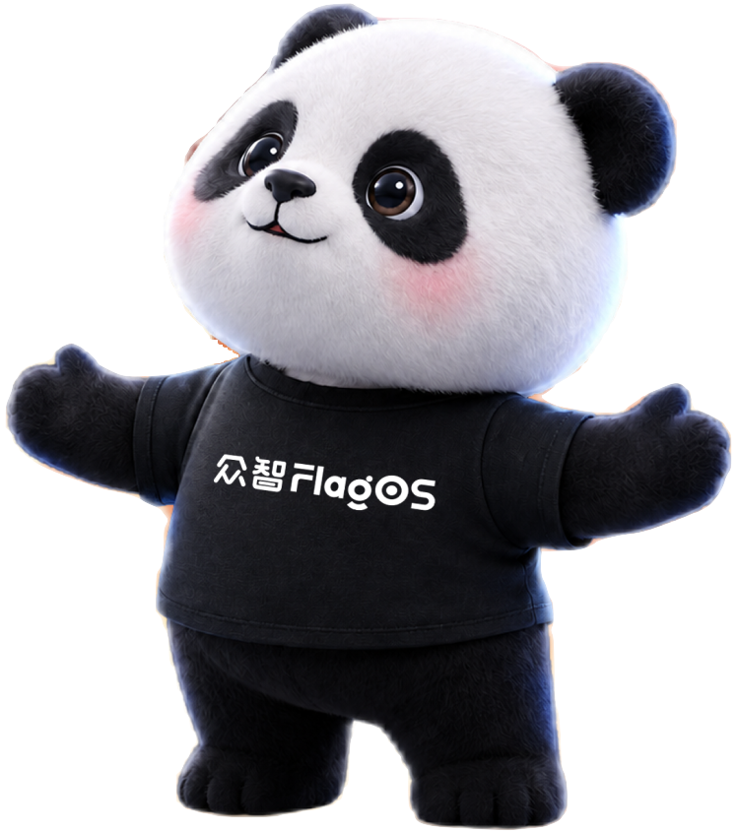
2026 OPEN AI COMPUTING CONFERENCE & FLAGOS TECHNOLOGY CONFERENCE
Sub-forum ① Open Computing & AI System
Day 1 afternoon · 13:30–17:40 · Yihe Hall
Full-stack AI system optimization and collaborative framework plug-in development: industrial-grade compilers and operator libraries, RISC-V and ARM edge inference, multi-chip training, and the "token factory" business of compute.
▪ Developer-Centric: Full Upgrade of the Ascend Operator Development Experience
Li Shouping · GM of Basic Software, Ascend Computing
▪ Agentic Reinforcement Learning Training in Practice for TeleChat
Yu Kaidong · Head of RL, Xingchen Lab, China Telecom AI
▪ Unified IR: Breaking the Triton Programming Paradigm for Multi-Chip Peak Performance
Yuan Sheng · Compiler Optimization System Architect
▪ FlagOS on RISC-V AI Chips: Adaptation Innovation & Edge-Agent Software Practices
Tang Linpeng · Chief AI Scientist, SpacemiT
▪ Compiler Software Stack for 3D-Stacked Multi-Die Compute-in-Memory
Jiang Guoyue · VP of R&D, TsingMicro
▪ Token Factory in Practice on FlagOS + Roundtable: AI System Software for Token Factories at Scale
Zhang Xianyi · Founder, Pengfeng Technology
Why it draws a crowd: the hardest multi-chip adaptation problems, answered in production code.
One Stack, Boundless Compute · October 17–18, 2026 · Beijing
06 / 13

Slide 7
2026 OPEN AI COMPUTING CONFERENCE & FLAGOS TECHNOLOGY CONFERENCE
Sub-forum ② In-Vehicle Intelligent Computing
Day 1 afternoon · parallel session
FlagOS-driven automotive open-source innovation: from smart cockpit to AI cockpit. The full chain — silicon, compiler, model, scenario — with carmakers, Tier-1s and chip vendors on one stage.
▪ Edge Intelligence: In-Vehicle LLM Deployment Based on Yuanjing AI
Zheng Xinfen · VP, BAIC Research Institute
▪ The Evolution of Li Auto's “Lixiang Tongxue” Livis Agent
Zeng Huan · Head of Software Systems & Ecosystem Products, Li Auto
▪ Edge AI for Automotive & NXP Solutions
Yuan Taichun · Senior FAE Manager, NXP Semiconductors
▪ Backend Integration of FlagOS's Unified Multi-Chip Compiler into Automotive Silicon
Men Chunlei · Team Lead, AI Systems Research, BAAI
▪ From Model Iteration to Cross-Silicon Deployment: AI Infra in Autonomous Driving
Gu Jiasheng · Head of AI Infrastructure, Desay SV
▪ AI Cockpit & Foundation-Model Business Models
StarChip · ModelBest · ByteDance Volcano Engine
Why it draws a crowd: the open computing base for the next million smart vehicles.
One Stack, Boundless Compute · October 17–18, 2026 · Beijing
07 / 13

Slide 8
2026 OPEN AI COMPUTING CONFERENCE & FLAGOS TECHNOLOGY CONFERENCE
Sub-forum ③ Quantum-AI Integration
Day 2 morning · 09:00–12:05 · Jingyi Hall
Quantum computing meets AI at the system level: the Quantum-AI Stack, the FlagOS × FlagQuantum × FlagQAI unified software stack — and the on-site launch of the Quantum-Intelligence Cloud Platform plan.
▪ Development Roadmap for Quantum Technology × AI Integration
Chang Kai · Executive Director, BAQIS
▪ High-Performance Quantum Cloud Computing Platform: A Bridge to Practical Quantum Computing
▪ Quantum Cloud Platform Plan — Launch Ceremony ★
▪ FlagOS × FlagQuantum × FlagQAI: A Unified System Stack for Quantum-AI Integration
▪ Panel: When Will Quantum Processors Join AI Infrastructure?
Bose Quantum · LiangKun · ZhongQi WuLiang · YaoZheng Quantum
Why it draws a crowd: a platform launch you can only witness on site, plus a roadmap debate across the quantum industry.
One Stack, Boundless Compute · October 17–18, 2026 · Beijing
08 / 13

Slide 9
2026 OPEN AI COMPUTING CONFERENCE & FLAGOS TECHNOLOGY CONFERENCE
Sub-forum ④ International AI Computing Cooperation
Day 2 morning · 09:00–12:00 · Yinghe Hall
Global AI talent development and research collaboration: open Earth foundation models, open-source co-designed courses, and FlagOS practice reports from classrooms and labs across Southeast Asia, Africa, South America and Europe.
▪ Fostering Inclusive Agentic AI for Cities
Serge Stinckwich · Research Lead, UN University Institute in Macau
▪ Hardware-Software Co-design & Open-source Curriculum: “Fundamentals of Intelligent Computing Systems” on FlagOS
Luo Guojie · Tenured Associate Professor, Peking University
▪ Enabling AI to Observe the Earth: Open Foundation Models for Earth & Global Research Collaboration
Feng Zhengpeng · PhD, University of Cambridge
▪ AI Empowerment in Thailand · Building AI Capacity in Botswana
Regional practice reports
▪ Competition-Education Integrated Reform of “AI Computing Systems” Powered by FlagOS
Wang Jing · Professor, Renmin University of China
Why it draws a crowd: AI for good — and a direct line into the global open-compute talent network.
One Stack, Boundless Compute · October 17–18, 2026 · Beijing
09 / 13

Slide 10
2026 OPEN AI COMPUTING CONFERENCE & FLAGOS TECHNOLOGY CONFERENCE
Sub-forum ⑤ Embodied Intelligence
Day 2 afternoon · parallel session
Humanoid robots and physical AI push compute to its real-time limits. Foundation models, world models, physics engines and cross-modal generalization — from chips and frameworks to on-robot deployment.
▪ Foundation Models for Embodied Intelligence: Perception-Cognition-Action Loop to Cross-Modal Generalization
▪ ORCA: A Multimodal Representational World Model
Wang Pengwei · Head of Embodied Intelligence Team, BAAI
▪ Methods and Systems for Efficient World Models
Gong Ruihao · Assistant Professor, Beihang University
▪ Towards a New Era of General World Models
Zhao Guosheng · Algorithm Researcher, GigaAI
▪ Embodied World Models × Hardware Foundations · A Domestic Physics Engine Bridging Virtual and Real
Ouyang Yao (TermiTech) · Liu Gang (Motphys)
▪ Real2Real: A Quantum Physical-AI Paradigm Without the Sim2Real Gap
Qiu Dicong · Co-founder & CTO, Shuyao Liangsheng
Why it draws a crowd: the complete chain for physical AI — silicon, framework, world model, body.
One Stack, Boundless Compute · October 17–18, 2026 · Beijing
10 / 13

Slide 11
2026 OPEN AI COMPUTING CONFERENCE & FLAGOS TECHNOLOGY CONFERENCE
Sub-forum ⑥ AI Agent
Day 2 afternoon · parallel session
Agents are no longer just applications — they are becoming builders of the infrastructure itself. Kernel engineering, AI-aided code generation, cross-chip model migration, evaluation benchmarks and enterprise toolchains.
▪ KernelGen: Design Principles & Engineering Practice of an Operator Auto-Generation Tool
▪ Revolution and Implementation of the Human-AI Collaborative Native Development Paradigm
▪ Multi-End Practice of a Native Secure AgentOS
▪ Design and Practice of the Bagua Furnace Intelligent Agent
▪ FlagScale-Agent: Agent Architecture for AI Infrastructure
Li Yuzhuo · Researcher, AI Framework Team, BAAI
▪ FlagQAI: A Quantum Scientific-Research Agent for Quantum-AI Convergence
Liu Wei · Researcher, Quantum & AI Fusion Systems, BAAI
Why it draws a crowd: watch agents write operators, migrate models and run the compute stack itself.
One Stack, Boundless Compute · October 17–18, 2026 · Beijing
11 / 13

Slide 12
2026 OPEN AI COMPUTING CONFERENCE & FLAGOS TECHNOLOGY CONFERENCE
Open Computing Hands-on Workshop
Day 2 · 10:00–17:00 · Jingming Hall — bring your laptop
No passive listening — a full day of guided coding across the complete FlagOS workflow: AI-aided operator generation, compiler chip-backend integration, on-device LLM deployment and model optimization. Five one-hour battles, taught by the engineers who build the stack.
10:00–11:00
KernelGen: Empowering AI from Code Generation to High-Performance Operator Engineering
11:00–12:00
Practical Deployment of FlagOS On-Device LLM Inference
14:00–15:00
Quantum-AI Integration: Hands-on Quantum AI Programming on Quantum Intelligence Cloud
15:00–16:00
Hands-on Optimization of Novel Attention Kernels with Triton-TLE
Bring your own project for a 1:1 “clinic” with FlagOS core engineers — and experience “write once, run on many chips” yourself.
16:00–17:00
FlagScale-Agent: Architecture Design and Hands-on Practice of Agents for AI Infrastructure
One Stack, Boundless Compute · October 17–18, 2026 · Beijing
12 / 13

Slide 13
2026 OPEN AI COMPUTING CONFERENCE & FLAGOS TECHNOLOGY CONFERENCE
Why You Should Be There
Two days to take in the year’s most consequential shifts in open compute
For Researchers
For Industry Developers
For Students & Faculty
Frontier results across heterogeneous compute, quantum-AI convergence, world models and embodied intelligence — plus platform releases you can cite and build on.
Production-grade answers to multi-chip adaptation: compilers, operator libraries, token factories, in-vehicle stacks — and 1:1 clinics for your own project.
Open-source courses, competition-education programs and a global collaboration network — a fast track from classroom to core-code contribution.
100+ speakers face to face — BAAI, CAS, Tsinghua, PKU, Li Auto, Baidu, Tencent, NVIDIA and more. Some announcements you will only hear on site.
Register: bagevent.com/event/FlagOS2026 · October 17–18, 2026, Zhongguancun Exhibition Center, 2 Xinjian Gongmen Road, Haidian, Beijing
See you in Beijing — let’s push the boundary of intelligent computing, together.
One Stack, Boundless Compute · October 17–18, 2026 · Beijing
13 / 13

