Slide 1

MY OPEN SOURCE JOURNEY
My Open Source Journey
我的开源之路
Zhu Qigang 朱其罡
Beijing Academy of Artificial Intelligence (BAAI)
FOSS

Slide 2
PROLOGUE · 序
The best gift is to share your real thoughts.
FOSS
02

Slide 3
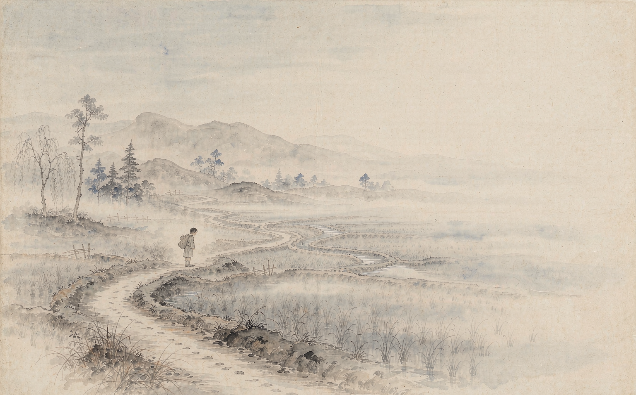
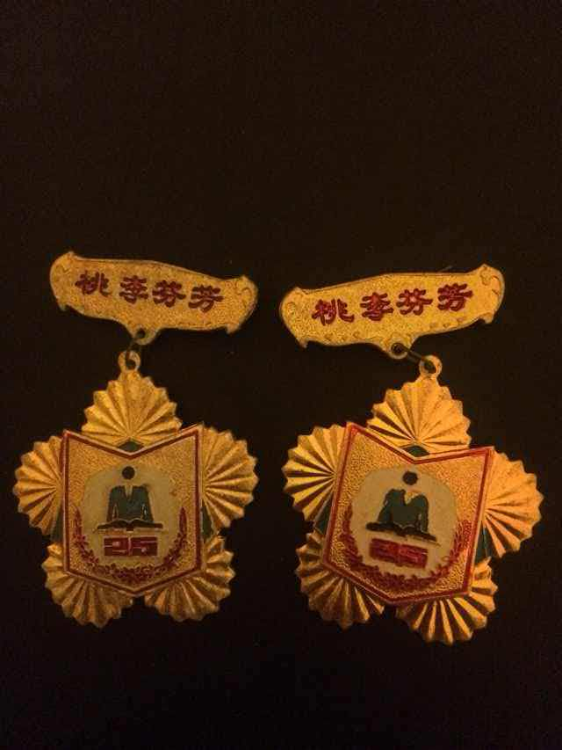
1952 · THE ROAD TO SCHOOL 母亲的上学路
— In 1952, my mother walked eighteen kilometres — four hours on foot — to reach her school.
— Her road taught me, before I was born: education is worth any distance.
Education was worth every single step.
03

Slide 4
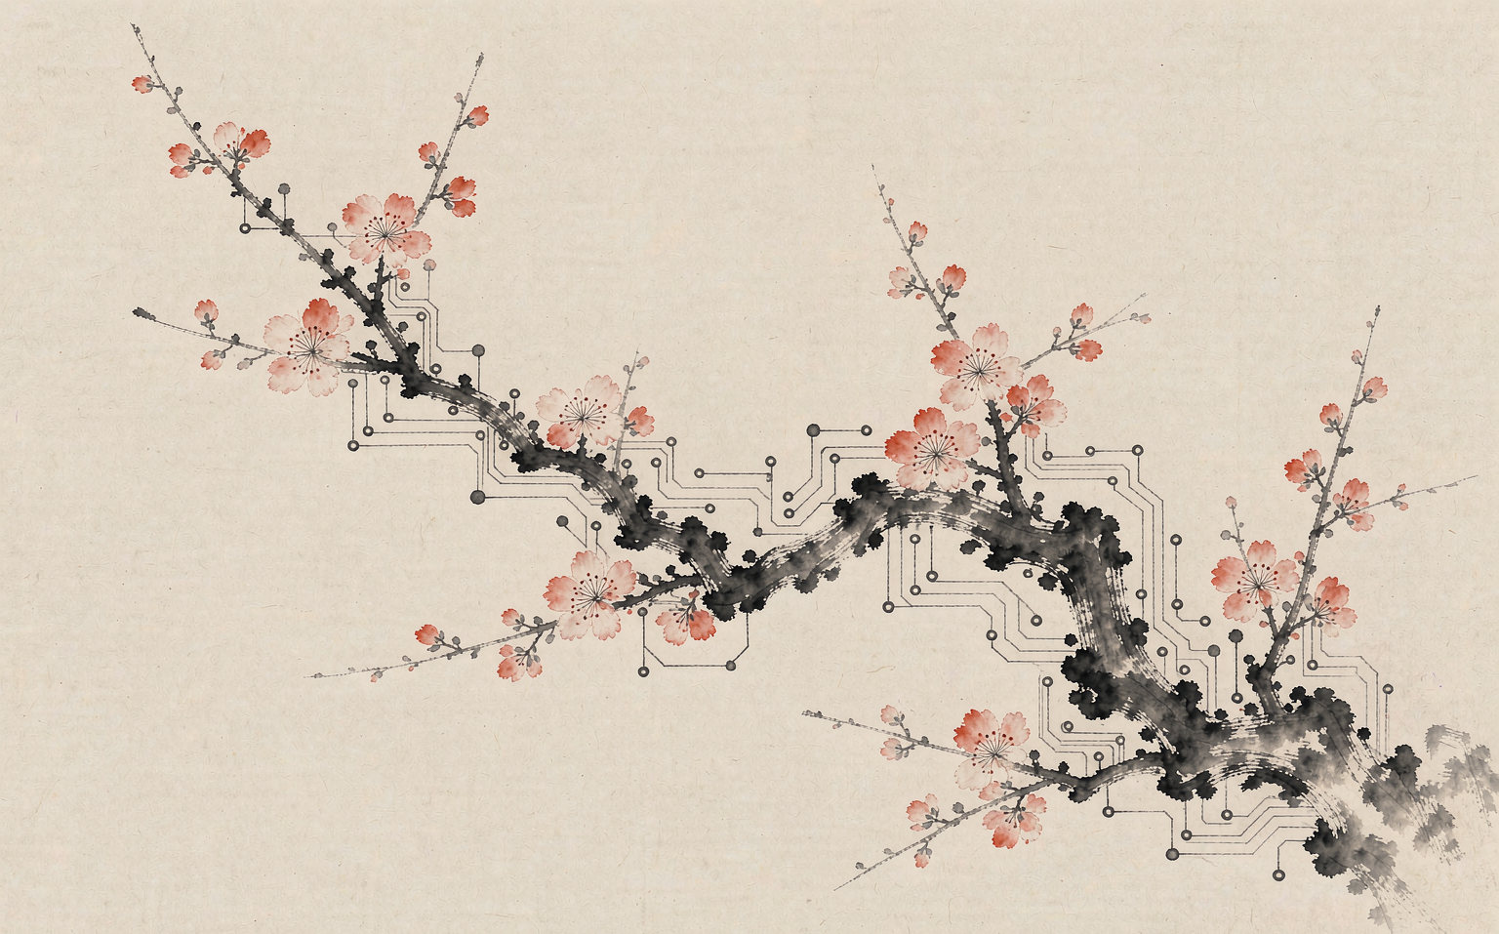
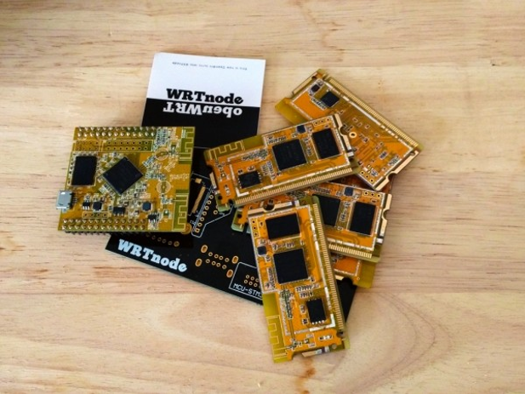
2013 · OPEN HARDWARE 一块开源开发板
— WRTnode: an open-source Linux board born from an ordinary home-router chip.
— The first open hardware platform publicly supported by OpenWrt.org.
— As capable as a server — for the price of a cup of latte.
Openness turns a tiny chip into a worldwide community.
04

Slide 5
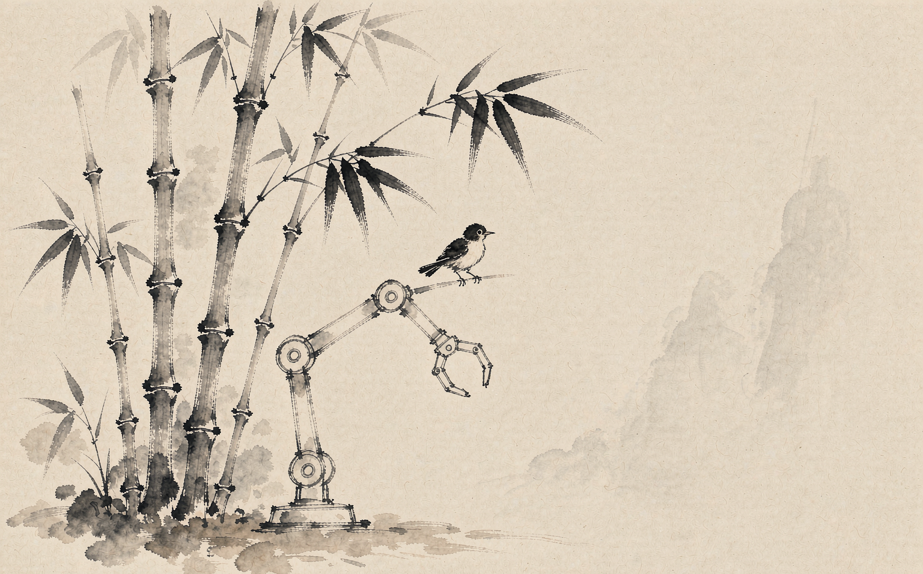
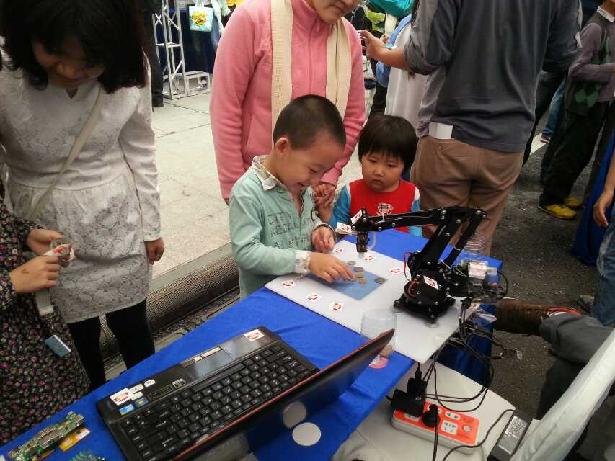
2014 · MAKER EDUCATION 创客教育
— A vision robotic arm for under 1,000 RMB — less than 150 dollars.
— We carried real engineering tools into children's classrooms.
When tools become affordable, creativity becomes universal.
05

Slide 6
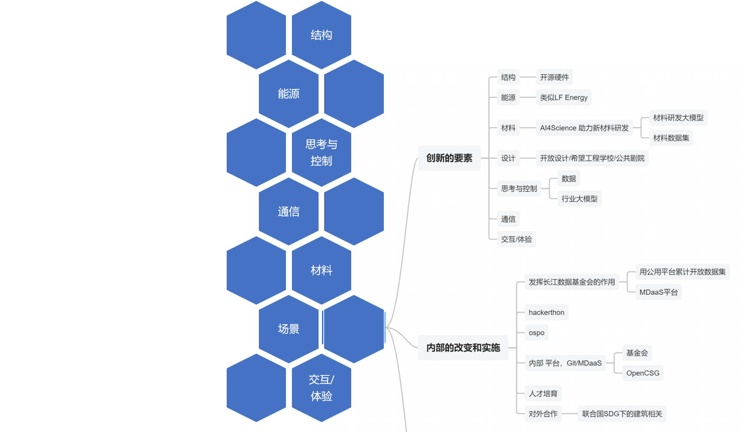
ON INNOVATION 关于创新
Innovation Has a Method
TRIZ — the theory of inventive problem solving.
Innovation follows patterns, and patterns can be taught.
Innovation is not magic; it is a method anyone can learn.
06

Slide 7

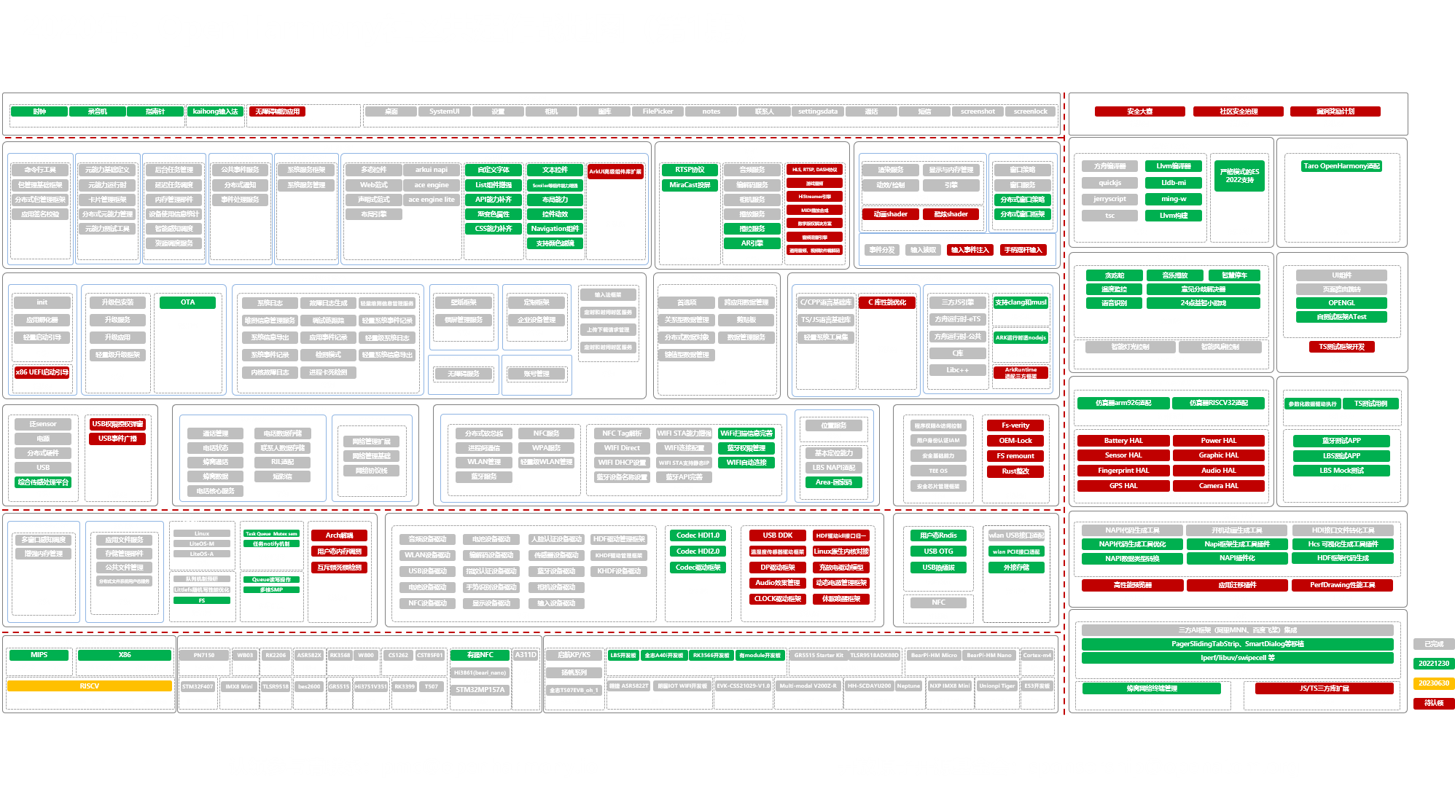
2020 · OPENHARMONY 共建开源鸿蒙
— A community 'battle map': hundreds of open tasks, claimed company by company.
— Dozens of enterprises building one operating system — together, in the open.
Alone, we write code. Together, we build a world.
07

Slide 8
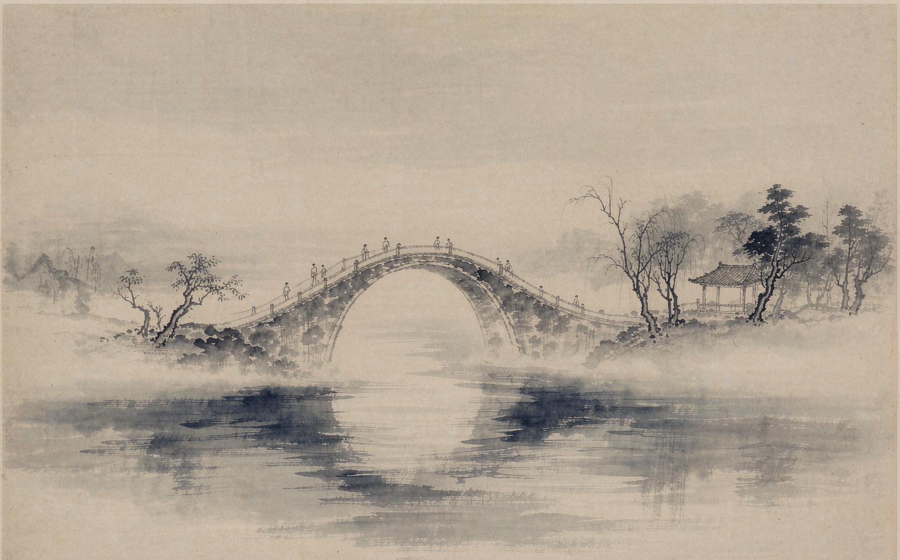
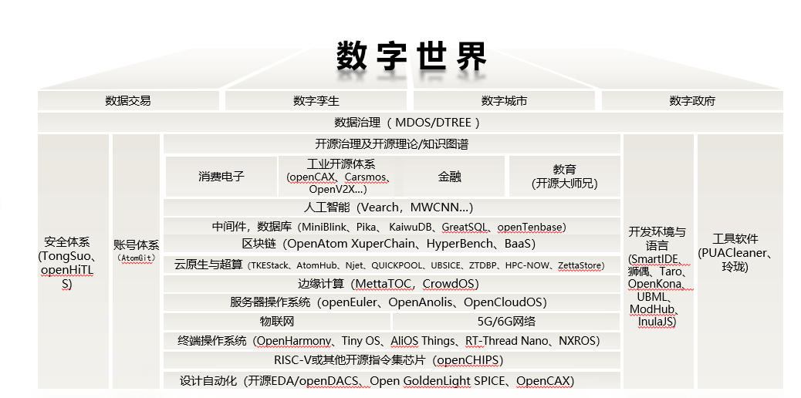
2023 · THE FOUNDATION 开放原子开源基金会
— Open source became digital infrastructure: operating systems, AI, RISC-V, blockchain.
— From writing code to building institutions — the commons as a public good.
A foundation is a bridge between ideals and institutions.
08

Slide 9
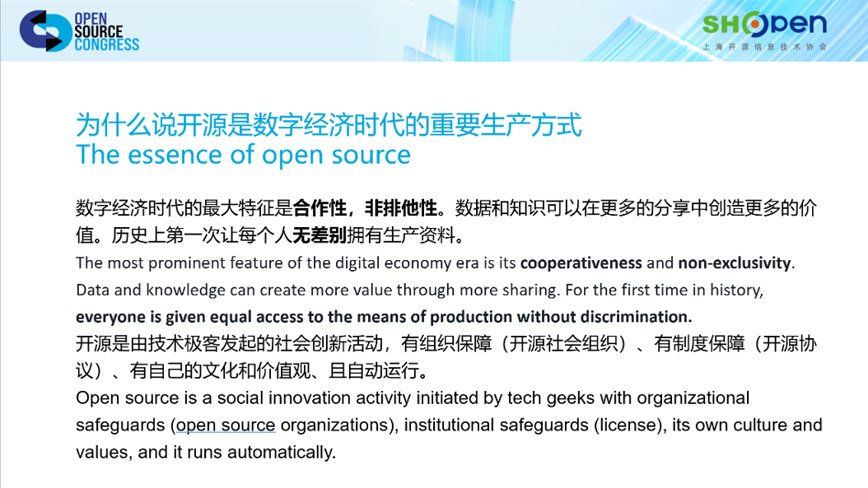
UNDERSTANDING OPEN SOURCE 开源理论研究
A New Economics of Sharing
Open source is reshaping the factors — and the relations — of production.
We study it not only as engineering, but as economics and philosophy.
Behind every line of code lies a new economics of sharing.
09

Slide 10
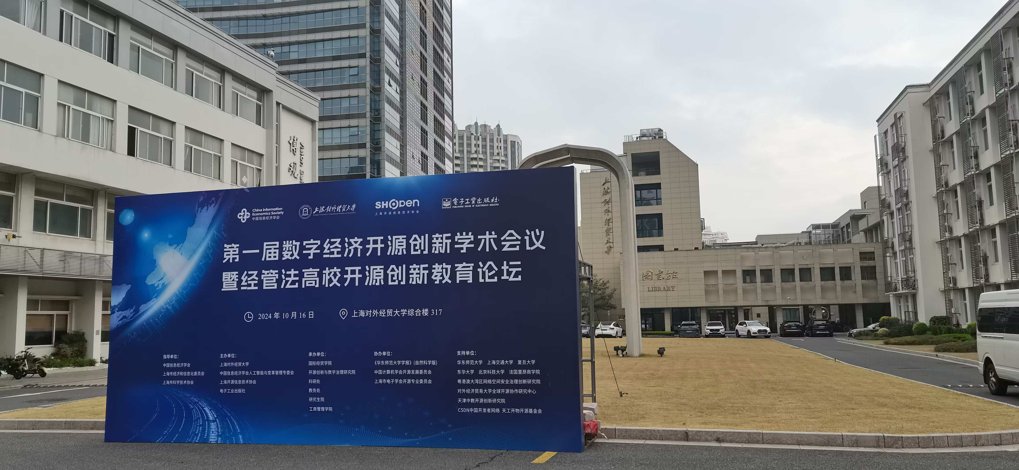
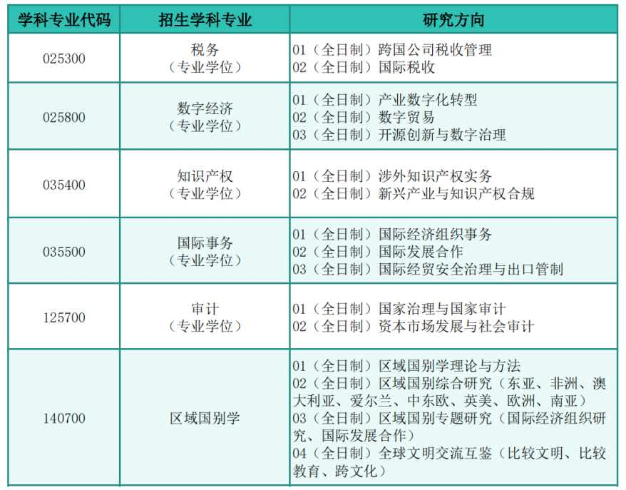
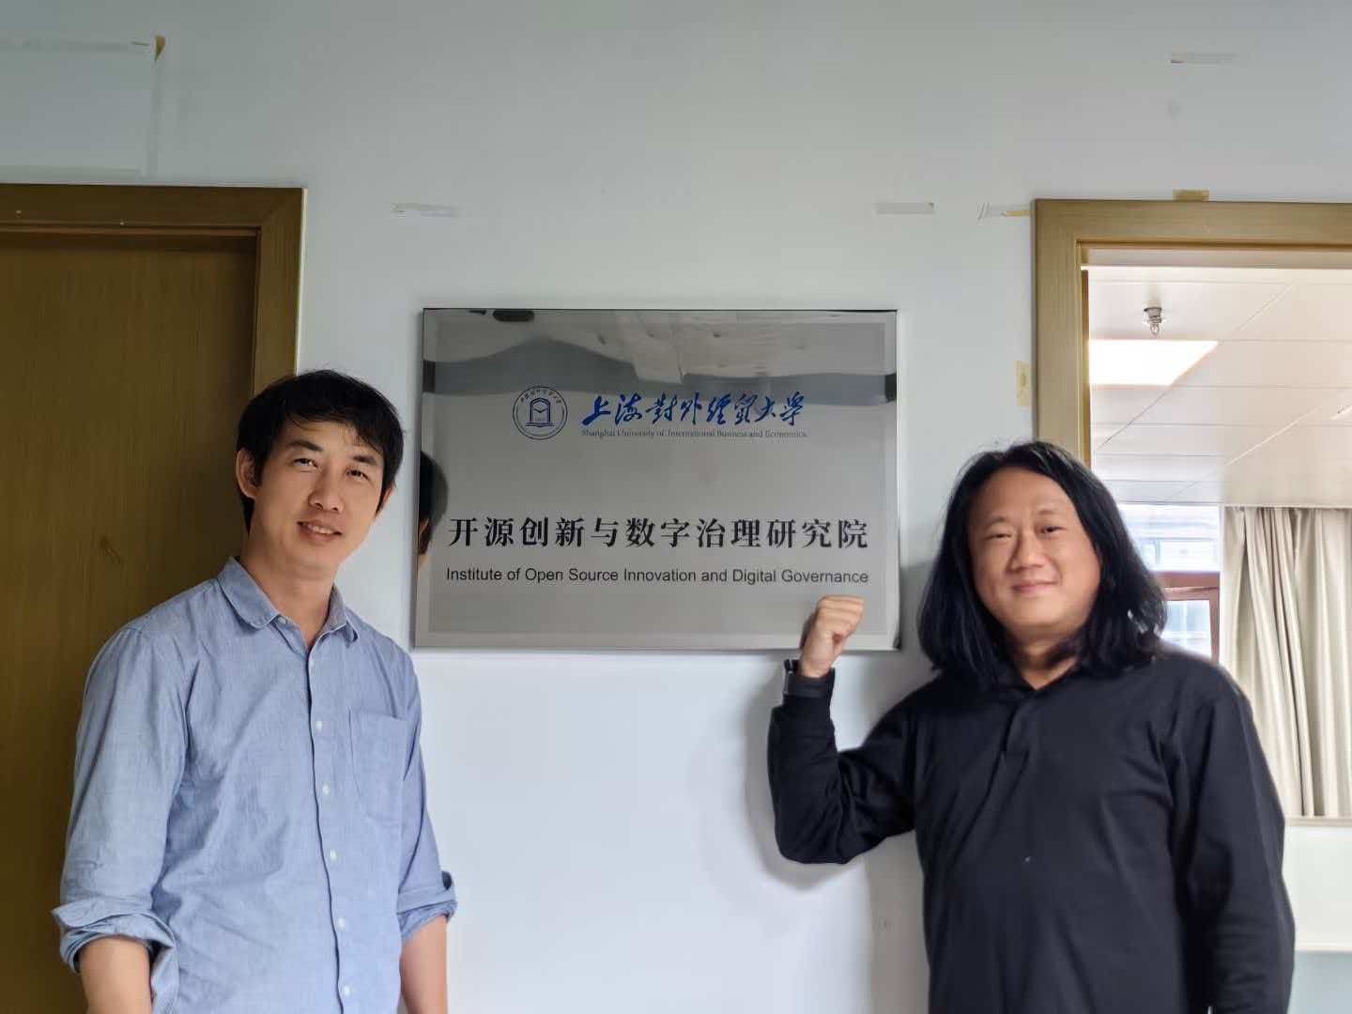
2024 · INTO THE ACADEMY 走进学术殿堂
Open Source Enters the Classroom
The first national academic conference on open source in China.
The first master's programme dedicated to open source.
What began as a speech has become a discipline.
10

Slide 11
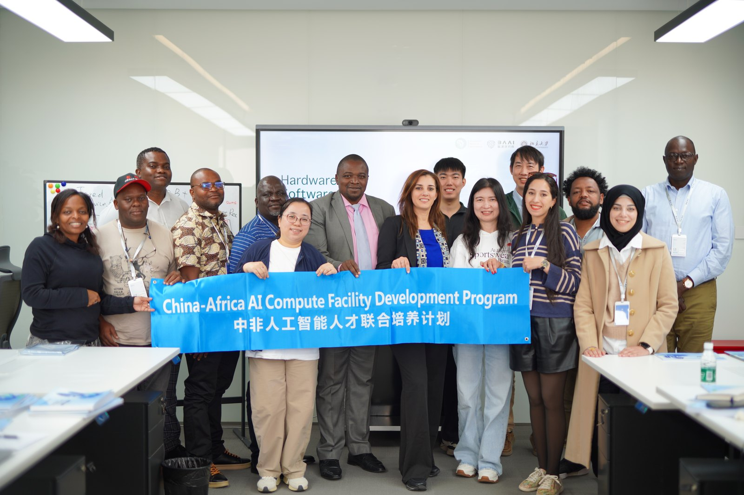
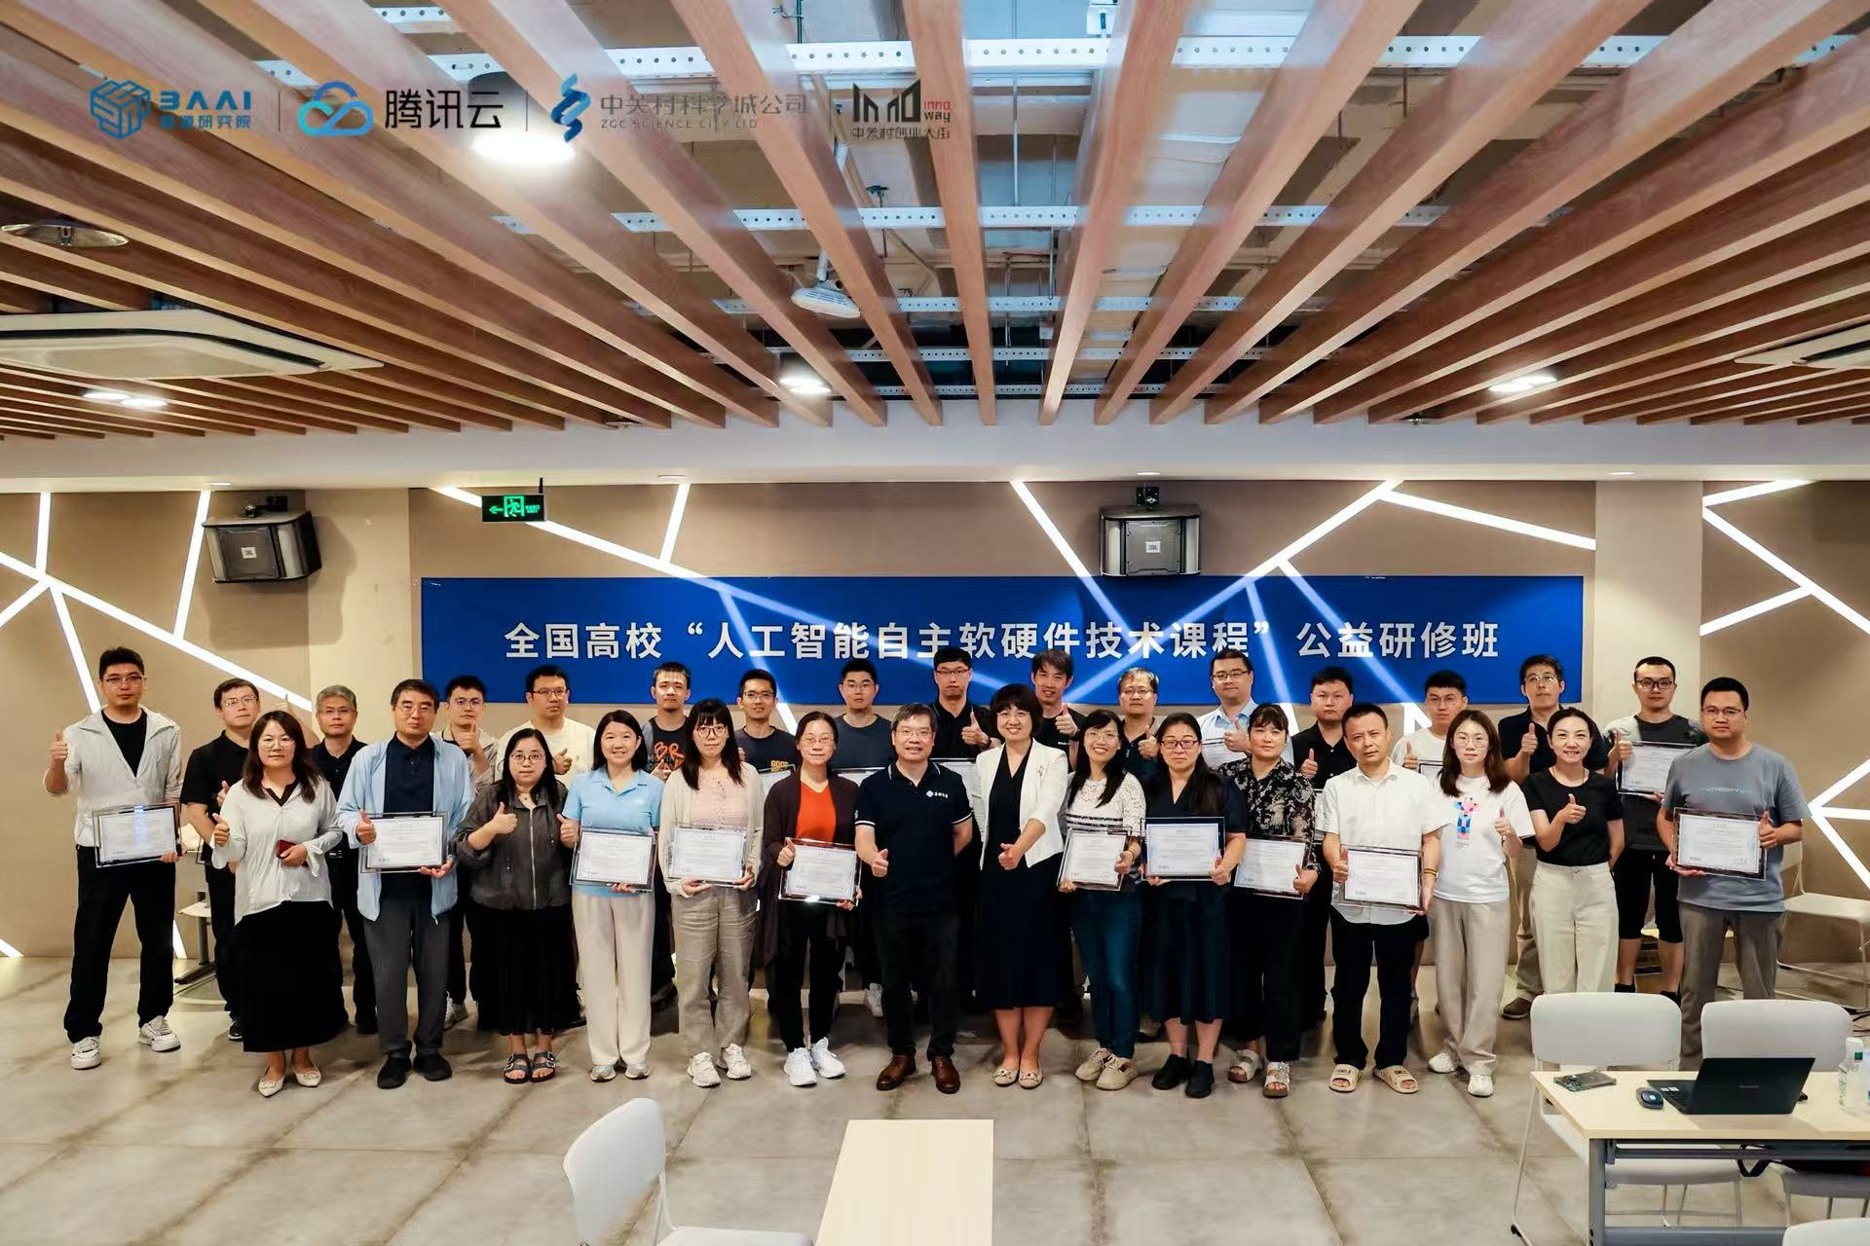
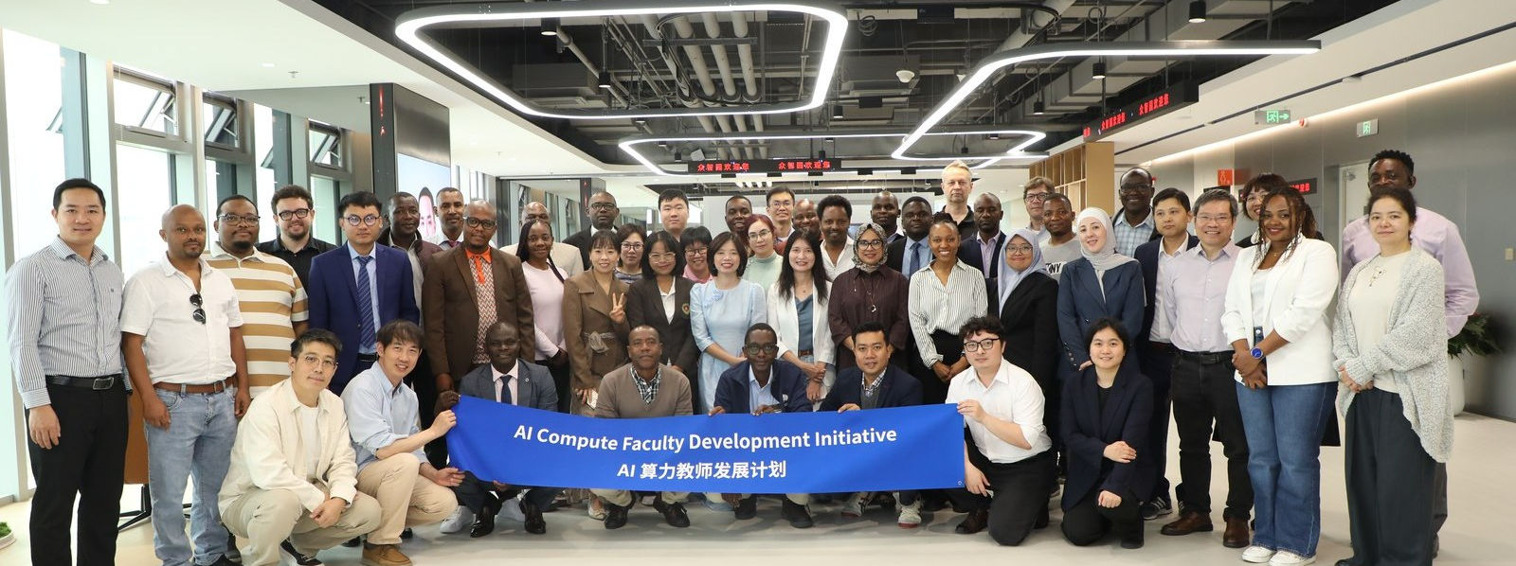
2026 · OpenCompute 开放计算
From one classroom in Beijing, to faculty everywhere.
11

Slide 12

FOSS
Make a better world
with Open Source
Thank you · 谢谢
Zhu Qigang 朱其罡 · Qgzhu@baai.ac.
12

