Slide 1

3D多芯粒存算一体架构的编译软件栈技术
Compiler Software Stack Technology for
3D Multi-Chiplet PIM Architectures
演讲人：蒋国跃

Slide 2

01 /
3D Chip Architectures
02 /
What kind of software technoloy is requied?
03 /
Compiler Software Technology for 3D Architectures
04 /
LLM Inference on 3D Chips

Slide 3
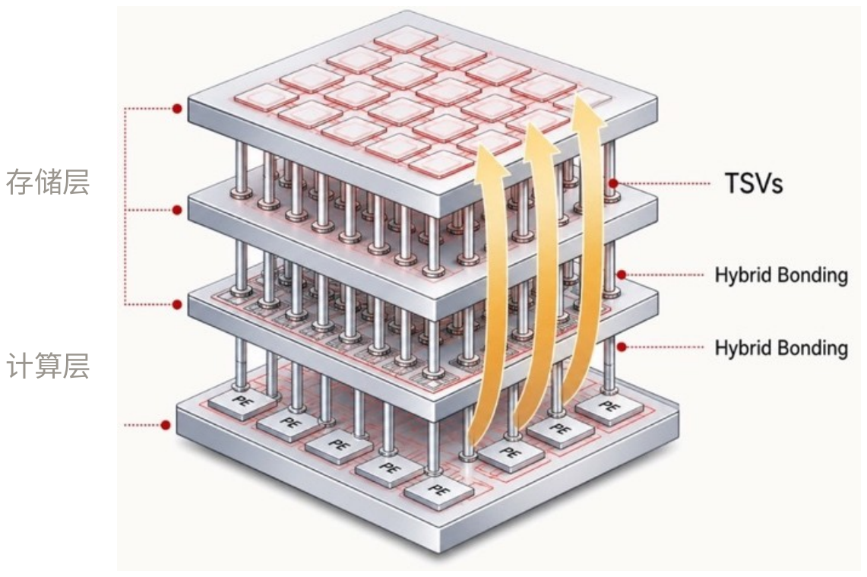
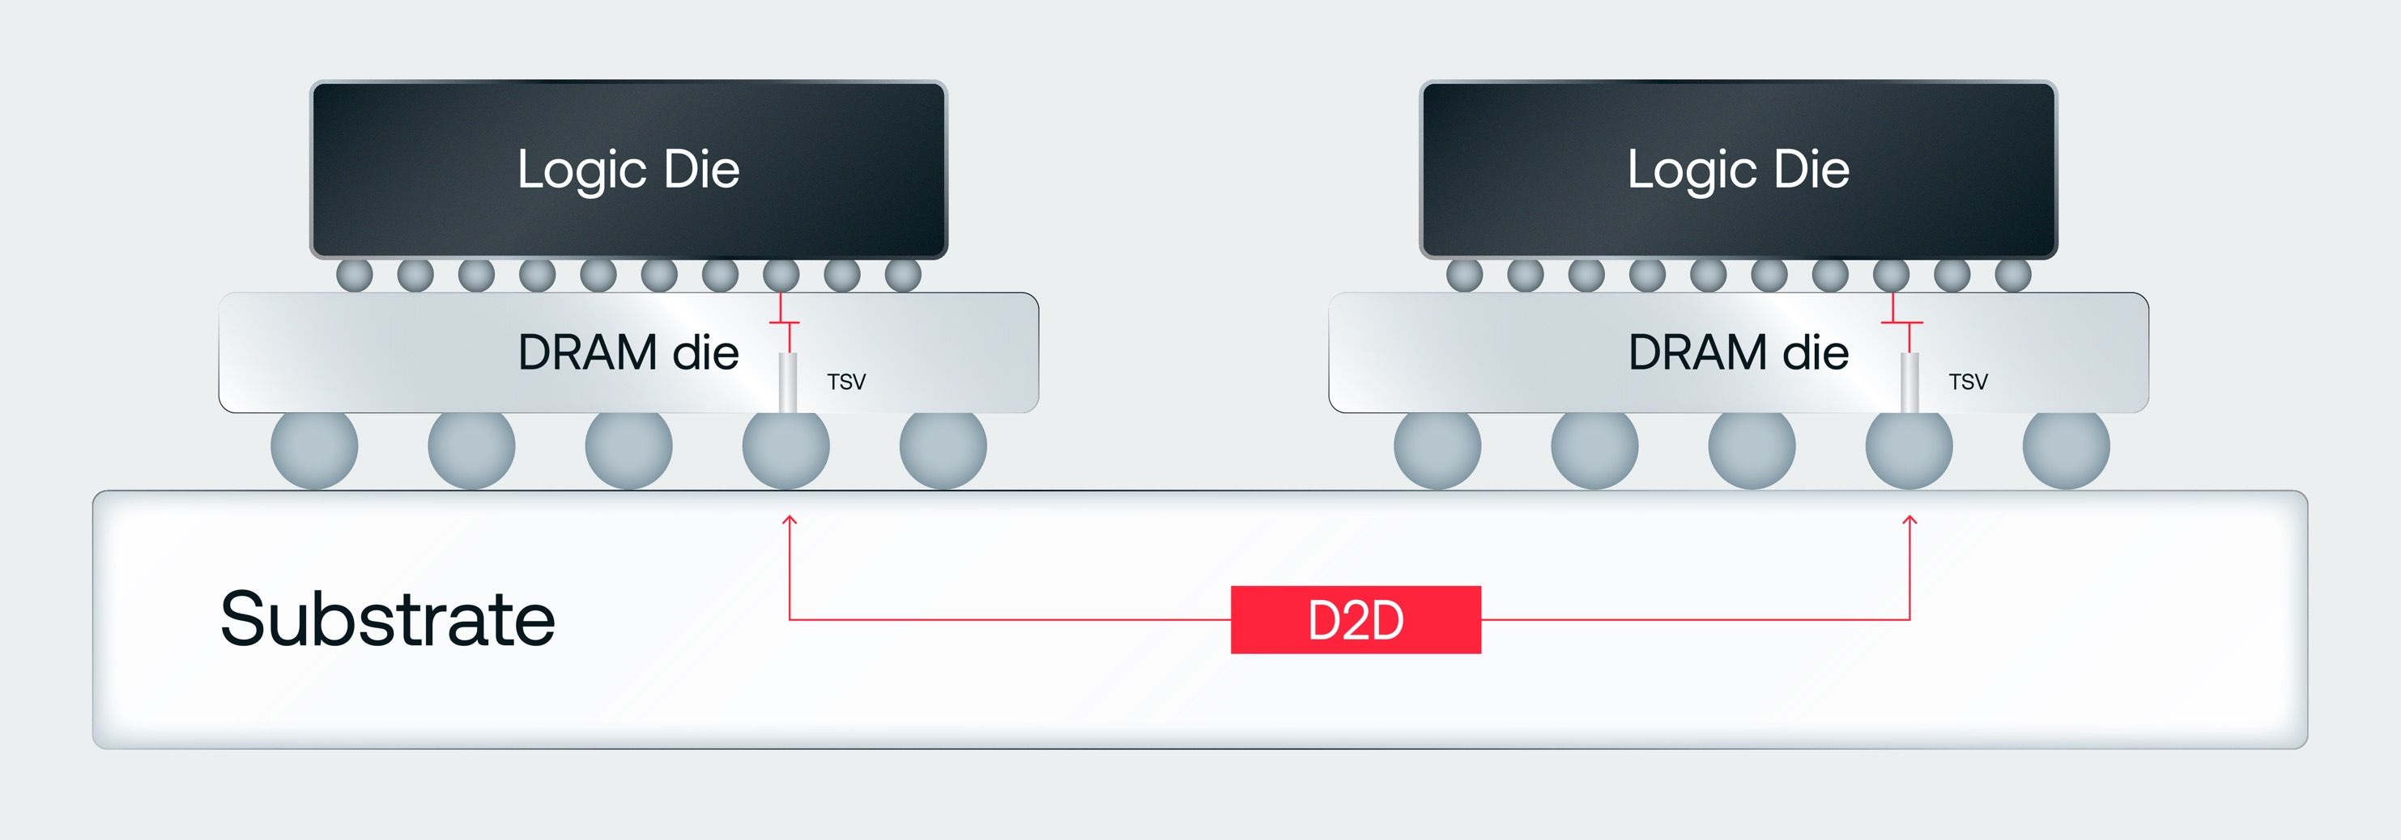
3D Chip Architectures
3D DRAM-based chip architectures are gaining significant international momentum as the semiconductor industry confronts the escalating memory bandwidth and capacity demands of AI workloads.
3DDRAM + Multi-Chiplet
Compared to 2.5D HBM, bandwidth is increased by more than 10 times.

Slide 4
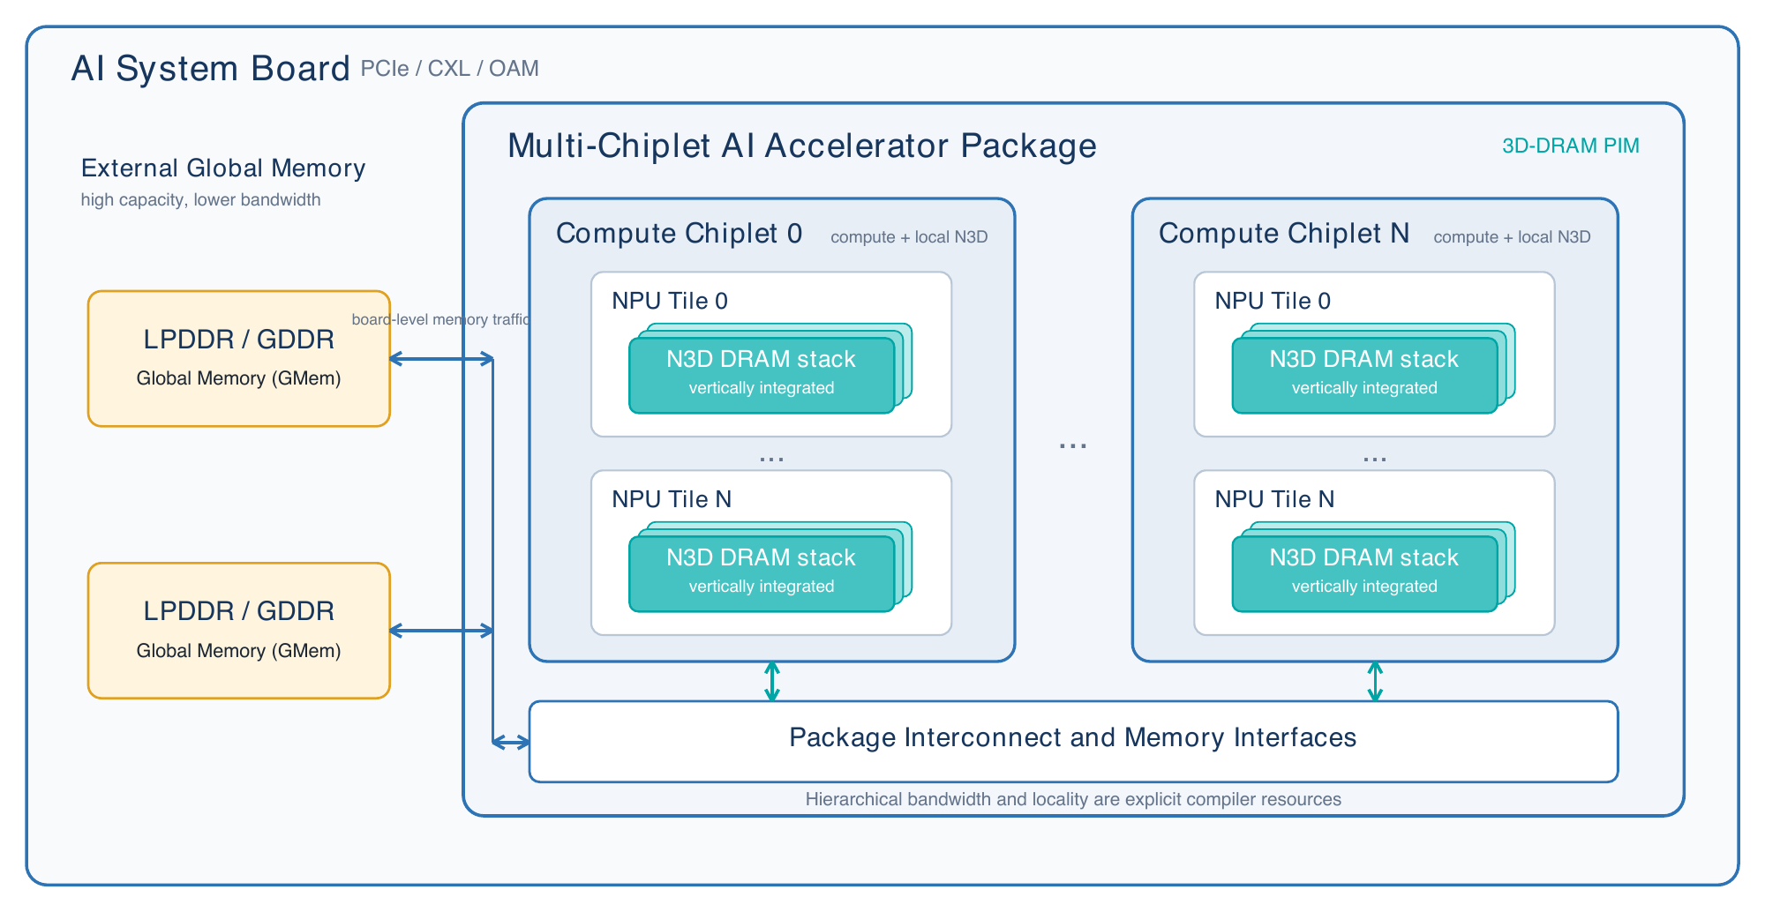
3D Chip Architectures
To achieve optimal 3D DRAM bandwidth utilization, the 3DDRAM-based architecture is used by compute cores through a distributed memory scheme based on near-memory computing or processing-in-memory (PIM).
A common 3D chip architecture
* N3D: Near-compute 3D-DRAM

Slide 5
3D Chip Architectures
Dimension | HBM-Based Chips | 3DDRAM-Based Chips
Memory Organization | Centralized pool shared by all compute cores | Distributed with dedicated memory banks per core
Data Movement | Via a limited number of channels | Massive vertical interconnect
Bandwidth Mechanism | High-frequency serial signaling over interposer | Wide, parallel vertical buses (e.g., 256-bit per bank)
Effective Bandwidth | ~8-16 TB/s per package (Rubin HBM4) | ~100 TB/s per card (Raptor)
Latency Characteristics | Non-deterministic (bank conflicts, contention) | Deterministic, SRAM-like access
Current programming models, compilers, and operator libraries are all designed for centralized memory, which makes them problematic on 3D DRAM-based processing-in-memory architectures.

Slide 6
01 /
3D Chip Architectures
02 /
What kind of software technology is required
03 /
Compiler Software Technology for 3D Architectures
04 /
LLM Inference on 3D Chips

Slide 7
What kind of software technoloy is requied?
Vertical Interconnect:
High Bandwidth
Low Latency
Inter-Die N3D Remote Access:
Low Bandwidth
High Latency
Data in N3D memory needs to be stored in a sharded manner. Who shards the data, and how to shard data?
Existing Operator programming Models assume centralized data. How can they adapt to sharded storage?
Local vertical access is significantly more efficient than remote access. How can data accesses be kept local to N3D as much as possible?
How can PyTorch's mainstream Eager Mode achieve high performance on N3D?
N3D
N3D
N3D
N3D
N3D
N3D
N3D
N3D
Core
Core
Core
Core
Core
Core
Core
Core
N3D
N3D
N3D
N3D
N3D
N3D
N3D
N3D
Core
Core
Core
Core
Core
Core
Core
Core
N3D
N3D
N3D
N3D
N3D
N3D
N3D
N3D
Core
Core
Core
Core
Core
Core
Core
Core
N3D
N3D
N3D
N3D
N3D
N3D
N3D
N3D
Core
Core
Core
Core
Core
Core
Core
Core
Die
Die
Intra-Die N3D Remote Access:
Limited Bandwidth due to the NoC
Latency is somewhat higher

Slide 8
What kind of software technoloy is requied?
The 3D DRAM-based chip architectures require new software technologies, but it must also remain compatible with the current software ecosystem.
Open3D-PIMC is an Open-source Compiler Framework for 3D-DRAM based Processing-In-Memory Architecture. It takes mainstream frameworks such as PyTorch as the frontend, uses Graph/Eager hybrid execution for dynamic models.
N3D Graph Compile
  N3D tensor sharding, N3D residency, Weight Preload, KV Cache Flush/Fetch, et al.
  From the graph perspective, ensure data access locality.
N3D Eager Mode
  Handle specific operators with strong dynamism: Flash Decoding, MOE, et al.
  Provide N3D operator programming capabilities as well.

Slide 9
01 /
3D Chip Architectures
02 /
What kind of software technoloy is requied?
03 /
Compiler Software Technology for 3D Architectures
04 /
LLM Inference on 3D Chips

Slide 10
Compiler Software Technology for 3D Architectures
Framework Adapters
PyTorch FX, Torch compile, JAX, XLA, et al.
Compatible with the current software ecosystem
Capture & Partition
Graph/Eager Regions, Dynamic Buckets
Middle End IR with Tile-level Distribution Information
PIM Graph IR
Tensor semantics, Symbolic shapes, Fusion
Tile Sharding
Multi-dimension N3D Sharding, Communications
L1/L0 Grouping
3D Graph Compiler Back End
Layout, N3D Whole Group, SRAM Residency
Parallel Scheduling
Compute, Communication, N3D Access, Parallel
Multi-Kernel CodeGen
N3D Compute, Weight Preload, KV Cache Flush/Fetch
Generate Multiple Kernels

Slide 11
Compiler Software Technology for 3D Architectures
PIM Graph IR
PIM Graph IR: Not only the conventional ops and shape information, but also the tile-level distributed sharding information
RmsNorm
shape: [B, S, H]
shard: [1, 32, 1]
Tile Sharding: Sharding can be either specified by frontend users or searched by the backend compiler.
Tile All Gather
shape: [B, S, H]
shard: [1, 1, 1]
Tile Collective Communication: Sharding changes, tile-level collective communication needs to be inserted. More frequently than card-level communications.
Q Gemm
shape: [B, S, H]
shard: [1, 4, 8]
V Gemm
shape: [B, S, H1]
shard: [1, 4, 8]
K Gemm
shape: [B, S, H2]
shard: [1, 4, 8]
N3D Data Layout: To maximize the memory access bandwidth of 3D DRAM, the data layout arrangement also needs to be considered alongside tile sharding.
RoPE
shape: [B, S, H1]
shard: [1, 4, 8]
RoPE
shape: [B, S, H2]
shard: [1, 4, 8]

Slide 12
Compiler Software Technology for 3D Architectures
PIM Graph IR
RmsNorm
shape: [B, S, H]
shard: [1, 32, 1]
L1 Grouping:
  The compiler searches for L1-level operator groups based on the distributed storage capacity of N3D, ensuring that all data interactions among the operators within a group can be kept in N3D.
  Since N3D has a very large capacity, the entire graph can often be searched and fused into a single L1 Group.
L0 Group 0
Tile All Gather
shape: [B, S, H]
shard: [1, 1, 1]
Q Gemm
shape: [B, S, H]
shard: [1, 4, 8]
V Gemm
shape: [B, S, H1]
shard: [1, 4, 8]
K Gemm
shape: [B, S, H2]
shard: [1, 4, 8]
L0 Grouping:
  Based on the SRAM capacity within a compute core, the compiler searches for L0-level operator combinations within an L1 Group, so that data interactions among the operators in the L0 Group occur only in SRAM.
  Since SRAM offers higher bandwidth and lower latency than N3D, this further improves the performance.
L0 Group 1
RoPE
shape: [B, S, H1]
shard: [1, 4, 8]
RoPE
shape: [B, S, H2]
shard: [1, 4, 8]
L0 Group 2
L0 Group 3
L1 Group

Slide 13
Compiler Software Technology for 3D Architectures
Computation-communication Parallel
N3D
N3D
N3D
N3D
Core
Core
Core
Core
Parallelism scheduling:
  Orchestrating the parallelism of Tensor computation, Vector computation, N3D memory access, and N3D communication
N3D
N3D
N3D
N3D
Core
Core
Core
Core
N3D
N3D
N3D
N3D
Core
Core
Core
Core
N3D
N3D
N3D
N3D
Distributed computing paradigm for 3D-PIM:
  Gemm, Flash Attention, et al.
Core
Core
Core
Core
N3D Communication
N3D Data Access
Computation

Slide 14
Compiler Software Technology for 3D Architectures
Compute Kernel CodeGen
Weight Preload CodeGen
KV Flush/Fetch CodeGen
Code
Code
Code
Code
void CSA(void* args) {
......
}
void Preload(void* args) {
......
}
void KVFlush(void* args) {
......
}
void KVFetch(void* args) {
......
}
LPDDR/Host DDR
LPDDR/Host DDR
N3D DRAM Stack
N3D DRAM Stack
Weight Shard Preload
Weight Shard Preload
KV Shard Flush
KV Shard Fetch
KV Shard Flush
KV Shard Fetch
LD
send
LD
ST
...
ST
N3D DRAM Stack
N3D DRAM Stack
AI Core
AI Core
N3D DRAM Stack
N3D DRAM Stack
send
...
...
Compute
Compute
AI Core
AI Core
AI Core
AI Core
Tile 0
Tile N
Tile 0
Tile N
Tile 0
Tile N
Flush the KV Cache from N3D to LPDDR or host memory.
Fetch the KV Cache from LPDDR or host memory to N3D.
Directly Using N3D Data for Computation
Preload the data shards before the formal computation.

Slide 15
Compiler Software Technology for 3D Architectures
Graph & Eager Hybrid
RmsNorm
shape: [B, S, H]
shard: [1, 32, 1]
Frameworks such as torch.compile and JAX/XLA support hybrid execution combining graph compilation and eager mode.
N3D Graph Compile
Tile All Gather
shape: [B, S, H]
shard: [1, 1, 1]
Here we propose N3D Compile and N3D Eager Mode. At the switch point between graph compile and eager mode, the data still remains in N3D storage.
Eager Mode allows hand-written operator optimizations.
Q Gemm
shape: [B, S, H]
shard: [1, 4, 8]
V Gemm
shape: [B, S, H1]
shard: [1, 4, 8]
K Gemm
shape: [B, S, H2]
shard: [1, 4, 8]
RoPE
shape: [B, S, H1]
shard: [1, 4, 8]
RoPE
shape: [B, S, H2]
shard: [1, 4, 8]
However, compared with ordinary Eager Mode, N3D Eager Mode has to consider various N3D data shards, which drastically increases the effort required for hand-written operators.
Flash Decoding
shape: [B, S, H]
shard: [1, 1, 1]
N3D Eager Mode
O Gemm
shape: [B, S, H]
shard: [1, 4, 8]
N3D Graph Compile

Slide 16
Compiler Software Technology for 3D Architectures
Gmem Operator Programming Model
N3D Operator Programming Model
int main() {
…
raisaMalloc(…);
raisaMemcpy(…, raisaMemcpyHostToDevice);
dim3 grids = {8, 1, 1};
dim3 blocks = {128, 1, 1};
kernel_func<<<grids, blocks, dynamic_shared, stream>>>(…);
raisaMemcpy(…, raisaMemcpyDeviceToHost);
…
raisaFree(…);
}
int main() {
raisa::NearMemory near(/*startRPCID*/0, /*RPCNum*/1, /*TileNumPerRPC*/8);
raisaDeviceLocalMalloc(near_addrs, bytes, near.startRPC(), near.numRPCs());
kernel_func<<<grids, blocks, near.startRPC(), dynamic_shared, stream>>>(…, near_addrs);
raisaDeviceLocalFree(near_addrs, near.startRPC(), near.numRPCs());
…
}
__global__ void kernel_func(const int64_t *NearAddrs , int offset, int out_offset) {
uint32_t block_id = blockIdx.x + blockIdx.y * gridDim.x + blockIdx.z * gridDim.x* gridDim.y;
_Float16 *near_memory = raisa::this_near<_Float16>(NearAddrs);
_Float16 *near_memory_a = near_memory;
_Float16 *near_memory_b = near_memory + offset;
float *near_memory_d = reinterpret_cast<float*>(near_memory) + out_offset;
// read from near_memory
…
}
__global__ void kernel_func(float *x, float *y, int nm, …) {
uint32_t block_id = blockIdx.x + blockIdx.y * gridDim.x
+ blockIdx.z * gridDim.x * gridDim.y;
for (int i = threadIdx.x; i < 2048; i += blockDim.x) {
…
}
}
We present a user-friendly programming model for 3D multi-chiplet PIM architectures, allowing users to author N3D operators and optimize performance.

Slide 17
01 /
3D Chip Architectures
02 /
What kind of software technoloy is requied?
03 /
Compiler Software Technology for 3D Architectures
04 /
LLM Inference on 3D Chips

Slide 18
LLM Inference on 3D Chips
vLLM/SGLang Start
vLLM/SGLang/PyTorch manages N3D memory
N3D Malloc
Integrate with torch.compile
Torch Compile or Eager
If a compiled cache artifact exists, skip the compilation process.
N3D Graph Compile
Weight Preload
Weight Preload
N3D Eager Compute
If weight had been preloaded, skip this operation.
N3D Graph Compute
No
When need multi-tier cache for KV Cache, launch KV Flush/Fetch kernels.
Multi-tier Cache？
Yes
KV Flush/Fetch

Slide 19
LLM Inference on 3D Chips
A KV Page Block:
KV Page Part0
KV Page Part1
KV Page Part2
KV Page Part3
3D KV Cache Management
vLLM or SGLang manages the distributed KV Cache Page Blocks.
N3D DRAM Stack
N3D DRAM Stack
AI Core
AI Core
Tile 0
Tile 1
KV cache page blocks are evenly partitioned by token across N3D distributed tiles.
N3D DRAM Stack
N3D DRAM Stack
AI Core
AI Core
Tile 2
Tile 3

Slide 20
Thanks

