Slide 1
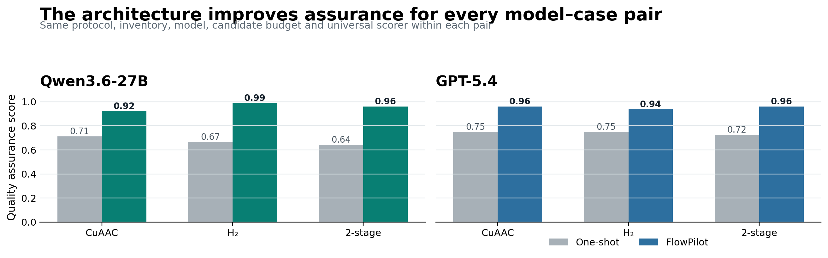
FlowPilot | NewGen benchmark
01
FlowPilot improves design assurance across model scales
Matched architecture comparison using identical protocols, inventories, model identity and scoring within each pair.
Qwen3.6-27B
0.674 → 0.958
architecture uplift +0.284
GPT-5.4
0.742 → 0.953
architecture uplift +0.212
6 / 6
paired QA improvements
All six full-pipeline outputs closed as executable SCREEN designs.
Interpretation
The same model becomes more dependable when coupled to retrieval, engineering calculations, inventory enforcement, specialist review and a final deterministic contract.
Three cases; one run per model–architecture–case cell; QA is not wet-lab yield accuracy.

Slide 2
FlowPilot | NewGen benchmark
02
How the matched benchmark was executed
The model is controlled within each pair; only the architecture changes.
1 Freeze input
2 Two matched paths
3 Deterministic closure
4 Universal scorer
Protocol + objective Inventory + limits Held-out source IDs
ONE-SHOT One model call FLOWPILOT Upstream + retrieval + calculator + council
Pump/MFC bounds Exact reactor assignment Gas basis + residence time Safety + topology gates
7 fixed QA dimensions Same weights for every case Readiness gates No held-out answer in prompt
Quality-assurance score
Validity 10%
Engineering 25%
Process 15%
Safety 15%
Evidence 10%
Decision 20%
Cal. 5%
Hard gates cap readiness when schema, gas bookkeeping, geometry, pumps/tubing, topology, or safety fail.
Controlled variables: candidate budget = 1 | temperature = 0 where provider-supported | lexical retrieval | source answer excluded | same case-specific inventory
Models: /models/Qwen3.6-27B and gpt-5.4-2026-03-05. Each model is used for both its one-shot and FlowPilot condition.

Slide 3
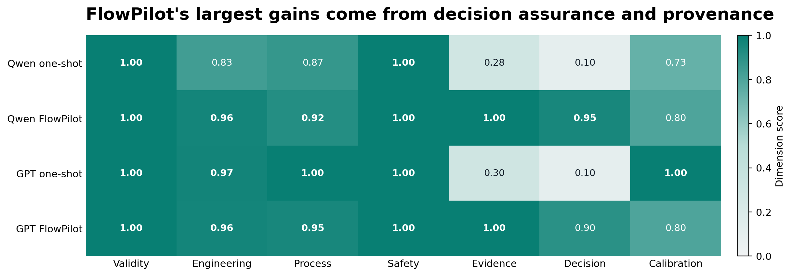
FlowPilot | NewGen benchmark
03
Why the architecture changes the outcome
One-shot numeric closure can be strong; FlowPilot adds traceable decision and process assurance.
Observed interventions
Rejected unsupported residence-time reductions.
Recomputed V/Q and stage-specific cumulative flows.
Converted H₂ inlet/STP flow to in-channel flow and equivalents.
Bound pumps, MFC, reactors, BPR and mixers to inventory IDs.
Published topology only after final deterministic closure.
Result: 6/6 executable SCREEN contracts
Three cases; one run per model–architecture–case cell; QA is not wet-lab yield accuracy.

Slide 4
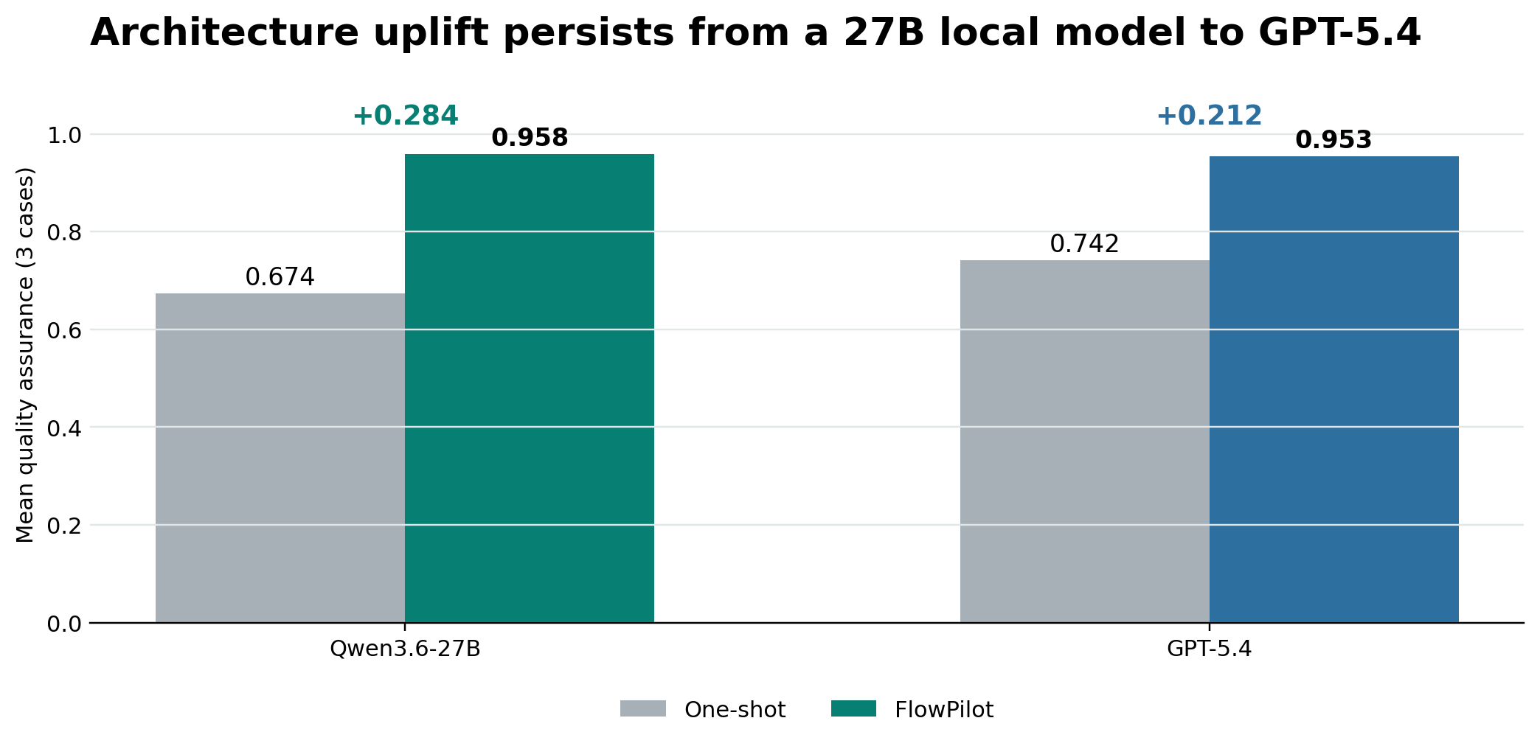
FlowPilot | NewGen benchmark
04
Presentation conclusion: architecture, not model size alone
The local 27B model in FlowPilot reaches essentially the same mean assurance as GPT-5.4 in FlowPilot.
Defensible claim
Across these three inventory-constrained cases, FlowPilot improved universal design-assurance scores for both Qwen3.6-27B and GPT-5.4, and produced executable screening contracts in every full-pipeline run.
Do not overclaim
• n = 3 cases and one run per cell • no statistical significance claim • scores assess design assurance, not reaction yield • final designs remain SCREEN until wet-lab validation
Recommended next step: pre-register a larger repeated benchmark and separately report wet-lab predictive accuracy.

