Slide 1
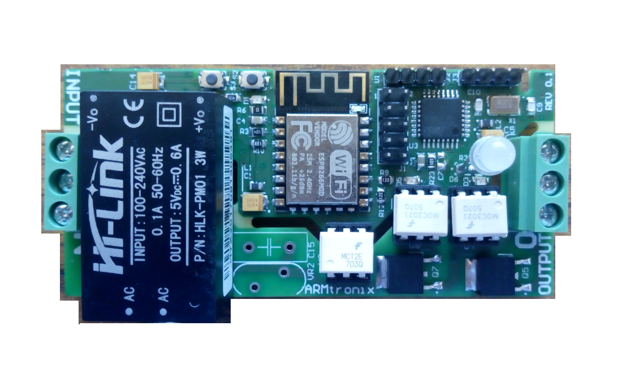
J3 Virtual Switch header
1
Power Module
J1
2
3
4
Controller
INPUT
LED
OUTPUT
Wireless module
Triac

Slide 2
OUTPUT
L N L
(J3) 2nd pin GPIO for ON & OFF
(J3) 3rd pin GPIO for Dimmer
(J3) 4th pin GND
(J3)3rd pin
3pin socket
E
Note* J3 2nd and 3rd
Are pure DC pins only
5V or 3.3V should
Supply .
*If 230V applied board
Will burn.
G
P
N
Neutral
3pin socket
E
G
P
N
(J3)2nd pin
INPUT
P N

Slide 3
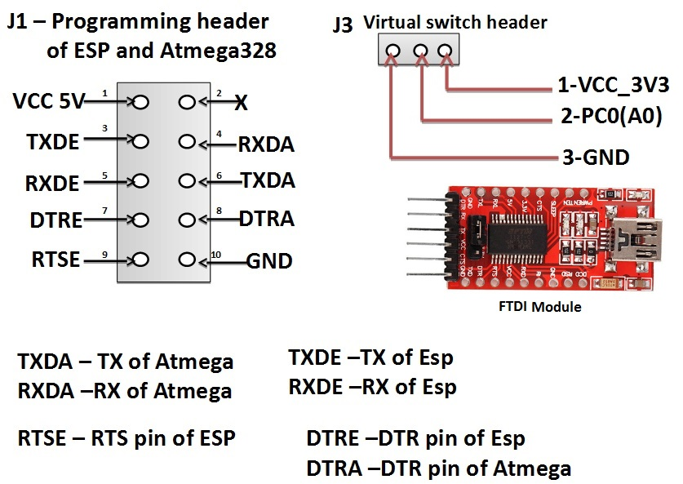

Slide 4
J3 Virtual Switch header
1 VCC_3V3
2 GPIO for ON and OFF
3 GPIO for Dimmer
4 GND
J3 Virtual Switch header
1 VCC_3V3
2 GPIO for ON and OFF
3 GPIO for Dimmer
4 GND

Slide 5
Communication Block Diagram
5V Virtual GPIOS
Web Browser/MQTT
Esp8266
Atmega328
HTTP/MQTT
UART
Triac
Appliances

Slide 6
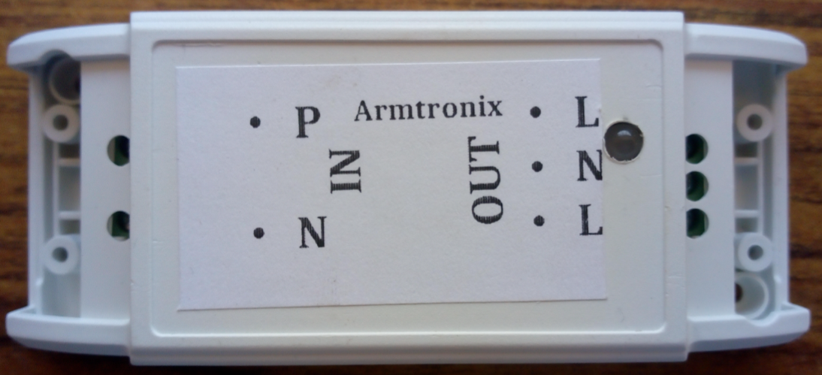
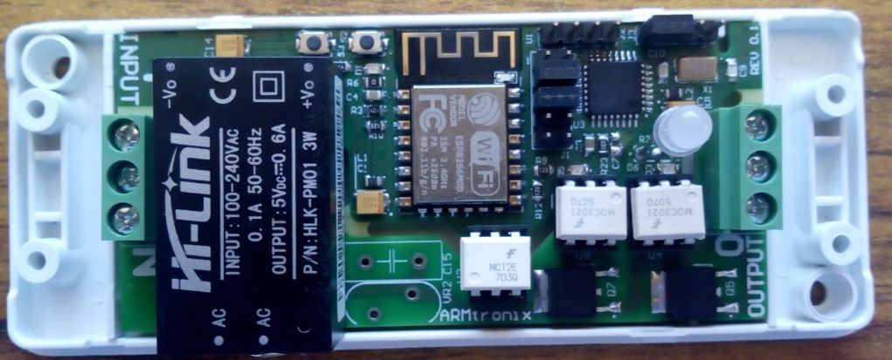
3-Holes are
Output side
(LOAD)
2-Holes are
Input side
(AC 230v)
Output LED
Match this
position

Slide 7
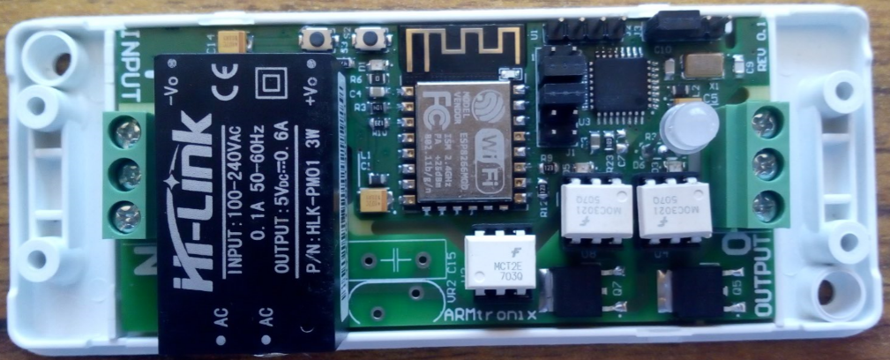
Box Size
114mm
44mm
39mm
84mm
Board Size

