Slide 1

Data Formats

Slide 2

Database formats
ODBC
Open Database Connectivity

Slide 3

Database formats
CSV
Comma Separated Values

Slide 4
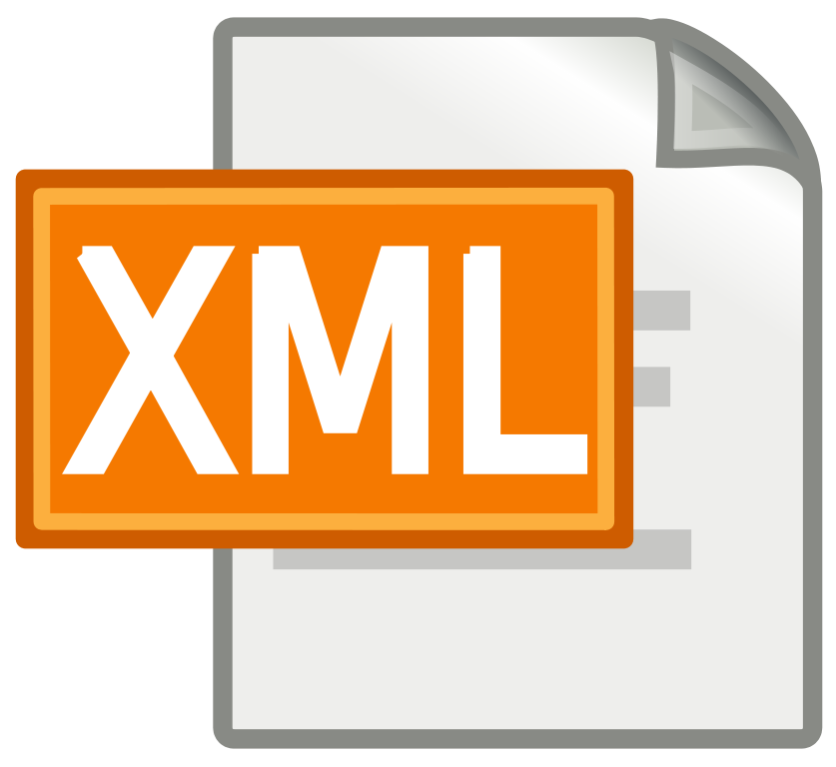
XML
Extensible Markup Language

Slide 5

JSON
JavaScript Object Notation
(really just a JS object)

Slide 6
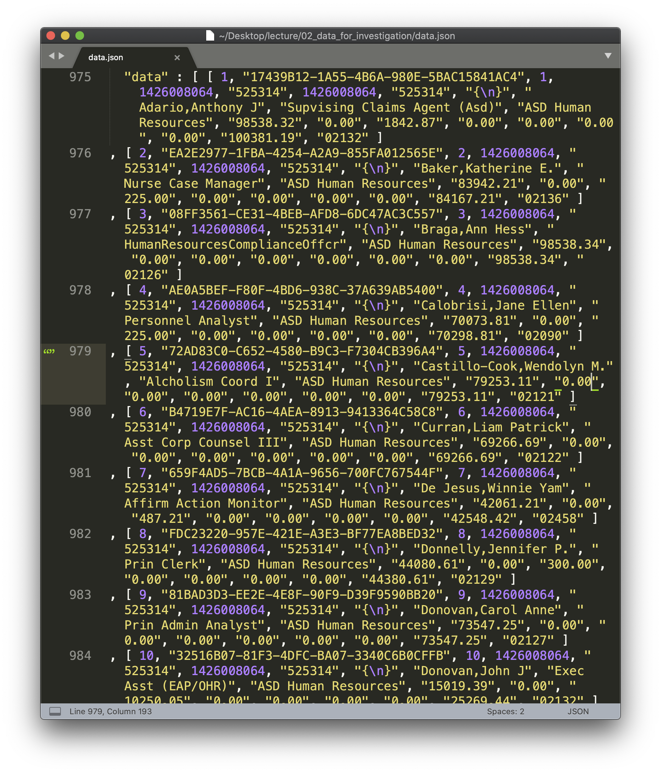
Data discovery

