Slide 1

Memory
1

Slide 2
Memory is the part of the computer that holds data and instructions for processing.
Most types of memory only store items while the computer is turned on; data is destroyed when the machine is turned off.
If more than one program is running at once a single program can not claim to memory.

Slide 3
Memory
Internal storage areas in the computer.
Memory is the electronic holding place for instructions and data.
We store program and data for our processing in the main memory.
The performance of the computer is not only depend on the processor but also on the RAM capacity and data transfer speed.
We retrieve the data from memory as and when require.

Slide 4
Types of memory
There are various types of memory is available:
1. Primary memory or Onboard memory
2. Secondary memory or Auxiliary

Slide 5
Primary memory or onboard memory
Primary storage (or main memory or internal memory), often referred to simply as memory, is the only one directly accessible to the CPU.
The CPU continuously reads instructions stored there and executes them as required.

Slide 6
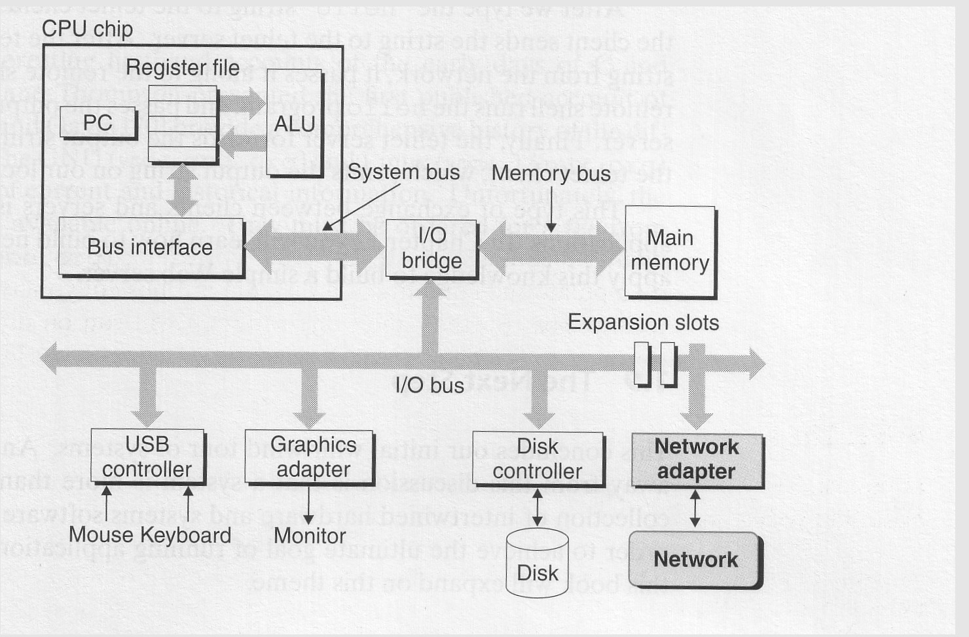

Slide 7
Types of primary memory
Register
RAM
ROM
Cache

Slide 8
Register
In a computer, a register is one of a small set of data holding places that are part of a computer processor
A register may hold a computer instruction, a storage address, or any kind of data.
It is an internal memory of a CPU.
The length of a register equals the number of bits it can store.
.

Slide 9
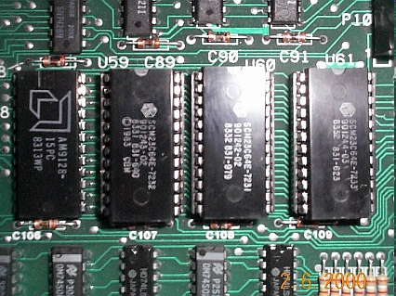



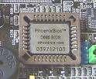
ROM

Slide 10
ROM
Read-Only Memory can be read but not changed.
It is non-volatile storage: it remembers its contents even when the power is turned off.
ROM chips are used to store the instructions a computer needs during start-up, called firmware.
Some kinds of ROM are PROM, EPROM, EEPROM.

Slide 11
ROM continue
Data can be read by the CPU in any order so ROM is also direct access.
Access time of between 10 and 50 nanoseconds.
Information stored is permanent.

Slide 12
No. | Address Range | Purpose
1 | F0000-F1FFF | Not used
2 | F2000-F3FFF | Not used
3 | F4000-F5FFF | User ROM
4 | F6000-F7FFF | Basic Interpreter
5 | F8000-F9FFF
6 | FA000-FBFFF
7 | FC000-FDFFF
8 | FE000-FFFFF | BIOS ROM

Slide 13
ROM Decode Logic
A13 Decoder(3X8)
Y0 A0-A12
A15
RD
A16
D0-D7
A19
MEMR Y7
74LS138
G
OE
BIOS ROM
CS

Slide 14
ROM Decode Logic
The 64 KB ROM space is split into 8 ROM chips of each 8KB
To select a ROM chip at a time 3X8 decoder ( 74LS138) is used
The ROM is located at the higher end of the memory map.
Any memory address is to be identified first as a valid ROM address.

Slide 15
A16 – A19 is the higher order address line which are the input line for NAND gate.
The out put of the NAND gate which enables the Decoder
The MEMR is the another enable input to the Decoder.
So the Decoder is enable during memory read operation for all address above F00000.

Slide 16
The next three address line A13-A15 are used to select the ROM chip.
The selection enables only one ROM chip at a time.
The lower address line A12-A0 are used to define the required address in the ROM.

Slide 17
For Example:-
If an address FE250 is given
First check for valid ROM address.
The most significant nibble F,A16 A17 A18 A19=1111, confirms a valid ROM address and it enable the decoder.
The A15 A14 A13=111 selects the output line Y7 which is the CS Signal for BIOS ROM and enable the ROM
A12-A0 specified the address on ROM
The content are made available in data bus

Slide 18
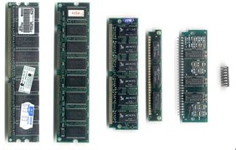
RAM
Information stored is for the immediate use.
Access of data is in random manner.
Each location has unique address.
Volatile kind of memory
RAM is used to hold programs while they are being executed, and data while it is being processed.

Slide 19
Types of RAM
1. Dynamic Random Access Memory (DRAM)
Contents are constantly refreshed 1000 times per second
Access time 60 – 70 nanoseconds
2. Synchronous Dynamic Random Access Memory (SDRAM)
Quicker than DRAM
Access time less than 60 nanoseconds

Slide 20
3. Direct Rambus Dynamic Random Access Memory (DRDRAM)
New type of RAM architecture
Access time 20 times faster than DRAM
More expensive
4. Static Random Access Memory (SRAM)
Doesn’t need refreshing
Retains contents as long as power applied to the chip
Access time around 10 nanoseconds
Used for cache memory
Also for date and time settings as powered by small battery

Slide 21
DRAM
Is a type of RAM that only holds its data if it is continuously accessed by special logic called a refresh circuit.
Many hundreds of times, this circuitry reads the contents of each memory cell, whether the memory cell is being used at that time by the computer or not.

Slide 22
The reading action itself refreshes the contents of the memory.
If this is not done regularly, then the DRAM will lose its contents, even if it continues to have power supplied to it.
This refreshing action is why the memory is called dynamic.

Slide 23
Cache memory
Small amount of memory typically 256 or 512 kilobytes
Temporary store for often used instructions
Level 1 cache is built within the CPU (internal)
Level 2 cache may be on chip or nearby (external)
Faster for CPU to access than main memory

Slide 24
Operation of cache memory
Main
Memory
(DRAM)
1. Cache fetches data from next to current addresses in main memory
2. CPU checks to see whether the next instruction it requires is in cache
CPU
Cache
Memory
(SRAM)
4. If not, the CPU has to fetch next instruction from main memory - a much slower process
3. If it is, then the instruction is fetched from the cache – a very fast position
= Bus connections

