Slide 1
Progress updates
O Hwang Kwon
Notes:
Hi, nice to meet you all. Today I want to discuss about the progress, so that we can brainstorm ideas with each other.

Slide 2
Contents
Current status – Data mining
Way to improve tweet mining
BERT language model
BERT model fine-tuned with Sentiment analysis -140
GPU Acceleration
Notes:
My presentation starts from the current status on the tweet mining.
Then, I will share some comments on the data mining process.
Also, I will present about a small experiment I completed with BERT language model.
Lastly, I will talk about GPU acceleration, which becomes pretty important as the project flows.

Slide 3
Current Status – Mining Tweets
Current Status – Data mining
4,500 nuclear tweets are collected from twitter.
Benchmarking the literature, at least 10,000 tweets are required for the research.
Source : Aparup Kahtua, Eric Cambria ‘Deciphering public opinion of nuclear energy on twitter)’
* Current Twitter API subscription allows us to obtain 10k tweets a month.
Notes:
Up to now, I have collected 4,500 tweets related to the nuclear.
Based on the literatures I have reviewed, I think we need at least 10k tweets related to nuclear in order to get reliable result.
Current twitter API has a few restriction, but no problem. I will keep collect those.

Slide 4
Can we improve Data Mining?
Clear presentation of keywords (queries)
Automation of data-mining process
Removing duplicated RT
Notes:
Those are some self-feedback that I want to mention about tweet mining.
I am keep reviewing the collected tweets, and it seems like a lot of tweets are irrelevant of nuclear power or nuclear energy.
In my opinion, we have presidential election next year. So a lot of tweets are just related to Donald Trump and nuclear button.
Plus, due to Ukraine war, there are many tweets just related to nuclear war, nuclear weapon, those kind of stuff.
I mean, these are not wrong, but I found that I can minimize those tweets by using clear keywords.
For example, it is better to search ‘Nuclear power safety’ instead of ‘Nuclear safety’.
Therefore, from now on, I will search with the keyword ‘nuclear power’ and ‘nuclear energy’.
Secondly, I will figure out how to automate the process. Currently I am using a software called postman, but maybe I can automatically collect data using bash command.
Lastly, I found that more than half of the collected tweets are duplicated. That was so bad, so I am trying to drop those retweets.

Slide 5
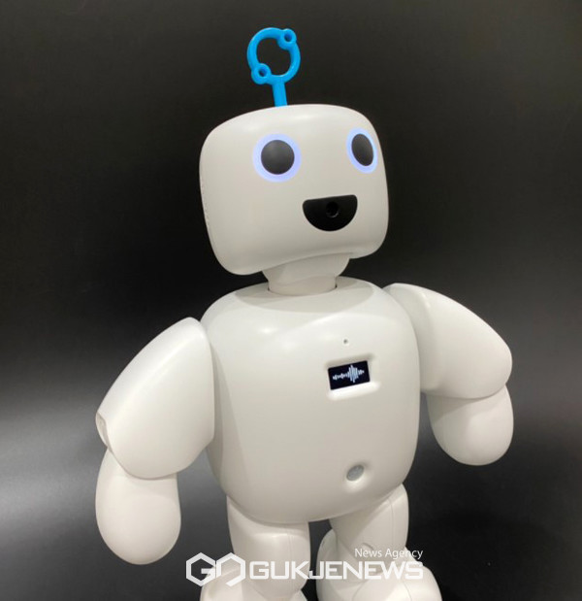

BERT language model
Idea
Fine-tuning
(Training with our nuclear tweets)
Pre-trained BERT
SURE project model
Notes:
Now I am trying to utilize BERT on our project.
BERT is a NLP model introduced by google in 2018.
It is based on the transformer architecture, which is a type of neural network model designed to process sequential data efficiently.
BERT is pre trained on a large corpus of unlabeled text data, such as Wikipedia articles and books.
So once we have BERT model, we can fine-tune this pre trained model with our nuclear tweets.
Then, BERT will be converted to ‘nuclear tweet specialized NLP model’.

Slide 6
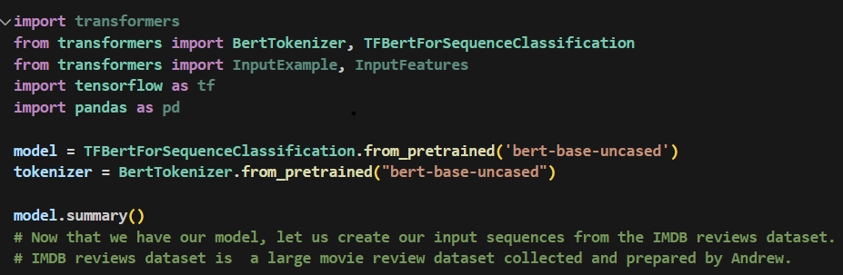
Fine-tuning with Sentiment Analysis140
Idea
Fine-tuning
(Sentiment Analysis 140)
Pre-trained BERT
BERT NLP model
BERT
Tokenizer
Notes:
At this point, since we do not have enough labeled data.
I did a small experiment with sentiment analysis 140 dataset.
We have 1.6 million tweets. So we can conduct fine tuning with this data at this moment, and then evaluate the performance.

Slide 7

Summary of BERT language model
Training_dataset = 200 tweets
Batch size = 32
Epoch = 3
Adam Optimizer : learning rate 2e-5
Loss function = Cross Entropy function
Dataset
(Sentiment 140)
Feature : Tweet
Label : Sentiment
Convert to tensor
Tokenize
Encode
Performance
Evaluation
With
Nuclear tweets
Notes:
I wrote the python script that can do fine-tuning with sentiment 140 dataset.
I tried to train the model with the whole data, but it took so long time. So I sliced the dataset into smaller one.
I took 100 positive tweets and then 100 negative tweets from the dataset.
Then, using python script, I could convert the dataset into tensors, so that we can use tensorflow.
This process includes tokenizing and encoding.
Then, with those hyper parameters, I gave 100 nuclear tweets to the model.
As you expect, the result was terrible. And it was not possible to get accuracy score since there is no neutral label in the sentiment 140 dataset.
But anyway it worked. The script itself worked pretty well.
So later on, when we get enough labeled tweets, we can try again.

Slide 8

GPU Acceleration
Current status
Tensorflow-gpu library is deprecated.
Tensorflow documentation recommends Docker.
Prerequisites for using Tensorflow GPU
NVIDIA driver
Cuda
Cuda CNN
All of those should be updated properly.
Notes:
I realized that machine learning process is very costly in terms of memory.
It takes a lot of time, because we only use CPU.
Therefore, in machine learning, GPU acceleration is a powerful tool to speed the training.
GPU is suitable for parallel computing, so it can process numerous operations simultaneously. This allows for faster execution of compute intensive task such as deep learning.
However, in order to use gpu in deep learning, there are a few prerequisites.
We need NVIDIA driver, Cuda, and Cuda CNN. Most importantly, all those prerequisites should be compatible.
Otherwise, it will not work.
So, those are pretty painful. So the Tensorflow-gpu library has been removed, and the documentation recommends docker.
Docker is a popular containerization platform that provides several advantages.
The most powerful feature of docker is portability. Docker allows you to package an application and all its dependencies into a single standardized container.
With that being said, you don’t need to install and update Cuda and Cuda CNN. A container in docker has it.
Currently, I am using gpu acceleration using docker. There are still some problems to solve to fully utilize this tool.
But I think this is the most efficient way to use gpu acceleration.

Slide 9

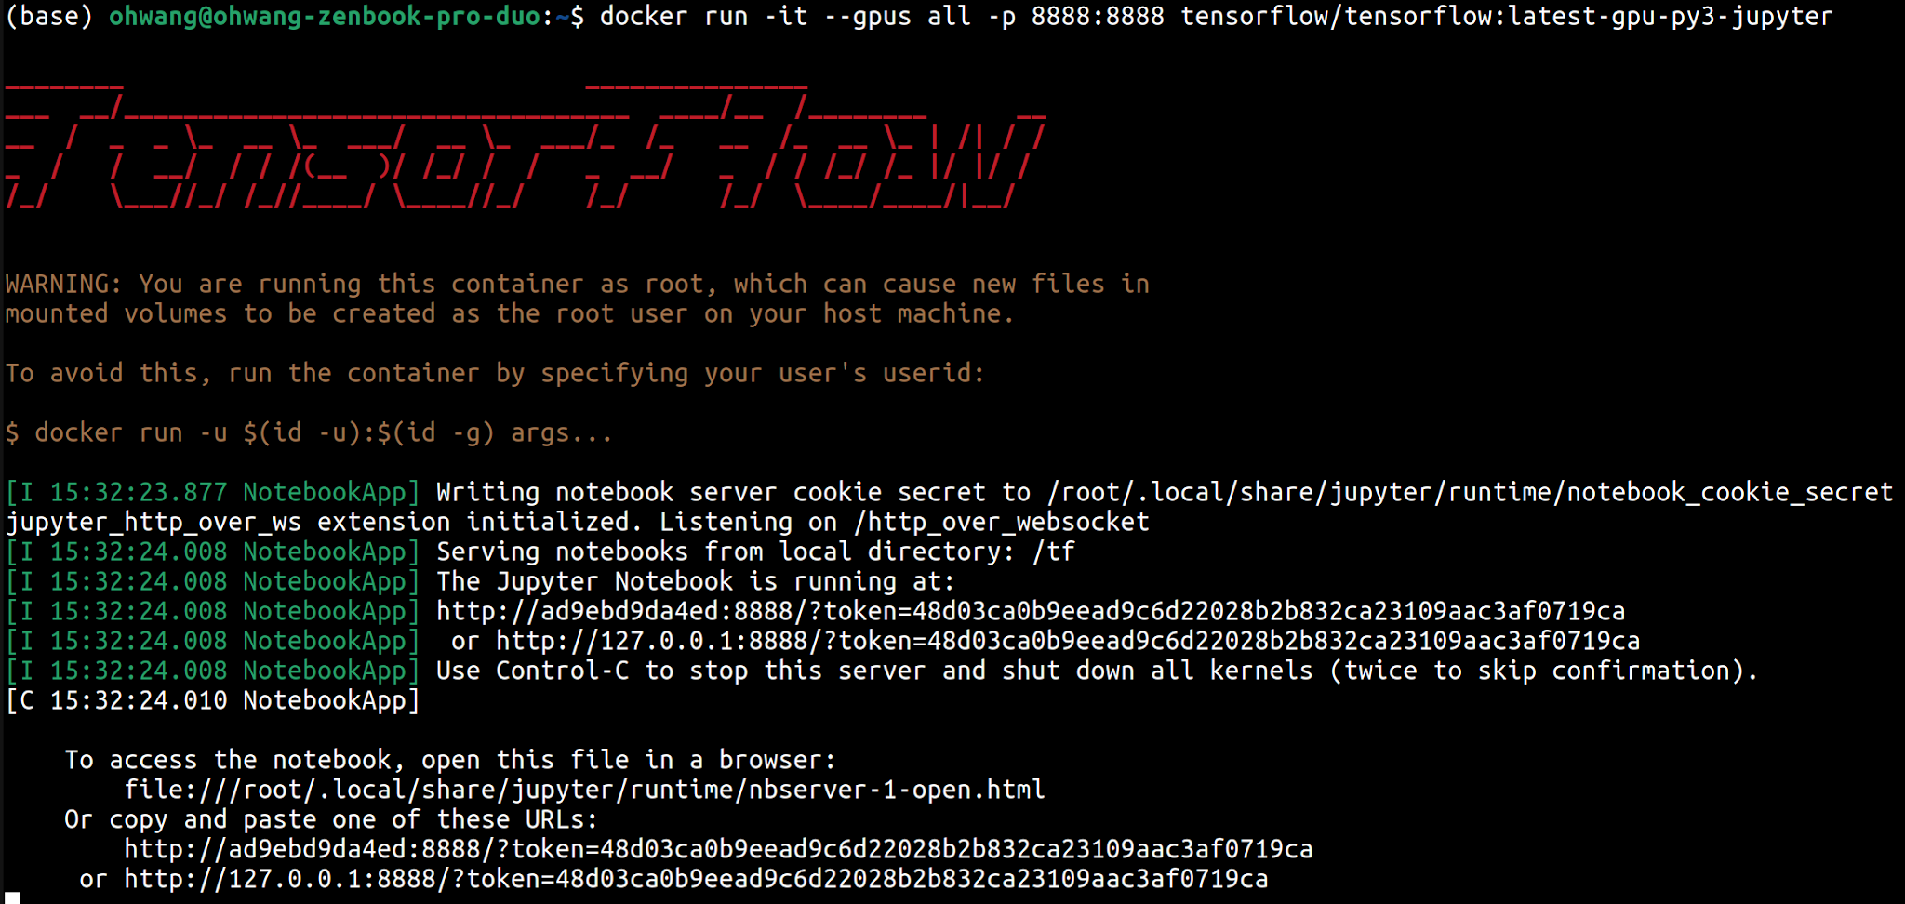
Using Docker for Tensorflow
Notes:
This is how I am docker for tensorflow.
As you can see on the first command line of the picture, I can run tensorflow gpu with jupyter notebook in the virtual port.
Docker run –it –gpus all –p 8888:8888 tensorflow/tensorflow-gpu-py3-jupyter
Once I execute this command, I will get the virtual URL.

Slide 10
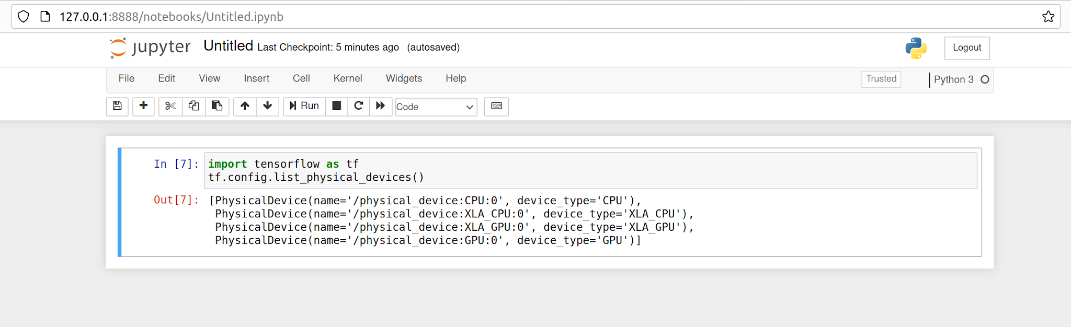
Checking GPU acceleration
Notes:
Once you visit the URL, you will see jupyter notebook.
And then we can check whether the GPUs are used or not.
On the picture above, We observed that the GPUs are successfully loaded on the system.
I still have some minor problems to solve, but I think docker is a promising tool for gpu acceleration.
Thank you for listening, and thise is pretty much I can tell you about my progress!

