Slide 1
Progress updates - Nuclear Tweets NLP
O Hwang Kwon
Notes:
Hi, for those who do not remember my name, I am Ohwang.
I am glad to see you again.
I am excited to finally kick off this project.

Slide 2
Contents
Current status
Active Learning
Notes:
Today, I want to discuss briefly about the research motivation and scheme.
Then, I will share my progress so far in the machine learning and neural networks.
I am absolutely new to the machine learning, and I just started to learn.

Slide 3
Research Workflow
Flow Chart
Supervised ML – What we are going to implement on the project.
Unsupervised ML
Reinforced ML
Neural Network
Data Mining
Labeling
Model
Test
Assessment
Modification
Notes:
First of all, the end goal of the project is analyzing the sentiment toward the nuclear power using NLP, based on the posts in the social media.
In purely engineering point of view, the input will be natural language from the social media and the output will be classified sentiments, for example good or bad.
First thing we need to do is collecting the data.
Once we establish the data pipeline, we can establish the base model and train with training dataset.
Then, we can assess the performance of the model based on the accuracy of the classification.
We will iterate this process until the model hits the target accuracy, which is above 90%.

Slide 4
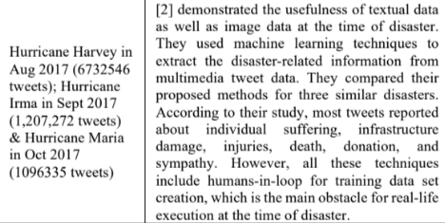
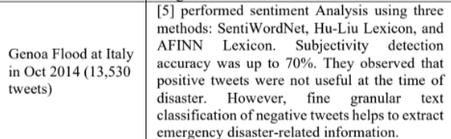
Current Status – Mining Tweets
Current Status – Data mining
More than 1,000 nuclear tweets are collected from twitter.
Benchmarking the literature, at least 10,000 tweets are required for the research.
Source : Aparup Kahtua, Eric Cambria ‘Deciphering public opinion of nuclear energy on twitter)’
* Current Twitter API subscription allows us to obtain 10k tweets a month.
Conclusion - The more, the better!
Notes:
First of all, the end goal of the project is analyzing the sentiment toward the nuclear power using NLP, based on the posts in the social media.
In purely engineering point of view, the input will be natural language from the social media and the output will be classified sentiments, for example good or bad.
First thing we need to do is collecting the data.
Once we establish the data pipeline, we can establish the base model and train with training dataset.
Then, we can assess the performance of the model based on the accuracy of the classification.
We will iterate this process until the model hits the target accuracy, which is above 90%.

Slide 5
Current Status – Data Labeling
Current Status – Data Labeling
Data labeling is one of the most arduous jobs in ML process. Industries usually hire people to label the data.
Doccano is a good software that we can utilize for data labeling management, but it seems like that we cannot automatically label all the data using python API.
Though Doccano can reduce the amount of work, it does not completely automate the labeling process. (Because API does not support for auto-labeling.)
Notes:
First of all, the end goal of the project is analyzing the sentiment toward the nuclear power using NLP, based on the posts in the social media.
In purely engineering point of view, the input will be natural language from the social media and the output will be classified sentiments, for example good or bad.
First thing we need to do is collecting the data.
Once we establish the data pipeline, we can establish the base model and train with training dataset.
Then, we can assess the performance of the model based on the accuracy of the classification.
We will iterate this process until the model hits the target accuracy, which is above 90%.

Slide 6
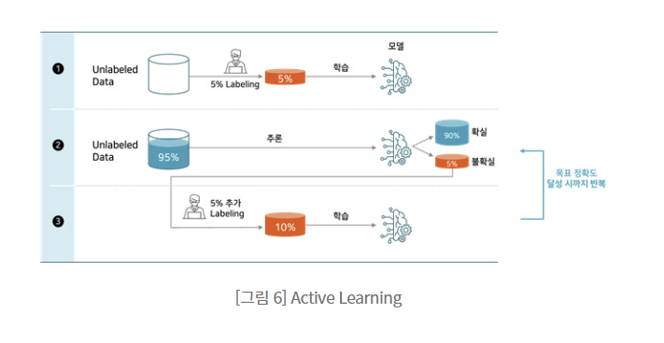
Possible Solution – Active Learning Process
Idea
ML is just like feeding a baby. Once they grow up, they feed themselves.
Notes:
First of all, the end goal of the project is analyzing the sentiment toward the nuclear power using NLP, based on the posts in the social media.
In purely engineering point of view, the input will be natural language from the social media and the output will be classified sentiments, for example good or bad.
First thing we need to do is collecting the data.
Once we establish the data pipeline, we can establish the base model and train with training dataset.
Then, we can assess the performance of the model based on the accuracy of the classification.
We will iterate this process until the model hits the target accuracy, which is above 90%.

Slide 7
Possible Solution – Label manager (Doccano)
Idea
ML is just like feeding a baby. Once they grow up, they feed themselves.
Notes:
First of all, the end goal of the project is analyzing the sentiment toward the nuclear power using NLP, based on the posts in the social media.
In purely engineering point of view, the input will be natural language from the social media and the output will be classified sentiments, for example good or bad.
First thing we need to do is collecting the data.
Once we establish the data pipeline, we can establish the base model and train with training dataset.
Then, we can assess the performance of the model based on the accuracy of the classification.
We will iterate this process until the model hits the target accuracy, which is above 90%.

Slide 8
Necessity for the Unified Label system
Idea
ML is just like feeding a baby. Once they grow up, they feed themselves.
Notes:
First of all, the end goal of the project is analyzing the sentiment toward the nuclear power using NLP, based on the posts in the social media.
In purely engineering point of view, the input will be natural language from the social media and the output will be classified sentiments, for example good or bad.
First thing we need to do is collecting the data.
Once we establish the data pipeline, we can establish the base model and train with training dataset.
Then, we can assess the performance of the model based on the accuracy of the classification.
We will iterate this process until the model hits the target accuracy, which is above 90%.

Slide 9
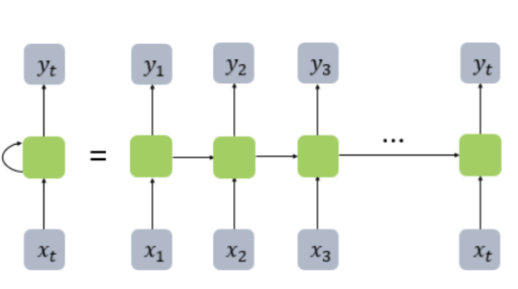
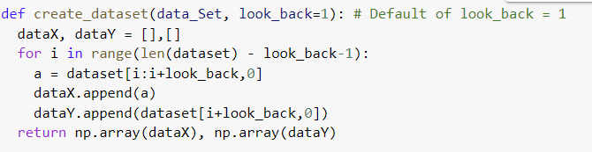
Current Progress – Recurrent Neural Network (RNN)
RNNs are a class of neural networks that allow previous outputs to be used as inputs while having hidden states.
Computation takes into account the historical information.
Application
- Prediction of the number of international airline passengers, based on the past data points.
Two inputs
Notes:
From now on, I would like to share what I did so far.
I started to study some basic neural network models as a preparation for the NLP.
In this meeting, I would like to present two models. One is Recurrent neural network, the other is Convolutional Neural Network.
First, RNN is widely used when we need to take the sequence into account.
The tutorial I did was about predicting the number of the international airline passengers based on the previous year’s data.
This code below represent what RNN really is.
This is a function that creates dataset for the machine training.
Look back represents the number of past years that we want to take into account.
By using this function, input data and the output data will be generated as a pair based on the look_back parameter.

Slide 10
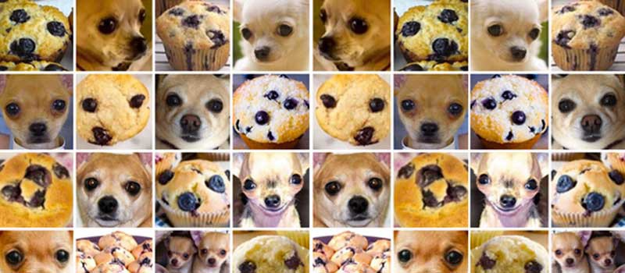
Current Progress – Convolutional Neural Network (CNN)
Convolutional neural network is frequently used in visual classification problems.
Notes:
Next tutorial I completed is about convolutional neural networks.
This model is frequently used in the image classification.
I also completed the tutorial related to the image classification.
In this case, the problem became different in that it is classification problem, not a regression problem.
Our input will be an image file. The machine should classify whether it is a raisin muffin or it is a dog.
I want to point out how we, human being actually perceive these visual information.
We don’t need a microscope to classify those images. Right?
The first thing we do when we perceive visual information is to extract the important features.

Slide 11
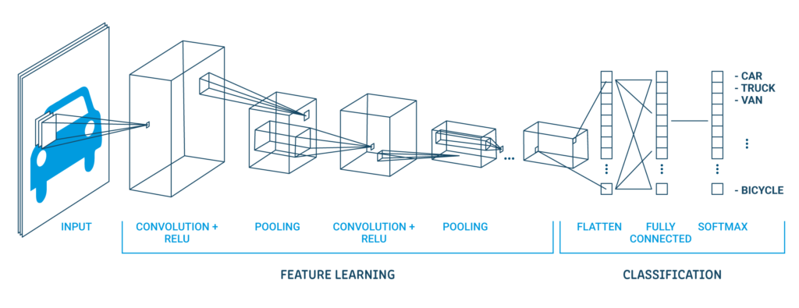
Current Progress – Convolutional Neural Network (CNN)
Notes:
So, we can apply that fact to the machine learning.
Simply speaking, other than analyzing pixel by pixel, we can extract the important features using the first few layers, and then we can take more details into account.
That is what convolutional neural networks do.

Slide 12
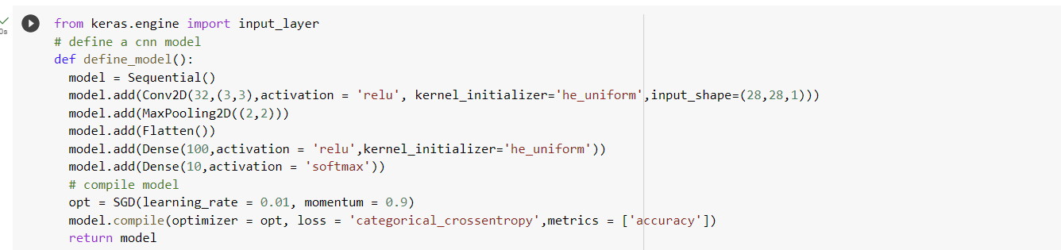
CNN for image classification
Notes:
This feature intuitively explains what cnn really is.
The left side image represents our input image, which is represented by the array of numerical values.
Then, we can see the 3*3 filters. Those filters will tell you whether the input image has certain feature or not.
If the input has the feature, the output value will be large.
Otherwise, it would be close to zero.
For example, we can put 3 filters for that chihuahua and muffin problem.
Chihuahua has eyes, nose, and ears.
So we can put filters for those important features. Once the machine recognizes those important features, it will classify the image much more efficiently.

Slide 13
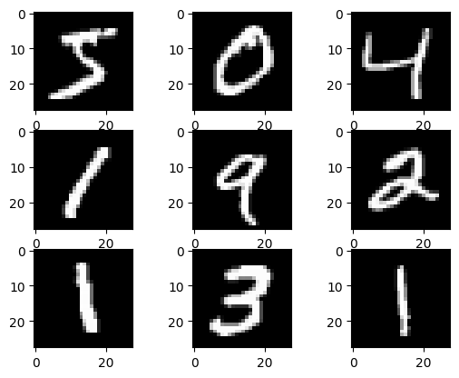
Current Progress – Convolutional Neural Network (CNN)
Single-digit integer classification problem is done for the practice using MNIST data.
Notes:
This is the actual tutorial I did using MNIST data.

