Slide 1
Progress updates
O Hwang Kwon
Notes:
Hi, for those who do not remember my name, I am Ohwang.
I am glad to see you again.
I am excited to finally kick off this project.

Slide 2
Contents
Current status
Active Learning
Notes:
Today, I want to discuss briefly about the research motivation and scheme.
Then, I will share my progress so far in the machine learning and neural networks.
I am absolutely new to the machine learning, and I just started to learn.

Slide 3
Research Workflow
Flow Chart
Supervised ML – What we are going to implement on the project.
Unsupervised ML
Reinforced ML
Neural Network
Data Mining
Labeling
Model
Test
Assessment
Modification
Notes:
First of all, the end goal of the project is analyzing the sentiment toward the nuclear power using NLP, based on the posts in the social media.
In purely engineering point of view, the input will be natural language from the social media and the output will be classified sentiments, for example good or bad.
First thing we need to do is collecting the data.
Once we establish the data pipeline, we can establish the base model and train with training dataset.
Then, we can assess the performance of the model based on the accuracy of the classification.
We will iterate this process until the model hits the target accuracy, which is above 90%.

Slide 4
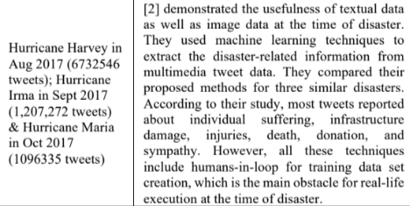
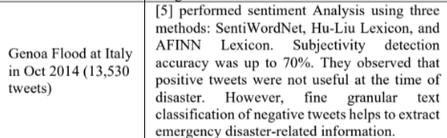
Current Status – Mining Tweets
Current Status – Data mining
More than 1,000 nuclear tweets are collected from twitter.
Benchmarking the literature, at least 10,000 tweets are required for the research.
Source : Aparup Kahtua, Eric Cambria ‘Deciphering public opinion of nuclear energy on twitter)’
* Current Twitter API subscription allows us to obtain 10k tweets a month.
Conclusion - The more, the better!
Notes:
First of all, the end goal of the project is analyzing the sentiment toward the nuclear power using NLP, based on the posts in the social media.
In purely engineering point of view, the input will be natural language from the social media and the output will be classified sentiments, for example good or bad.
First thing we need to do is collecting the data.
Once we establish the data pipeline, we can establish the base model and train with training dataset.
Then, we can assess the performance of the model based on the accuracy of the classification.
We will iterate this process until the model hits the target accuracy, which is above 90%.

Slide 5
Current Status – Data Labeling
Current Status – Data Labeling
Data labeling is one of the most arduous jobs in ML process. Industries usually hire people to label the data.
Doccano is a good software that we can utilize for data labeling management, but it seems like that we cannot automatically label all the data using python API.
Though Doccano can reduce the amount of work, it does not completely automate the labeling process. (Because API does not support for auto-labeling.)
Notes:
First of all, the end goal of the project is analyzing the sentiment toward the nuclear power using NLP, based on the posts in the social media.
In purely engineering point of view, the input will be natural language from the social media and the output will be classified sentiments, for example good or bad.
First thing we need to do is collecting the data.
Once we establish the data pipeline, we can establish the base model and train with training dataset.
Then, we can assess the performance of the model based on the accuracy of the classification.
We will iterate this process until the model hits the target accuracy, which is above 90%.

Slide 6
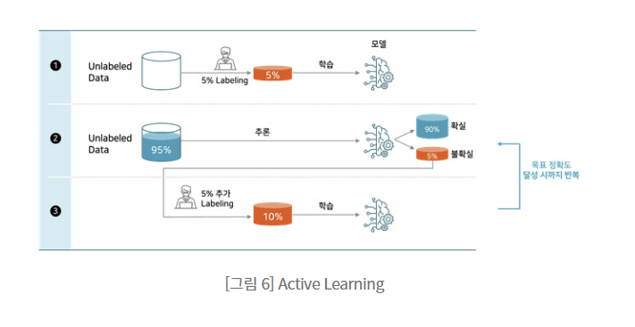
Possible Solution – Active Learning Process
Idea
ML is just like feeding a baby. Once they grow up, they feed themselves.
Notes:
First of all, the end goal of the project is analyzing the sentiment toward the nuclear power using NLP, based on the posts in the social media.
In purely engineering point of view, the input will be natural language from the social media and the output will be classified sentiments, for example good or bad.
First thing we need to do is collecting the data.
Once we establish the data pipeline, we can establish the base model and train with training dataset.
Then, we can assess the performance of the model based on the accuracy of the classification.
We will iterate this process until the model hits the target accuracy, which is above 90%.

Slide 7
Possible Solution – Label manager (Doccano)
Idea
ML is just like feeding a baby. Once they grow up, they feed themselves.
Notes:
First of all, the end goal of the project is analyzing the sentiment toward the nuclear power using NLP, based on the posts in the social media.
In purely engineering point of view, the input will be natural language from the social media and the output will be classified sentiments, for example good or bad.
First thing we need to do is collecting the data.
Once we establish the data pipeline, we can establish the base model and train with training dataset.
Then, we can assess the performance of the model based on the accuracy of the classification.
We will iterate this process until the model hits the target accuracy, which is above 90%.

Slide 8
Necessity for the Unified Label system
Idea
ML is just like feeding a baby. Once they grow up, they feed themselves.
Notes:
First of all, the end goal of the project is analyzing the sentiment toward the nuclear power using NLP, based on the posts in the social media.
In purely engineering point of view, the input will be natural language from the social media and the output will be classified sentiments, for example good or bad.
First thing we need to do is collecting the data.
Once we establish the data pipeline, we can establish the base model and train with training dataset.
Then, we can assess the performance of the model based on the accuracy of the classification.
We will iterate this process until the model hits the target accuracy, which is above 90%.

