Slide 1

FOCUS INTELLIGENCE PLATFORM
FocusGuard AI
AI-Powered Productivity & Focus Intelligence Platform
"Understand Your Focus. Improve Your Productivity."
COORDINATOR
Srikanth
MENTOR
Purushothaman

Slide 2





THE PROBLEM
The Problem Behind Productivity
People often work for hours without understanding where their time actually goes.
Activity
Digital distractions quietly reduce concentration throughout the day.
Analysis
Productivity is difficult to measure objectively — most tools rely on self-reporting.
Traditional tools track completed tasks, not the behavior behind them.
AI Insights
Users rarely get guidance personalized to their own activity patterns.
Better Decisions
"FocusGuard AI turns activity data into actionable productivity intelligence."
Improved Focus
FocusGuard AI

Slide 3
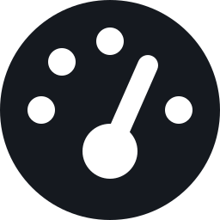
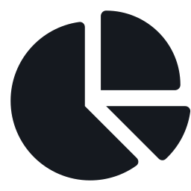

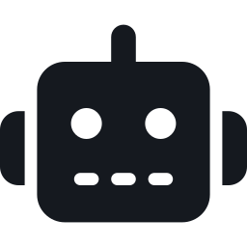


THE SOLUTION
One Platform. Complete Focus Intelligence.
Productivity Dashboard
Activity Intelligence
Focus Goals
A centralized, role-based overview of focus and productivity
Distinguishes productive, neutral, and distracting activity
Measurable productivity goals with priority, deadline, and progress
AI Productivity Coach
AI Chatbot
Smart Analytics & Reports
Personalized insights and recommendations from activity patterns
A scoped assistant for productivity-related questions and coaching
Daily, weekly, and monthly trends, exportable as CSV or PDF
FocusGuard AI

Slide 4
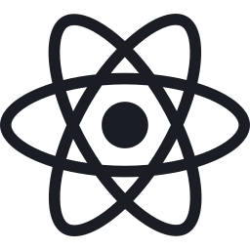

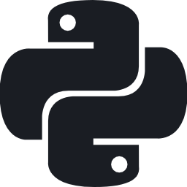

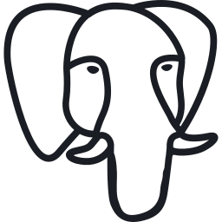


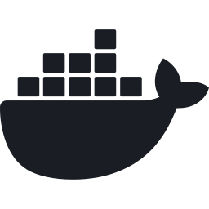

TECHNOLOGY
Built on a Modern & Scalable Technology Stack
React
Tailwind CSS
Python
Django + DRF
Groq LLM
FRONTEND
FRONTEND
BACKEND
BACKEND
AI
PostgreSQL
Redis
Celery
Docker
Nginx
DATABASE
INFRASTRUCTURE
INFRASTRUCTURE
INFRASTRUCTURE
INFRASTRUCTURE
Frontend
REST API
Backend
Business Logic + AI
Database
Redis + Celery support the backend with caching and asynchronous task processing.
FocusGuard AI

Slide 5

HOW IT WORKS
How FocusGuard AI Works
1
2
3
4
5
6
User Activity
Data Collection & Processing
Productivity Analysis
AI Processing
Personalized Insights
Improved Focus
Web sessions generate activity signals
Events queued and processed asynchronously
Activity classified and scored
Patterns interpreted for meaning
Recommendations and goals generated
User takes action, focus improves
FocusGuard AI

Slide 6

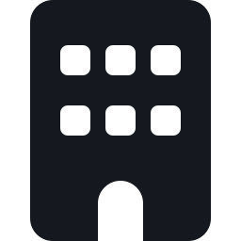
BUSINESS VALUE
Why FocusGuard AI Matters
For Individuals
For Organizations
• Better awareness of time usage
• Organisation-level productivity visibility
• Improved, sustained focus
• Scoped user insights for org admins
• Personalized productivity guidance
• Role-based access and accountability
• Goal tracking with real progress
• Foundation for data-driven decisions
• Clear identification of distractions
KEY DIFFERENTIATOR
TRADITIONAL PRODUCTIVITY TOOLS
FOCUSGUARD AI
"What tasks did you complete?"
"How effectively did you use your time — and how can you improve?"
FocusGuard AI

Slide 7



ROADMAP
Where FocusGuard AI Can Go Next
NOW
NEXT
FUTURE
Web platform with AI coaching
Productivity forecasting
Predictive burnout-risk intelligence
Focus goals & scoring
Calendar integration
Enterprise productivity intelligence
Multilingual interface
Native Mobile Application (iOS/Android)
AI-generated work planning
FocusGuard AI

Slide 8


CONCLUSION
Turning Time Into Intelligence
Measure
Understand
Improve
Scale
FocusGuard AI makes productivity and focus visible through activity-based analytics.
AI and analytics help users identify productive patterns and distractions.
Personalized recommendations and goals turn insight into action.
A foundation that can evolve into a broader productivity intelligence ecosystem.
"FocusGuard AI doesn't just track productivity — it helps users understand it, act on it, and improve it."
FocusGuard AI

Slide 9
Thank You
FocusGuard AI
"Understand Your Focus. Improve Your Productivity."

