Slide 1
A Research Roadmap for Physical AI Systems
Arnab Raha
Chief NPU Architect
Intel AI
IBM IEEE CAS/EDS – AI Compute Symposium – October 2026

Slide 2
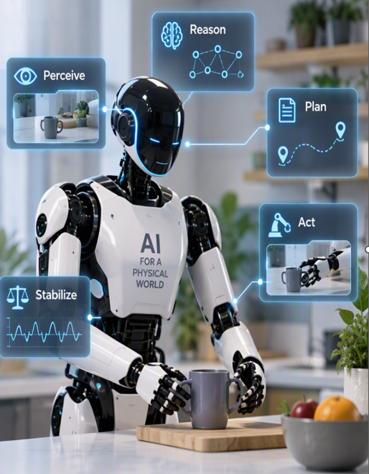
Robotics is Entering the Physical AI Era
Robotics Compute Architectures Must Evolve
Traditional Robotics
Fixed programming
Rule-based control
Dedicated controllers
Predictable workloads
Physical AI Robotics
VLMs
VLA Models
Diffusion Policies
Imitation Learning
Autonomous Planning
New Challenge
Robots must:
✅ Reason
✅ Perceive
✅ Plan
✅ Act
✅ Stabilize
All simultaneously
Notes:
Key Message: Physical AI requires a fundamentally new compute architecture.

Slide 3
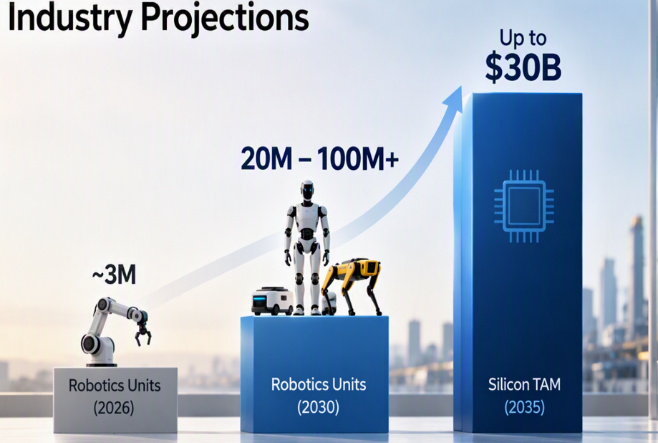
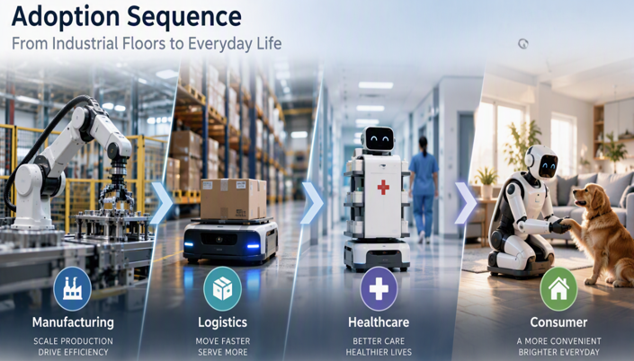
The Opportunity
Physical AI Market Inflection Point
Requirements
2000 TOPs
16 Cameras
256 GB Memory
<100 ms Vision to Action

Slide 4
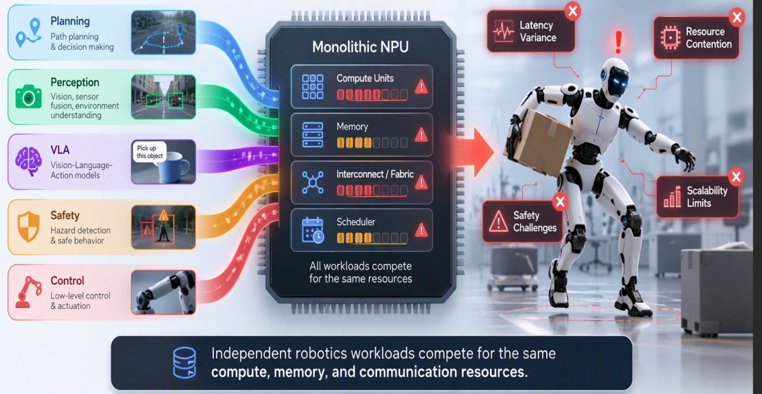

Why Current AI SoCs Are Not Enough
Monolithic NPU Architecture
Single Large NPU
Planning
Perception
VLA
Safety
Control
All workloads compete for:
Compute
Memory
Fabric
Scheduling
Result:
❌ Latency Variance
❌ Resource Contention
❌ Safety Challenges
❌ Scalability Limits

Slide 5
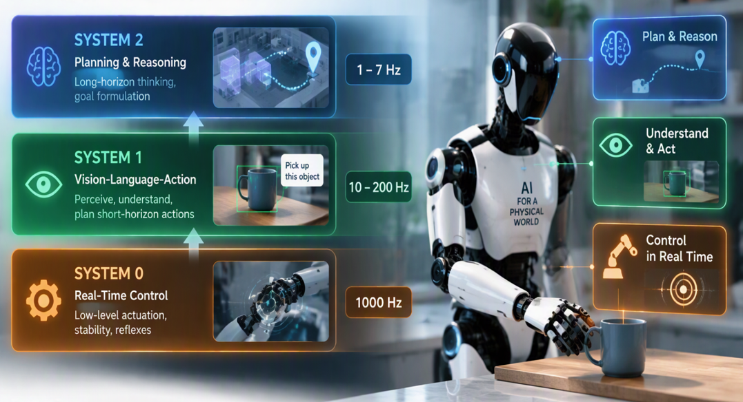
The Robotics Brain Architecture
Key Observation
  These workloads are fundamentally different
  A single NPU cannot optimize all three simultaneously

Slide 6
Why Multi-NPU?
Physical AI introduces three simultaneous execution domains:
System 0 : Real-Time Control (~1 kHz)
System 1 : Action Generation (10-200 Hz)
System 2 : Reasoning (1-7 Hz)
Monolithic NPUs are not optimized for all three.
Multi-NPU is not about achieving higher TOPs
It is about isolating cognitive functions operating at different timescales, safety domains, and resource requirements.

Slide 7
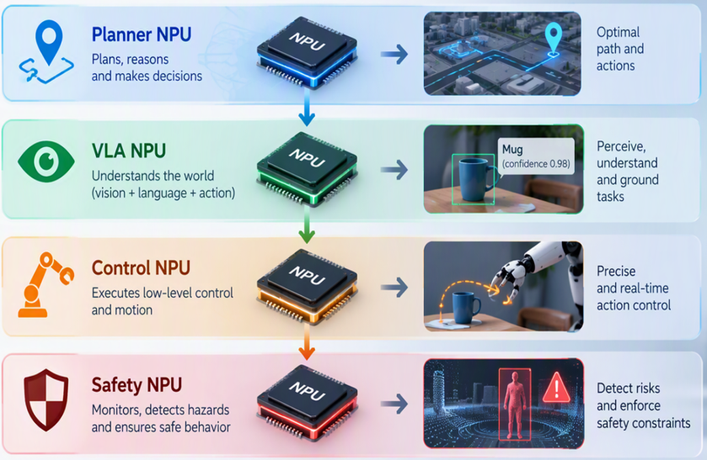
Introducing Multi-NPU Architecture
Each NPU optimized for a specific cognitive task.
  Benefits
  ✅ Isolation
  ✅ Deterministic Execution
  ✅ Better Scaling
  ✅ Improved Safety
  ✅ Higher Utilization

Slide 8
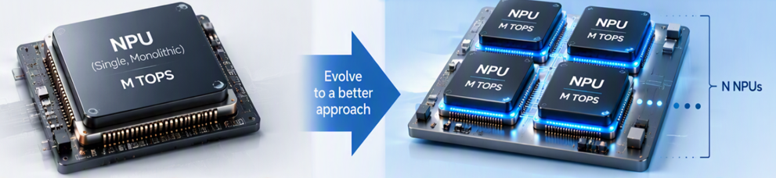
Multi-NPU Solves Compute Scaling
Challenge #1 → 2000 TOPs Requirement
Traditional Scaling : One Giant NPU
Problems
Bigger die
Higher cost
Yield loss
Power inefficiency
Multi-NPU Scaling : N instances of NPUs x M TOPs per NPU instance
Benefits
✅ Modular growth
✅ Better yield with Tiled/Chiplet based
✅ Product segmentation
✅ Future scaling to 3000+ TOPs

Slide 9
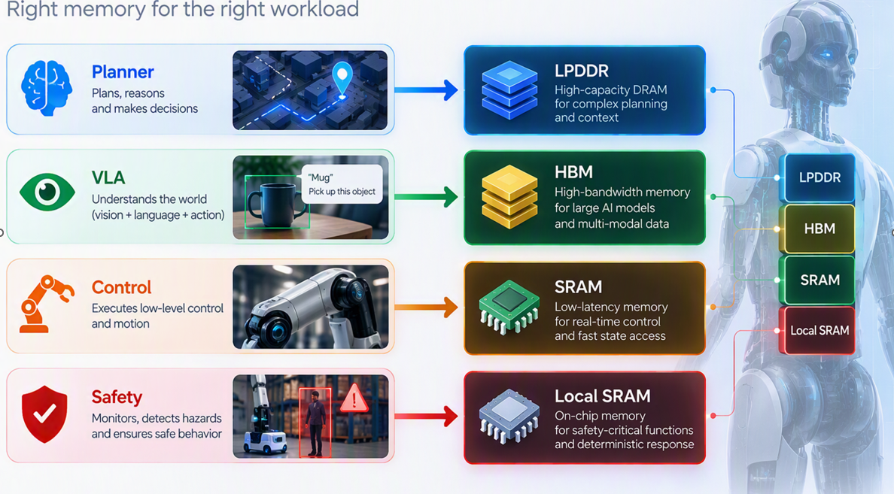
Multi-NPU Solves Memory Bandwidth
Challenge #2 → 1 TB/s Bandwidth
Monolithic Architecture : Shared DRAM
Results:
Contention
Cache thrashing
Latency spikes
Multi-NPU Memory Hierarchy
Benefits:
✅ Distributed bandwidth
✅ Lower latency
✅ Localized data processing
✅ Better efficiency

Slide 10
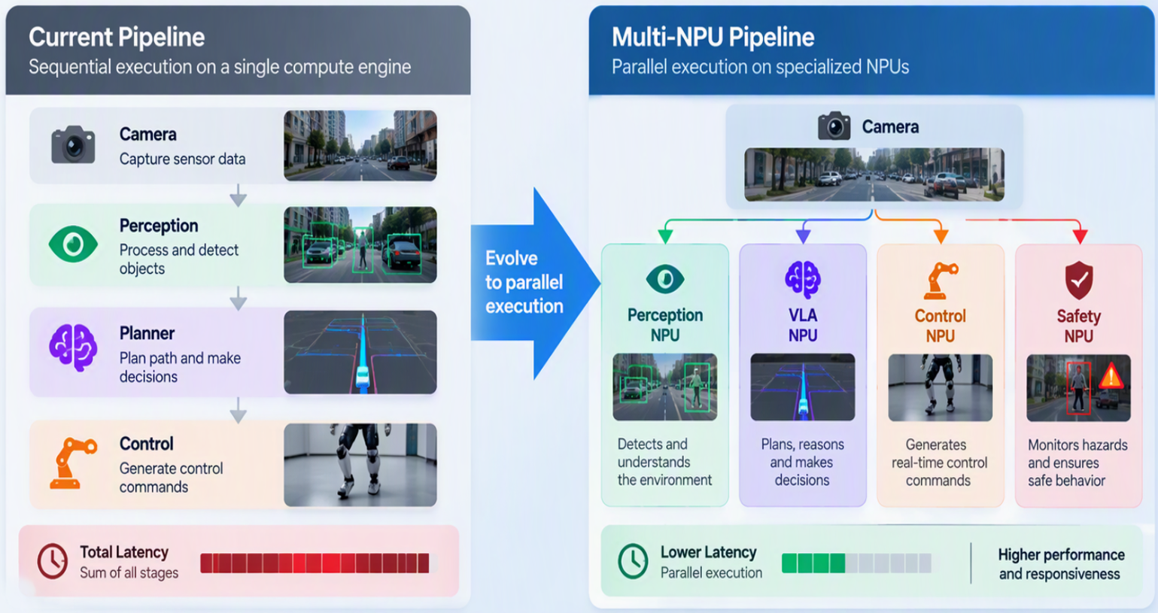
Multi-NPU Solves Vision-to-Action Latency
Challenge #3 → <100 ms Response
Current Pipeline : Sequential Execution
Results:
Latency accumulation
AI tasks block control decisions
Resource contention
Poor scalability
Jitter and Unpredictability
Multi-NPU Pipeline : Parallel Execution
Benefits:
✅ Reduced latency
✅ Higher throughput
✅ Concurrent execution

Slide 11
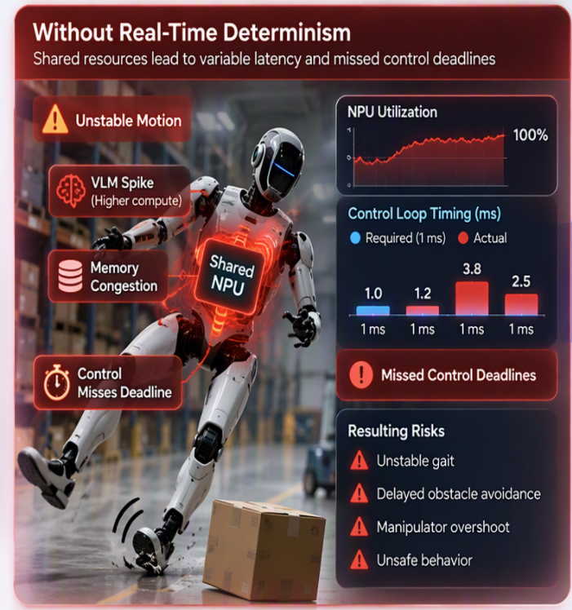
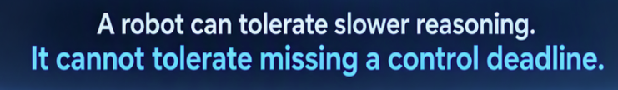
Multi-NPU Solves Real-Time Determinism
Challenge #4 → 1 kHz Control Loop
Current Risk
Potential Instability:
VLM Spike
Memory Congestion
Control Misses Deadline
Dedicated Real-Time NPU :
System 0 NPU (Reserved Resources, Reserved Bandwidth and Reserved Memory)
Benefits:
✅ Hard real-time operation
✅ Bounded latency
✅ No AI interference

Slide 12
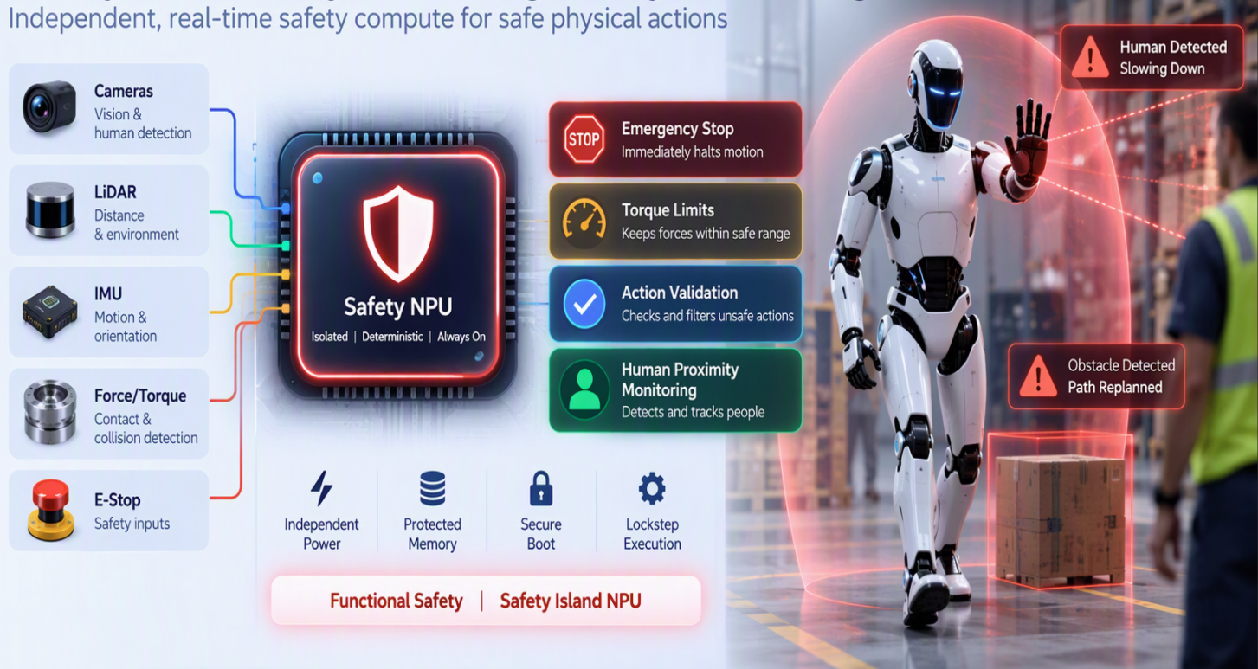

Multi-NPU Solves Functional Safety
Challenge #5 – Safe Physical Actions
Traditional Architecture :
Problems:
Safety shares resources with AI
Single point of failure
Safety Island NPU
Functions:
Emergency stop
Torque limits
Action validation
Human proximity monitoring
Benefits :
✅ Independent power
✅ Protected memory
✅ Secure boot
✅ Lockstep execution

Slide 13
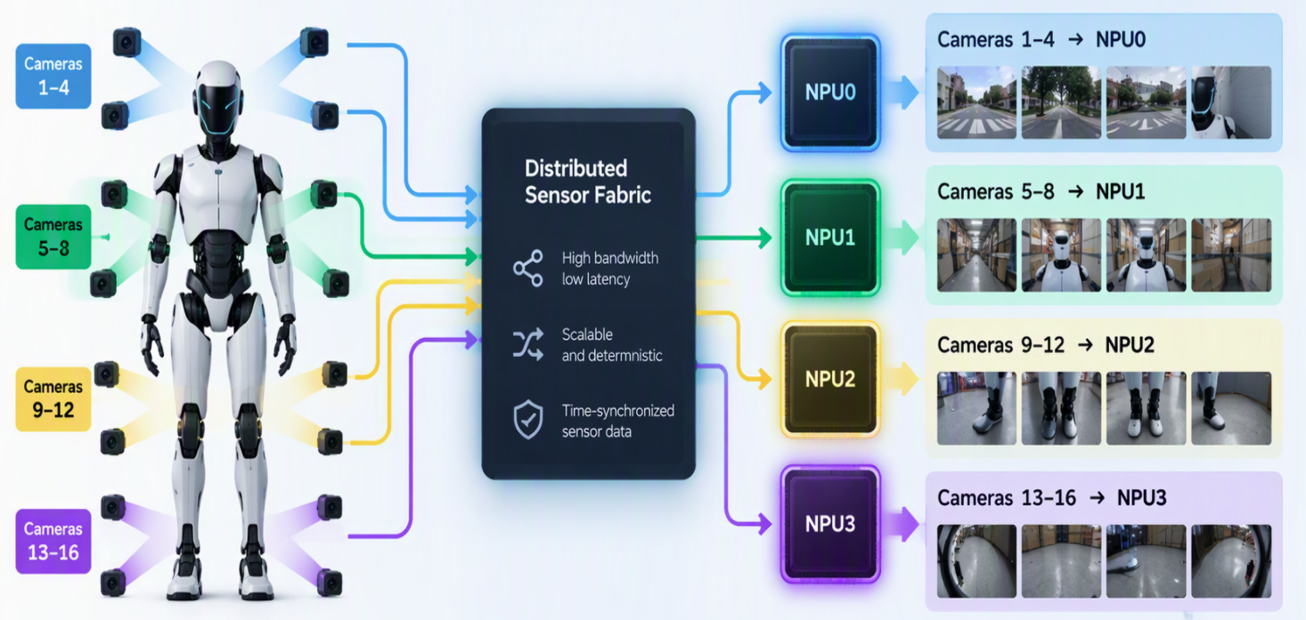
Multi-NPU Solves Camera Scaling
Challenge #6 → 16 Camera Robotics
Future Humanoid
16 Cameras
Force Sensors
Audio
Tactile Sensors
Distributed Sensor Fabric
Benefits:
✅ Linear camera scaling
✅ Reduced memory traffic
✅ Lower latency

Slide 14
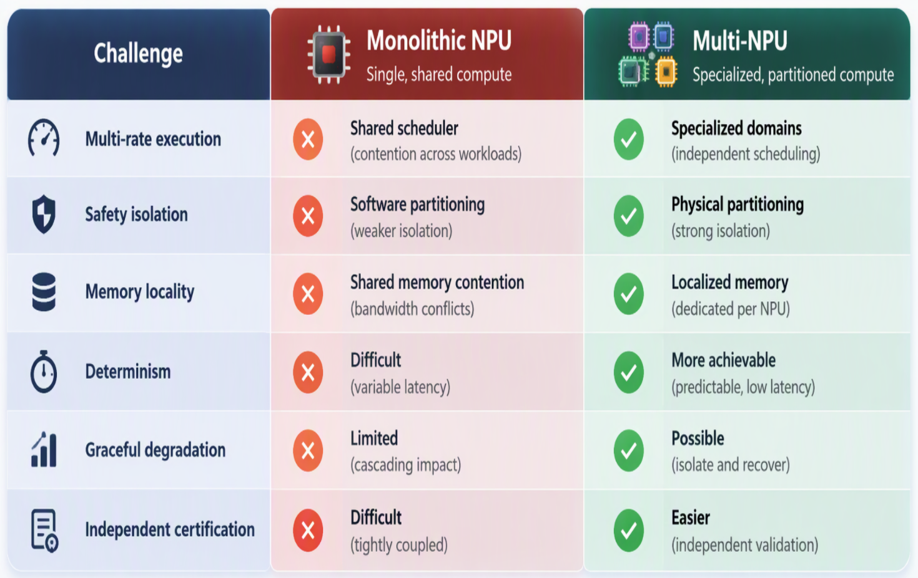
Monolithic NPU Vs Multi-NPU

Slide 15
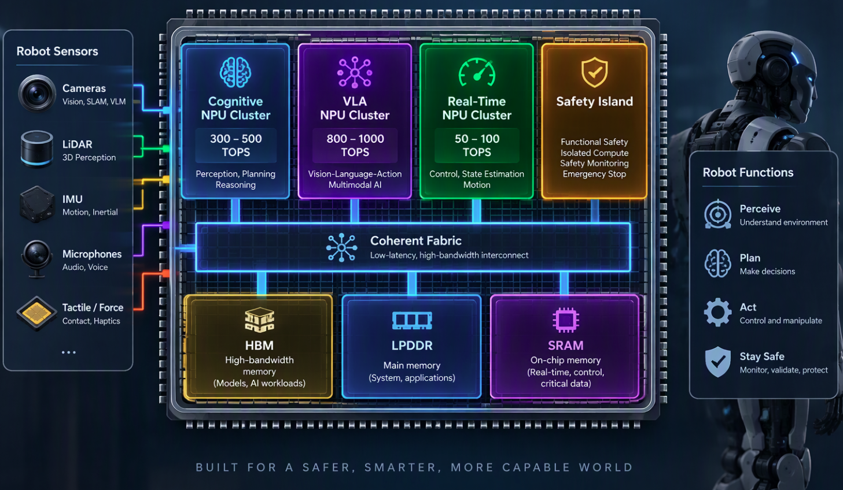
Hardware Architecture
Robotics Multi-NPU SoC
Key HW Features
4-16 NPUs
Unified Address Space
QoS Aware Fabric
TSN Support
16 Camera Support
Functional Safety

Slide 16
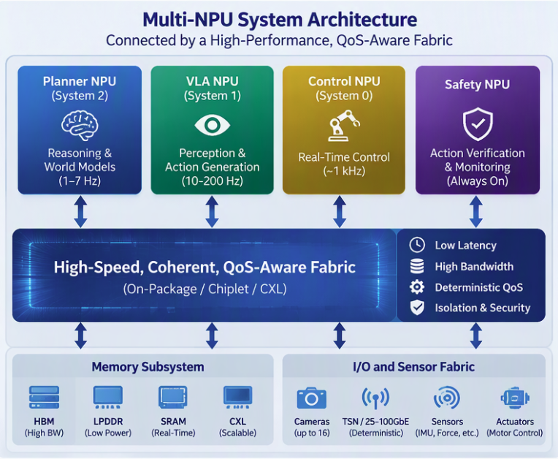
The Fabric Is the Computer
Inter-NPU Communication Will Define Multi-NPU Scalability
Today’s Focus
More NPUs
More TOPs
More Models
Tomorrow’s Bottleneck :
Moving Data
Synchronizing State
Sharing Context
Meeting Deadlines

Slide 17
Multi-NPU Creates New Challenges
Benefits
  ✅ Specialization
  ✅ Isolation
  ✅ Modularity
  ✅ Scalability
New Challenges
  ⚠ Fabric bandwidth
  ⚠ Synchronization
  ⚠ Data locality
  ⚠ Memory coherence
  ⚠ Distributed scheduling
  ⚠ Runtime complexity
  ⚠ Software fragmentation
Multi-NPU is not a free scaling mechanism. It shifts the challenge from computation to communication, orchestration, and memory management.

Slide 18
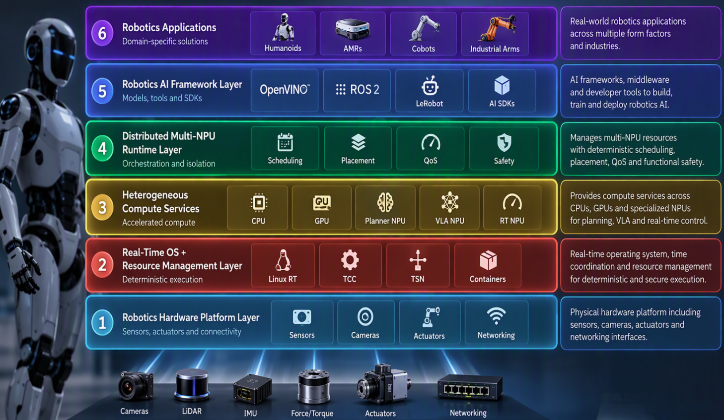
Software Architecture
Robotics Distributed Runtime
Key SW Features
Model Placement
NPU Scheduling
Resource Management
Safety Enforcement
Software Stack : OpenVINO + ROS 2 + Real-Time Linux + oneAPI

Slide 19
Software Architecture : Layer 1
OpenVINO : The AI deployment framework for Robotics
Functions
Model Optimization
  Converts (PyTorch, TensorFlow, JAX, ONNX) into optimized execution graph
Model Quantization
  Supports FP32, FP16, INT8, INT4, FP4
Hardware Abstraction
  Developer writes : deploy (model)
  OpenVINO decides :
    CPU
    GPU
    Planner NPU
    VLA NPU
    RT NPU

Slide 20
Software Architecture : Layer 2
ROS 2 : The application framework of robotics
Responsibilities
Device Management
  Sensors (Cameras, Lidar, IMU, Force sensors)
Robotics Services
  Mapping
  Localization
  Motion Planning
  State estimation
Communication
  DDS Middleware
  Publisher/Subscriber Architecture

Slide 21
Software Architecture : Layer 3
Real-Time Linux : Guarantees deterministic behavior
Role : Provides the 1 kHz+ Control Loop Support
Deterministic Scheduling
  Guarantee execution windows
Resource Isolation
  Provides Control NPU from Planner NPU activities
Low Latency Interrupts
  Critical for :
    Motor control
    Sensors
    Functional Safety

Slide 22
Software Architecture : Layer 4
Robotics-Specific oneAPI Extensions
Functions
Cognitive Domain APIs
  Reasoning Task
  Policy Task
  Control Task
  Safety Task
Multi-NPU Placement
  Queues for Planner, Action and Real-Time tasks
Unified Memory
  Developer sees single pointer
  Runtime handles behind the scenes
    HBM
    LPDDR
    SRAM

