Slide 1
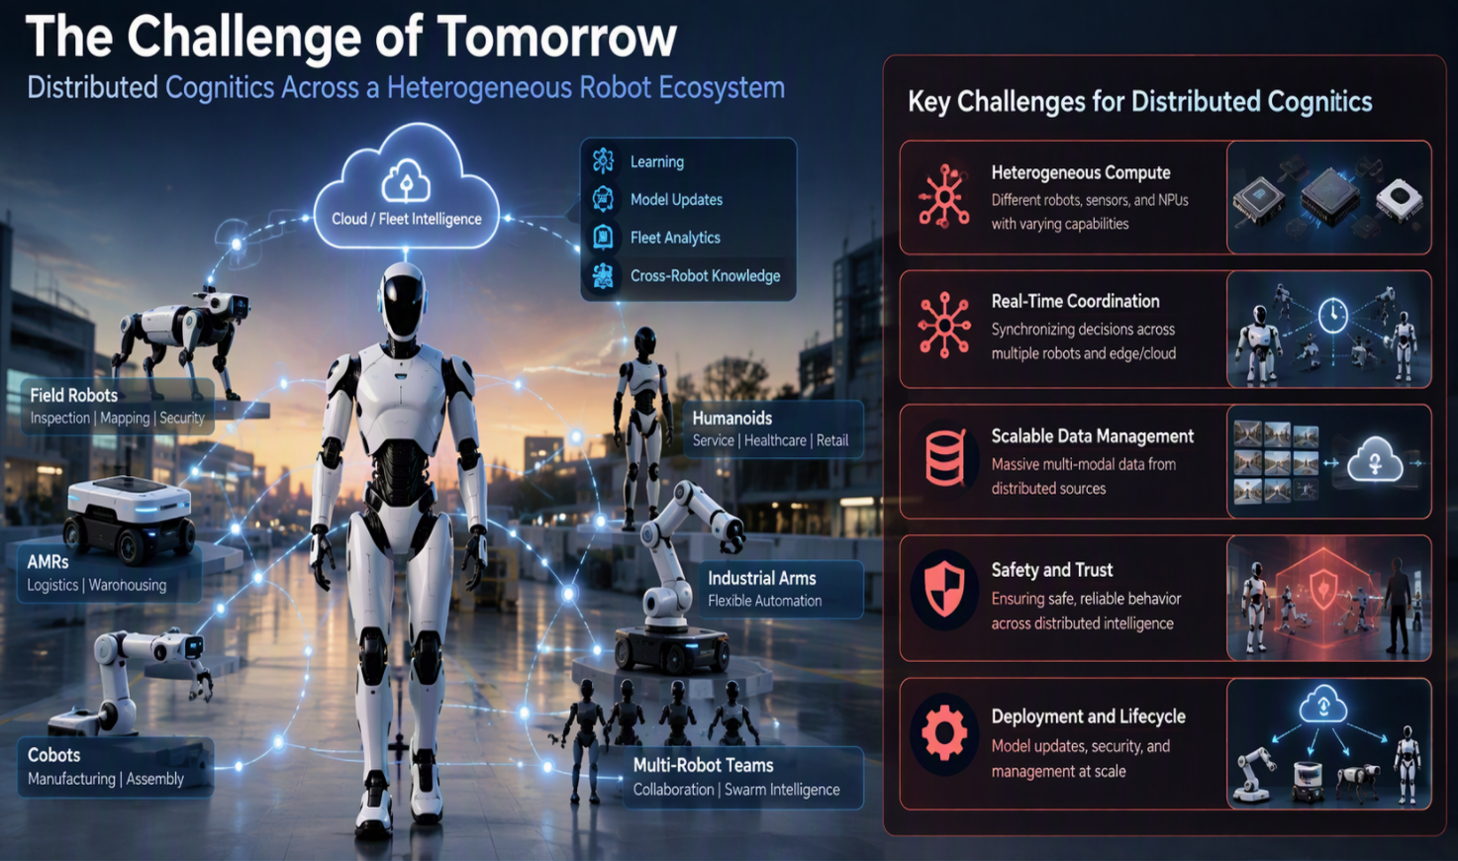
The Next Decade of Robotics Research
Multi-NPU Is Necessary, But Not Sufficient
Today’s Vision : CPU + GPU + Multi-NPU
Tomorrow’s Challenge
  Future robots will need :
  Lifelong learning
  Multi-robot collaboration
  World Models
  Human collaboration
  Autonomous adaptation
Next Challenge is not compute, it is Intelligence Orchestration

Slide 2
Future Robotics Architecture
Distributed Cognitive Systems
Today:
One Robot
One Brain
Future:
Many Robots
Many Brains
Shared Intelligence
Robots learn collectively, which brings in new challenges and opportunities

Slide 3
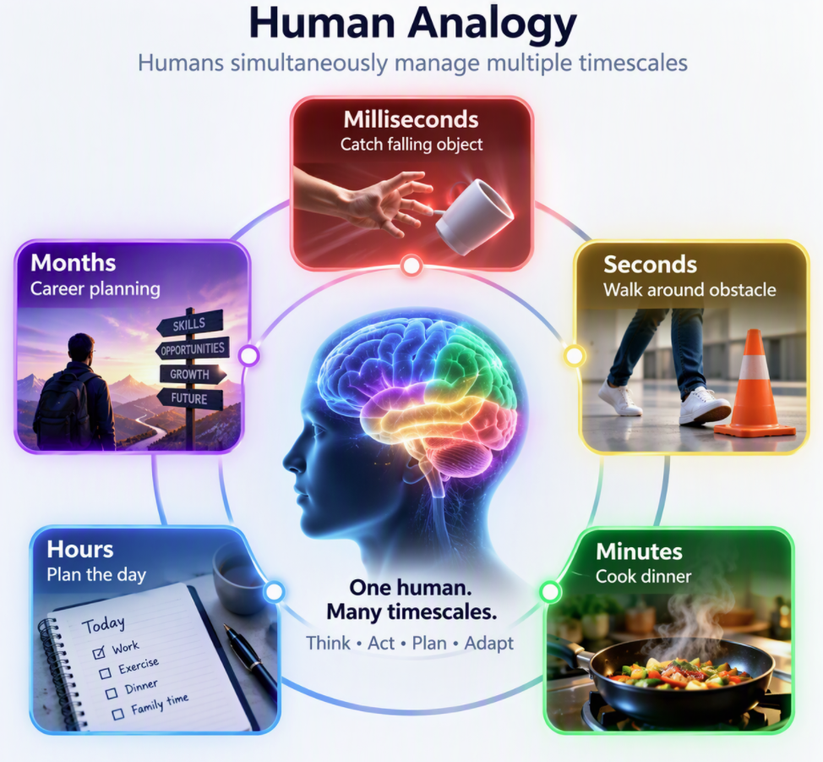
Future Challenge #1
Reasoning across Multiple Time Horizons
Current AI: Seconds
Future Robotics:
Physical AI must think at multiple speeds simultaneously ☺
Microseconds (Motor Stabilization)
Milliseconds (Balance Control)
Seconds (Object Manipulation)
Minutes (Task Planning)
Hours (Mission Planning)
Days (Learning & Adaptation)
Research Gap: Hierarchical Cognition (No architecture today that efficiently spans this hierarchy)
1 kHz Control
1 Hz Reasoning
24-hour Planning

Slide 4
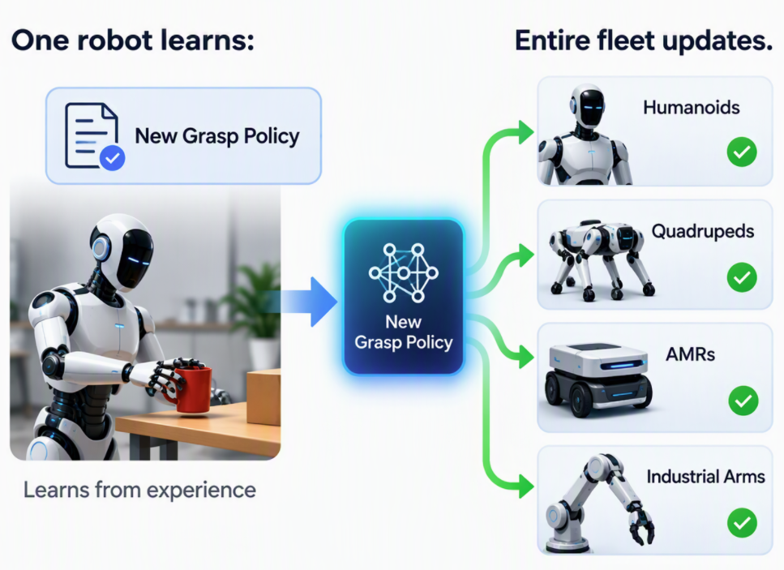
Future Challenge #2
Distributed Cognitive Fabrics
Current Multi-NPU: One SoC
Future Robots: Shared Cognition
Robot
↔ Robot
↔ Edge
↔ Cloud
Research Gap: How do autonomous robots :
Share experience?
Share models?
Share uncertainty?
Coordinate actions?

Slide 5
Future Challenge #3
Memory Is Becoming More Important Than Compute
Current AI: TOPs
Future Robotics: Memory becomes critical
Working Memory
Episodic Memory
Semantic Memory
Spatial Memory
Procedural Memory
Fleet Memory
Similar to humans for better recall, experience retention and long-term knowledge
Research Gap: Robotics Memory Hierarchy Does Not Exist Yet
How Should Robots Remember Experiences?
How much memory will future Robots Need?
Memory retrieval for Robotics
Shared Memory Across Robot Fleets

Slide 6
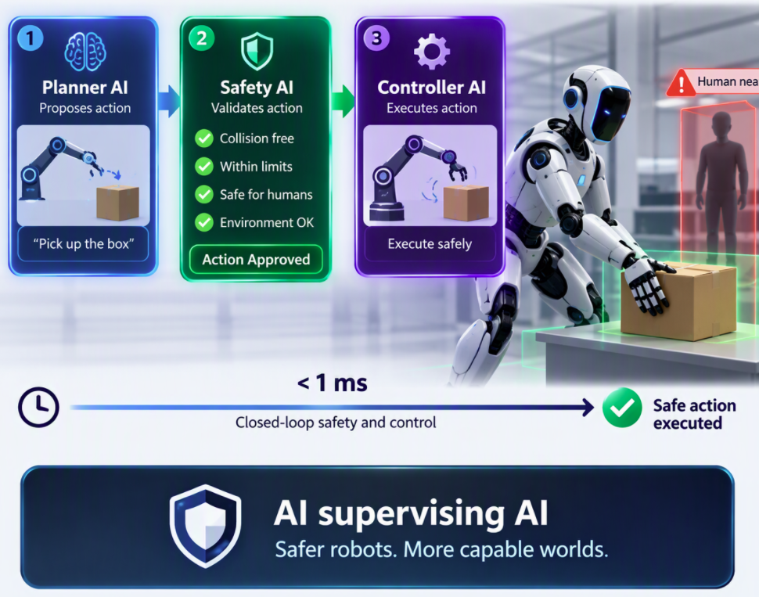
Future Challenge #4
Real-Time AI Safety
Current Robot Safety: Deterministic safety mechanism
Future Robotics: Independent Runtime Assurance
Safety
Reliability
Predictability
Verifiable Actions
Research Gap: How do we guarantee that an AI-generated action is safe before it is executed?
No Real-Time AI Verification Framework
AI Models Lack Formal Safety Guarantees
Human-Aware Safety
Safety for Learning Systems
Safety Certification of AI

Slide 7
Future Challenge #5
Autonomous Learning in the Real World
Current Training: Data center
Future Robotics: Continuous Learning while deployed
Research Gap: How can robots learn without:
Forgetting
Destabilizing
Violating safety rules

Slide 8
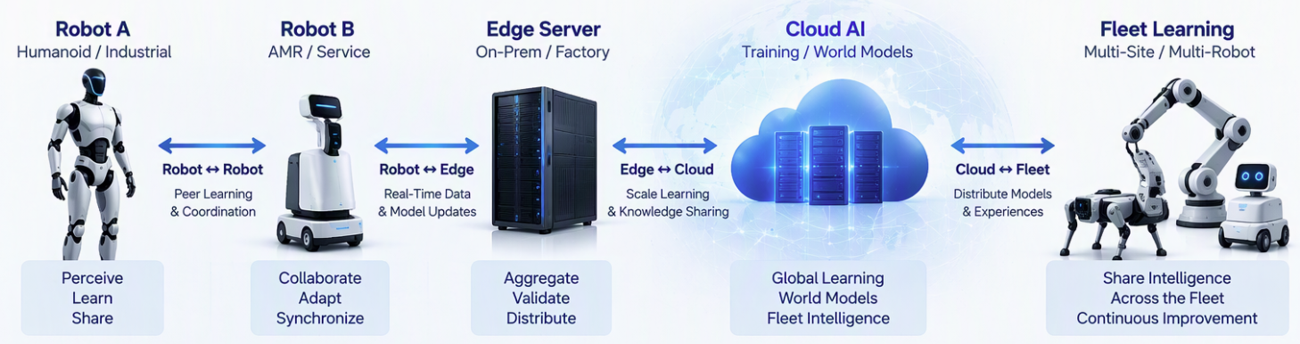
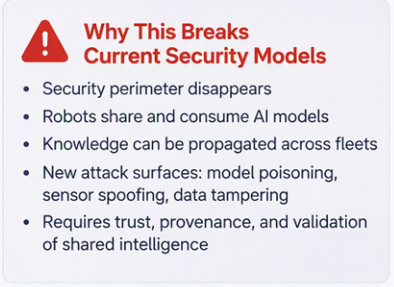
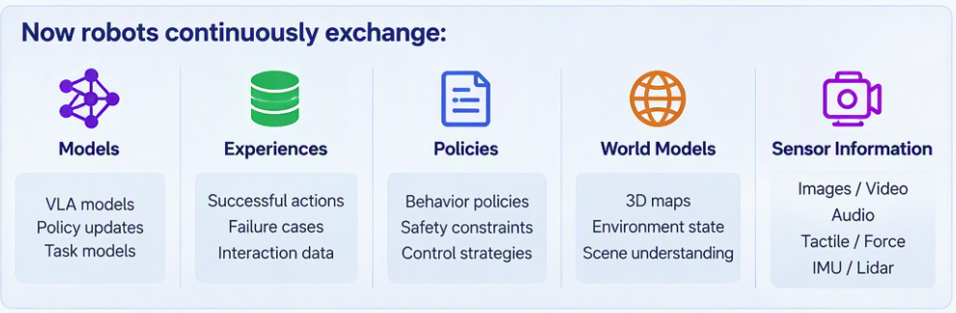
Future Challenge #6
Secure Distributed Cognition
Current AI: Network protection and access control
Device Security (Prevent unauthorized software)
Network Security (Protect communication)
System Security (Prevent unauthorized control)
Assumption : Robot operates largely as an isolated system.
Future Robotics: Cognitive Security
Safety prevents unintended harm
Security prevents an attacker from making the robot unsafe
Research Gap:
Can robots trust model updates?
Can robots trust shared memory?
Can robots trust sensor inputs?
Can fleet learning be poisoned?

Slide 9
Hardware Research Agenda
Priorities
Multi-NPU Systems
  Distributed NPU architecture
  Cognitive fabrics
  Chiplet-based robots
Memory Systems
  Memory pools
  Persistent memory
  In-memory computing
Networking
  TSN evolution
  Robot-to-robot communication
  Distributed fabrics
Safety
  Safety islands
  AI verification engines

Slide 10
Software Research Agenda
Priorities
Distributed Cognition
  Multi-agent reasoning
  Shared world models
Lifelong Learning
  Online adaptation
  Continual learning
Robotics Runtime
  NPU scheduling
  Resource orchestration
Safety
  AI validation frameworks
  Verified action generation
Human-Robot Collaboration
  Intent understanding
  Collaborative planning

Slide 11
University + Industry Call To Action
What should academia lead?
Foundation Research
Distributed cognition
Lifelong learning
AI safety
Neuromorphic systems
Multi-agent coordination
What should industry lead?
Productization
Robotics SoCs
Multi-NPU platforms
Runtime software
Safety certification
Open ecosystems
Shared Opportunity : Create the equivalent of x86 for Robotics. A common platform for Physical AI

Slide 12
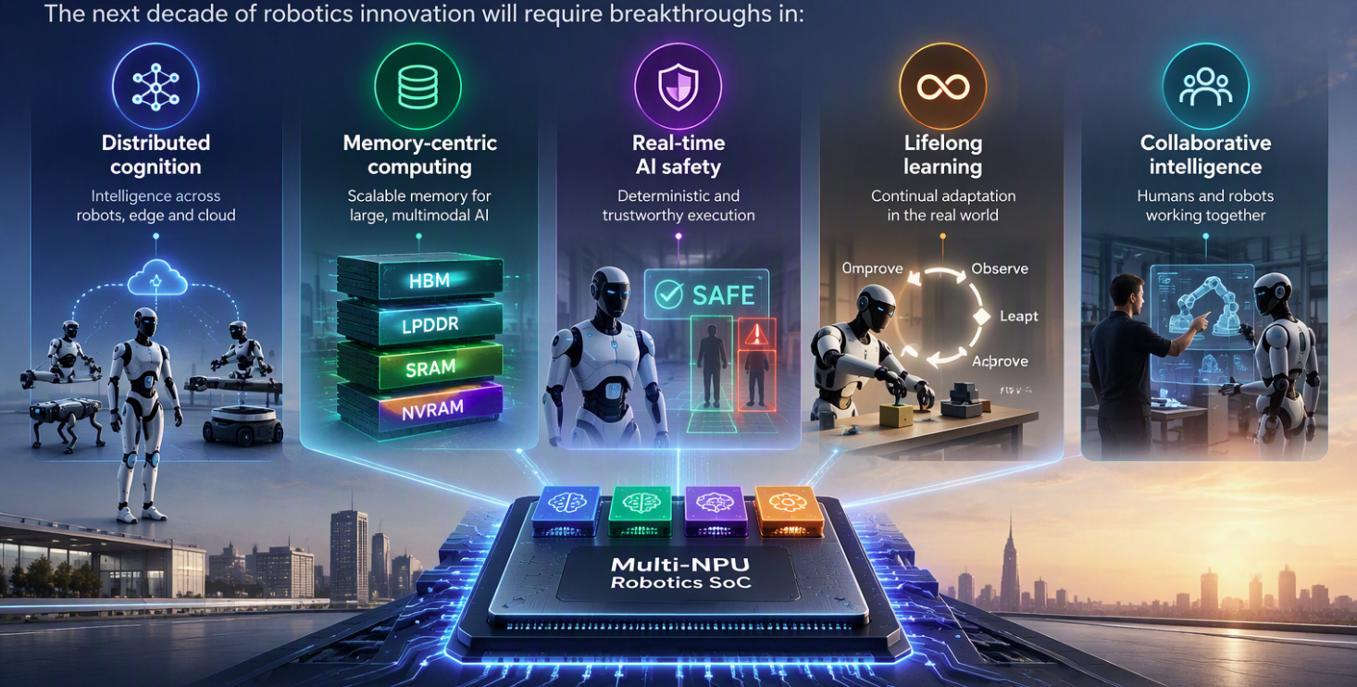
Final Vision
From Multi-NPU to Distributed Cognitive Systems
Robotics Era
CPU
+ GPU
+ Multi-NPU
+ Safety Island
Physical AI Era
Robot
↔ Robot
↔ Edge
↔ Cloud
Multi-NPU is the beginning, not the destination
Companies and Universities that solve these challenges will define the computing architecture of the Physical AI era

Slide 13
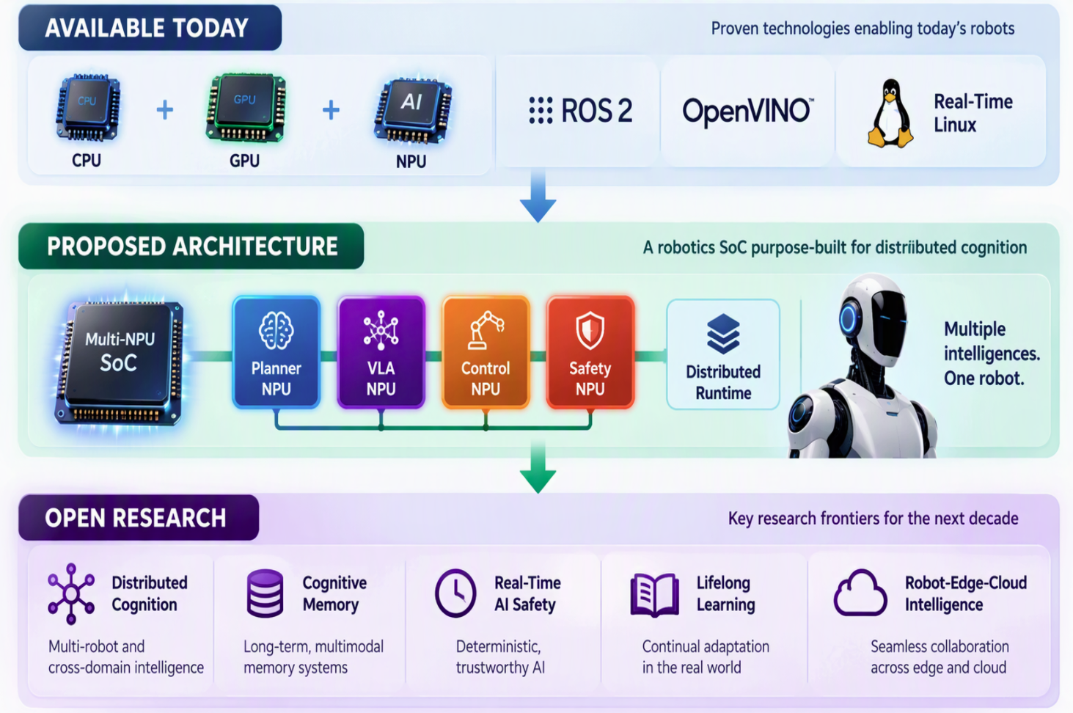
Conclusion : Evolution Toward Physical AI

