Slide 1
Name: Arnab Maiti
Roll-No: 24IM10017
IIT Kharagpur
IIT Kharagpur Open Source Society
Exploring Public-Private Key Encryption and Bitcoin Wallets
Topics Overview
1)Symmetric-key and Asymmetric-key Cryptography
2)Public Keys and Private Keys Generation
3)Digital Signatures
4)Public and Private Key Encryption and Bitcoin Transaction
5)Types of BTC Wallets
6)Practices for Securing BTC Wallets

Slide 2
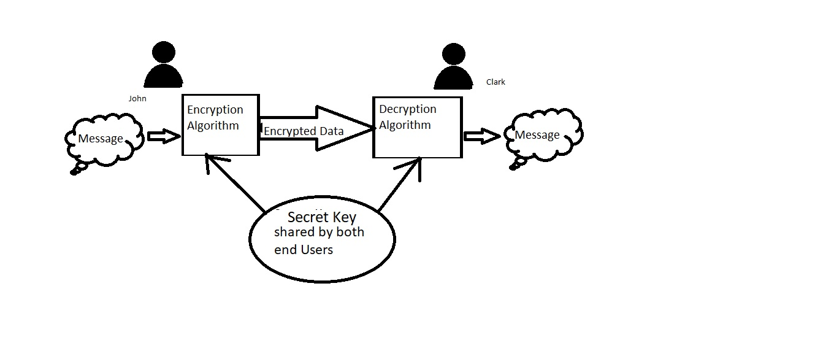
Symmetric and Asymmetric Cryptography
Symmetric-key Cryptography: Basically a type of One Lock One Key type function , where encryption and decryption shares the same Secret key for decoding where the copy of the key is possible , thus the attacker has the full freedom of performing brute force attacks
Example:Caesar Cipher

Slide 3
Asymmetric-key Cryptography
This type of cryptography uses a pair of keys Public Key and Private Key, where the Public key is used for Encryption of any message to cipher text while the Private key is used for Decryption of any received Cipher text to plain Text Message
The benefits of asymmetric key cryptography is it’s secured as this type of Cryptography works as a Trapdoor One-way function. This means for every Private-key there is a specific public-key generation, but the reverse although mathematically possible it is not computationally possible , means you cannot trace back a private key from a given public key.
For a cryptographic function f:X Y ,Y=f_{p}(X) for unique X we get a unique Y
X=f_{p}⁻¹(Y) for this even though the Y is known , X is not computationally possible,
In this case X=Private Key, Y=Public Key
Algorithms example: RSA(Rivest-Shamir-Adleman),ECC(Elliptic-Curve-Cryptography)

Slide 4
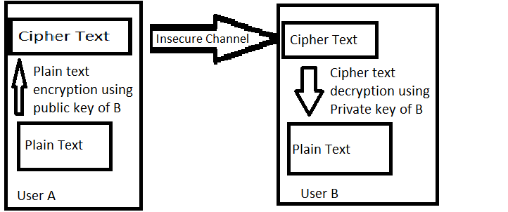
Public Keys and Private Keys
Private key is the unique key of every individual participant , the Private key under cryptographic algorithm generates a corresponding Public key , which is available to every user on that network. For an user A to send a Message to B , A must have the Public Key of B to encrypt the message and send it to B. For B to decipher the message he has to use his own Private Key to decrypt the message.

Slide 5
Digital Signatures
Digital signatures are somewhat similar to that of a handwritten signature only difference is that handwritten signature are tied to a person while digital signature is tied to the User’s private key. Digital signatures are a way of assuring that the Cipher or message received is not corrupted during transfer. The receiver verifies the message using the Public Key of the sender and the sender’s Digital signature .
Let us take a scenario where user A is sending a message to User B
ENCRYPTED MESSAGE IN SHA-256 ALGORITHM
Message to User B
Message to User B
+
User A’s Digital Signature
User A’s Private Key

Slide 6
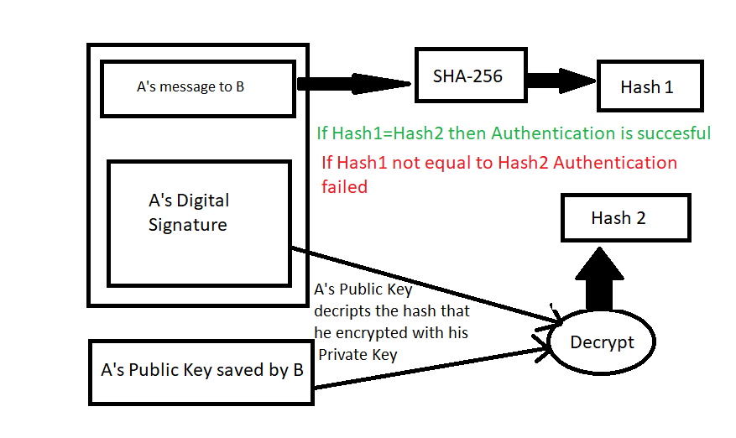
User B authentication of Digital Signature

Slide 7
Public-Private-Key encryption to secure and manage Bitcoin transactions
Public key of a wallet is like the user’s Bank Account number while the Private Key is the password for managing the Transactions of the account.
For user A to make some transaction to user B , A needs the Wallet Address of B which is the Public Key here and to authorize the transaction A uses his Private Key to make it happen.

Slide 8
Types of Bitcoin Wallets
Bitcoin wallets are way of storing the bitcoin assets not directly but in blockchains making it secure. Only using the private key one can access it.
Bitcoin Wallets can be classified in two types Hot Wallets and Cold Wallets
Hot Wallets: Desktop Wallets, Web Wallets , Mobile Wallets
Cold Wallets: Paper Wallets, Hardware Wallets
Advantage of Hot Wallet: Non-existent in physical form , safely stored on an exchange
Disadvantage of Hot Wallet: Vulnerable to theft , like ByBit Exchange Hack causing sweeping away of 1.46 billion USD cryptoassets
Advantage of Cold Wallet: Limited vulnerabilities from getting hacked
Disadvantage of Cold Wallet: May accidently get lost or problem in hardware

Slide 9
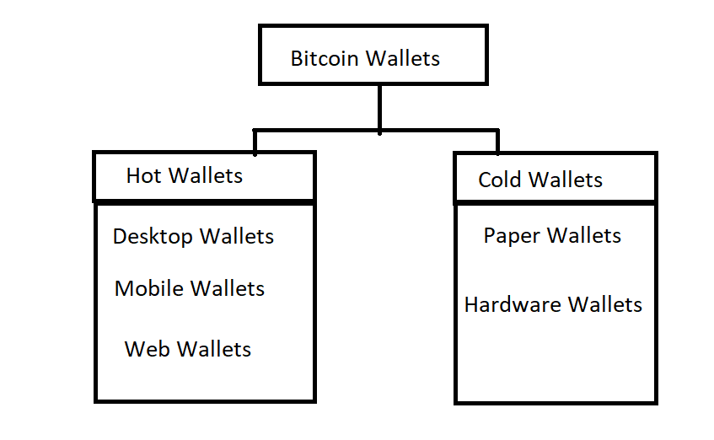

Slide 10
Practices for Securing BTC Wallets
There are various ways to secure your bitcoin wallets , but mainly we are going to talk about two ways
Backing up of Private Key
Multi factor Authentication

