Slide 1


INTERNSHALA STUDENT PARTNER & CAMPUS AMBASSADOR OF TECHNO ENGINEERING COLLEGE BANIPUR
Mr. ARNAB CHAKRABORTY. [ECE,3RD YEAR]

Slide 2


INTERNSHALA
INTERNSHIPS
TRAININGS

Slide 3

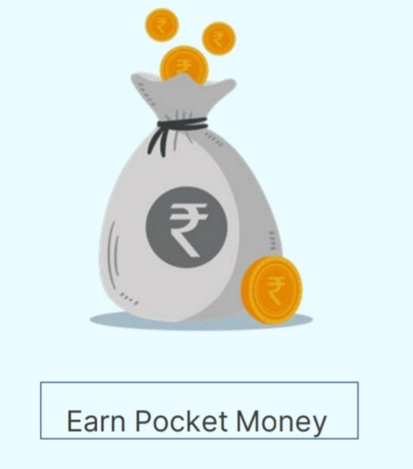


Work 2-3 hours a day
Value addition to your resume

Slide 4

Students can apply for the internships completely free of cost .

Slide 5
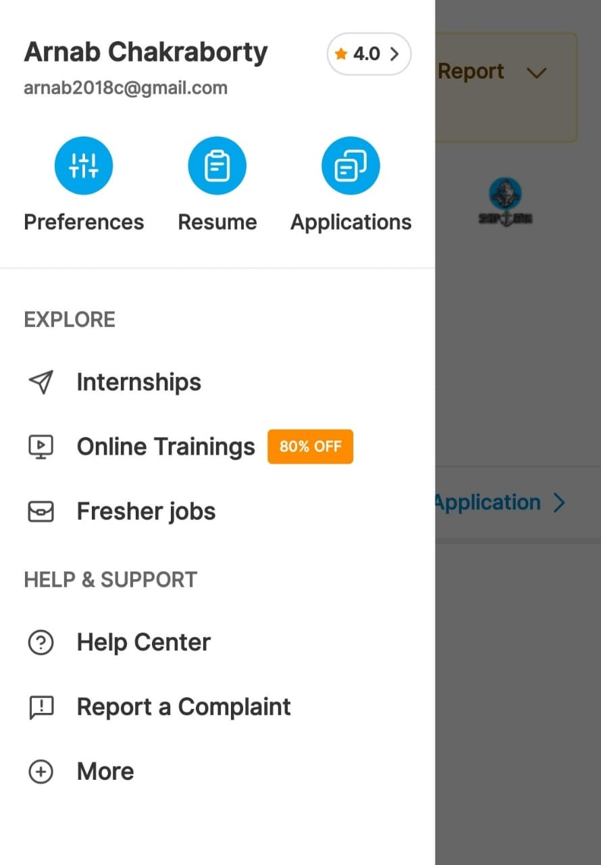
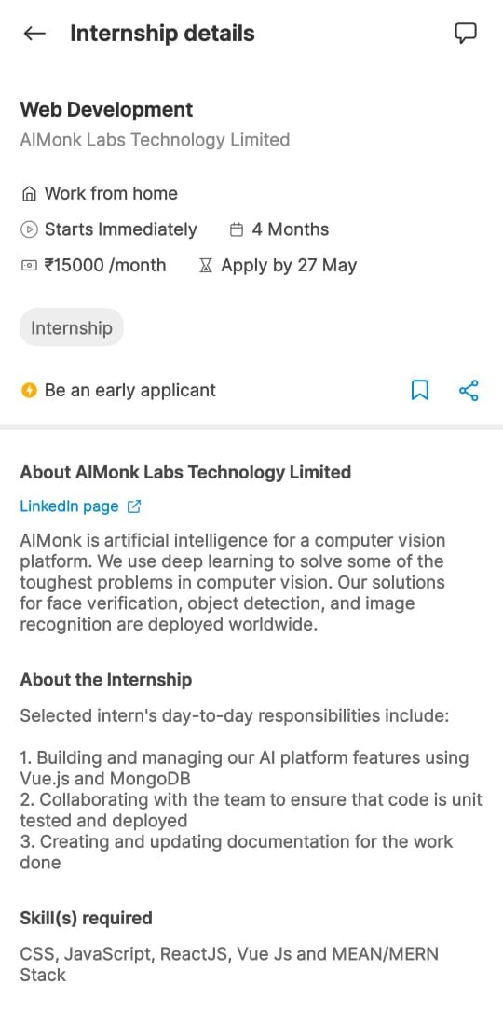

Slide 6
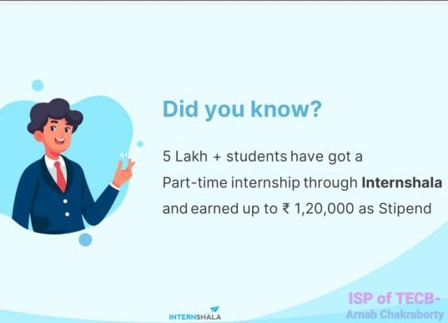

Slide 7
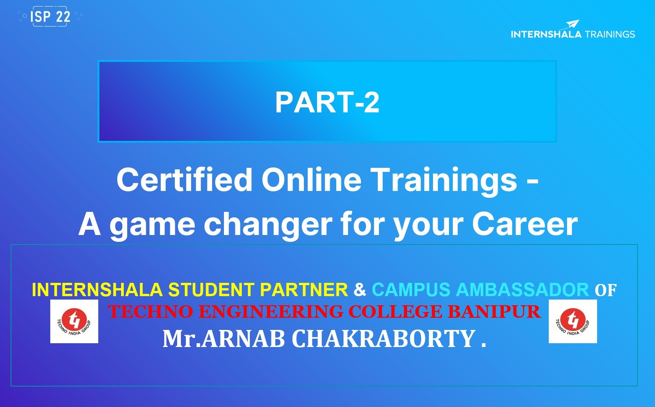

Slide 8



MAKAUT
MAKAUT
MAR ( Mandatory Additional Activities )
Total: 100 Points
( 25 + 25 + 25 + 25 )
MOOCS ( Massive Open Online Courses )
Total: 20 Points
( 8 + 4 + 4 + 4 )
Advanced Programming
Analytical Skills
Python
C++
Java
Machine-
Learning
Trainings
Graphic-
Design
Full-Stack
Web Development
Ethical Hacking

Slide 9
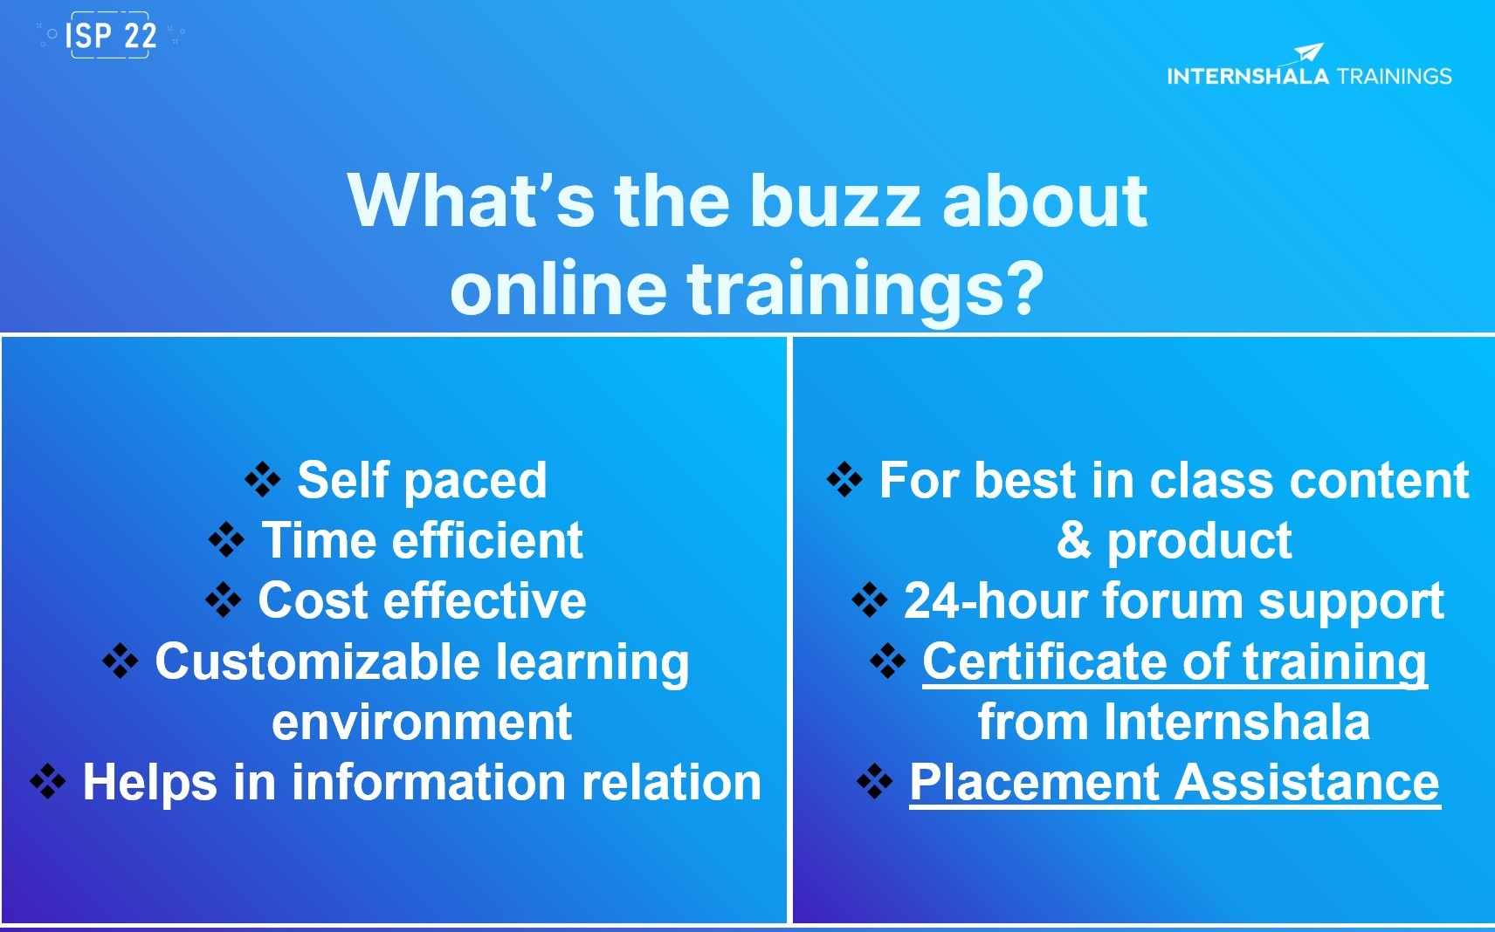
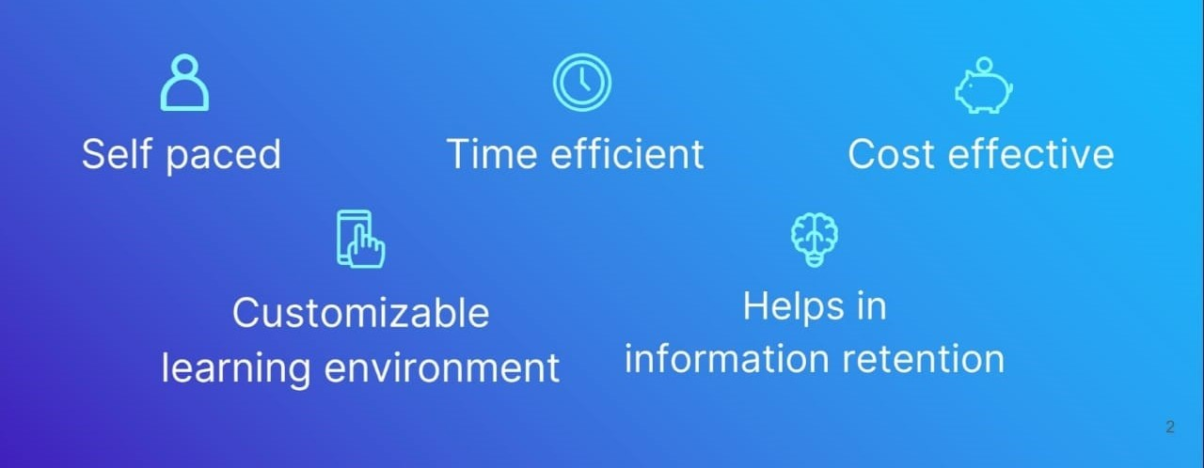
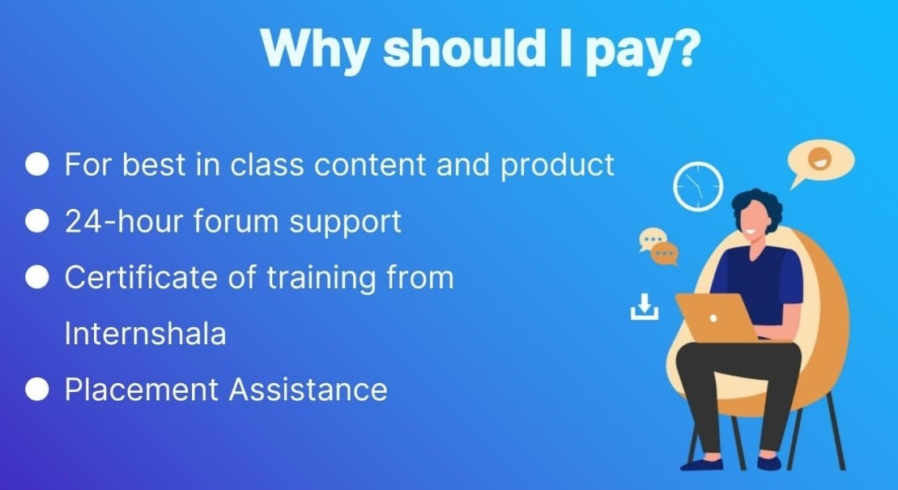

Slide 10
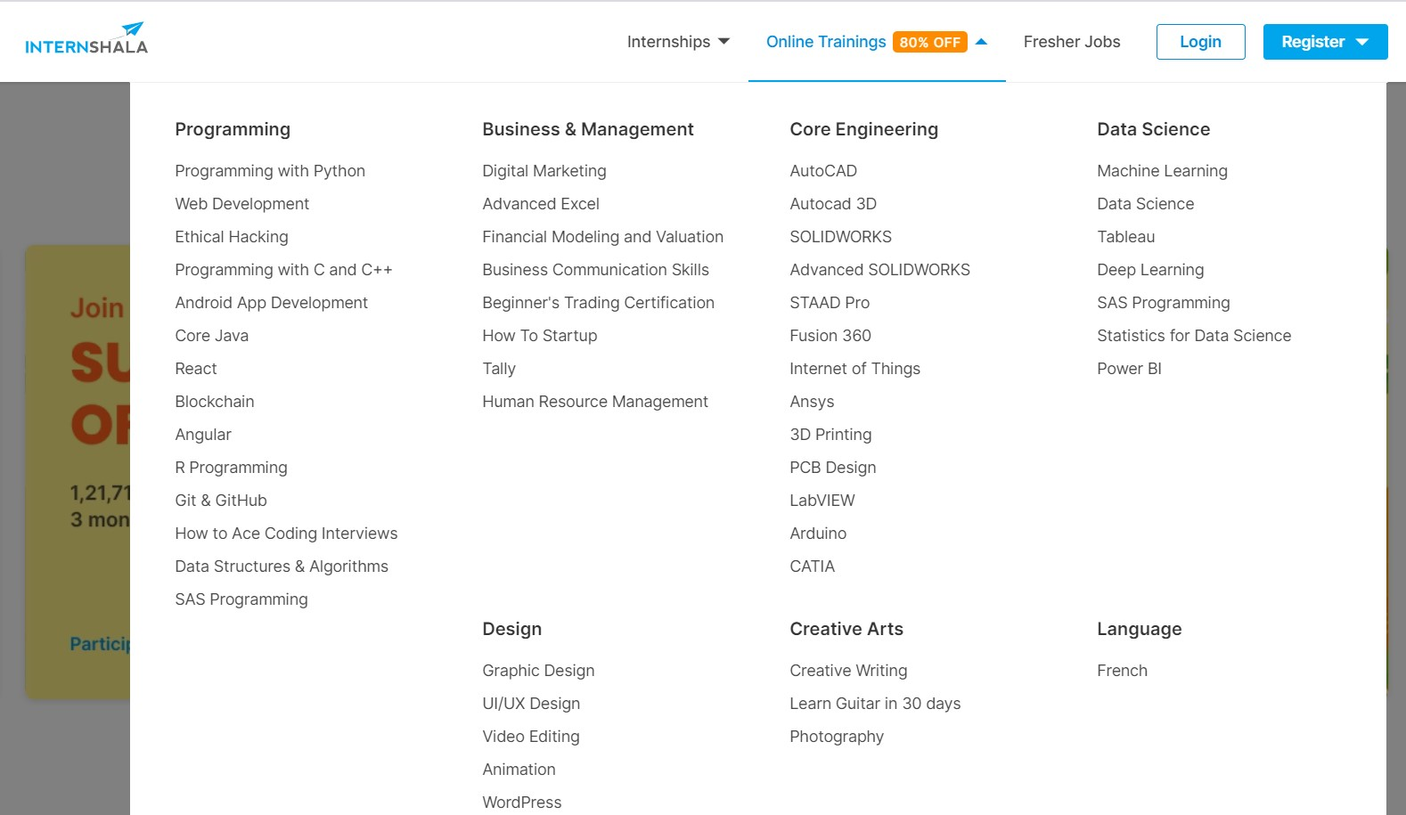

Slide 11


Slide 12
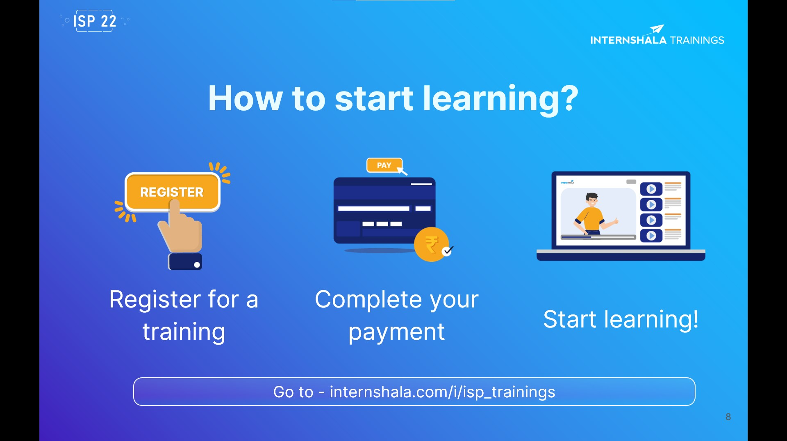
https://internshala.com/i/GSIFISP-ISP22ARNA7001
11

Slide 13



https://internshala.com/i/GSIFISP-ISP22ARNA7001
Questions ?
Notes:
You can ask me any questions that you might have related to Internshala Trainings.

Slide 14
THANK YOU
PRESENTATOR: ARNAB CHAKRABORTY .
[ INTERNSHALA STUDENT PARTNER & CAMPUS AMBASSADOR of TECHNO ENGINEERING COLLEGE BANIPUR ]
Contact: 7001215116 ( Whatsapp )
Email id: arnab2018c@gmail.com

