Slide 1
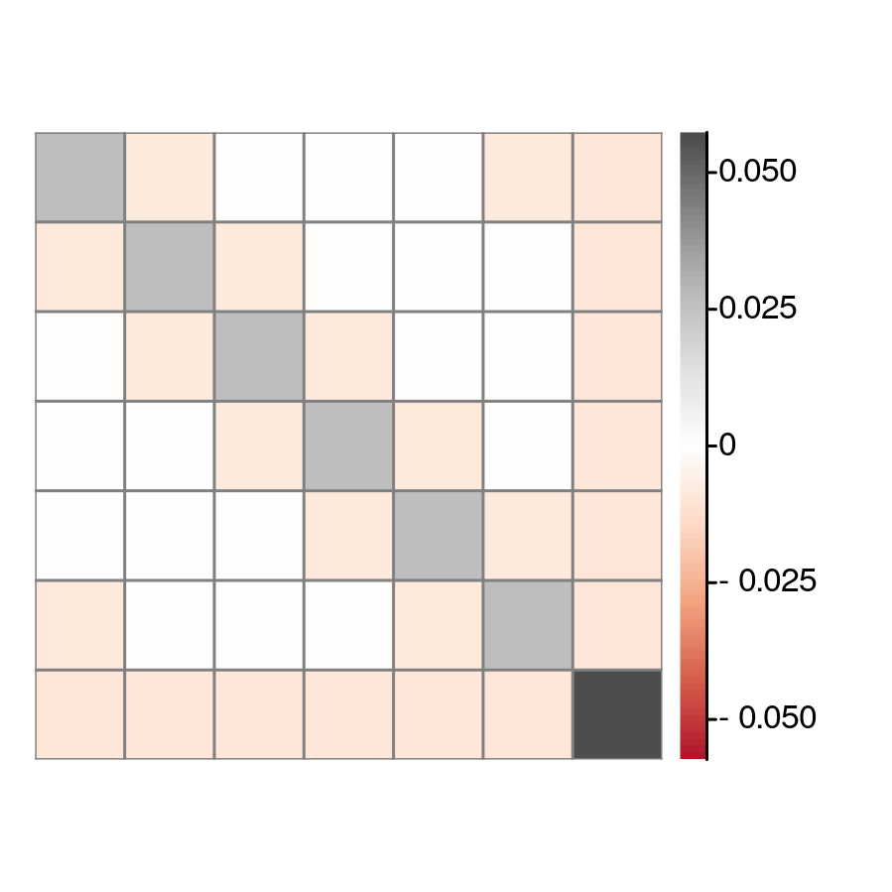

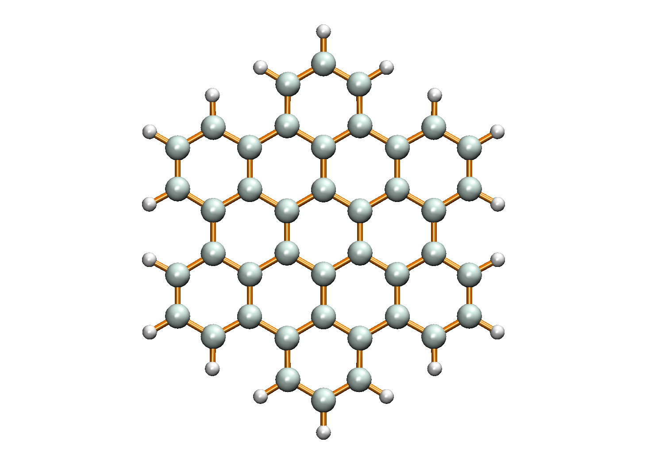


1
1
2
2
3
3
3
2
4
4
7
4
1
5
5
5
6
6
6
7
7
$\hat{N}$ operator correlation
(b) Hexabenzocoronene
(c) ${\hat{S}}^{z}$operator correlation

