Slide 1
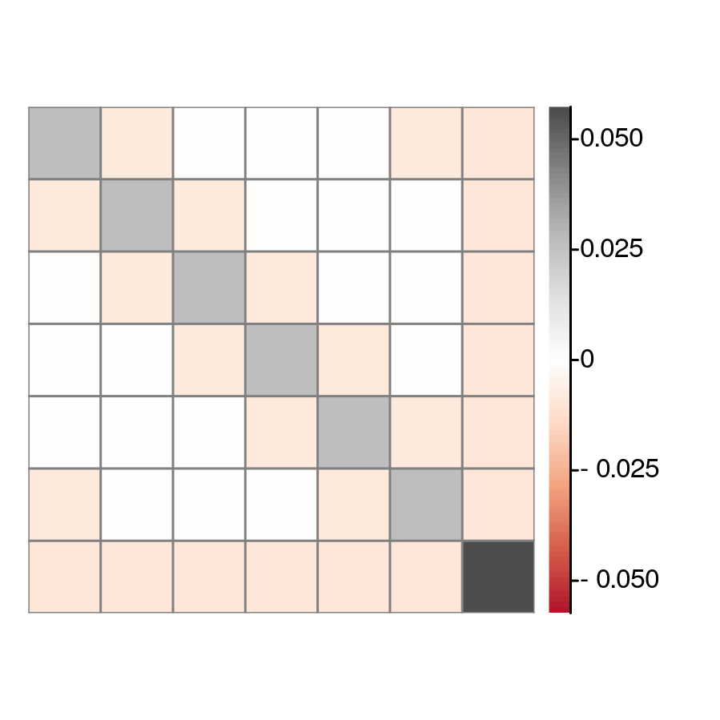

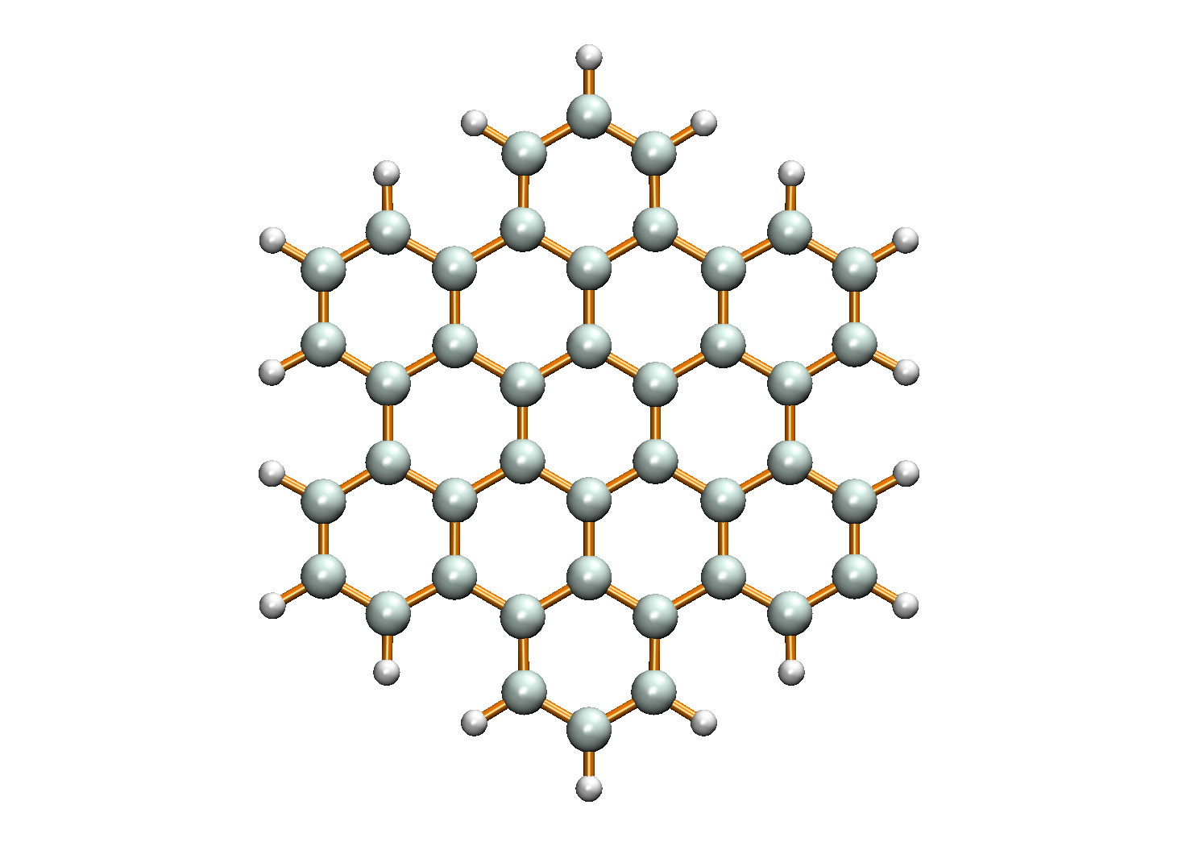
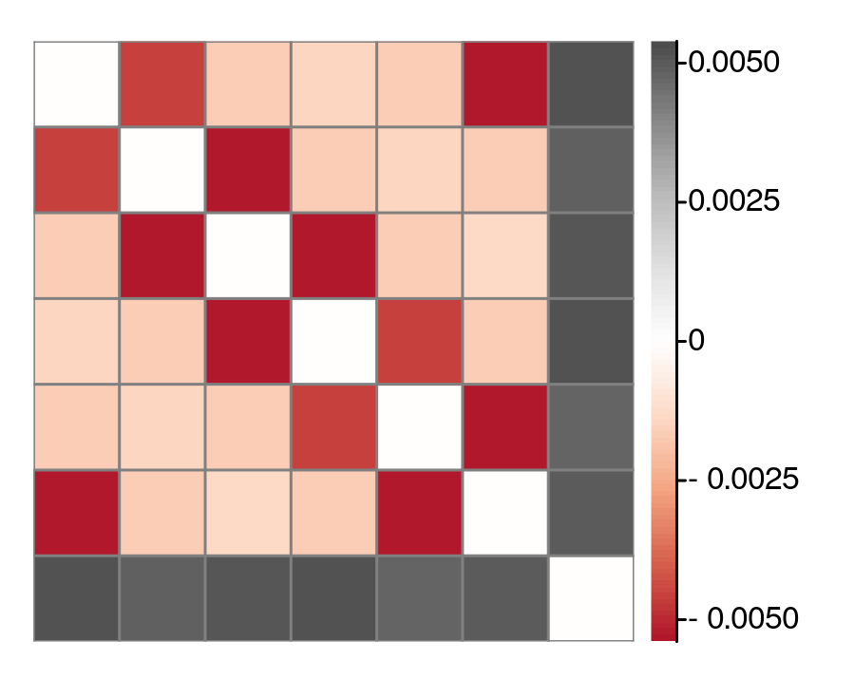
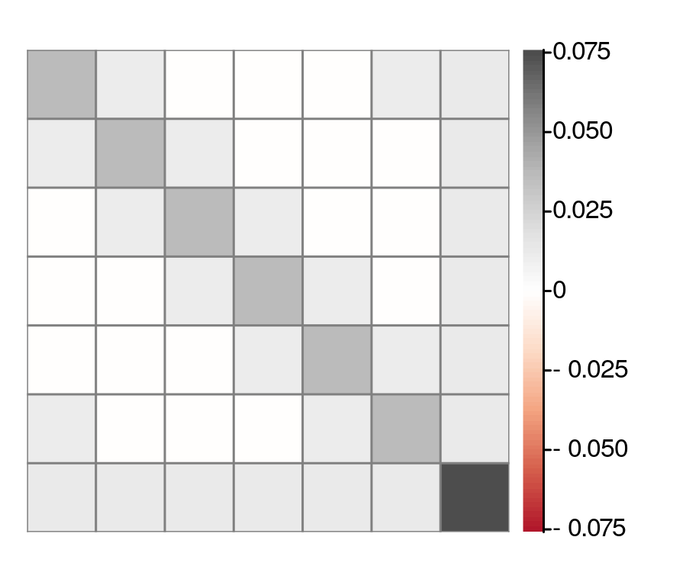


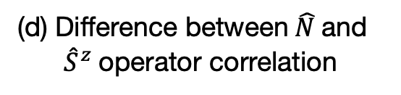
1
1
2
2
3
3
3
2
4
4
7
4
5
1
5
5
6
6
6
7
7
(a) $\hat{N}$ operator covariance
(b) Hexabenzocoronene
(c) ${\hat{S}}^{z}$operator covariance
1
1
2
2
3
3
4
4
5
5
6
6
7
7
(d) Difference between $\hat{N}$and
${\hat{S}}^{z}$operator correlation
(e) Correlation between cumulants of
excitations outside reference space

