Slide 1
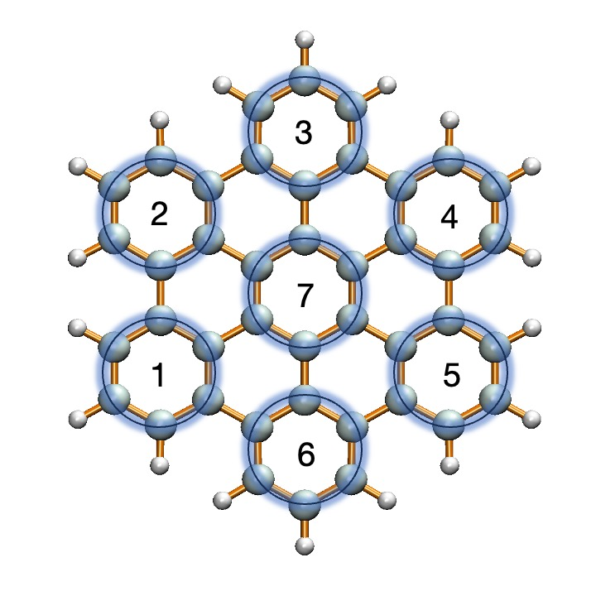
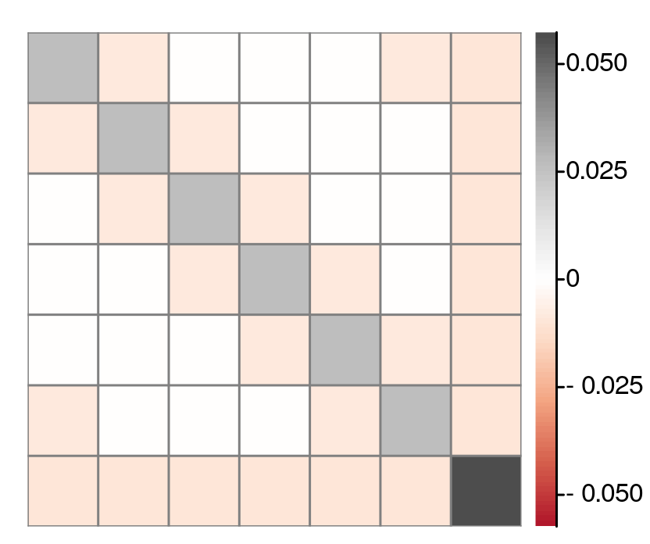
1
2
3
4
5
6
7
(a) Cluster Labels
(b) Energy Extrapolation
(c) Charge Covariances

