Slide 1
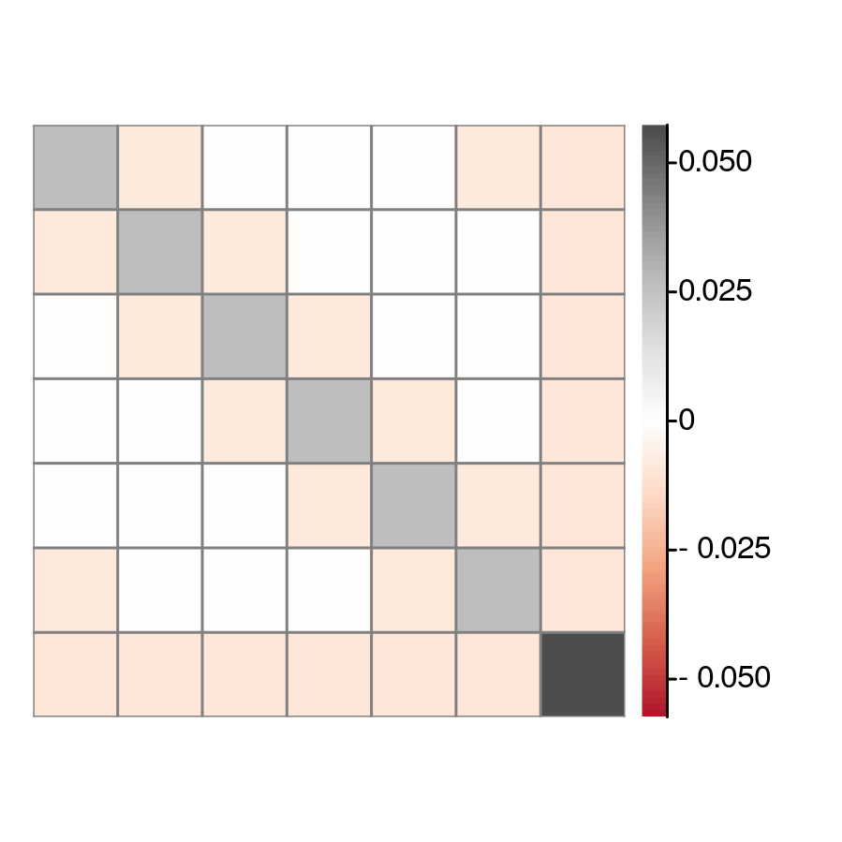
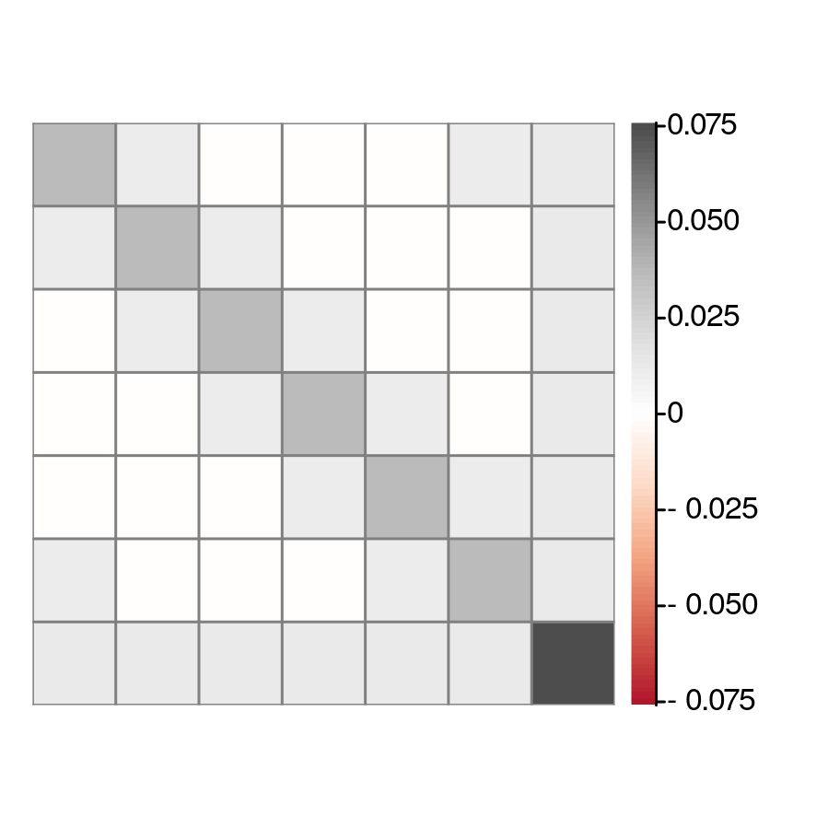
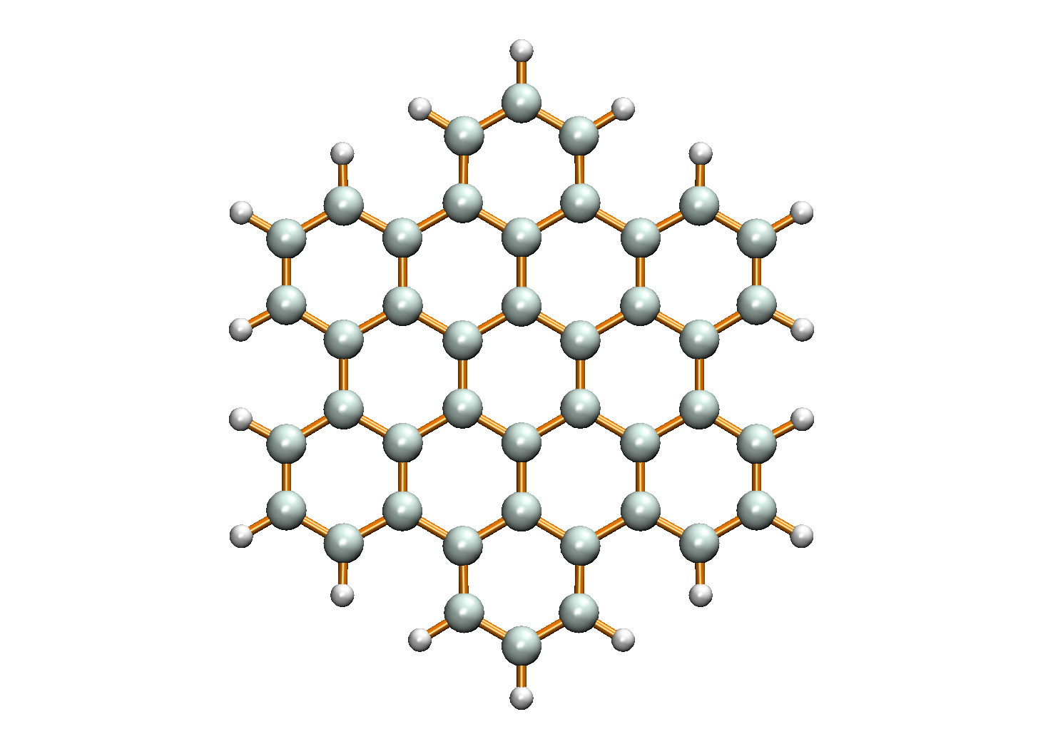


1
1
2
2
3
3
2
4
3
4
7
4
1
5
5
5
6
6
6
7
7
(a) $\hat{N}$ operator correlation
(b) Hexabenzocoronene
(c) $\hat{Q}$ covariance matrix

