Slide 1
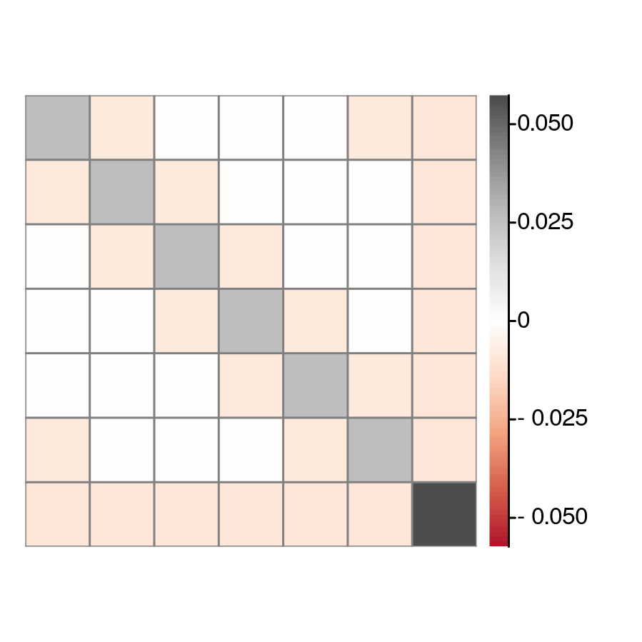

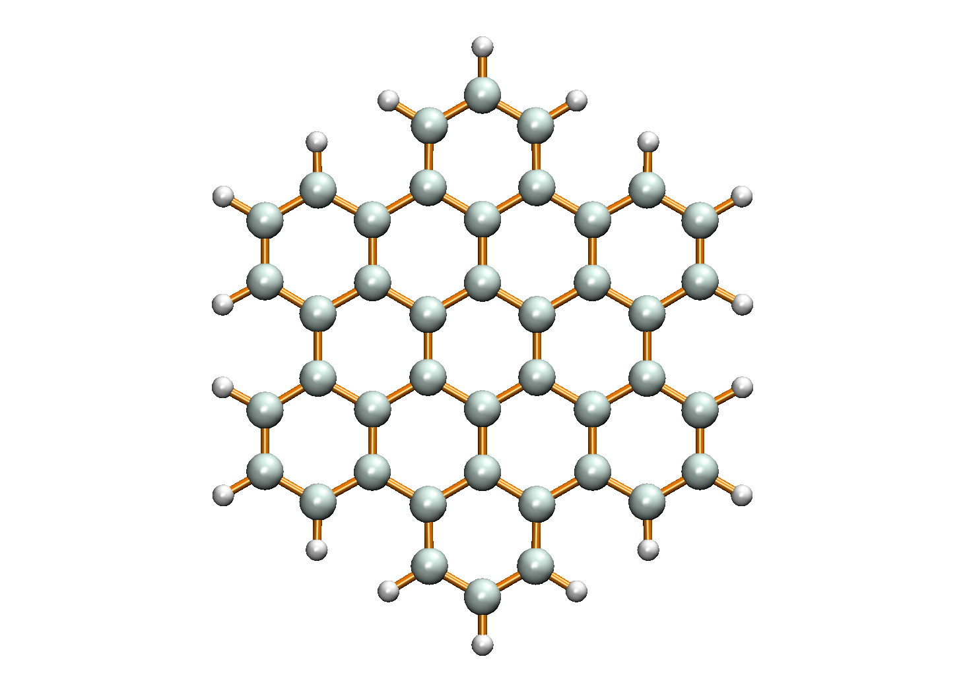


1
1
2
2
3
3
3
2
4
4
4
7
5
1
5
5
6
6
6
7
7
(a) $\hat{N}$ operator correlation
(b) Hexabenzocoronene
(c) ${\hat{S}}^{z}$operator correlation

Slide 2
3
2
4
7
1
5
6

