Slide 1
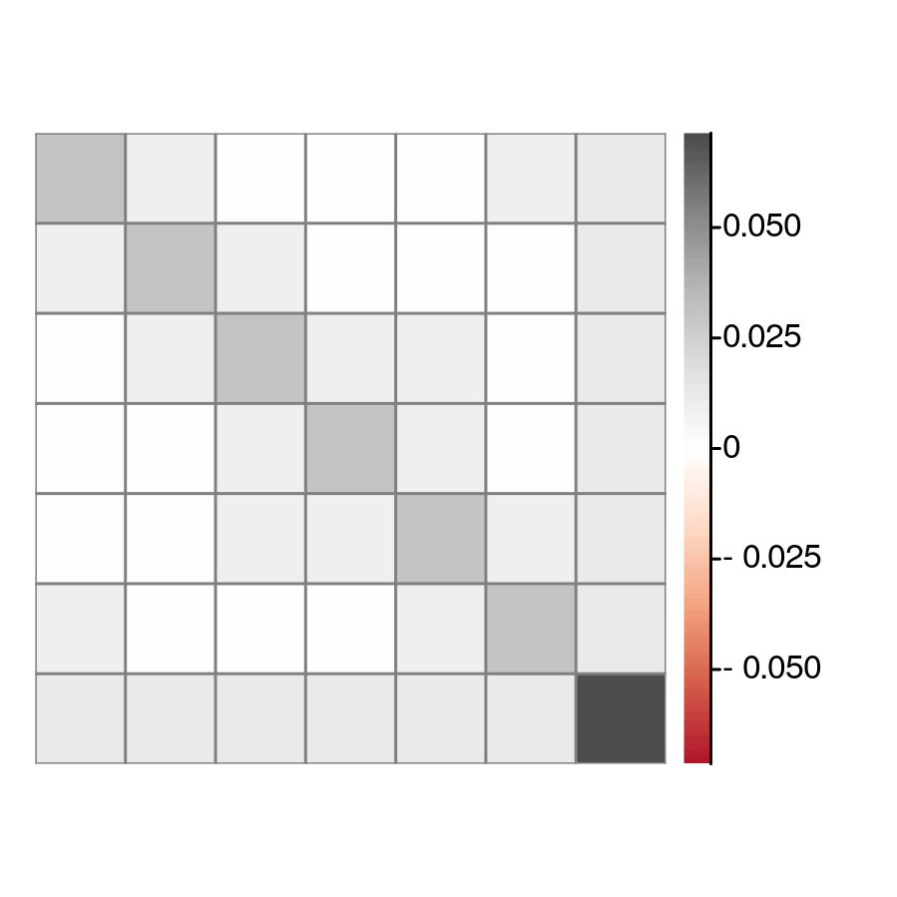
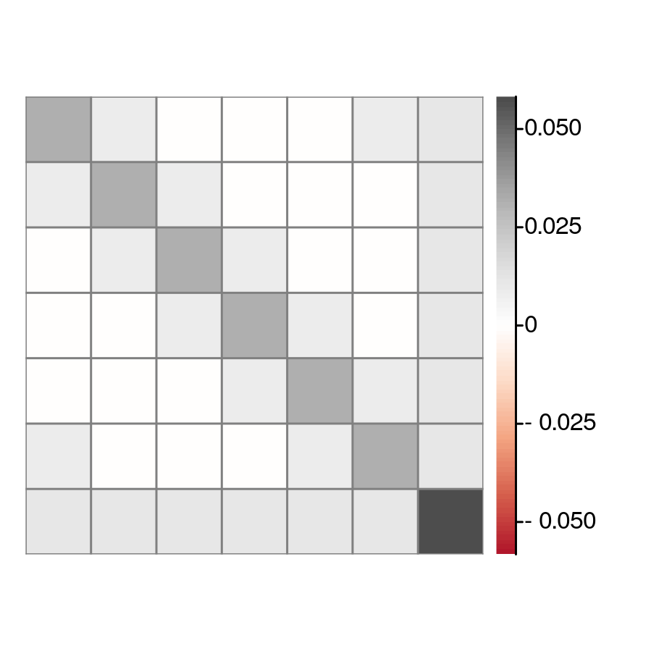
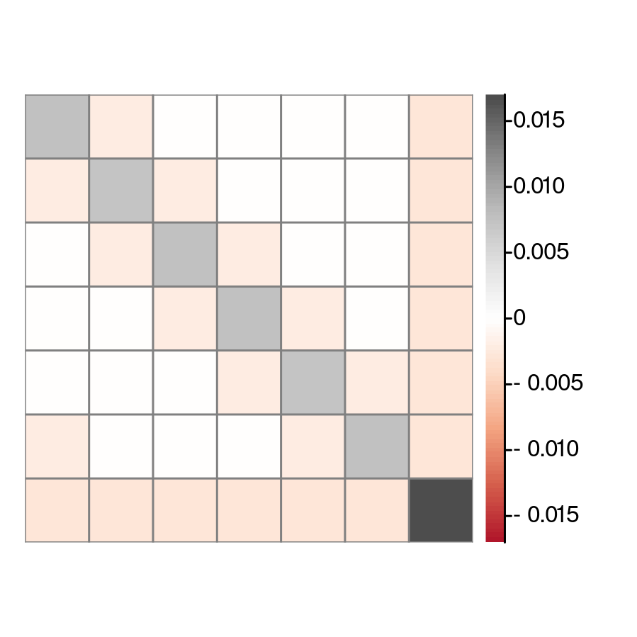



(b)${\hat{S}}^{2 }$operator covariance
(a) ${\hat{S}}^{z}$ operator covariance
(c) $\hat{Q}$ covariance matrix

