Slide 1
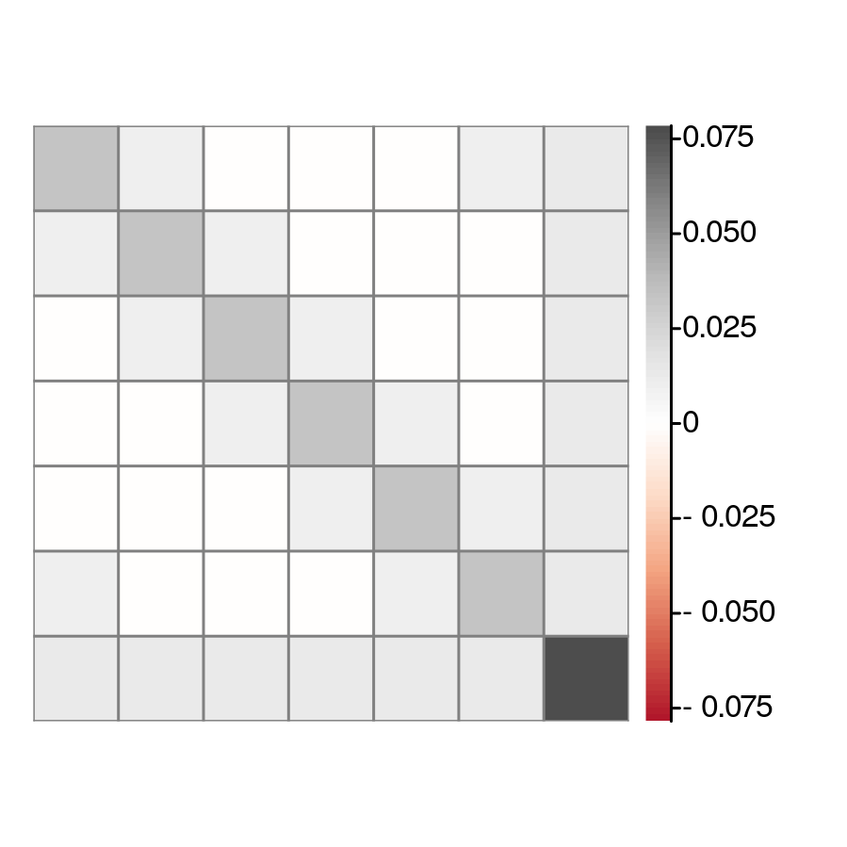
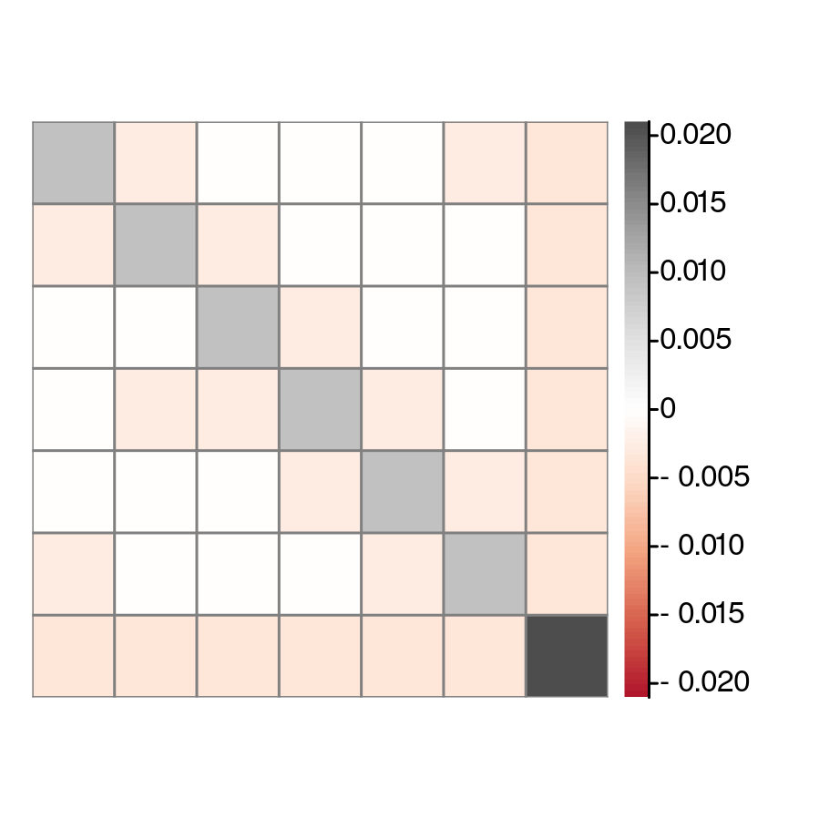
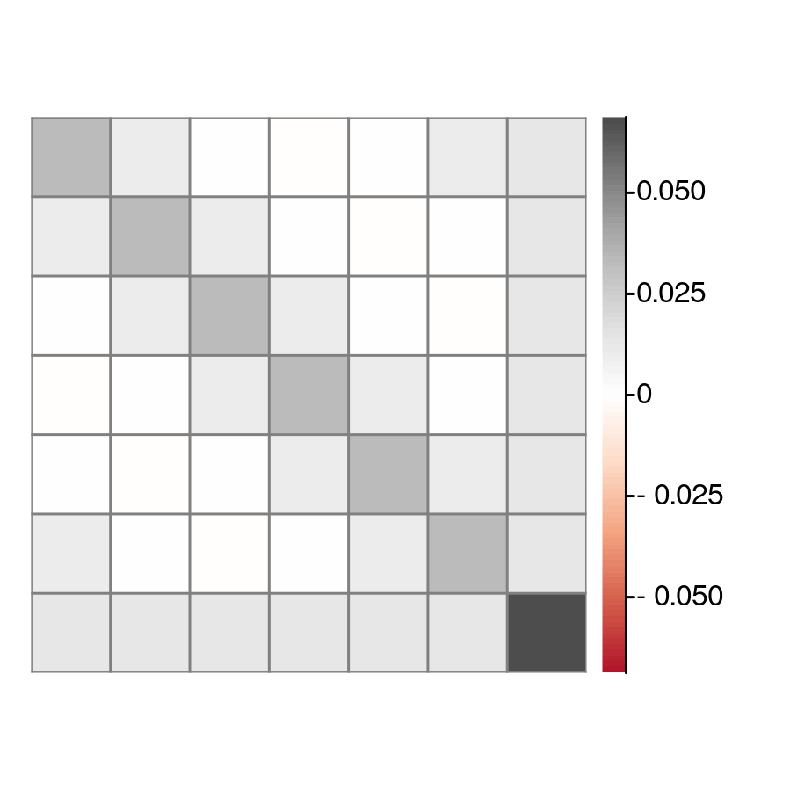



(a)${\hat{S}}^{2 }$operator covariance
(b) ${\hat{S}}^{z}$ operator covariance
(c) $\hat{Q}$ covariance matrix

