Slide 1

Education Performance Analysis
A Data-Driven Approach to Student Success
Presented by :
Arnab Roy & Moupiya Mondal
Notes:
封面标题特殊字体为百度简综艺.可以自行下载使用或改为微软雅黑.

Slide 2

INTRODUCTION
• Understanding student performance through data analysis.
• Utilizing SQL, Pandas, Seaborn, and Matplotlib.
• Automated reporting and visualization for insights.

Slide 3
Problem Statement
• Difficulty in analyzing student performance trends.
• Need for automated reports and visual insights.
• Lack of data-driven decision-making in education

Slide 4

Methodology
• Data collection and preprocessing using SQL.
• Analysis using Python libraries ( Pandas ).
• Visualization with Seaborn and Matplotlib.
• Automated reporting and performance insights.

Slide 5
Final project repository & Demo
• Here is the Github Link:
https://github.com/arnab825/Final_Major_Project.git
• Demo:
https://acrobat.adobe.com/id/urn:aaid:sc:ap:942ea4b0-a885-45c3-a798-a4452dc3ce9a

Slide 6
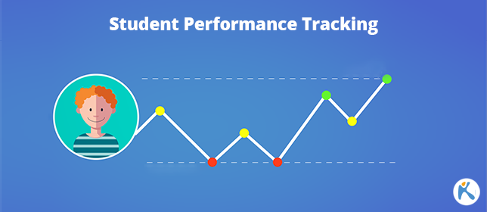
Key Findings
• Performance trends identified across different classes.
• Correlation between attendance and grades.
• Identified areas where students
struggle the most.

Slide 7
Conclusion & Future Scope
• Data-driven decisions improve student outcomes.
• Potential integration with AI for predictive insights.
• Future enhancements: interactive dashboards & ML models.

Slide 8
THANK YOU

