Slide 1

NITRiders - NIT Rourkela
Team Members
Santanu Senapati
Arnab Paikaray
Adityaraj Sahu
Suyash Verma
Autonomous Stair Climbing Robot

Slide 2
Amazon warehouses are single stored and need larger area for building bigger warehouses. Instead, a multi - stored warehouse can be built where autonomous stair climbing robots can be deployed for transporting goods and packages all around the warehouse.
Problem Statement

Slide 3
Functions
Assistance in package delivery within the warehouse
Fully autonomous movement, even along the stairs.
Active payload stability that works even along stairs.
Of the autonomous robot

Slide 4
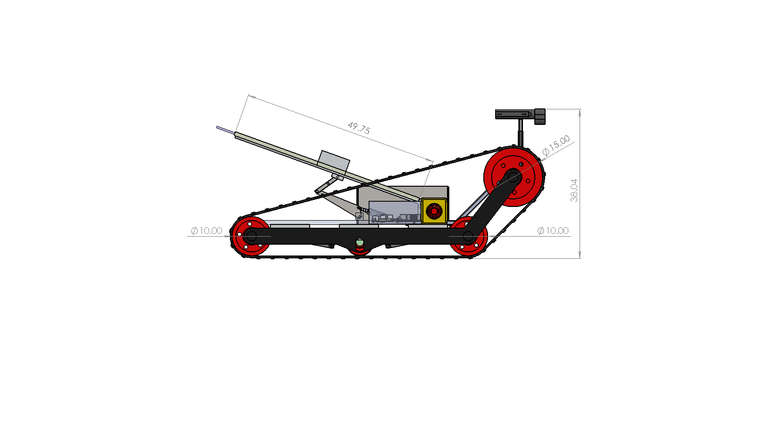
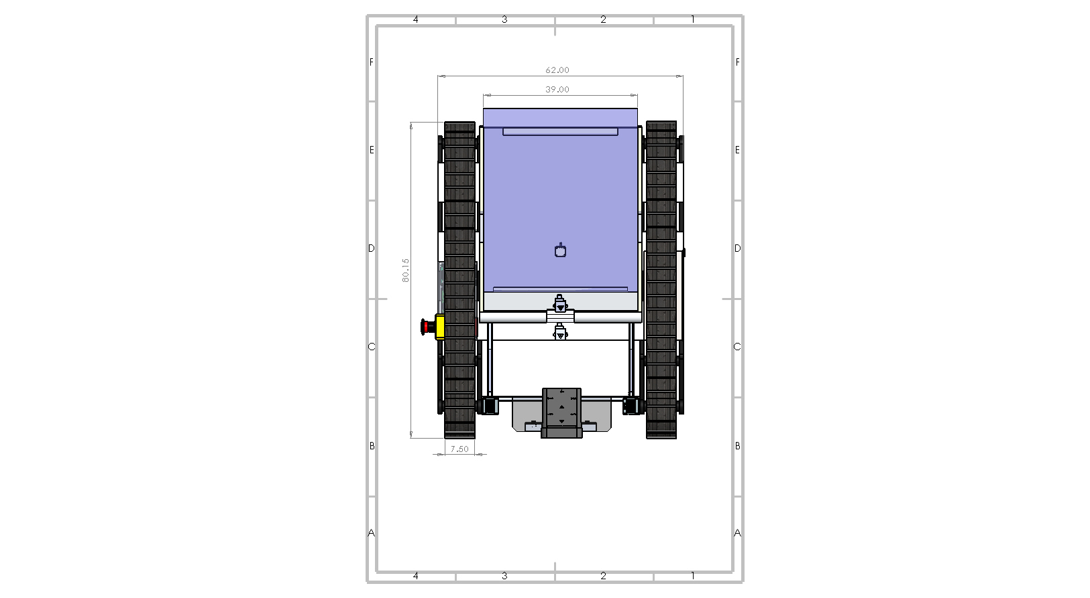
Robot Specifications
Physical Specifications |  | Terrain sensing
Length | 80 cm | Horizontal range of view | Camera dependent
Width | 62 cm | Range | Camera dependent
Height | 38 cm | Obstacle avoidance | Maintains set distance
Caterpillar Treads |  | Motor Specifications
Length | 89 cm | Motor Type | Planetary Geared Motor
Width | 7.5 cm | Supply Voltage | 12 V
Thickness | 0.5 cm | No-load Current | 0.8 A
Platform |  | Load Current | up to 7.5 A (max)
Area | 2015.58 cm² | Weight | 0.3 kg
Inclination(max.) | 42° | Connectivity
Length(max.) | 90 cm | Wi-Fi | 2.4 GHz b/g/n
Locomotion |  | Battery
Type | Skid steer drive | Battery type | Lithium Ion
Typical speed (without payload) | 0.2 m/s | Nominal Voltage | 14.8 V
Max. Slope | 44.7° | Nominal Capacity | 6000 mAh
Min. turning radius | 2 | No. of cells | 12 (4S3P)
Payload |  | Weight | 0.8 kg
Max. weight | 10 kg | Power (estimate) | 35 W
Ground clearance | 4.28 cm | Voltage | 12 V

Slide 5








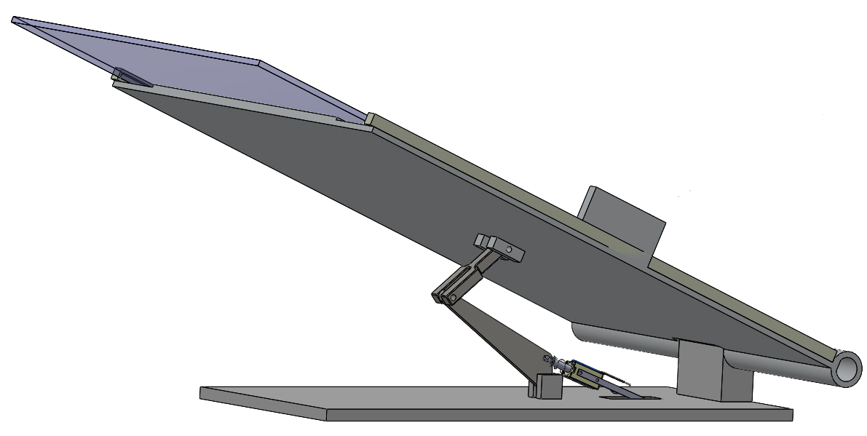
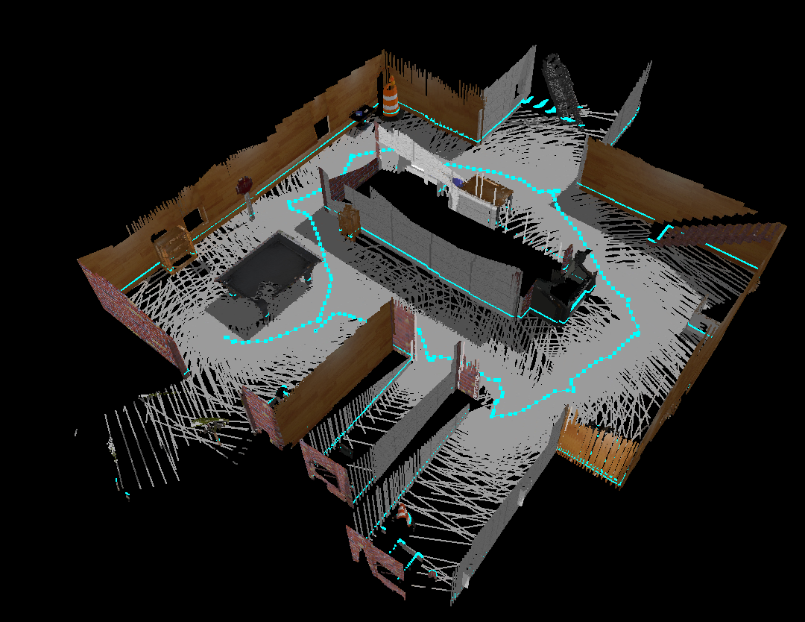

Brief of Programming Modules
Development
Nodes written in python and C++, with ROS providing necessary abstraction, running on top of Ubuntu Mate.
Simulation
Worlds and models written in markup formats like SDF, URDF and Xacro, to be run within Gazebo.
Locomotion Control
Control algorithms to translate high level twist messages to motor rotation speeds.
Battery Management System
To monitor charging, discharging cycles and schedule auto recharge accordingly.
Obstacle avoidance and Fall detection
By fusing data from ultrasonic sensors and depth map.
Payload Management
To check the weight of the payload and stabilise it using readings from platform sensors.
V-SLAM
Localisation of the robot and mapping of its environment using visual input.
Path Planning
Given two waypoints, the shortest viable path needs to found and followed.

