Slide 1
Help Mate AI Subtitle : - AI-Powered Intelligent Search Assistant
AUTHOR : -
Arnab Bera ( ML C63 )

Slide 2
Table of Contents
Introduction
Approach
System Architecture
Workflow Execution
Key Functions
Results & Demonstration
Conclusions
Challenges
Acknowledgments
Thank You!

Slide 3
Introduction
Introduction
Generative Search Help Mate AI is a system designed to perform intelligent document searches using semantic search and re-ranking techniques. It processes PDF documents, retrieves relevant information, and generates responses based on the search results.
Problem Statement
Traditional keyword-based searches often fail to retrieve accurate information from complex insurance policy documents due to ambiguous terms and lack of contextual understanding. This project aims to build a Retrieval-Augmented Generation (RAG) based generative search system that enhances search accuracy by:
Using efficient text chunking for better document processing.
Leveraging semantic search and re-ranking for relevant results.
Generating context-aware answers using a robust AI model.
This system will provide precise, efficient, and user-friendly access to policy information, overcoming the limitations of conventional search methods.

Slide 4
Approach
Objectives
To develop an AI-powered search system that retrieves contextually relevant information.
To integrate semantic search and re-ranking techniques for better search results.
To provide an efficient and user-friendly document search experience.
Approach
Extract and preprocess text from PDF documents.
Generate embeddings for document chunks using transformer-based models.
Perform semantic search with caching for efficiency.
Re-rank search results to improve relevance.
Generate responses based on retrieved information.

Slide 5
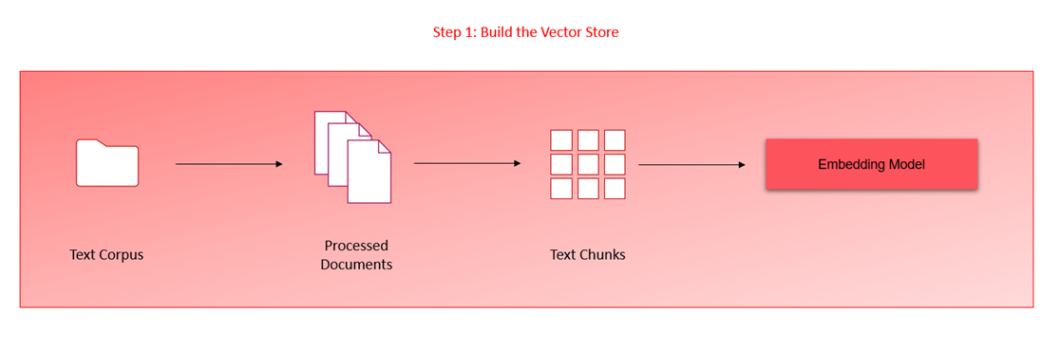
System Architecture
Embedding Layer:
Document Extraction: Use “pdfplumber” to extract text and tables from PDFs.
Data Structuring: Store extracted data in a Data-frame.
Embedding Generation: Convert data to vector representations using OpenAI’s text-embedding-ada-002 or Sentence Transformers.
Storage: Store embeddings in Chroma DB.

Slide 6
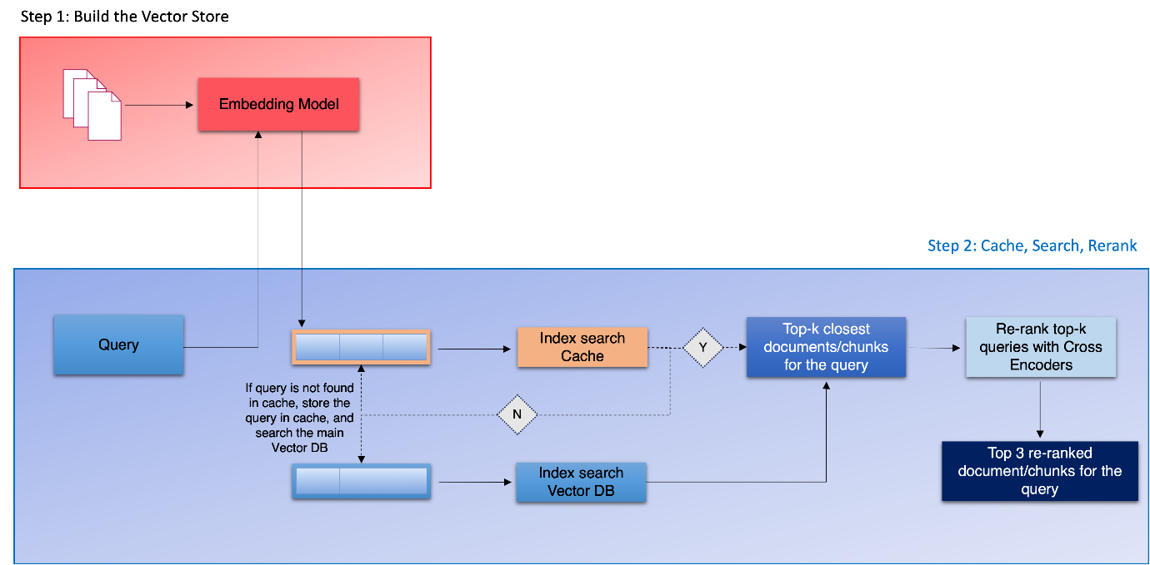
System Architecture
Search Layer:
Query Processing: Convert user queries to vector embeddings.
Semantic Search: Perform similarity search in Chroma DB.
Cache: Retrieve from cache if query exists.
Re-ranking: Use cross-encoding models for result refinement.

Slide 7
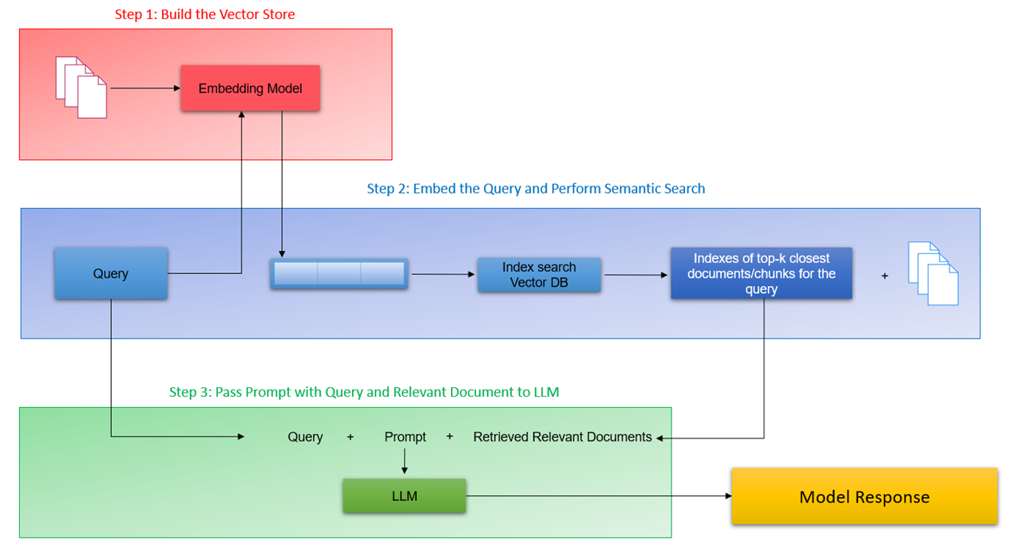
System Architecture
Generation Layer:
Prompt Engineering: Design prompts using query and relevant document chunks.
Cache Storage:
Efficient Cache: Store queries and results in ChromaDB for faster retrieval.
Threshold: Use semantic similarity threshold (e.g., 0.2) for cache management.

Slide 8
Key Functions
`semantic_search(input_query)` :
Performs a semantic search for the given input query and returns the search results.
`rerank_scores(input_query, search_df)` :
Re-ranks the search results based on their relevance to the input query.
`search_results_RAG(input_query)`:
Combines semantic search and re-ranking to generate the final response for the input query.
`generative_search(query, top_3_RAG)`:
Generate a response using GPT-3.5's ChatCompletion based on the user query and retrieved information.

Slide 9
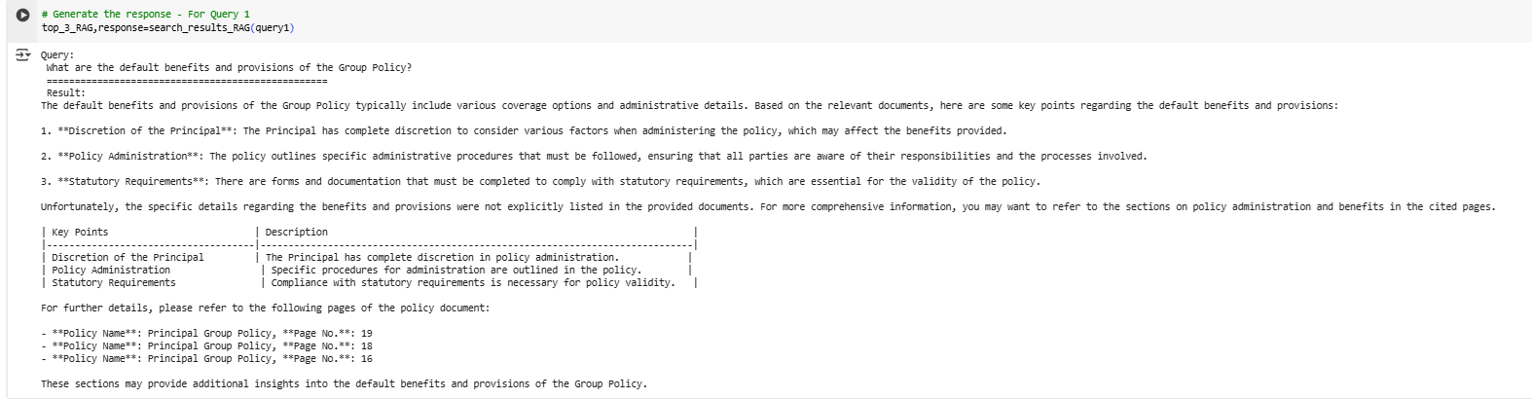
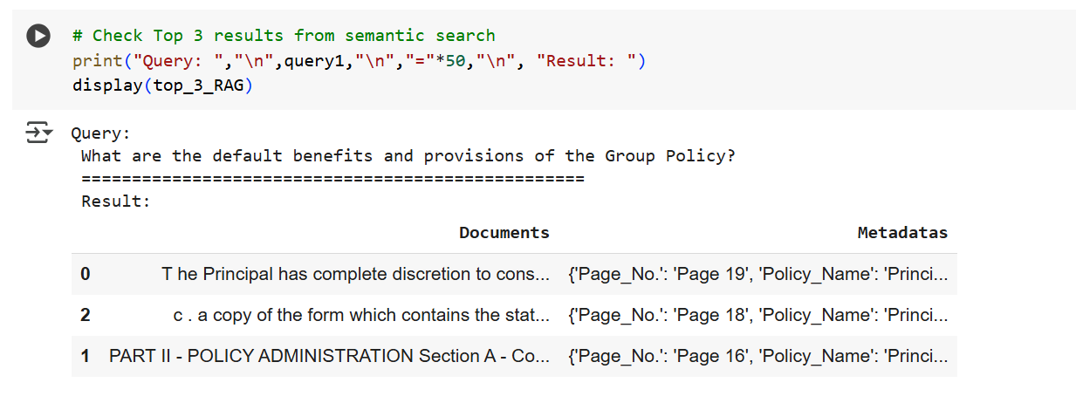
Results & Demonstration
Sample Query
“ What are the default benefits and provisions of the Group Policy? “

Slide 10
Conclusions
Generative Search Help Mate AI enhances search accuracy with semantic search and re-ranking techniques.
Delivered a scalable and efficient solution for document retrieval and information extraction. Successfully implemented a semantic search system with the RAG pipeline and cache layer.
Enables efficient retrieval of relevant information from large document repositories.
Successfully implemented a semantic search system with the RAG pipeline and cache layer.

Slide 11
Challenges
Challenges:
Performance Scaling: Address concerns about system performance with an increased number of documents or users by implementing vector databases and scaling up compute units.
Cache Storage: Optimize the cache collection to efficiently store and retrieve queries and results.
Lessons Learned:
Efficient Document Processing: Processing PDFs efficiently is crucial; libraries like “pdfplumber” and suitable data structures for storage play a vital role.
Semantic Search Optimization: Fine-tune semantic search parameters and thresholds for optimal results.
Cache Management: Implement an effective cache management strategy to balance storage and retrieval efficiency.

Slide 12
Acknowledgements
The project references course materials from upGrad's curriculum.
The project references presentations in upGrad’s recorded module given by Aditya Bhattacharya.
The project references presentations in upGrad’s recorded module given by Akshay Ginodia.
The project references insights and inferences from presentations in upGrad’s doubt clear session given by Shridhar Galande.
The project references presentations in upGrad's live class given by Sheshanth AS.

Slide 13
Thank You !!!
CONTACT ME : -
LinekdIn - https://www.linkedin.com/in/arnabbera-tech/
Git Hub Repo - https://github.com/arnabberawork/Help-Mate-AI

