Slide 1
Azure Governance Solution
Secure, Compliant, and Scalable Cloud Adoption
Arnab Dey
May 28, 2025

Slide 2
Why Azure Governance?
Cloud adoption brings agility, but also risk
- Uncontrolled resource sprawl
- Security & compliance gaps
- Cost overruns
Governance ensures control, security, and efficiency.

Slide 3
What is Azure Governance?
Framework of policies, processes, and controls for managing Azure resources.
Key pillars:
- Management Groups & Hierarchy
- Policy & Compliance
- Role-Based Access Control (RBAC)
- Security & Monitoring

Slide 4
Our Approach
- Enterprise-scale landing zone architecture
- Automated deployment with Infrastructure as Code (Terraform)
- Modular, reusable, and customizable
- Continuous compliance and monitoring

Slide 5
Core Components
- Management Group Hierarchy: Organize subscriptions for policy inheritance
- Azure Policies: Enforce standards (e.g., tagging, allowed locations)
- RBAC: Least-privilege access, custom roles
- Security Center: Threat protection & compliance
- Monitoring: Centralized logging & alerting

Slide 6
Key Benefits
- Accelerated cloud adoption
- Reduced risk & improved compliance
- Cost control & resource optimization
- Scalable and repeatable deployments

Slide 7
Customer Success Story
- Brief case study or testimonial
- Before & after metrics
(Add your customer story here)

Slide 8
How We Deliver
- Assessment & design
- Automated deployment (CI/CD pipelines)
- Knowledge transfer & documentation
- Ongoing support

Slide 9
Next Steps
- Discovery workshop
- Proof of concept
- Full-scale rollout

Slide 10
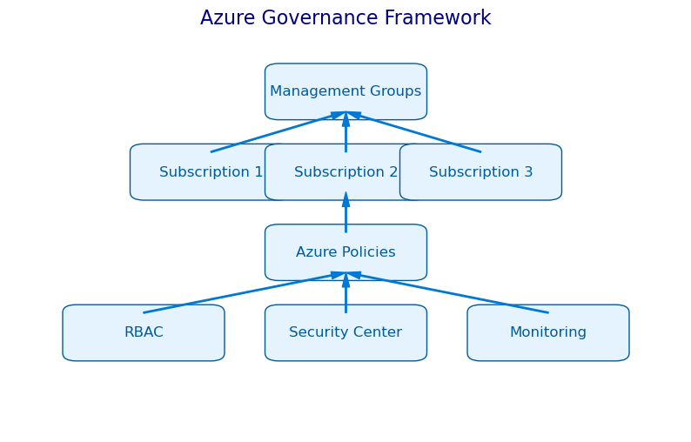
Azure Governance Framework

Slide 11
Q&A / Contact
Thank you!
Contact us for more information:
mail@arnabdey.dev

