Slide 1
Azure SQL Data Warehouse Connector
Arnab Ganguly – Microsoft

Slide 2
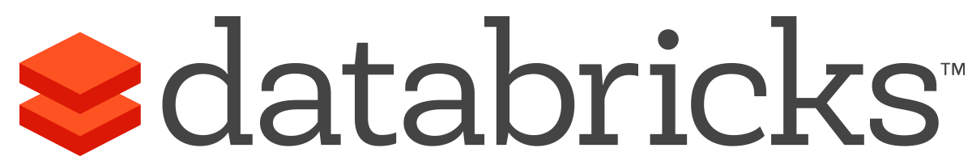


What is Azure Databricks?
A managed, fast, easy and collaborative Apache® Spark™ based analytics platform optimized for Azure
Best of Databricks
Best of Microsoft
Designed in collaboration with the founders of Apache Spark
One-click set up; streamlined workflows
Interactive workspace that enables collaboration between data scientists, data engineers, and business analysts.
Native integration with Azure services (Power BI, SQL DW, Cosmos DB, Blob Storage)
Enterprise-grade Azure security (Active Directory integration, compliance, enterprise-grade SLAs)
Notes:
Azure Databricks features –
Enhance your teams’ productivity
Get started quickly by launching your new Spark environment with one click.
Share your insights in powerful ways through rich integration with PowerBI.
Improve collaboration amongst your analytics team through a unified workspace.
Innovate faster with native integration with rest of Azure platform.
Build on the most compliant and trusted cloud
Simplify security and identity control with built-in integration with Active Directory.
Regulate access with fine-grained user permissions to Azure Databricks’ notebooks, clusters, jobs and data.
Build with confidence on the trusted cloud backed by unmatched support, compliance and SLAs.
Scale without limits
Operate at massive scale without limits globally.
Accelerate data processing with the fastest Spark engine.

Slide 3

Azure Databricks
  Azure Databricks is a first party service on Azure.
    Unlike with other clouds, it is not an Azure Marketplace or a 3rd party hosted service.
  Azure Databricks is integrated seamlessly with Azure services:
    Azure Portal: Service an be launched directly from Azure Portal
    Azure Storage Services: Directly access data in Azure Blob Storage and Azure Data Lake Store
    Azure Active Directory: For user authentication, eliminating the need to maintain two separate sets of uses in Databricks and Azure.
    Azure SQL DW and Azure Cosmos DB: Enables you to combine structured and unstructured data for analytics
    Apache Kafka for HDInsight: Enables you to use Kafka as a streaming data source or sink
    Azure Event Hub & Azure IOT Hubs: Enables you to use Event Hub and IOT Hub as a streaming data source
    Azure Billing: You get a single bill from Azure
    Azure Power BI: For rich data visualization
Microsoft Azure

Slide 4
Roadmap
Add-ons to public preview
Deep integration with SQL DW
Integration with Cosmos DB, Azure Data Factory (v2), Event Hub, IOT Hub.
Power BI Support via Apache Spark Connector
VNET Peering
Reserved Instances & commit pricing
Security Enhancements
12 Regions
End-to-end experience
Create first-party Databricks workspace and cluster from Azure portal
Enterprise-grade security with AAD authentication & Single sign-On
Integration with External stores like Blob Store, ADLS, SQL DW, Cosmos DB, HDI Kafka
Power BI Integration via JDBC/ODBC endpoint
REST APIs
3 regions
Add-ons to general availability
Deep integration with PowerBI
ADLS Passthrough
Deploy into customer VNET
Certifications (ISO 27001, SOC2, HIPAA)
Community Edition, Trial Edition
Delta
Add-ons to Private Preview
Billing
Clusters – Tagging, Disk Storage
DBFS mount points
Jobs – email alerts
OMS for service monitoring
Azure ML integration
All Azure regions
PCI & other certifications
Private Preview
Oct 2017
Gated Public Preview
Nov 2017
Connect ()
Ungated Public Preview
Q1 2018
April 2018
GA+
2018
GA++
2018-19
3 Regions
West US
East US 2
West Europe
12 Regions
East US, East US2
Central US, North Central US, West Central US, South Central US
West US, West US2
North Europe, West Europe
South East Asia, East Asia
Provided by Microsoft and Databricks under NDA
Notes:
This needs to be finalized net week.

Slide 5
Modern Big Data Warehouse
Ingest
Store
Prep & Train
Model & Serve
Intelligence
Logs, files and media
(unstructured)
Data factory
Azure storage
Azure Databricks
(Spark)
Business / custom apps
(Structured)
Polybase
Data factory
Azure SQL Data Warehouse
Analytical dashboards

Slide 6
Managing Information for Analytics

Slide 7
Two Approaches to Information Management for Analytics: Top-Down + Bottom-Up
Top-Down
(Deductive)
Bottom-Up
(Inductive)
VALUE
How can we
make it happen?
Prescriptive Analytics
What will
happen?
Theory
Theory
Predictive Analytics
Why did
it happen?
Hypothesis
Hypothesis
OPTIMIZATION
Diagnostic Analytics
Pattern
Observation
What
happened?
Observation
Confirmation
Descriptive Analytics
INFORMATION
DIFFICULTY
Notes:
There are two approaches to doing information management for analytics:
Top-down (deductive approach). This is where analytics is done starting with a clear understanding of corporate strategy where theories and hypothesis are made up front. The right data model is then designed and implemented prior to any data collection. Oftentimes, the top-down approach is good for descriptive and diagnostic analytics. What happened in the past and why did it happen?
Bottom-up (inductive approach). This is the approach where data is collected up front before any theories and hypothesis are made. All data is kept so that patterns and conclusions can be derived from the data itself. This type of analysis allows for more advanced analytics such as doing predictive or prescriptive analytics: what will happen and/or how can we make it happen?
In Gartner’s 2013 study, “Big Data Business Benefits Are Hampered by ‘Culture Clash’”, they make the argument that both approaches are needed for innovation to be successful. Oftentimes what happens in the bottom-up approach becomes part of the top-down approach.
.

Slide 8

Data Warehousing Uses A Top-Down Approach
Gather Requirements
Understand Corporate Strategy
Implement Data Warehouse
Reporting &
Analytics Design
BI and analytic
Reporting & Analytics Development
Business
Requirements
Dashboards
Reporting
Data warehouse
Dimension Modelling
Physical Design
ETL
ETL Design
ETL Development
Technical
Requirements
Data sources
Setup Infrastructure
Install and Tune
OLTP
ERP
CRM
LOB
Notes:
The Data Warehouses leverages the top-down approach where there is a well-architected information store and enterprisewide BI solution. To build a data warehouse follows the top-down approach where the company’s corporate strategy is defined first. This is followed by gathering of business and technical requirements for the warehouse. The data warehouse is then implemented by dimension modelling and ETL design followed by the actual development of the warehouse. This is all done prior to any data being collected. It utilizes a rigorous and formalized methodology because a true enterprise data warehouse supports many users/applications within an organization to make better decisions.

Slide 9

The “Data Lake” Uses A Bottom-Up Approach
Ingest all data regardless of requirements
Store all data
in native format without schema definition
Do analysis
Using analytic engines like Hadoop
Devices
Social
Batch queries
LOB applications
Video
Devices
Interactive queries
LOB applications
Social
Real-time analytics
Web
Sensors
Sensors
Video
Machine Learning
Relational
Web
Clickstream
Data warehouse
Relational
Clickstream
Notes:
The data lake on the other hand leverages a bottoms-up approach. A data lake is an enterprise wide repository of every type of data collected in a single place. Data of all types can be arbitrarily stored in the data lake prior to any formal definition of requirements or schema for the purposes of operational and exploratory analytics. Advanced analytics can be done using Hadoop, Machine Learning tools, or act as a lower cost data preparation location prior to moving curated data into a data warehouse. In these cases, customers would load data into the data lake prior to defining any transformation logic.
This is bottom up because data is collected first and the data itself gives you the insight and helps derive conclusions or predictive models.

Slide 10
Data Lake + Data Warehouse Better Together
What will happen?
What if?
How risky is it?
What should happen?
What is the best option?
How can I optimize?
What happened?
What is happening?
Why did it happen?
What are key relationships?
Notes:
In Gartner’s 2013 study, “Big Data Business Benefits Are Hampered by ‘Culture Clash’”, they make the argument that both approaches are needed for innovation to be successful. Oftentimes what happens in the bottoms-up approach becomes part of the top-down approach.
The Top-down approach with the data warehouse utilizes a rigorous and formal approach to designing an enterprise wide data warehouse that can support the entire enterprise. It usually can answer questions that are backwards facing like what just happened or even answer why things happened.
The bottoms-up approach with the data lake utilizes a exploratory and informal approach of collecting all data in a single place so that data scientists can do advanced analytics like leveraging Hadoop and machine learning tools. It usually can identify new opportunities, predict future outcomes, etc.
In the ideal world, both are leveraged so that they can exploit information in the most valued way where each works together with the other to grow the business.

Slide 11


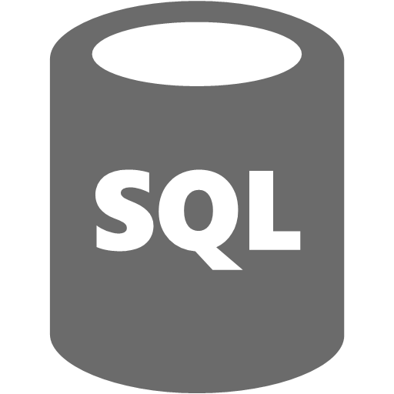
Data Lake & Data Warehouse
Unknown Value Data
XML
High Value Data
JSON
TEXT
Model
  Load
  Transform
  Aggregate
  Consume
Data Preparation
  Pre-process
  Transpose
  Re-format
Batch
Batch
Ad-hoc

Slide 12
Azure Databricks Connector

Slide 13
Parallel load via Azure Blob Storage
Compute Node
DMS
Bridge
Control Node
Compute Node
DMS
DMS
Azure Blob Storage (WASB)
Bridge
Compute Node
DMS
Bridge

Slide 14
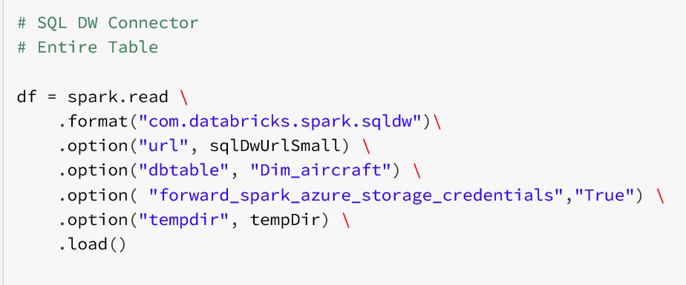
Import into Databricks from SQL DW
JDBC Connection String
Azure Storage Blob Directory

Slide 15
What happens when DF created
DF.Load()
Control Node
JDBC Connection
Master Node
Compute Node
Compute Node
Compute Node
Worker Node
Worker Node
Worker Node
Notes:
Select * FROM SYS.DM_PDW_EXEC_REQUESTS

Slide 16
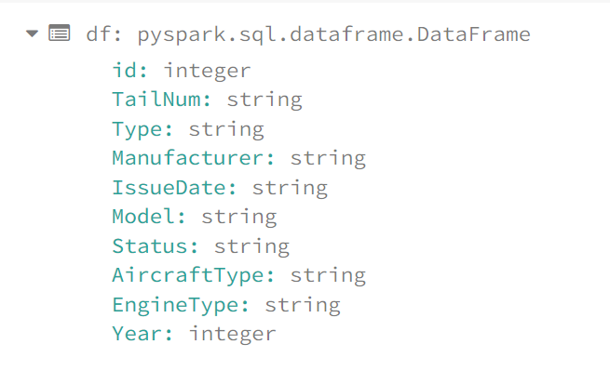
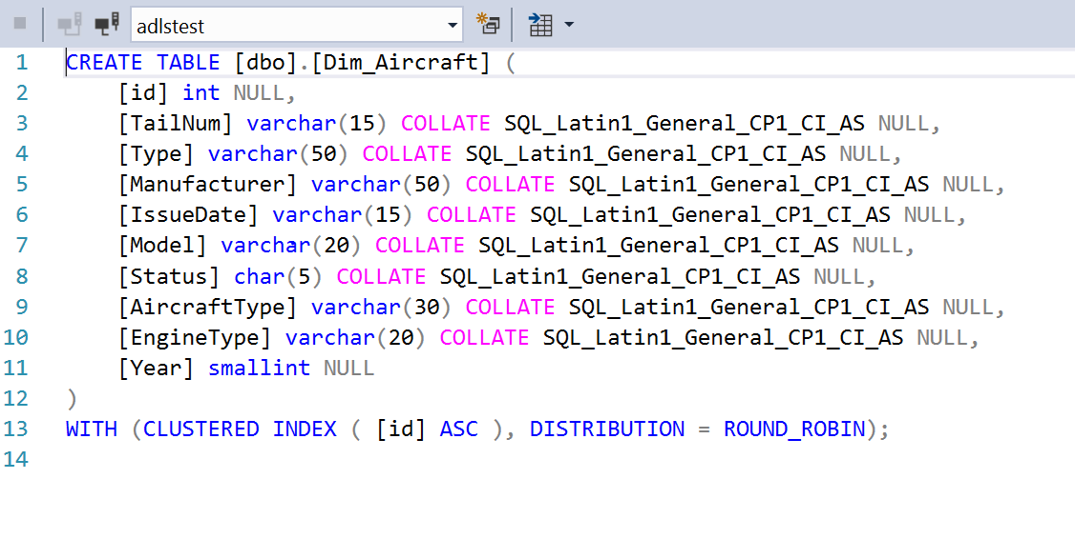
Schema based on Table Definition

Slide 17
What happens when action taken
Control Node
DF.Load()
JDBC Connection
Master Node
Compute Node
Compute Node
Compute Node
Worker Node
Worker Node
Worker Node
tmpDir
Azure Storage Blob
Parquet
Parquet
Parquet

Slide 18
What happens in JDBC connection
Create Database Scoped Credential
Create External Data Source
Create External File Format
CETAS with column projection
Drop all objects

Slide 19
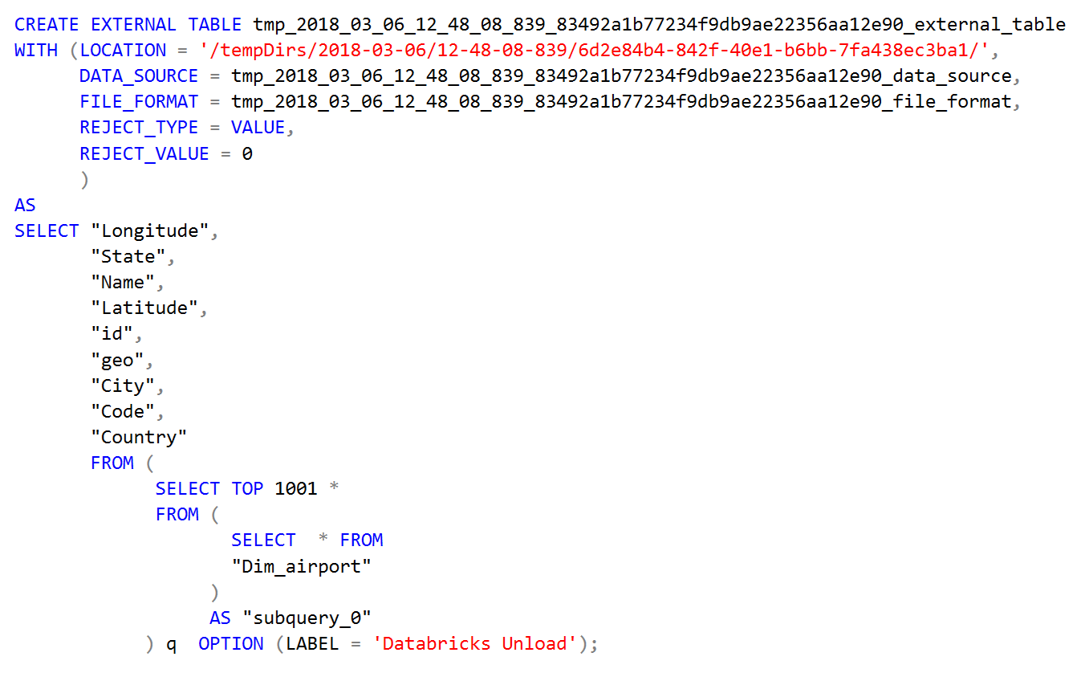
Display(DF)
Auto Generated Objects
Column Projection
Limit pushdown
Query Label for easy debugging
Notes:
CREATE EXTERNAL TABLE tmp_2018_03_06_12_48_08_839_83492a1b77234f9db9ae22356aa12e90_external_table
WITH (LOCATION = '/tempDirs/2018-03-06/12-48-08-839/6d2e84b4-842f-40e1-b6bb-7fa438ec3ba1/',
DATA_SOURCE = tmp_2018_03_06_12_48_08_839_83492a1b77234f9db9ae22356aa12e90_data_source,
FILE_FORMAT = tmp_2018_03_06_12_48_08_839_83492a1b77234f9db9ae22356aa12e90_file_format,
REJECT_TYPE = VALUE,
REJECT_VALUE = 0
)
AS
SELECT "Longitude",
"State",
"Name",
"Latitude",
"id",
"geo",
"City",
"Code",
"Country"
FROM (
SELECT TOP 1001 *
FROM (
SELECT * FROM
"Dim_airport"
)
AS "subquery_0"
) q OPTION (LABEL = 'Databricks Unload');

Slide 20
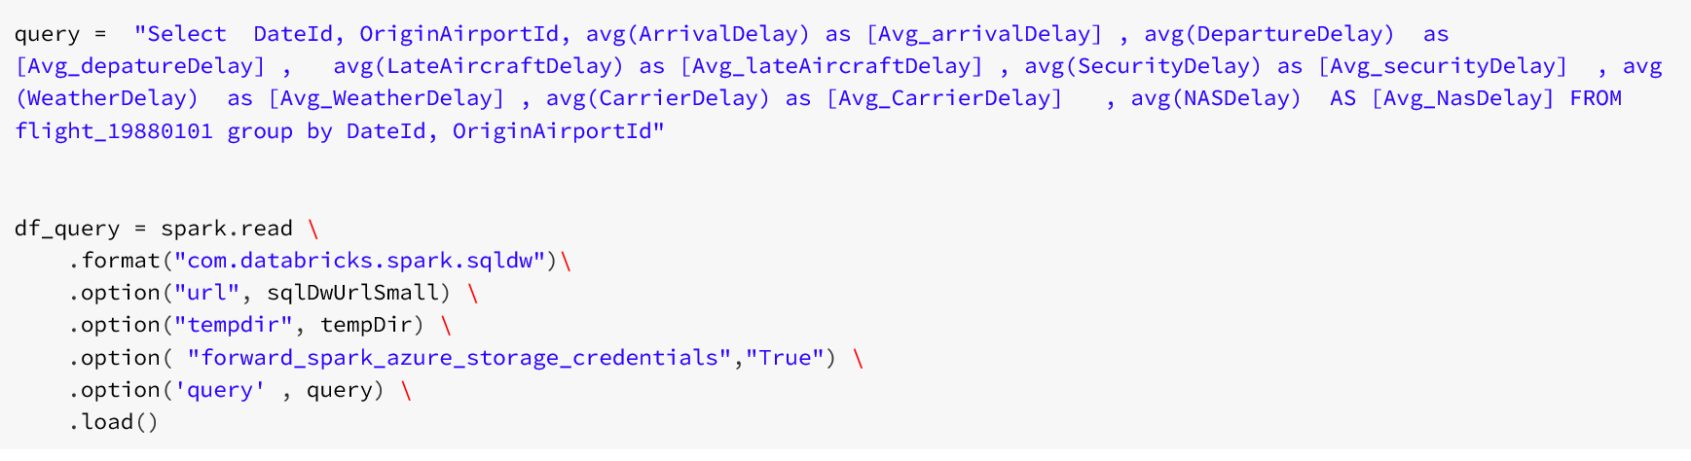
Query Pushdown

Slide 21
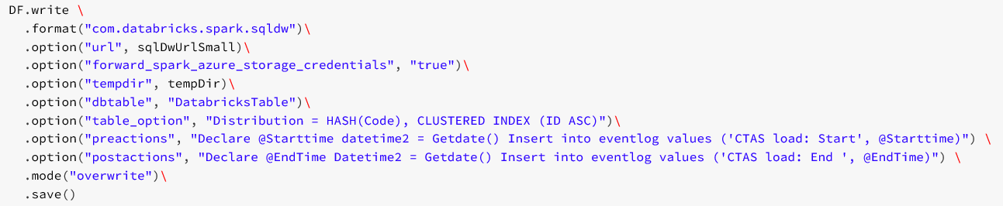
Export Databricks into SQL DW

Slide 22
What Happens
JDBC Connection
Control Node
DF.save()
Master Node
Compute Node
Compute Node
Compute Node
Worker Node
Worker Node
Worker Node
tmpDir
Azure Storage Blob
Parquet
Parquet
Parquet

Slide 23
Write Options
Append: Append data to existing table
Overwrite: Drop existing table and create new table
Error: Throw error if table object exists
Ignore: Do nothing if table exists

Slide 24
SQL DW Future vision

Slide 25
New! Preview is optimized for compute
Cores
Memory
Cores
Memory
Cores
Memory
Compute
NVMe SSD
NVMe SSD
NVMe SSD
Cache
Tempdb
Cache
Tempdb
Cache
Tempdb
Remote Storage
Snapshot backups
Data
Log

Slide 26
Tiered storage model automates data temperature
Cores
Memory
Cores
Memory
Cores
Memory
Compute
NVMe SSD
NVMe SSD
NVMe SSD
Cache
Tempdb
Cache
Tempdb
Cache
Tempdb
Remote Storage
Snapshot backups
Data
Log

Slide 27
Compute Scalability

Slide 28
Storage Scalability
∞
5x
5x

Slide 29
Investments through H1 2018
Optimized for Compute GA
Enterprise Grade
Analytics @ Scale
5x compute capacity
V-Net Service Endpoint
2x faster broadcast & partition moves
4x max concurrent queries
TDE on by default
Auto/streaming stats
Unlimited columnar storage
GDPR compliant
Approx. Functions
count distinct
23 regions for compute tier
Custom restore points
Improve CCI string segment elimination
2x price perf
Maintenance notifications
Query over ADL data
2x faster shuffling data
QDS Integration
Resource Pools (Workload isolation)
5min same server restore
AAS loading experience
Load, enrich and query data with Azure Databricks (Spark)

Slide 30


Thank You for Visiting us at Spark + AI Summit
Please take a minute to complete a short survey in return for a free gift!
https://aka.ms/SPARKAI
Notes:
UPDATE WITH SPARK & AI SURVEY INFORMATION
https://microsoft.ca1.qualtrics.com/ControlPanel/?ClientAction=EditSurvey&Section=SV_8k9V30xy3TYJHwh&SubSection=&SubSubSection=&PageActionOptions=&TransactionID=6&Repeatable=0
https://urlmanager.cloudapp.net/app/html/index.html#/aka.ms

