Slide 1
EEP 596 Project Presentation: Attribute conditioned face image generation using diffusion models
Arnab Karmakar
Student ID 2372381
arnabk1@uw.edu

Slide 2
Problem Statement
We try to develop a conditional diffusion model to generate images conditioned on facial attributes
The end goal is to generate accurate hand-object interactions for robotic grasping
We divide the problem in 3 smaller steps:
Implement the code for a conditional diffusion model [3]
Train the model in (1) MNIST and (2) CelebA datasets to verify the image generation capability of the model

Slide 3
Project Summary
Implemented the conditional diffusion model with learned attribute embedding – trained from scratch [completed]
Achieved class conditioned image generation for MNIST [results] and attribute conditioned image generation on CelebA [results]
Smooth interpolation of CelebA attributes in generated images [results]
Pose conditioned Diffusion model for HOI image synthesis [future work]

Slide 4
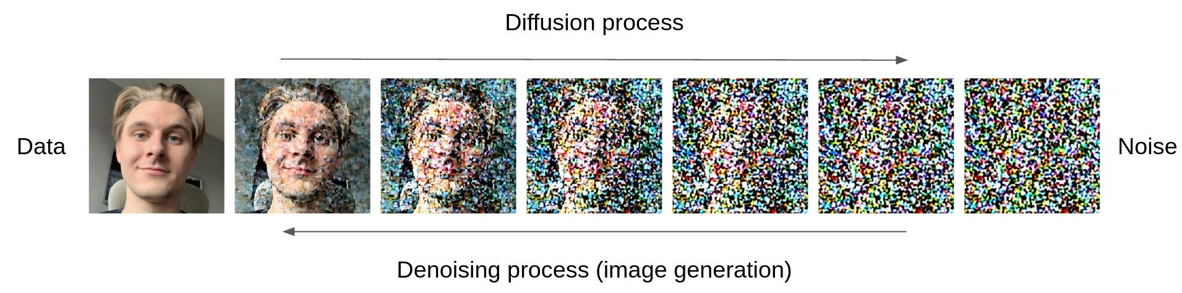
Proposed Method: Diffusion models
A diffusion model (DDPM) starts with a noise (corrupt) image and gradually adds details in every timestep until it becomes a realistic image
In our case, the architecture is a U-Net with 1.7M parameters
We add the conditional information (classes/attributes) to the input image at every denoising timestep
The model leverages the class/attribute information to guide the image generation process

Slide 5
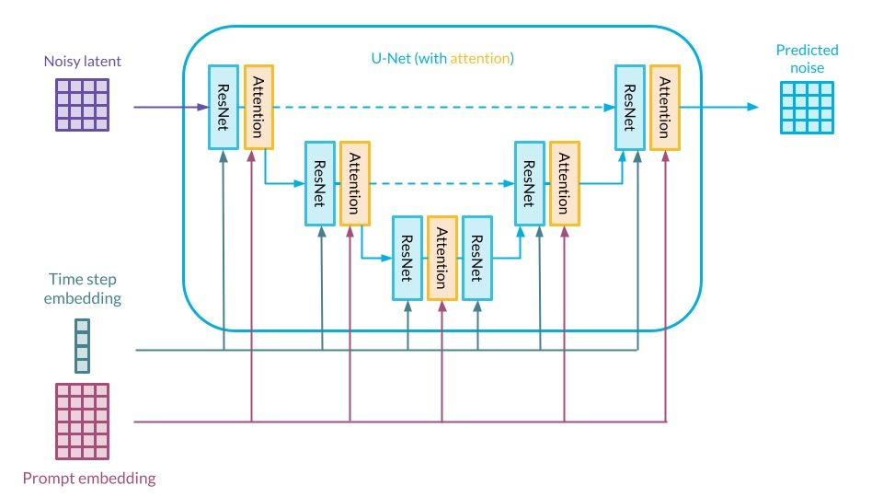
Proposed Method: Classifier (free) guidance
We can derive that diffusion models can be casted as a noise predictor
The error in the noise prediction is propagated back to update the model
t
attribute embedding

Slide 6
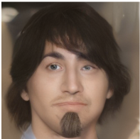
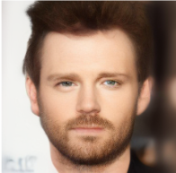
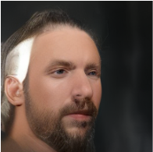
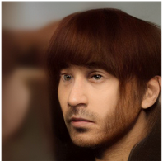
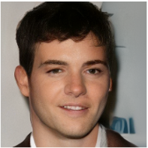
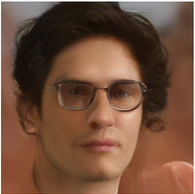
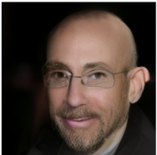
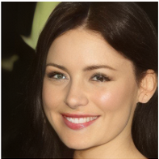
Qualitative results (CelebA)
attr: [black_hair, beard, man]
( X )
attr:
[+ beard,
+ bald]
attr:
[+ eye_glasses]
attr:
[- male, + lipstick, +makeup]

Slide 7
Results (CelebA)
Model | FID | IS
Baseline (unconditional) | 5.268 | 3.425
Conditional | 4.356 | 3.409
We used the Fréchet Inception Distance (FID) and Inception score (IS) on a subset of generated images
The higher FID in conditional model suggests better quality of images, whereas a slightly lower IS indicative of lesser diversity
Given a larger training dataset and more evaluation time, the FID and IS values are expected to improve

Slide 8
Conclusion
Developed a complete conditional image generation pipeline from scratch
The generated face images for celebA are of reasonably good quality
We show smooth interpolation between image attributes – an improvement of this model can lead to various downstream application in GenAI, including image editing
Challenges
Training from scratch is expensive (time and resources) – increases exponentially with model parameter increase
Specialized applications require a unique model architecture, so pre-trained weights are not always available

Slide 9
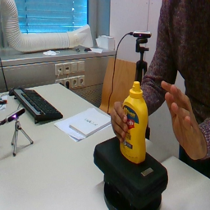
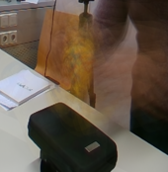
Limitations and Future work
The model, in its current configuration, fails to generate hand-object interaction images conditioned on image pose
Possible reasons – large background area, model capacity, training time etc.
Future work
Add a localization method to identify correct object location, then crop original image to generate focused training data
Changing the model architecture and incorporating more advanced models
Incorporating multi-step training framework
Advanced sampling method for faster training (?)
cropped input
Diffuser output
Actual image

Slide 10
References
[1] Ye, Yufei, et al. "Affordance diffusion: Synthesizing hand-object interactions." Proceedings of the IEEE/CVF Conference on Computer Vision and Pattern Recognition. 2023.
[2] Hasson, Yana, et al. "Learning joint reconstruction of hands and manipulated objects." Proceedings of the IEEE/CVF conference on computer vision and pattern recognition. 2019.
[3] Ho, Jonathan, and Tim Salimans. "Classifier-free diffusion guidance." arXiv preprint arXiv:2207.12598 (2022).

