Slide 1


Pens
&
Printers
Report
dated 09 Jun 2024
by
Arnab Chakraborty
since 1984
Dissecting the performances of the sales methods post launch of the new product

Slide 2
Points to cover
1. An overview of the project and business goals
2. A summary of the work undertaken and how this addresses the problem
3. Key findings including the metric to monitor and current estimation
4. Recommendations to the business
Let’s get started >>>>>>>

Slide 3
Section 1 : An overview of the project and business goals
Pens and Printers was founded in 1984 and provides high quality office products to large organizations
Six weeks ago, Pen and Printers launched a new line of office stationery
Pens and Printers have tested three different sales strategies for this, targeted email and phone calls, as well as combining the two
Pens and Printers wants to understand the current performance and expects to increase the total revenues generated out of the sales methods.
1
3
Perform analysis and write a report for the sales team on “sales approaches” for the new product line.
Identify and define a metric for the business to monitor including initial estimates based on current data.
2
4
Recommendations to the business:
Method(s) which can be continued to be used
Method(s) which may be discontinued.
Based on dataset provided by the sales team, share keys findings to the business to understand:
Customers and revenues by different sales methods
Spread of revenue – overall and by sales methods
Effect of time on revenue.

Slide 4
Section 2 : A summary of the work undertaken and how this addresses the problem
Data validation and cleaning was performed on the raw dataset that was provided by the sales team:
a) Each column was checked for null values. Records with null values in revenue were removed
b) Consistency in the sales method column. For example: ‘email’ and ‘Email’, ‘em + call’ and ‘Email + Call’ are the same.
c) Each column was validated for the data type based on the guidelines provided.
d) Outliers in the ‘years as customers’ column were identified for records > 40 years as customers. Values were corrected to the upper cap i.e. 40 years (Pens & Printers are in business since 1984 i.e. 40 years)
d) Data type and unique records checked for and validated.
A cleaned and validated dataset will be accurate to run the analysis on
Exploratory analysis was performed on the clean dataset to answer customer questions.
a) Different types of graphs were used
b) Description of the findings were included.
This would allow the business to gain key insights into the performance of the different sales methods.
Metric was defined for the business to monitor including:
Monitoring approach
Initial value(s) based on current data
This would allow the business to keep regular track of how each sales method performs over a period of time.
Recommendations were identified for the business based on the statistics and insights generated out of the given dataset.
This would enable the business to understand which sales method to continue and which can be it be less vested on.

Slide 5
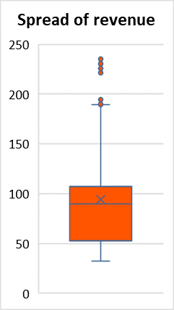
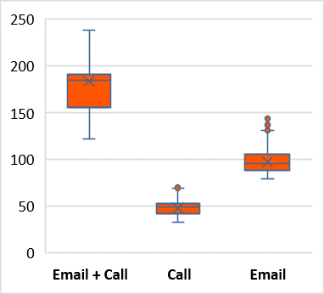
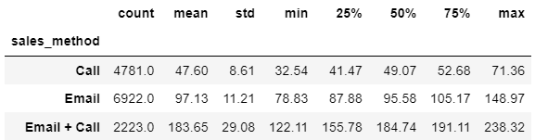
Section 3 (part a) : Our key findings
1. ‘Email’ approach has achieved the highest number of customers followed by ‘Call’ and ‘Email + Call’
2. Revenue generated by ‘Email’ approach is highest followed by ‘Email + Call’
3. Spread of revenue (overall) has a mean > median
4. ‘Email + Call’ has the highest average revenue followed by ‘Email’. ‘Call’ has the lowest variance followed by ‘Email’.
mean | 93.93
std | 47.44
min | 32.54
25% | 52.47
50% | 89.51
75% | 107.33
max | 238.32
Sales method

Slide 6
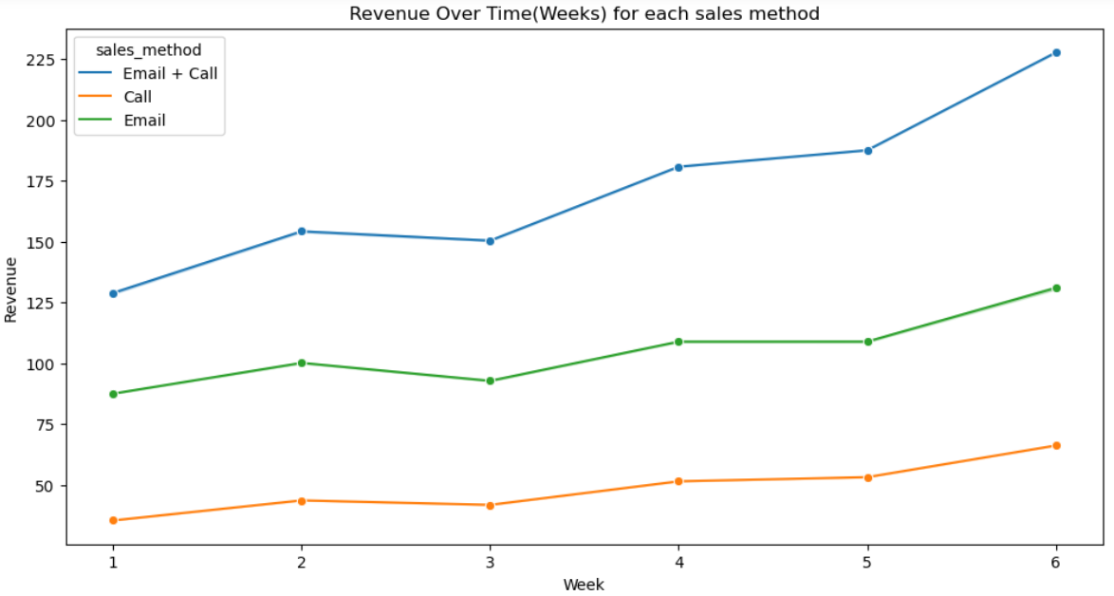
Section 3 (part a): Our key findings (continued…)
5. With time, the revenue for each sales method increases with ‘Email + Call’ having the highest rate of increase overall
sales method
Note: Week (x-axis) denotes the number of weeks passed since the launch of the product when the sale was made

Slide 7
Section 3 (part b): Metric to monitor and current estimates
Metric definition and business goal
Metric:
Average Weekly Revenue by Sales Method
Definition:
Total revenue generated by a given sales method per week of sales executed in that method
Business Goal:
To increase the revenue generated from sales by applying and monitoring the performance of different sales methods or approach (Email, Calls, Email + Calls)
Monitoring approach
Track the average weekly revenue for each sales method over time to assess effectiveness.
Current (initial) estimates
Sales method | Average weekly revenue
Call | 37927.25
Email | 112052.97
Email + Call | 68042.78

Slide 8




Section 4 : Recommendations to the business
Continue to keep working with 'Email + Calls' approach
Average revenue generated per customer is much higher as compared with the other two approaches.
Even the minimum value of the revenue generated by any customer is higher than the corresponding average values in ‘Calls’ or in ‘Email’
Although takes time, but average weekly revenue (based on current estimates) is almost double that of ‘Calls’
Continue to keep working with 'Email' approach
Count of customers is maximum
High average weekly revenue
There is consistency in the revenue generated in this method studied over the weeks and customers. This is indicated by a lower standard deviation observed in the spread of revenue as compared with ‘Email + Call’
The business can consider discontinuing 'Calls' approach for sometime and see
Low average weekly revenue.
Average revenue is quite small as compared with the corresponding value of the population
The company can give it a thought and consider to discontinue 'Calls' approach.

Slide 9
Thank You
since 1984

