Slide 1
Beyond Interoperability
Hands-On Federated ML for Research Data Curation Infrastructure
Technical Companion: Conformal Prediction for Site-Level Heterogeneity in Federated Clinical Data
UCI Heart Disease federation · 4 hospitals · 920 patients
Arnab Mukherjee
Oklahoma State University — Center for Health Science, Tulsa
RSAA 2026
Notes:
Good morning, everyone. I'm Arnab Mukherjee, from the Center for Health Science at Oklahoma State University. Today we look at one problem: a model can look fine on average, and still be badly wrong at one hospital, with no warning at all.
We will build three things in code. First, a simple model, trained the normal way. Second, that same model trained across three hospitals together, without ever sharing patient records -- this is called federated learning. Third, a check that tells us, with one clear number, whether we can trust the model at a hospital it has never seen -- this is called conformal prediction.
If your environment is ready, open notebooks 00, 01, 03, and 04. Those are the four we will use today.

Slide 2
ABSTRACT
The one idea to remember from today
▪ A model trained across several hospitals can look perfectly healthy on average while being quietly wrong at one specific hospital — with no warning in its own confidence score.
▪ This talk uses conformal prediction to catch that failure and measure it directly, and federated learning to train the shared model in the first place, without any hospital's patient records leaving the building.
▪ Everything shown is a real result from this project's own model and data: a simple classifier trained across three hospitals, tested at a fourth it never saw.
▪ It's hands-on: the exact notebooks and code that produced every number and figure in this talk.
Beyond Interoperability · Abstract
2
Notes:
Two ideas sit at the center of today. Federated learning lets several hospitals train one shared model together, without any patient record leaving its own hospital. Conformal prediction checks, with a real number, whether that shared model can be trusted at a hospital it never trained on.
By the end, you will have seen the model itself, how it is trained, its accuracy at hospitals it trained on versus one it never saw, and the exact moment its guarantee breaks down at that new hospital.

Slide 3
AGENDA
What this deck covers
▪ 1. Our Dataset — Why Hospitals Differ
▪ 2. The Model — Trained Without Sharing Data
▪ 3. Conformal Prediction
▪ 4. The Headline Result
Beyond Interoperability · Agenda
3
Notes:
Here is the plan. Section one shows why these four hospitals' data is not as similar as it looks. Section two introduces the model -- what it is, and how it trains across hospitals without sharing data. Section three is conformal prediction -- how we turn the model into a checkable guarantee. Section four is the headline result: we watch that guarantee hold at three hospitals, then break at a fourth.

Slide 4
1
Our Dataset
The UCI Heart Disease Federation
HANDS-ON: notebooks 00, 01
Beyond Interoperability
4
Notes:
Let's start with the data. Everything later -- the model, the shared training, the guarantee -- depends on understanding that these four hospitals are not interchangeable. Open notebook 00 now and run the first cell. It loads all four hospitals into memory.

Slide 5
OUR DATASET
Why this particular dataset
▪ Four real, independent hospitals filled out the exact same intake form — the data moves cleanly between them.
▪ Underneath that shared form, the four hospitals differ in ways that matter: real differences between patient populations, and separately, real differences in what each hospital routinely measures.
▪ Every difference shown in this section is a real effect present in the data — nothing here was constructed or exaggerated to make a point.
Beyond Interoperability · Our Dataset
5
Notes:
Three things make this dataset good for today. First, all four hospitals filled out the same intake form, so the data is genuinely comparable. Second, underneath that shared form, the hospitals differ in ways that matter -- both in who their patients are and in what they routinely measure. Third, everything I show you next is a real pattern already in the data, not something built to make a point. Let's go find these differences.

Slide 6
OUR DATASET
The 13 features, and the values they cover
Variable | Description | Values / range
age | Age of the patient (years) | 28 – 77
sex | Sex of the patient | 0 = female, 1 = male
cp | Chest pain type | 1 typical angina, 2 atypical angina, 3 non-anginal pain, 4 asymptomatic
trestbps | Resting blood pressure on admission (mm Hg) | 0 – 200
chol | Serum cholesterol (mg/dl) | 0 – 603 (0 = not measured, e.g. all of Switzerland)
fbs | Fasting blood sugar > 120 mg/dl | 0 = false, 1 = true
restecg | Resting ECG result | 0 normal, 1 ST-T wave abnormality, 2 probable/definite LV hypertrophy
thalach | Maximum heart rate achieved | 60 – 202
exang | Exercise-induced chest pain (angina) | 0 = no, 1 = yes
oldpeak | ST depression induced by exercise | −2.6 – 6.2
slope | Slope of the peak exercise ST segment | 1 upsloping, 2 flat, 3 downsloping
ca | Major vessels colored by fluoroscopy | 0 – 3 (one patient recorded as 9 — a likely data-entry error)
thal | Thalassemia stress-test result | 3 normal, 6 fixed defect, 7 reversible defect
num (target) | Diagnosis of heart disease — not a feature, this is what the model predicts | 0 no disease, 1–4 increasing severity
Every hospital recorded the same 13 measurements. Continuous measurements are shown as their real-world min–max range; categorical ones list every code they can take.
Beyond Interoperability · Our Dataset
12
Notes:
This is a reference slide -- not something to read line by line, just skim it with me. These are the same 13 measurements from the model slide earlier: for each one, what it means in plain terms, and either the real-world range it covers, or the codes it can take.
A couple worth calling out. Cholesterol runs 0 to 603 mg/dl, but 0 is not a real reading -- it is the placeholder we saw earlier for Switzerland, where the test was never recorded. And the vessel-count field, ca, is documented as 0 to 3, but one single patient in the raw data has a 9 -- almost certainly a decades-old typo, left in exactly as found rather than silently fixed.
Keep this slide in mind -- we will refer back to these same 13 names for the rest of the talk.

Slide 7
OUR DATASET
The four hospitals
Hospital | Institution | Patients | Share with any heart disease | Most common severity
Cleveland | Cleveland Clinic Foundation | 303 | 45.9% | No disease (54.1%)
Hungary | Hungarian Inst. of Cardiology | 294 | 36.1% | No disease (63.9%)
Switzerland | Univ. Hospital Zurich / Basel | 123 | 93.5% | Mild (39.0%)
V.A. Long Beach | V.A. Medical Center | 200 | 74.5% | Mild (28.0%)
All four combined | – | 920 | 55.3% overall | –
▪ The share of patients with any heart disease nearly triples across these four hospitals, from 36% to 94% — that's a genuine difference in who each hospital sees, not a data-entry problem.
Beyond Interoperability · Our Dataset
6
Notes:
Run the site-summary cell in notebook 00 now. You should see this exact table print out, computed live from the four hospital files.

Slide 8
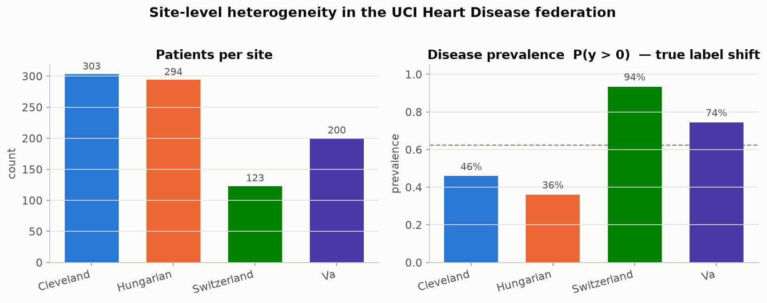
OUR DATASET
Patient counts and disease rates, by hospital
Disease prevalence swings from 36% at Hungary to 94% at Switzerland — a real difference in which patients each hospital sees, not a data-entry mistake.
Beyond Interoperability · Our Dataset
7
Notes:
This is notebook 00's first chart. Disease rates swing from 36% at Hungary to 94% at Switzerland. Hold onto that number -- it's half of a two-part story. This half is a real difference between patients. The next slide shows the other half: a difference that has nothing to do with the patients, only with what each hospital chose to write down.

Slide 9
OUR DATASET
Two very different kinds of hospital-to-hospital difference
Measurement | Cleveland | Hungary | Switzerland | V.A. | What kind of difference is this?
Cholesterol never recorded | 0.0% | 0.0% | 100.0% | 24.5% | Measurement habit (specific to one hospital)
Vessel count never recorded | 1.3% | 98.6% | 95.9% | 99.0% | Measurement habit (almost everywhere except Cleveland)
Thalassemia test never recorded | 0.7% | 90.5% | 42.3% | 83.0% | Measurement habit (almost everywhere except Cleveland)
How severe the disease is | mixed | skews healthy | skews sicker | mixed | Real difference in who the hospital sees
Beyond Interoperability · Our Dataset
8
Notes:
This table is the key idea for this whole section. The bottom row is a real difference between patients -- that's biology. The rows above it are just differences in what each hospital wrote down -- that's habit, not biology. Almost everything else in this section is evidence for one row or the other.

Slide 10
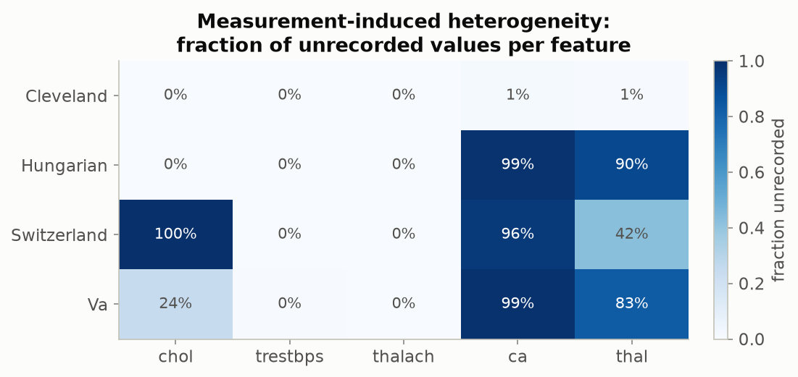
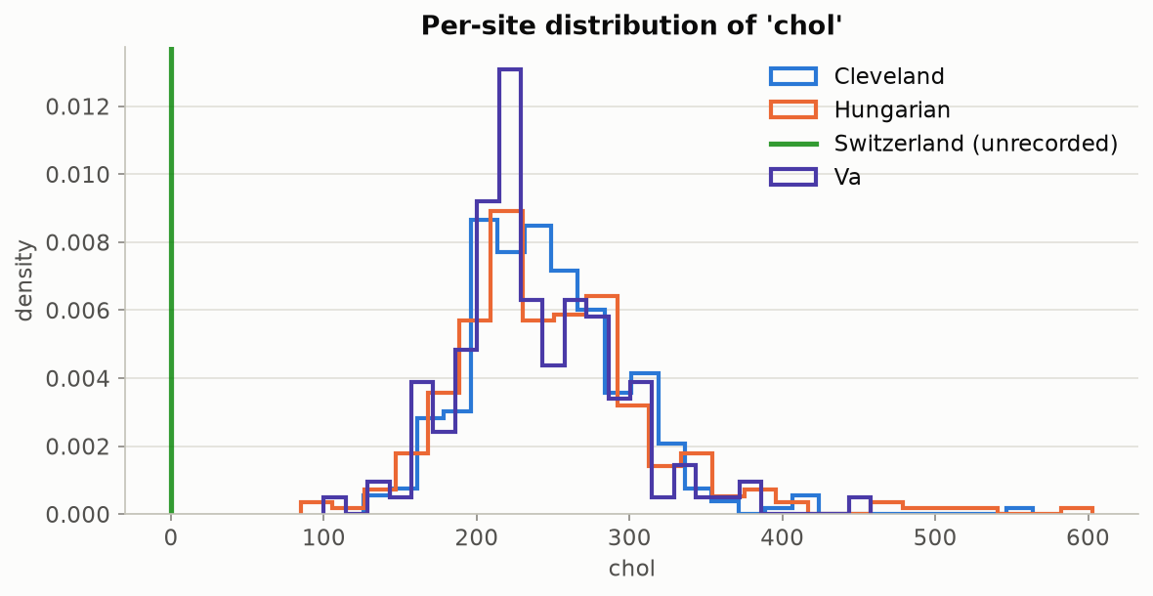
OUR DATASET
How much is missing, and what cholesterol looks like when it is recorded
Left: the fraction of patients missing each measurement, by hospital — cholesterol's complete 100% gap at Switzerland stands out, alongside the much bigger, near-universal gap in vessel count and thalassemia results outside Cleveland. Right: cholesterol values where they were actually recorded (Switzerland has none to show). Why is Switzerland at 100%? Every one of its patients has cholesterol coded as exactly 0 mg/dl in the original source file — a value that's biologically impossible for a living patient, so it's clearly a placeholder for “not measured,” not a real reading. This dataset was assembled from four separate hospital studies run independently in 1988–89, each using its own case-report form; the most likely explanation is that serum cholesterol simply wasn't part of the Zurich/Basel site's own data-collection protocol the way it was at Cleveland — a difference in what got tested, not a data-loss accident. No surviving documentation from the original study states this explicitly, so treat it as the best-supported reading of the evidence, not a confirmed fact.
Beyond Interoperability · Our Dataset
9
Notes:
These two charts are simpler than they look. The left one is a grid: each row is a hospital, each column is a measurement, and the color tells you what share of patients are missing that value -- darker means more missing. Look at Switzerland's cholesterol square: completely dark, 100%.
The right chart shows the actual cholesterol values for patients where we have them. Each colored line is one hospital's typical range. Switzerland has no line at all, just a flat spike at zero, because every single Swiss patient's cholesterol was recorded as exactly zero -- which isn't possible for a living person. So zero here means 'not measured,' not a real reading.
Why would a whole hospital skip this test? This dataset comes from four separate hospital studies, run on their own in 1988 and 1989, each with its own paperwork. Cholesterol was very likely just never part of the Zurich and Basel site's routine testing, the way it was at Cleveland. That's a difference in what got tested, not lost data. It's our best reading of the evidence, not a proven fact.
This is exactly the kind of habit-based gap this project is built to catch. Notebook 01 is where you compute this same percentage yourself.

Slide 11
OUR DATASET
A simple test: can you guess the hospital just from the patient's numbers?
 | Cleveland | Hungary | Switzerland | V.A.
Cleveland | 50 / 50 | 89% | 100% | 88%
Hungary | 89% | 50 / 50 | 100% | 93%
Switzerland | 100% | 100% | 50 / 50 | 88%
V.A. | 88% | 93% | 88% | 50 / 50
▪ Train a simple classifier whose only job is to guess which hospital a patient came from, using nothing but their clinical measurements — no diagnosis, no label. Every off-diagonal number here is how often it guesses right for that pair. 88%+ everywhere means: yes, easily.
Beyond Interoperability · Our Dataset
10
Notes:
Train the simplest possible model, and give it one job: guess which hospital a patient came from, using only their vital signs and lab values -- no diagnosis, no label. Look at these numbers: 88% or better, for every pair of hospitals. That's about as clear a sign as you can get that these are different patient groups, and the model doesn't even need to know who is sick.

Slide 12
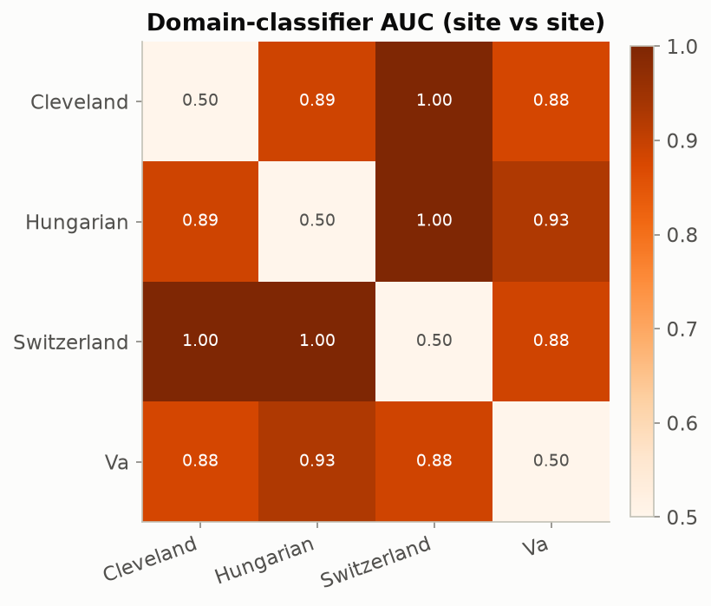
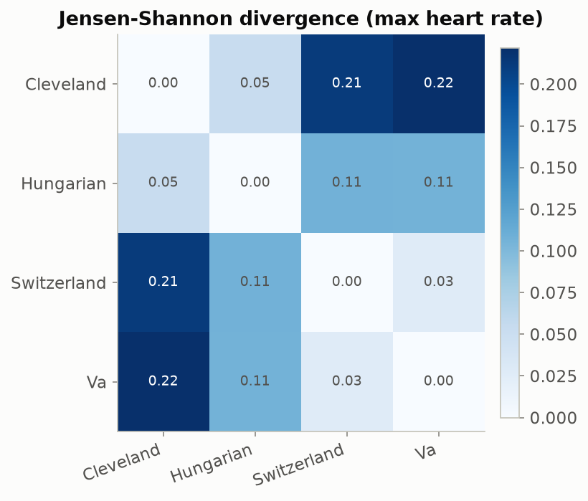
OUR DATASET
The same finding, confirmed a second, independent way
Left: the previous table's guess-the-hospital accuracy, drawn as a heatmap. Right: a completely different, classifier-free way of measuring how differently shaped two hospitals' data is — applied here to maximum heart rate — pointing to the same conclusion.
Beyond Interoperability · Our Dataset
11
Notes:
Both charts here answer the same question in two different ways: can you tell two hospitals apart just from the numbers?
The left chart uses a score called AUC, short for 'area under the curve.' Don't worry about the curve part -- all you need is this: AUC runs from 0.5 to 1.0. A score of 0.5 means a classifier is just guessing, like flipping a coin. A score of 1.0 means it can always tell the two groups apart, perfectly. Here, we train a simple classifier to guess 'which hospital did this patient come from,' for every pair of hospitals. Every score is 0.88 or higher -- far above 0.5 -- so these hospitals are easy to tell apart from their numbers alone.
The right chart checks the same idea a completely different way, with no classifier at all. It directly compares the shape of one measurement -- maximum heart rate -- between hospitals, using a score called Jensen-Shannon divergence. Bigger numbers mean the two hospitals' patients look less alike on that measurement. Cleveland and Switzerland score the highest, matching the AUC picture.
Two different methods, same answer -- so this isn't just one particular classifier being quirky. This is notebook 01, computing both of these yourself.

Slide 13
2
The Model
Learned Without Sharing Patient Data
HANDS-ON: notebook 03
Beyond Interoperability
13
Notes:
Now let's build the model itself -- what it is, and how three hospitals train it together without ever sharing their patients' records. Open notebook 03 when I say so.

Slide 14
THE MODEL
What the model actually is
▪ It's a multinomial logistic regression: a weighted combination of the 13 patient measurements, turned into a probability for each of the 5 severity classes (no disease, mild, moderate, severe, critical).
▪ About 70 numbers total — 13 measurements × 5 classes of weights, plus 5 bias terms, one per class — small enough to print out and read in full.
▪ It outputs a probability for every class, e.g. ‘58% no disease, 22% mild, 12% moderate, 5% severe, 3% critical’ — the raw material conformal prediction turns into a checkable prediction set.
▪ Nothing deep-learning about it — deliberately the simplest model that can still learn something real, so every number in this pipeline stays inspectable.
Beyond Interoperability · The Model
14
Notes:
This is a model you already know how to think about: a multinomial logistic regression. Thirteen clinical measurements go in -- age, cholesterol, maximum heart rate, and so on -- and out comes a probability for each of the five severity levels. Under the hood, it's about seventy numbers: one weight per measurement, per class, plus one bias term per class. Small enough to print out and actually read.
Here's why this matters later: conformal prediction doesn't care what kind of model made these probabilities. It only needs the probabilities themselves. So everything we build next works with any model, not just this one.

Slide 15
THE MODEL
Under the hood: how each hospital's nudge is computed
▪ In plain terms: after each hospital scores its own patients, it looks at how far off those scores were and nudges its copy of the model a small step in the direction that would have made them less wrong. Repeated a few times, that's “training.”
▪ The loss it's minimizing: cross-entropy (how wrong the predicted probabilities were) plus a small penalty that discourages overly large weights: L(θ) = −mean(log P[i, yᵢ]) + (λ/2)·‖W‖², λ = 1e-2.
▪ The update rule: θ ← θ − lr·∇L(θ) — a fixed small step, repeated a few times per round, at every hospital. No shortcuts or acceleration tricks, so every line of it is something you can read and hand-verify.
Beyond Interoperability · The Model
15
Notes:
In plain terms, a 'nudge' works like this: each hospital looks at how wrong its guesses were, then adjusts its copy of the model a small step toward being less wrong. Do that a few times, and that's training. The formulas on this slide are for anyone who wants the exact math -- a standard cross-entropy loss with a small penalty against large weights, updated by ordinary gradient descent. Every line of it lives in src/fedconformal/federated.py, if you want to match the code to the formulas.

Slide 16
THE MODEL
How the hospitals train one shared model together
▪ One shared model learns to weigh each of the 13 patient measurements and combine them into a severity guess — nothing fancier than a weighted combination, about 70 numbers total, small enough to print out and read.
▪ Each round, the server sends the current shared model out to the three training hospitals — Cleveland, Hungary, the V.A. Patient records themselves never leave any hospital; only the model's numbers travel.
▪ Each hospital nudges its own copy slightly, using only its own patients, to make it fit its local data a bit better.
▪ The server then averages the three nudged copies back into one, weighting each hospital by how many patients it contributed — a bigger hospital's nudge counts for more.
▪ That whole cycle repeats 200 times. Switzerland is deliberately left out of training entirely, so it can later serve as a genuinely unseen hospital.
Beyond Interoperability · The Model
16
Notes:
Open notebook 03 now. One shared model -- the seventy numbers from the last slide -- gets sent out to three hospitals: Cleveland, Hungary, and the V.A. Patient records never leave their hospital; only those numbers travel. Each hospital nudges its own copy using only its own patients. Then the server averages the three nudged copies back into one model, giving more weight to hospitals with more patients.
Run the training cell now -- it repeats this cycle 200 times. Notice that Switzerland is left out on purpose, so it can serve later as a hospital the model has truly never seen.

Slide 17
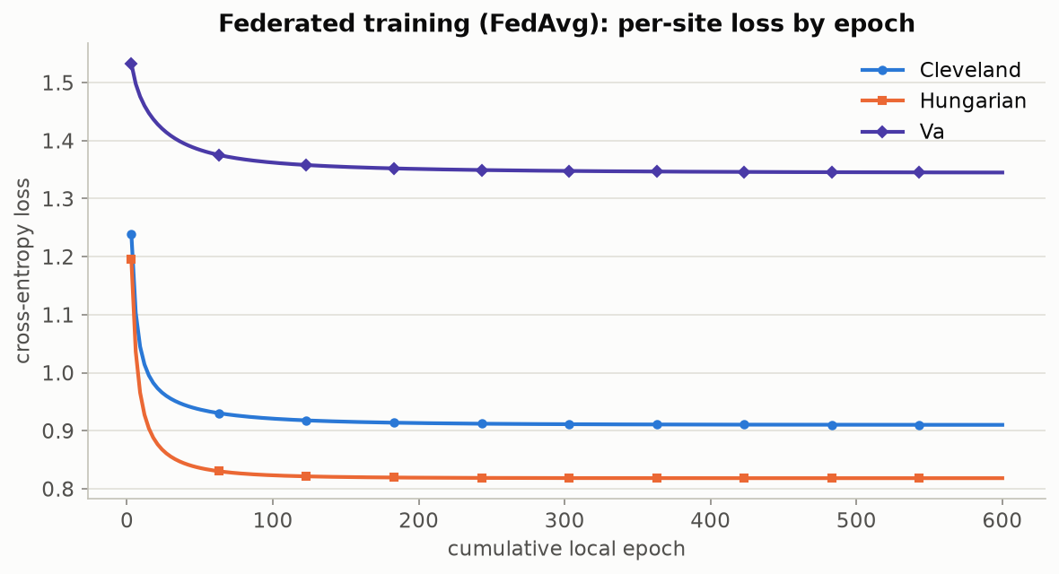
THE MODEL
Confirming the training actually finished learning
Each line is one hospital's cross-entropy loss during training, computed on that hospital's own patients — the same 797 patients (Cleveland 303, Hungary 294, V.A. 200) the model is actively learning from. All three are still dropping visibly early on and go essentially flat by round ~150, a sign that training ran long enough to settle. Switzerland's 123 patients never appear on this chart at all — it takes no part in training, so there is no loss curve for it here.
Beyond Interoperability · The Model
17
Notes:
Your training cell should produce a chart like this one. Each line is one hospital's cross-entropy loss, measured on that hospital's own patients as it trains -- Cleveland, Hungary, and the V.A., about 797 patients between them. All three drop quickly at first, then flatten out by round 150. That flat line tells us training ran long enough to settle down, instead of being stopped too early.
Notice who is missing: Switzerland. It never appears on this chart, because it never takes part in training at all -- no loss curve, nothing. That's on purpose, so it can serve later as a hospital the model has genuinely never seen.

Slide 18
THE MODEL
Training accuracy, and test accuracy at a hospital it never saw
Hospital | Shared-model accuracy | Hypothetically-pooled accuracy
Cleveland (training) | 60.7% | 61.1%
Hungary (training) | 71.1% | 70.7%
Switzerland (test — never trained on) | 21.1% | 20.3%
V.A. Long Beach (training) | 44.0% | 44.0%
▪ Cleveland, Hungary, and the V.A. rows are training accuracy — the model has seen these patients. Switzerland is test accuracy — a hospital held out entirely, never trained on.
▪ “Pooled” is a hypothetical reference point: a model trained as if every patient record could sit in one place, which this project could never actually do with real hospital data. Federated training, without ever pooling data, lands within about a point of it everywhere.
▪ The loss chart on the previous slide only shows these same three training hospitals. Switzerland shows up for the first time right here, in this table — the one hospital never included in training, evaluated now for the first time.
Beyond Interoperability · The Model
18
Notes:
This table answers two questions at once. First: training accuracy versus test accuracy. Cleveland, Hungary, and the V.A. are training accuracy -- the model has already seen these patients. Switzerland is test accuracy, at a hospital the model never trained on, and it's much lower, around 21%. These are the exact same three training hospitals from the loss chart on the last slide -- Cleveland, Hungary, and the V.A. Switzerland never appeared on that chart either; this table is the first place it gets evaluated at all.
Second: does training this way, without sharing data, cost us anything compared to pooling every hospital's records in one place -- something we could never really do with patient data? Compare the two columns: the federated model lands within about a point of the pooled version, everywhere.
One thing worth saying clearly: Switzerland's low accuracy here is a separate story from the result coming up next. Accuracy asks 'did it get the diagnosis right.' Coverage asks 'did the true answer make it into the prediction set.' We are about to focus entirely on that second question.

Slide 19
3
Conformal Prediction
Checking Whether We Can Trust the Model
HANDS-ON: notebook 02
Beyond Interoperability
19
Notes:
This is the center of today. We have a model, and we've trained it across hospitals. Now the question is: how do we know whether to trust it at a hospital it has never seen? That's what conformal prediction checks. In a moment, open notebook 02 -- you'll build a conformal predictor yourself in about five lines of code.

Slide 20
CONFORMAL PREDICTION
An everyday version of the problem
A weather forecaster who says “90% chance of rain” should be right about 9 days out of 10 whenever they say that. If they're only right 6 times out of 10, you stop trusting the number — even though every individual forecast still sounded confident.
A model that reports “92% confident” should work the same way. Conformal prediction is the tool that checks whether it actually does — and says so honestly when it doesn't.
Beyond Interoperability · Conformal Prediction
20
Notes:
A weather forecaster who says '90% chance of rain' should be right about 9 days out of 10, every time they say that number. If they're only right 6 times out of 10, the number stops meaning anything -- even though every single forecast still sounded confident. A model that says '92% confident' should work the same way. Conformal prediction is the tool that checks whether it actually does.

Slide 21
CONFORMAL PREDICTION
The problem: a model can sound confident and still be wrong
▪ A model says “92% chance of heart disease.” That number is not automatically trustworthy — nothing forces the model to actually be right 92% of the time.
▪ Move that same model to a new hospital, and it often keeps sounding just as confident even while its real, checkable accuracy quietly drops.
▪ The model has no way to know it has left home. It can't tell you it's now guessing in unfamiliar territory — that silence is the dangerous part.
▪ Getting data to move between hospitals is a separate problem from whether the model's judgment still holds once it's there — solving the first does nothing for the second.
Beyond Interoperability · Conformal Prediction
21
Notes:
A model says it is 92% confident. That number sounds precise, but nothing forces it to actually be right 92% of the time -- it's just a number the model outputs. Move that same model to a new hospital, and it often keeps sounding just as confident, even while its real accuracy quietly drops. The model has no way of knowing it has left home. And this is a separate problem from getting data to move between hospitals in the first place -- solving that does nothing for whether the model's judgment still holds once it gets there.

Slide 22
CONFORMAL PREDICTION
What conformal prediction actually gives you
▪ Instead of one confident guess, it hands back a short list of plausible answers — for example, “the true severity is somewhere in {1, 2, 3}.”
▪ That list comes with a promise attached: statements built this way are right at least 90% of the time, if you ask for 90%. Not a hope — a guarantee you can go check.
▪ The guarantee holds no matter how good or bad the underlying model is — the only thing it needs is that the patients used to set the threshold look statistically like the patients it's later asked to judge.
▪ When a new hospital's patients don't look like that anymore, the promise breaks — and because we can measure the promise, we can catch the break instead of it happening silently.
Beyond Interoperability · Conformal Prediction
22
Notes:
Instead of one confident guess, conformal prediction hands back a short list of likely answers -- for example, 'the true severity is somewhere in {1, 2, 3}.' That list comes with a guarantee: built this way, it's right at least 90% of the time, if that's what you asked for. The guarantee doesn't need the model to be any good. It only needs one thing: the patients used to set the threshold must look statistically like the patients it's later used on. When a new hospital's patients stop looking like that, the guarantee breaks -- and because we can measure it, we catch the break instead of it happening silently.
Open notebook 02 now and run the cells. You'll build exactly this kind of list yourself, in about five lines of code.

Slide 23
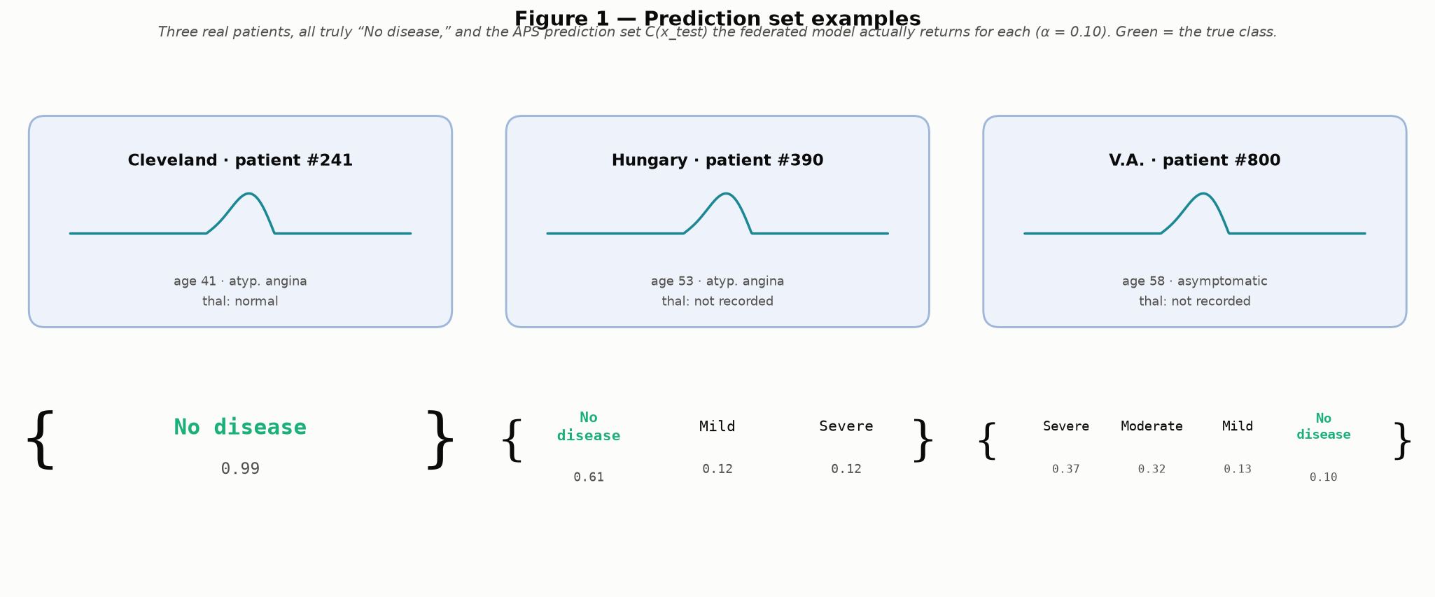
CONFORMAL PREDICTION
What a prediction set actually looks like
Three real patients from this project's data, all truly "No disease," and the list of plausible answers the calibrated model actually returns for each — a confident single answer, a so-so 3-answer list, and a genuinely unsure 4-answer list. In that hardest case, the model's own best guess is wrong — yet the correct answer, "No disease," still made the list. That is the whole point of the guarantee: even when the model is confused, the true answer still shows up somewhere in what it hands you.
Beyond Interoperability · Conformal Prediction
23
Notes:
Each box on this slide is one real patient, and every curly bracket below shows the list of answers the model actually returned for them, all truly 'no disease.' Read it like this: the model looked at the patient's numbers, and instead of picking one answer, it handed back every answer it wasn't confident enough to rule out.
Look at the hardest case, on the right: the model's own top guess is actually wrong there. And yet 'no disease,' the true answer, still made the list. That is the whole point of the guarantee -- even when the model is confused, the true answer still shows up somewhere in the list it hands you. The next two slides explain exactly how that list gets built.

Slide 24
CONFORMAL PREDICTION
The one assumption everything rests on
▪ In plain terms: the patients used to set the threshold have to look statistically like the patients the model will later be asked to judge. Statisticians call this “exchangeability” — think of it as “no surprises between calibration and deployment.”
▪ It does not require the data to follow a bell curve, or be cleanly separable, or come from any particular kind of model — about as weak and general an assumption as a guarantee can rest on.
▪ This is exactly the assumption cross-hospital deployment can break outright: Cleveland's patients (46% have any disease) and Switzerland's patients (94% have any disease) simply don't look alike statistically.
▪ This dataset was chosen specifically because it breaks that assumption in a real, measurable way — so the failure is something you can see and quantify, not just describe.
Beyond Interoperability · Conformal Prediction
24
Notes:
Everything we've built rests on one assumption. Statisticians call it 'exchangeability.' Here's the plain version: the patients you use to set your threshold must look statistically like the patients you'll use it on later. No surprises between calibration and real use. It doesn't need bell-curve data, and it doesn't need any particular kind of model -- about as light an assumption as you can ask for, which is why it works with any model.
And here's the key point: moving a model between two very different hospitals can break this outright. In Cleveland, 46% of patients have any disease. In Switzerland, it's 94%. Those two groups don't look statistically alike -- and that gap is exactly what we're about to measure.

Slide 25
CONFORMAL PREDICTION
The recipe, in three steps: score, find a cutoff, draw the boundary
▪ Step 1 — score: for every calibration patient, ask “how surprising was their true answer to the model?” We use the simplest version: score = 1 − the model's predicted probability on the true class. A confident, correct answer scores low; a confident, wrong answer scores high.
▪ Step 2 — find a cutoff: sort those scores and take a percentile near the top, called q̂. Formally, q̂ = Quantile(calibration scores; ⌈(n + 1)(1 − α)⌉ / n) — the ceiling and the “+1” are a small correction so the guarantee is exact even with a limited number of patients.
▪ Step 3 — draw the boundary: for a new patient, keep every class whose score doesn't clear that cutoff: C(x) = { y : s(x, y) ≤ q̂ }. That set — sometimes one class, sometimes several — is the “prediction set” from the previous slide.
▪ The guarantee this produces: P(true answer is in the returned set) ≥ 1 − α — true for any underlying model, confident or not.
Beyond Interoperability · Conformal Prediction
25
Notes:
Three steps: score, cutoff, boundary. Score -- for every calibration patient, ask how surprising their true answer was, using score = 1 minus the model's probability on the true class. Cutoff -- sort those scores and pick a percentile near the top, call it q-hat. The small correction in the formula just makes sure the guarantee holds exactly, not only on average. Boundary -- for a new patient, keep every class whose score doesn't clear that cutoff. That's exactly how every list on the last slide was built, and it's the same few lines you ran in notebook 02.

Slide 26
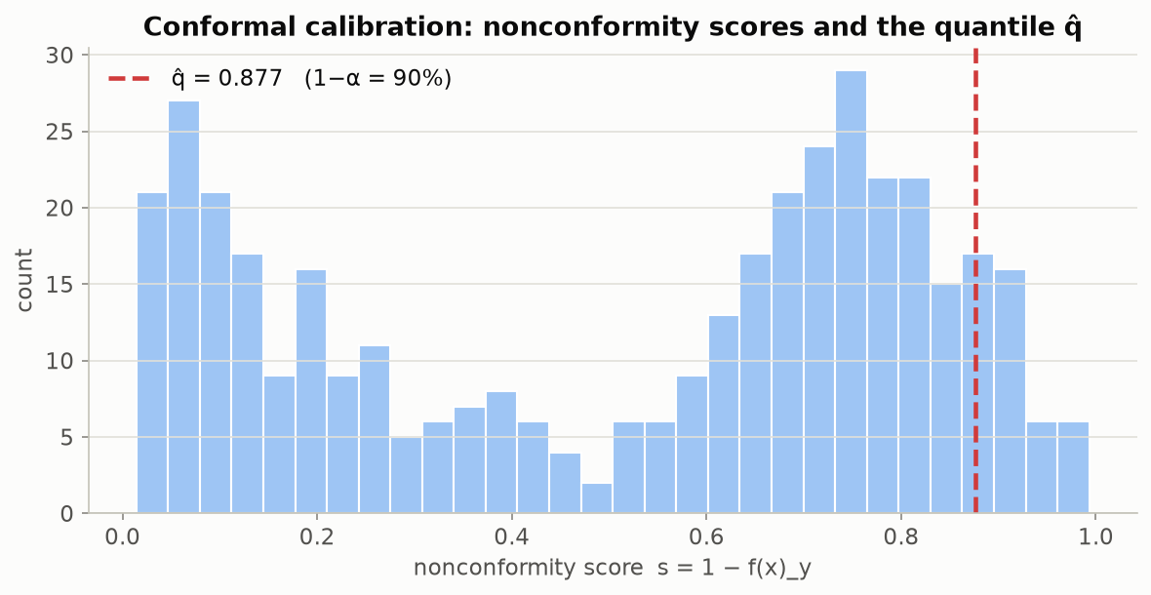
CONFORMAL PREDICTION
Not a toy example — this project's own numbers
Every one of these bars is a real calibration score from this project's own federated model, trained across Cleveland, Hungary and the V.A. The red line is the cutoff q̂ — everything to its left is what makes the 90% promise hold.
Beyond Interoperability · Conformal Prediction
26
Notes:
This chart is a histogram: each bar shows how many calibration patients landed at that surprise score, and taller bars mean more patients. Every bar here comes from our own federated model -- nothing made up. The red dashed line is the cutoff, q-hat. Everything to its left is what makes the 90% guarantee hold. This is the real number our pipeline computed, not a textbook illustration.

Slide 27
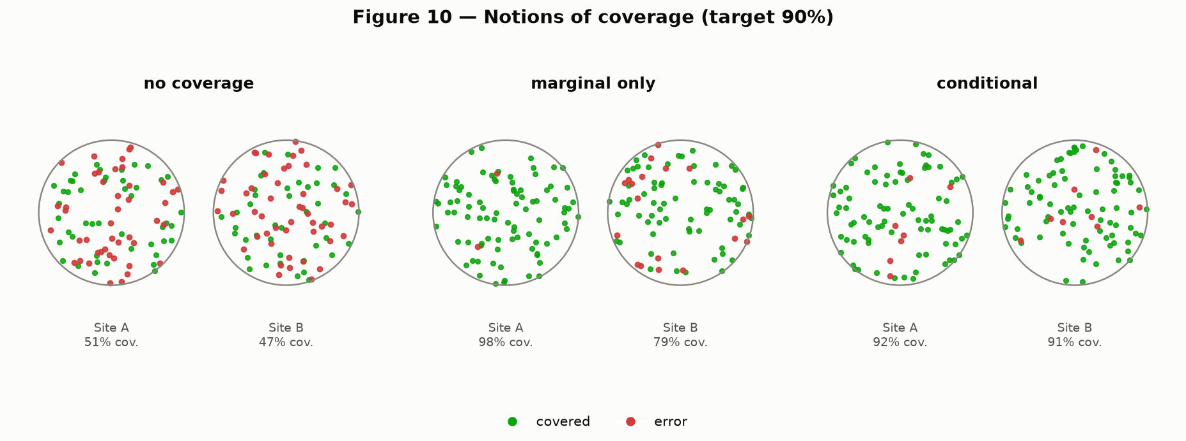
CONFORMAL PREDICTION
Two ways an average can lie to you
Picture two patient groups. Left: no promise at all — the model could be right any fraction of the time. Middle: the promise holds only on average — the two groups' results are blended together, so one can quietly fail while the blended number still looks fine. Right: the promise holds for every group separately — nothing is hidden by blending. Recreation of Angelopoulos & Bates (2022), Figure 10.
Beyond Interoperability · Conformal Prediction
27
Notes:
Each dot here stands for one patient. A green dot means the true answer was in the model's list; a red dot means it was missed. Look at the three panels left to right. On the left, both hospitals miss constantly -- no guarantee at all. In the middle, one hospital does great and the other does poorly, but if you only looked at the combined average, it would still look fine -- that's the trap. On the right, both hospitals hit the target -- the guarantee holds everywhere, not just on average. 'Meets the target on average' and 'meets the target everywhere' are different claims, and only the second one is safe to rely on.

Slide 28
4
The Headline Result
Watching the Guarantee Break
HANDS-ON: notebook 04
Beyond Interoperability
28
Notes:
This is where everything comes together. We calibrate using only one hospital's patients, then use that same model and threshold at a hospital it has never seen. Open notebook 04 in a moment.

Slide 29
THE HEADLINE RESULT
Setting the threshold that makes the promise exact
▪ Once the shared training rounds finish, the model's numbers are frozen — nothing about the model itself changes again from this point on.
▪ Each training hospital's patients are then split in half: one half sets the threshold (calibration), the other half is kept aside purely to double-check it later — neither half was used to train the model in the first place.
▪ The frozen model scores the calibration half only; those scores are what the “score, cutoff, boundary” recipe from earlier runs on.
▪ The cutoff picked from those scores becomes q̂ — the one and only number this whole process still has to “fit” once the model itself is done training.
▪ That cutoff is only trustworthy for patients who look statistically like the ones it was set on — which is exactly the assumption the next slide puts to the test.
Beyond Interoperability · The Headline Result
29
Notes:
Training is done, and the model is frozen -- nothing about it changes from here on. Each training hospital's patients get split in half. One half sets the threshold; the other half is set aside just to double-check it later. Neither half was used in training. That threshold, q-hat, is the one number still left to set once the model is done. And it's only trustworthy for patients who look statistically like the ones it was set on. Let's put that claim to the test.

Slide 30
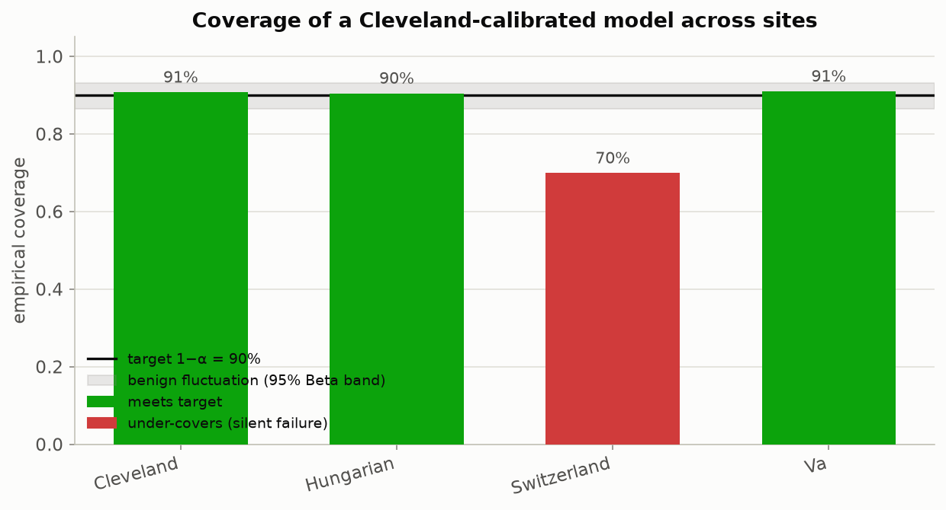
THE HEADLINE RESULT
The headline result: watch the promise break
A conformal predictor is calibrated using only Cleveland's patients, then deployed at all four hospitals unchanged. It keeps its 90% promise at Cleveland, Hungary and the V.A. — and silently drops to 71% at Switzerland. The shaded band marks ordinary random wobble; 71% falls well outside it, so this is a real effect, not noise.
Beyond Interoperability · The Headline Result
30
Notes:
This bar chart is the single most important figure today. Each bar is one hospital, and the height shows how often the true answer actually landed in the model's prediction set -- what we call coverage. The black line marks our 90% target, and the gray band around it is normal, expected wobble.
Here's the setup: we set the threshold using only Cleveland's 303 patients. Then we use that same model and threshold at all four hospitals, including Switzerland, which it never trained or calibrated on. No retraining, no adjusting, no peeking at Switzerland's answers first.
Cleveland: 91%. Hungary: 90%. The V.A.: 91%. Switzerland: 70%, shown in red because it falls well outside the gray band. That is a real, measurable failure, and we caught it only because we checked.

Slide 31
THE HEADLINE RESULT
Why you have to check every site, not just the average
Deployment site | Empirical coverage | Gap vs. 90% promise | Verdict
Cleveland (calibration site) | 90.8% | +0.8 pp | Promise kept
Hungary | 90.8% | +0.8 pp | Promise kept
V.A. Long Beach | 90.5% | +0.5 pp | Promise kept
Switzerland (held out entirely) | 70.7% | −19.3 pp | Promise broken, silently
▪ Calibrated only on Cleveland's 303 patients. Blend all four sites into one overall coverage number and it lands close to 90% — looking perfectly healthy. Only by checking Switzerland on its own does the 19-point failure become visible.
Beyond Interoperability · The Headline Result
31
Notes:
This table lays out the same story in numbers. Each row is one hospital: how often the model actually hit the target, how far that is from our 90% goal, and whether the promise held.
Here's the trap: if you blended all four hospitals into one overall number, it would land close to 90% and look perfectly healthy -- completely hiding Switzerland's failure. The only way to catch it is to check every hospital on its own, never just the average. That check is cheap. You can add it to any model already running today.

Slide 32
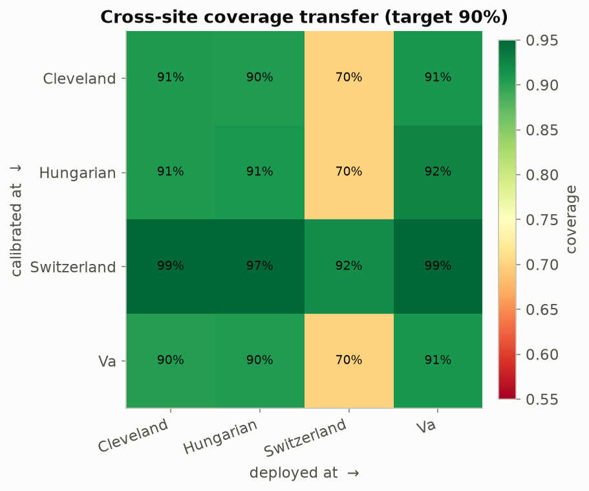
THE HEADLINE RESULT
Every hospital pair, tested at once
Each row is 'the hospital we set the threshold using'; each column is 'the hospital we then deploy at.' Reading straight down the diagonal (same hospital both times) is always healthy. Anything set using Cleveland, Hungary or the V.A. and then deployed at Switzerland lands around 70-72%; a threshold set using Switzerland instead over-delivers everywhere else. All four hospitals recorded the same 13 measurements used by the model: age, sex, chest pain type, resting blood pressure, cholesterol, fasting blood sugar, resting ECG result, maximum heart rate, exercise-induced chest pain, ST depression, ST slope, number of major vessels, and thalassemia test result.
Beyond Interoperability · The Headline Result
32
Notes:
Let's check all sixteen possible pairings at once. Each row is 'which hospital we used to set the threshold'; each column is 'which hospital we then used it at.' Reading straight down the diagonal -- same hospital both times -- is always healthy.
Look at the Switzerland column: anything set using Cleveland, Hungary, or the V.A. lands around 70 to 72% there. Now flip it around: set the threshold using Switzerland instead, and it doesn't fail elsewhere -- it over-delivers, because Switzerland has the sickest patients, so its threshold ends up looser everywhere else. These mismatches don't always fail in the scary direction, but they're still worth catching every time.
All of this uses the same 13 measurements as the model on slide 13: age, sex, chest pain type, resting blood pressure, cholesterol, fasting blood sugar, resting ECG result, maximum heart rate, exercise-induced chest pain, ST depression, ST slope, number of major vessels, and thalassemia test result.

Slide 33
WRAP-UP
Where this stands, and what's honestly still missing
▪ For what it set out to do, yes — every claim on these slides is backed by a figure anyone can reproduce by running the notebooks, and automated tests confirm the underlying math is implemented correctly.
▪ It correctly tells apart real population differences from measurement gaps, and it shows the coverage guarantee breaking concretely, with real numbers, not just in theory.
▪ What's honestly still missing: robustness checks on more than one clinical question, coverage checks broken out by patient subgroup (not just by hospital), a flag for “was this value filled in or actually measured,” a first real attempt at fixing the problem rather than just detecting it, a genuinely new fifth hospital never touched during development, and a more adaptive scoring rule than the simple one shown here.
Beyond Interoperability · Wrap-Up
33
Notes:
Let's be honest about where this stands. For what it set out to do -- yes. Every claim on these slides is backed by a chart anyone can reproduce by running these notebooks, and automated tests confirm the underlying math is correct. It tells apart real population differences from measurement habits, and it shows the coverage guarantee breaking with real numbers, not just in theory.
But I want to be equally honest about what's still missing: checking this on more than one clinical question, coverage broken out by patient subgroup and not just by hospital, a flag for whether a value was truly measured or just filled in, a real first attempt at fixing this rather than only detecting it, a genuinely new fifth hospital, and a more adaptive scoring method than the simple one shown here.

Slide 34
REFERENCES
▪ A. N. Angelopoulos & S. Bates. “Conformal Prediction: A Gentle Introduction.” FTML 16(4), 2023. — the main source behind the score/cutoff/boundary recipe, in a genuinely readable form.
▪ H. B. McMahan et al. “Communication-Efficient Learning of Deep Networks from Decentralized Data.” AISTATS 2017. — introduces FedAvg, the training method built from scratch in notebook 03.
▪ J. O. du Terrail et al. “FLamby: Datasets and Benchmarks for Cross-Silo Federated Learning.” 2022. — uses this same four-hospital population as a recognized benchmark.
▪ R. Detrano et al. “International Application of a New Probability Algorithm for the Diagnosis of Coronary Artery Disease.” Am. J. Cardiology, 1989. — the original clinical study behind this dataset.
▪ UCI Machine Learning Repository. “Heart Disease” dataset (ID 45). archive.ics.uci.edu/dataset/45/heart+disease.
Beyond Interoperability · References
34
Notes:
One pointer before we wrap up: if you want to go deeper, start with Angelopoulos and Bates. It's written to be genuinely easy to read, with no advanced statistics background assumed, and it's the source behind the recipe we just walked through.

Slide 35
Thank you
Questions & discussion
fedconformal-clinical toolkit — Arnab Mukherjee
Oklahoma State University — Center for Health Science, Tulsa
arnab.mukherjee@okstate.edu
Notes:
Let's close the loop. We built a simple, readable model -- a multinomial logistic regression. We trained it across three hospitals without ever sharing their patient records -- that's federated learning, notebook 03. Then we wrapped it in a conformal predictor that checks, with one real number, whether we can trust it somewhere new -- notebook 02.
We watched that number hold at 90% for three hospitals, then quietly drop to 70% the moment we used it at a hospital the model had never seen. That's the whole talk: build the model, train it across hospitals, and use conformal prediction to know when to stop trusting it. Let's open it up -- what questions do you have?

