Slide 1
Beyond Interoperability
Hands-On Federated ML for Research Data Curation Infrastructure
Technical Companion: Conformal Prediction for Site-Level Heterogeneity in Federated Clinical Data
UCI Heart Disease federation · 4 hospitals · 920 patients
Arnab Mukherjee
Oklahoma State University — Center for Health Science, Tulsa
[Workshop / venue name and date — add here]

Slide 2
ABSTRACT
The one idea to remember from today
▪ Getting data to move between hospitals is a solved problem. Getting that data to mean the same thing once it arrives is not — and that gap is what this whole workshop is about.
▪ The worst kind of failure is a model that looks perfectly healthy on average while quietly getting one hospital's patients wrong — with nothing in its own output warning you it happened.
▪ This workshop uses a tool called conformal prediction to catch that kind of silent failure, and to measure exactly how much two hospitals' data actually differ, before anyone trusts a shared model on both.
▪ The goal: tell apart genuine differences between patient populations from differences that are really just measurement habits — and give a curation team a concrete number they can act on, not a vague worry.
▪ It's hands-on throughout: real Python exercises, code you can reuse, and diagnostics you can point at your own data after today.
Beyond Interoperability · Abstract
2

Slide 3
AGENDA
What this deck covers
▪ 1. Introduction
▪ 2. Challenges
▪ 3. Motivation
▪ 4. The Difficulty of Working With Real Clinical Data
▪ 5. Our Dataset: The UCI Heart Disease Federation
▪ 6. Methods of Interoperability
▪ 7. Why Conformal Prediction Helps
▪ 8. The Mathematics
▪ 9. Pipeline Walkthrough
▪ References & Appendix
Beyond Interoperability · Agenda
3

Slide 4
AGENDA
Workshop notebook sequence
# | Notebook | What it does | Runs during
00 | input_data_exploration.ipynb | Load the 4 raw hospital files, inspect columns, first-look plots | Section 5 — Our Dataset
01 | site_heterogeneity.ipynb | Missingness, label shift, covariate shift, domain-classifier alarm | Section 5 — Our Dataset
02 | conformal_basics.ipynb | Build a LAC conformal predictor from scratch in ~5 lines of NumPy | Section 7 / 8 — Conformal Prediction & the Math
03 | federated_training.ipynb | Implement FedAvg from scratch; train the shared model across 3 sites | Section 9 — Pipeline (Training)
04 | conformal_under_site_shift.ipynb | Calibrate on Cleveland only, deploy everywhere — the coverage break | Section 7 & 9 — Headline Result / Deployment
05 | recreating_paper_figures.ipynb | Recreate the Angelopoulos & Bates illustrations on this project's data | Section 8 — The Mathematics
06 | chest_pain_multiclass.ipynb | Repeat the full pipeline on a second, independent target | Section 9 — Robustness (chest-pain task)
07 | task_comparison.ipynb | Compare heterogeneity and set sizes, disease vs. chest-pain, side by side | Section 9 — Robustness
▪ Run these in order, 00 → 07 — each takes roughly 10-20 minutes and produces some of the figures shown later in this deck.
▪ Every notebook is a narrated walk-through of the same reusable code library — nothing is built twice, so what you see live is exactly what generated every slide.
▪ Two extra clinical questions (Section 9's resting-ECG and exercise-angina results) come from a standalone script rather than a dedicated notebook — flagged again when that part of the deck is reached.
Beyond Interoperability · Agenda
4

Slide 5
1
Introduction
Beyond Interoperability
5

Slide 6
INTRODUCTION
Moving data and trusting data are two different problems
▪ “Interoperability” means two computer systems can send and read each other's data without a person manually translating in between. That part is largely solved today.
▪ It says nothing about whether the data means the same thing once it lands somewhere new.
▪ A concrete example: two hospitals can both have a “cholesterol” field, in the exact same format, in the exact same spot — and still be describing a different measurement habit, if one hospital tests every patient and the other only tests when there's a specific reason to.
▪ That gap — data successfully arriving vs. data being safe to trust the same way everywhere — is the problem this entire project is built around.
Beyond Interoperability · Introduction
6

Slide 7
INTRODUCTION
Conformal prediction: a tool for catching that gap
▪ Think of it as a wrapper you can put around any existing model — it turns a single confident guess into a short, honest list of plausible answers.
▪ It comes with a promise: build enough of these lists, and the true answer will be somewhere on the list at least as often as you asked for (say, 90% of the time) — but only measured at the hospital the model was calibrated on.
▪ Take that same model and list-building recipe to a second hospital, and the promise is only as good as the assumption that the two hospitals' patients look statistically alike.
▪ When they don't look alike, the promise breaks — and, crucially, breaks in a way you can measure and point to, instead of failing silently the way a raw confidence score does.
Beyond Interoperability · Introduction
7

Slide 8
INTRODUCTION
What you'll actually build today
▪ The real UCI Heart Disease dataset, loaded from its four original hospitals: Cleveland, Hungary, Switzerland, and the V.A. Long Beach — not a cleaned-up, pre-packaged version.
▪ A federated-learning simulator, built from scratch, so you can see exactly how hospitals train one shared model without ever pooling their patients' records.
▪ A conformal-prediction library, also built from scratch, implementing the two list-building recipes used throughout the workshop.
▪ A full set of diagnostics for telling apart “these hospitals' patients are genuinely different” from “these hospitals just measure things differently.”
▪ Dozens of figures, each paired with a plain-language explanation, the math behind it for anyone who wants it, and an honest note on what's solid versus what would need more work.
Beyond Interoperability · Introduction
8

Slide 9
2
Challenges
Beyond Interoperability
9

Slide 10
CHALLENGES
Five things that make this genuinely hard
▪ Telling apart a real difference between patient populations from a difference that's just how carefully something was measured — with no outside answer key to check against.
▪ Silent failure: a model's own confidence score gives you no warning at all that it has wandered outside the population it was trained on.
▪ You usually can't just combine everyone's data to sidestep the first two problems — patient records typically have to stay inside their own hospital by law and policy.
▪ Two hospitals using the identical data format doesn't mean they mean the same thing by every field — shared structure isn't shared meaning.
▪ The usual scorecards (overall accuracy, one blended coverage number) hide every one of the above — you need to check results broken out by hospital, by diagnosis, and by patient subgroup to see any of it.
Beyond Interoperability · Challenges
10

Slide 11
3
Motivation
Beyond Interoperability
11

Slide 12
MOTIVATION
Why this matters right now, not just academically
3.1 AI in medicine is moving faster than cross-hospital checking
▪ A model that tests well at one hospital regularly does worse at another — different patient mix, different equipment, different measurement habits all play a role.
▪ Regulators are catching up: the FDA's approach to AI-based medical software now expects tracking of real-world performance after deployment, broken out by patient subgroup — not just one number measured before launch.
3.2 Federated learning has gone from research idea to practical necessity
▪ The core method used in this workshop (FedAvg) was introduced by McMahan et al. in 2017, and quickly became well known through its use in mobile phone keyboard prediction.
▪ In healthcare specifically, gathering every hospital's patient records into one place is often simply not legally possible — so this approach is closer to the only option than a stylistic preference.
▪ A well-known 2022 benchmark collection (FLamby) uses this exact same four-hospital dataset as its own standard test case — this is a recognized, real testbed, not an invented toy problem.
Beyond Interoperability · Motivation
12

Slide 13
MOTIVATION
Rules require the data to move; they don't require it to mean the same thing
3.3 Current data-sharing rules mandate that data CAN move, not that it means the same thing everywhere
▪ In the US, federal rules now require standardized APIs for health data exchange, and a nationwide exchange network is already operating.
▪ The EU has its own parallel regulation (the European Health Data Space), phasing in from 2027.
▪ Both kinds of rules guarantee the bytes can travel between systems — neither one guarantees that a value means the same clinical fact once it arrives somewhere new.
3.4 A checkable uncertainty number fills exactly that gap
▪ Conformal prediction's promise doesn't depend on assuming any particular shape for the data — it works essentially the same way regardless of what the underlying numbers look like.
▪ It doesn't require the model to be any particular type, or built any particular way.
▪ It hands a reviewer a number they can go check for themselves empirically — not something they have to simply take on faith.
Beyond Interoperability · Motivation
13

Slide 14
MOTIVATION
The gap this workshop is built to close
Hospitals today can share data with each other. What's still missing is a checkable way to know whether that shared data can actually be trusted the same way once it arrives — this workshop's toolkit exists to make that trust something you can measure, not just assume.
Beyond Interoperability · Motivation
14

Slide 15
4
The Difficulty of Working With Real Clinical Data
Beyond Interoperability
15

Slide 16
REAL CLINICAL DATA
Stacking up the barriers to a public download
Barrier | What it requires | What that means in practice
Ethics review | Formal review or a documented exemption for nearly any use of patient records | Weeks to months, repeated at every hospital involved
Privacy protections | Careful, expert-verified removal of identifying details | Requires dedicated specialized expertise
Data-sharing agreements | A negotiated legal contract between every pair of institutions sharing data | Gets harder roughly by the square of how many hospitals are involved
Access credentialing | Signed agreement plus required training, per individual researcher | Days to weeks, and has to be renewed periodically
Net effect | Most clinical data never becomes a public, freely reusable research dataset | Federated learning becomes close to a practical necessity, not a preference
Beyond Interoperability · Real Clinical Data
16

Slide 17
5
Our Dataset
The UCI Heart Disease Federation
HANDS-ON: notebooks 00, 01
Beyond Interoperability
17

Slide 18
OUR DATASET
Why this particular dataset
▪ Four real, independent hospitals all filled out the exact same intake form — so the data genuinely can move between them cleanly.
▪ And yet, underneath that shared form, the four hospitals' patients and practices differ in ways that genuinely matter.
▪ Every difference shown in this section is a real effect actually present in the data — nothing here was constructed or exaggerated to make a point.
▪ It carries none of the access barriers just described in Section 4 — open, free to use, and properly citable.
Beyond Interoperability · Our Dataset
18

Slide 19
OUR DATASET
Variable dictionary (UCI Heart Disease, ID 45)
Variable | Role | Type | Description | Units | Missing
age | Feature | Integer | Age of the patient | years | no
sex | Feature | Categorical | Sex of the patient | – | no
cp | Feature | Categorical | Chest pain type | – | no
trestbps | Feature | Integer | Resting blood pressure (on admission) | mm Hg | no
chol | Feature | Integer | Serum cholestoral | mg/dl | no
fbs | Feature | Categorical | Fasting blood sugar > 120 mg/dl | – | no
restecg | Feature | Categorical | Resting electrocardiographic results | – | no
thalach | Feature | Integer | Maximum heart rate achieved | – | no
exang | Feature | Categorical | Exercise induced angina | – | no
oldpeak | Feature | Integer | ST depression induced by exercise | – | no
slope | Feature | Categorical | Slope of the peak exercise ST segment | – | no
ca | Feature | Integer | Major vessels (0-3) by flourosopy | – | yes
thal | Feature | Categorical | Thalassemia stress-test result | – | yes
num | Target | Integer | Diagnosis of heart disease (severity) | – | no
Source: UCI Machine Learning Repository, archive.ics.uci.edu/dataset/45/heart+disease
Beyond Interoperability · Our Dataset
19

Slide 20
OUR DATASET
Coded sub-values behind every categorical field
Variable | Coded sub-values
sex | 1 = male; 0 = female
cp | 1 typical angina; 2 atypical angina; 3 non-anginal pain; 4 asymptomatic
fbs | 1 = fasting blood sugar > 120 mg/dl; 0 = false
restecg | 0 normal; 1 ST-T wave abnormality; 2 probable/definite LV hypertrophy
exang | 1 = exercise induced angina; 0 = no
slope | 1 upsloping; 2 flat; 3 downsloping
ca | 0, 1, 2 or 3 major vessels colored by flourosopy
thal | 3 normal; 6 fixed defect; 7 reversable defect
num (target) | 0 no disease; 1–4 increasing severity / vessels affected
Beyond Interoperability · Our Dataset
20

Slide 21
OUR DATASET
The four hospitals
Hospital | Institution | Patients | Share with any heart disease | Most common severity
Cleveland | Cleveland Clinic Foundation | 303 | 45.9% | No disease (54.1%)
Hungary | Hungarian Inst. of Cardiology | 294 | 36.1% | No disease (63.9%)
Switzerland | Univ. Hospital Zurich / Basel | 123 | 93.5% | Mild (39.0%)
V.A. Long Beach | V.A. Medical Center | 200 | 74.5% | Mild (28.0%)
All four combined | – | 920 | 55.3% overall | –
▪ The share of patients with any heart disease nearly triples across these four hospitals, from 36% to 94% — that's a genuine difference in who each hospital sees, not a data-entry problem.
Beyond Interoperability · Our Dataset
21

Slide 22
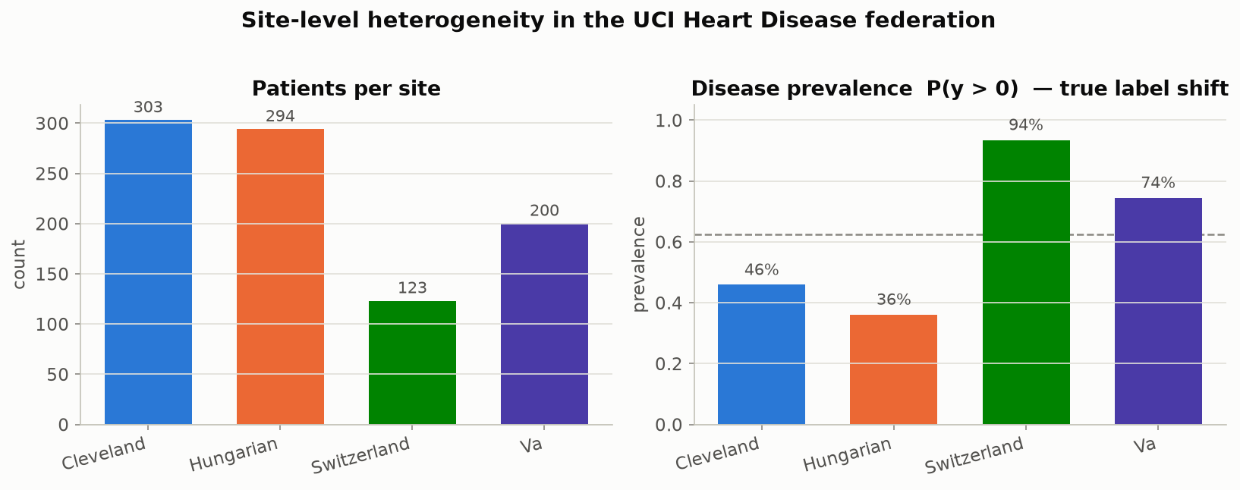
OUR DATASET
Patient counts and disease rates, by hospital
Disease prevalence swings from 36% at Hungary to 94% at Switzerland — a real difference in which patients each hospital sees, not a data-entry mistake.
Beyond Interoperability · Our Dataset
22

Slide 23
OUR DATASET
Two very different kinds of hospital-to-hospital difference
Measurement | Cleveland | Hungary | Switzerland | V.A. | What kind of difference is this?
Cholesterol never recorded | 0.0% | 0.0% | 100.0% | 24.5% | Measurement habit (specific to one hospital)
Vessel count never recorded | 1.3% | 98.6% | 95.9% | 99.0% | Measurement habit (almost everywhere except Cleveland)
Thalassemia test never recorded | 0.7% | 90.5% | 42.3% | 83.0% | Measurement habit (almost everywhere except Cleveland)
How severe the disease is | mixed | skews healthy | skews sicker | mixed | Real difference in who the hospital sees
Beyond Interoperability · Our Dataset
23

Slide 24
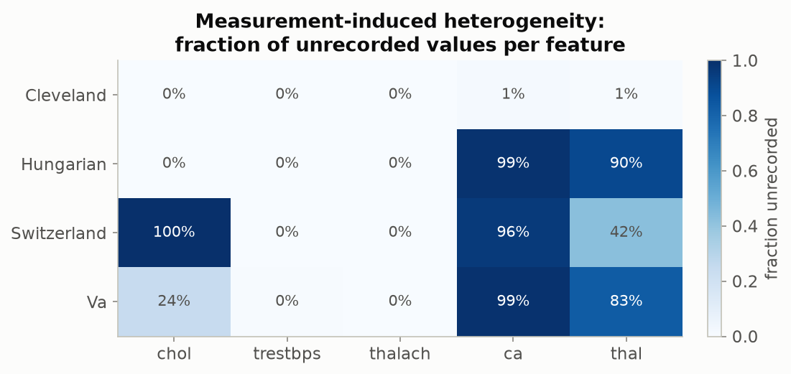
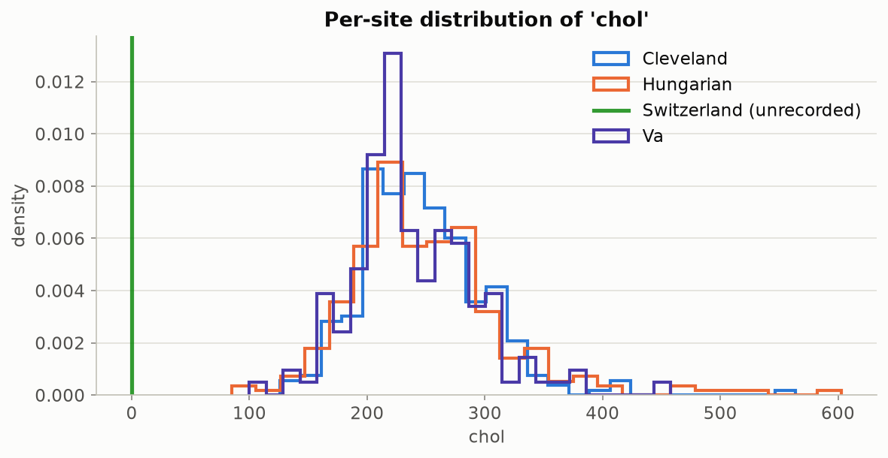
OUR DATASET
How much is missing, and what cholesterol looks like when it is recorded
Left: the fraction of patients missing each measurement, by hospital — cholesterol's complete 100% gap at Switzerland stands out, alongside the much bigger, near-universal gap in vessel count and thalassemia results outside Cleveland. Right: cholesterol values where they were actually recorded (Switzerland has none to show). Why is Switzerland at 100%? Every one of its patients has cholesterol coded as exactly 0 mg/dl in the original source file — a value that's biologically impossible for a living patient, so it's clearly a placeholder for “not measured,” not a real reading. This dataset was assembled from four separate hospital studies run independently in 1988–89, each using its own case-report form; the most likely explanation is that serum cholesterol simply wasn't part of the Zurich/Basel site's own data-collection protocol the way it was at Cleveland — a difference in what got tested, not a data-loss accident. No surviving documentation from the original study states this explicitly, so treat it as the best-supported reading of the evidence, not a confirmed fact.
Beyond Interoperability · Our Dataset
24

Slide 25
OUR DATASET
A real difference in outcomes: how severe cases are, by hospital
Severity | Cleveland | Hungary | Switzerland | V.A. | All combined
No disease | 164 | 188 | 8 | 51 | 411 (44.7%)
Mild | 55 | 37 | 48 | 56 | 196 (21.3%)
Moderate | 36 | 26 | 32 | 41 | 135 (14.7%)
Severe | 35 | 28 | 30 | 42 | 135 (14.7%)
Critical | 13 | 15 | 5 | 10 | 43 (4.7%)
▪ Hungary is mostly “no disease”; Switzerland is almost entirely disease-positive.
Beyond Interoperability · Our Dataset
25

Slide 26
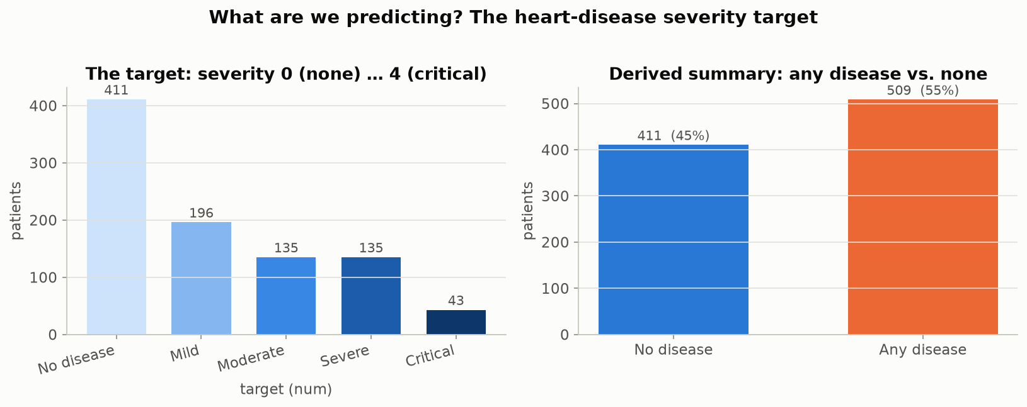
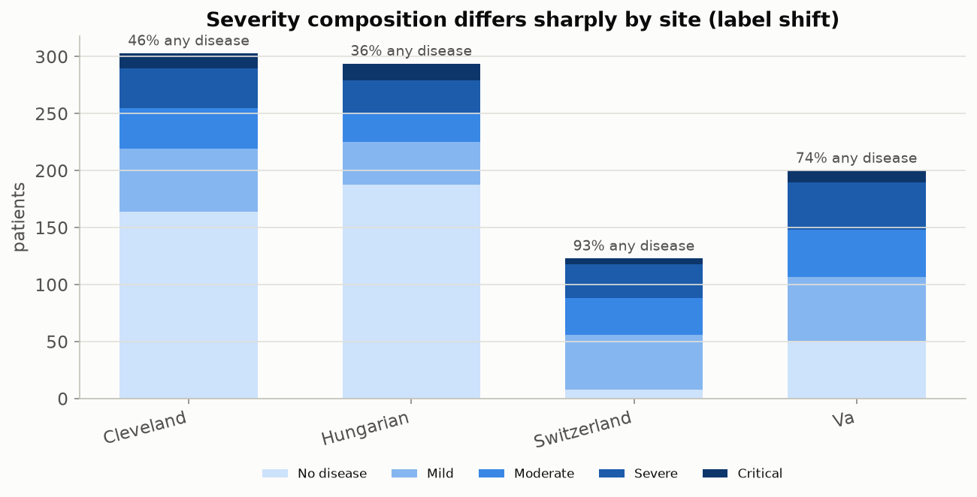
OUR DATASET
The severity split, overall and by hospital
Left: the overall severity split across all 920 patients, plus a simplified any-disease-or-not summary. Right: the same breakdown, now split out by hospital — the previous table, drawn as a picture.
Beyond Interoperability · Our Dataset
26

Slide 27
OUR DATASET
A simple test: can you guess the hospital just from the patient's numbers?
 | Cleveland | Hungary | Switzerland | V.A.
Cleveland | 50 / 50 | 89% | 100% | 88%
Hungary | 89% | 50 / 50 | 100% | 93%
Switzerland | 100% | 100% | 50 / 50 | 88%
V.A. | 88% | 93% | 88% | 50 / 50
▪ Train a simple classifier whose only job is to guess which hospital a patient came from, using nothing but their clinical measurements — no diagnosis, no label. Every off-diagonal number here is how often it guesses right for that pair. 88%+ everywhere means: yes, easily.
Beyond Interoperability · Our Dataset
27

Slide 28
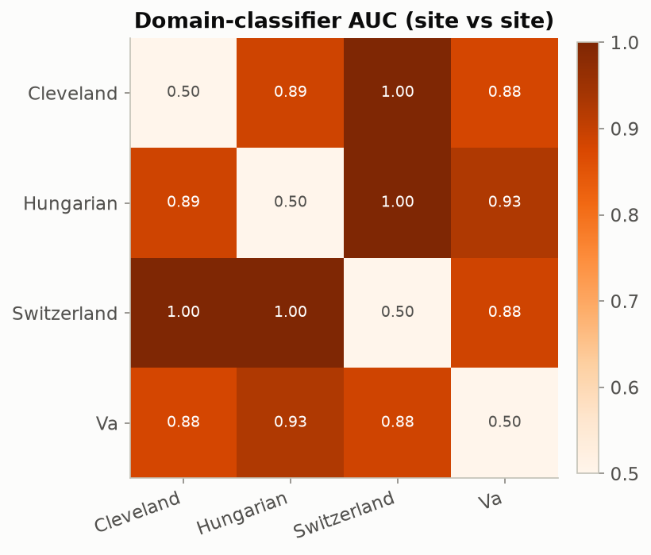
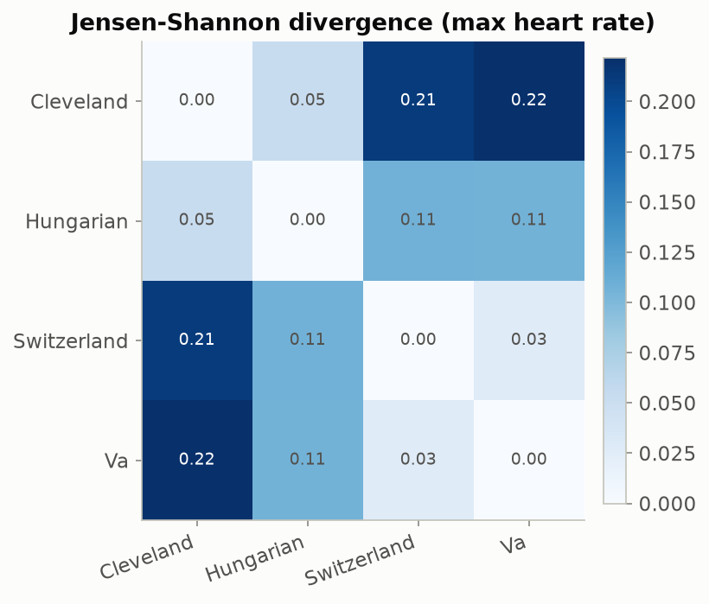
OUR DATASET
The same finding, confirmed a second, independent way
Left: the previous table's guess-the-hospital accuracy, drawn as a heatmap. Right: a completely different, classifier-free way of measuring how differently shaped two hospitals' data is — applied here to maximum heart rate — pointing to the same conclusion.
Beyond Interoperability · Our Dataset
28

Slide 29
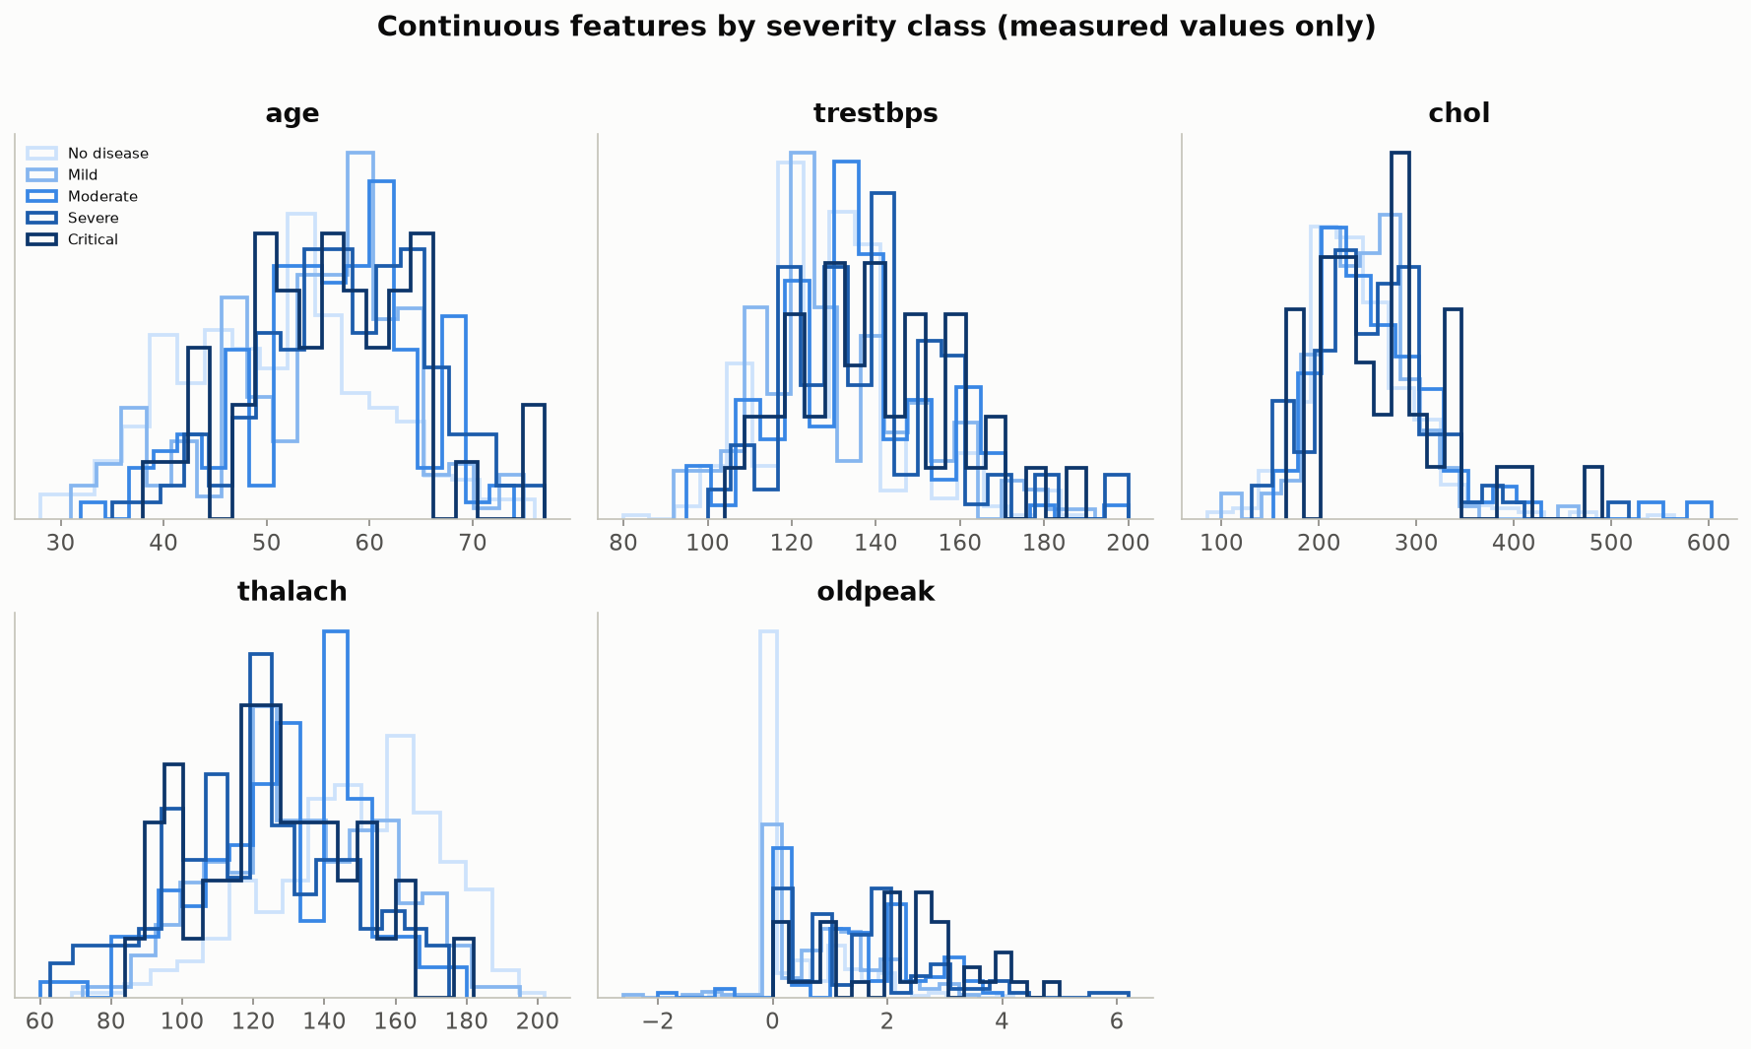
OUR DATASET
Which measurements matter most for telling severity apart
Each panel is one continuous measurement, with five curves (one per severity level, lightest = no disease, darkest = critical). Where the curves pull apart from each other, that measurement is genuinely useful for predicting severity; where they sit on top of each other, it isn't.
Beyond Interoperability · Our Dataset
29

Slide 30
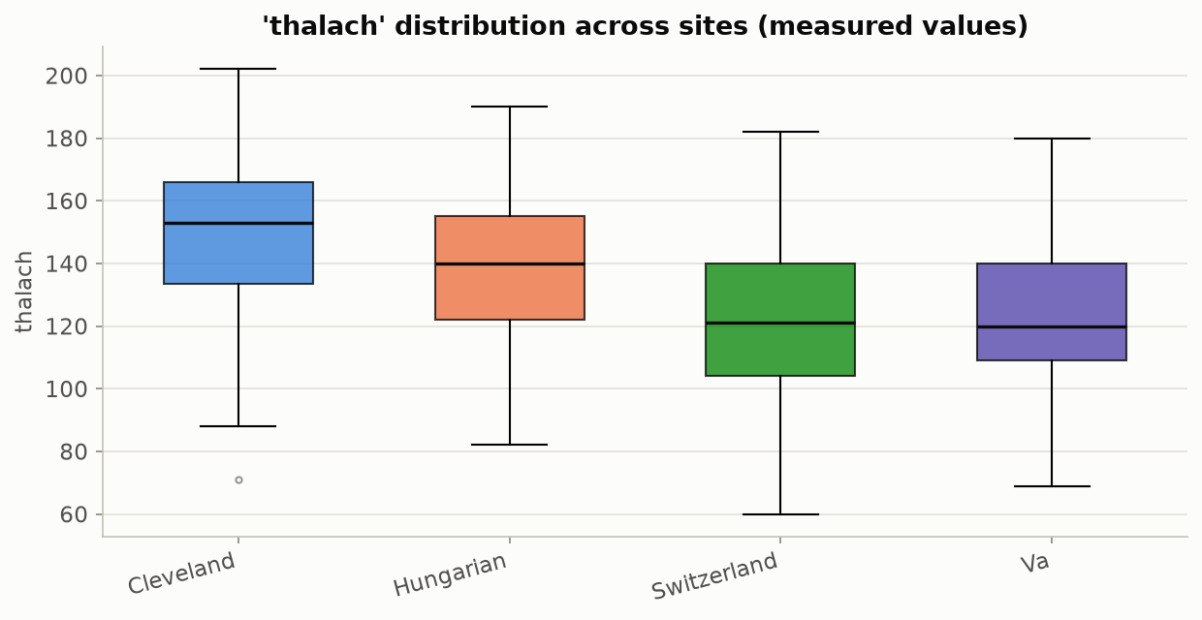
OUR DATASET
One measurement, isolated by hospital instead of by severity
Maximum heart rate stood out on the previous slide as one of the more informative measurements for severity. Here it's the same measurement, but grouped by hospital instead — a cleaner look at how its typical range shifts from one hospital to the next.
Beyond Interoperability · Our Dataset
30

Slide 31
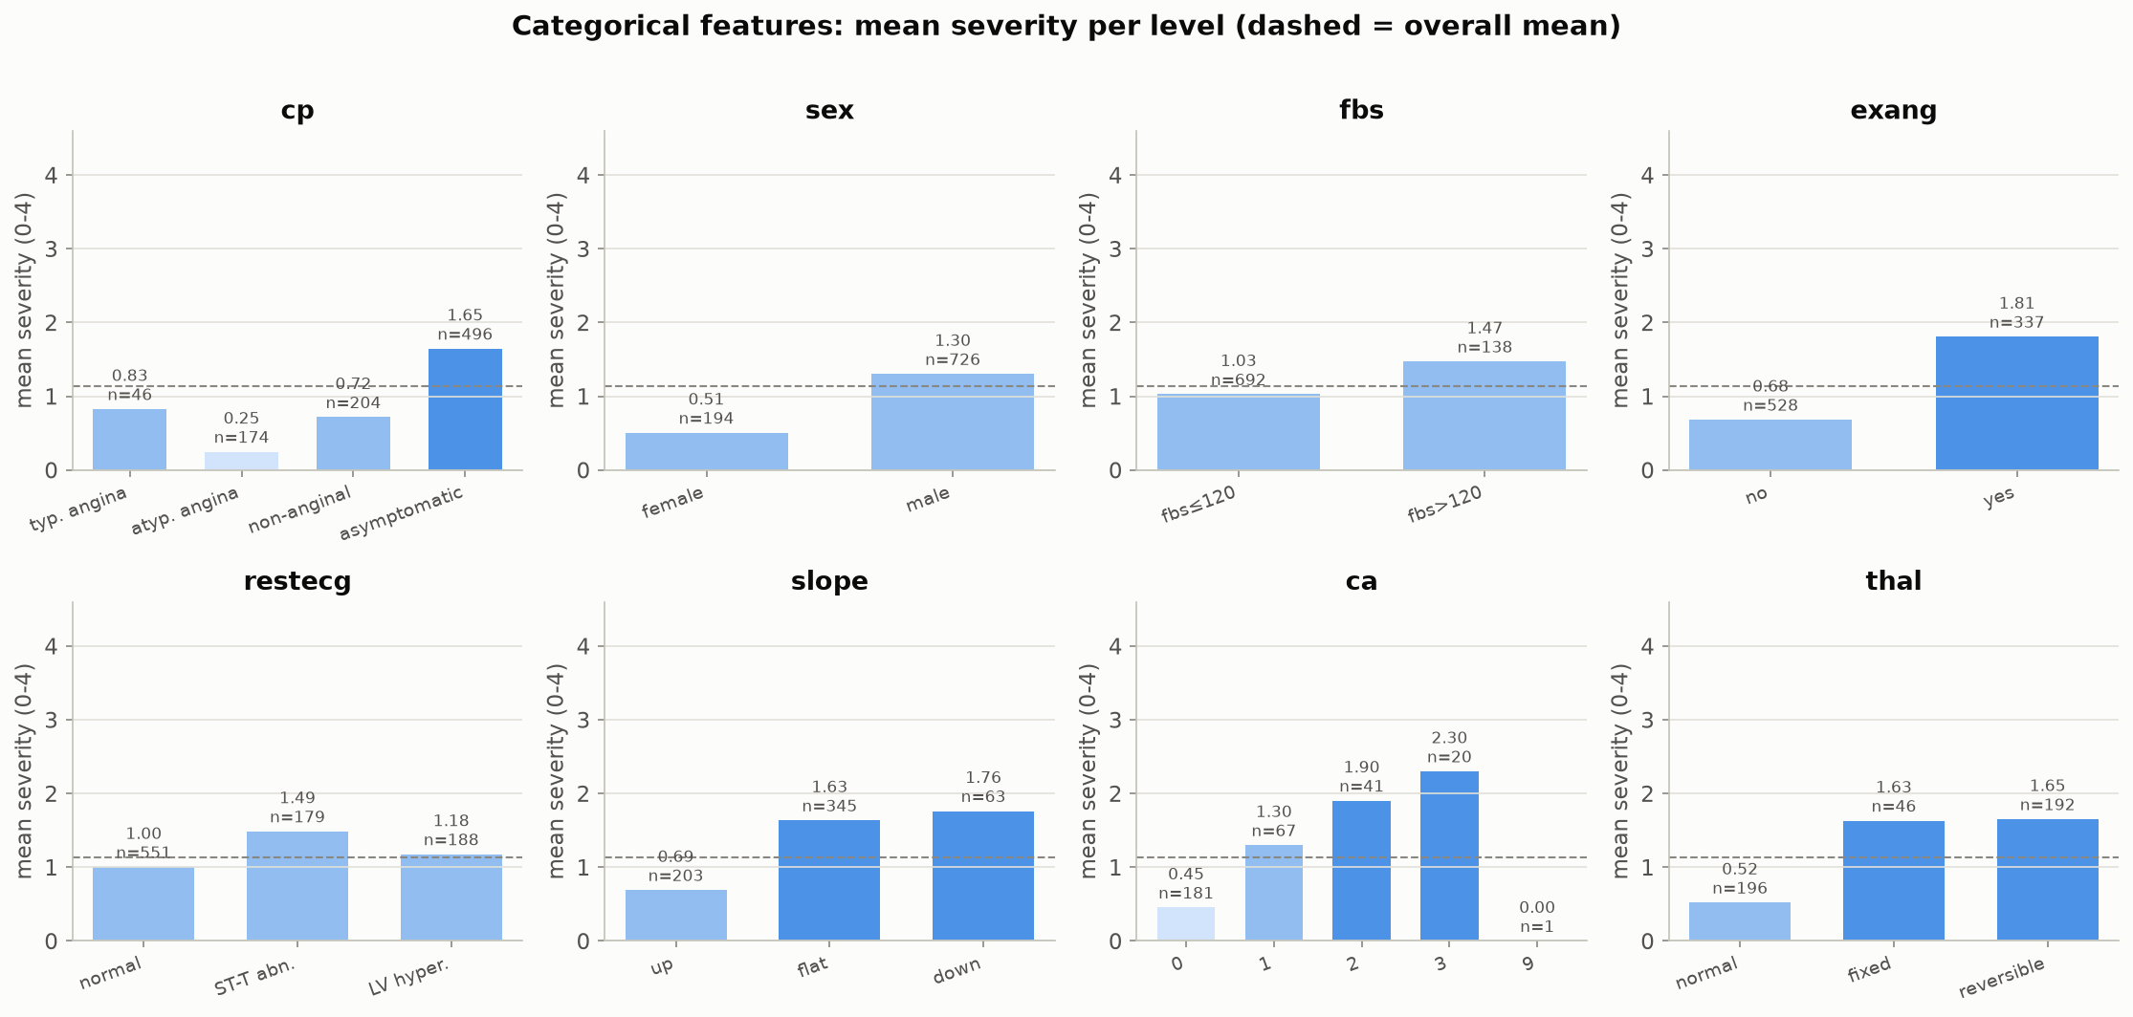
OUR DATASET
The rest of the measurements, by severity
Average severity within each category, for all eight non-numeric measurements — chest-pain type, sex, blood sugar, exercise-induced chest pain, resting-ECG result, ST-segment slope, vessel count, and thalassemia test result. Several show a clear pattern: asymptomatic chest pain, exercise-induced chest pain, an abnormal ST slope, high blood sugar, more affected vessels, and an abnormal thalassemia result all line up with higher average severity.
Beyond Interoperability · Our Dataset
31

Slide 32
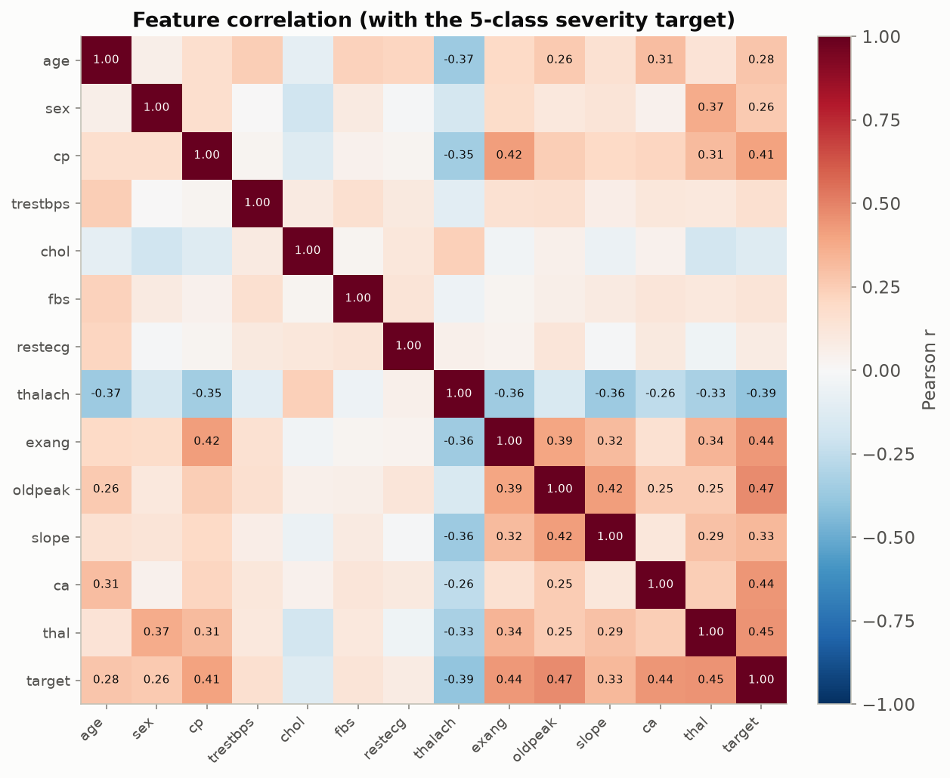
OUR DATASET
How every measurement relates to severity, at a glance
How strongly every pair of measurements (and the severity target) move together. Chest-pain type, exercise-induced chest pain, ST depression, maximum heart rate, and vessel count are the strongest, most reliable signals.
Beyond Interoperability · Our Dataset
32

Slide 33
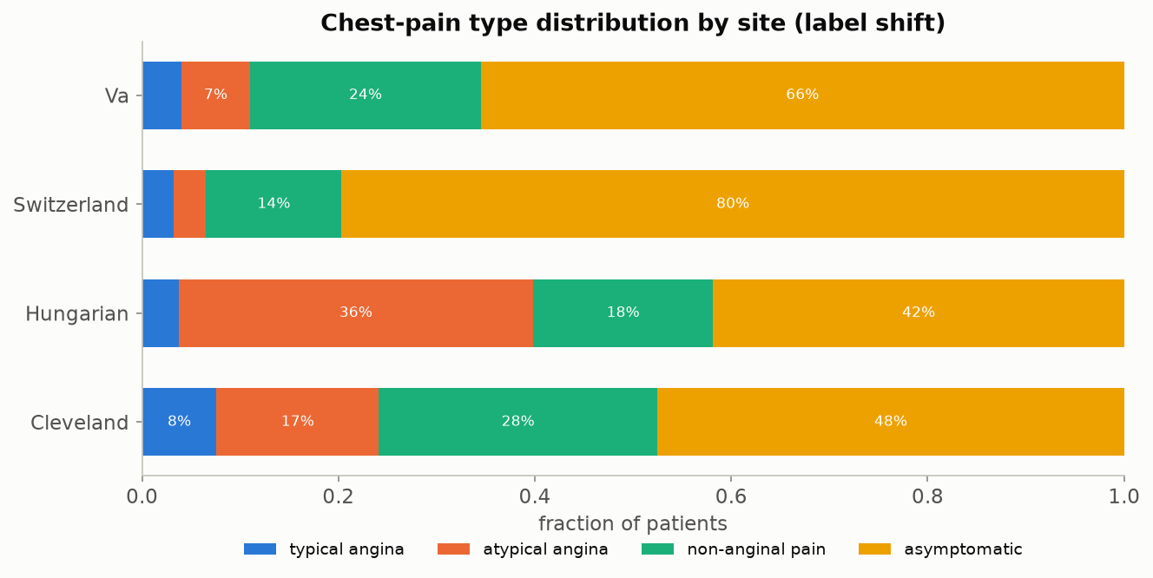
OUR DATASET
The same story, on a completely different question
Instead of disease severity, this predicts chest-pain type — a different clinical question, same four hospitals. Hungary sees mostly atypical chest pain; Switzerland is roughly 80% asymptomatic. The same hospital-to-hospital differences show up again here, confirming this isn't specific to one particular question.
Beyond Interoperability · Our Dataset
33

Slide 34
OUR DATASET
Recap: what makes this dataset unusually good for teaching this
▪ Genuinely shareable — all four hospitals used the exact same 13-measurement intake form.
▪ Genuinely different underneath, in two distinguishable ways: real differences between patient populations (disease rates ranging 36%-94%) and simple measurement-habit gaps (cholesterol, and much more severely, vessel count and thalassemia results).
▪ Small enough to train and calibrate live during a single workshop (920 patients total), yet large enough that every effect shown is statistically real, not noise.
▪ Open and free to use — no legal agreement stands between anyone in this room and running the code today.
▪ Every finding shown here reappears on a second, independently chosen clinical question from the same four hospitals.
Beyond Interoperability · Our Dataset
34

Slide 35
6
Methods of Interoperability
Choosing a Standard
Beyond Interoperability
35

Slide 36
INTEROPERABILITY
“Interoperable” isn't just one thing — it comes in degrees
▪ Think of it as four separate levels: can the data move at all? Is its format standardized? Does a given value mean the same clinical fact everywhere? And is there shared agreement on the policies and workflows around it?
▪ Most of today's regulations do a good job on the first two levels — getting data to move, in a standard format.
▪ The third level — a value actually meaning the same thing everywhere — is where this entire project's heterogeneity findings live. It's the hardest level to mandate by law, and the easiest one to think you've solved when you've really only gotten partway there.
Beyond Interoperability · Interoperability
36

Slide 37
INTEROPERABILITY
A quick tour of today's data-sharing standards
Standard | What it's mainly used for | How well it fits multi-hospital research
HL7 v2 messaging | Older-generation, point-to-point clinical messaging | Weak fit — built to run hospital operations, not pooled research
HL7 FHIR | Modern web-API-style data exchange (what current mandates require) | Good for moving data live; not itself a research-analysis format
OMOP (OHDSI) | Standardizing observational data specifically across institutions | Excellent — built specifically for this exact use case
openEHR | Detailed, template-based clinical record modeling | Good in principle; not widely adopted by US hospitals yet
CDISC SDTM/ADaM | Formal clinical-trial data submission to regulators | Weak fit — built for trials, not everyday hospital records
DICOM | Medical imaging exchange and storage | Not applicable to this kind of tabular data — but the right choice once imaging enters the picture
Beyond Interoperability · Interoperability
37

Slide 38
INTEROPERABILITY
What a shared format can fix, and what it can't
▪ It reduces measurement-habit differences between hospitals, but it doesn't eliminate them.
▪ A hospital can code cholesterol using the exact correct standard term and still simply order that test far less often than another hospital does — no format fixes that.
▪ No shared format changes the fact that a specialist referral center sees a sicker, pre-selected group of patients to begin with — that's about who walks in the door, not how the data is written down.
▪ Checking for these gaps has to happen after adopting a shared format, as an ongoing check — not as a one-time substitute for doing that checking at all.
▪ Worth remembering: this project's own dataset predates every standard in the table above — an honest, unfiltered look at what hospital data looks like before any of this standardization happened.
Beyond Interoperability · Interoperability
38

Slide 39
7
Why Conformal Prediction Helps
With Site-Level Heterogeneity
HANDS-ON: notebooks 02, 04
Beyond Interoperability
39

Slide 40
CONFORMAL PREDICTION
An everyday version of the problem
A weather forecaster who says “90% chance of rain” should be right about 9 days out of 10 whenever they say that. If they're only right 6 times out of 10, you stop trusting the number — even though every individual forecast still sounded confident.
A model that reports “92% confident” should work the same way. Conformal prediction is the tool that checks whether it actually does — and says so honestly when it doesn't.
Beyond Interoperability · Conformal Prediction
40

Slide 41
CONFORMAL PREDICTION
The problem: a model can sound confident and still be wrong
▪ A model says “92% chance of heart disease.” That number is not automatically trustworthy — nothing forces the model to actually be right 92% of the time.
▪ Move that same model to a new hospital, and it often keeps sounding just as confident even while its real, checkable accuracy quietly drops.
▪ The model has no way to know it has left home. It can't tell you it's now guessing in unfamiliar territory — that silence is the dangerous part.
▪ Getting the data to move between hospitals (interoperability) is a separate problem from whether the model's judgment still holds once it arrives. Solving the first does nothing for the second.
Beyond Interoperability · Conformal Prediction
41

Slide 42
CONFORMAL PREDICTION
What conformal prediction actually gives you
▪ Instead of one confident guess, it hands back a short list of plausible answers — for example, “the true severity is somewhere in {1, 2, 3}.”
▪ That list comes with a promise attached: statements built this way are right at least 90% of the time, if you ask for 90%. Not a hope — a guarantee you can go check.
▪ The guarantee holds no matter how good or bad the underlying model is — the only thing it needs is that the patients used to set the threshold look statistically like the patients it's later asked to judge.
▪ When a new hospital's patients don't look like that anymore, the promise breaks — and because we can measure the promise, we can catch the break instead of it happening silently.
Beyond Interoperability · Conformal Prediction
42

Slide 43
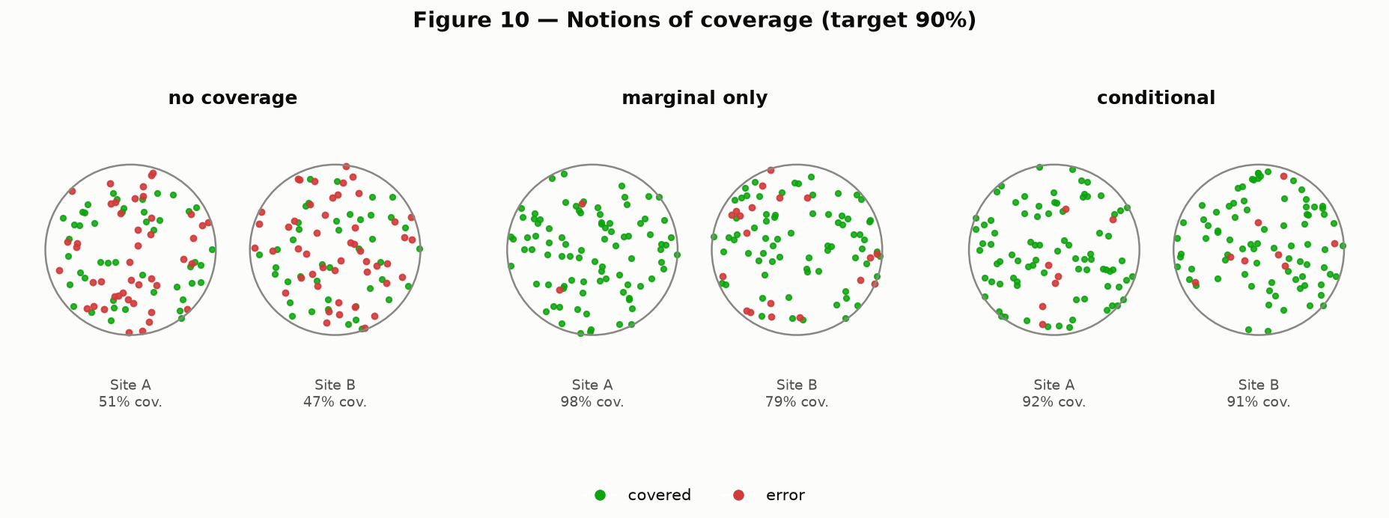
CONFORMAL PREDICTION
Two ways an average can lie to you
Picture two patient groups. Left: no promise at all — the model could be right any fraction of the time. Middle: the promise holds only on average — the two groups' results are blended together, so one can quietly fail while the blended number still looks fine. Right: the promise holds for every group separately — nothing is hidden by blending. Recreation of Angelopoulos & Bates (2022), Figure 10.
Beyond Interoperability · Conformal Prediction
43

Slide 44
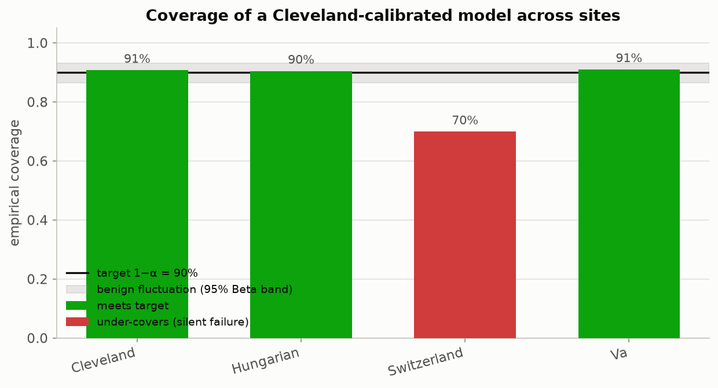
CONFORMAL PREDICTION
The headline result: watch the promise break
A conformal predictor is calibrated using only Cleveland's patients, then deployed at all four hospitals unchanged. It keeps its 90% promise at Cleveland, Hungary and the V.A. — and silently drops to 71% at Switzerland. The shaded band marks ordinary random wobble; 71% falls well outside it, so this is a real effect, not noise.
Beyond Interoperability · Conformal Prediction
44

Slide 45
CONFORMAL PREDICTION
Why you have to check every site, not just the average
Deployment site | Empirical coverage | Gap vs. 90% promise | Verdict
Cleveland (calibration site) | 90.8% | +0.8 pp | Promise kept
Hungary | 90.8% | +0.8 pp | Promise kept
V.A. Long Beach | 90.5% | +0.5 pp | Promise kept
Switzerland (held out entirely) | 70.7% | −19.3 pp | Promise broken, silently
▪ Calibrated only on Cleveland's 303 patients. Blend all four sites into one overall coverage number and it lands close to 90% — looking perfectly healthy. Only by checking Switzerland on its own does the 19-point failure become visible.
Beyond Interoperability · Conformal Prediction
45

Slide 46
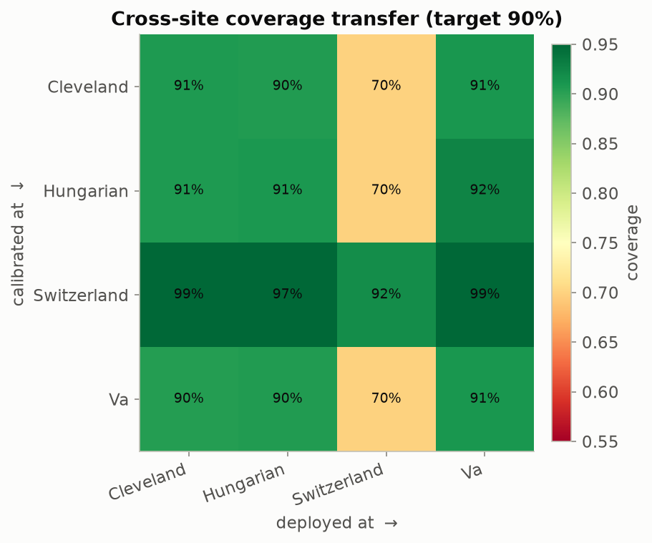
CONFORMAL PREDICTION
Every hospital pair, tested at once
Each row is 'the hospital we set the threshold using'; each column is 'the hospital we then deploy at.' Reading straight down the diagonal (same hospital both times) is always healthy. Anything set using Cleveland, Hungary or the V.A. and then deployed at Switzerland lands around 70-72%; a threshold set using Switzerland instead over-delivers everywhere else.
Beyond Interoperability · Conformal Prediction
46

Slide 47
8
The Mathematics
And What Every Piece of Code Produces
HANDS-ON: notebooks 02, 05
Beyond Interoperability
47

Slide 48
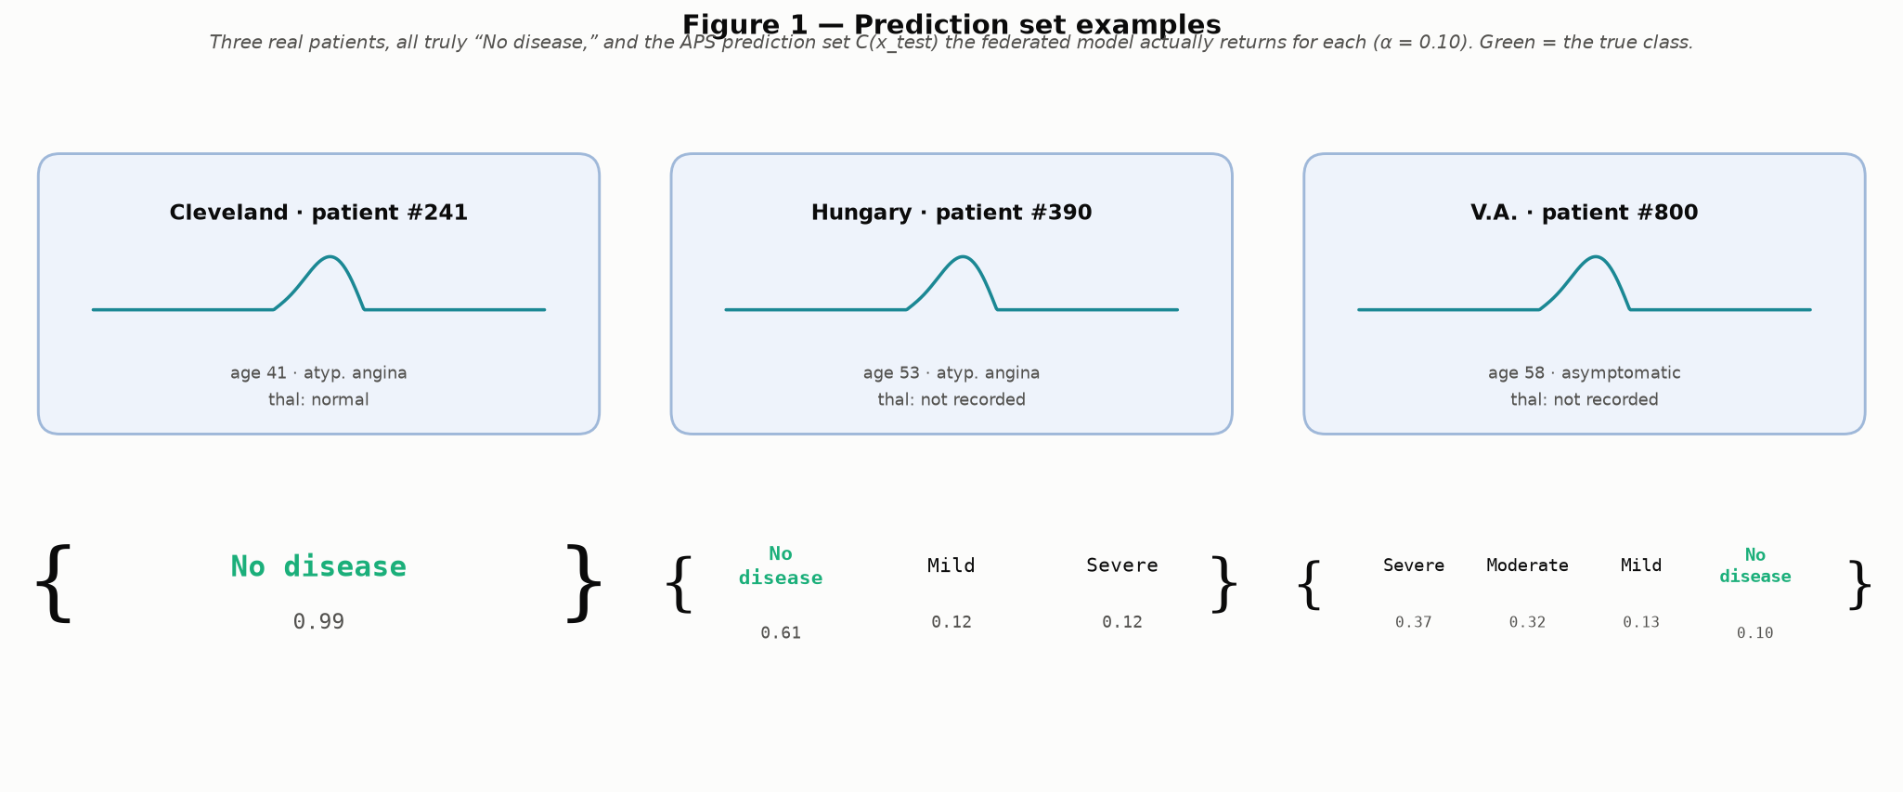
MATHEMATICS
What a prediction set actually looks like
Three real patients from this project's data, all truly "No disease," and the list of plausible answers the calibrated model actually returns for each — a confident single answer, a so-so 3-answer list, and a genuinely unsure 4-answer list. In that hardest case, the model's own best guess is wrong — yet the correct answer, "No disease," still made the list. That is the whole point of the guarantee: even when the model is confused, the true answer still shows up somewhere in what it hands you.
Beyond Interoperability · Mathematics
48

Slide 49
MATHEMATICS
The one assumption everything rests on
▪ In plain terms: the patients used to set the threshold have to look statistically like the patients the model will later be asked to judge. Statisticians call this “exchangeability” — think of it as “no surprises between calibration and deployment.”
▪ It does not require the data to follow a bell curve, or be cleanly separable, or come from any particular kind of model — about as weak and general an assumption as a guarantee can rest on.
▪ This is exactly the assumption cross-hospital deployment can break outright: Cleveland's patients (46% have any disease) and Switzerland's patients (94% have any disease) simply don't look alike statistically.
▪ This dataset was chosen specifically because it breaks that assumption in a real, measurable way — so the failure is something you can see and quantify, not just describe.
Beyond Interoperability · Mathematics
49

Slide 50
MATHEMATICS
The recipe, in three steps: score, find a cutoff, draw the boundary
▪ Step 1 — score: for every calibration patient, ask “how surprising was their true answer to the model?” (a nonconformity score, written s(x, y)). A confident, correct answer scores low; a confident, wrong answer scores high.
▪ Step 2 — find a cutoff: sort those scores and take a percentile near the top, called q̂. Formally, q̂ = Quantile(calibration scores; ⌈(n + 1)(1 − α)⌉ / n) — the ⌈⌉ and the “+1” are just a small correction so the guarantee is exact even with a limited number of patients, not just true on average over many repeats.
▪ Step 3 — draw the boundary: for a new patient, keep every possible answer whose surprise score doesn't clear that cutoff: C(x) = { y : s(x, y) ≤ q̂ }.
▪ The guarantee this produces: P(true answer is in the returned list) ≥ 1 − α — true for any scoring rule, and any underlying model, confident or not.
▪ Two scoring rules used in this toolkit: LAC keeps things simple (score = 1 − the model's probability on the true class) and tends to return the shortest lists. APS is a bit more adaptive — it adds up sorted probabilities until they cover the true class — and tends to size each list to how genuinely uncertain that particular patient is.
Beyond Interoperability · Mathematics
50

Slide 51
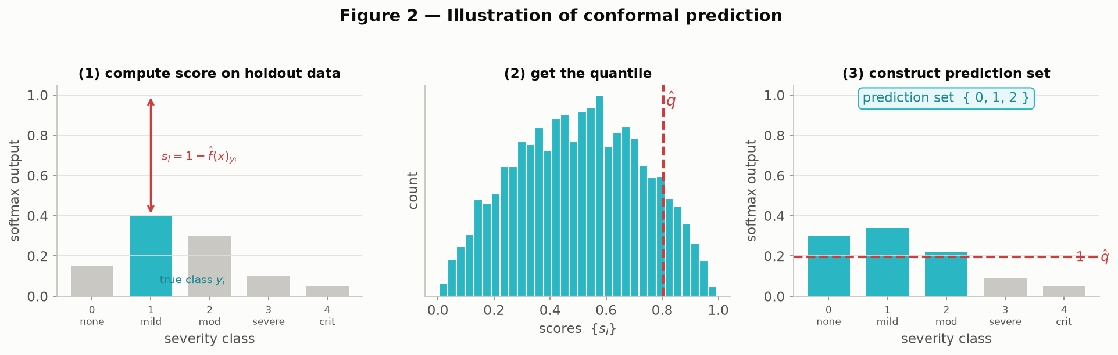
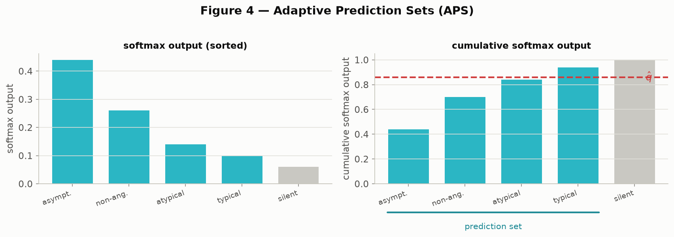
MATHEMATICS
The two scoring rules, worked through visually
Left (LAC): score a calibration patient → plot all the calibration scores as a histogram and mark the cutoff q̂ → for a new patient, keep every answer whose probability clears that bar. Right (APS): same three steps, but answers are sorted from most to least likely and added up until the running total crosses q̂.
Beyond Interoperability · Mathematics
51

Slide 52
MATHEMATICS
LAC vs. APS, head to head on the same model
Scoring rule | Average list length | Coverage achieved
LAC (simpler rule) | 3.09 out of 5 answers | 90.3% (target 90%)
APS (adaptive rule) | 2.96 out of 5 answers | 90.3% (target 90%)
▪ Same model, same calibration data, same 90% target — only the scoring rule changes. Both keep their promise; APS does it with slightly shorter lists on average, because it adapts list length to how uncertain each individual patient is rather than using one fixed rule for everyone.
Beyond Interoperability · Mathematics
52

Slide 53
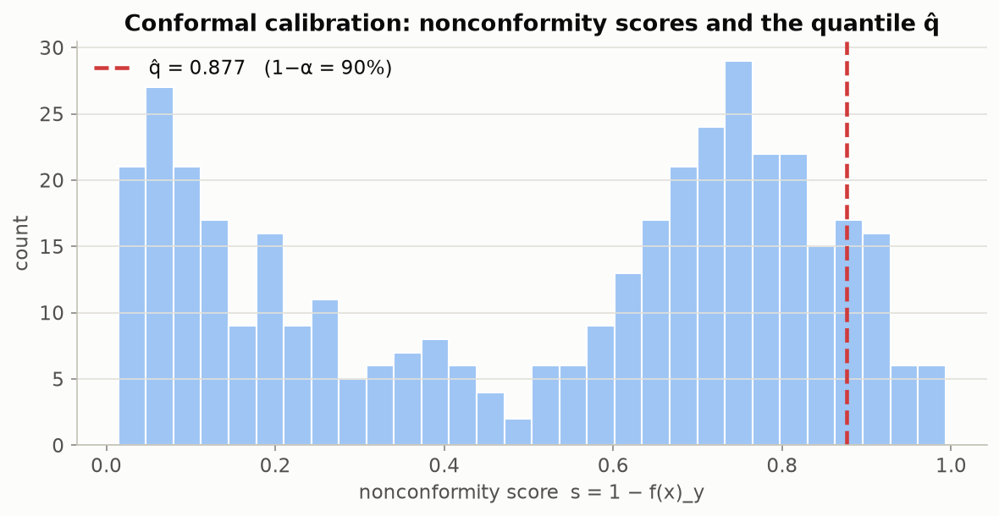
MATHEMATICS
Not a toy example — this project's own numbers
Every one of these bars is a real calibration score from this project's own federated model, trained across Cleveland, Hungary and the V.A. The red line is the cutoff q̂ — everything to its left is what makes the 90% promise hold.
Beyond Interoperability · Mathematics
53

Slide 54
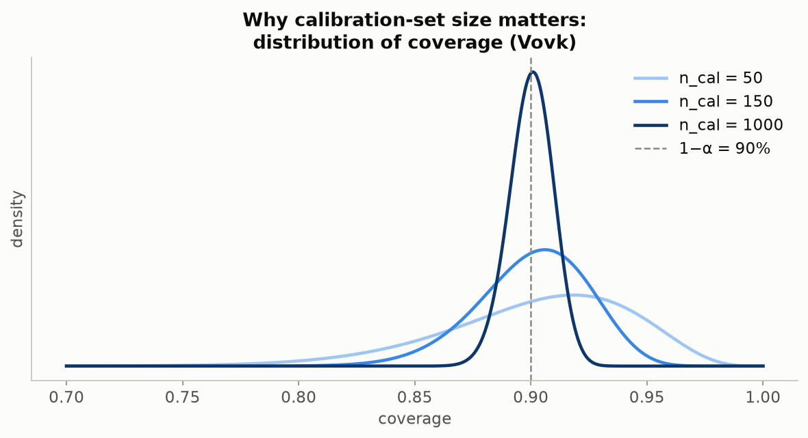
MATHEMATICS
How many patients do you need before you can trust the number?
Run the calibration step many times on small random samples and the achieved coverage bounces around — sometimes a little high, sometimes a little low, just from the luck of which patients happened to land in the sample. At 50 patients that bounce is wide; at 1,000 it's tight. Switzerland's 71% sits far outside even the widest realistic bounce at Cleveland's own scale (303 patients) — so it isn't bad luck, it's a genuine site effect.
Beyond Interoperability · Mathematics
54

Slide 55
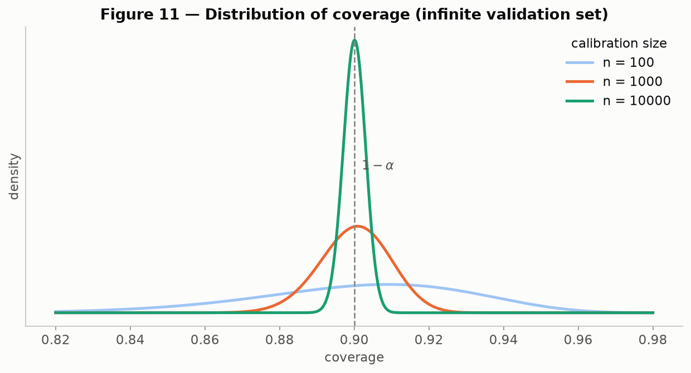
MATHEMATICS
The same reassurance, at a much bigger scale
The same bounce-from-sample-size idea, now shown at the much larger scales used in the original paper (100, 1,000, and 10,000 calibration patients) — the spread narrows sharply as the sample grows. Recreation of Angelopoulos & Bates (2022), Figure 11.
Beyond Interoperability · Mathematics
55

Slide 56
MATHEMATICS
Coverage alone isn't the whole story
▪ There's a cheap, useless way to hit 90% coverage: always return every possible answer. Technically correct, completely unhelpful to a clinician.
▪ A genuinely useful list is short when the model is confident and long when it's genuinely unsure — and it should visibly grow at hospitals where that particular patient's outcome is harder to call.
▪ One overall coverage number can also hide a second, subtler failure: it can be right on average across all patients while being badly wrong for one specific true diagnosis.
▪ Concrete example: on the chest-pain task, the rarest true diagnosis (typical angina, only 23 patients) is only covered 26% of the time against a 90% promise — a failure that's completely invisible in the overall pooled number.
Beyond Interoperability · Mathematics
56

Slide 57
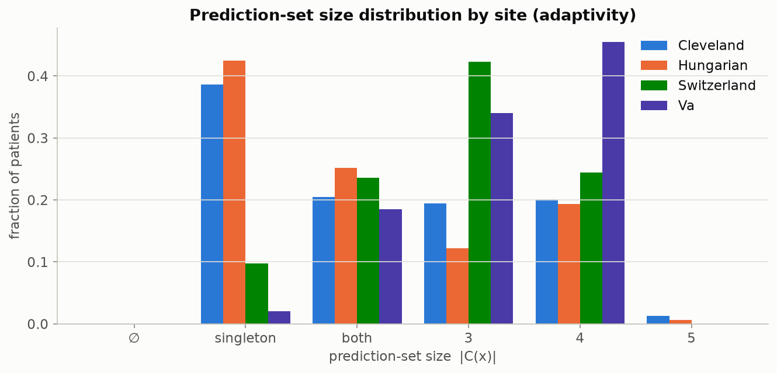
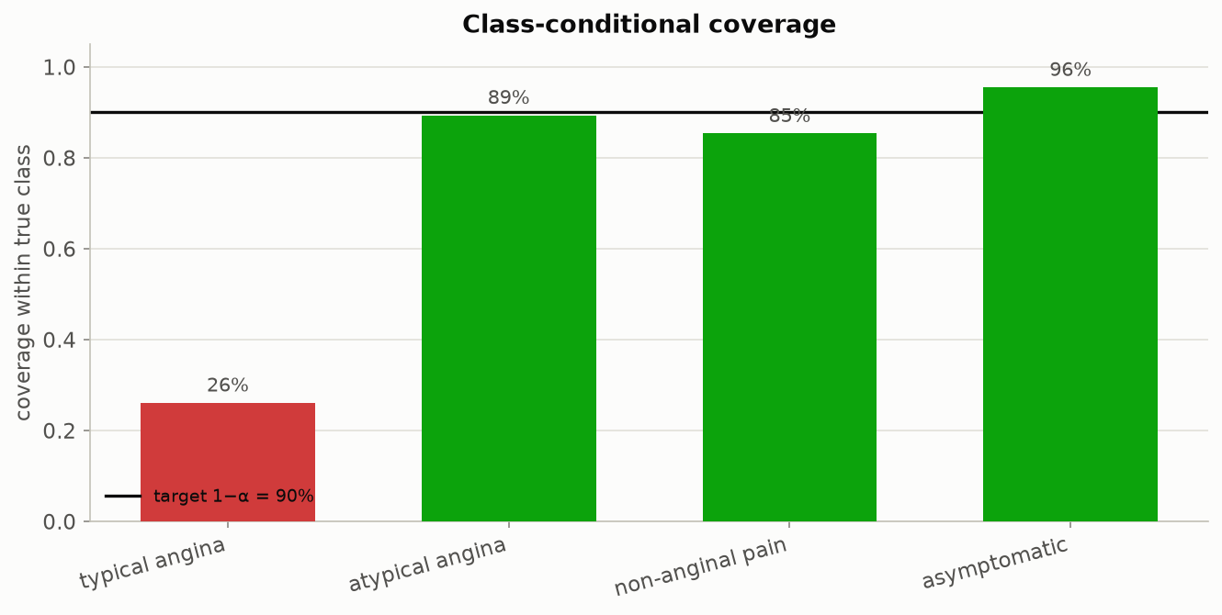
MATHEMATICS
Two more things worth checking, side by side
Left: how long the returned lists are, by hospital (disease task) — longer lists at a hospital mean the model is systematically less sure about that hospital's patients. Right: coverage broken out by true chest-pain diagnosis — the rarest diagnosis (typical angina, 23 patients) is covered only 26% of the time, a failure the overall 90% number never reveals.
Beyond Interoperability · Mathematics
57

Slide 58
MATHEMATICS
The same trick works well beyond classification
▪ The three-step recipe from earlier — score how surprising something is, find a cutoff, use the cutoff to draw a boundary — isn't specific to picking from a list of diagnoses.
▪ Predicting a number instead of a category (e.g. a lab value)? Take a fitted range and widen it by exactly the cutoff amount to reach the same guarantee.
▪ Have a single best-guess number plus some notion of how uncertain it is? Widen a band around that guess the same way.
▪ Working with a full Bayesian model instead? The same idea turns its output into a region above a probability threshold.
▪ These next three slides use small made-up examples, exactly as the original paper does — they're here to show the idea generalizes, not as results from this project's own clinical data.
Beyond Interoperability · Mathematics
58

Slide 59
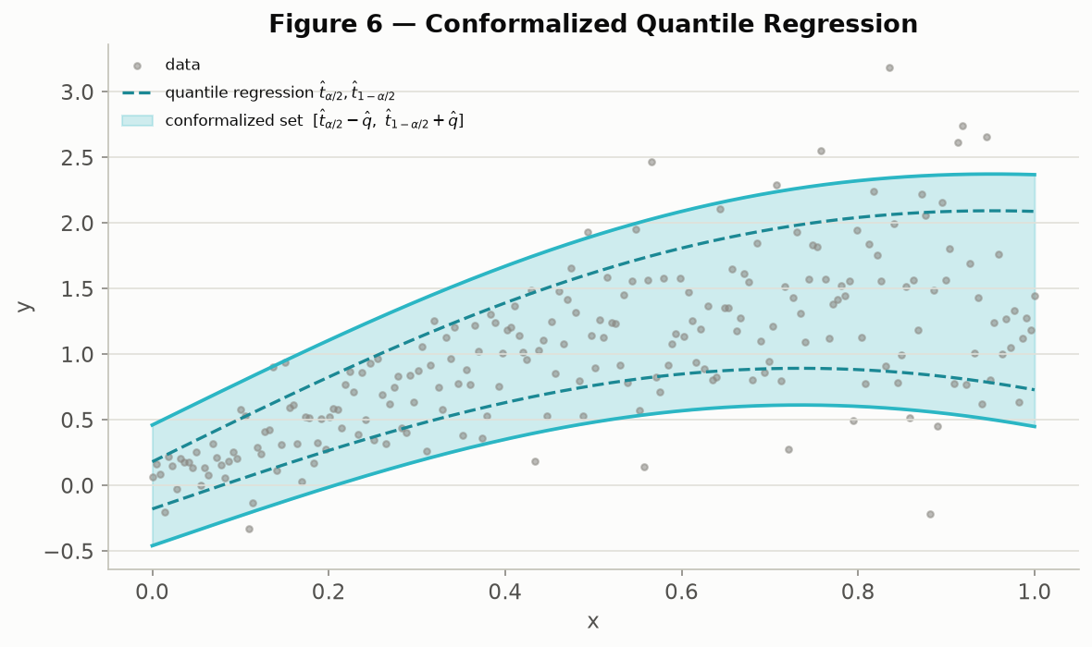
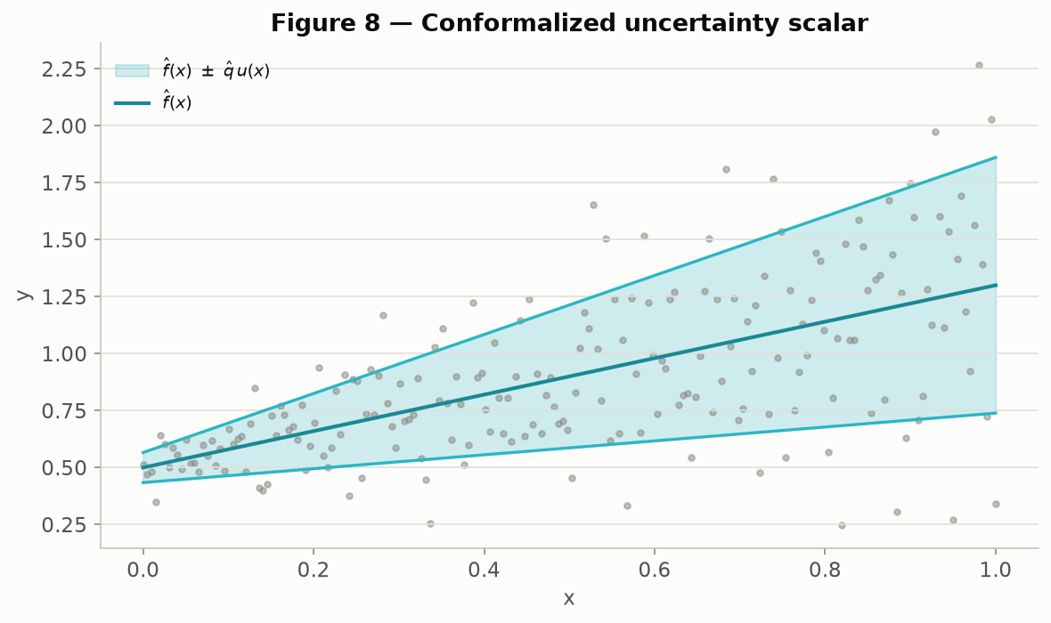
MATHEMATICS
The same trick, applied to numbers instead of categories
Left: a fitted range of likely numeric values (dashed) widened by the cutoff amount to reach the guarantee (solid). Right: a single best-guess number with a symmetric widened band around it. Both are made-up illustrative examples, recreating Angelopoulos & Bates (2022), Figures 6 and 8.
Beyond Interoperability · Mathematics
59

Slide 60
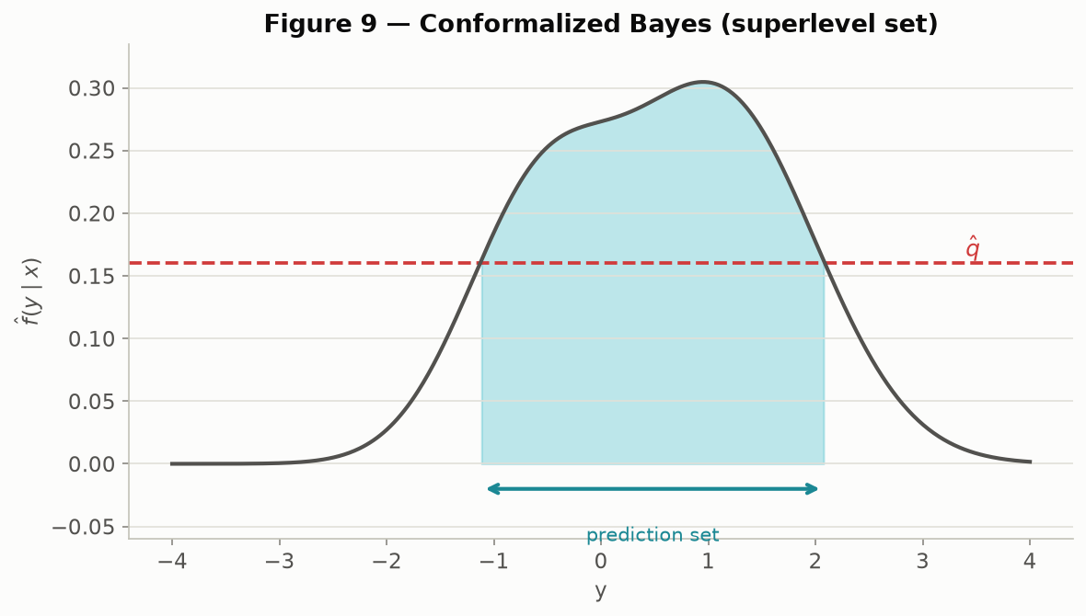
MATHEMATICS
The same trick, inside a Bayesian model
Instead of a category list or a numeric range, the returned answer is a region: every outcome whose estimated probability clears a threshold. Made-up illustrative example, recreating Angelopoulos & Bates (2022), Figure 9.
Beyond Interoperability · Mathematics
60

Slide 61
9
Pipeline Walkthrough
and Justification: Is This Enough?
HANDS-ON: notebooks 03, 04, 06, 07
Beyond Interoperability
61

Slide 62
PIPELINE — TRAINING
How the hospitals train one shared model together
▪ One shared model learns to weigh each of the 13 patient measurements and combine them into a severity guess — nothing fancier than a weighted combination, about 70 numbers total, small enough to print out and read.
▪ Each round, the server sends the current shared model out to the three training hospitals — Cleveland, Hungary, the V.A. Patient records themselves never leave any hospital; only the model's numbers travel.
▪ Each hospital nudges its own copy slightly, using only its own patients, to make it fit its local data a bit better.
▪ The server then averages the three nudged copies back into one, weighting each hospital by how many patients it contributed — a bigger hospital's nudge counts for more.
▪ That whole cycle repeats 200 times. Switzerland is deliberately left out of training entirely, so it can later serve as a genuinely unseen hospital.
Beyond Interoperability · Pipeline — Training
62

Slide 63
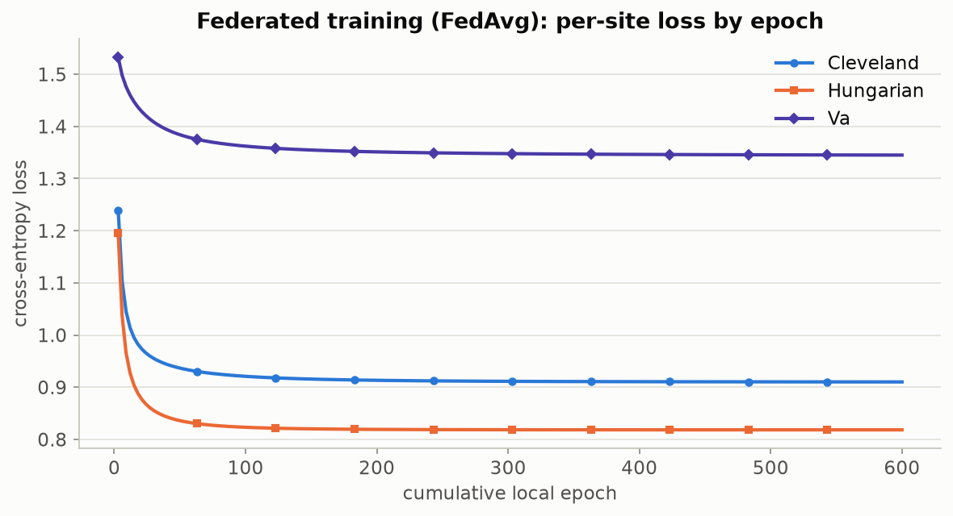
PIPELINE — TRAINING
Confirming the training actually finished learning
Each line is one hospital's error rate as training progresses. All three are still dropping visibly early on and go essentially flat by round ~150 — a sign that training ran long enough to settle, rather than being cut off partway through.
Beyond Interoperability · Pipeline — Training
63

Slide 64
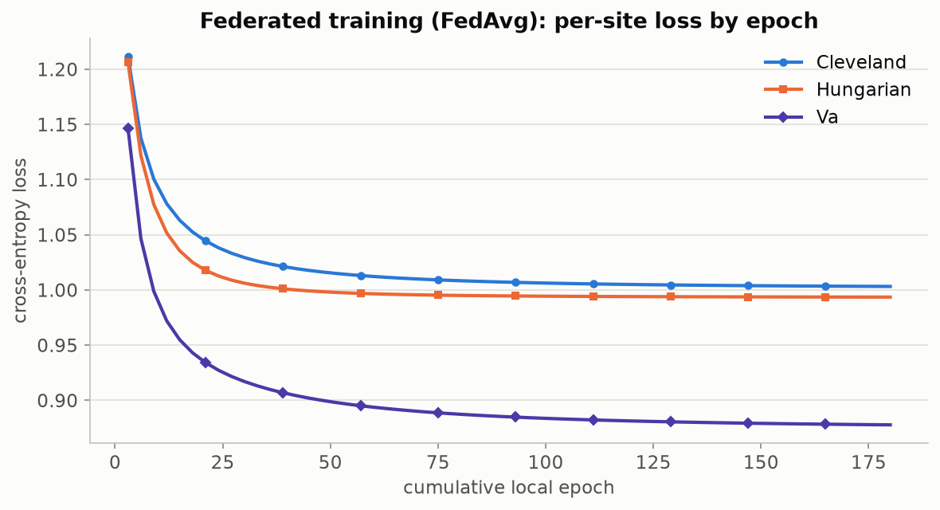
PIPELINE — TRAINING
Same check, a completely different prediction target
The identical training setup, now predicting chest-pain type instead of disease severity. Same settling-down pattern — a sign this behavior is a property of the method, not a coincidence specific to one target.
Beyond Interoperability · Pipeline — Training
64

Slide 65
PIPELINE — TRAINING
Does sharing models beat pooling all the data?
Hospital | Shared-model accuracy | Hypothetically-pooled accuracy
Cleveland | 60.7% | 61.1%
Hungary | 71.1% | 70.7%
Switzerland (never trained on) | 21.1% | 20.3%
V.A. Long Beach | 44.0% | 44.0%
▪ “Pooled” means a hypothetical model trained as if every patient record could sit in one place — the comparison this project is not allowed to run in a real hospital setting, only here as a reference point. The shared model trained without ever pooling data lands within a point of it everywhere — the privacy-preserving approach costs almost nothing in accuracy.
Beyond Interoperability · Pipeline — Training
65

Slide 66
PIPELINE — TRAINING
Under the hood: how each hospital's nudge is computed
▪ In plain terms: after each hospital scores its own patients, it looks at how far off those scores were and adjusts its copy of the model a small step in the direction that would have made them less wrong. Repeated a few times, that's "training."
▪ The formal version, for anyone who wants it: the loss is cross-entropy plus a small penalty that discourages overly large weights (L(θ) = −mean(log P[i, yᵢ]) + (λ/2)·‖W‖², λ = 1e-2, applied only to the weights, not the bias).
▪ Weight gradient: ∇W = Xᵀ(P − Y) / n + λW — “P minus Y” is just “what the model guessed minus what actually happened,” averaged over patients.
▪ Bias gradient: ∇b = mean(P − Y, axis=0) — the same idea, just for the model's baseline offset.
▪ Update rule — the plainest possible version, no shortcuts or acceleration tricks: θ ← θ − lr·∇L(θ), a fixed step size applied a few times per round at every hospital, so every line of it can be read and hand-verified rather than trusted as a black box.
Beyond Interoperability · Pipeline — Training
66

Slide 67
PIPELINE — CALIBRATION
Setting the threshold that makes the promise exact
▪ Once the shared training rounds finish, the model's numbers are frozen — nothing about the model itself changes again from this point on.
▪ Each training hospital's patients are then split in half: one half sets the threshold (calibration), the other half is kept aside purely to double-check it later — neither half was used to train the model in the first place.
▪ The frozen model scores the calibration half only; those scores are what Section 8's “how surprising was this” recipe runs on.
▪ The cutoff picked from those scores becomes q̂ — the one and only number this whole process still has to “fit” once the model itself is done training.
▪ That cutoff is only trustworthy for patients who look statistically like the ones it was set on — which is exactly the assumption the next slide puts to the test.
Beyond Interoperability · Pipeline — Calibration
67

Slide 68
PIPELINE — DEPLOYMENT
The real test: an entirely unfamiliar hospital
▪ The toughest version of the test: set the threshold using only Cleveland's patients (303 of them) — nothing from any other hospital.
▪ Then deploy that frozen model and fixed threshold at every hospital, including Switzerland — a hospital the model never trained on and the threshold never saw.
▪ No retraining, no adjusting, no sneaking a look at Switzerland's answers first — just running the frozen model forward and applying the same fixed threshold everywhere.
▪ The result: the 90% promise holds at Cleveland, Hungary and the V.A. — and quietly slips to 70.7% at Switzerland (see the table earlier in this section). The promise breaks exactly where Switzerland's patients stop looking statistically like Cleveland's.
Beyond Interoperability · Pipeline — Deployment
68

Slide 69
PIPELINE — ROBUSTNESS
Is this specific to one clinical question?
What we're measuring | Disease severity (5 possible answers) | Chest-pain type (4 possible answers)
How differently the answer is distributed across hospitals | 0.128 (bigger gap) | 0.073
How easily a hospital can be told apart from its patients alone | 0.930 | 0.929 (essentially the same)
Average promise kept across all four hospitals (target 90%) | 90.9% | 91.0%
Worst single hospital's promise kept | 87% | 88%
Average list length returned | 2.68 out of 5 | 2.25 out of 4
▪ Same full pipeline, run start to finish a second time on a completely different clinical question. Disease severity shows a bigger gap across hospitals — no surprise, since its prevalence swings further (36%–94%) than chest-pain type's does — but both questions keep every hospital close to the 90% promise.
Beyond Interoperability · Pipeline — Robustness
69

Slide 70
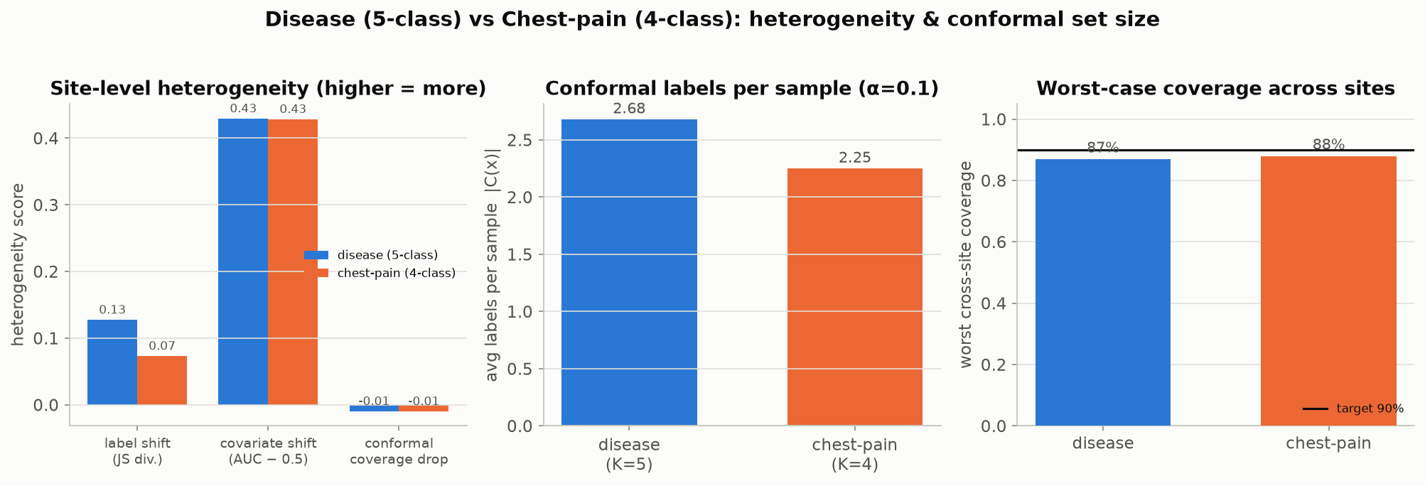
PIPELINE — ROBUSTNESS
The same comparison, as a picture
The five numbers from the previous table, side by side, disease-severity vs. chest-pain-type. The same story shows up in both: real cross-hospital differences, but the 90% promise holds close to target everywhere.
Beyond Interoperability · Pipeline — Robustness
70

Slide 71
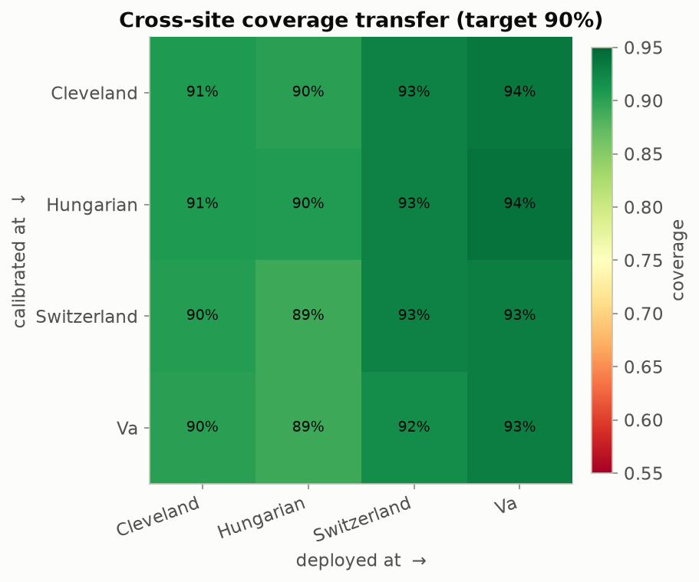
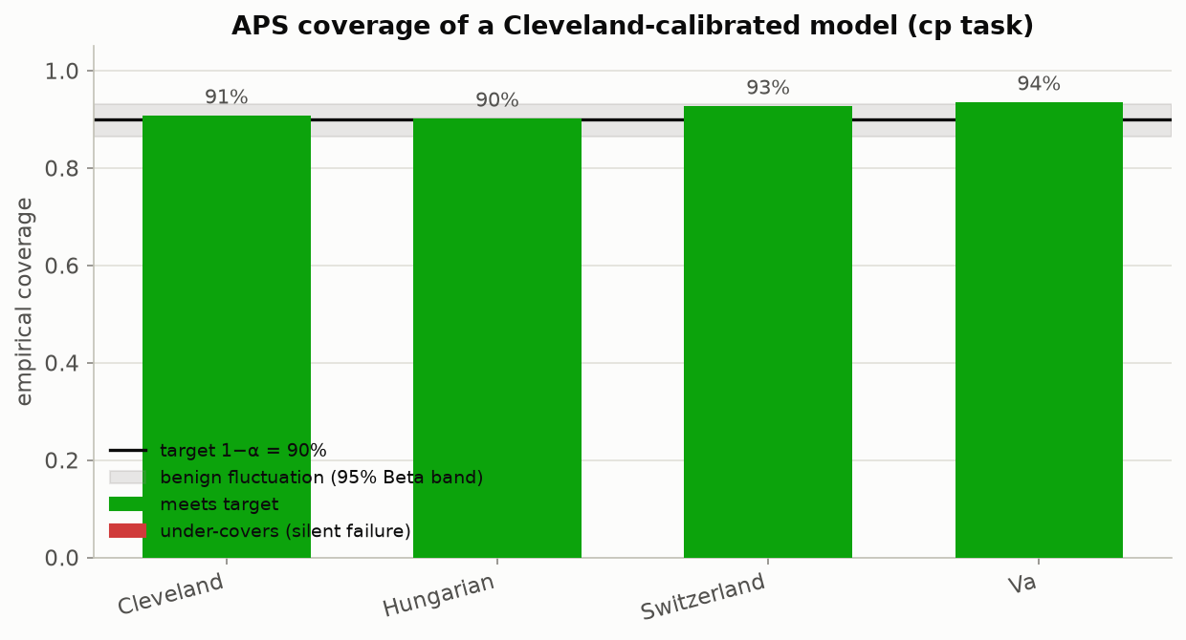
PIPELINE — CHEST-PAIN TASK
Running the full headline test a second time
Left: every hospital-pair combination for the chest-pain question — the same all-pairs test as Section 7's disease-severity version, just applied to a different diagnosis. Right: a Cleveland-only threshold, tested at all four hospitals.
Beyond Interoperability · Pipeline — Chest-Pain Task
71

Slide 72
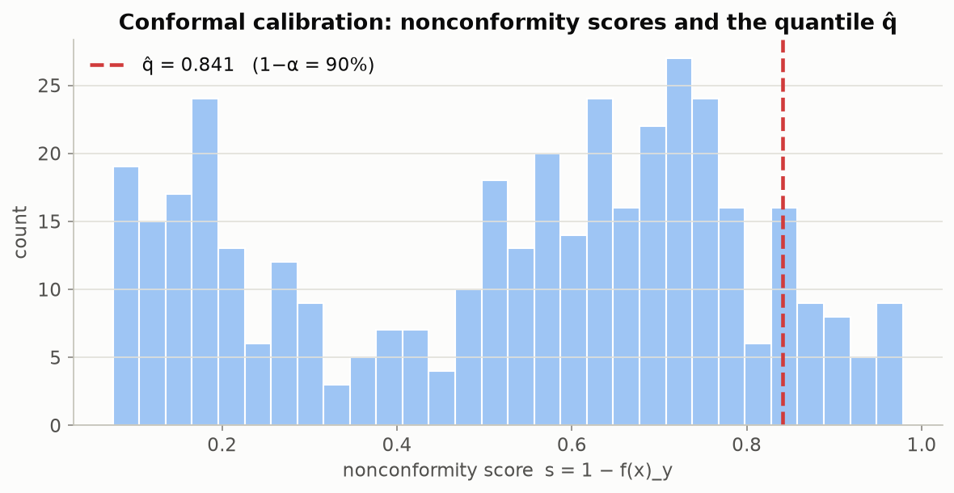
PIPELINE — CHEST-PAIN TASK
Calibration scores and per-diagnosis coverage
Left: the chest-pain question's own calibration-score histogram — the same kind of chart shown earlier for disease severity. Right: coverage broken out by true chest-pain diagnosis — the rarest one (typical angina) is covered just 26% of the time.
Beyond Interoperability · Pipeline — Chest-Pain Task
72

Slide 73
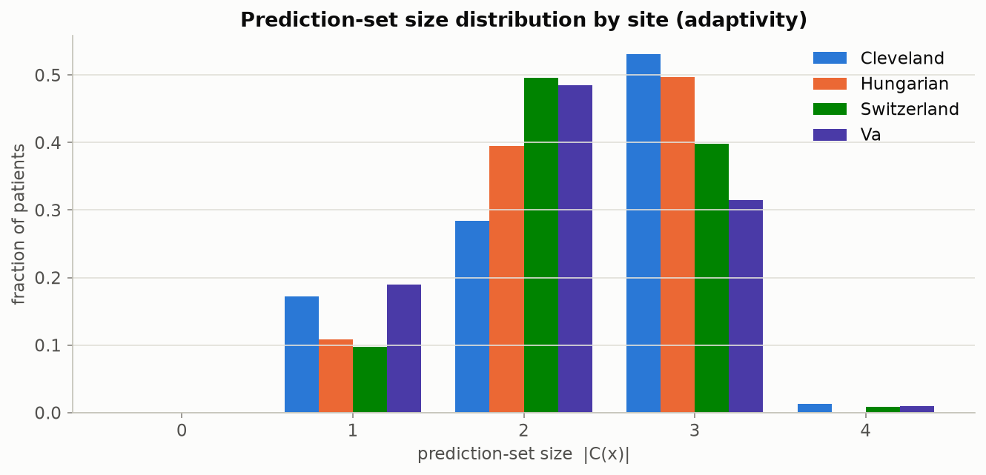
PIPELINE — CHEST-PAIN TASK
How long are the returned lists, by hospital?
The chest-pain question's version of the list-length-by-hospital chart shown earlier for disease severity.
Beyond Interoperability · Pipeline — Chest-Pain Task
73

Slide 74
PIPELINE — FURTHER TARGETS
Pushing further: two more clinical questions
▪ Two questions (disease severity, chest-pain type) already show this isn't a fluke of one particular label — but could it still be a fluke of those two specific labels?
▪ A companion script reruns the exact same federated-plus-conformal pipeline on two more columns from the same four hospitals: the resting-ECG result (three possible readings) and whether the patient has exercise-induced chest pain (yes/no).
▪ Both were picked because they're almost fully filled in across every hospital (missing for only 2 patients and 55 patients respectively out of 920) — unlike a few other columns that are missing for the large majority of patients at some hospitals and would leave a question barely answerable there.
▪ The yes/no question runs through a simpler two-outcome version of the model automatically — but every downstream check (scoring rule, coverage, list length) works exactly the same way regardless.
Beyond Interoperability · Pipeline — Further Targets
74

Slide 75
PIPELINE — FURTHER TARGETS
The worst-hospital promise, across four independent questions
Clinical question | Possible answers | Worst single hospital | Gap vs. 90% promise
Disease severity | 5 | 70.7% | −19.3 pp
Resting-ECG result | 3 | 74.5% | −15.5 pp
Exercise-induced chest pain | 2 | 82.8% | −7.2 pp
Chest-pain type | 4 | 89.0% | −1.0 pp
▪ Three of these four completely independent clinical questions show a real, double-digit-point promise failure at their hardest hospital. The size of each failure tracks how differently that specific measurement is distributed across hospitals — this isn't one generic side effect of combining these four hospitals, it's a real, question-by-question signal.
Beyond Interoperability · Pipeline — Further Targets
75

Slide 76
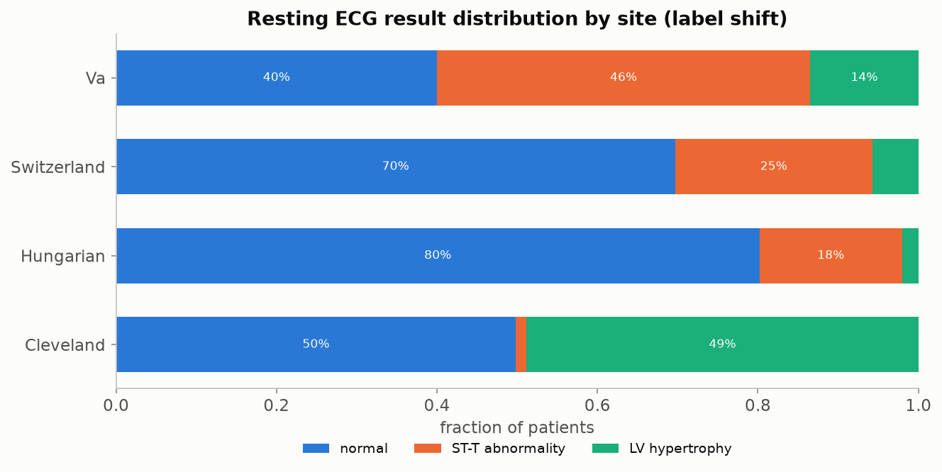
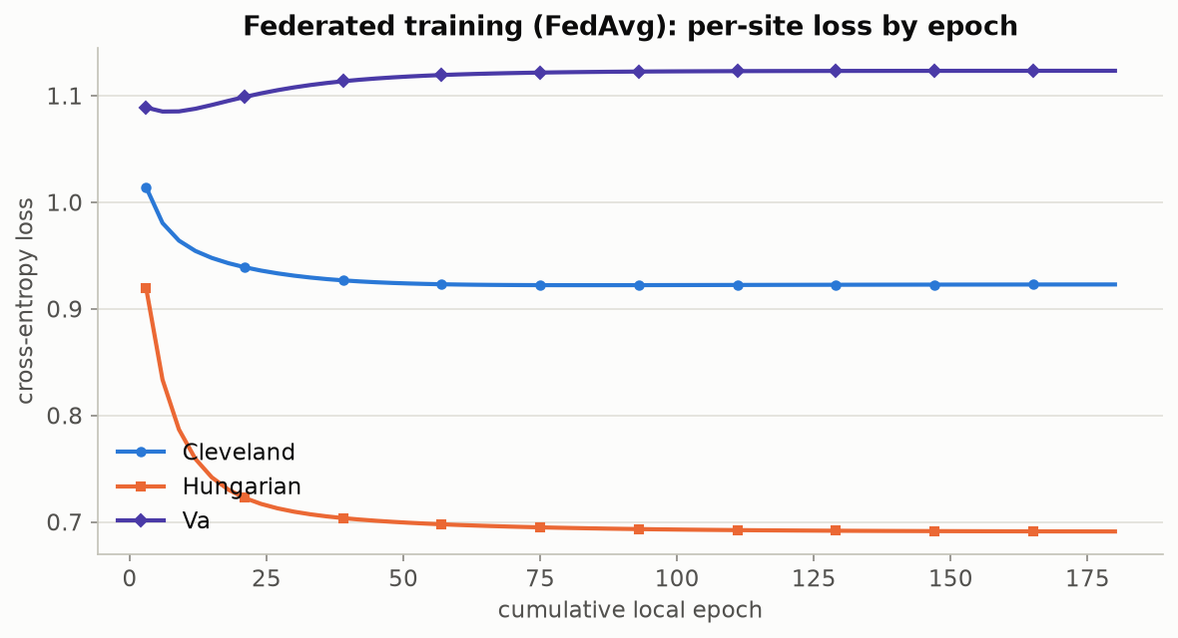
PIPELINE — RESTING-ECG TASK
Third question: resting-ECG result
Left: how the resting-ECG reading is distributed by hospital — normal readings dominate at Hungary and Switzerland, while the V.A. leans toward one specific abnormality. Right: the training-settled-down check, same as before, for this question.
Beyond Interoperability · Pipeline — Resting-ECG Task
76

Slide 77
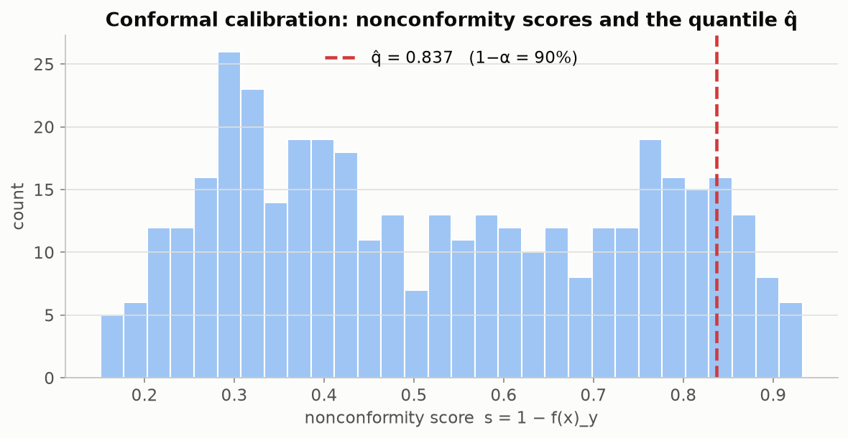
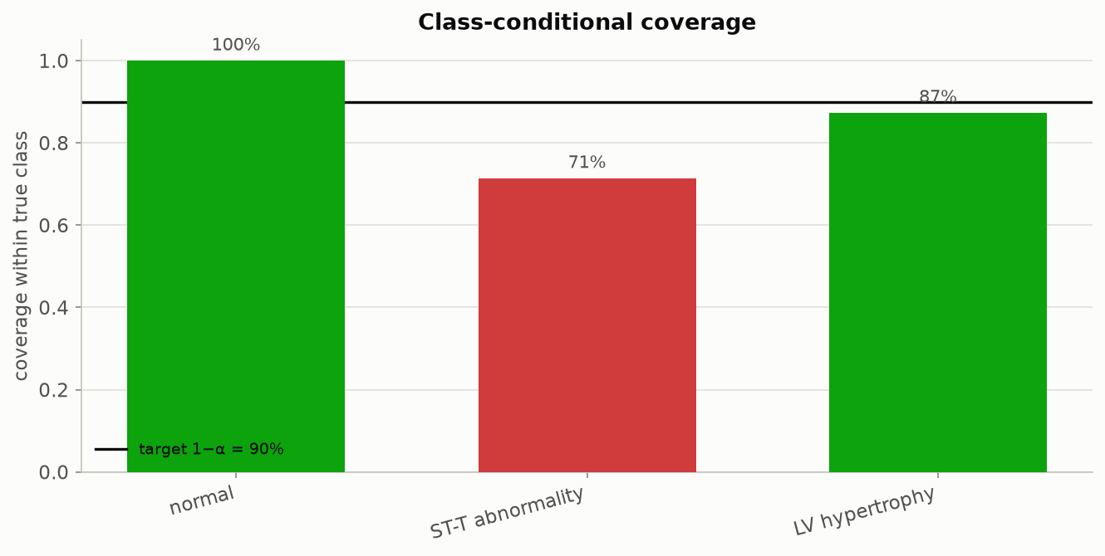
PIPELINE — RESTING-ECG TASK
Resting-ECG: calibration scores and per-diagnosis coverage
Left: the resting-ECG question's own calibration-score histogram. Right: coverage broken out by true resting-ECG reading.
Beyond Interoperability · Pipeline — Resting-ECG Task
77

Slide 78
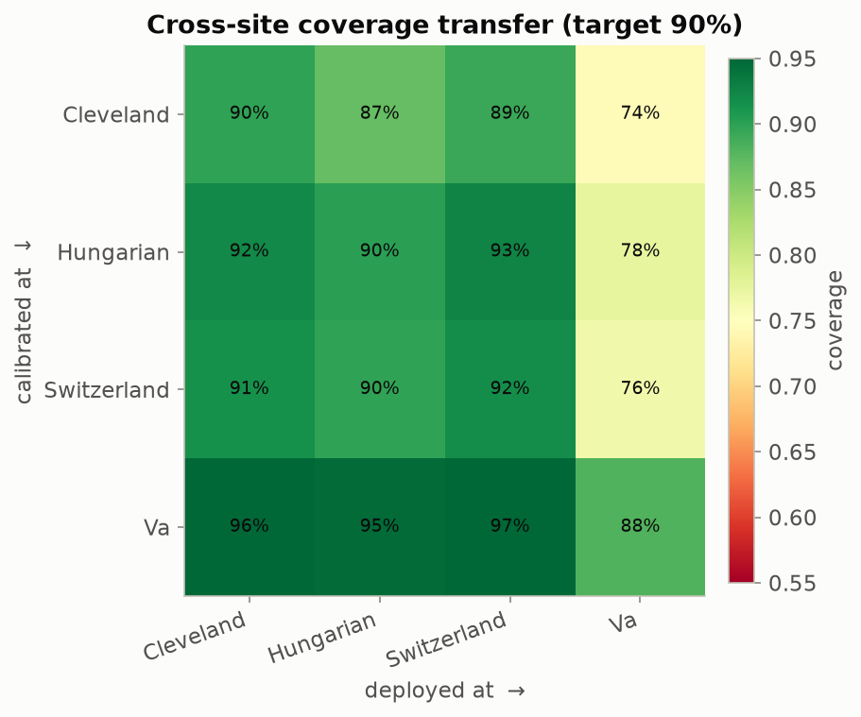
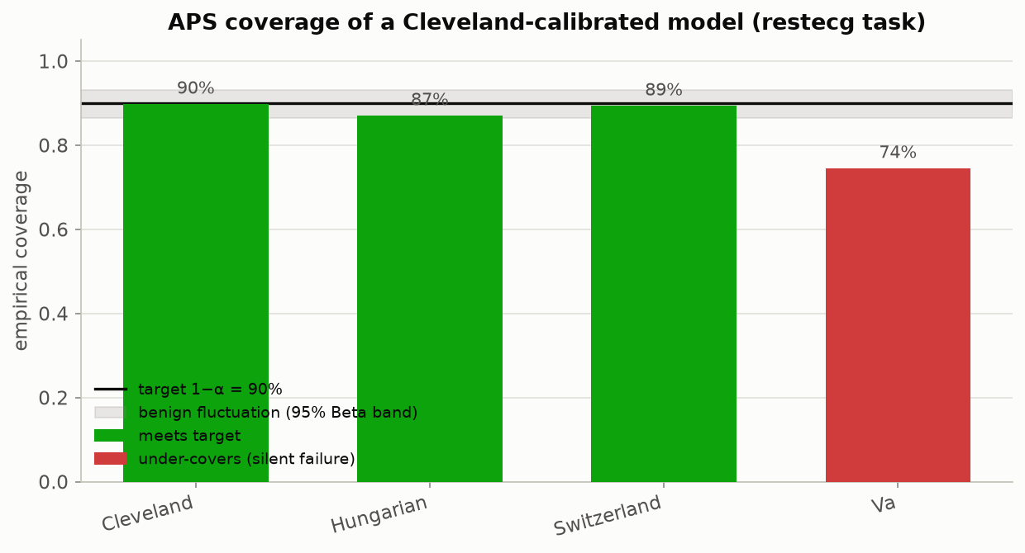
PIPELINE — RESTING-ECG TASK
Resting-ECG: every hospital pair, and the headline test
Left: every hospital-pair combination for resting ECG — the V.A. is the hardest hospital to deploy at no matter which hospital set the threshold, landing 74-88% against the 90% promise. Right: a Cleveland-only threshold, tested at all four hospitals.
Beyond Interoperability · Pipeline — Resting-ECG Task
78

Slide 79
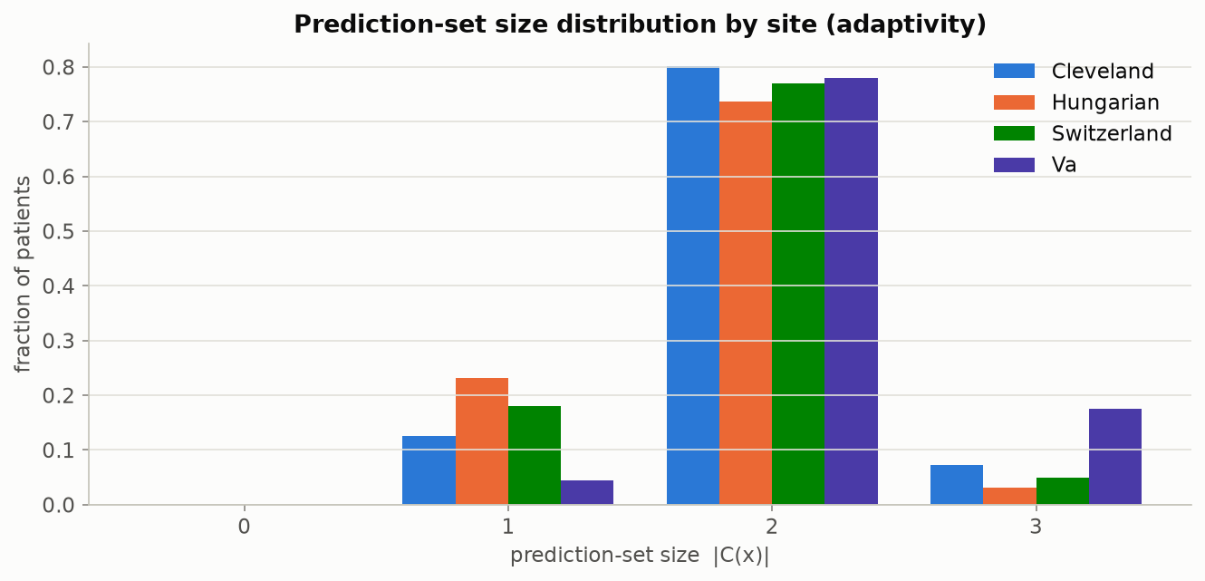
PIPELINE — RESTING-ECG TASK
How long are the returned lists, by hospital?
Beyond Interoperability · Pipeline — Resting-ECG Task
79

Slide 80
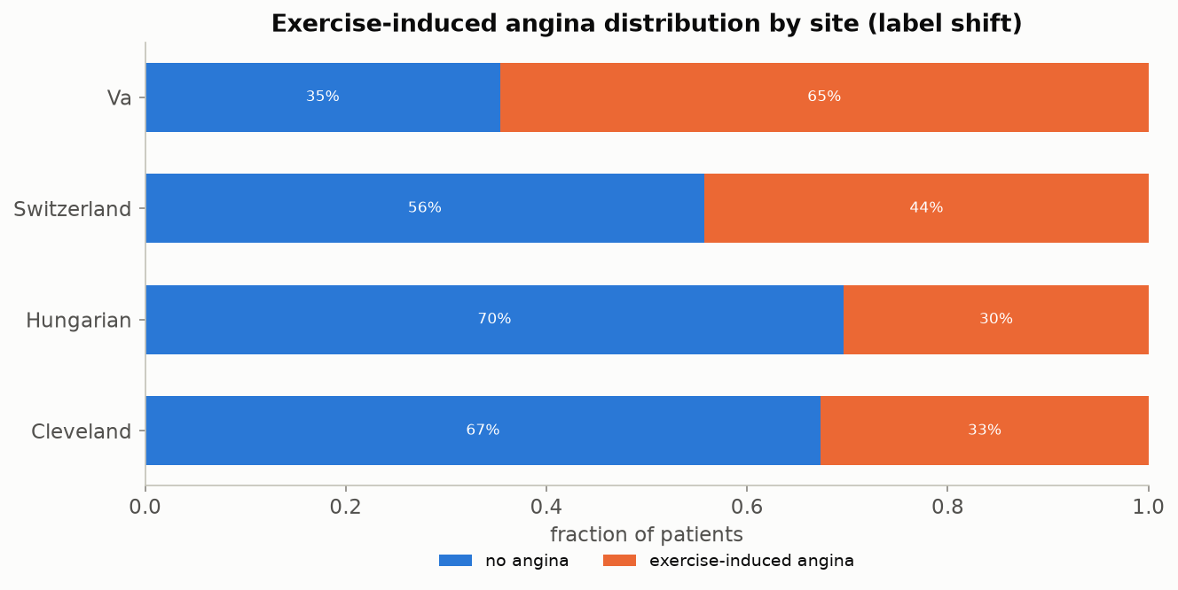
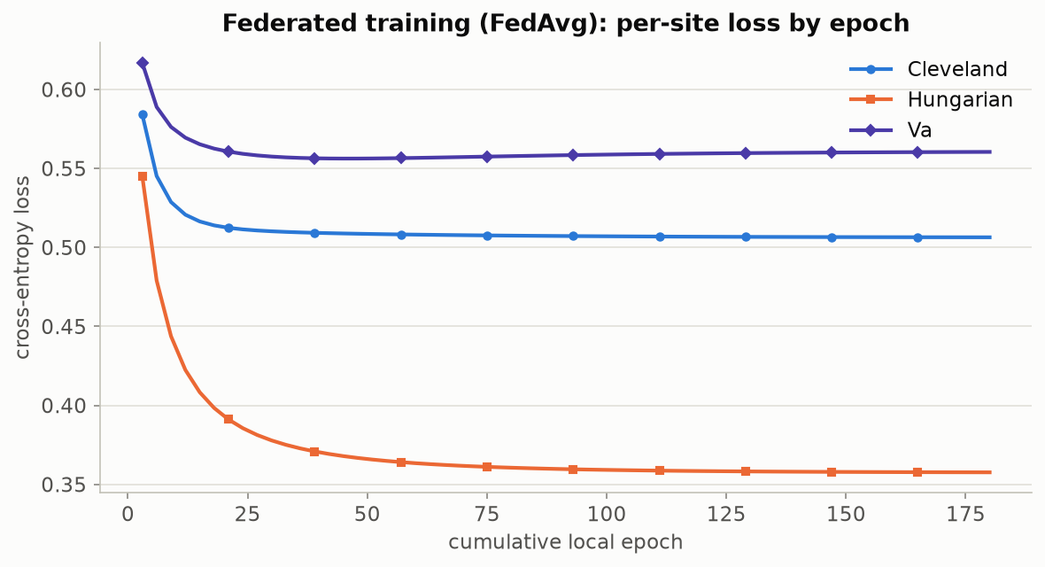
PIPELINE — EXERCISE-ANGINA TASK
Fourth question: exercise-induced chest pain
Left: how common exercise-induced chest pain is by hospital — roughly doubling from Hungary (30%) to the V.A. (65%), a milder version of the same kind of hospital-to-hospital swing seen for disease severity. Right: the training-settled-down check for this question.
Beyond Interoperability · Pipeline — Exercise-Angina Task
80

Slide 81
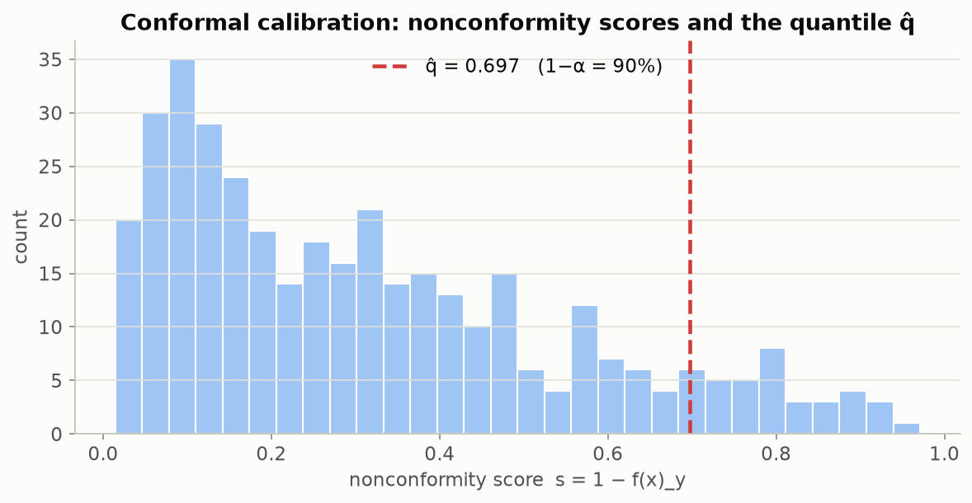
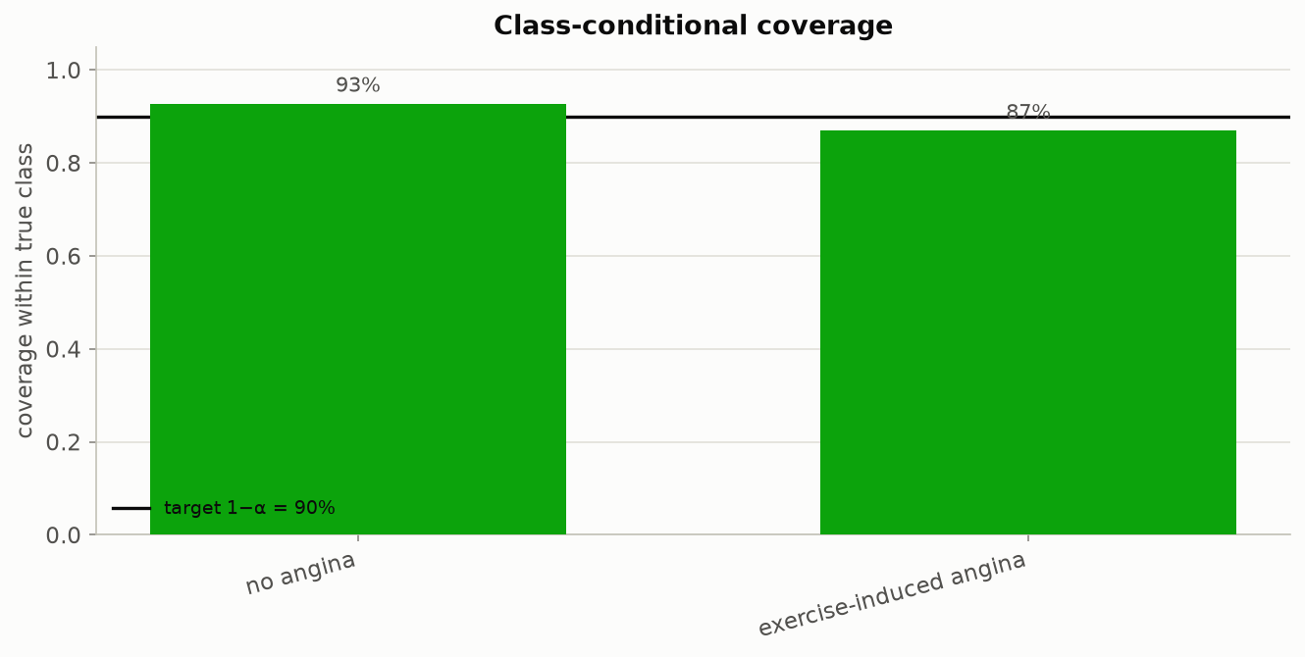
PIPELINE — EXERCISE-ANGINA TASK
Exercise angina: calibration scores and per-diagnosis coverage
Left: the exercise-angina question's own calibration-score histogram. Right: coverage broken out by true yes/no answer.
Beyond Interoperability · Pipeline — Exercise-Angina Task
81

Slide 82
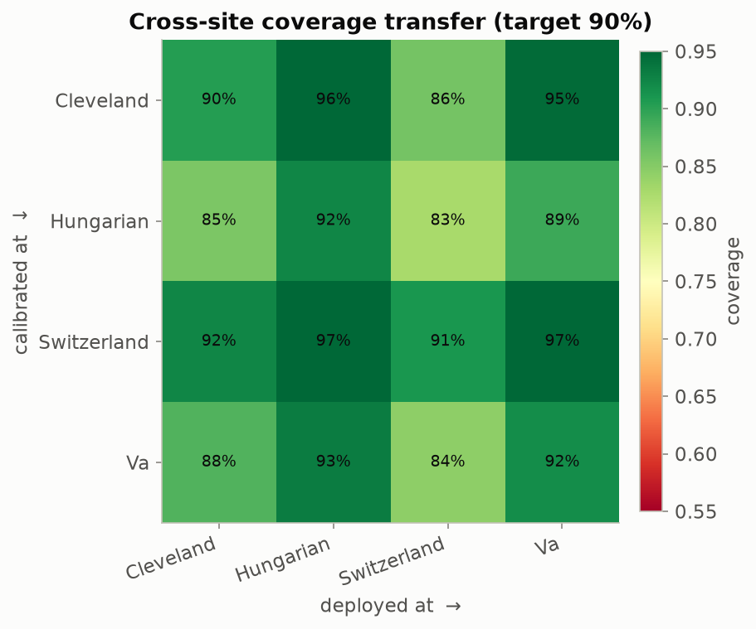
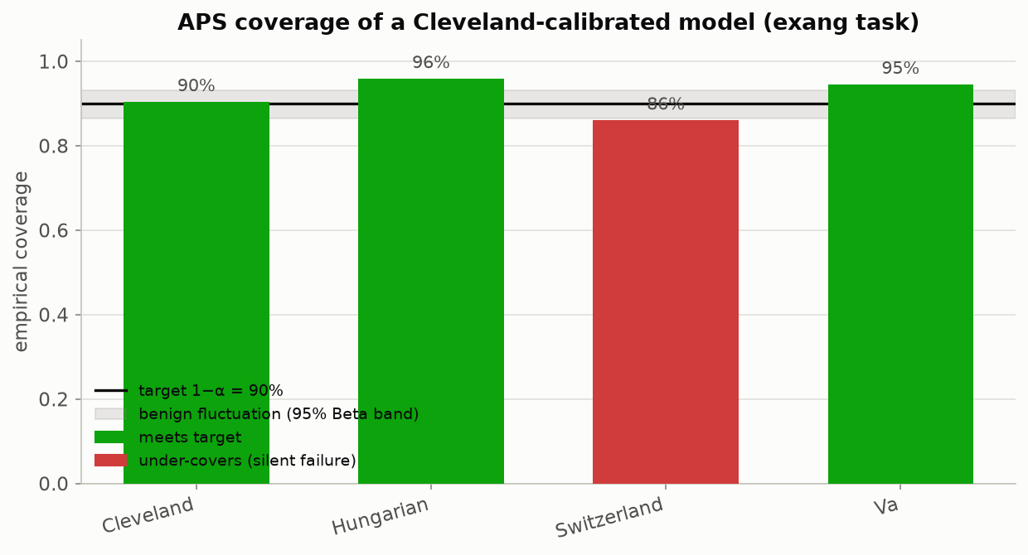
PIPELINE — EXERCISE-ANGINA TASK
Exercise angina: every hospital pair, and the headline test
Left: every hospital-pair combination for exercise angina — the weakest single pairing (threshold set at Hungary, deployed at Switzerland) lands at 83%, a real gap but a smaller one than resting ECG or disease severity showed. Right: a Cleveland-only threshold, tested at all four hospitals.
Beyond Interoperability · Pipeline — Exercise-Angina Task
82

Slide 83
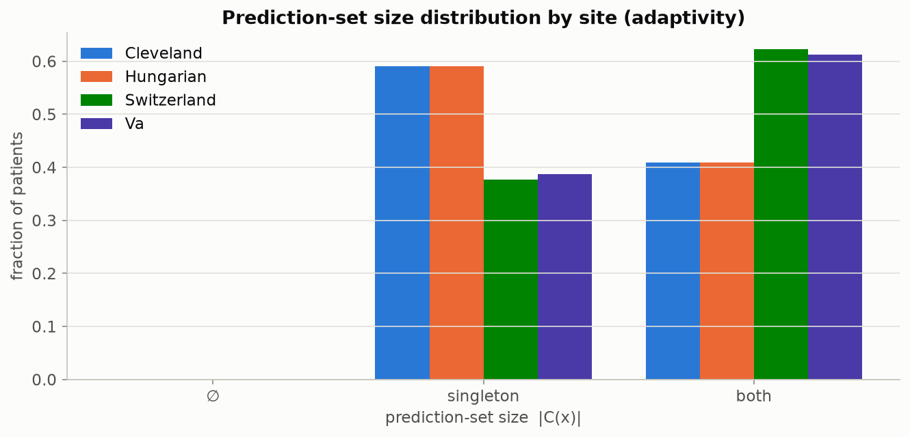
PIPELINE — EXERCISE-ANGINA TASK
How long are the returned lists, by hospital?
Beyond Interoperability · Pipeline — Exercise-Angina Task
83

Slide 84
PIPELINE
Where this stands, and what's honestly still missing
▪ For what it set out to do, yes — every claim on these slides is backed by a figure anyone can reproduce by running the notebooks, and ten automated tests confirm the underlying math is implemented correctly.
▪ It correctly tells apart real population differences from measurement gaps, and it shows the coverage promise breaking concretely, with real numbers, not just in theory.
▪ The finding holds up across two different clinical questions and two different scoring rules — it isn't a fluke of one particular choice.
▪ What's honestly still missing: reliability charts that go a layer deeper than coverage alone, coverage checks broken out by patient subgroup (not just by hospital), a flag for “was this value filled in or actually measured,” a first real attempt at fixing the problem rather than just detecting it, a genuinely new fifth hospital never touched during development, and mapping this dataset onto a real clinical data standard.
Beyond Interoperability · Pipeline
84

Slide 85
REFERENCES
▪ A. N. Angelopoulos & S. Bates. “Conformal Prediction: A Gentle Introduction.” FTML 16(4), 2023. — the main source behind Section 8's math, in a genuinely readable form.
▪ Y. Romano, M. Sesia & E. Candès. “Classification with Valid and Adaptive Coverage.” NeurIPS 2020. — introduces the APS scoring rule used throughout this project.
▪ H. B. McMahan et al. “Communication-Efficient Learning of Deep Networks from Decentralized Data.” AISTATS 2017. — introduces FedAvg, the training method built from scratch in notebook 03.
▪ J. O. du Terrail et al. “FLamby: Datasets and Benchmarks for Cross-Silo Federated Learning.” 2022. — uses this same four-hospital population as a recognized benchmark.
▪ R. Detrano et al. “International Application of a New Probability Algorithm for the Diagnosis of Coronary Artery Disease.” Am. J. Cardiology, 1989. — the original clinical study behind this dataset.
▪ UCI Machine Learning Repository. “Heart Disease” dataset (ID 45). archive.ics.uci.edu/dataset/45/heart+disease.
Beyond Interoperability · References
85

Slide 86
Thank you
Questions & discussion
fedconformal-clinical toolkit — Arnab Mukherjee
Oklahoma State University — Center for Health Science, Tulsa

