Slide 1
Open IIT Data Analytics
TEAM - DA8

Slide 2
TABLE OF CONTENT
1
2
3
DATA PRE- PROCESSING
METHOD
USING TF-IDF VECTORIZER
4
5
TRAINING MODEL
RESULT

Slide 3
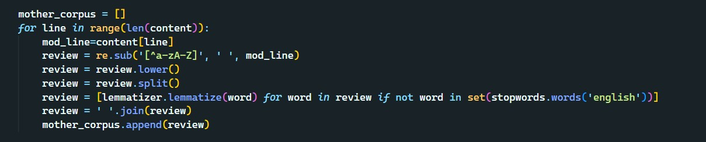
DATA PRE-PROCESSING
We performed standard data pre-processing here i.e.
1.Got rid of numbers, punctuation and other characters other than the alphabets 2.We lowered the case of all the alphabets
3.Then we split the words and removed all the stop words before lemmatizing them, consequently joining them back.
We decided to pre process all the sentences before joining them as it was computationally very expensive to iterate over all the pairs of sentences after joining/concatenating them.

Slide 4
EXAMPLE
'1 Besides these forests naturally developed forests , there are man made forests too , which are developed artificially over a vast area of land . \n'
LEMMATIZATION
['besides forest naturally developed forest man made forest developed artificially vast area land']

Slide 5
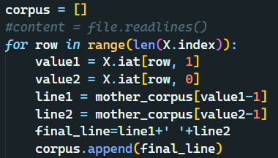
THE METHOD
We concatenated every pair of sentences and stored each combined sentence in our corpus list, from which we later extracted all the lines for training.

Slide 6
METHOD
'98 From the very ancient periods men used to apply ointments on their faces and on special parts of the body to increase the beauty , for religious reasons , in wars , and many festivals and to protect the skin from excessive cold or heat . \n'
'651 Men and women of all ages participate in this celebration . \n'
LEMMATIZATION
'besides forest naturally developed forest man made forest developed artificially vast area land'

Slide 7
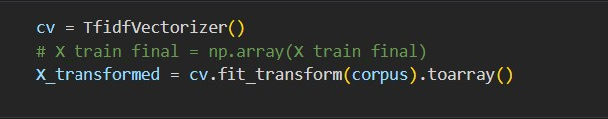
USING TF-IDF VECTORIZER
As we explained earlier that we had concatenated the sentences to make our prediction thus in our endeavor we had to give more weight to the number of times certain words were appearing in the document.
Since both the sentences had nothing to do with each other in terms of context, we found the tf-idf vectorizer suitable for the above objectives.
The TF-IDF has certain features and the following were useful in our model

Slide 8
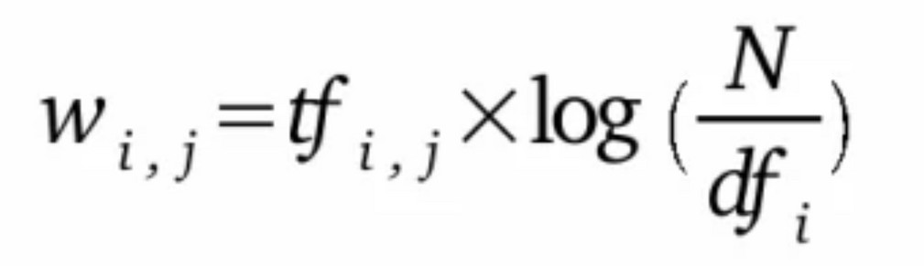
USING TF-IDF VECTORIZER
The TF-IDF has certain features and the following were useful in our model
It does not take into account the context of the sentences
Since certain gender-sensitive words do not occur very frequently and thus the TF-- IDF helps us to give more weight to such words specifically. Like words like 'policeman', 'mankind', and 'housewife'.
All the words that have more frequency that is usually used more n day to day sentences like 'walking', sleeping','went' 'play' etc will be given less weightage in the model.
We have assumed that the learning parameters of our model will identify the frequency of gender-sensitive words and their position in a sentence to classify the pair of sentences as biased or unbiased.

Slide 9
USING TF-IDF VECTORIZER
For instance, the pairs labeled 0 i.e., the ones with both sentences biased or unbiased will have a higher number of gender-sensitive words and no gender- sensitive words respectively.
Again, a pair of sentences having one sentence biased and another sentence unbiased message will have an intermediate/less number of gender-sensitive words, though not zero like the pairs having no gender-biased statements.

Slide 10
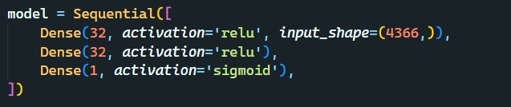
TRAINING THE MODEL
We have used a simple sequential neural network with two hidden layers with 32 nodes each with reLU as the activation function.
And the last layer was a single output layer with sigmoid activation it is a binary classification problem.

Slide 11

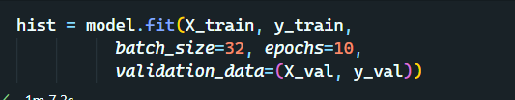
TRAINING THE MODEL
We have used the stochastic gradient descent optimization and binary cross entropy as the loss function.
We have taken batch sizes of 32 and 10 epochs while training thee model.

Slide 12
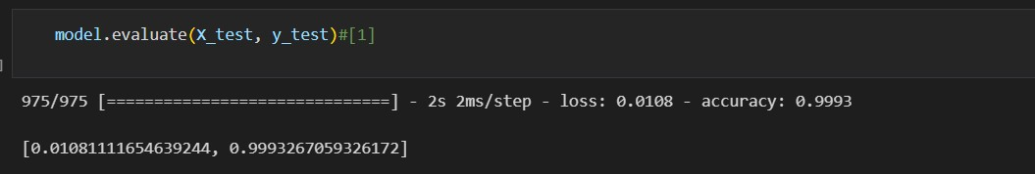
RESULTS
We are getting an accuracy of 99.94% and 99.96% on the train and validation set respectively.
And an accuracy of 99.94% on the training set.

Slide 13
THANK YOU

